Slide 1

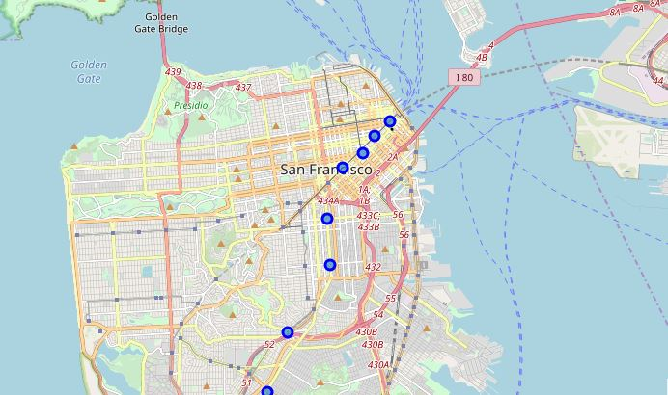
Food Carts and BARTs

Slide 2
Introduction
An entrepreneur is opening a food cart business in San Francisco which will provide goods similar to cafes and coffee shops.
He wants to place 5 food carts at metro stations (BART Stations) throughout the city during morning rush hour, but he doesn't know which stations are the best selections.
It's tough to succeed in the food industry, so he wants to leverage data on existing cafes and coffee shops to improve his business' chance for first-effort success.
Segmenting the market is an effective way to build foundations of understanding and get insights.

Slide 3
Purpose of This Study
This preliminary study aims to provide a foundation for a future boots-on-the-ground survey of BART commuters to gauge project interest, which will ask whether or not the person drinks beverages (hot/cold) around that time of day, and whether or not they already had that beverage at home or outside. While this survey is out of the scope of this project, its description serves to provide context for this project.

Slide 4
Data Acquisition and Cleaning
Foursquare API searches for specific venue categories and their ratings were run to obtain the total number of businesses in the “Cafe” and “Coffee Shop” categories within the 250 meter radius of each BART station.
In total, 410 rows and 13 features represented the raw data.
Data that were dropped were those that were incomplete, out of scope, or had little statistical value.
Cleaned data included 9 features of 8 BART stations which were applied to a machine learning algorithm which provides clusters (or segments) of data, to develop a 10th feature: the prospective market segmentation.

Slide 5
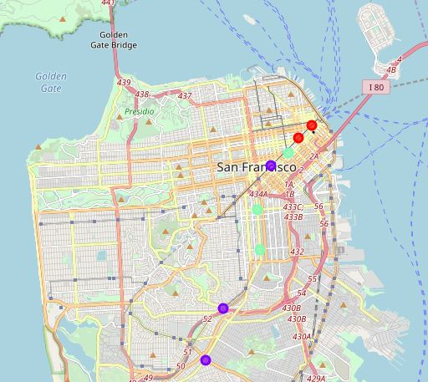
Segmented BART Stations
Purple, Cluster 1: “Land of Opportunity”
Mint, Cluster 2: “The Middle Ground”
Red, Cluster 0: “High
Risk, High Reward?”

Slide 6
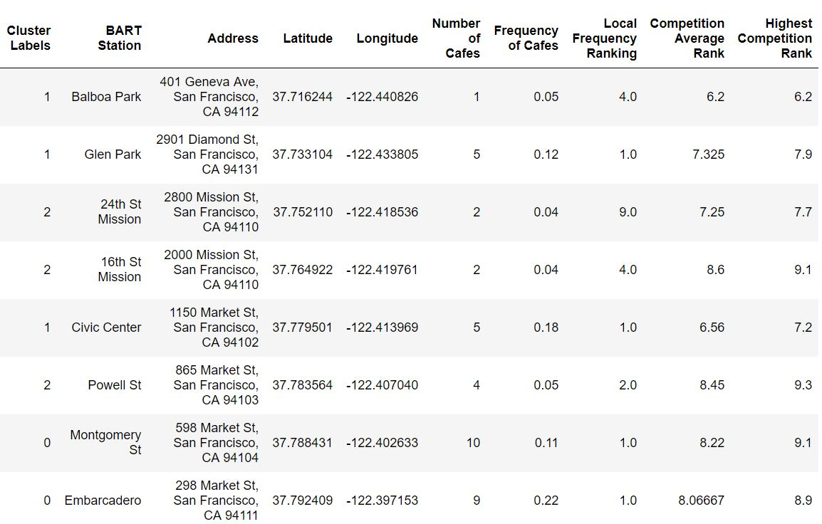
Segmented Station Details (ordered geographically)

Slide 7
Purple (1), Land of Opportunity
Medium amount of Cafes (easier market to enter)
High relative market presence (popular market for the area)
Low customer ratings (opportunity to capitalize on dissatisfied customers)
Origin metro stations (more hungry customers)

Slide 8
Segmented Station Details (ordered geographically)

Slide 9
Mint (2), The Middle Ground
Low amount of Cafes (easiest market to enter)
Low relative market presence (NOT a popular market for the area)
Medium customer ratings (less opportunity to capitalize on dissatisfied customers)
Origin metro stations (hungry customers)

Slide 10
Segmented Station Details (ordered geographically)

Slide 11
Red (0), High Risk, High Reward?
High amount of Cafes (hardest market to enter)
Highest relative market presence (NOT a popular market for the area)
High customer ratings (less opportunity to capitalize on dissatisfied customers)
Destination metro stations (less hungry customers)

Slide 12
Segmented Station Details (ordered geographically)

Slide 13
Market insights
Because the ratings of cafes tend to rise as they become closer to downtown, study and model your business offerings after those closer to downtown.
25% of the businesses are corporate:
~Model your business mainly after local ones, but...
~Use surveys to find best aspects of corporate ones to increase overall market yield.

Slide 14
Current Recommendations
Placement: two food carts within “Land of Opportunity,” two within “The Middle Ground,” and one within “High Risk, High Reward?”
Rotate carts within the clusters to gauge market interest and gather more data.

Slide 15
Conclusion and Future Recommendations
Built successful scalable model for segmenting market areas with opportunity for success.
Model will only continue to improve with more data, so acquiring new data is advised.
Data to capture/consider:
Foot traffic at documented time intervals
Surveys of consumer breakfast patterns
BART stations in Alameda County
Consumer demographics
Cart revenue at specific stations and times of day.

