Slide 1
STEGANOGRAPHY
By: Belén Alastruey, Roger Casals, Gerard Contreras,
Malgorzata Cybulska, Adrián Hernández, Roger Taulé
Directed by: Jordi Saludes

Slide 2
WHAT IS STEGANOGRAPHY?
It’s the practice of writing hidden messages in ordinary text, pictures, etc.
The hidden messages appear to be (or to be part of) something else: images, articles, shopping lists or some other cover text
The advantage of steganography is that the intended secret message does not attract attention to itself

Slide 3
Since everyone can read, encoding text in neutral sentences is doubtfully effective.

Slide 4
Since everyone can read, encoding text in neutral sentences is doubtfully effective.
‘secret inside’

Slide 5

PARTS OF TEXT STEGANOGRAPHY
Prompt
Text 1
Text 2
Text 3
...
Hello World!
Artificial language
model
Aritmetic Coding
Prompt
Artificial language
model
Text
17
17
Key

Slide 6
ARTIFICIAL LANGUAGE MODEL - Finding a corpus
What is a CORPUS? A large database of words, sentences and texts.
Each model uses a corpus.
Largest corpus with diversity of topics.
Two examples: GPT-2 and Markovify

Slide 7
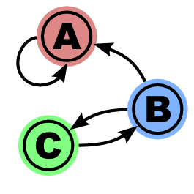
ARTIFICIAL LANGUAGE MODEL - Markovify
What is Markovify? How it uses the corpus?
Which corpus have we used?

Slide 8
MARKOVIFY - Examples

Slide 9
ARTIFICIAL LANGUAGE MODEL - GPT2
Natural language processing task.
Artificial intelligence model .
Multitask learner.
Trained from a dataset of million of web pages called WebText.
Non supervised learning.
The model achieved state of the art results in most categories of testing.

Slide 10
GPT2 - How does it work
The model calculates a probability distribution from a set of examples.
It expresses the probability of a given example as a product of conditional probabilities for the symbols in each string p(x) = Πp(sn | s1, … , sn-1).
All in all it creates a probability distribution for the output based in the input: p(output | input).
Given that it is a multitask learner it is really p(output | input, task).
Ideally the model would learn the task without explicit specification

Slide 11
GPT2 - Examples of execution
There are 4 different versions of GPT2, and only the biggest version is private.
Here we can see an online implementation of the biggest public version of GPT2:
https://talktotransformer.com/

Slide 12
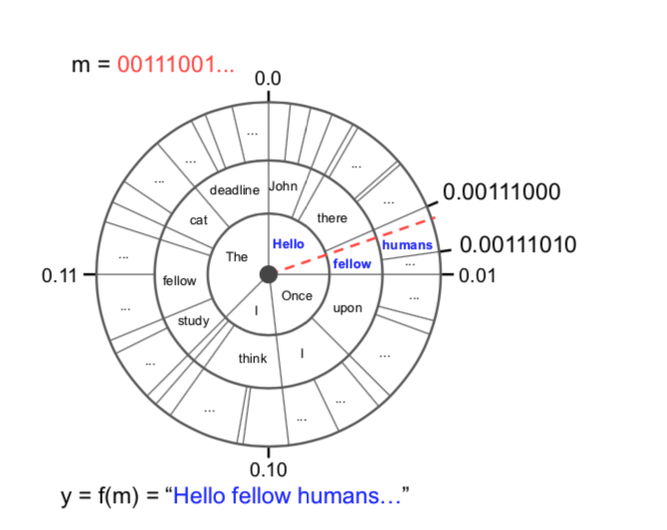
ARITHMETIC CODING

Slide 13
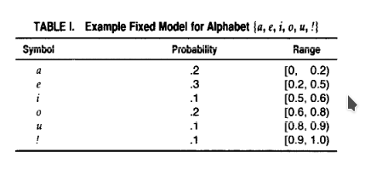
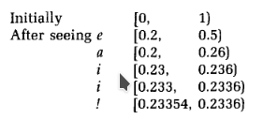
USING ARITHMETIC CODING TO HIDE A MESSAGE IN A TEXT
We need and alphabet and the probability of each character
As each symbol is processed, the range is narrowed to that portion of it allocated to the symbol.

Slide 14
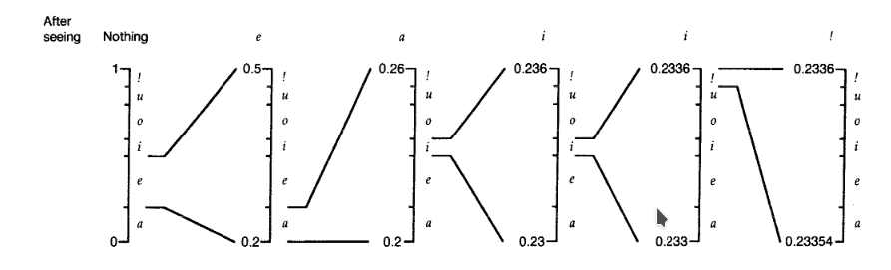
Arithmetic coding example

Slide 15
EXAMPLE
https://steganography.live/encrypt

Slide 16
OBJECTIVES FOR THE FINAL PRESENTATION
Prompt
+
17
Artificial language
model
TEXT
Hello World!
Arithmetic Coding
Key

