Slide 1
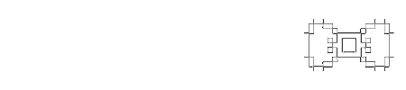
RU ITEC Agenda
Six-week Project Update

Slide 2
Our Project
“RU ITEC Agenda” - a mobile app that helps you keep track of your assignments
Core:
Stores your class schedule and a list of assignments
You can add/edit/remove assignments as needed
Wishlist:
Weekly calendar view of schedule and due dates
Sharing assignments with other RU users
The app will be designed so that it could eventually be integrated into RU mobile, so that your schedule could be automatically imported by logging in.

Slide 3
The story so far...
Week 2 | Hello team. Team name, poster
Week 3 | Team “setup” - first team meeting, started website, sharing through Google Docs, chose phase managers, scheduled client meeting
Week 4 | Met with client. Started planning document. Functionally complete website. Delivered Client Project Worksheet (barefoot in the snow, uphill both ways, etc.)
Week 5 | Finished and delivered the Planning Document
Week 6 | Worked on app UI mockups and delivered this update

Slide 4
The Plan™
In the requirements phase, hence we’ll be spending the next few weeks determining the functional, UX, and resources requirements for the app.
Client meeting in the next week to discuss UI et al
Post-requirements (after March 27), the remainder of the semester will be spent designing and implementing the app
Final delivery - April 29

Slide 5
UI Mockups
Our initial idea is to provide three main views:
All assignments for all classes in chronological order
Assignments grouped by class
The user’s class schedule

Slide 6
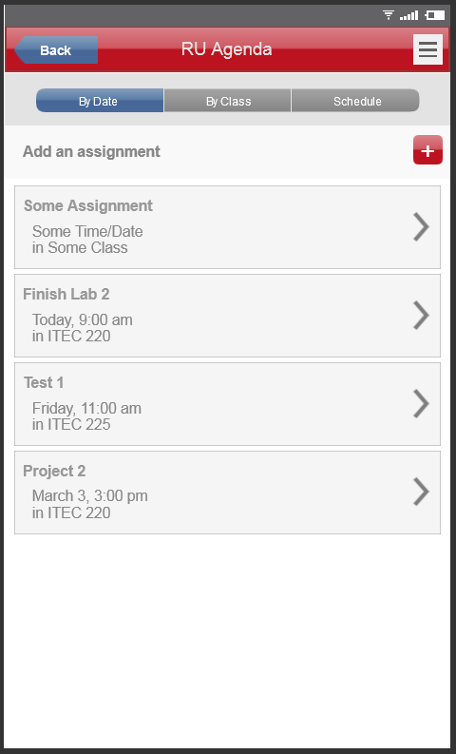

Slide 7
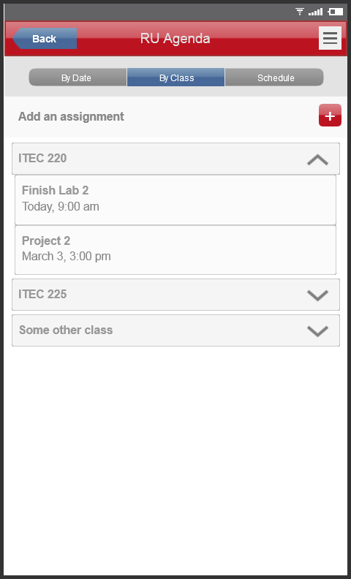

Slide 8
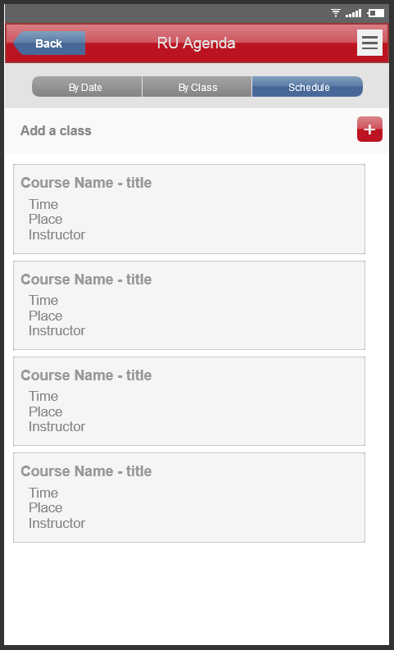

Slide 9
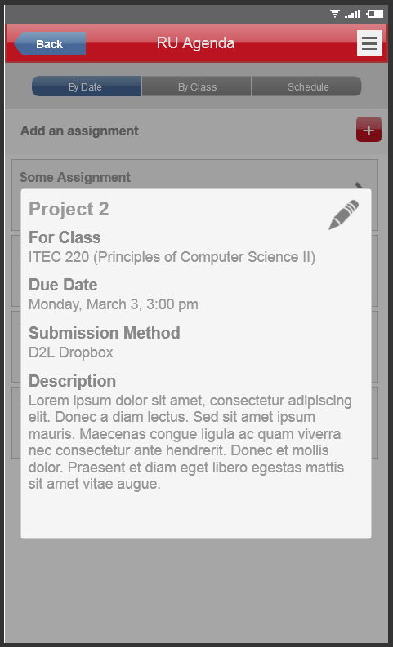

Slide 10
