Slide 1




ISA 401: Business Intelligence & Data Visualization
08: Connecting to APIs in
Fadel M. Megahed, PhD
Raymond E. Glos Professor in Business Farmer School of Business
Miami University
@FadelMegahed fmegahed fmegahed@miamioh.edu
Automated Scheduler for Office Hours
Fall 2025

Slide 2
Quick Refresher from Last Week
✅ Understand when can we scrape data (i.e., robots.txt)
✅ Scrape a webpage Using
✅ Utilize loops to scrape data from multiple webpages

Slide 3
Kahoot Competition # 2
To assess your understanding and retention of the topics covered last week, you will compete in a Kahoot competition (consisting of 9 questions):
Go to https://kahoot.it/
Enter the game pin, which will be shown during class
Provide your first (preferred) and last name
Answer each question within the allocated 20-second window (fast and correct answers provide more points)
Winning the competition involves having as many correct answers as possible AND taking the shortest duration to answer these questions. The winner of the competition from each section will receive: 0.25 on their Web Scraping II Assignment. Good luck!!!

Slide 4
Learning Objectives for Today's Class
Describe what we mean by an API
Explain how APIs will be a huge part of your career as a business analyst and/or data scientist
Use APIs for extracting web data

Slide 5
WWhhaatt iiss nn AAPPII??
((AA WWeebb SSeerrvveerr BBaasseedd PPeerrssppeeccttiivv
55 // 1188

Slide 6
What is an API? [1]
An API is an acronym for application programming interface.
It is a popular approach to interact with an application/service or data since it:
Defines a set of functionalities independent of implementation (i.e., it only exposes information that a programmer might find useful and keep those parts consistent even if the implementation changes later)
Provides some level of privacy/control over one's internal data and the rate at which it can be accessed.

Slide 7
What is an API? [2]
What is an API?

Slide 8
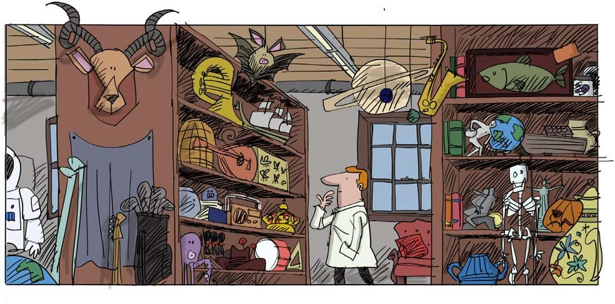
What is an API? [3]
Scenario: Alone, you went into a warehouse and are trying to retrieve 3 screwdrivers, a toolbox, and 15 Phillips screws. But you do not know, where those things are in the warehouse.
The API is the set of instructions provided by the warehouse manager on where/how to retrieve this information without touching/accessing other things in there.
Source: Matt Z. (2018). What is an API? (explanation with cartoon picture so a 5 year old could understand it)
8 / 18

Slide 9
AAPPII UUsseeaaggeess ffoorr BBuussiinneessss AAnnaallyyssttss aanndd DDaattaa SScciieennttiissttss
99 // 1188

Slide 10
Application #1: Request Data from Web Server
This is the classical example, which was explained in the previous slides and we will be coding several in-class demos to illustrate how to perform such operations in .

Slide 11








Application #2: Access Python Libraries
Getting started | Search Ctrl + K 2.3 (stable) User API _{Development} Release Guide reference notes
 |  | › API reference › Input/output › pandas.read_csv pandas.read_csv pandas.read_csv(filepath_or_buffer, *, sep=<no_default>, delimiter=None, header='infer', names=<no_default>, index_col=None, usecols=None, dtype=None, engine=None, converters=None, true_values=None, false_values=None, skipinitialspace=False, skiprows=None, skipfooter=0, nrows=None, na_values=None, keep_default_na=True, na_filter=True, verbose=<no_default>, skip_blank_lines=True, parse_dates=None, infer_datetime_format=<no_default>, keep_date_col=<no_default>, date_parser=<no_default>, date_format=None,
Input/output
pandas.read_pickle
pandas.DataFrame.to_pickle pandas.read_table
pandas.read_csv
pandas.DataFrame.to_csv
pandas.read_fwf pandas.read_clipboard
pandas.DataFrame.to_clipb

Slide 12
Application #3: Use a Pretrained ML Model
02:47
Please click on the "Watch on Vimeo" to see OpenAI's explanation of their DALL·E 2 model.

Slide 13
AAcccceessssiinngg AAPPIIss iinn
1133 // 1188

Slide 14
The 3 Step Process
Before you dive into the API documentation, you should first check if there is a R (or Python if you are familiar) package/library that serves as a wrapper for that API.
Find the API's documentation and find information about the following:
Does the API require an authentication key?
What are the API's base URL and query parameters?
How does the request URL look like?
Craft your request. My recommendations are to:
First, start with a simple request.
Test that request in your browser and see what results you get.
Construct that request in by either:
If the generated content seems to be a JSON file/webpage, you can capitalize on the reading the content from jsonlite::fromJSON(); OR
By passing the base url inside the httr::GET() and parsing the results with
httr::content().
14 / 18

Slide 15
Demo: The CryptoCompare API
Demo Description Code and Results
Create a Personal (Free) account at CryptoCompare.com
Click on create your free key to create your API key and copy the key.
Go to the documentation, and test their sample call by executing the call after you have pasted your API key in the call.
The executed call returns the price of BTC (Bitcoin) in USD, JPY and EUR.
Now click on the Historical Data Tab on the left
Click on Daily Pair OHLCV and Execute the Sample Call for BTC
This returns 10 days worth of OHLCV for BTC in USD.
Let us obtain the price for $BTC over the past 100 days.
15 / 18

Slide 16
RReeccaapp
1166 // 1188

Slide 17
Summary of Main Points
By now, you should be able to do the following:
Describe what we mean by an API
Explain how APIs will be a huge part of your career as a business analyst and/or data scientist
Use APIs for extracting web data

Slide 18
Things to Do to Prepare for Next Class
Getting Started with httr
Getting Started with httr2
Managing secrets

