Slide 1




ISA 401: Business Intelligence & Data Visualization
09: Tidy Data in
Fadel M. Megahed, PhD
Raymond E. Glos Professor in Business Farmer School of Business
Miami University
@FadelMegahed fmegahed fmegahed@miamioh.edu
Automated Scheduler for Office Hours
Fall 2025

Slide 2
Quick Refresher from Last Class
✅ Describe what is an API
✅ Download data using APIs

Slide 3
Learning Objectives for Today's Class
Define tidy data
Perform pivot and rectangling operations in

Slide 4
TTiiddyy DDaattaa 🧹🧹
44 // 3311

Slide 5



Sources: All three images are obtained from Upsplash
5 / 31

Slide 6
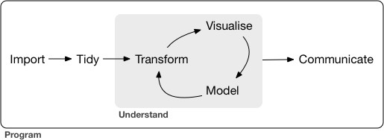
The R for Data Science Workflow
Source: Image is from Wickham, H. Grolemnund, G. (2017). "R for Data Science", O'Reily. https://r4ds.had.co.nz/introduction.html
6 / 31

Slide 7
The Rationale for Tidy Data
The tidy framework provides a consistent way to organize your data in .
Getting your data into this format requires some upfront work, but that work pays off in the long term.
Once you have tidy data and the tidy tools provided by packages in the tidyverse, you will spend much less time munging data from one representation to another, allowing you to spend more time on the analytic questions at hand.
Source: Slide is based on Wickham, H. Grolemnund, G. (2017). "R for Data Science", O'Reily. https://r4ds.had.co.nz/tidy-data.html.
7 / 31

Slide 8
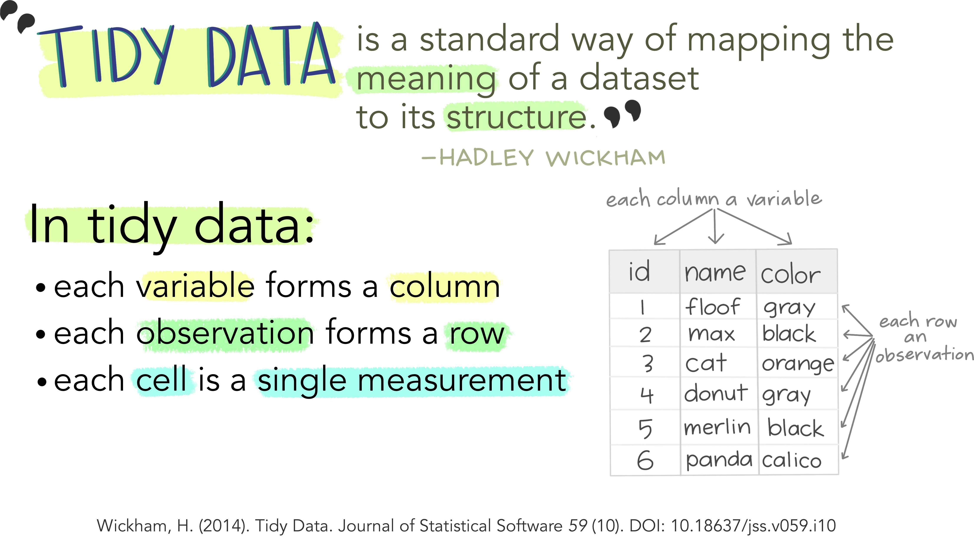
Source: Illustration is from the Openscapes blog Tidy Data for reproducibility, efficiency, and collaboration by Julia Lowndes and Allison Horst

Slide 9
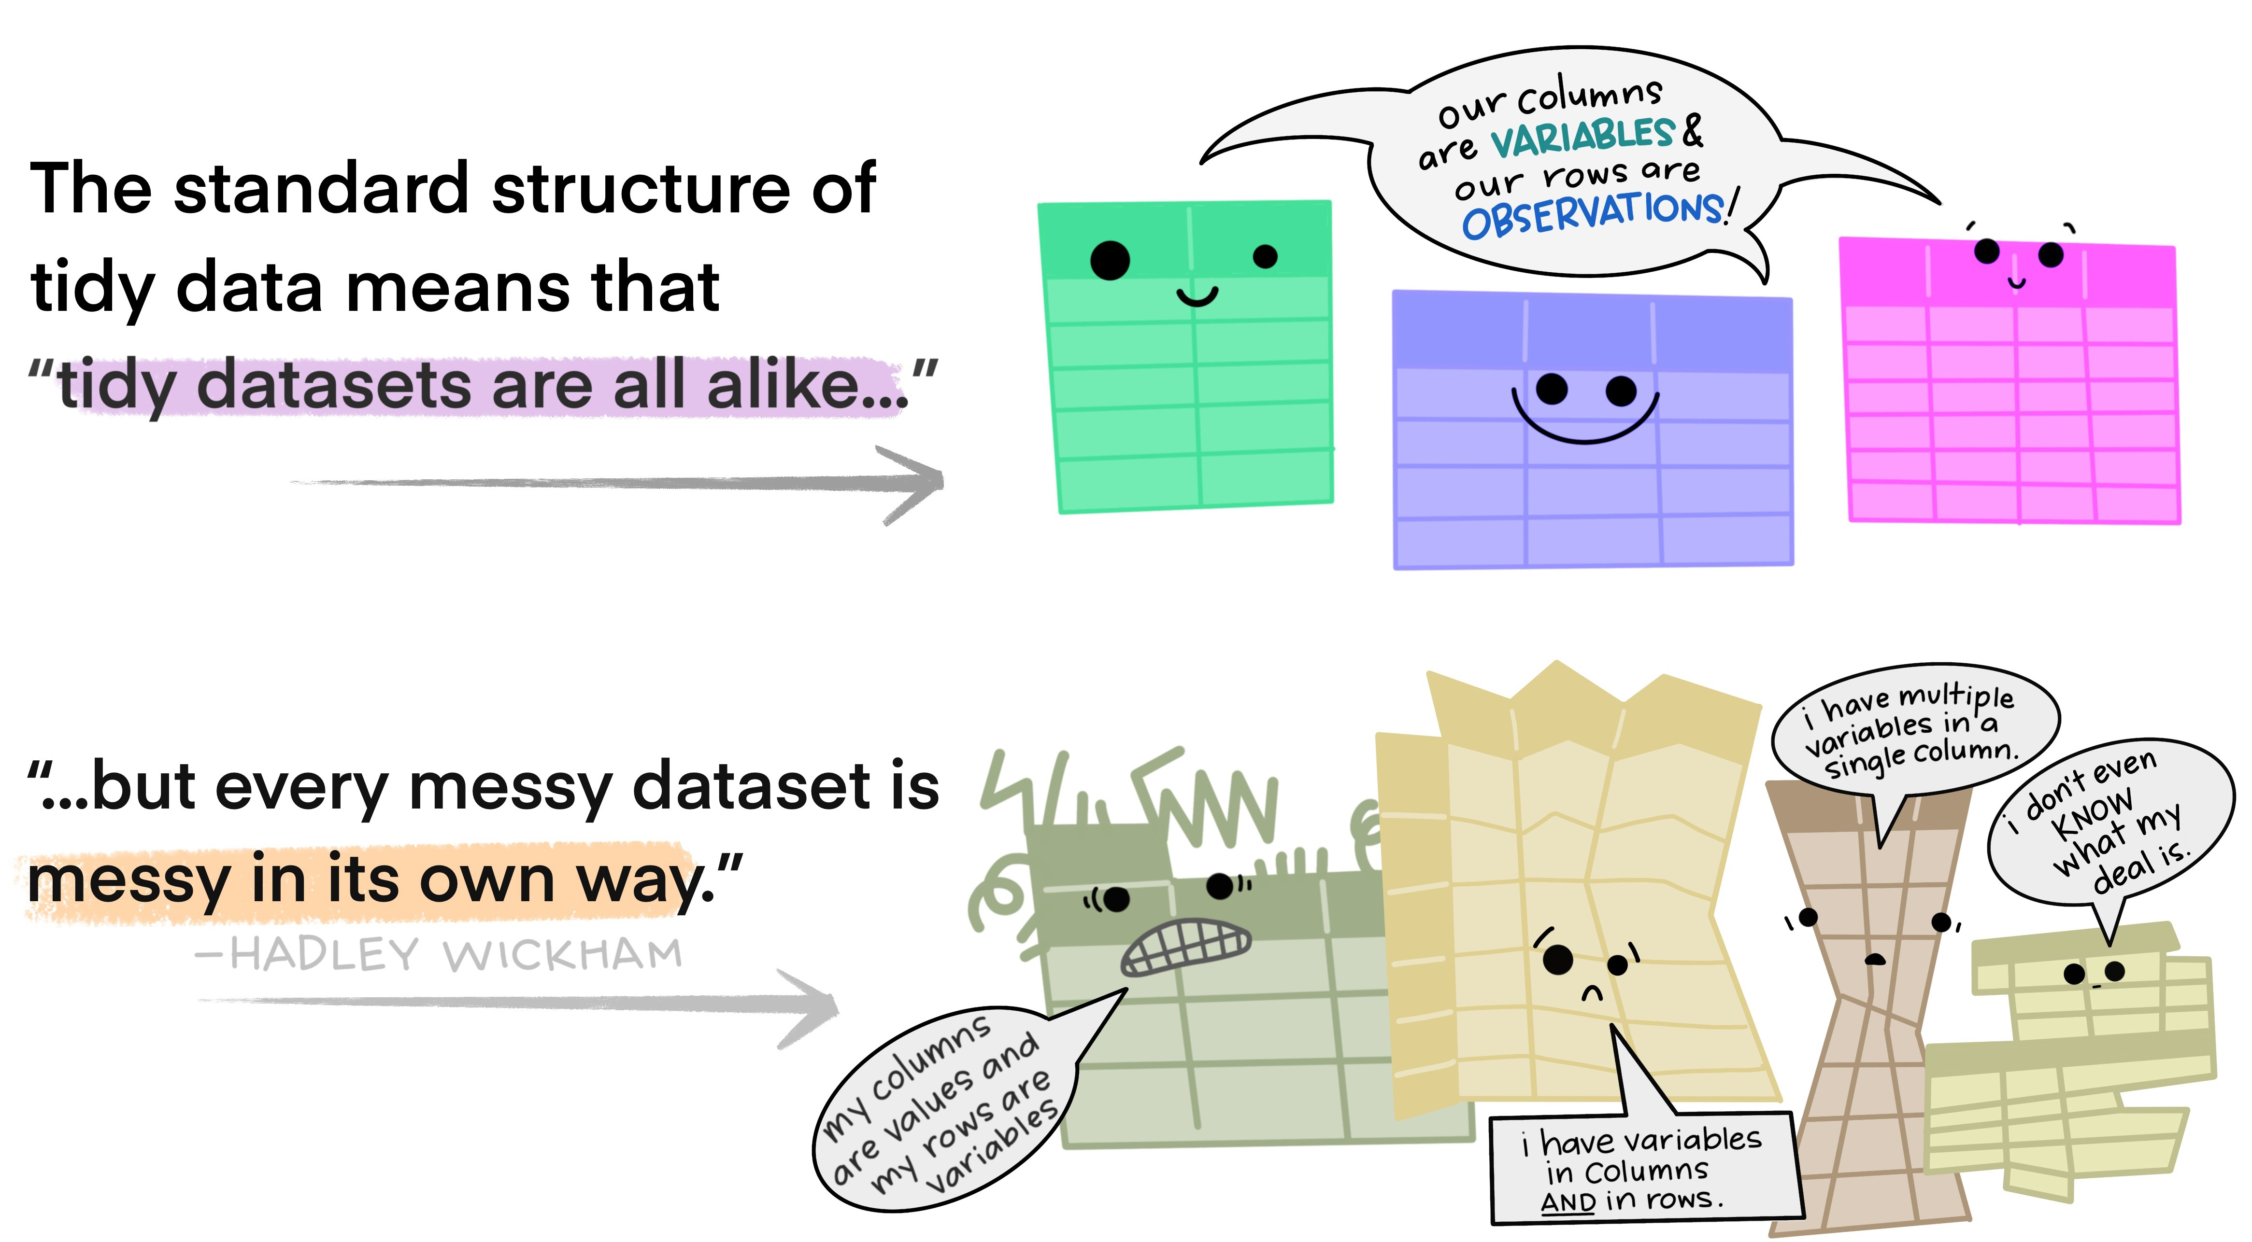
Source: Illustration is from the Openscapes blog Tidy Data for reproducibility, efficiency, and collaboration by Julia Lowndes and Allison Horst

Slide 10
tidy data
clean data
The movies data is tidy but not clean.
movies <- tibble::as_tibble(jsonlite::read_json( "https://vega.github.io/vega-editor/app/data/movies.json", simplifyVector = TRUE))
movies |>
dplyr::relocate(Release_Date, US_DVD_Sales) |> # move cols to front dplyr::slice(37:39, 268:269) |> # filter specific row numbers print(width = 80) # print nicely
## ## | # | A tibble: 5 × 16 Release_Date US_DVD_Sales Title |  | US_Gross | Worldwide_Gross | Production_Budget
## | <chr> |  | <int> <chr> | <int> | <dbl> | <int>
## | 1 | 9-Mar-94 | NA Four Wed… | 52700832 | 242895809 | 4500000
## | 2 | 18-Oct-06 | NA 51 Birch… | 84689 | 84689 | 350000
## | 3 | 1963-01-01 | NA 55 Days … | 10000000 | 10000000 | 17000000
## | 4 | <NA> | NA Drei | 0 | 0 | 7200000
## | 5 | 16-Jan-98 | NA The Dress | 16556 | 16556 | 2650000
## | # | ℹ 10 more variables: MPAA_Rating <chr>, Running_Time_min <int>,
## | # | Distributor <chr>, Source <chr>, Major_Genre <chr>, Creative_Type |  |  |  |  | <chr>,
## | # | Director <chr>, Rotten_Tomatoes_Rating <int>, IMDB_Rating <dbl>,
10 / 31

Slide 11
05:00
Non-graded Activity: Tidy or Not?
Activity table1 table2 table3 table4a table4b
In the next five panels, there five tables all displaying the number of TB cases documented by the World Health Organization in Afghanistan, Brazil, and China between 1999 and 2000.
The data contains values associated with four variables (country, year, cases, and population), but each table organizes the values in a different layout.
Based on the information in the previous slide, please document which of the table(s) is(are) tidy and if not, which rules are violated.
Discuss your answer with your neighboring colleague.
Note that you have a total of five minutes for this non-graded activity.
11 / 31

Slide 12
GGeettttiinngg DDaattaa iinnttoo TTiiddyy FFoorrmmaatt
1122 // 3311

Slide 13

Key Functions from the tidyr
type | function() | function()
pivoting | pivot_longer() | pivot_wider()
splitting/combining | separate() | unite()
nesting/unnesting | nest() | unnest()
missing complete() fill()
Source: Slide is based on Earo Wang's STAT 220 Slides
13 / 31

Slide 14
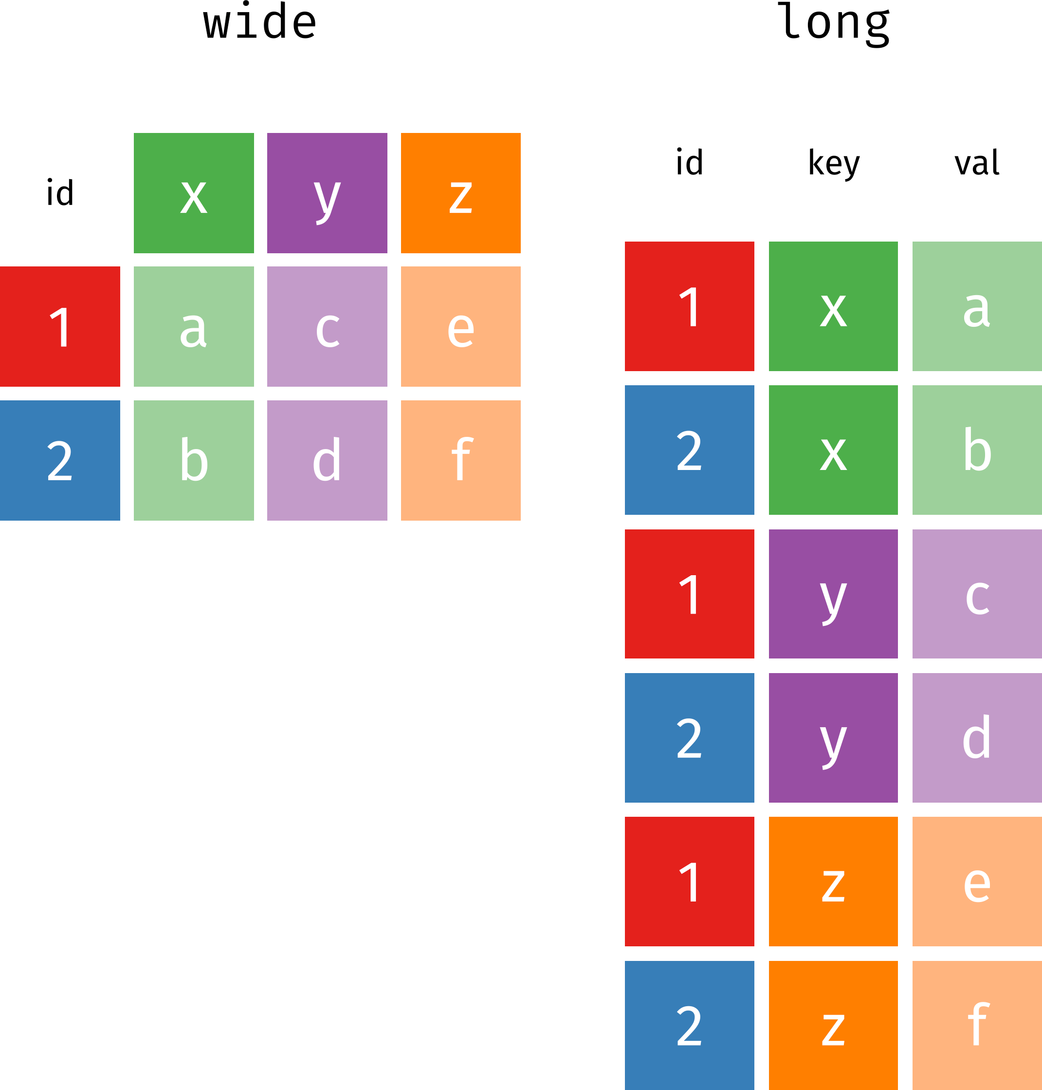
Wide Vs Long Data
Source: Image is from Garrick Aden-Buie's excellent tidyexplain GitHub Repository

Slide 15
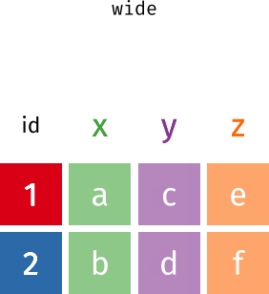
pviot_() to Transform Wide from/to Long
Source: Image is from Garrick Aden-Buie's excellent tidyexplain GitHub Repository

Slide 16
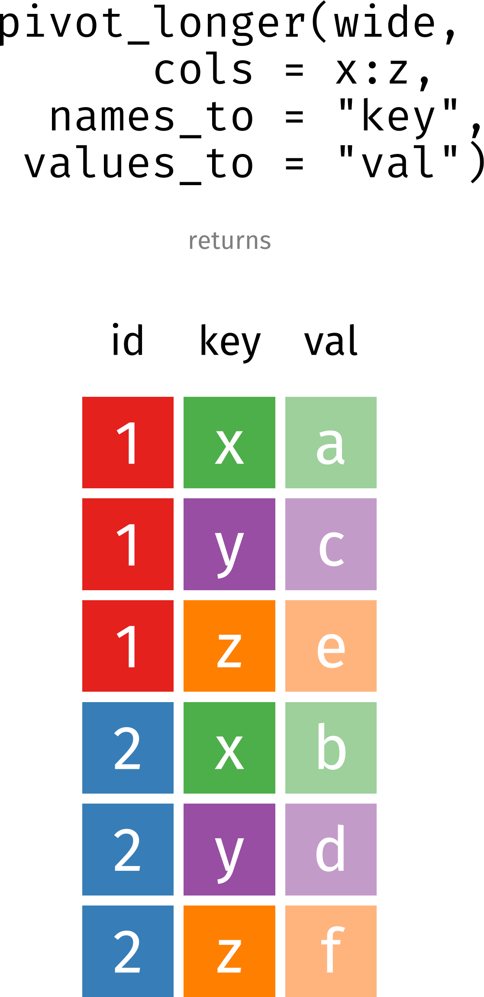
The pivot_longer() Function
Source: Image is from Garrick Aden-Buie's excellent tidyexplain GitHub Repository

Slide 17
pivot_longer() for table4a [1]
To tidy a dataset like this, we need to pivot the offending columns into a new pair of variables. To describe that operation we need three parameters:
The set of columns whose names are values, not variables. In this example, those are the columns 1999 and 2000.
The name of the variable to move the column names to. Here it is year.
The name of the variable to move the column values to. Here it’s cases.
17 / 31

Slide 18
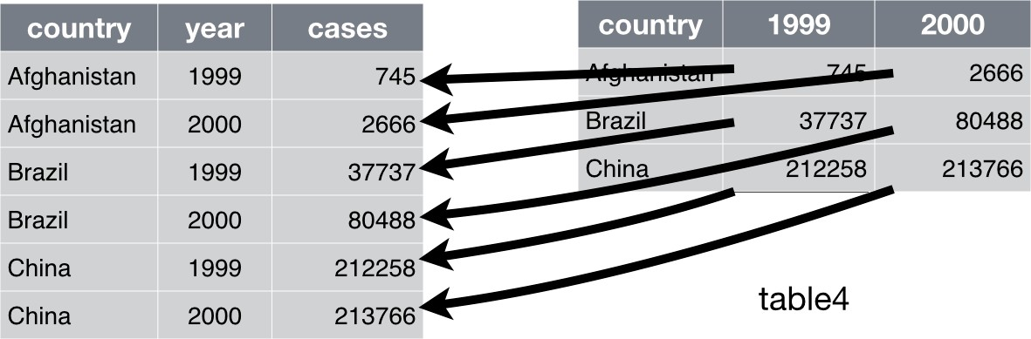
pivot_longer() for table4a [2]
Pivoting table4a into a longer, tidy form
Source: Slide is based on Wickham, H. Grolemnund, G. (2017). "R for Data Science", O'Reily. https://r4ds.had.co.nz/tidy-data.html.
18 / 31

Slide 19
pivot_longer() for table4a [3]
tidyr::pivot_longer(table4a, c(`1999`, `2000`), names_to = "year", values_to = "cases")
## # A tibble: 6 × 3
## country | year | cases
## <chr> | <chr> | <dbl>
## 1 Afghanistan | 1999 | 745
## 2 Afghanistan | 2000 | 2666
## 3 Brazil | 1999 | 37737
## 4 Brazil | 2000 | 80488
## 5 China | 1999 | 212258
## 6 China | 2000 | 213766
19 / 31

Slide 20
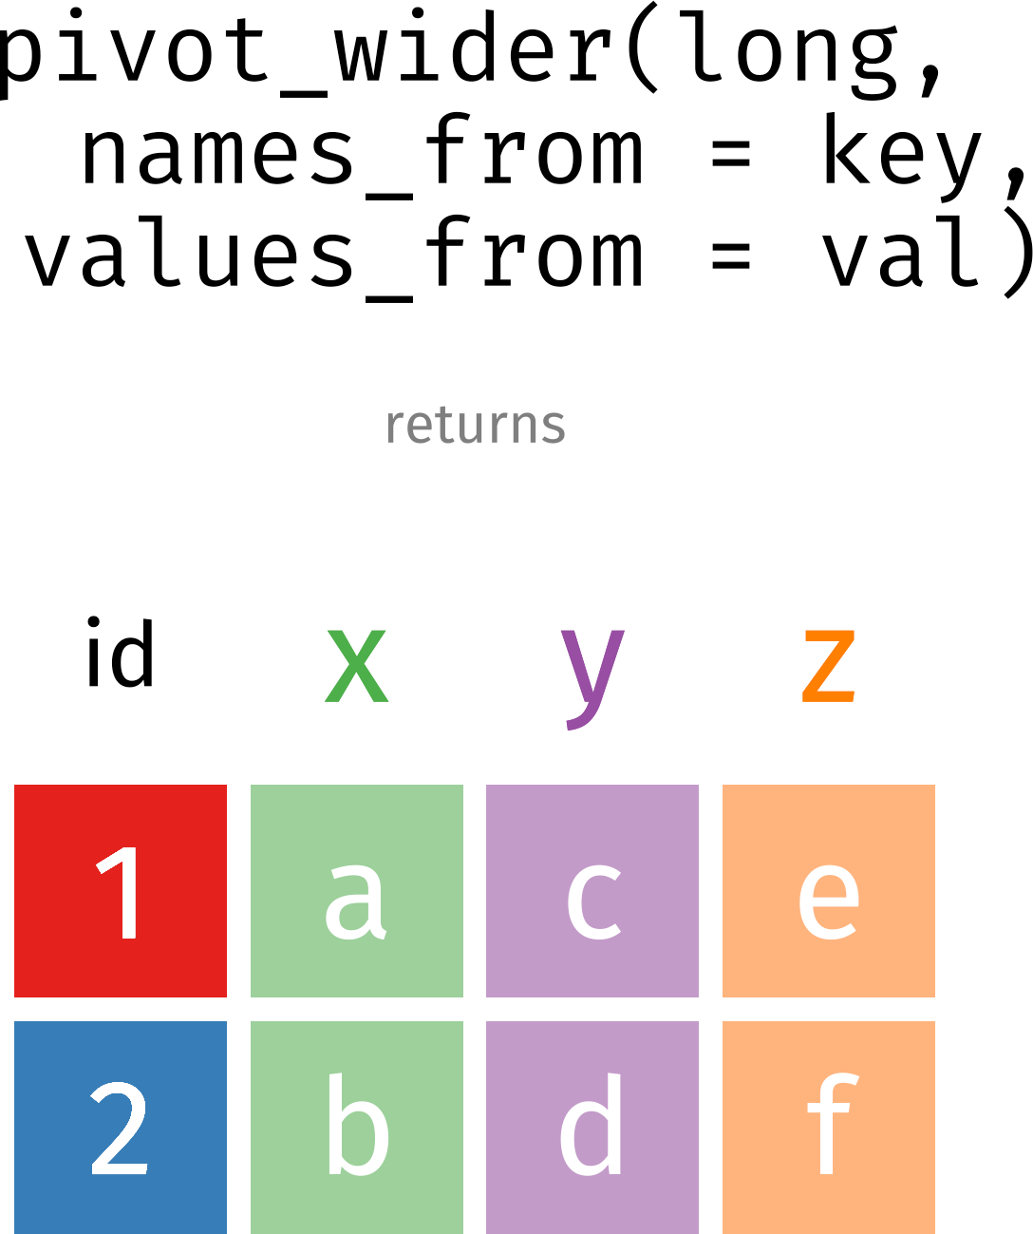
The pivot_wider() Function
Source: Image is from Garrick Aden-Buie's excellent tidyexplain GitHub Repository
20 / 31

Slide 21
pivot_wider() for table2 [1]
pivot_wider() is the opposite of pivot_longer().
You use it when an observation is scattered across multiple rows.
For example, take table2: an observation is a country in a year, but each observation is spread across two rows.
head(table2, n = 3)
## # A tibble: 3 × 4
## country year type
## <chr> <dbl> <chr>
count
<dbl>
## | 1 | Afghanistan | 1999 | cases | 745
## | 2 | Afghanistan | 1999 | population | 19987071
## | 3 | Afghanistan | 2000 | cases | 2666
21 / 31

Slide 22
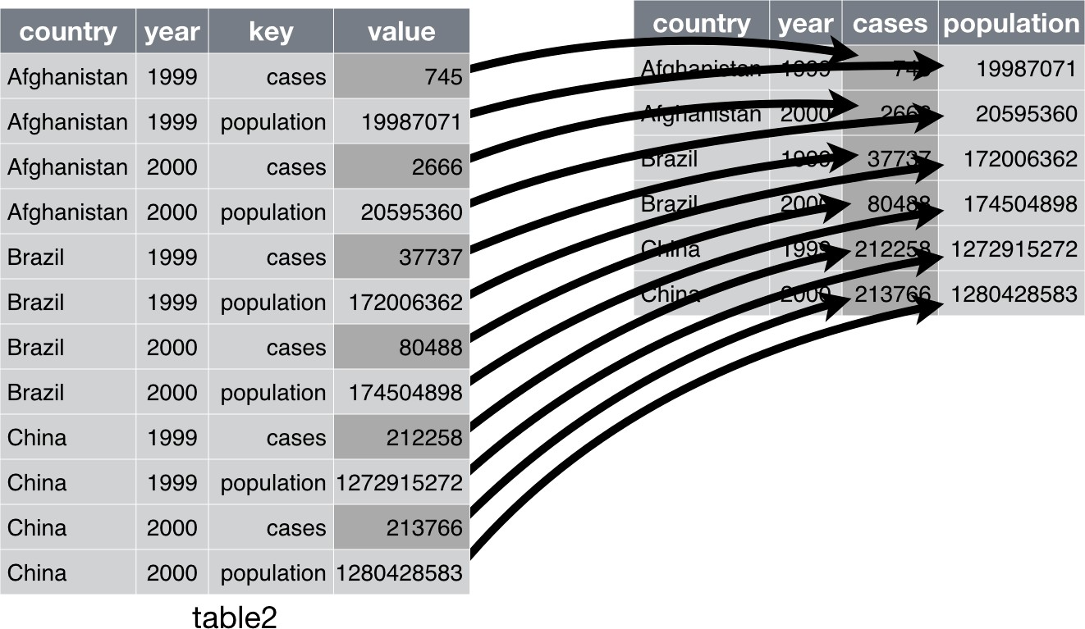
pivot_wider() for table2 [2]
Source: Slide is based on Wickham, H. Grolemnund, G. (2017). "R for Data Science", O'Reily. https://r4ds.had.co.nz/tidy-data.html.
22 / 31

Slide 23
pivot_wider() for table2 [3]
tidyr::pivot_wider(table2, names_from = type, values_from = count)
 | ## # A tibble: 6 × 4 ## country year | cases | population
 | ## <chr> <dbl> | <dbl> | <dbl>
 | ## 1 Afghanistan 1999 | 745 | 19987071
 | ## 2 Afghanistan 2000 | 2666 | 20595360
 | ## 3 Brazil 1999 | 37737 | 172006362
 | ## 4 Brazil 2000 | 80488 | 174504898
 | ## 5 China 1999 | 212258 | 1272915272
 | ## 6 China 2000 | 213766 | 1280428583

Slide 24
separate() for table3 [1]
## | # | A tibble: 6 | × 3
## |  | country | year | rate
## <chr> |  |  | <dbl> | <chr>
## | 1 | Afghanistan | 1999 | 745/19987071
## | 2 | Afghanistan | 2000 | 2666/20595360
## | 3 | Brazil | 1999 | 37737/172006362
## | 4 | Brazil | 2000 | 80488/174504898
## | 5 | China | 1999 | 212258/1272915272
## | 6 | China | 2000 | 213766/1280428583
table3 has a different problem:
we have one column (rate) that contains two variables (cases and population).
To fix this problem, we’ll need the separate() function.

Slide 25
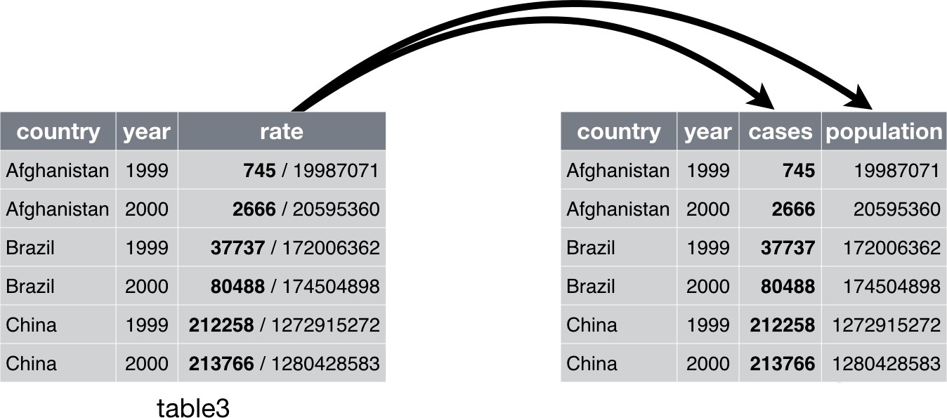
separate() for table3 [2]
Source: Slide is based on Wickham, H. Grolemnund, G. (2017). "R for Data Science", O'Reily. https://r4ds.had.co.nz/tidy-data.html.
25 / 31

Slide 26
separate() for table3 [3]
 | tidyr::separate(table3, | rate, | into = c("cases", "population"), convert = TRUE)
 | ## # A tibble: 6 × 4
 | ## country year ## <chr> <dbl> | cases <int> | population <int>
 | ## 1 Afghanistan 1999 | 745 | 19987071
 | ## 2 Afghanistan 2000 | 2666 | 20595360
 | ## 3 Brazil 1999 | 37737 | 172006362
 | ## 4 Brazil 2000 | 80488 | 174504898
 | ## 5 China 1999 | 212258 | 1272915272
 | ## 6 China 2000 | 213766 | 1280428583

Slide 27
05:00
Non-graded Class Activity
Activity Your Solution
In this five minute non-graded activity, please do the following
Go to https://usafacts.org/visualizations/coronavirus-covid-19-spread-map/
Download the data for Deaths by clicking on the tab to the right of the page.
Tidy this data based on the information you have learned in today's class.

Slide 28
RReeccaapp
2288 // 3311

Slide 29
Summary of Main Points
By now, you should be able to do the following:
Define tidy data
Perform pivot and rectangling operations in
29 / 31

Slide 30
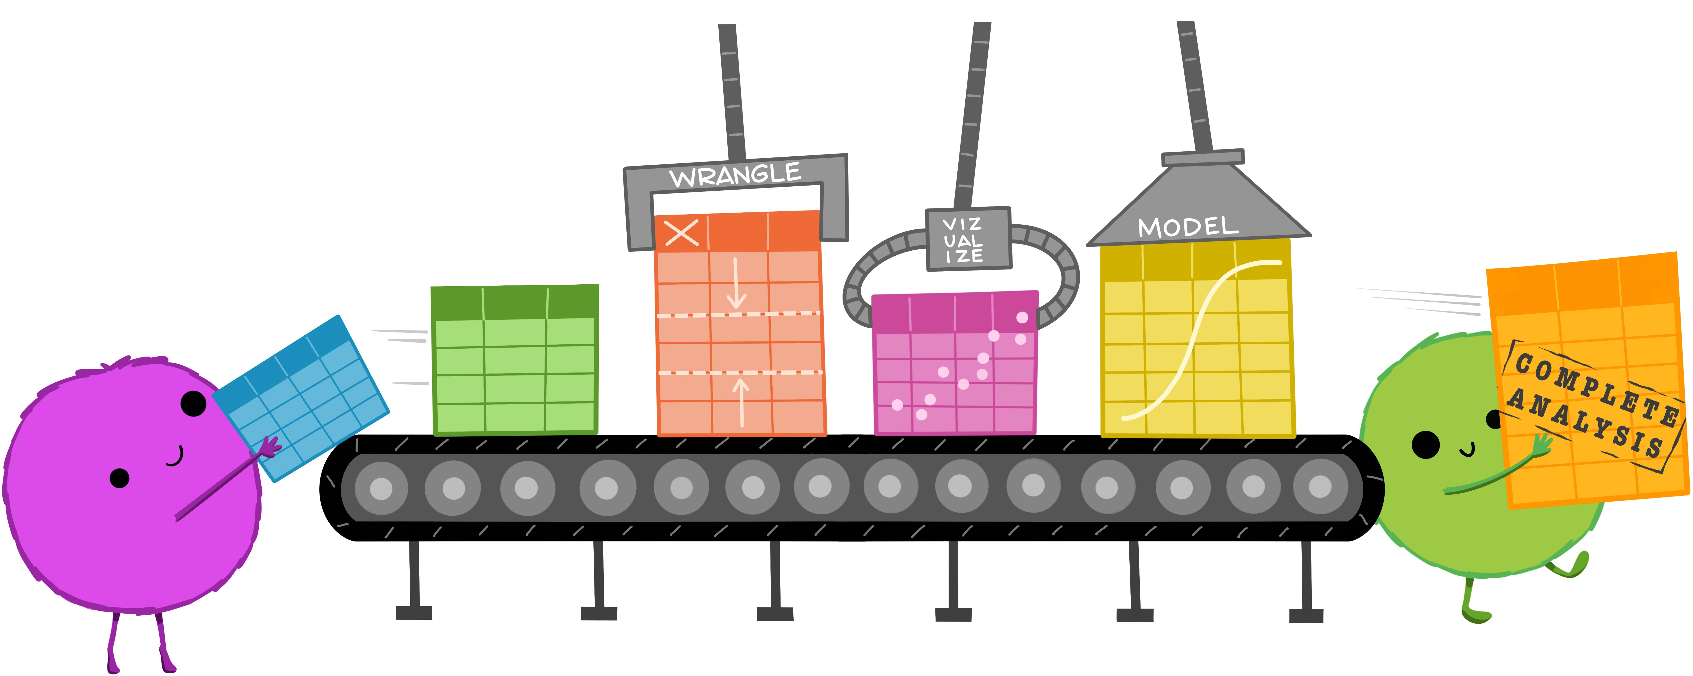
Advantages of Tidy Data
one set of consistent tools for different datasets
easier for automation and iteration
Source: Illustration is from the Openscapes blog Tidy Data for reproducibility, efficiency, and collaboration by Julia Lowndes and Allison Horst
30 / 31

Slide 31
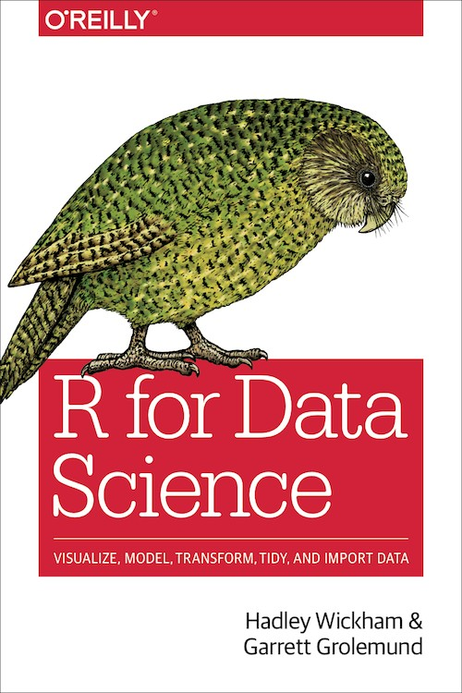
Things to Do Prior to Next Class
Please go through the following two supplementary readings and complete assignment 06: tidy data.
Tidy data
{tidyr} cheatsheet
31 / 31

