Slide 1




ISA 401: Business Intelligence & Data Visualization
10: Towards Technically Correct and Consistent Data
Fadel M. Megahed, PhD
Raymond E. Glos Professor in Business Farmer School of Business
Miami University
@FadelMegahed fmegahed fmegahed@miamioh.edu
Automated Scheduler for Office Hours
Fall 2025

Slide 2
Quick Refresher from Last Class
✅ Define tidy data
✅ Perform pivot and rectangling operations in

Slide 3
Learning Objectives for Today's Class
Explain the concept of "technically correct" data
Examine the different column types and their summaries
Recode factors and convert dates
Manipulate characters
Explain the concept of "consistent" data

Slide 4
🔍🔍 AAnn AAlltteerrnnaattiivvee PPiippeelliinnee ffoorr SSttaattiissttiiccaall DDaattaa AAnnaallyyssiiss
44 // 2288

Slide 5
Data Analysis: A Crowd-Sourced Definition
Wikipedia's data analysis article defines it to be the process of:
inspecting, cleansing, transforming and modeling data with the goal of discovering
useful information, informing conclusion and supporting decision-making. Data
analysis has multiple facets and approaches, encompassing diverse techniques under a variety of names, and is used in different business, science, and social science domains.
5 / 28

Slide 6
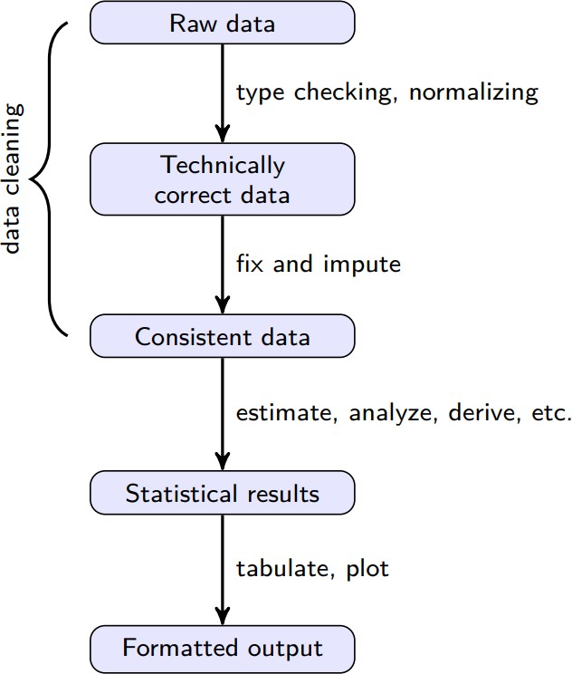
Post Tidy Data: The Data Analysis Value Chain
Source: De Jonge and Van Der Loo (2013), An introduction to data cleaning with R. Please click on the link and read p. 7-8.
6 / 28

Slide 7
Technically Correct Data
Raw data files may lack headers, contain wrong data types (e.g. numbers stored as
strings), wrong category labels, unknown or unexpected character encoding and so on.
Technically correct data is the state in which data can be read into an R data.frame, with correct name, types and labels, without further trouble. However, that does not mean that the values are error-free or complete. --- De Jonge and Van Der Loo (2013)
7 / 28

Slide 8
TTeecchhnniiccaallllyy CCoorrrreecctt DDaattaa
88 // 2288

Slide 9
Functions for Cleaning/Renaming Variables
type | package | function() | description
cleaning names | janitor | clean_names() | Resulting names are unique, consisting only of the _ character, numbers, and letters
renaming | base R | names()[colNum(s)] | Will rename a column by its number, e.g., names(df)[1] = ‘new_name’ will rename the first column in df to ‘new_name’
renaming | dplyr | rename(df, new_name = old_name) | Will rename a the column titled ‘old_name’ to ‘new_name’ You can pass a vector of names to rename multiple cols, e.g., rename(df, c(new_name1 = old_name1, new_name2 = old_name2))

Slide 10
An Example for Renaming Columns: The Data
iris_tbl = tibble::tibble(iris) # convert to tibble print(iris_tbl, # printing it
width= 80) # make it wider
## # A tibble: 150 × 5
## |  | Sepal.Length | Sepal.Width | Petal.Length | Petal.Width | Species
## |  | <dbl> | <dbl> | <dbl> | <dbl> | <fct>
## | 1 | 5.1 | 3.5 | 1.4 | 0.2 | setosa
## | 2 | 4.9 | 3 | 1.4 | 0.2 | setosa
## | 3 | 4.7 | 3.2 | 1.3 | 0.2 | setosa
## | 4 | 4.6 | 3.1 | 1.5 | 0.2 | setosa
## | 5 | 5 | 3.6 | 1.4 | 0.2 | setosa
## | 6 | 5.4 | 3.9 | 1.7 | 0.4 | setosa
## | 7 | 4.6 | 3.4 | 1.4 | 0.3 | setosa
## | 8 | 5 | 3.4 | 1.5 | 0.2 | setosa
## | 9 | 4.4 | 2.9 | 1.4 | 0.2 | setosa
## | 10 | 4.9 | 3.1 | 1.5 | 0.1 | setosa
## | ℹ | 140 more rows

Slide 11
An Example for Renaming Columns: Code
iris_tbl = janitor::clean_names(iris_tbl) #<< # overwrite w/ clean_names names(iris_tbl) # seeing new names
## [1] "sepal_length" "sepal_width" "petal_length" "petal_width" "species"
names(iris_tbl)[names(iris_tbl)=='species'] = 'type' names(iris_tbl)
## [1] "sepal_length" "sepal_width" "petal_length" "petal_width" "type"
renaming with rename iris_tbl = dplyr::rename(
iris_tbl, c(sepal_l = sepal_length, sepal_w = sepal_width)
)
names(iris_tbl)
## [1] "sepal_l"
"sepal_w"
"petal_length" "petal_width"
"type"

Slide 12
Functions for Examining Column Classes
package | function() | description
base R | class(iris_tbl$sepal_length) | Will return the class of the column titled ‘sepal_length’
base R | sapply(iris_tbl, class) | Will apply the class() function to all columns in the iris_tbl
base R | str(iris_tbl) | Will return the internal structure of the iris_tbl, which includes the dimensions of the df/tibble, column names, column types and first few observation values
purrr | map_chr(iris_tbl, class) | The tidyverse equivalent to sapply()
dplyr | glimpse(iris_tbl) | glimpse() is like a transposed version of print(): columns run down the page, and data runs across. It’s a little like str() but shows you as much data as possible.
skimr | skim(iris_tbl) | returns variable types, names, statistical summaries & histograms of numeric variables.
DataExplorer | plot_str(iris_tbl) | while more useful for lists, returns a plot of the internal structure of your data.

Slide 13

Functions for Changing Column Classes
Convert to Factor:
To convert a numeric vector to factors, we will typically use the chain of as_factor( as_character() ).
To convert a character vector to factors, we will simply use the as_factor().
Convert to Date:
To convert a character vector to date, you should use an appropriate function or chain of functions from the lubridate .
To change multiple columns at once, we will resort to the mutate_at() or mutate_if
functions from the dplyr .
For any of the above operations, we will need to overwrite the original column's data.

Slide 14
Functions for Labeling Factors
package | function() | description
base R | levels(df$fct_column)= c() | Passing a character vector to recode the levels of a factor column. Order matters here so you need to check the order of both the levels and the inputs to c()
df fct_{c}olumn = fct_{r}ecode(df
fct_column, fruit = ‘apple’)
If the factor colum contained a level called apple, it will be renamed to fruit. Multiple levels can be changed per ?fct_recode
forcats

Slide 15
TToowwaarrddss CCoonnssiisstteenntt DDaattaa
1155 // 2288

Slide 16
Consistent Data
Consistent data is the stage where data is ready for statistical inference. It is the data
that most statistical theories use as a starting point. Ideally, such theories can still be applied without taking previous data cleaning steps into account. In practice however, data cleaning methods like imputation of missing values will influence statistical results and so must be accounted for in the following analyses or interpretation thereof. --- De Jonge and Van Der Loo (2013)
Features of Consistent Data
[Usually] no missing data
Values within and across columns meet your expected "rules" for the data
It is what we will colloquially refer to as "clean" data
16 / 28

Slide 17
Considerations to Achieving Consistent Data
Do you have missing values in any of the variables?
Are the values for each variable reasonable? e.g., do you have a negative age?
Are the values across the columns for a given observation reasonable? e.g., does the count of registered and casual riders add up to the total number of riders?
Some Useful Packages in
The pointblank for data validation.
The editrules and deducorrect for localizing errors and performing some basic imputations of data.
Note that any efforts to achieve consistent data will have to be:
Dataset dependent; and
Research question dependent
17 / 28

Slide 18
AA DDeemmoo UUssiinngg aa PPooppuullaarr BBiikkeesshhaarriinngg DDaattaasseett
1188 // 2288

Slide 19
Tasks
In this in-class, demo we will:
Read the bike_sharing_data.csv data. The description of all fields (with the exception of the
sources column) can be found at Kaggle dataset description.
Check whether the dataset is technically correct, generate a report on how each variable meets/contradicts its expected data type/class, and fix any observed issue(s).
We will create a set of consistency rules for variables and examine the instances (rows) when any of the rules are violated.
We will generate an additional report on the status of our data's consistency.

Slide 20
Data Validation Pipeline: pointblank
bike_tbl =
readr::read_csv('../../data/bike_sharing_data.csv') |> janitor::clean_names()
act = pointblank::action_levels(warn_at = 0.01, notify_at = 0.01, stop_at = NULL) agent =
pointblank::create_agent(bike_tbl, actions = act) |> pointblank::col_is_date(columns = pointblank::vars(datetime)) |> pointblank::col_is_factor(
columns = pointblank::vars(season, holiday, workingday, weather)
) |> pointblank::col_is_numeric(
columns = pointblank::vars(temp, atemp, humidity, windspeed)
) |> pointblank::col_is_integer(
columns = pointblank::vars(casual, registered, count)
) |>
pointblank::col_is_character(columns = pointblank::vars(sources))
res = pointblank::interrogate(agent, sample_limit = nrow(bike_tbl)) res

Slide 21

Data Validation Pipeline: pointblank
 |  |  |  |  |  |  |  |  |  |  |  |  |  
 | Pointblank Validation
 | [2025-09-25|12:09:19]
 | TIBBLE bike_tbl
 | STEP COLUMNS |  | VALUES | TBL | EVAL | UNITS | PASS | FAIL | W S | N | EXT
 | 1 col_is_date() | ▮datetime | — | ✓ |  | 1 | 0 0.00 | 1 1.00 | — | ● | —
 | 2 col_is_factor() | ▮season | — | ✓ |  | 1 | 0 0.00 | 1 1.00 | — | ● | —
 | 3 col_is_factor() | ▮holiday | — | ✓ |  | 1 | 0 0.00 | 1 1.00 | — | ● | —
 | 4 col_is_factor() | ▮workingday | — | ✓ |  | 1 | 0 0.00 | 1 1.00 | — | ● | —
 | 5 col_is_factor() | ▮weather | — | ✓ |  | 1 | 0 0.00 | 1 1.00 | — | ● | —
 | 6 col is numeric() | ▮temp | — | ✓ |  | 1 | 1 | 0 | — | ○ | —
WARN | 0.01 | STOP | — | NOTIFY | 0.01

Slide 22
Changing the Column Types that Need "Fixing"
Please refer to our in-class code.

Slide 23
Examining the Consistency of the Data
library(pointblank)
act <- action_levels(warn_at = 0.01, notify_at = 0.01, stop_at = NULL) agent <-
create_agent(bike_tbl, actions = act) |>
col_vals_between(columns = vars(temp, atemp, humidity, windspeed), 0, 100) |> col_vals_gte(columns = vars(casual, registered), 0) |>
col_vals_gt(columns = vars(count), 0) |>
col_is_factor(columns = vars(season, holiday, workingday, weather)) |> col_vals_in_set(columns = vars(hour), set = seq(0, 23, by = 1)) |> col_vals_not_null(columns = names(bike_tbl)) |> col_vals_expr(expr(count == casual + registered) ) |>
col_vals_expr(expr = expr(sources %in% c('AD campaign', 'ad campaign'))) |> col_vals_expr(expr = ~ str_detect(sources, pattern = 'google'),
label = 'non google sources')
res <- interrogate(agent, sample_limit = nrow(bike_tbl)) res |> export_report(filename = 'report_consistency.html')

Slide 24


Examining the Consistency of the Data
 |  |  |  |  |  |  |  |  |  |  |  |  |  
 | Pointblank Validation
 | [2025-09-25|12:09:20]
 | TIBBLE bike_tbl
 | STEP COLUMNS |  | VALUES | TBL | EVAL UNITS PASS |  |  | FAIL W S |  | N | EXT
 | 1 col_vals_between() | ▮temp | [0, 100] | ✓ |  | 17K | 17K 1.00 | 0 0.00 | — | ○ | —
 | 2 col_vals_between() | ▮atemp | [0, 100] | ✓ |  | 17K | 17K 1.00 | 0 0.00 | — | ○ | —
 | 3 col_vals_between() | ▮humidity | [0, 100] | ✓ |  | 17K | 17K 0.99 | 1 0.01 | — | ○ | CSV
 | 4 col_vals_between() | ▮windspeed | [0, 100] | ✓ |  | 17K | 17K 1.00 | 0 0.00 | — | ○ | —
 | 5 col_vals_gte() | ▮casual | 0 | ✓ |  | 17K | 17K 1.00 | 0 0.00 | — | ○ | —
 | 6 col vals gte() | ▮registered | 0 | ✓ |  | 17K | 17K | 0 | — | ○ | —
WARN | 0.01 | STOP | — | NOTIFY | 0.01

Slide 25
Changing the Column Values that Need "Fixing"
Please refer to our in-class code.

Slide 26
RReeccaapp
2266 // 2288

Slide 27
Summary of Main Points
By now, you should be able to do the following:
Explain the concept of "technically correct" data
Examine the different column types and their summaries
Recode factors and convert dates
Manipulate characters
Explain the concept of "consistent" data

Slide 28


Things to Do Prior to Next Class
Please go through the following two supplementary readings and complete assignment 07.
From raw data to technically correct data
From technically correct to consistent data
An introduction to the funmodeling package
Data preperation with funmodeling

