Slide 1




ISA 401: Business Intelligence & Data Visualization
20: Charts Used for Spatial and Spatiotemporal Data
Fadel M. Megahed, PhD
Raymond E. Glos Professor in Business Farmer School of Business
Miami University
@FadelMegahed fmegahed fmegahed@miamioh.edu
Automated Scheduler for Office Hours
Fall 2025

Slide 2
Learning Objectives for Today's Class
Explain the different types of spatial plots
Select suitable spatial graphs for different scenarios
Understand how spatiotemporal plots can help in storytelling (what makes BI special)
2 / 13

Slide 3
SSppaattiiaall PPlloottss
33 // 1133

Slide 4
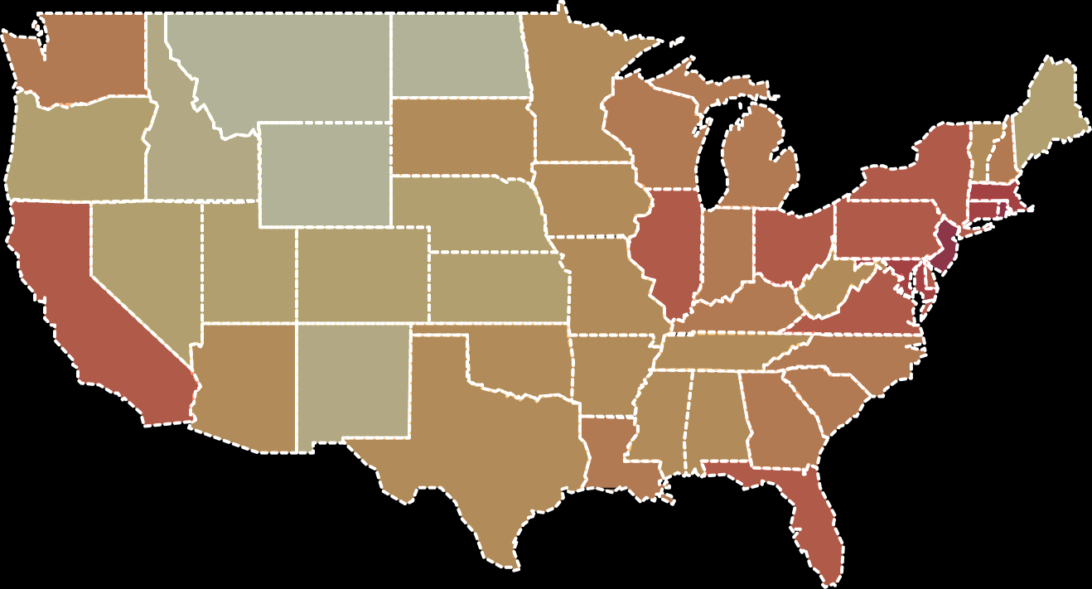
Choropleth Maps
Maps where areas are shaded, colored, or patterned relative to a data attribute value.
+
−
0 – 10
10 – 20
20 – 50
50 – 100
100 – 200
200 – 500
500 – 1,000
1,000 – Inf
Leaflet | © Mapbox © OpenStreetMap contributors Improve this map
Population Density in U.S.
4 / 13

Slide 5
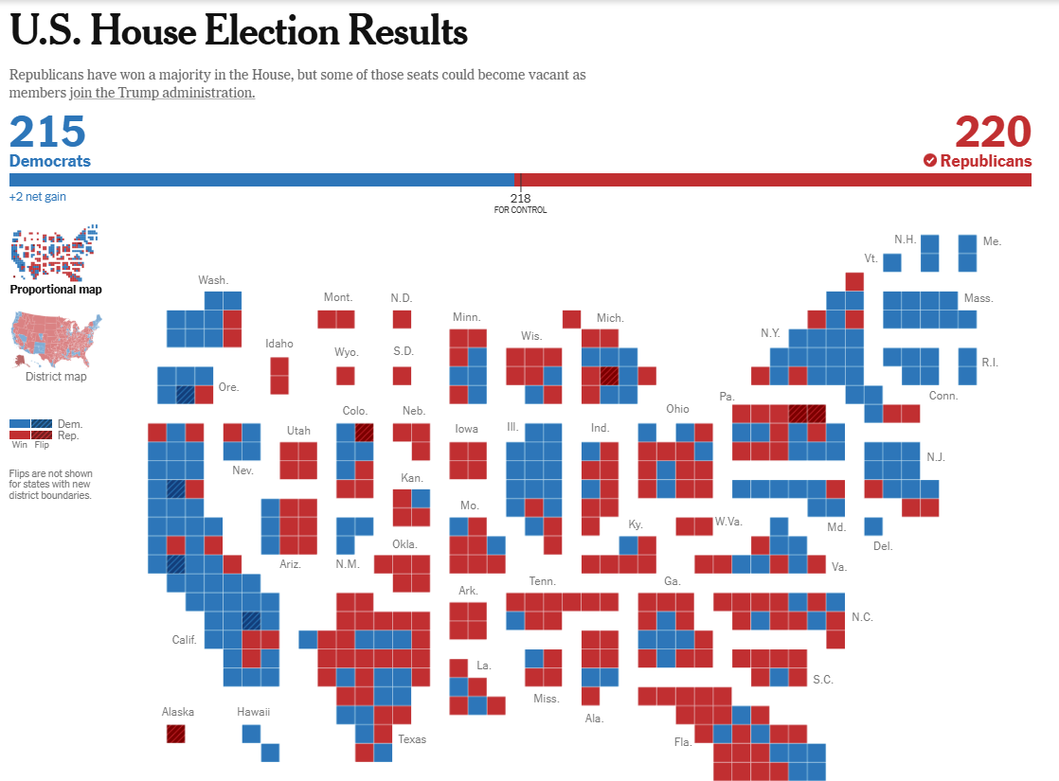
Cartograms
A cartogram is a map in which areas are scaled and distorted relative to a data attribute value
The NYT's U.S. House Election Results 2024
5 / 13

Slide 6
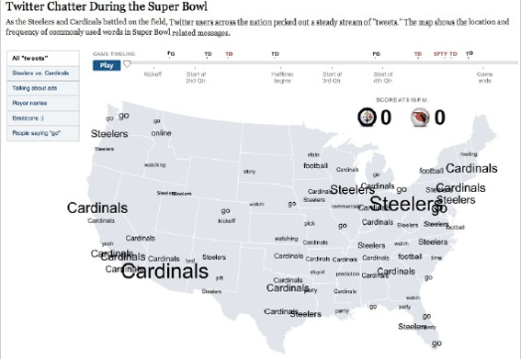
Proportional Symbols Map
The NYT's U.S. Coverage of 2009 Super Bowl
6 / 13

Slide 7
SSppaattiiootteemmppoorraall MMaappss
77 // 1133

Slide 8
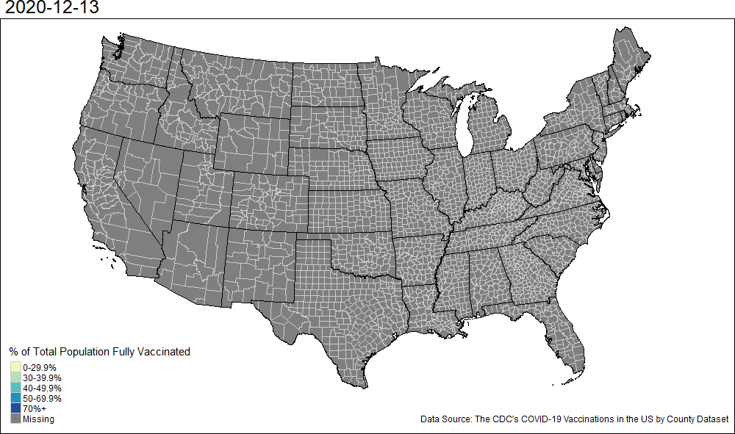
Spatiotemporal Maps
8 / 13

Slide 9
SSooffttwwaarree DDeemmoo
99 // 1133

Slide 10
Exploring the Cincy Crashes Dataset
Let us use Tableau to explore the cincy_2024_crashes.csv, where we will create the following:
A calculated field titled unique_count
A plot of the total number of unique crashes per day
A table of number of unique crashes by week day
A table of number of unique crashes by week day
An animated symbols map
10 / 13

Slide 11
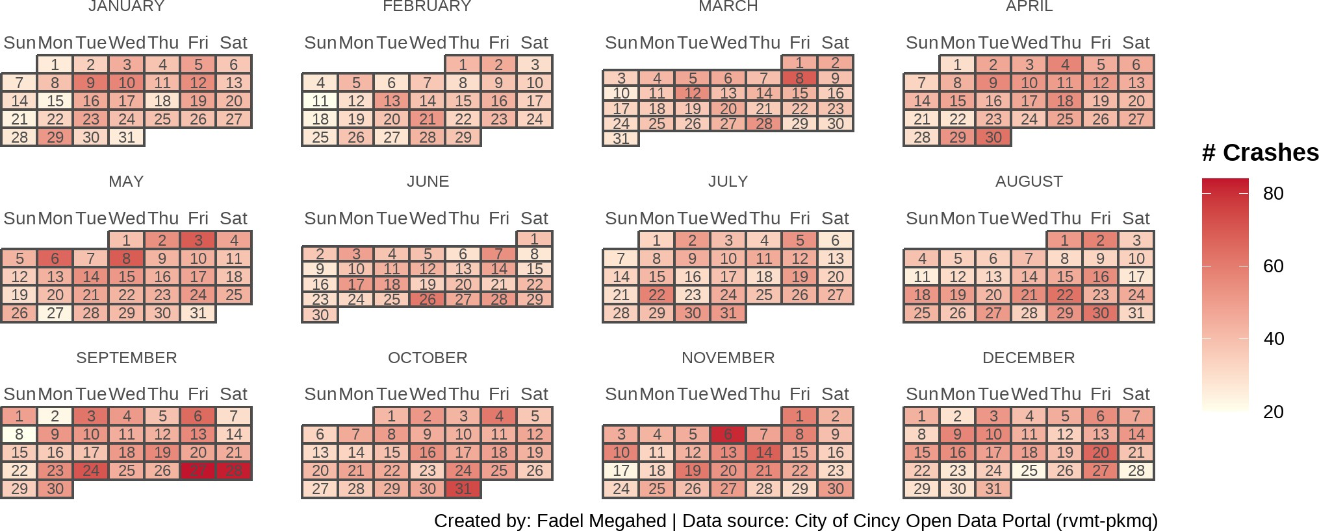
Bonus: A Calendar Plot in PowerBI
Let us use inside Power BI to create this based on cincy_daily_crashes_2024.csv.
11 / 13

Slide 12
RReeccaapp
1122 // 1133

Slide 13
Summary of Main Points
Explain the different types of spatial plots
Select suitable spatial graphs for different scenarios
Understand how spatiotemporal plots can help in storytelling (what makes BI special)
13 / 13

