Slide 1




ISA 401/501: Business Intelligence & Data Visualization
01: Introduction to BI and Data Viz
Fadel M. Megahed, PhD
Enders Associate Professor Farmer School of Business Miami University
@FadelMegahed fmegahed fmegahed@miamioh.edu
Automated Scheduler for Office Hours
Fall 2022

Slide 2
Learning Objectives for Today's Class
Describe course objectives and structure.
Define data visualization and describe its main goals.
Describe the BI methodology and its major concepts.

Slide 3
Course Design, Expectations, and Overview

Slide 4
The Analytics Journey: Pre-Analytics [1]
Pre-Analytics/Data Management: where one attempts to extract the needed data for analysis. Data can either be:
🥫
Stale, uninteresting, convenient
Highly processed and archived
Example: iris, mtcars, titanic
🍅
Fresh, interesting, challenging
Impactful
Examples: Cincinnati Open Data Portal, Ohio Data Portal, US Government's Open Data.
While the highly processed data can be useful in learning basic concepts, real-world (often messy) data real are much interesting to work with -- e.g., we can make useful & meaningful decision from the data. In this class, we will learn how to scrape, extract and clean messy data in addition to visualizing clean[ed] data.
Source: Slide inspired by Kia Ora's What I mean by "data".
4 / 38

Slide 5
05:00
The Analytics Journey: Pre-Analytics [2]
Non-Graded Class Activity #1
Take 5 minutes to discuss with your partner
Activity Your Solution Fadel's Approach (No Solution Shown)
Go to https://data.cincinnati-oh.gov/Safety/Traffi c-Crash-Reports-CPD-/rvmt-pkmq/data
Download the data utilizing the export column and answer the following questions:
How many observations/rows and columns do we have in the dataset?
How many crashes are reported in the dataset?
5 / 38

Slide 6
05:00
The Analytics Journey: Pre-Analytics [2]
Non-Graded Class Activity #1
Take 5 minutes to discuss with your partner
Activity Your Solution Fadel's Approach (No Solution Shown)
Insert your solution here (Use Chrome as your browser to edit this part of the page)
5 / 38

Slide 7
05:00
The Analytics Journey: Pre-Analytics [2]
Non-Graded Class Activity #1
Take 5 minutes to discuss with your partner
Activity
Your Solution
Fadel's Approach (No Solution Shown)
if(require(tidyverse) == FALSE) install.packages("tidyverse")
Link obtained from site -> Export -> "Right Click on" CSV
crashes = readr::read_csv("https://data.cincinnati-oh.gov/api/views/rvmt-pkmq/rows.csv?acces
Number of rows and columns nrow(crashes)
ncol(crashes)
Or alternatively dim(crashes)
Total number of crashes
Will be discussed in class in greater detail
5 / 38

Slide 8
The Analytics Journey: Descriptive [1]
Descriptive Analytics: where one attempts to understand the data through descriptive statistics and visualizations.
Descriptive Statistics for 2 Categorical Variables
## $dayofweek ##
## FRI SAT TUE MON WED SUN THU ## 5038 3735 4198 4093 4267 3301 4593 ##
## | $weather
##
## |  | 1 | - CLEAR | 4 | - RAIN
## |  |  | 19910 |  | 3771
## |  | 2 - CLOUDY |  | 99 - OTHER/UNKNOWN
## |  | 4555 |  | 268
## |  | 6 - SNOW |  | 3 - FOG, SMOG, SMOKE
## |  | 638 |  | 18
## | 8 - BLOWING | SAND, SOIL, DIRT, SNOW |  | 9 - FREEZING RAIN OR FREEZING DRIZZLE
## |  | 2 |  | 20
## |  | 5 - SLEET, HAIL |  | 7 - SEVERE CROSSWINDS
## |  | 41 |  | 2

Slide 9
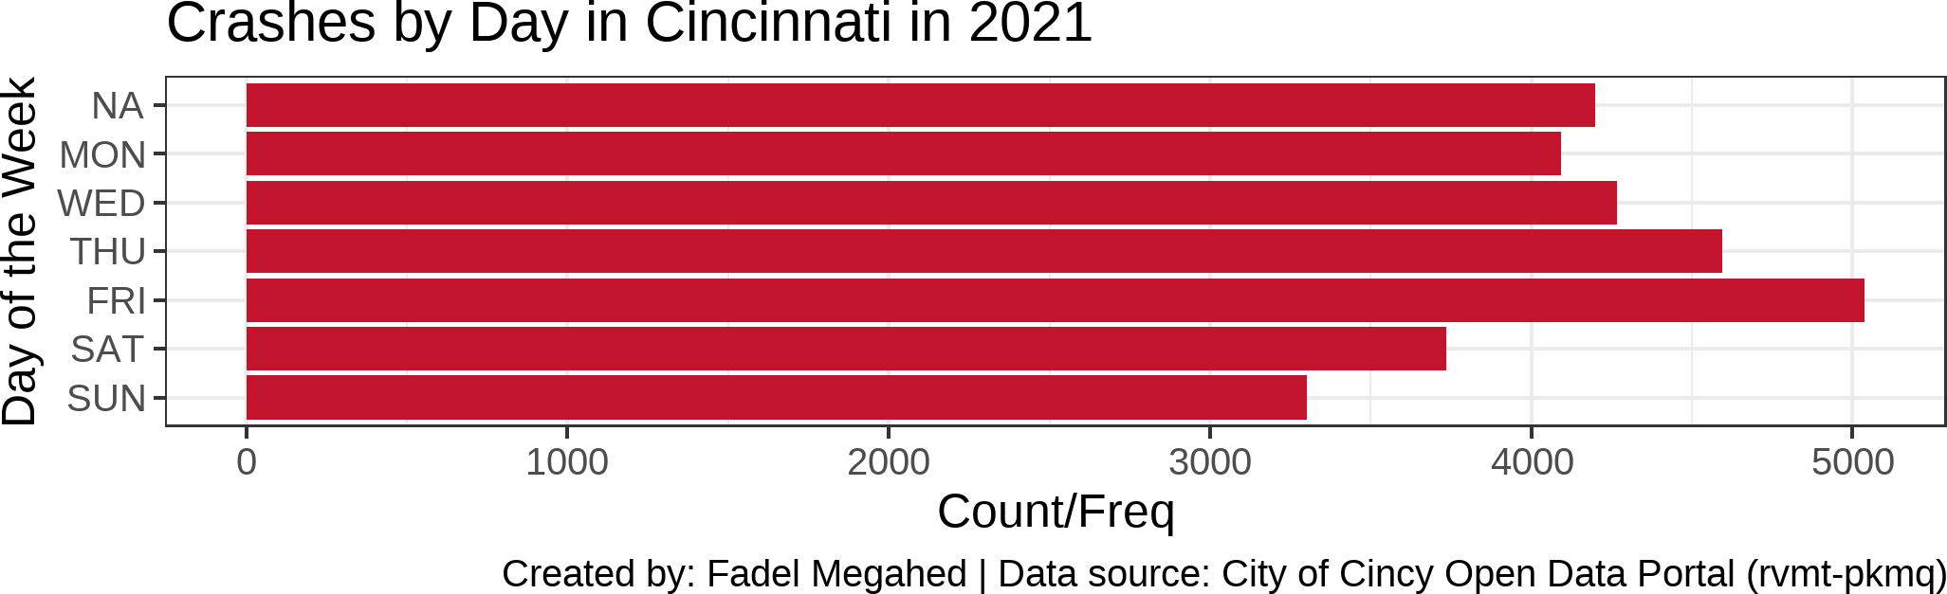
The Analytics Journey: Descriptive [2]
Descriptive Analytics: where one attempts to understand the data through descriptive statistics and visualizations.
A Simple Visualization - A Bar Chart of Crashes Per Day

Slide 10
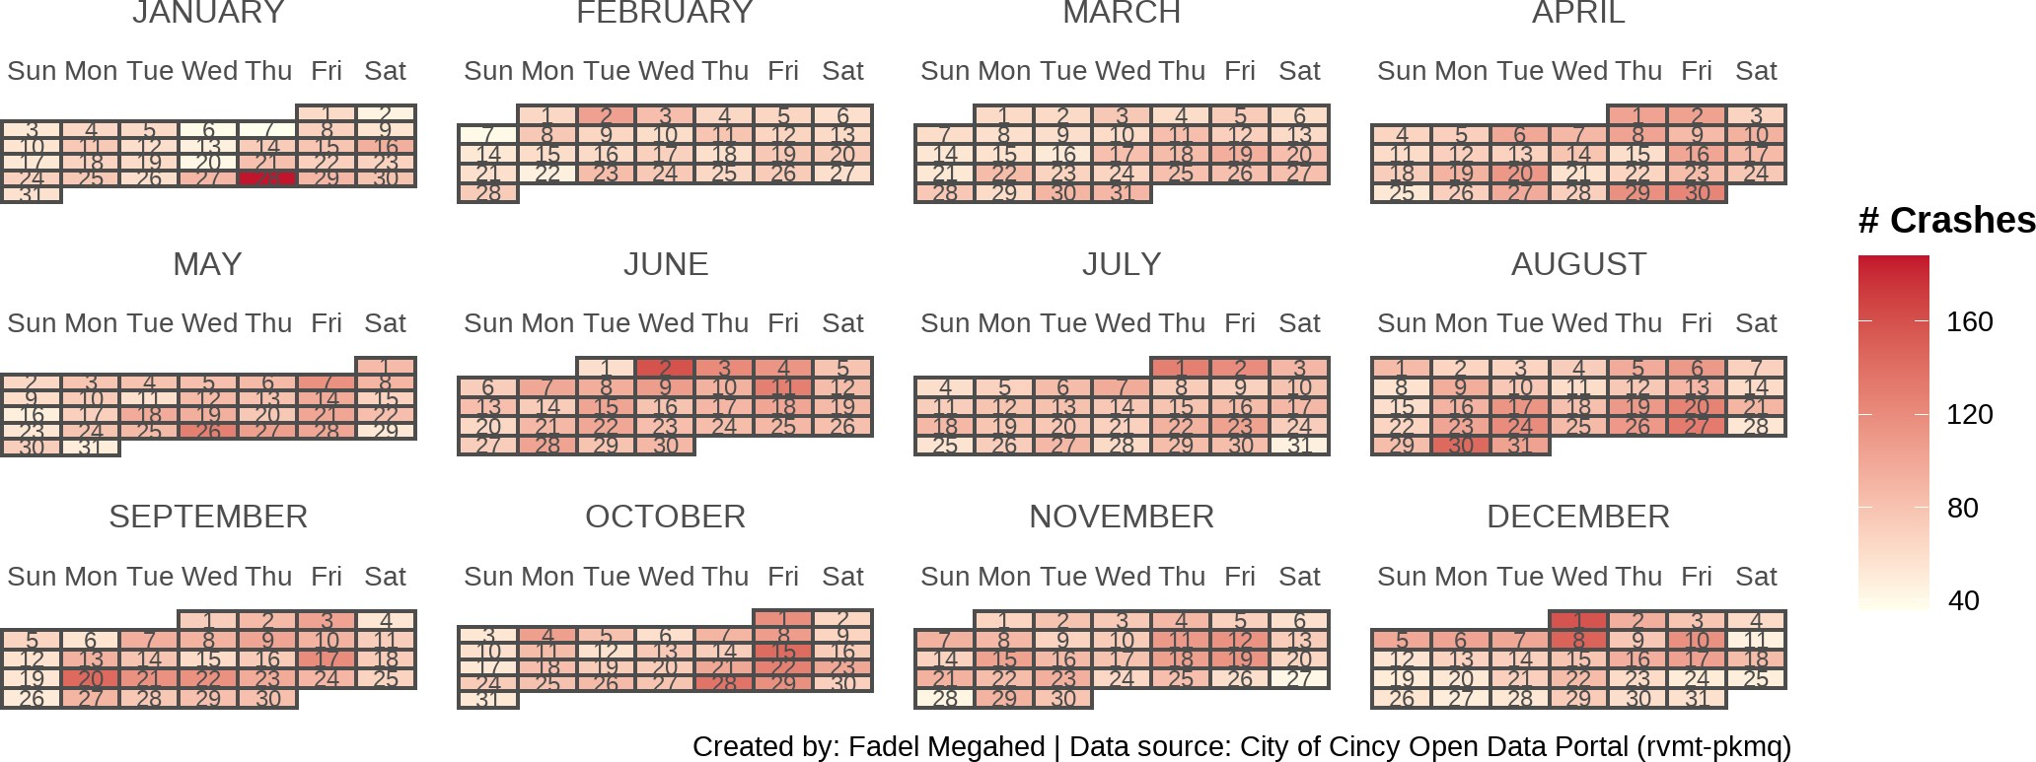
The Analytics Journey: Descriptive [3]
Descriptive Analytics: where one attempts to understand the data through descriptive statistics and visualizations.

Slide 11
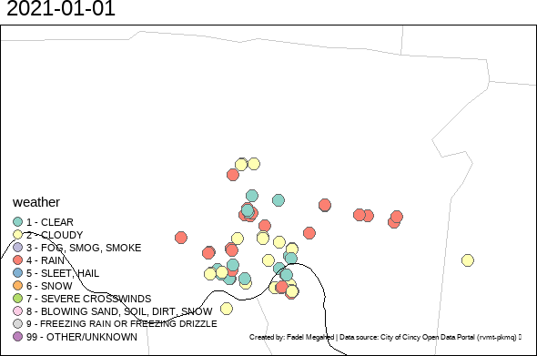
The Analytics Journey: Descriptive [4]
Descriptive Analytics: where one attempts to understand the data through descriptive statistics and visualizations.

Slide 12
The Analytics Journey: Predictive [1]
Predictive Analytics: where statistical and machine learning models are used to help us utilize independent variable[s] to predict an outcome variable of choice.
Many consider this component to be the 🍰 aspect of the analytics journey.
IMO, this is not always true, but your success in this stage is hinged on:
Correct ✅ data, i.e.,
Do you actually capture the important predictors?
Is your data aggregated to the right level?
Cleaned 🛀 data, i.e.,
Is your data tidy?
Is your data technically correct?
Is your data consistent?

Slide 13
The Analytics Journey: Predictive [2]
Predictive Analytics: where statistical and machine learning models are used to help us utilize independent variable[s] to predict an outcome variable of choice.
With the aforementioned constraints/setup, now you can explore how to model the data using statistical and machine learning models?
Some recommendations:
Start with the simplest (which is also often the most easy-to-explain) model first.
If you are happy with the predictive performance (i.e., no gains would be of practical benefit), you are done 👏.
If not, ↩ and try other models.

Slide 14
The Analytics Journey: Prescriptive
Prescriptive Analytics: where mathematical models are used to make recommendations for business actions.
Our overarching goal behind data/business analytics, is to make informed decisions based on what we have learned from the data. Hence, this stage is where we build on what we learned during the descriptive and predictive stages to make more informed decisions.
Imagine that you are a large trucking company (e.g., Amazon, Fedex, JB Hunt), and you have models that show both:
Safety critical events that are associated with crashes.
The occurrence of safety critical events can be reasonably predicted as a function of: (a) driver characteristics, (b) weather conditions, and (c) traffi c conditions.
As a business analyst, what two reasonable questions would you attempt to approach/optimize for?

Slide 15
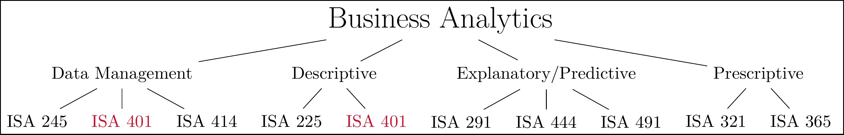
How does our Curriculum at Miami University Prepare you for this Journey?
My take on the courses within the business analytics major/minor at Miami University

Slide 16
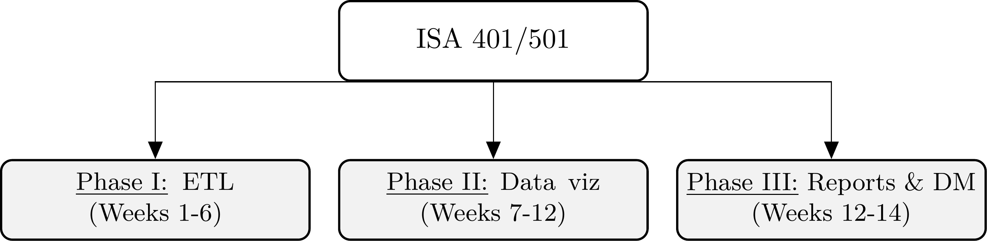
ISA 401/501 Course: An Overview
How the ISA 401/501 course is organized.

Slide 17
ISA 401/501 Course Objectives
Even though software will be extensively used, this is not a software class. Instead, the focus is on understanding the underlying methods and mindset of how data should be approached.
Be capable of extracting, transforming and loading (ETL) data using multiple platforms (e.g.
, Power BI and/or Tableau).
Write basic scripts to preprocess and clean the data.
Explore the data using visualization approaches that are based on sound human factors.
Understand how statistical/machine learning can capitalize on the insights generated from the data visualization process.
Create interactive dashboards that can be used for business decision making, reporting and/or performance management.
Be able to apply the skills from this class in your future career.

Slide 18
04:00
Should you Care? Read this Job Ad
When I have designed this course, I have incorporated a lot of feedback from industry collaborators, peer/leading academic programs, and state-of-the-art-research advancements. Thus, this is meant to be a hands-on, practically-relevant course.
Non-Graded Class Activity #2
Activity Documentation Space
To demonstrate the practicality of this course, let us consider this job ad.
Please open the Data Scientist (6257U) - CED Data Scientist position at UC - Berkeley by clicking here.
Compare the responsibilities and the required qualifications with the course objectives.
Read through the required qualifications.
Document what you will learn in this course to make you more competitive.
16 / 38

Slide 19
04:00
Should you Care? Read this Job Ad
When I have designed this course, I have incorporated a lot of feedback from industry collaborators, peer/leading academic programs, and state-of-the-art-research advancements. Thus, this is meant to be a hands-on, practically-relevant course.
Non-Graded Class Activity #2
Activity Documentation Space
Insert your solution here (Use Chrome as your browser to edit this part of the page)

Slide 20
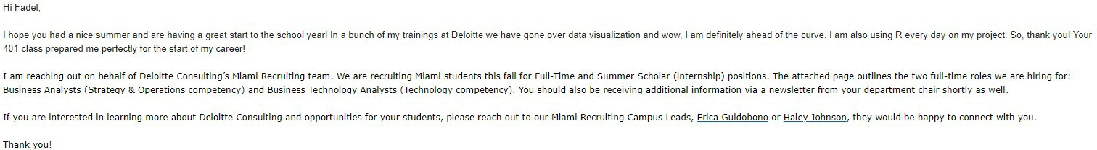

Should you Care? Recent Alumni Testimonials

Slide 21
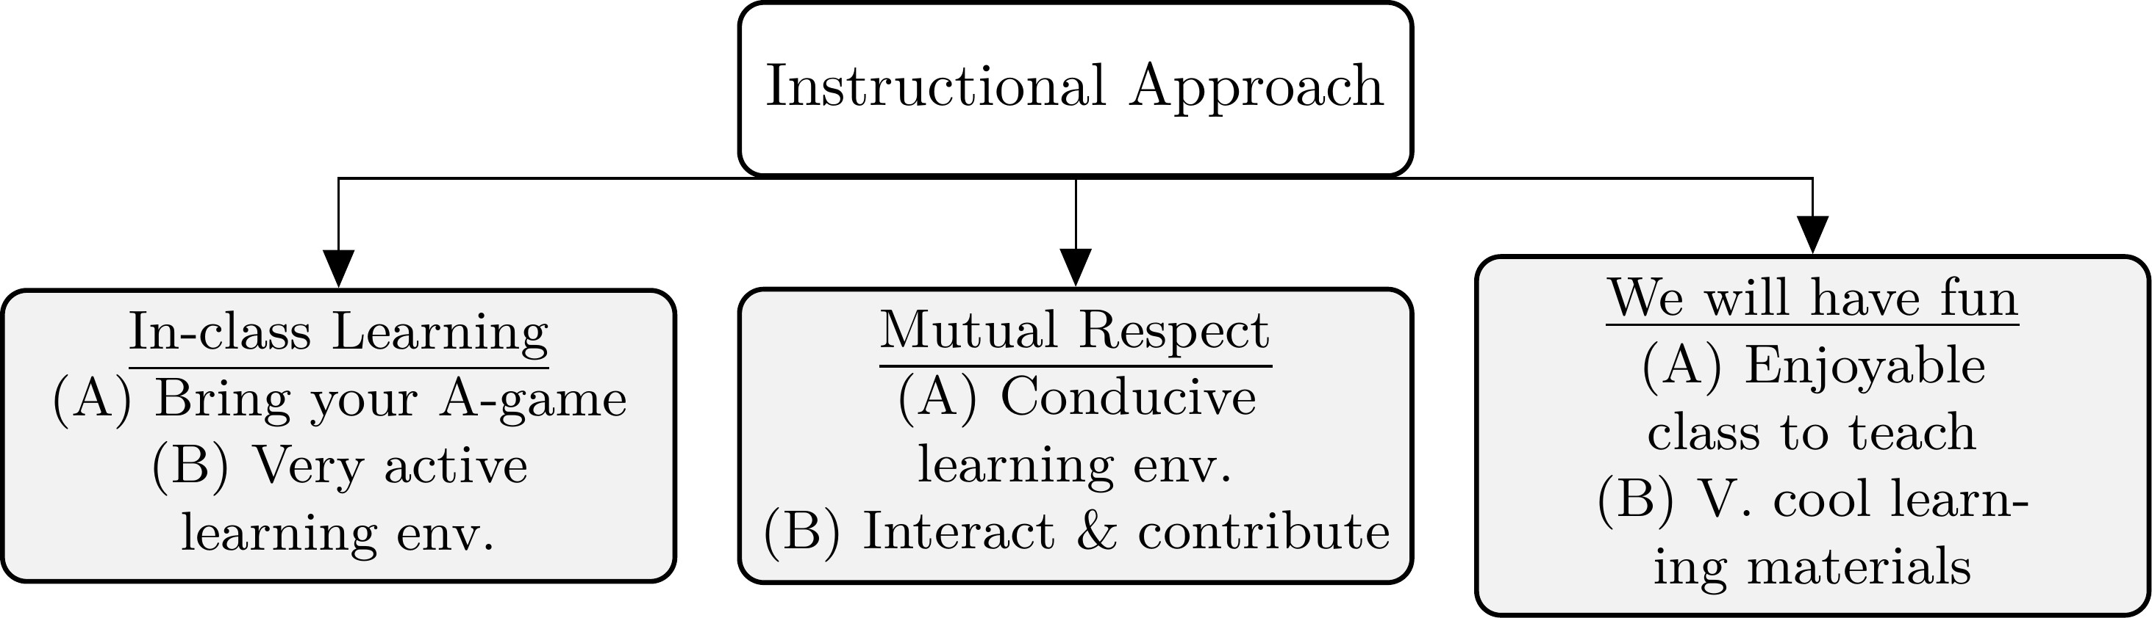
Instructional Approach
An overview of the instructional approach for ISA 401/501.

Slide 22
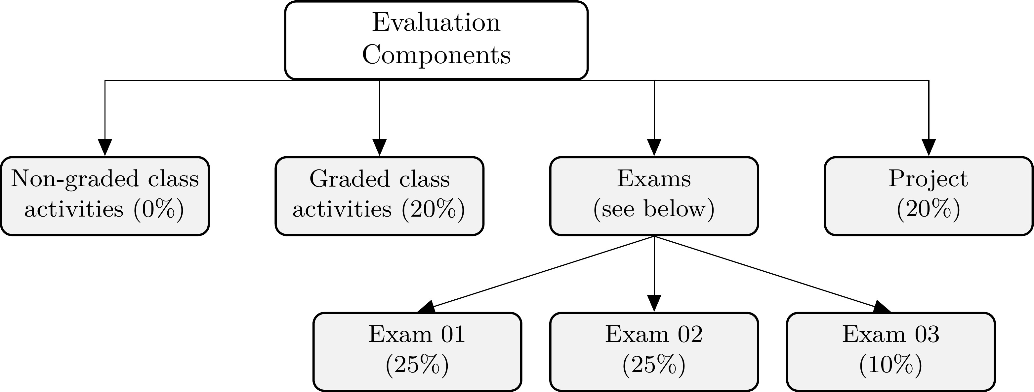
How will I Evaluate your Learning?
An overview of the evaluation components for ISA 401/501.

Slide 23
Introductions: Getting to Know Each Other

Slide 24
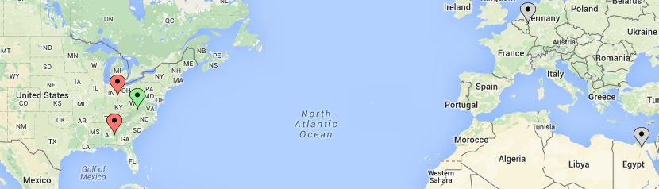
About Me – My route to Miami University
Application of data-driven decisions (D3) in 3 continents.
Interests: Applications in logistics, manufacturing, occupational safety & portfolios.
Collaborations with: Aflac, GE Research, Gore, IBM Research, & Tennibot
My journey with data-driven decision making.

Slide 25


Getting to Know Your Learning Objectives
Go to www.menti.com and use the code 12 34 56
What are you hoping to get out of ISA 401/501?

Slide 26
So What is Data Visualization?

Slide 27
What is Data Visualization?
Data visualization involves presenting data in a graphical format. It is really a process that starts by getting data, creating initial plot(s) and modifying them to answer questions of interest (and possibly making the plot aesthetically pleasing). For example, see Cedric Scherer's visualization of the UNESCO data on global student to teacher ratios.

Slide 28
The Goals of Data Visualization
Record information
Analyze data to support reasoning
Develop and assess hypotheses (EDA)
Reveal patterns
Discover errors in data
Communicate ideas to others
Infographics
Statistic charts
Interactive charts
Dashboards
Interact with the data (which supports all the above)

Slide 29



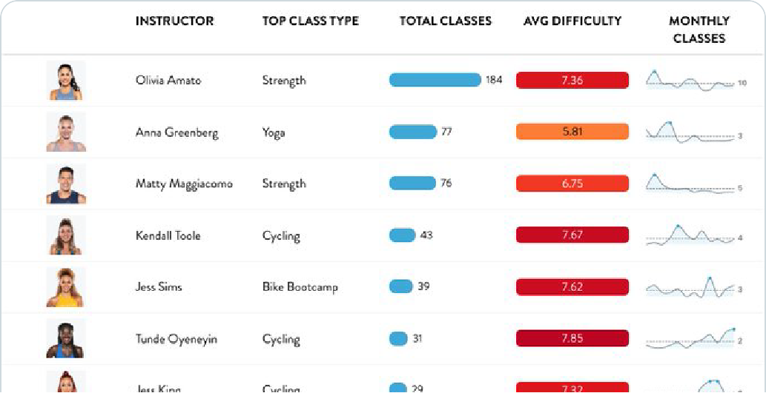
Record Information
Tanya Shapiro
@tanya_shapiro · Follow
I'm a sucker for clean tables. Last week, I used # RStats
and gtExtra magic to summarize by Peloton data.
This week, I couldn't resist taking reactablefmtr for a test drive too. @ kc_analytics, this package is beautiful!
: t anyashapiro.com/interactive-vi…

Slide 30
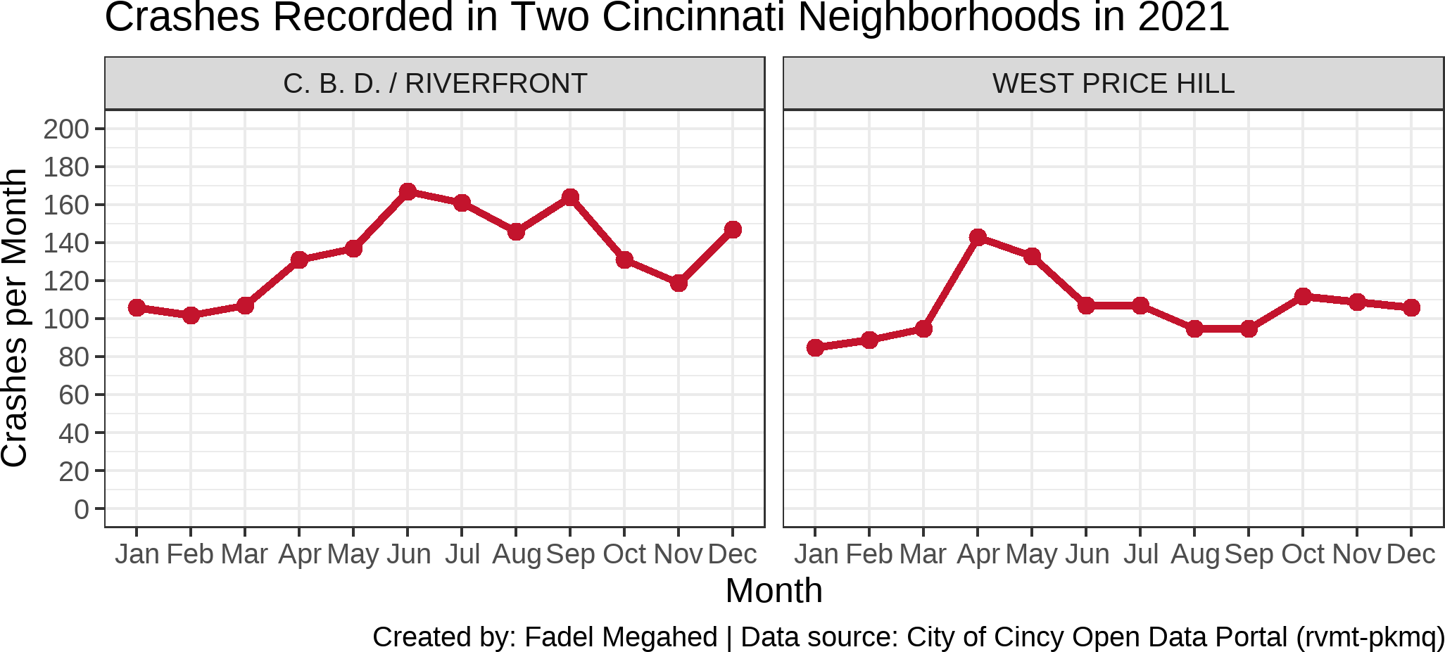
Analyze Data

Slide 31
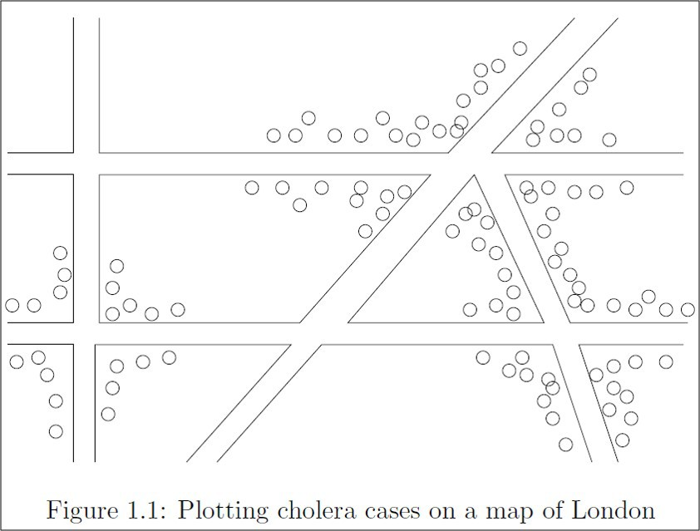
Reveal Patterns: The 1854 Cholera Outbreak
The physician John Snow, dealing with a Cholera outbreak plotted the cases on a map of the city (see schematic above).
Source: Leskovec, J., Rajaraman, A., & Ullman, J. D. (2020). Mining of Massive Data Sets (Third Edition). Cambridge University Press. Image is from Chapter 1, which can be accessed here.
28 / 38

Slide 32
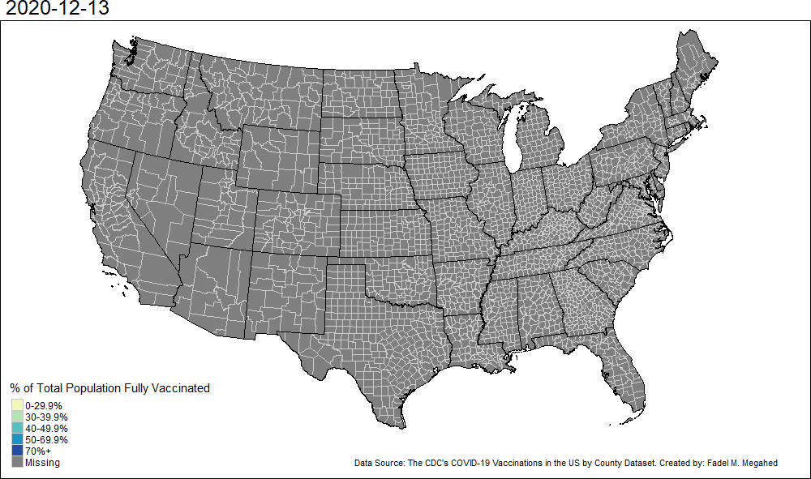
Reveal Patterns: COVID-19 Vaccination Rates

Slide 33
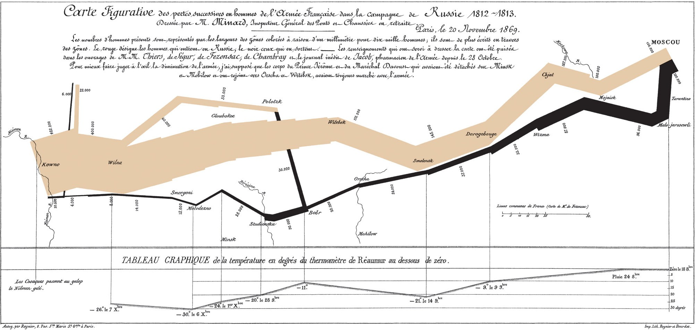
Communicate Ideas: C.J Minard 1869

Slide 34
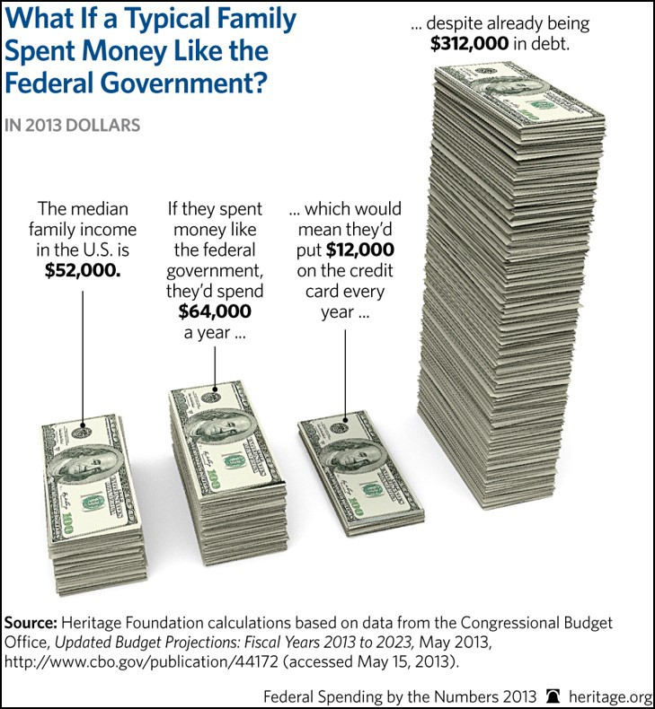
05:00
Communicate Ideas
Activity
Your Solution
Non-Graded Class Activity #3
Who is the target audience?
What is the data represented in this visualization? Be Specific.
How is the data visually encoded?
Do you like/dislike this visualization? Why?
Would you do visualization like this for a similar dataset? Why? Why not?
31 / 38

Slide 35
05:00
Communicate Ideas
Activity Your Solution
Insert your solution here (Use Chrome as your browser to edit this part of the page)
31 / 38

Slide 36



Interact: GapMinder/ Hans Rosling Example
Hans Rosling
The best stats you've ever seen

Slide 37
Business Intelligence: From Visualizations to Dashboards to Insights

Slide 38
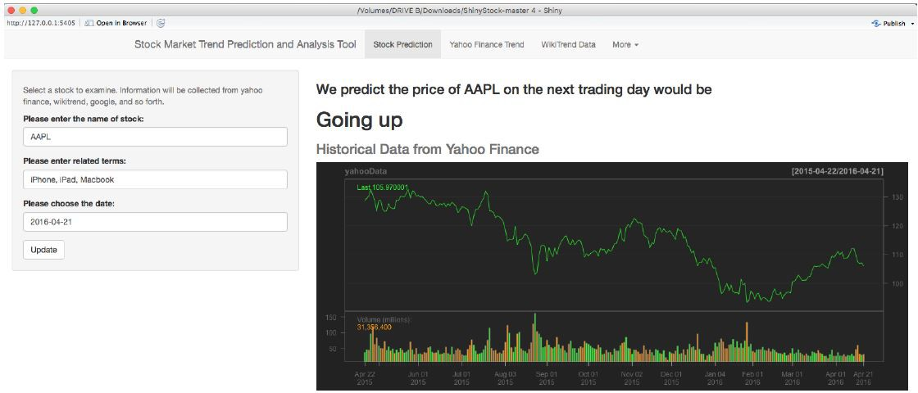
What is Business Intelligence?
"... to enable interactive access (sometimes in real time) to data, to enable
manipulation of data, and to give business managers and analysts the ability to conduct appropriate analysis. By analyzing ... data, situations, and performances, decision makers get valuable insights that enable them to make more informed and better decisions ... BI is based on the transformation of data to information, then to decisions, and finally to actions."
Quote from Sharda, R., Delen, D., & Turban, E. (2013). Business Intelligence: A managerial perspective on analytics. Prentice Hall Press.
Image Credit: Joint work with Bin Weng.
34 / 38

Slide 39
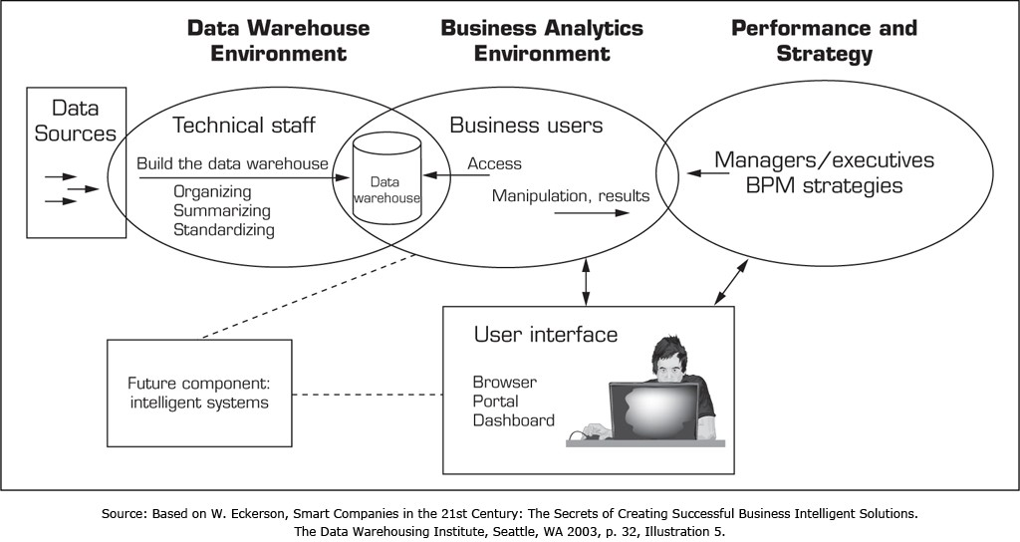
The BI Process
Image Credit: Sharda, R., Delen, D., & Turban, E. (2013). Business Intelligence: A managerial perspective on analytics. Prentice Hall Press.
35 / 38

Slide 40
Recap

Slide 41
Summary of Main Points
By now, you should be able to do the following:
Describe course objectives and structure.
Define data visualization and describe its main goals.
Describe the BI methodology and its major concepts.

Slide 42


Things to Do to Prepare for Our Next Class
Go over your notes and complete Assignment 01 on Canvas.
Read through the following references in preparation of our next class.
Workflow: basics
Workflow: scripts
Workflow: project
Names and values
Vectors
Subsetting
38 / 38

