Slide 1




ISA 401: Business Intelligence & Data Visualization
19: Charts Used for Time-Series Data
Fadel M. Megahed, PhD
Raymond E. Glos Professor in Business Farmer School of Business
Miami University
@FadelMegahed fmegahed fmegahed@miamioh.edu
Automated Scheduler for Office Hours
Fall 2025

Slide 2
10:00
Non-graded: COVID19 Data Viz
Over the next 10 minutes, use Tableau to answer the following questions based on the
covid_cases_county.csv (which can be downloaded from Canvas):
What are the total number of cases per county? Use a suitable map to answer this question.
What are the total number of deaths per state? You can show that using either a table or a map. In case of a map, please show the numbers for each state on the map as well.

Slide 3
Learning Objectives for Today's Class
Understand main goals behind visualizing time-series data
Explain the different types of charts for univariate and multivariate time-series

Slide 4
TTyyppeess ooff DDaattaa OOvveerr TTiimmee
44 // 2255

Slide 5

Cross Sectional Data
Cross Sectional Data: Measurements on multiple units, recorded in a single time period.
Example 1: H1B 2020-2025 Data for Senior Data Scientists at Netflix
 | START DATE ▲ | ▼ JOB TITLE ▲ | ▼ BASE SALARY ▲ | ▼ LOCATION ▲▼
1 | 2021-08-11 | SENIOR DATA SCIENTIST | 118,955 | LOS GATOS, CA
2 2021-06-14 SENIOR DATA SCIENTIST 143,291 LOS GATOS, CA
3 | 2021-06-14 | SENIOR DATA SCIENTIST | 143,291 | LOS GATOS, CA
4 2021-06-14 SENIOR DATA SCIENTIST 143,291 LOS GATOS, CA
5 | 2021-09-09 | SENIOR DATA SCIENTIST | 143,291 | LOS GATOS, CA
Showing 1 to 5 of 24 entries
Previous
1
2
3
4
5
Next
Data scraped from https://h1bdata.info/index.php?em=Netflix+Inc&job=Senior+Data+Scientist&city=LOS+GATOS&year=All+Years on October 28, 2025 using the rvest . The printing was limited to those individuals who started on/after January 01, 2020, with the filters specified in the URL.
5 / 25

Slide 6

Cross Sectional Data
Cross Sectional Data: Measurements on multiple units, recorded in a single time period.
Example 2: NBA 2025-2026 Leaders - Top Players in PTS/Game
Player ▲▼ |  | Pos ▲▼ | Age▲▼ | _{G}▲▼ | FG▲▼ | FG%▲▼ | eFG%▲▼ | PTS▲▼
1 | Shai Gilgeous-Alexander | PG | 26 | 76 | 11.3 | 0.519 | 0.569 | 32.7
2 Giannis Antetokounmpo |  | PF 30 67 11.8 0.601 0.607 30.4
3 | Nikola Jokić | C | 29 | 70 | 11.2 | 0.576 | 0.627 | 29.6
4 Luka Dončić |  | PG 25 50 9.2 0.45 0.536 28.2
5 | Luka Dončić | PG | 25 | 28 | 8.8 | 0.438 | 0.53 | 28.2
Showing 1 to 5 of 736 entries
Previous 1 2 3 4
Source: Data scraped from Basketball-Reference on October 28, 2025 using the rvest . The printing was limited to the selected variables.
5 …
148
Next
6 / 25

Slide 7
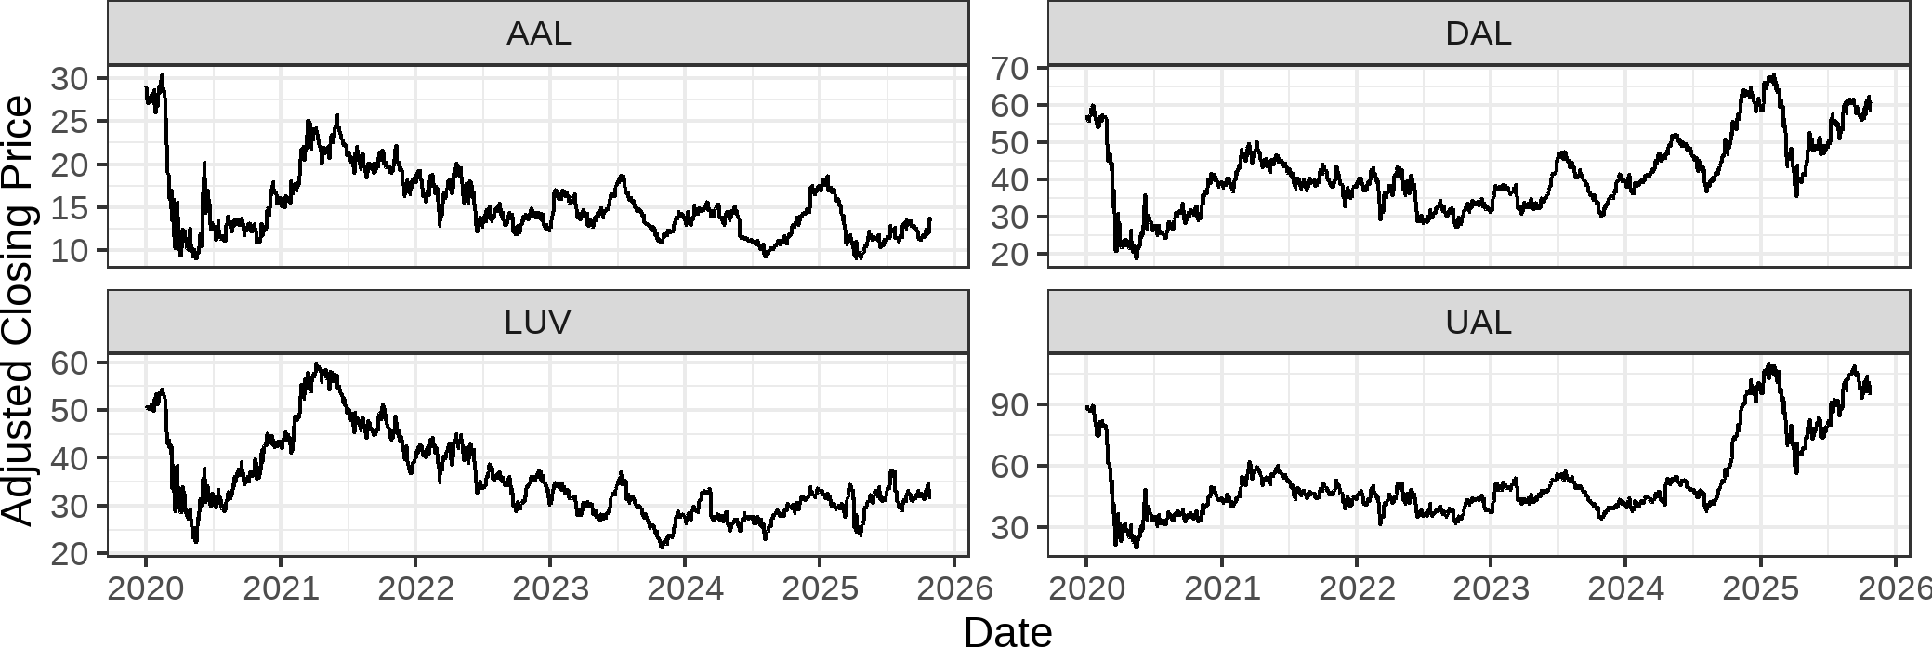
Time Series Data
Time Series Data: Comparable measurements recorded on a single (or a few) variables over time (usually a long period of time).
Example 2: Stock prices of U.S. Airlines
7 / 25

Slide 8

Panel Data
Panel Data: Cross sectional measurements (usually many variables) repeated over time (usually over a few time periods).
Example: World Bank's Data
iso3c▲▼ |  | date▲▼ | NY.GDP.MKTP.KD.ZG▲▼ | SH.DYN.NMRT▲▼ | SH.HIV.INCD.ZS▲▼ | SH.MED.BED
1 | CHN | 2022 | 3.1 | 3
2 | CHN | 2023 | 5.4 | 2.8
3 | CHN | 2024 | 5 | 2.8
4 | EGY | 2022 | 6.6 | 9.6 | 0.1
5 | EGY | 2023 | 3.8 | 9.3 | 0.1
 |  |  |  |  |  | 
Showing 1 to 5 of 9 entries
Previous 1 2 Next
in R. The printed results show a snapshot of 7 variables (out of a much larger panel dataset). You can think of panel
Source: Data queried from the World Bank Data using the wbstats
8 / 25
data as a cross-sectional dataset with a longitudinal/time component.

Slide 9
CCoommppoonneennttss ooff aa TTiimmee SSeerriieess
99 // 2255

Slide 10
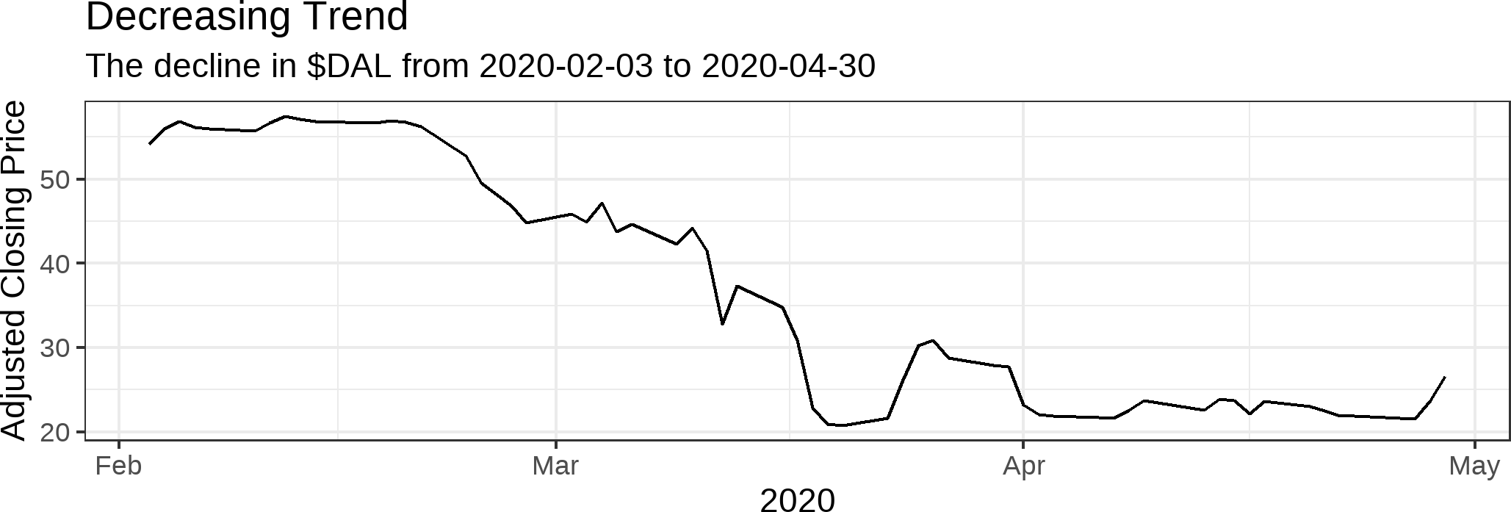
Trend
A trend is an increasing or decreasing pattern over time.

Slide 11
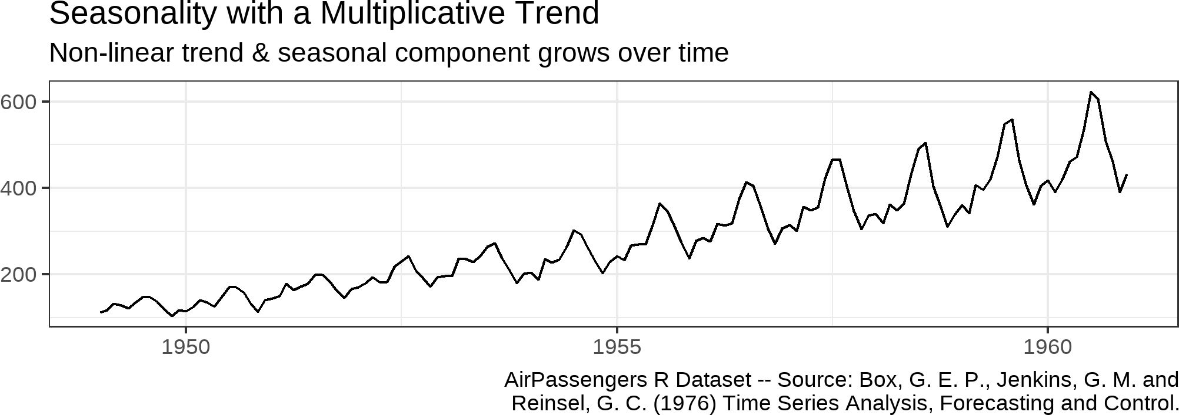
Seasonality
Seasonality refers to the property of a time series that displays REGULAR patterns that repeat at a constant frequency (m).

Slide 12
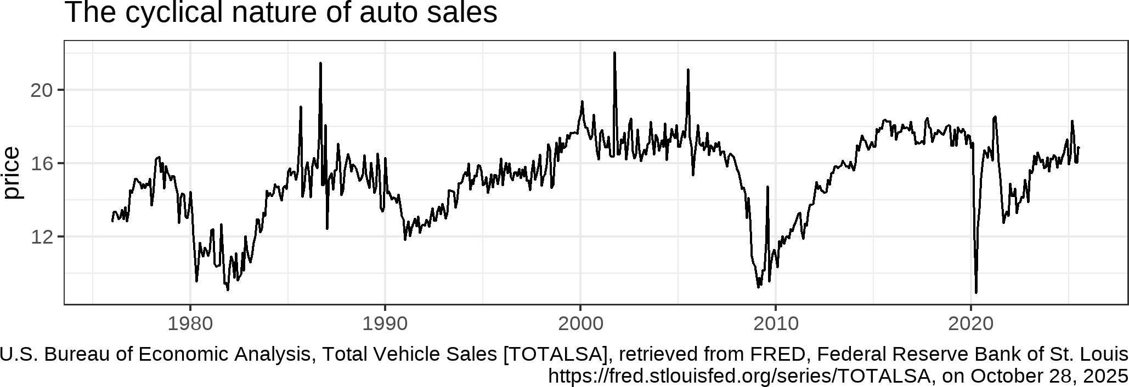
Cycle
Cyclical fluctuations are somewhat irregular (unknown duration).

Slide 13
TThhee GGooaallss BBeehhiinndd VViissuuaalliizziinngg ((TTiimmee SSeerriieess)) DDaattaa
1133 // 2255

Slide 14
Exploratory vs Confirmatory Viz Goals
Visualizations can be used to explore data, to confirm a hypothesis, or to manipulate
a viewer. . . In exploratory visualization the user does not necessarily know what he is looking for. This creates a dynamic scenario in which interaction is critical. . . In a confirmatory visualization, the user has a hypothesis that needs to be tested. This scenario is more stable and predictable. System parameters are often predetermined.
-- (Grinstein and Ward 2001, 22)
14 / 25

Slide 15
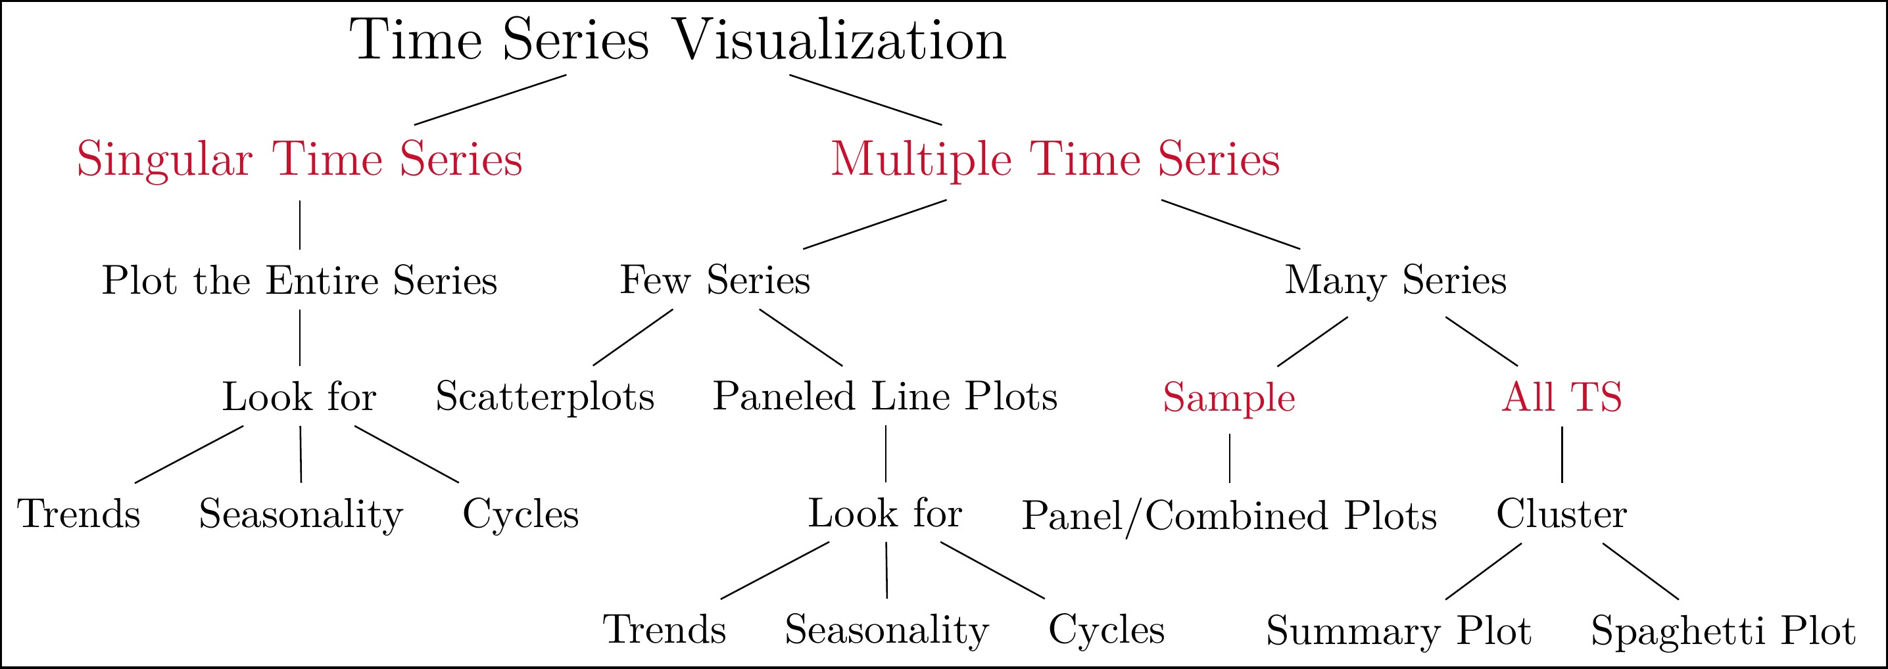
A Structured Approach for Time Series Viz
A Potential Framework for Time Series Visualization
This is my best attempt to improve on the general advice provided in the previous slide. Many of the suggestions, presented in this flow chart, stem from my past and current research/consulting collaborations. They are by no means a comprehensive list of everything that you can do.
15 / 25

Slide 16
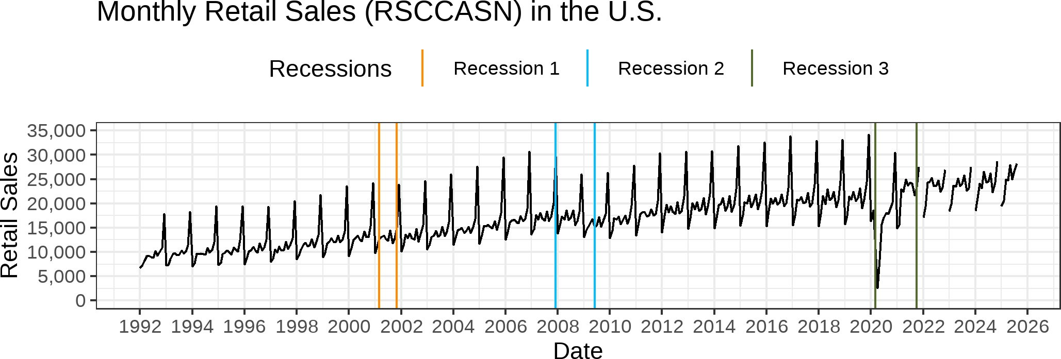
Singular TS

Slide 17
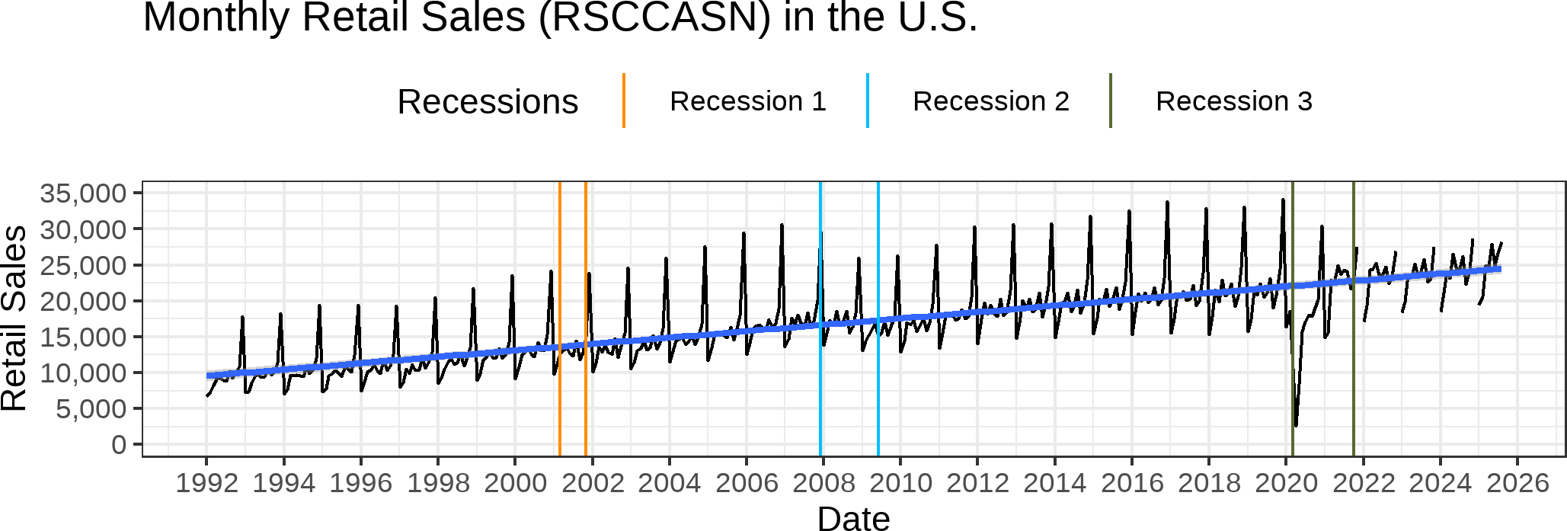
Looking for Trends

Slide 18
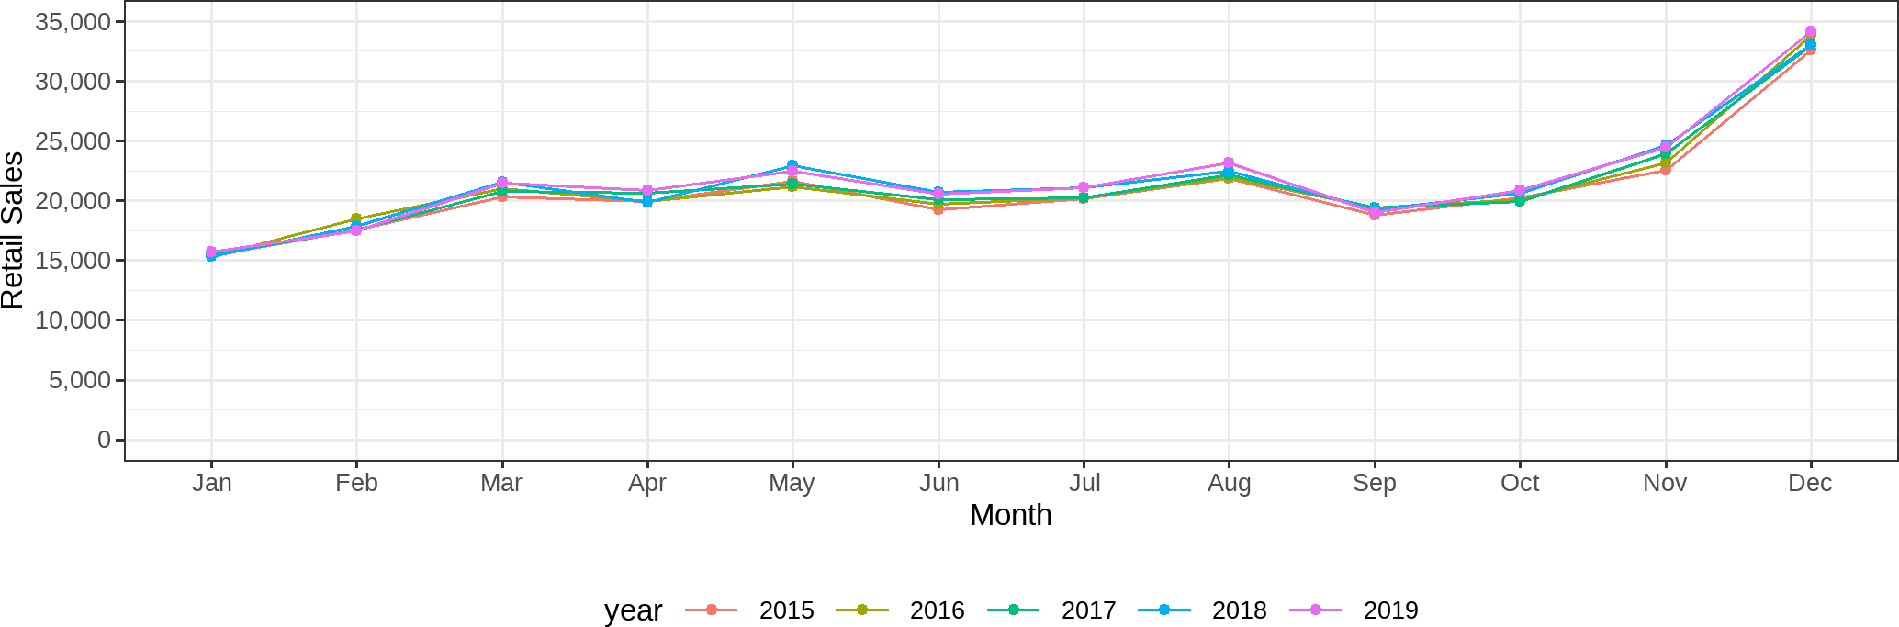
Looking for Seasonality

Slide 19
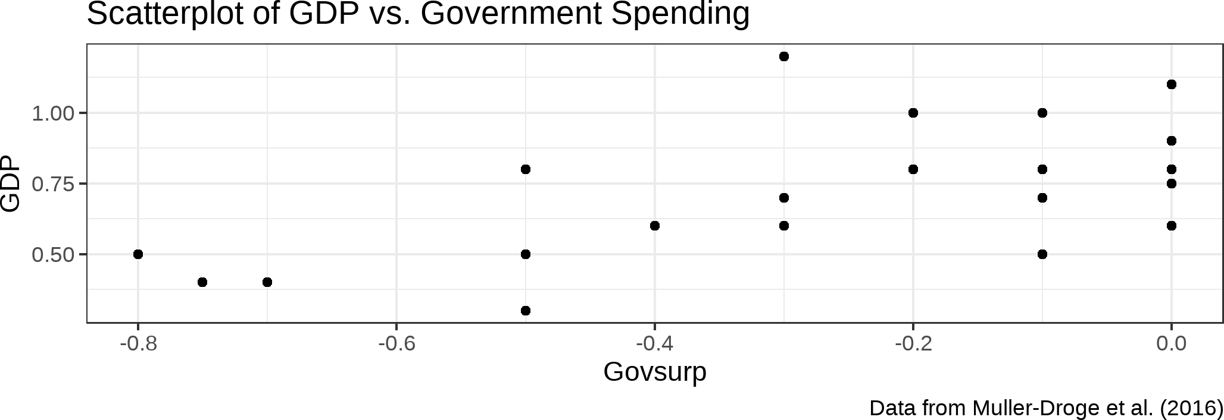
Multiple TS: Scatterplots

Slide 20
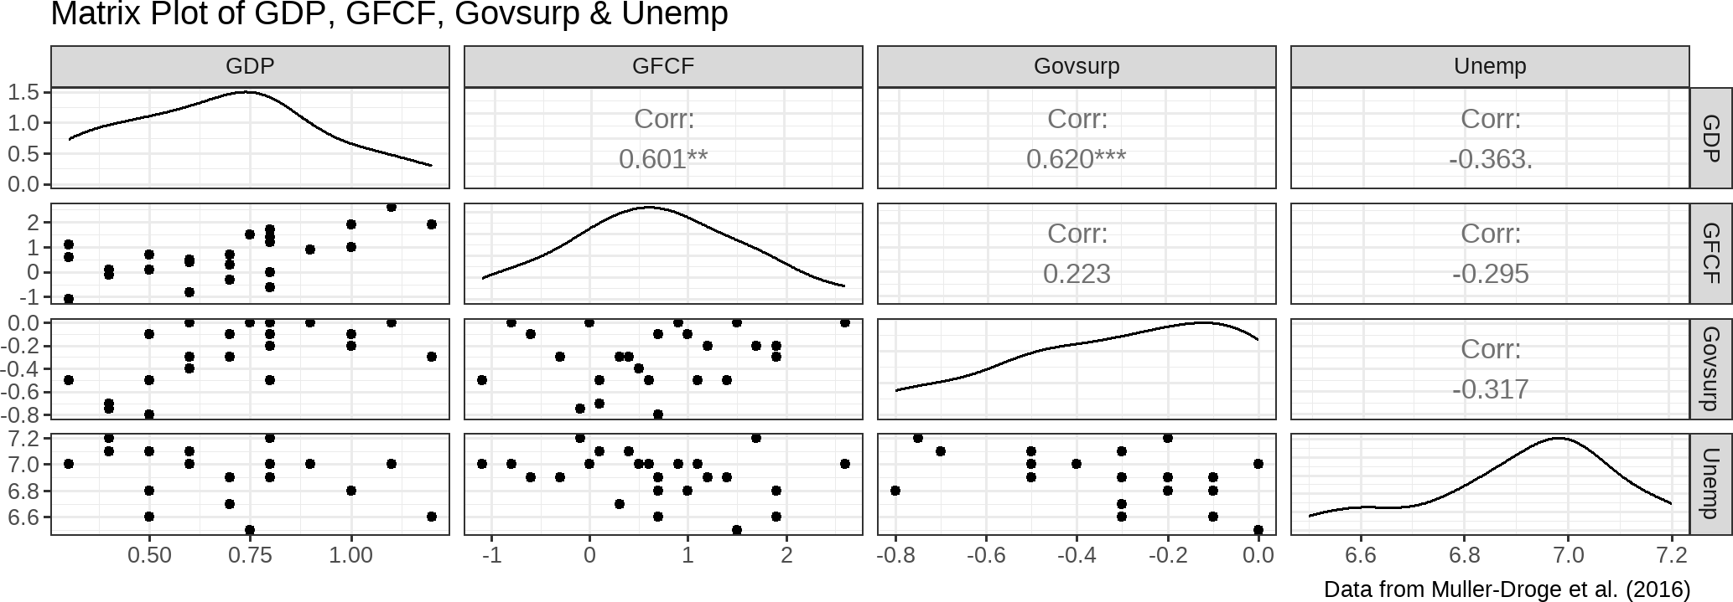
Multiple TS: Scatterplot Matrix

Slide 21
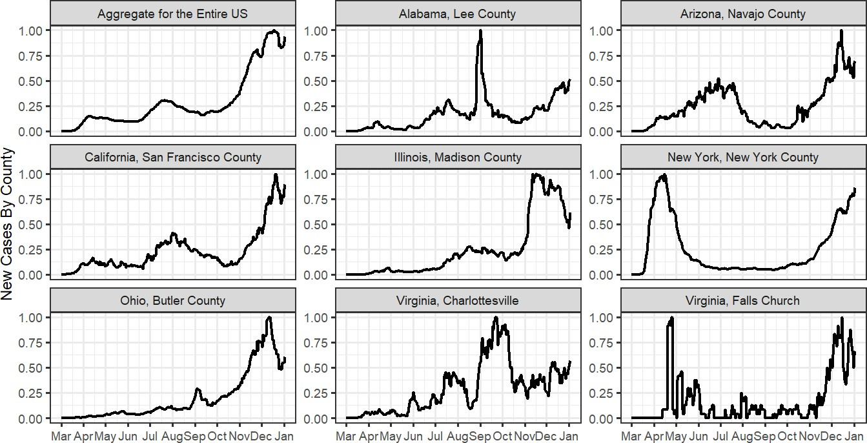
Multiple TS: Panel Plots

Slide 22
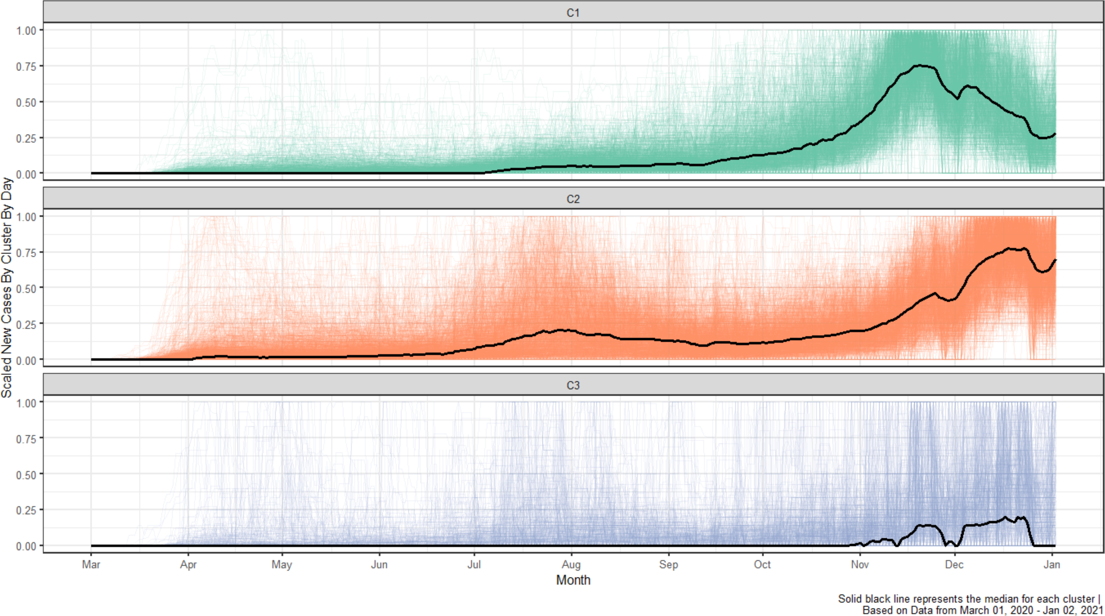
Spaghetti Plots (Often w/ Clustering)

Slide 23
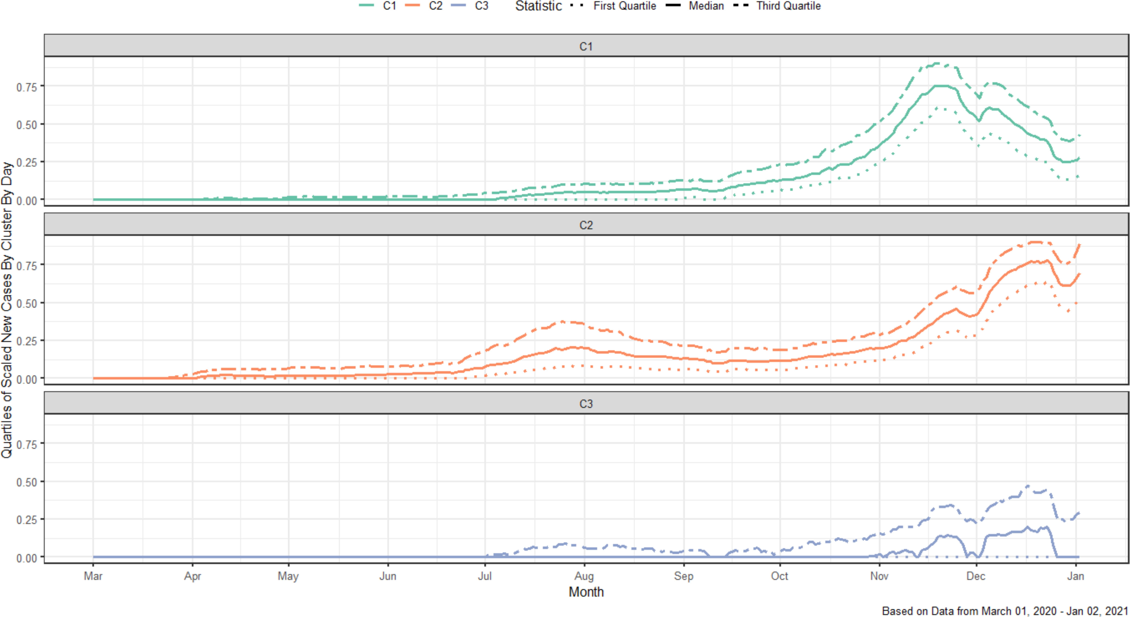
Summary Plots (Often w/ Clustering)

Slide 24
RReeccaapp
2244 // 2255

Slide 25
Summary of Main Points
Understand main goals behind visualizing time-series data
Explain the different types of charts for univariate and multivariate time-series
25 / 25

