Slide 1




ISA 401: Business Intelligence & Data Visualization
18: Charts Used for Comparisons, Relationships, Distributions and Correlations
Fadel M. Megahed, PhD
Raymond E. Glos Professor in Business Farmer School of Business
Miami University
@FadelMegahed fmegahed fmegahed@miamioh.edu
Automated Scheduler for Office Hours
Fall 2025

Slide 2
Learning Objectives for Today's Class
Identify strengths & weaknesses of basic charts
Use appropriate charts based on objective
Avoid using pie charts (never use pie charts)
Avoid 3D graphs (unless VR changes their utility)

Slide 3
A Catalog of Commonly Used Graph Types
PolicyViz Data Visualization Catalog
Graph Type | ▼ Organization ▼ Author |  | ▼
Graph Type ▲ | ^{Description/} Organization Author Notes | Small Multiples | Year |  | URL | Image
LLooookkeerr SSttuuddiioo

Slide 4
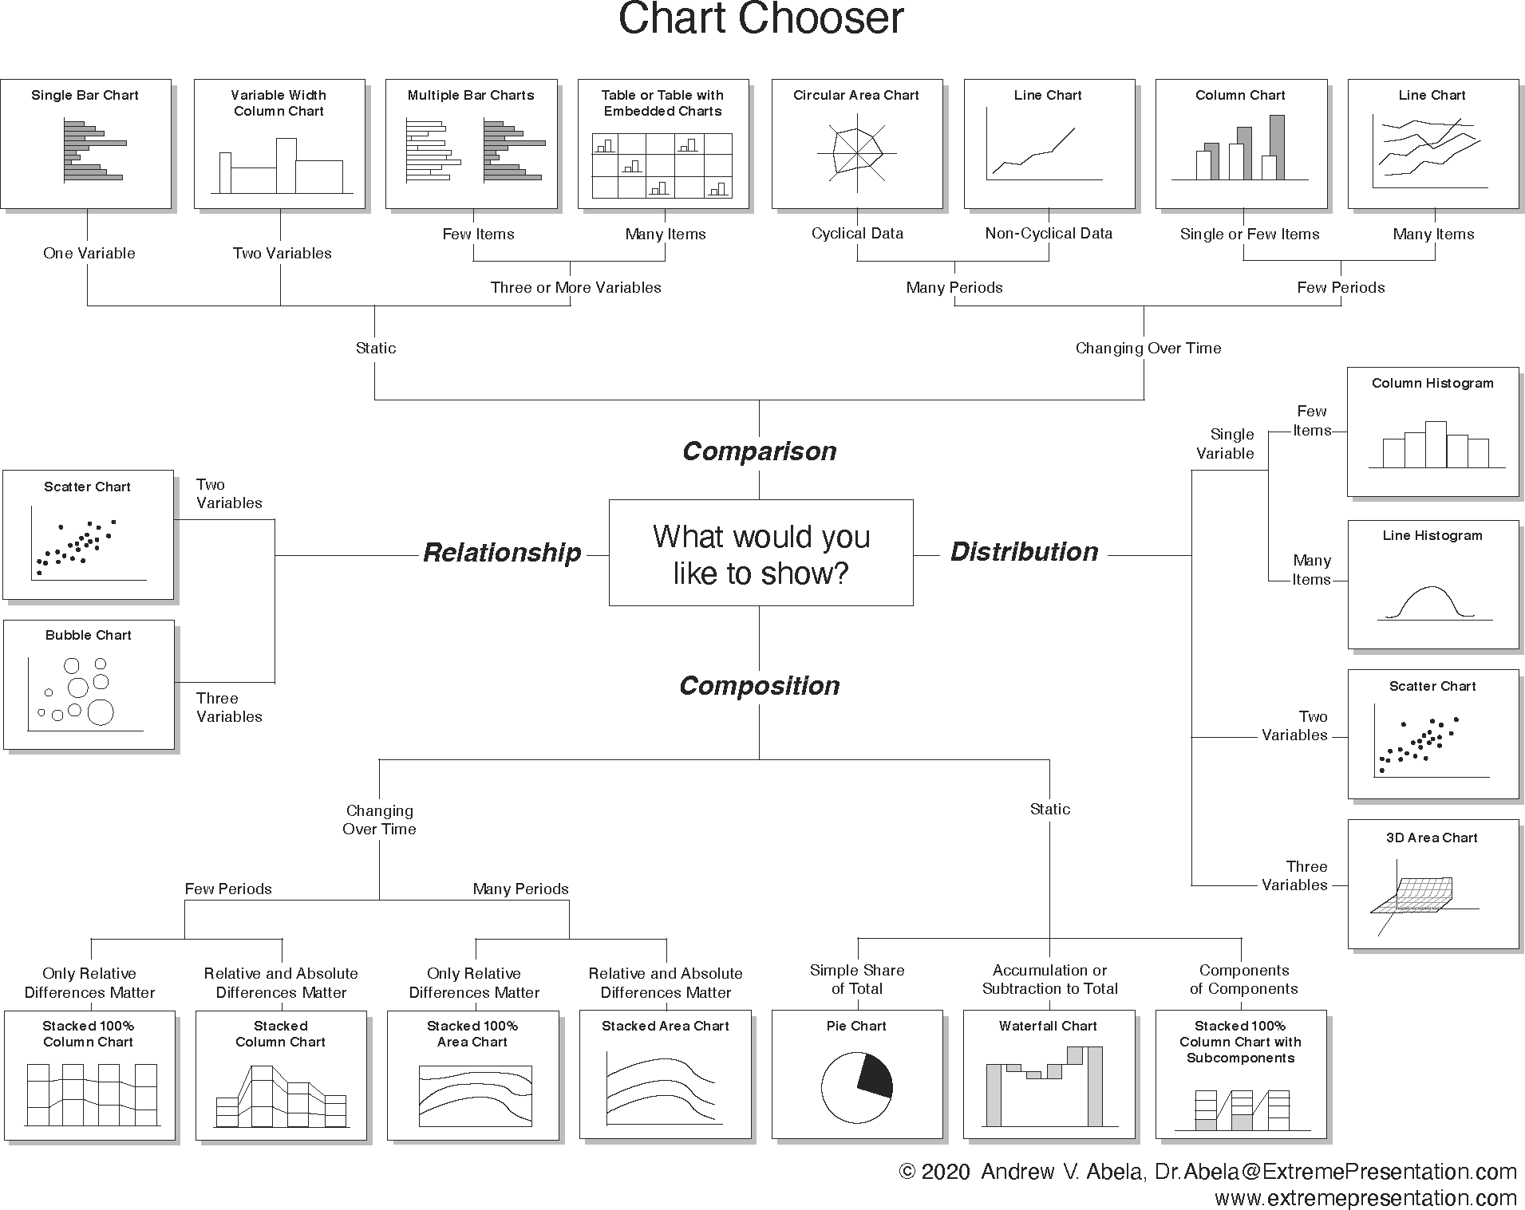
Chart Suggestions
Source: Chart Chooser, created by Andrew Abela in 2006 and last updated on Sept 06, 2020.

Slide 5
CChhaarrttss UUsseedd ffoorr CCoommppaarriinngg DDaattaa
((UUnniitt ooff AAnnaallyyssiiss iiss BBaass
dd nn aa NN mmiinnaall
CCaatteeggoorriiccaall VVaarriiaabbllee
55 // 3322

Slide 6
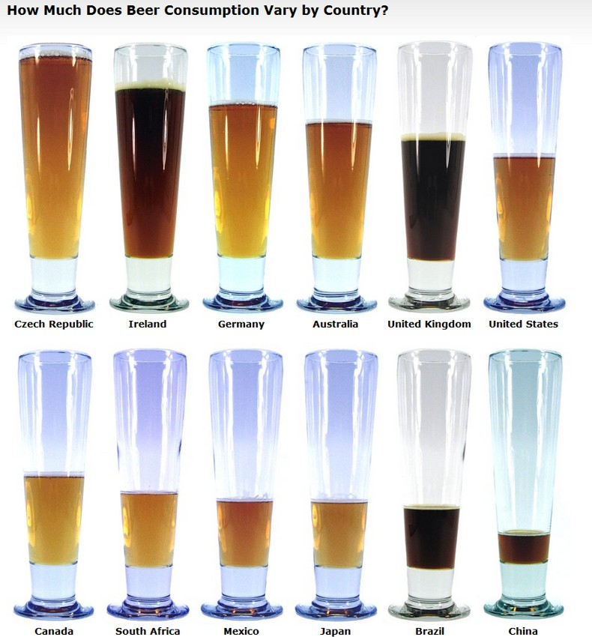
04:00
A Literal Bar Chart
Activity
Your Solution
Answer the following questions:
How many variables do we have in this graph?
How many observations?
Please discuss the type of variables in the graph? (i.e. nominal, ordinal, etc.)
How is the data encoded in the graph?
Any other comments/observations?
Source: The image is from How Much Does Beer Consumption Vary by Country?, and the data seems to be based on a 2004 report from the Kirin Holdings Company.
6 / 32

Slide 7
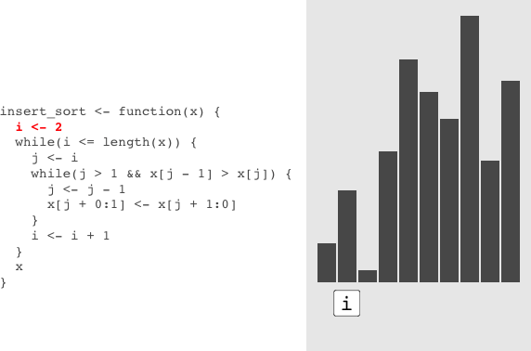
Using a Bar Chart to Visualize R Code
Source: See the amazing watcher package, which allows you to record the state of R function during evaluation. For more details, please click on the link.
7 / 32

Slide 8
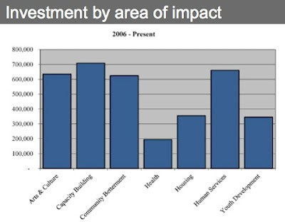
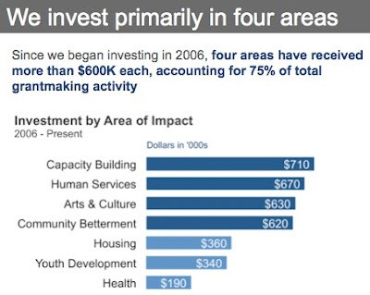
04:00
Non-graded activity: Two Bar Charts
Activity Your Solution
Over the next five minutes, identify 3-4 differences that make the graph on the right
better, and suggest how you can further improve the graph on the right
8 / 32

Slide 9
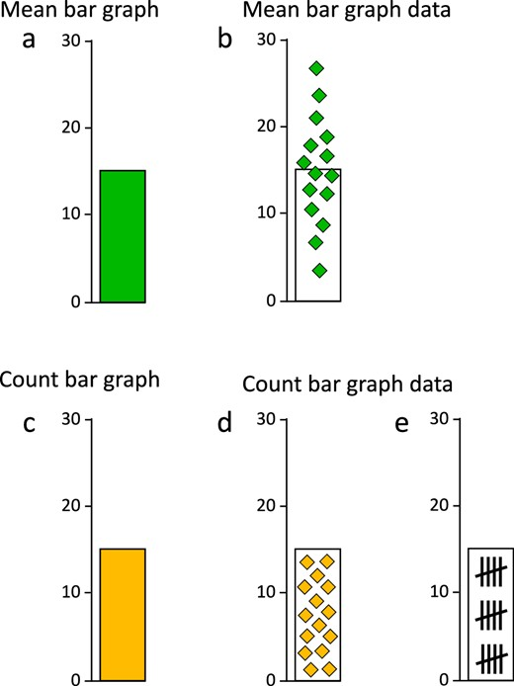
Issues with the Interpretation of Bar Charts
Data distribution differs categorically between mean and count graphs. (a) Mean bar graphs and (c) count bar graphs do not differ in
basic appearance, but they do depict categorically different data distributions.
Source: Kerns and Wilmer (2021). Journal of Vision. DOI: https://doi.org/10.1167/jov.21.12.17
9 / 32

Slide 10
Key Takeaway 1
The typically used bar chart should not be to depict means of categorical variables.

Slide 11
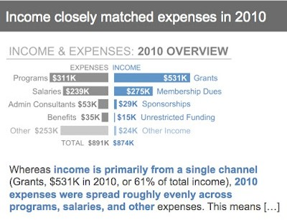
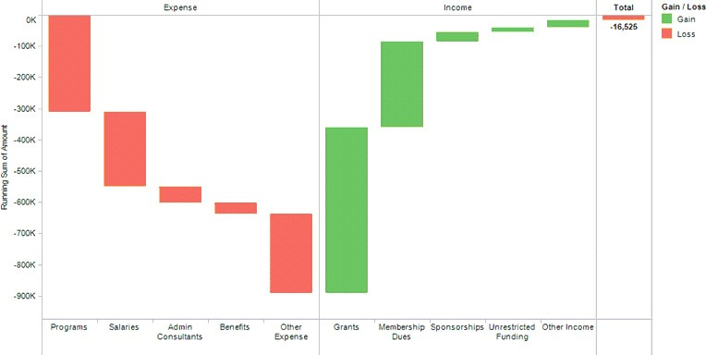
04:00
Waterfall Charts
Activity Your Solution
What are the advantages and disadvantages of these two charts? They are using the
same exact data. Please try to list 2-4 in each category for each chart.

Slide 12
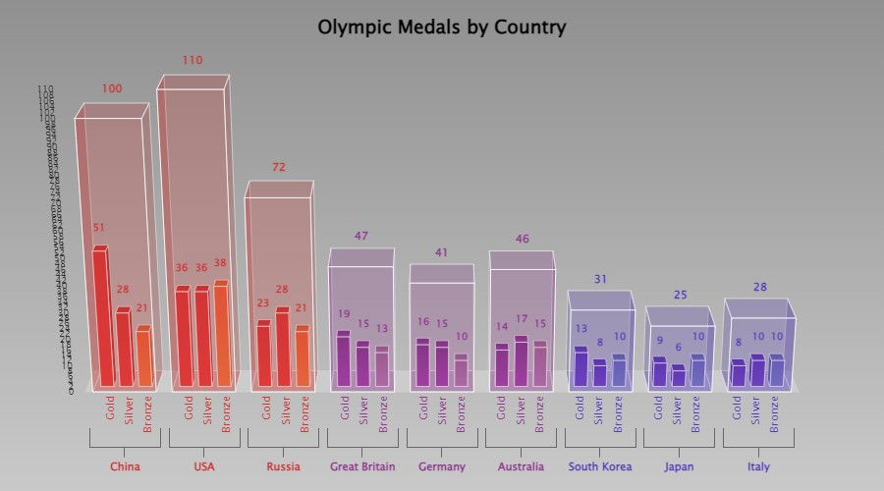
3D Charts are Awful: Even This
Source: See the interactive version of the chart by clicking here

Slide 13




Dot Charts: Recall the Playfair Example
London Constantinople
Paris Naples Vienna Moscow Amsterdam
Dublin Venice Petersburgh
Rome Berlin Madrid Palermo Lisbon Copenhagen
Warsaw
Turin Genoa Florence Stockholm Edinburgh
City
300
600
Population
900
13 / 32

Slide 14
PPrrooppoorrttiioonnss
1144 // 3322

Slide 15
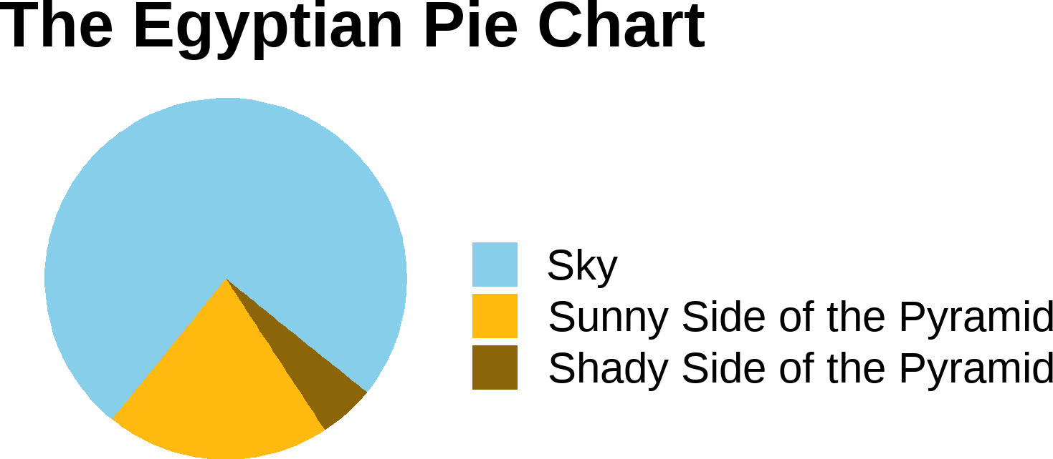
My Favorite Pie Chart
Note: Humor aside, pie charts are almost always awful!!
15 / 32

Slide 16
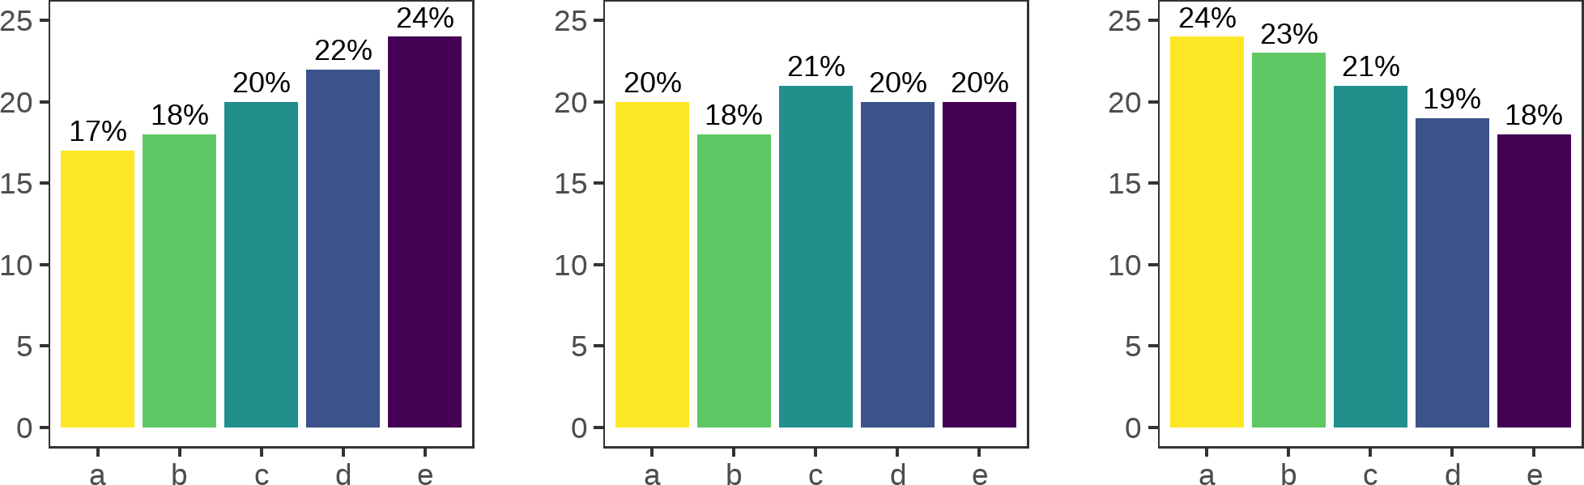
Pie Charts are Awful By Design

Slide 17
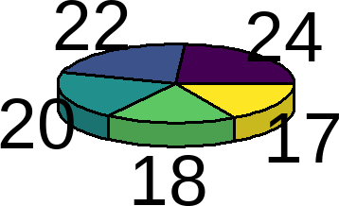
And often made even worse: 3D

Slide 18
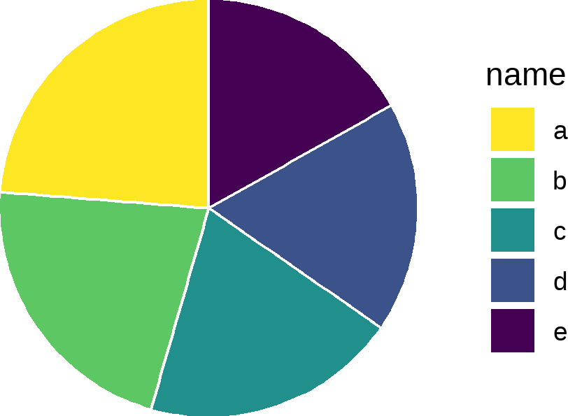
And often made even worse: Side Legend

Slide 19
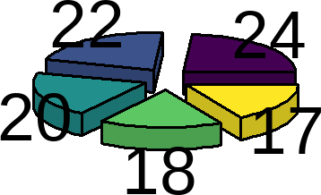
And often made even worse: Exploded Pie

Slide 20
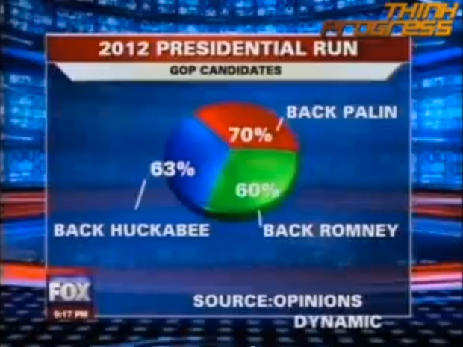
And often made even worse: SUM(%) != 100%

Slide 21
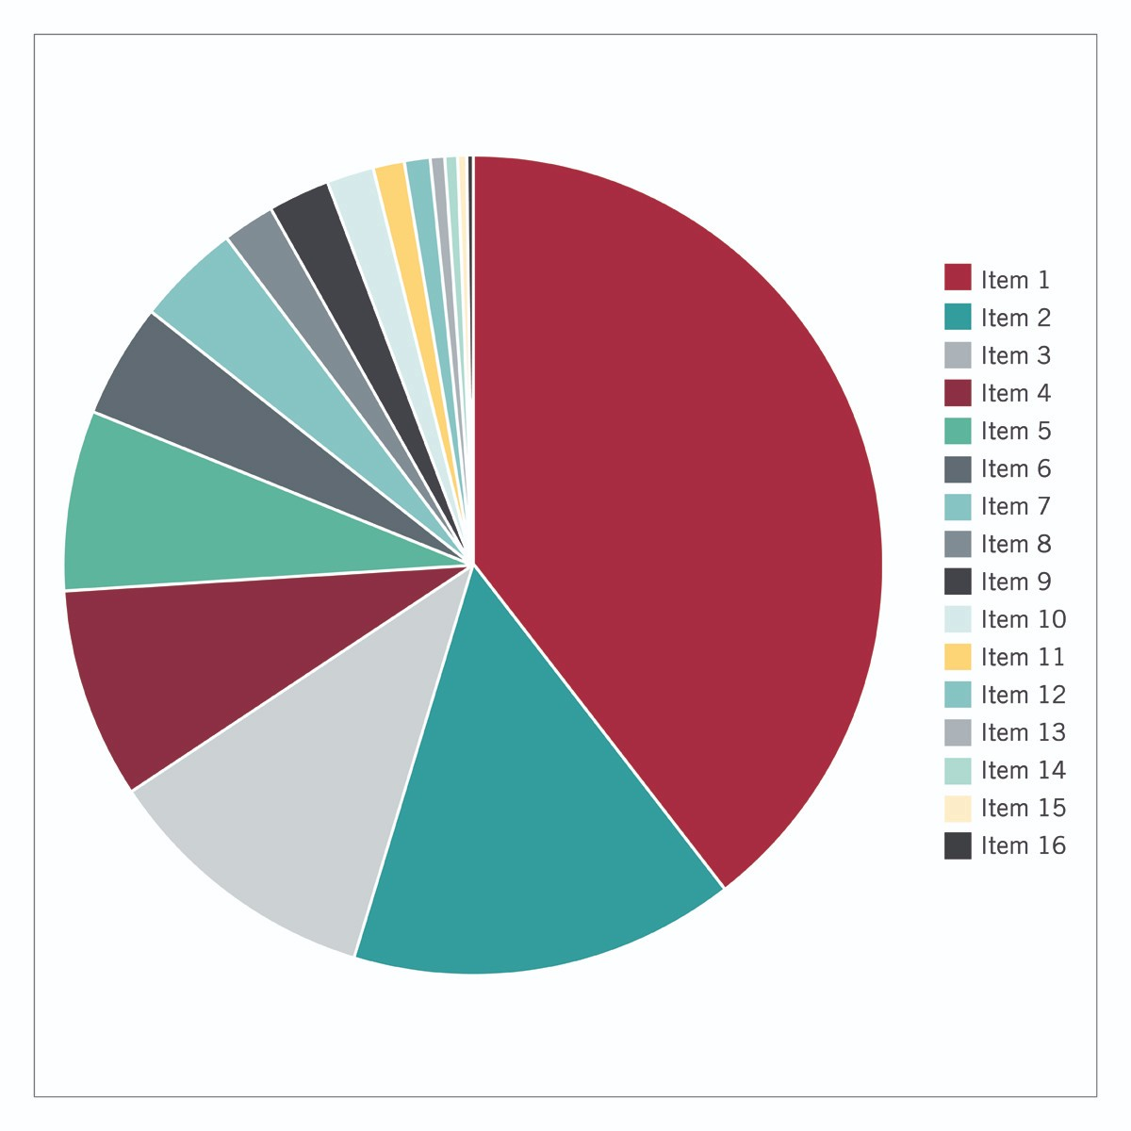
And often made even worse: Many Levels

Slide 22
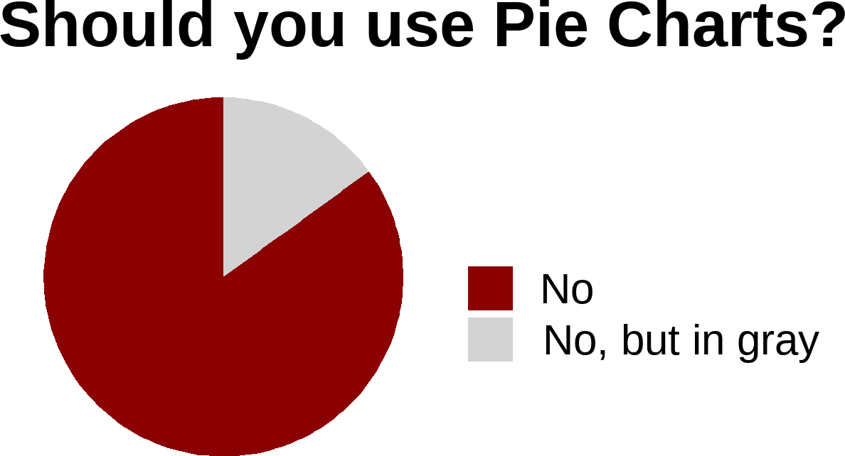
Key Takeaway 2
Please do NOT use pie charts.
If you need any further evidence, please check ?pie() in R. Even statistical software are recommending against using pie charts!!

Slide 23
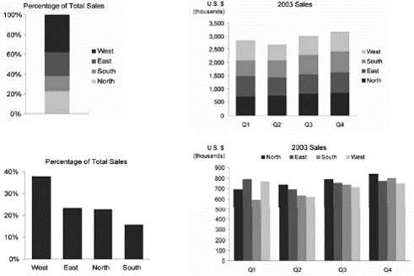
04:00
Stacked Bar Charts
Activity Your Solution
When it is best to use the four charts below? They are using the same exact data.

Slide 24
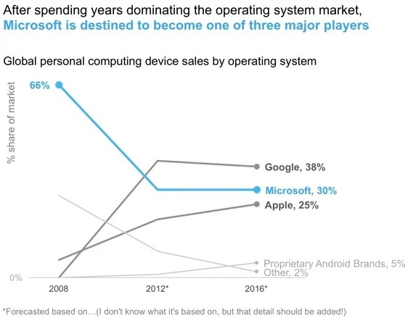
A Note on Stacked Bar Charts
Source: Storytelling with Data: To Stack or Not to Stack

Slide 25
DDiissttrriibbuuttiioonnss aanndd CCoorrrreellaattiioonnss
2255 // 3322

Slide 26
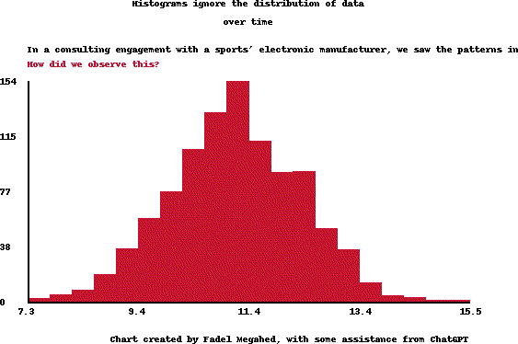
Issues with Histograms
Source: In a quality improvement project with a major manufacturer of electronic devices, we discovered an issue in the customer's seemingly 'normal' data.
26 / 32

Slide 27
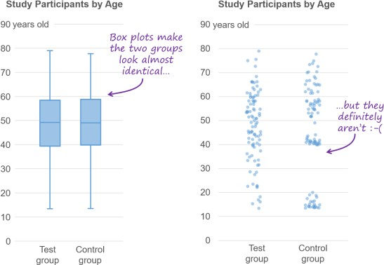
Issues with Box Plots
Source: Nick Desbarats (2021) I've Stopped Using Box Plots. Should You?
27 / 32

Slide 28
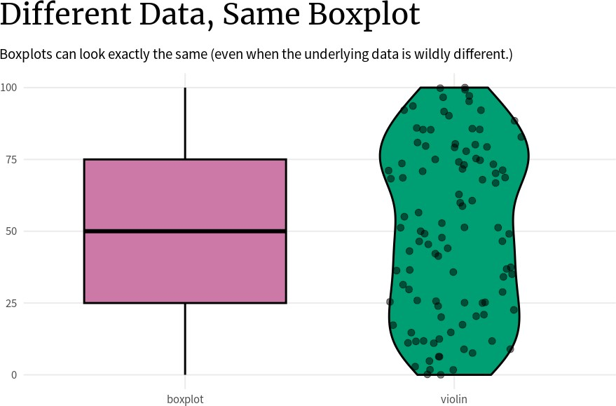
Additional Issues with Box Plots
Source: Albert Rapp (2024) Issues with Box Plots
28 / 32

Slide 29
Key Takeaway 3
To capture the variability in a dataset, the use of box plots may not be appropriate!!!!
29 / 32

Slide 30
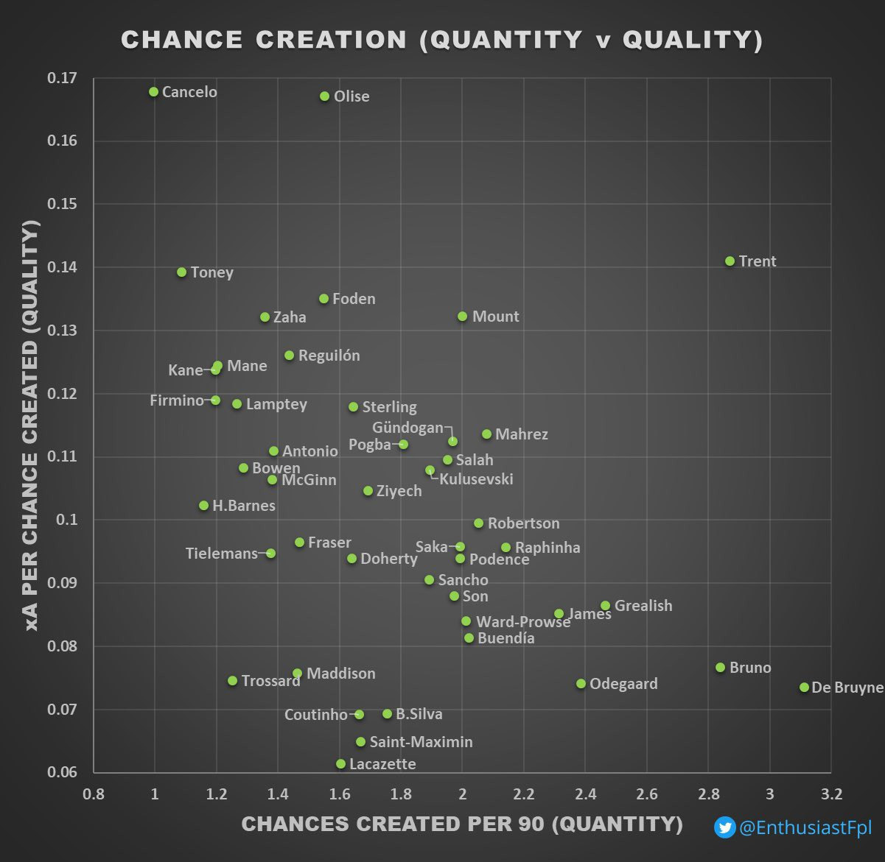
Scatter Plots
Source: Chart created by @EnthusiastFpl and shared on
on March 25, 2022.
30 / 32

Slide 31
RReeccaapp
3311 // 3322

Slide 32
Summary of Main Points
Identify strengths & weaknesses of basic charts
Use appropriate charts based on objective
Avoid using pie charts (never use pie charts)
Avoid 3D graphs (unless VR changes their utility)
32 / 32

