Slide 1




ISA 401: Business Intelligence & Data Visualization
04: Scraping Webpages in
Fadel M. Megahed, PhD
Raymond E. Gloss Professor in Business Farmer School of Business
Miami University
@FadelMegahed fmegahed fmegahed@miamioh.edu
Automated Scheduler for Office Hours
Fall 2025

Slide 2
Quick Refresher from Last Class
✅ Subset data in .
✅ Read text-files, binary files (e.g., Excel, SAS, SPSS, Stata, etc), json files, etc.
✅ Export data from .

Slide 3
Learning Objectives for Today's Class
Understand when can we scrape data (i.e., robots.txt)
Scrape a webpage using .

Slide 4
WWeebb TTeecchhnnoollooggyy
SSoouurrccee:: SSlliiddeess 55--1155aarree ff
rroomm
DDrrEEaarroo WWaanngg''ss SSTTAATT 222200 WWeebb SSccrraappiinnggSS
lliiddeess
,, wwhhiicchh wweerree aaddaapptteedd ff
rroomm
DDrrEEmmii TTaannaa
kkaa''ss
""CCoommmmuunniiccaattiinngg wwiitthh DDaattaa"" ccoouurrssee..
44 // 3300

Slide 5



World Wide Web (WWW)
WWW (or the Web) is the information system where documents (web pages) are identified by Uniform Resource Locators (URLs)
A web page consists of:
HTML provides the basic structure of the web page
CSS controls the look of the web page (optional)
JS is a programming language that can modify the behavior of elements of the web page (optional)

Slide 6
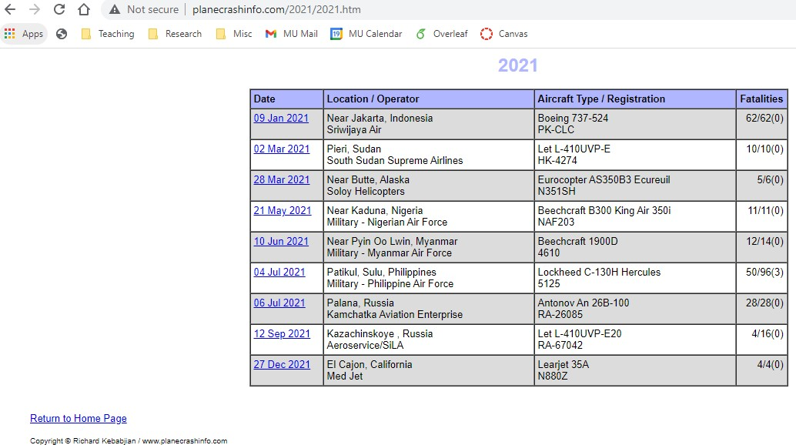
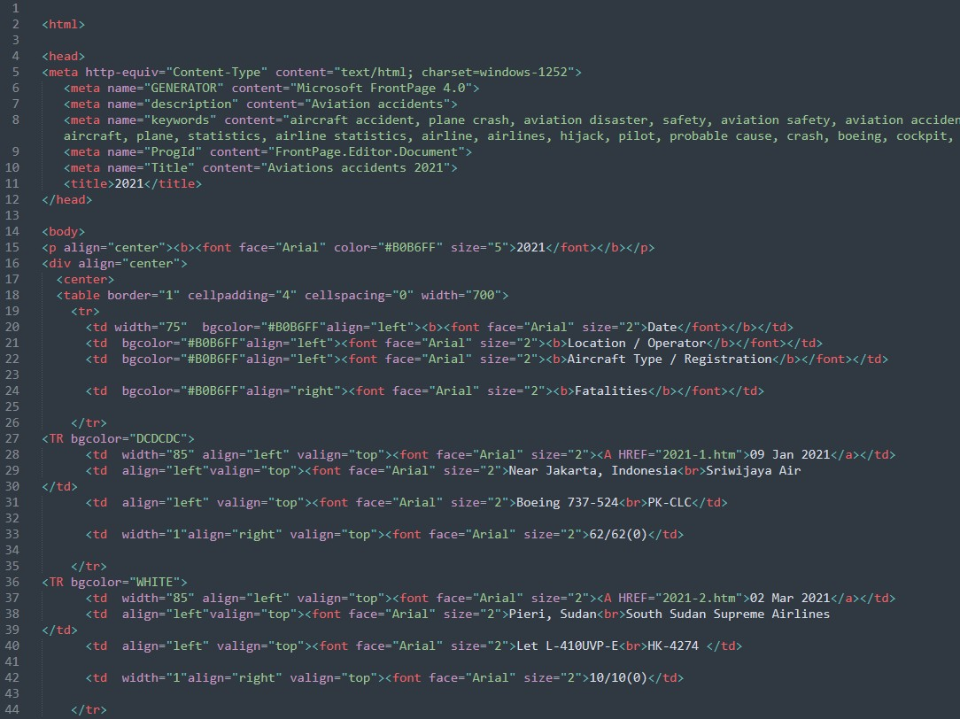
Hypertext Markup Language (HTML)
with the extension .html.
rendered using a web browser via an URL.
text files that follows a special syntax that alerts web browsers how to render it.
via a web browser via a text editor

Slide 7
HTML Structure
<!DOCTYPE html>
<html>
<!--This is a comment and ignored by web client.-->
<head>
<!--This section contains web page metadata.-->
<title>ISA 401: Business Intelligence and Data Viz</title>
<meta name="author" content="Fadel Megahed">
<link rel="stylesheet" href="css/styles.css">
</head>
<body>
<!--This section contains what you want to display on your web page.-->
<h1>I'm a first level header</h1>
<p>This is a <b>paragraph</b>.</p>
</body>
</html>

Slide 8

HTML Syntax
<span style="color:blue;">Author content</span> Author content
start tag: | <span style="color:blue;">Author content</span>
end tag: | <span style="color:blue;">Author content</span>
content: | <span style="color:blue;">Author content</span>
element name: | <span style="color:blue;">Author content</span>
attribute: | <span style="color:blue;">Author content</span>
attribute name: | <span style="color:blue;">Author content</span>
attribute value: | <span style="color:blue;">Author content</span>
Not all HTML tags have an end tag, for example:
<img height="40px" src="https://tinyurl.com/rlogo-svg">

Slide 9
HTML Elements
block element: | <div>content</div>
inline element: | <span>content</span>
paragraph: | <p>content</p>
header level 1: | <h1>content</h1>
header level 2: | <h2>content</h2>
italic: | <i>content</i>
emphasised text: | <em>content</em>
strong importance: | <strong>content</strong>
link: unordered list: | <a href="https://github.com/fmegahed/isa401">content</a> <ul> <li>item 1</li> <li>item 2</li> </ul>

Slide 10
Cascading Style Sheet (CSS)
with the extension .css
3 ways to style elements in HTML:
inline by using the style attribute inside HTML start tag:
<h1 style="color:blue;">Blue Header</h1>
externally by using the <link> element:
<link rel="stylesheet" href="styles.css">
internally by defining within <style> element:
<style type="text/css"> h1 { color: blue; }
</style>
By convention, the <style> and <link> elements tend to go into the <head> section of the HTML document.

Slide 11
CSS Syntax
<style type="text/css"> h1 { color: blue; }
</style>
<h1>This is a header</h1>
This is a header
selector: | h1 { color: blue; }
property: | h1 { color: blue; }
property name: | h1 { color: blue; }
property value: | h1 { color: blue; }
You may have multiple properties for a single selector.➡
h1 {
color: blue; font-size: 16pt;
}

Slide 12
CSS Properties
<div>Sample text</div>
background color: | div { background-color: yellow; } | Sample text
text color: | div { color: purple; } | Sample text
border: | div { border: 1px dashed brown; } | Sample text
left border only: | div { border-left: 10px solid pink; } | Sample text
text size: | div { font-size: 10pt; } | Sample text
padding: | div { background-color: yellow; padding: 10px; } | Sample text
margin:
div { background-color: yellow; margin: 10px; }
Sample text

Slide 13
Unlike class, you can only have one id value and must be unique in the whole HTML document.
<h1>This is a sample html
</h1>
data with a soul.</p>
CSS Selector
<blockquote>
<p>Maybe stories are just
<footer>—Brene Brown</footer>
</blockquote>
.classname
selects all elements with the attribute class="classname".
<div id="p1" class="parent"> Hmm
<p>Hi!</p> How are you?
<div class="child nice">
<p>Hello!</p>
</div>
</div>
.c1.c2
selects all elements with both c1 and c2 within its class attribute.
.c1 .c2
selects all elements with class c2 that is a descendant of an element with class c1.
<p>Household 1</p>
<div class="parent">
<p>Hi!</p>
<blockquote class="child rebel">
<p>Don't talk to me!</p>
</blockquote>
</div>
#p1
selects all elements with the attribute id="p1".
<span class="child">
<span class="parent child rebel">
<p>Clean your room!</p>
</span>
</span>
<p>End of households</p>
13 / 30

Slide 14
JavaScript (JS)*
JS is a programming language and enable interactive components in HTML documents.
2 ways to insert JS into a HTML document:
internally by defining within <script> element:
<script>
document.getElementById("p1").innerHTML = "content";
</script>
externally by using the src attribute to refer to the external file:
<script src="js/myjs.js"></script>
14 / 30

Slide 15
WWeebb SSccrraappiinng 🕸🕸
g
1155 // 3300

Slide 16
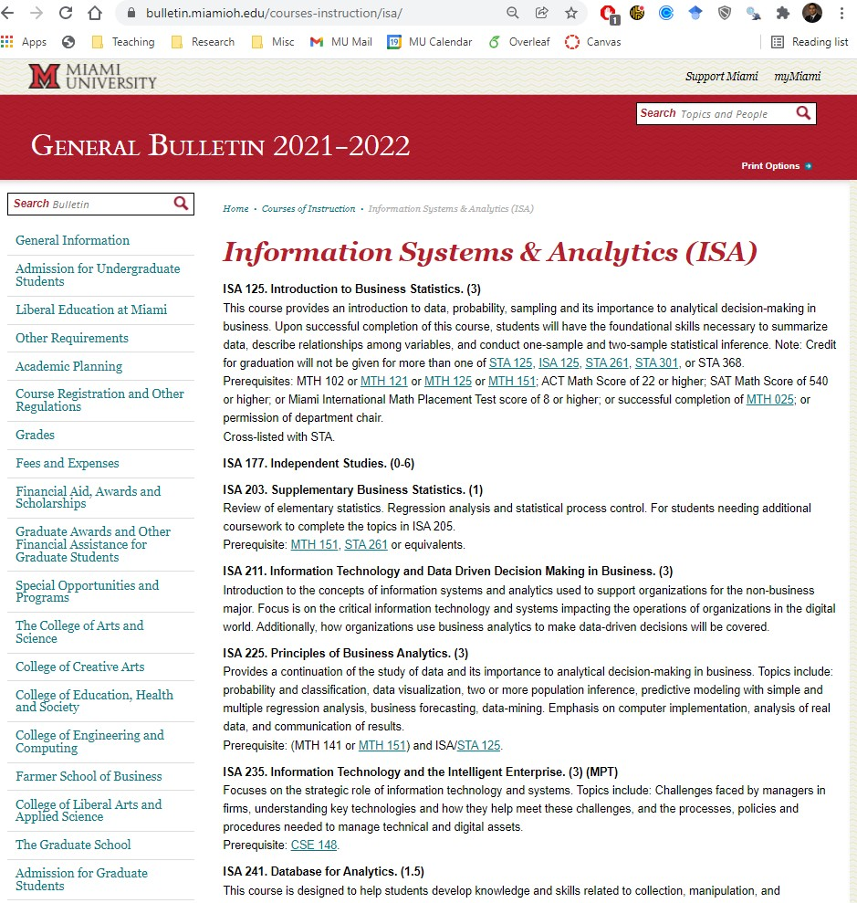
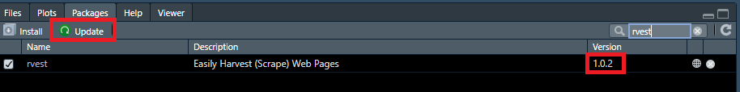
rvest: Step 1 - Reading Static HTML Pages
Use {rvest} >= v1.0.2 (if not, update)
if(require(pacman)==FALSE) install.packag pacman::p_load(rvest)
isa_courses = read_html("http://bulletin.
isa_courses
 
## {html_document}
## <html xml:lang="en" lang="en" dir="ltr ## [1] <head>\n<title>Information System ## [2] <body>\n\n\n\n\n\n<!-- Google Tag
 

Slide 17
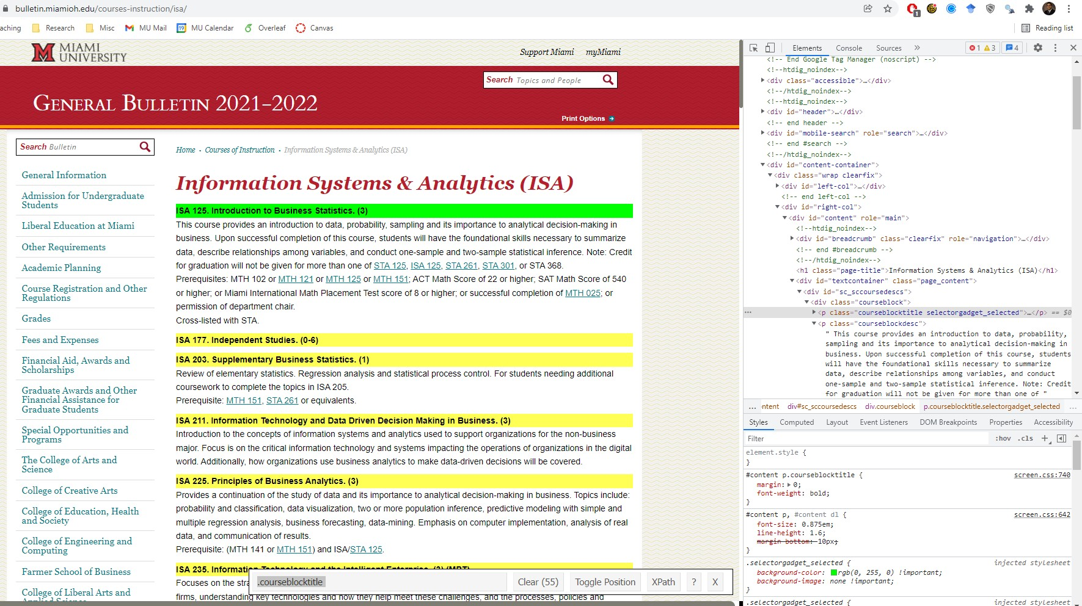
rvest: Step 2 - Selecting HTML Elements
Inspector Selector Gadget

Slide 18
rvest: Step 2 - Selecting HTML Elements
isa_course_titles = isa_courses |> html_elements(css = "p.courseblocktitle
isa_course_titles
 
## {xml_nodeset (50)}
## | [1] | <p | class="courseblocktitle"><str
## | [2] | <p | class="courseblocktitle"><str
## | [3] | <p | class="courseblocktitle"><str
## | [4] | <p | class="courseblocktitle"><str
## | [5] | <p | class="courseblocktitle"><str
## | [6] | <p | class="courseblocktitle"><str
## | [7] | <p | class="courseblocktitle"><str
## | [8] | <p | class="courseblocktitle"><str
## | [9] | <p | class="courseblocktitle"><str
## | [10] | <p | class="courseblocktitle"><str
## | [11] | <p | class="courseblocktitle"><str
## | [12] | <p | class="courseblocktitle"><str
## | [13] | <p | class="courseblocktitle"><str
## | [14] | <p | class="courseblocktitle"><str
## | [15] | <p | class="courseblocktitle"><str
18 / 30

Slide 19
rvest: Step 3 - Getting HTML Text
isa_course_titles_en = html_text2()
isa_course_titles_en
isa_course_titles


## | [1] | "ISA | 125. | Introduction to Busines
## | [2] | "ISA | 177. | Independent Studies. (0
## | [3] | "ISA | 211. | Information Technology
## | [4] | "ISA | 225. | Principles of Business
## | [5] | "ISA | 235. | Information Technology
## | [6] | "ISA | 241. | Database for Analytics.
## | [7] | "ISA | 242. | Programming for Analyti
## | [8] | "ISA | 250. | Basic Math for Analytic
## | [9] | "ISA | 277. | Independent Studies. (0
## | [10] | "ISA | 301. | Business Data Communica
## | [11] | "ISA | 303. | Enterprise Systems. (3)
## | [12] | "ISA | 305. | Information Technology
## | [13] | "ISA | 321. | Optimization in Busines
## | [14] | "ISA | 333. | Nonparametric Statistic
## | [15] | "ISA | 335. | Blockchain and Business
## | [16] | "ISA | 340. | Internship. (0-20)" | 19 / 30

Slide 20
Demo: Scraping the Course Descriptions
We will build on the previous example and we will scrape the course descriptions
associated with these courses.
Then, we will create a data frame containing both the course titles and descriptions
Then, we will export the results to a CSV so that we can analyze that in a separate program if we wanted to.

Slide 21
04:00
Non-Graded Class Activity
Activity Your Solution My Solution
Go to this database on plane crashes
Scrape the HTML table. Note the difference from text elements:
The CSS selector for html_elements() will be different.
You will extract a table (in its entirety) and hence:
we will use html_table() instead of html_text2()
Store the scraped data in an appropriate location on your computer (e.g., within the data folder for ISA 401)

Slide 22
LLeeggaall aanndd EEtthhiiccaall IIssssuueess wwiitthh WWeebb SSccrraappiinngg
2222 // 3300

Slide 23

Robots.txt
When scraping/crawling the web you need to be aware of robots.txt.
The robots exclusion standard, also known as the robots exclusion protocol or simply
robots.txt, is a standard used by websites to communicate with web crawlers and other web robots. The standard specifies how to inform the web robot about which areas of the website should not be processed or scanned. --- Wikipedia
Using the excellent robotstxt to check if scraping/crawling a specific directory is allowed.
if(require(robotstxt)==FALSE) install.packages("robotstxt")
robotstxt::paths_allowed(paths = "2025/", domain = "planecrashinfo.com", bot
= "*")
## [1] TRUE

Slide 24
Terms of Service
Most large companies have terms of service that supplement what is permitted and/or disallowed on their robots.txt file. Examples include:
Yelp's US Terms of Service
LinkedIn Terms of Service

Slide 25
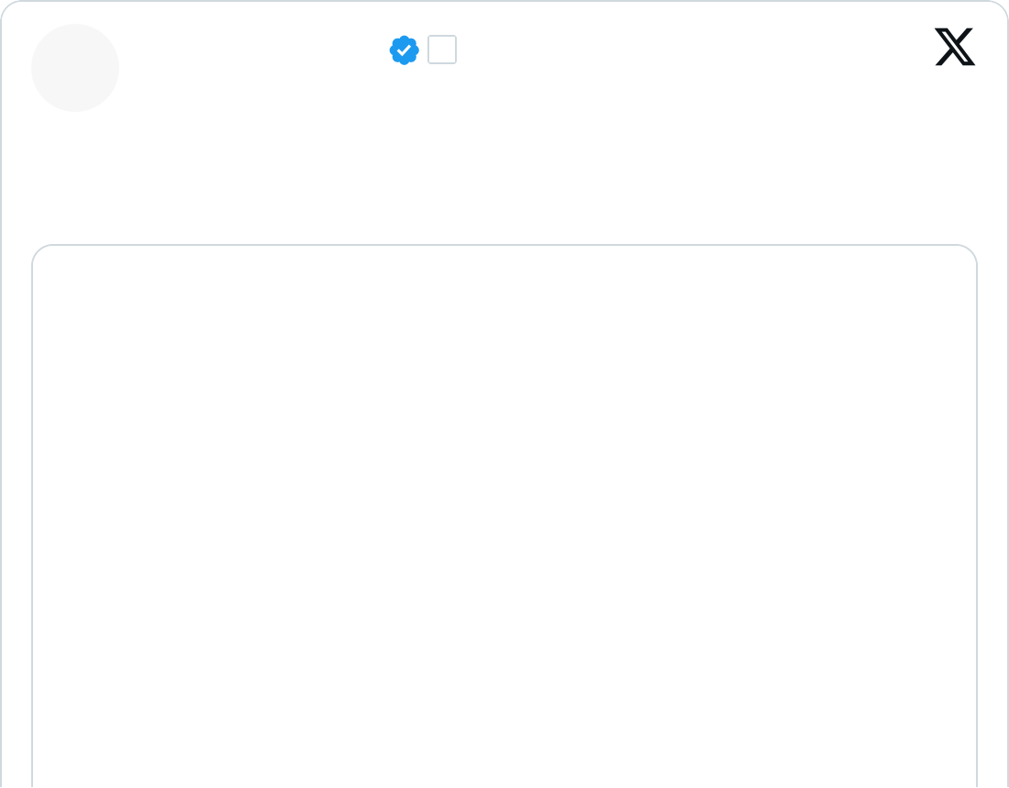
Ethical/Legal Considerations
Use of publicly available reviews as a part of your service: Would you classify the Yelp vs Google Feud as such an example?
Jeremy Stoppelman
@jeremys · Follow
Wow Google, congrats on a new low. Consumer searches for Yelp gets "reviews" which are Google Ads.

Slide 26
Ethical/Legal Considerations
Use of publicly available profiles as a part of your service:
LinkedIn vs Hiq Labs: Ninth Circuit Decision in 2019
Revival of Case in 2021 by Supreme Court

Slide 27
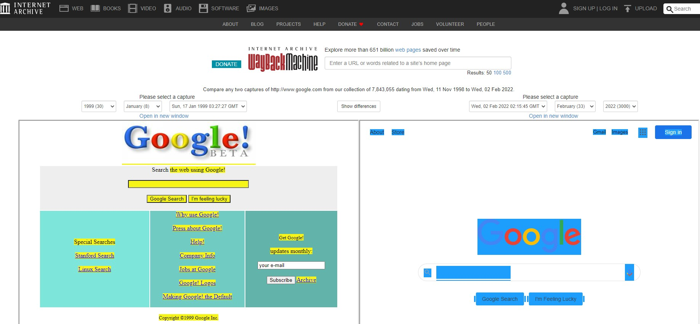
Ethical/Legal Considerations
What about scraping entire websites/webpages for the purpose of archiving the internet?
The evolution of the home page for Google per the Wayback Machine

Slide 28
RReeccaapp
2288 // 3300

Slide 29
Summary of Main Points
By now, you should be able to do the following:
Understand when can we scrape data (i.e., robots.txt)
Scrape a webpage using .
29 / 30

Slide 30
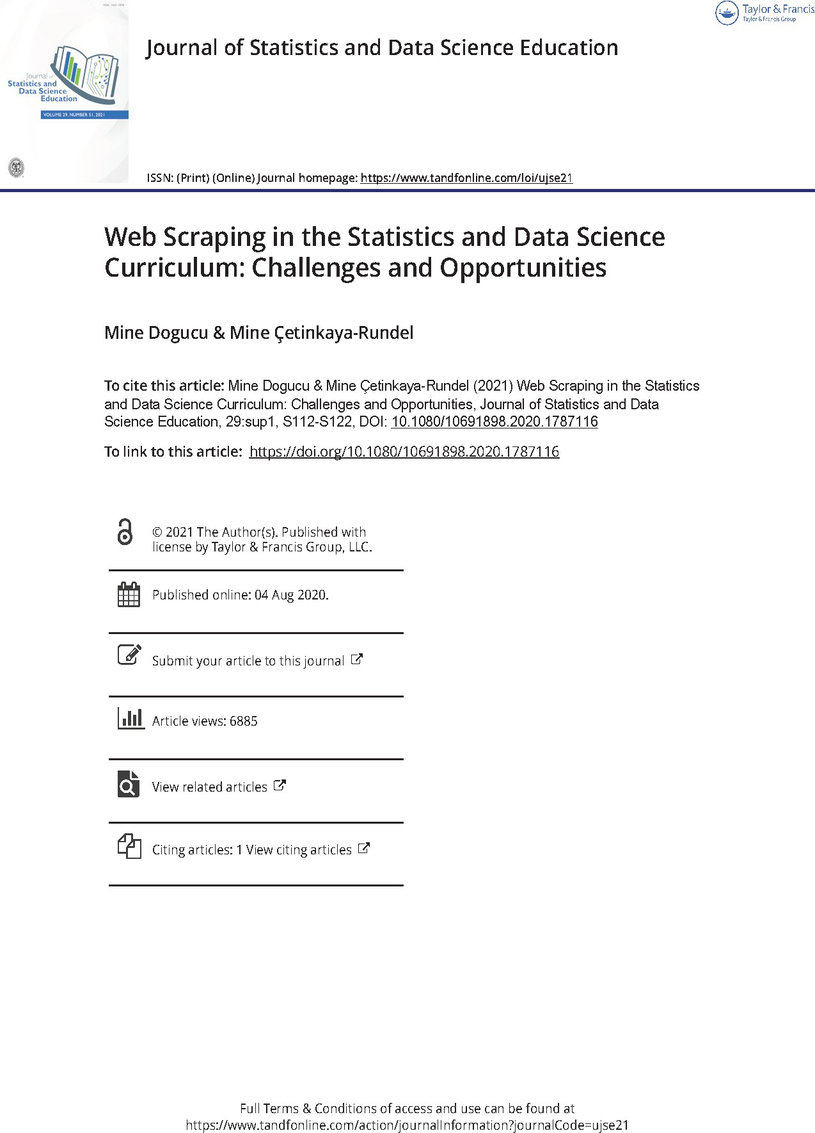

Things to Do to Prepare for Next Class
Go over your notes, read through the supplementary material (below) and complete Assignment 04 on Canvas.
PDF of Published Paper
ePub of Published Paper
Selector Gadget
Getting Started with rvest
30 / 30

