Slide 1




ISA 401: Business Intelligence & Data Visualization
06: Scraping Multiple Webpages
Fadel M. Megahed, PhD
Raymond E. Glos Professor in Business Farmer School of Business
Miami University
@FadelMegahed fmegahed fmegahed@miamioh.edu
Automated Scheduler for Office Hours
Fall 2025

Slide 2
Quick Refresher from Last Class
✅ Understand when can we scrape data (i.e., robots.txt)
✅ Scrape a webpage using

Slide 3
06:00
Non-Graded Assessment of Your Understanding
Scrape the Names and Positions of the current cabinet members from https://www.whitehouse.gov/administration/cabinet/ and save the results into a data frame that contains two columns: (a) name, and (b) position.

Slide 4
Learning Objectives for Today's Class
Scrape multiple webpages using .
Use loops and/or tidymodeling approaches to scrape data from multiple webpages.

Slide 5
WWeebb SSccrraappiinngg DDeemmooss ((CCoonntt..))
55 // 1111

Slide 6
Demo 1: Scraping all Plane Crashes 2020-2025
We will build on the previous example and we will scrape all the plane crashes that were recorded in the plane crash database between 2020-2025.
Then, we will create a single data frame for all crashes. It will contain the fields in the individual tables as well as the year of crash.
Then, we will export the results to a CSV so that we can analyze that in a separate program if we wanted to.

Slide 7
Practice Outside of Class
The most popular listings on Netflix are rated and reviews on ImDb are available at https://www.imdb.com/search/title/?companies=co0144901. Write an script that will produce a tibble that contains the following information for the first 300 entries:
title, which you will save in a column titled title
year/years of show, which you will save in a column titled year
1-2 sentence summary of show, which you save in a column titled summary

Slide 8
RReeccaapp
88 // 1111

Slide 9
Summary of Main Points
By now, you should be able to do the following:
Scrape multiple webpages using .
Use loops and/or tidy modeling approaches to scrape data from multiple webpages.

Slide 10
Kahoot Competition # 1
To assess your understanding and retention of the topics covered last week, you will compete in a Kahoot competition (consisting of 16 questions):
Go to https://kahoot.it/
Enter the game pin, which will be shown during class
Provide your first (preferred) and last name
Answer each question within the allocated 20-second window (fast and correct answers provide more points)
Winning the competition involves having as many correct answers as possible AND taking the shortest duration to answer these questions. The winner of the competition will receive a
0.15 bonus on the next assignment. Good luck!!!

Slide 11
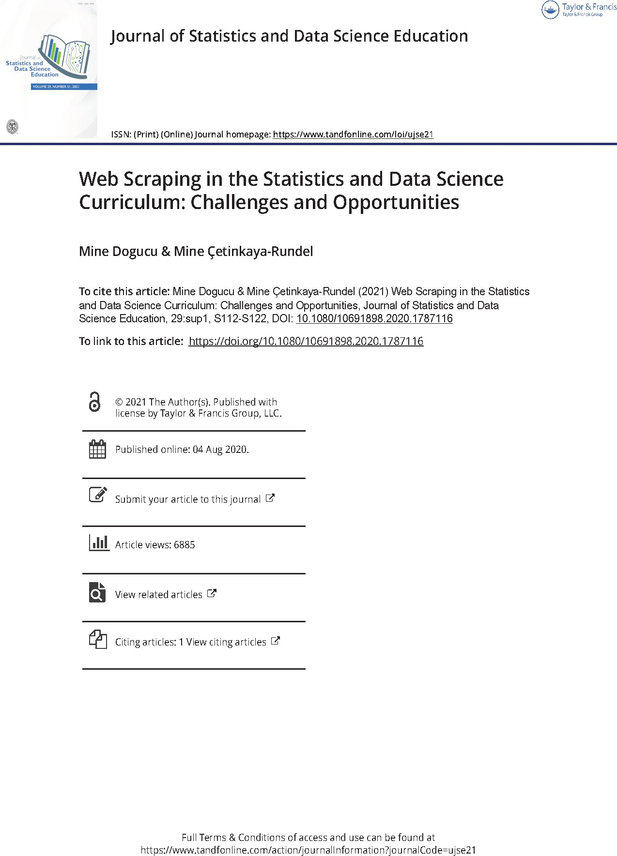

Things to Do to Prepare for Next Class
Go over your notes, read through the supplementary material (below), and complete Assignment 05 on Canvas.
PDF of Published Paper
ePub of Published Paper
Practical Web Scraping in R
11 / 11

