Slide 1




ISA 401: Business Intelligence & Data Visualization
25: A Short Introduction to Exploratory Data Mining
Fadel M. Megahed, PhD
Raymond E. Glos Professor in Business Farmer School of Business
Miami University
@FadelMegahed fmegahed fmegahed@miamioh.edu
Automated Scheduler for Office Hours
Fall 2025

Slide 2
A Recap of What we Learned Last Week
Define a “business report” & its main functions
Understand the importance of the right KPIs
Automate traditional business reports
Dashboards as real-time business reporting tools
2 / 33

Slide 3

Course Objectives Covered so Far
[Y]ou will be re-introduced to how data should be explored ... Instead, the focus is on understanding the underlying methodology and mindset of how data should be approached, handled, explored, and incorporated back into the domain of interest. ... You are expected to:
Be capable of extracting, transforming and loading (ETL) data using multiple platforms (e.g. & Tableau).
Write basic scripts to preprocess and clean the data.
Explore the data using visualization approaches that are based on sound human factors (i.e. account for human cognition and perception of data).
Understand how data mining and other analytical tools can capitalize on the insights generated from the data viz process.
Create interactive dashboards that can be used for business decision making, reporting and/or performance management.
Be able to apply the skills from this class in your future career.
3 / 33

Slide 4
Learning Objectives for Today's Class
Describe the goals & functions of data mining
Understand the statistical limits on data mining
Describe the data mining process
What is “frequent itemsets” & the application of this concept
Explain how and why “association rules” are constructed
Use to populate both concepts
4 / 33

Slide 5
AAnn OOvveerrvviieeww ooff DDaattaa MMiinniinngg
55 // 3333

Slide 6
What is Data Mining?
The most common definition of data mining is the discovery of models from data.
Discovery of patterns and models that are:
  Valid: hold on new data with some certainty
  Useful: should be possible to act on the item
  Unexpected: non-obvious to the system
  Understandable: humans should be able to interpret the pattern
Subsidiary Issues:
  Data cleansing: detection of bogus data
  Data visualization: something better than MBs of output
  Warehousing of data (for retrieval)
Source: The slide is adapted from Jure Leskovic, Stanford CS246, Lecture Notes, see http://cs246.stanford.edu
6 / 33

Slide 7
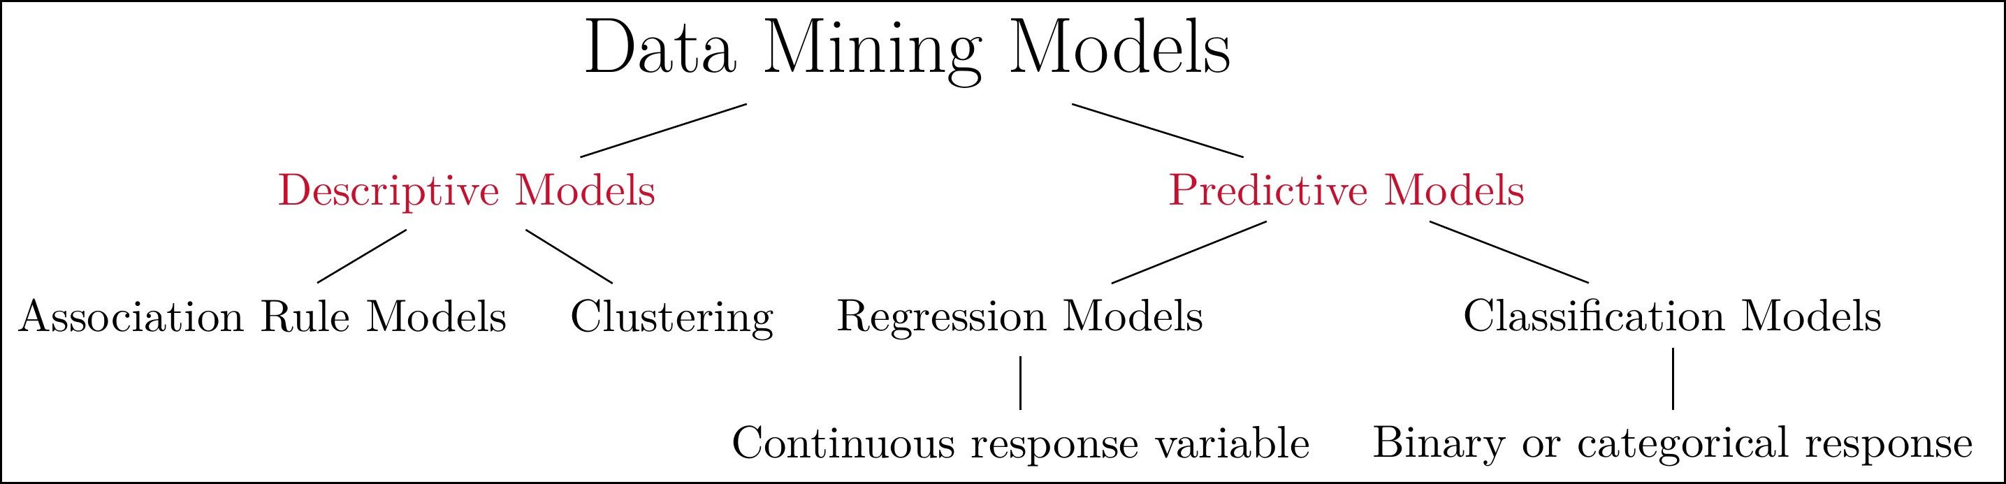
A Simplistic View of Data Mining Models
A simplistic summary of data mining models. Note that, in ISA 401, we will only briefly cover descriptive/exploratory data mining models

Slide 8
Data Mining is Hard
Data mining is hard since it has the following issues:
Scalability
Dimensionality
Complex and Heterogeneous Data
Data Quality
Data Ownership and Distribution
Privacy Preservation
Note that I have intentionally not included fitting/training a model since this is relatively easy if you understand the data, engineered/captured the important predictors, and have the data in the "correct" shape/quality.

Slide 9
Association Rules
Data
Top 5 Rules
Scatter Plot of all Rules
Graph-based Plot of Top 5 Rules
## transactions as itemMatrix in sparse format with ## 9835 rows (elements/itemsets/transactions) and ## 169 columns (items) and a density of 0.02609146 ##
## | most frequent items:
## | whole milk other vegetables | rolls/buns | soda
## | 2513 1903 | 1809 | 1715
## | yogurt (Other)
## | 1372 34055
##
## | element (itemset/transaction) length | distribution:
## | sizes
## | 1 | 2 | 3 | 4 | 5 | 6 | 7 | 8 | 9 | 10 | 11 | 12 | 13 | 14 | 15 | 16
## | 2159 1643 1299 |  |  | 1005 | 855 | 645 | 545 | 438 | 350 | 246 | 182 | 117 | 78 | 77 | 55 | 46
## | 17 18 19 |  |  | 20 | 21 | 22 | 23 | 24 | 26 | 27 | 28 | 29 | 32
## | 29 14 14 |  |  | 9 | 11 | 4 | 6 | 1 | 1 | 1 | 1 | 3 | 1
##
## | Min. 1st Qu. | Median | Mean 3rd Qu. | Max.
## ## | 1.000 2.000 | 3.000 | 4.409 6.000 | 32.000 | 9 / 33

Slide 10
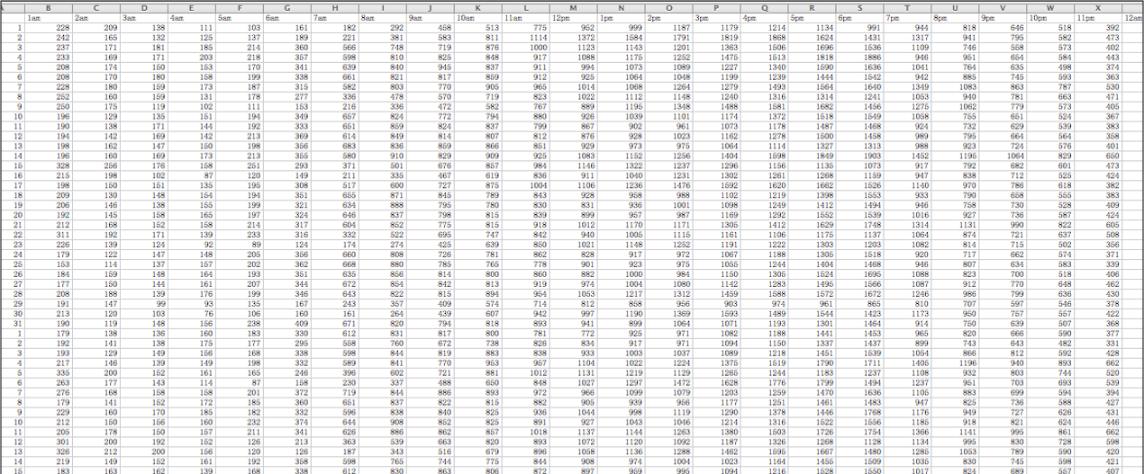
04:00
Clustering of Traffic Volume on I-85
Data
Calendar Plot of Clustered Data
Insights from Chart?

Slide 11
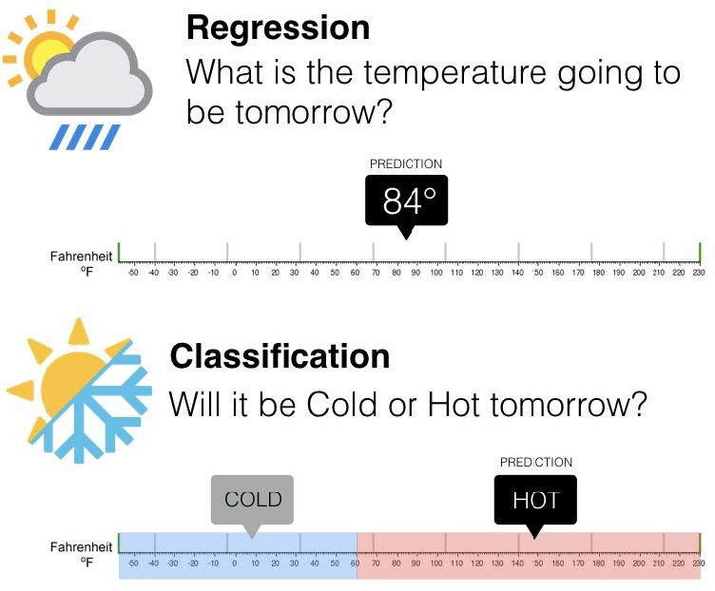
Regression vs Classification

Slide 12
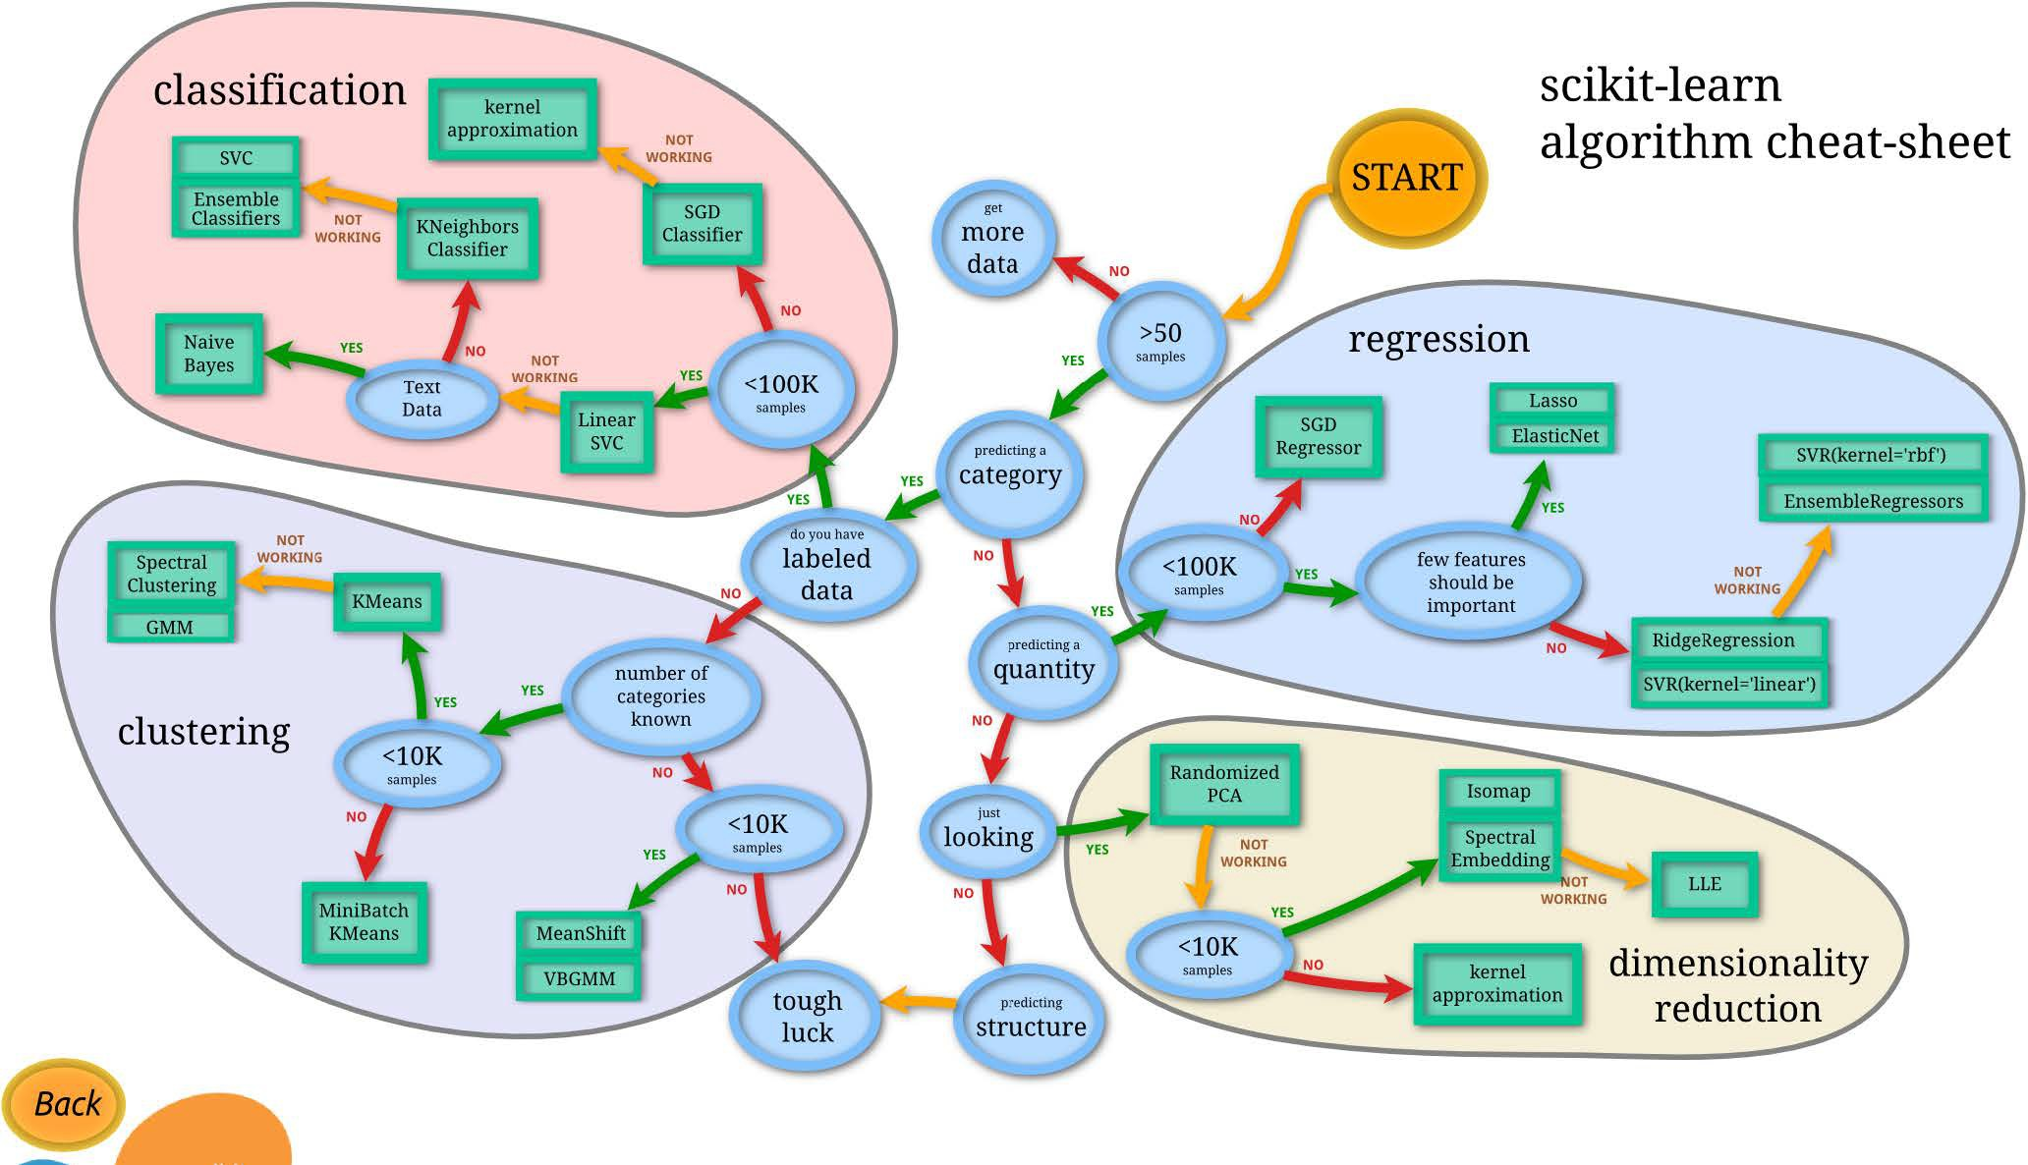
An Overview of Common Data Mining Models

Slide 13
LLiimmiittss oonn DDaattaa MMiinniinngg
1133 // 3333

Slide 14
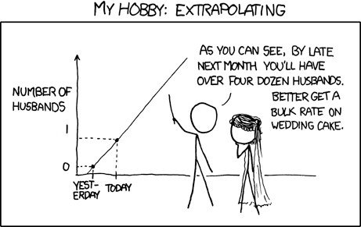
Meaningfulness of Answers from DM Models
A big risk when data mining is that you will discover patterns that are meaningless.
Bonferroni’s Principle: (roughly) if you look in more places for interesting patterns than your amount of data will support, you are bound to find.

Slide 15
Rhines Paradox: An Example of Overzealous DM?
Joseph Rhine was a parapsychologist in the 1950s who hypothesized that some people had
Extra-Sensory Perception.
He devised an experiment where subjects were asked to guess 10 hidden cards red or blue.
He discovered that almost 1 in 1000 had ESP they were able to get all 10 right!
He told these people they had ESP and called them in for another test of the same type.
Alas, he discovered that almost all of them had lost their ESP.
What did he conclude?
  He concluded that you should not tell people they have ESP; it causes them to lose it.
  Why is this an incorrect conclusion?

Slide 16

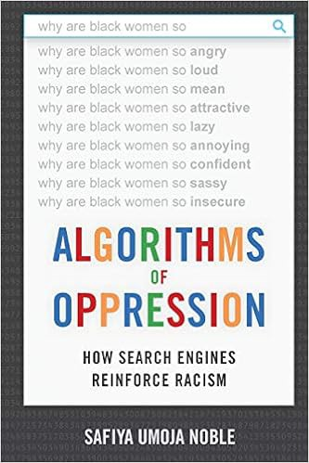
Ethical Issues with Data Mining

Slide 17
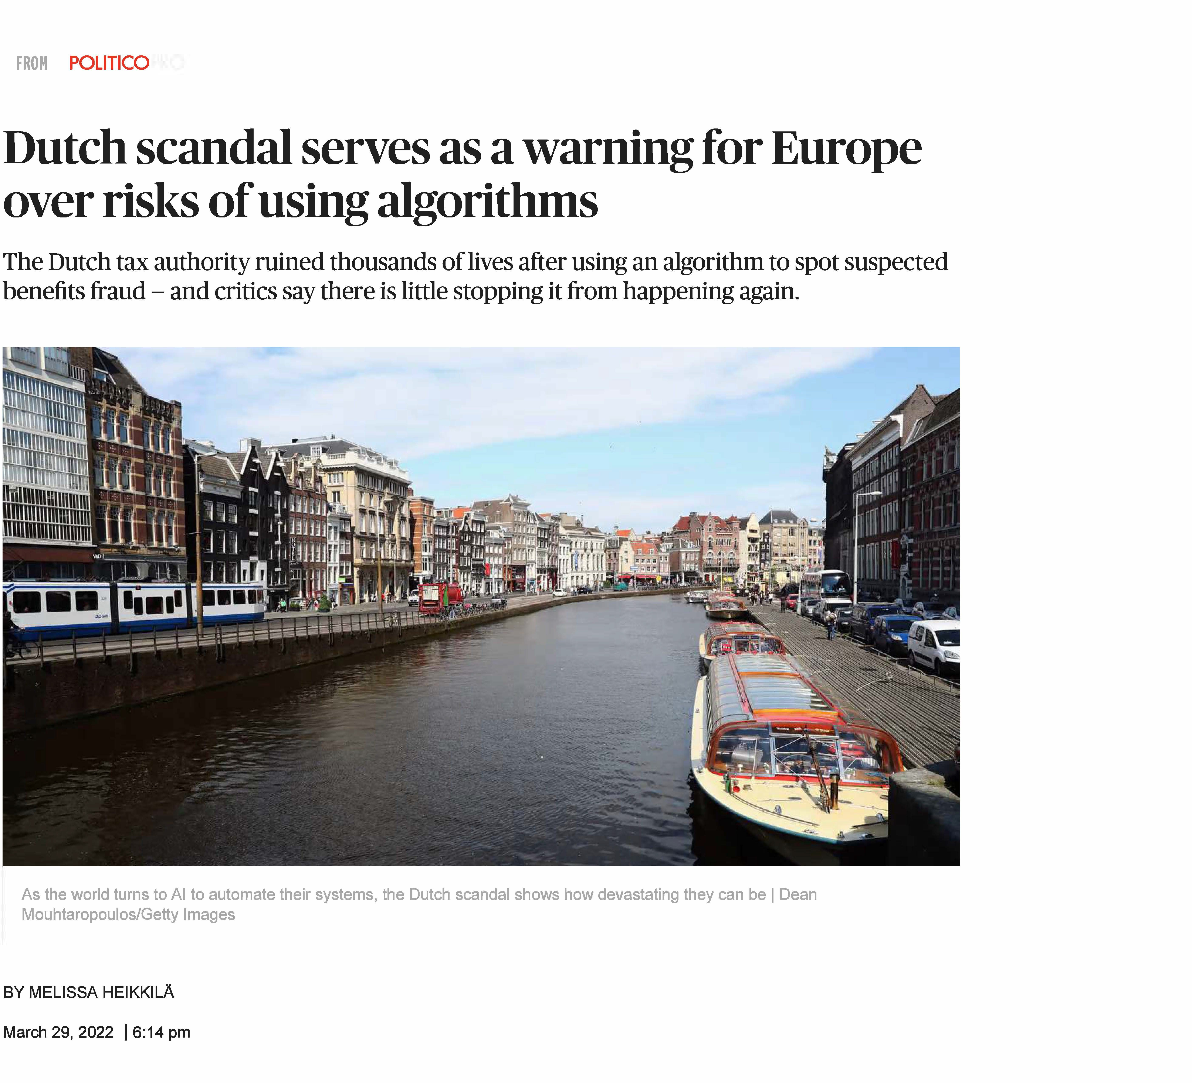
In the News: AI Implementation Scandals

Slide 18
TThhee DDaattaa MMiinniinngg PPrroocceessss
1188 // 3333

Slide 19
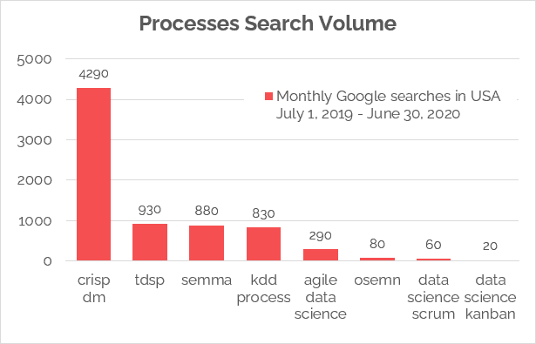
Frameworks for Data Mining Projects

Slide 20
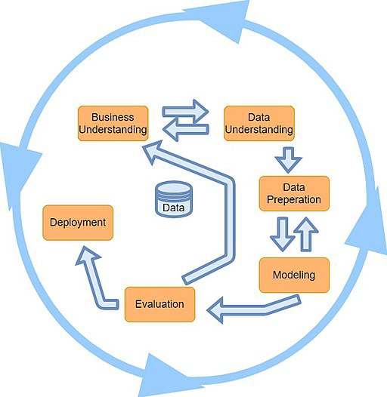
The CRISP-DM Process
You are expected to read the original CRISP-DM paper
Each step has several substeps
Most of the project time is typically spent in steps 1-3

Slide 21
FFrreeqquueenntt IItteemmsseettss,, MMaarrkkeett BBaasskkeett AAnnaallyyssiiss aa AAssssoocciiaattiioonn RRuull MMiinniinngg
2211 // 3333

Slide 22
Association Rule Discovery
Supermarket shelf management – Market-basket model:
Goal: Identify items that are bought together by sufficiently many customers
Approach: Process the sales data collected with barcode scanners to find dependencies among items
A classic rule:
  If someone buys diaper and milk, then he/she is likely to buy beer
  Don’t be surprised if you find six-packs next to diapers!
Source: J. Leskovec, A. Rajaraman, J. Ullman: Mining of Massive Datasets, http://www.mmds.org

Slide 23
The Market-Basket Model
A large set of items
  e.g., things sold in a supermarket
A large set of baskets
Each basket is a small subset of items
  e.g., the things one customer buys on one day
Want to discover association rules
  People who bought {x,y,z} tend to buy {v,w}
  Amazon!
Input:
Basket # | Items
1 | Bread, Coke, Milk
2 | Beer, Bread
3 | Beer, Coke, Diaper, Milk
4 | Beer, Bread, Diaper, Milk
5 | Coke, Diaper, Milk
Output: Discovered Rules
{Milk} --> {Coke}
{Diaper, Milk} --> {Beer}
Source: J. Leskovec, A. Rajaraman, J. Ullman: Mining of Massive Datasets, http://www.mmds.org

Slide 24
Definitions: Support & Support Threshold
Simplest question: Find sets of items that appear together “frequently” in baskets
Support for itemset I: Number of baskets containing all items in I
  Often expressed as a fraction of the total number of baskets
Given a support threshold s, then sets of items that appear in at least s baskets are called frequent itemsets
Input:
Basket # | Items
1 | Bread, Coke, Milk
2 | Beer, Bread
3 | Beer, Coke, Diaper, Milk
4 | Beer, Bread, Diaper, Milk
5 | Coke, Diaper, Milk
Support of {Beer, Bread}: = 2
Source: J. Leskovec, A. Rajaraman, J. Ullman: Mining of Massive Datasets, http://www.mmds.org

Slide 25
04:00
Non-graded Activity: Frequent Itemsets
Activity Your Solution
Items = {Milk, Coke, Pepsi, Beer, Juice}
With a support threshold of 3 baskets, find all frequent itemsets based on these 8 baskets:
B₁ = {Milk, Coke, Beer}
B₃ = {Milk, Beer}
B₅ = {Milk, Pepsi, Beer}
B₆ = {Coke, Beer, Juice}
B₂ = {Milk, Pepsi, Juice}
B₄ = {Coke, Juice}
B₆ = {Milk, Coke, Beer, Juice}
B₈ = {Coke, Beer}
25 / 33

Slide 26
Association Rules
Association Rules: If-then rules about the contents of baskets
{i₁, i₂,…,i_{k}} → j means: "if a basket contains all of i₁, … , i_{k} then it is likely to contain j"
In practice there are many rules, want to find significant/interesting ones!
Confidence of this association rule is the probability of j given I = {i₁,…,i_{k}}
conf(I → j) = P (j | I) =
support(I ∩ j)
support(I)
Not all high-confidence rules are interesting
  The rule X → milk may have high confidence for many itemsets X, because milk is just purchased very often (independent of X) and the confidence will be high
Lift of an association rule I → J is the ratio between its confidence and the fraction of
baskets containing j: lift(I → j) =
conf(I→j)
Pr(j)
Adaped from J. Leskovec, A. Rajaraman, J. Ullman: Mining of Massive Datasets, http://www.mmds.org
26 / 33

Slide 27
04:00
Non-Graded Activity: Confidence and Lift
Activity Your Solution
B₁ = {Milk, Coke, Beer}
B₃ = {Milk, Beer}
B₅ = {Milk, Pepsi, Beer}
B₆ = {Coke, Beer, Juice}
B₂ = {Milk, Pepsi, Juice}
B₄ = {Coke, Juice}
B₆ = {Milk, Coke, Beer, Juice}
B₈ = {Coke, Beer}
For the association rule: {Milk, Beer} → Coke, compute both its confidence and lift.

Slide 28
Finding Association Rules
Problem: Find all association rules with support ≥ s and confidence ≥ c
  Note: Support of an association rule is the support of the set of items on the left side
Hard part: Finding the frequent itemsets!
  If {i₁, i₂,…,i_{k}} → j has high support and confidence, then:
  both {i₁, i₂,… ,i_{k}} and both {i₁, i₂,…,i_{k}, j} will be “frequent”

Slide 29
Naïve Approach to Counting Frequent Itemsets
Naïve approach to finding frequent pairs
Read file once, counting in main memorythe occurrences of each pair:
From each basket of n items, generate its
Fails if (#items)² exceeds main memory
n(n−1)
pairs by two nested loops
2
Remember: #items can be 100K (Wal-Mart) or 10B (Web pages)
Suppose 10⁵ items, counts are 4-byte integers
Number of pairs of items:
10⁵(10⁵−1)
= 5 ∗ 10⁹
2
Therefore, 2 ∗ 10¹⁰ (20 gigabytes) of memory needed
Source: J. Leskovec, A. Rajaraman, J. Ullman: Mining of Massive Datasets, http://www.mmds.org

Slide 30
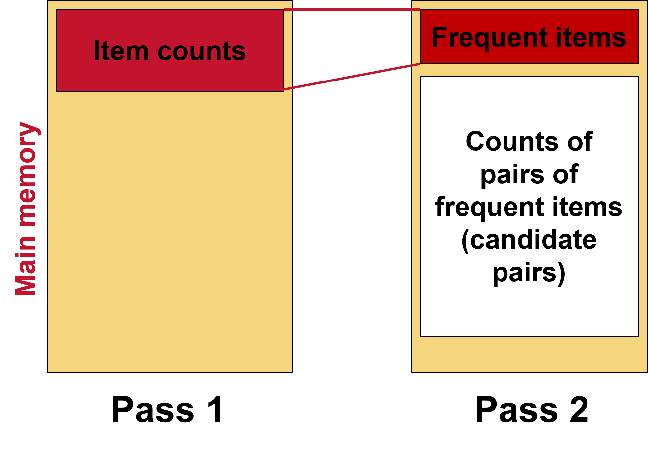
A-Priori Algorithm
Pass 1: Read baskets and count in main memory the occurrences of each individual item
  Requires only memory proportional to #items
Items that appear ≥ s times are the frequent items
Pass 2: Read baskets again and count in main memory only those pairs where both elements are frequent (from Pass 1)
Source: J. Leskovec, A. Rajaraman, J. Ullman: Mining of Massive Datasets, http://www.mmds.org

Slide 31
Using to Mine Association Rules
In class, we will go through this R code, explaining: (a) what each function is doing, and (b) the outputs from each step.
if(require(pacman)==FALSE) install.packages('pacman') pacman::p_load(arules, tidyverse)
data('Groceries') # note its class summary(Groceries)
itemFrequency(Groceries) # returns frequency in alphabetic order itemFrequency(Groceries) %>% sort(decreasing = T)
itemFrequencyPlot(Groceries, support = 0.1) itemFrequencyPlot(Groceries, topN = 20)
mine association rules with a certain min support and confidence grocery_rules = apriori(
Groceries, parameter = list(
support = 0.01, confidence = 0.5, minlen = 2, maxlen = 5) )
summary(grocery_rules) inspect(grocery_rules)
sort(grocery_rules, by ='lift', decreasing = T)[1:3] %>% inspect()
31 / 33

Slide 32
RReeccaapp
3322 // 3333

Slide 33
Summary of Main Points
Describe the goals & functions of data mining
Understand the statistical limits on data mining
Describe the data mining process
What is “frequent itemsets” & the application of this concept
Explain how and why “association rules” are constructed
Use to populate both concepts
33 / 33

