Slide 1




ISA 401: Business Intelligence & Data Visualization
26: A Short Introduction to Clustering
Fadel M. Megahed, PhD
Raymond E. Glos Professor in Business Farmer School of Business
Miami University
@FadelMegahed fmegahed fmegahed@miamioh.edu
Automated Scheduler for Office Hours
Fall 2025

Slide 2
A Recap of What we Learned Last Class
Describe the goals & functions of data mining
Understand the statistical limits on data mining
Describe the data mining process
What is “frequent itemsets” & the application of this concept
Explain how and why “association rules” are constructed
Use to populate both concepts

Slide 3
Kahoot: A Recap of Phase 3 of Class So Far
Let us go to Kahoot and compete for a $10 Starbucks gift card. To evaluate your understanding of the material, please answer the questions correctly and as quickly as possible to get the most points.

Slide 4
Learning Objectives for Today's Class
Describe the different steps of the k-means algorithm
Cluster using k-means (by hand)
Cluster using k-means (software)
•
  Tableau

Slide 5
AAnn OOvveerrvviieeww ooff CClluusstteerriinngg TTeecchhnniiqquueess
55 // 2222

Slide 6
The Problem of Clustering
Given a set of (high-dimensional) observations, with a notion of distance between observations, group the observations into some number of clusters, so that:
  Members of a cluster are close/similar to each other
  Members of different clusters are dissimilar
Usually:
  The observations are in a high-dimensional space
  Similarity is defined using a distance measure, e.g.,
    Euclidean, Cosine, Jaccard, edit distance, etc.
Source: J. Leskovec, A. Rajaraman, J. Ullman: Mining of Massive Datasets, http://www.mmds.org
6 / 22

Slide 7
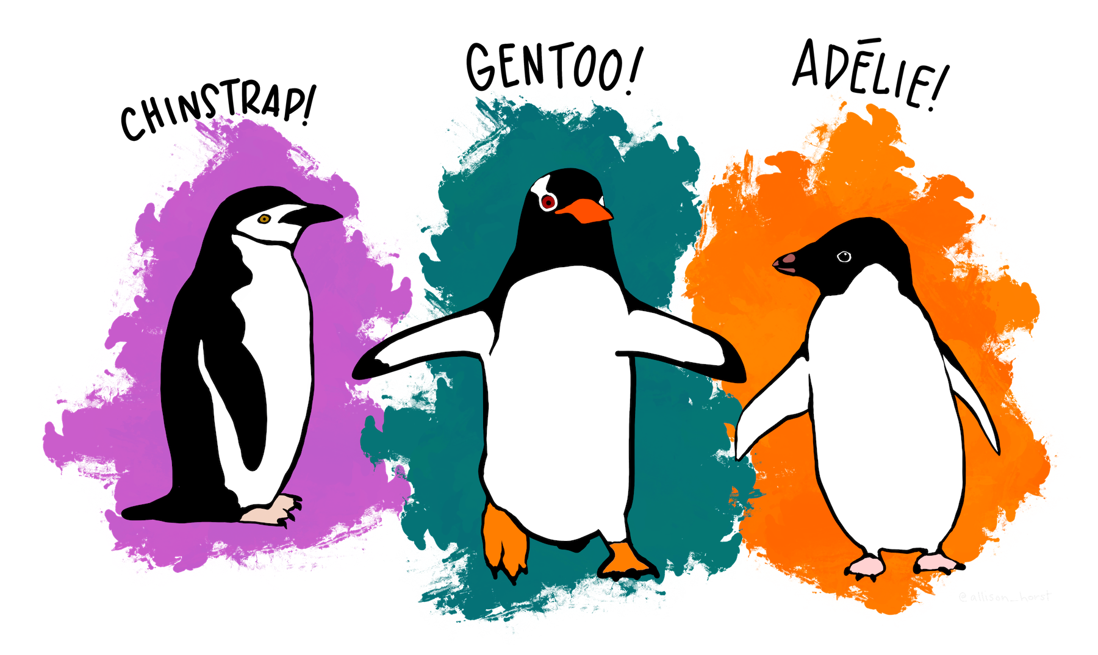
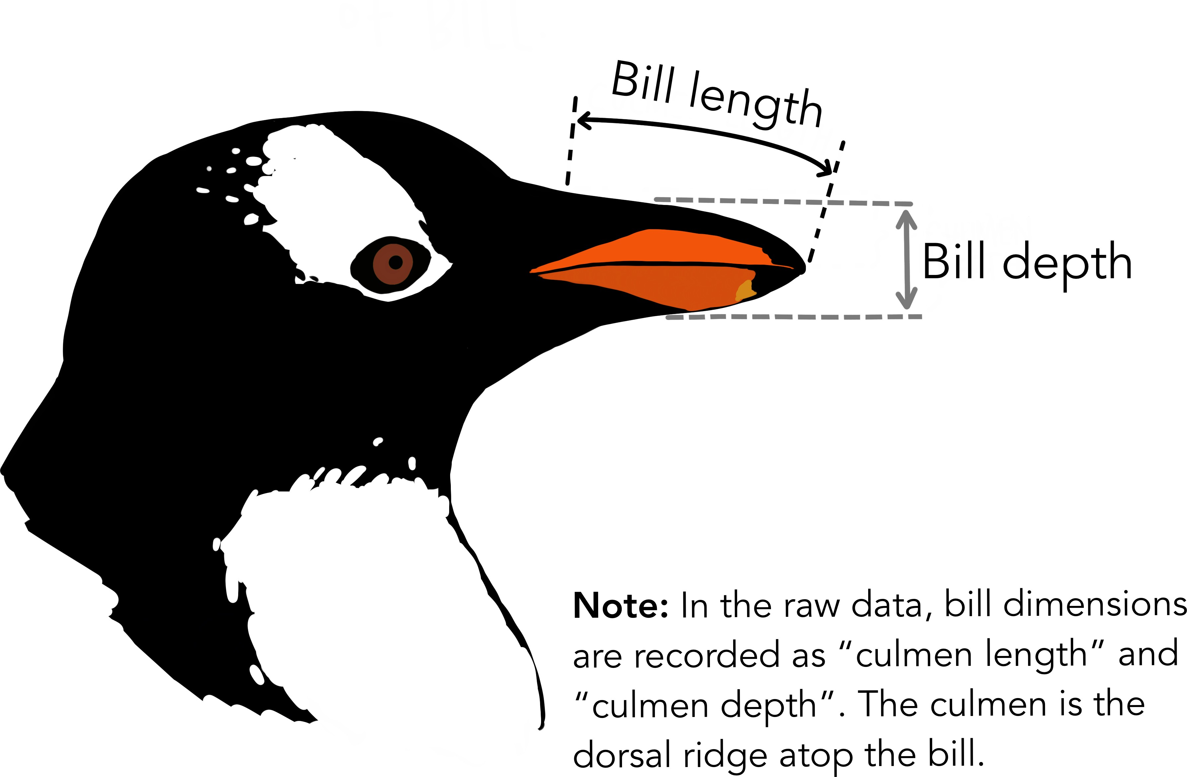
Clustering in 2D Space
Meet the Palmer penguins
Anatomical description of the dataset:
Source: The data are available by CC-0 license in accordance with the Palmer Station LTER Data Policy and the LTER Data Access Policy for Type I data. The artwork is by Allison Horst and
available at https://allisonhorst.github.io/palmerpenguins/, and the data is downloaded using the palmerpenguins
package.

Slide 8
Clustering in 2D Space: Formulation
Given a set of observations (each containing bill length and depth), with a notion of
Euclidean distance between observations, group the observations into 3 clusters, so that:
  Members of a cluster are close/similar to each other
  Members of different clusters are dissimilar
Note we are assuming that we did not have a "label/type" for each penguin.
Source: The data are available by CC-0 license in accordance with the Palmer Station LTER Data Policy and the LTER Data Access Policy for Type I data. The artwork is by Allison Horst and
available at https://allisonhorst.github.io/palmerpenguins/, and the data is downloaded using the palmerpenguins
package.

Slide 9
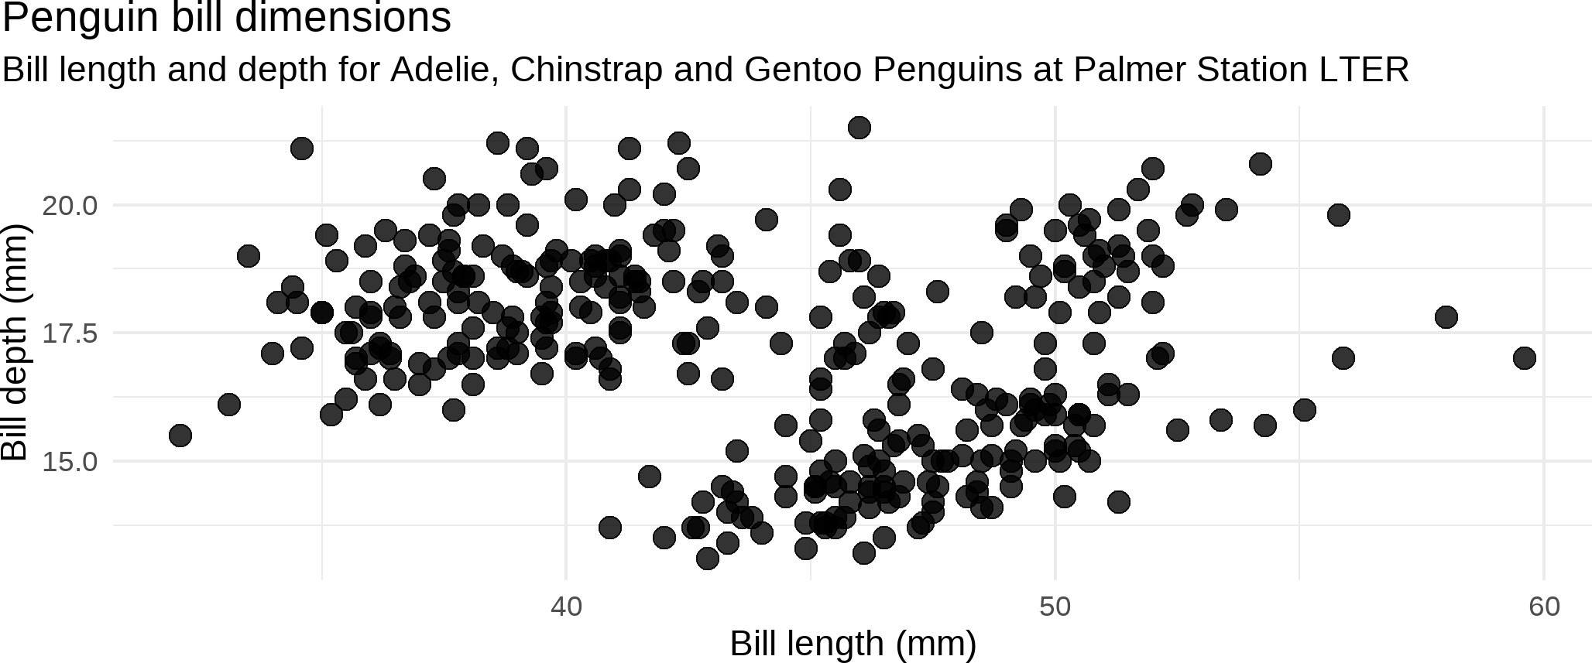
Clustering in 2D Space: Raw Data
Source: The data are available by CC-0 license in accordance with the Palmer Station LTER Data Policy and the LTER Data Access Policy for Type I data. The artwork is by Allison Horst and
available at https://allisonhorst.github.io/palmerpenguins/, and the data is downloaded using the palmerpenguins
package.

Slide 10
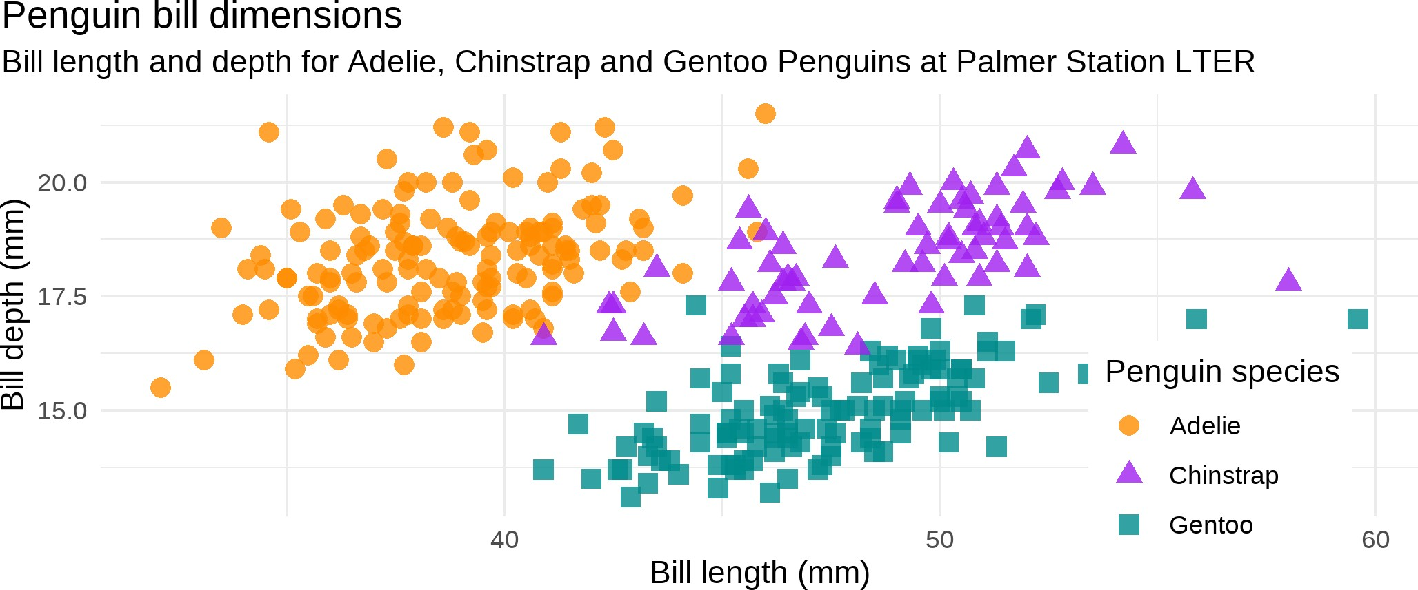
Clustering in 2D Space: Labeled Raw Data
Source: The data are available by CC-0 license in accordance with the Palmer Station LTER Data Policy and the LTER Data Access Policy for Type I data. The artwork is by Allison Horst and
available at https://allisonhorst.github.io/palmerpenguins/, and the data is downloaded using the palmerpenguins
package.

Slide 11
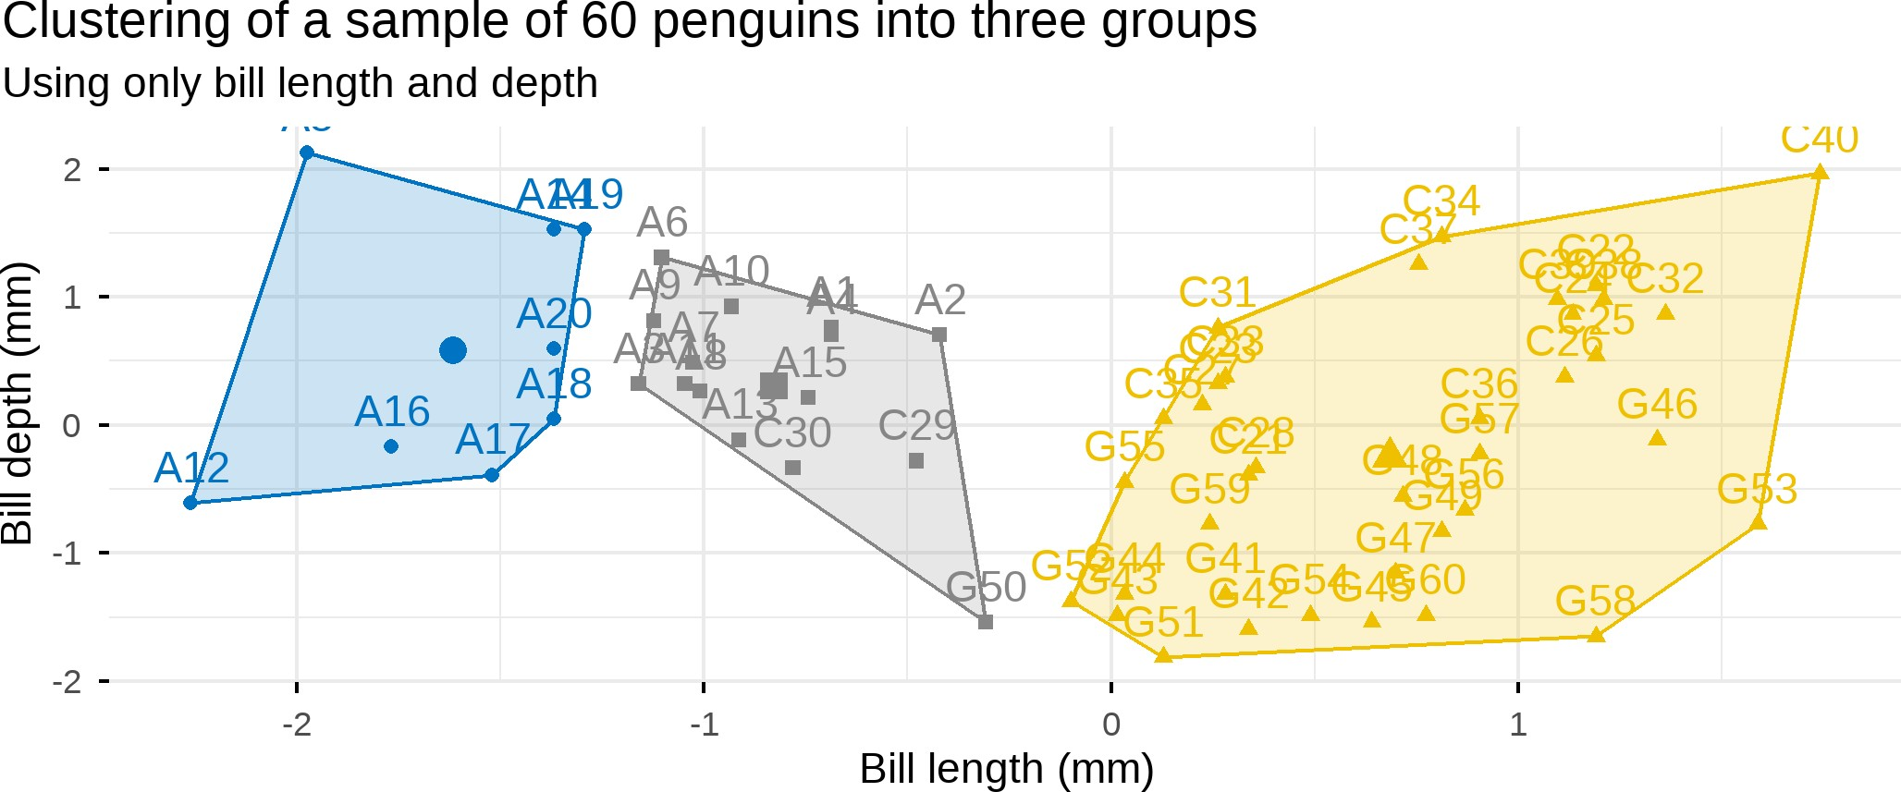
Clustering in 2D Space: Clustering Results
Source: The data are available by CC-0 license in accordance with the Palmer Station LTER Data Policy and the LTER Data Access Policy for Type I data. The artwork is by Allison Horst and
available at https://allisonhorst.github.io/palmerpenguins/, and the data is downloaded using the palmerpenguins
package.

Slide 12
Comments on the 2D Clustering Problem
Even though the 2D Space clustering problem is the easiest problem to "solve" since we can benefit by plotting the data, clustering is hard.
Some important questions:
With all the variables being numerical, we often assume Euclidean distance. This can be problematic when:
  variables have significantly different scales
  we are including information that is not pertinent to grouping
How do you determine the number of clusters (k)?
How to represent a cluster of many points?
How do we determine the "nearness" of clusters?
12 / 22

Slide 13
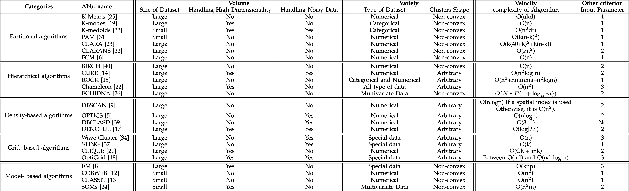
An Overview of Clustering Methods
Source: A. Fahad, et al.,"A Survey of Clustering Algorithms for Big Data: Taxonomy and Empirical Analysis" in IEEE Transactions on Emerging Topics in Computing, vol. 2, no. 03, pp. 267-279, 2014. https://doi.org/10.1109/TETC.2014.2330519
13 / 22

Slide 14
kk mmeeaannss AAllggoorriitthhmm
--
1144 // 2222

Slide 15
General Idea
The k-means algorithm clusters data by trying to separate samples in n groups of equal variance, minimizing a criterion known as the inertia or within-cluster sum-of-squares (see below). This algorithm requires the number of clusters to be specified.
∑n
min (||x_{i} − μ_{j}||²)
i=0
μ_{j}∈C
Inertia is a measure of how internally coherent clusters are; however, it suffers from various drawbacks:
Inertia makes the assumption that clusters are convex and isotropic, which is not always the case. It responds poorly to elongated clusters, or manifolds with irregular shapes.
Inertia is not a normalized metric: we just know that lower values are better and zero is optimal. But in very high-dimensional spaces, Euclidean distances tend to become inflated.
Source: Clustering — scikit-learn 1.0.2 documentation https://scikit-learn.org/stable/modules/clustering.html#$k$-means

Slide 16
The Steps of the k-means Algorithm
In basic terms, the algorithm has three steps.
Step 0 chooses the initial centroids, with the most basic method being to choose ksamples from the dataset X . After initialization, k-means consists of looping between the remaining two steps.
Step 1 assigns each sample to its nearest centroid.
Step 2 creates new centroids by taking the mean value of all of the samples assigned to each previous centroid. The difference between the old and the new centroids are computed.
The algorithm repeats these last two steps the centroids do not move significantly.
Source: Clustering — scikit-learn 1.0.2 documentation https://scikit-learn.org/stable/modules/clustering.html#$k$-means

Slide 17
Out-Of-Class Activity: Finish by Friday
Use the k-means algorithm to cluster the following observations. Use k = 2 and Euclidean distance. Use this handout to go through the k-means algorithm implementation (by hand).
Observation | X1 | X2
1 | 1.0 | 1.0
2 | 1.5 | 2.0
3 | 3.0 | 4.0
4 | 5.0 | 7.0
5 | 3.5 | 5.0
6 | 4.5 | 5.0
7 | 3.5 | 4.5
Solution: Once you complete the handout, you can check your solution (starting from Saturday) by downloading this file.
17 / 22

Slide 18
Practical Issues with k-means Clustering
Data Prep k-means (k=3) Optimal k Viz Clusters
penguins_tbl = palmerpenguins::penguins # our data for today
penguins_tbl # printing it out
## # A tibble: 344 × 8
##
## <fct> ## 1 Adelie
## 2 Adelie
## 3 Adelie
## 4 Adelie
## 5 Adelie
## 6 Adelie
## 7 Adelie
## 8 Adelie
species island
bill_length_mm bill_depth_mm flipper_length_mm body_mass_g
<fct> Torgersen Torgersen Torgersen Torgersen Torgersen Torgersen Torgersen Torgersen Torgersen
<dbl> 39.1
39.5
40.3
NA 36.7
39.3
38.9
39.2
34.1
42
<dbl> 18.7
17.4
18
NA 19.3
20.6
17.8
19.6
18.1
20.2
<int>
181
186
195
NA 193
190
181
195
193
190
<int> 3750
3800
3250
NA 3450
3650
3625
4675
3475
4250
## 9 Adelie
## 10 Adelie Torgersen
## # ℹ 334 more rows
## # ℹ 2 more variables: sex <fct>, year <int>

Slide 19
Summary of Practical Issues
Rescale numeric data prior to k-means implementation. The scaling can be:
  a z-transformation similar to what we did in the example
  a 0-1 scaling
  converting count data into percentage or counts per a certain number of the population
  etc.
Use more than one metric to determine k when using k-means clustering
Your cluster solution is not the end result, you will need to:
  visualize it in appropriate way (simple representation as in the previous slide, spatially, time-based, etc.)
  Attempt to explain the cluster membership using an appropriate binomial/multinomial model (e.g., see this analysis)

Slide 20
k-means in Tableau
Let us use Tableau to implement the k-means clustering implementation on the 60 sample observations from the penguins dataset as shown in Slide 11 of this presentation.

Slide 21
RReeccaapp
2211 // 2222

Slide 22
Summary of Main Points
Describe the different steps of the k-means algorithm
Cluster using k-means (by hand)
Cluster using k-means (software)
•
  Tableau
22 / 22

