Slide 1




ISA 419: Data-Driven Security
19: Authentication Using Behavioral Biometrics
Fadel M. Megahed, PhD
Professor
Farmer School of Business Miami University
@FadelMegahed fmegahed fmegahed@miamioh.edu
Automated Scheduler for Office Hours
Spring 2025

Slide 2
Learning Objectives for Today's Class
Motivating the use of behavioral biometrics for authentication purposes
Explain possible sources of data and application for behavioral biometrics
Model behavioral biometrics data using machine learning techniques
2 / 22

Slide 3
MMoottiivvaattiinngg tthhee UUssee ooff BBeehhaavviioorraall BBiioommeettrriiccss ffoorr AAuutthheennttiiccaattiioonn PPuurrppoosseess
33 // 2222

Slide 4
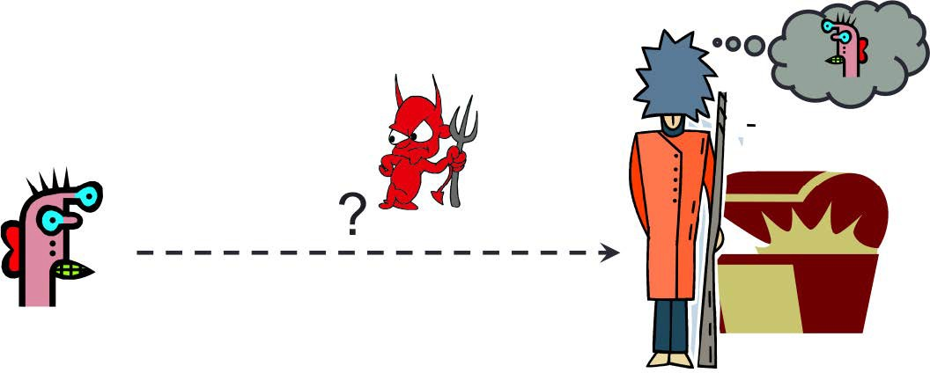
Authentication
Authentication is the process of verifying the identity of a user or system.
How do you prove to someone that you are who you claim to be?

Slide 5
Information Traditionally Used for Authentication
User authentication is the most common and best studied human security task.
Something you know Passwords, PINs, security questions Something you have: Smart cards, tokens, mobile phones Something you are: Biometrics (fingerprint, face, iris, etc.)

Slide 6
Lifecycle for Authentication Information
Issuance: User enrolls in the system and provides authentication information
Usage: User logs in and provides authentication information
Maintenance/Revocation: User's authentication information is revised or retired

Slide 7
Lifecycle: Something You Know
Issuance:
User "has" to memorize a new password or (unfortunately) reuse an existing one.
Should follow password guidelines (length, complexity, uniqueness)
Needs to be sufficiently secure and memorable
Usage:
Can I remember my password?
If so, which one is it (out of the many I have or the updates I have made)?
Maintenance:
Subject to loss/expiration
Re-issuance may require secondary mechanism
Rules on freshness/variation for re-issued data

Slide 8
Lifecycle: Something You Have
Issuance:
User "has" to carry a new token or smart card.
Should be kept secure and not shared with others.
Needs to be sufficiently secure and portable.
Usage:
Requirements on human memory: Where did I leave my card? Which card is it?
Requirements on physical presence: Do I have it with me?
Maintenance:
Subject to loss/theft
Requires periodic replacements
8 / 22

Slide 9
Lifecycle: Something You Are
Issuance:
“Reverse issuance” required to submit biometrics
Accessibility: not all humans have readable fingerprints, irises, etc.
Usage:
Minimal requirements placed upon human memory, e.g., “Which finger did I use?”, though may be specified at authentication
Human-machine interface issues, e.g., what to do with a cut finger?
Maintenance:
May possibly change with aging, injury, etc.
In general, there are limited options for renewal due to finite set of biometrics.

Slide 10
Lifecycle: General Guidelines
Issuance:
Limit amount of physical interaction
Limit human processing and learning requirements
Limit number of seemingly artificial constraints
Usage:
Limit human memory requirements
Limit requirements for perfect accuracy
Maintenance:
See Issuance guidelines
Limit excessive update requirements

Slide 11
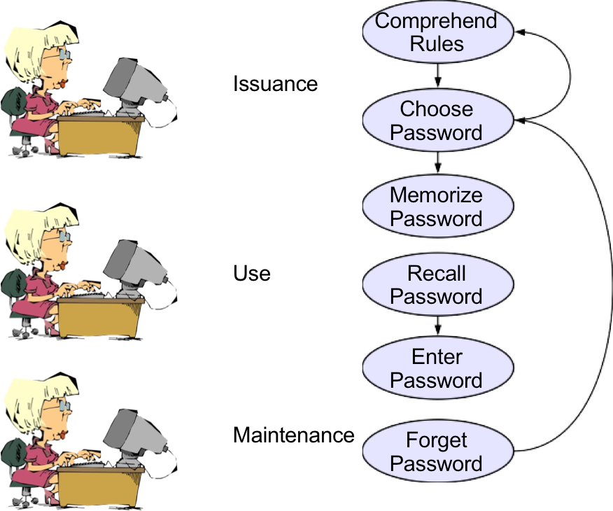
Password Lifecycle

Slide 12
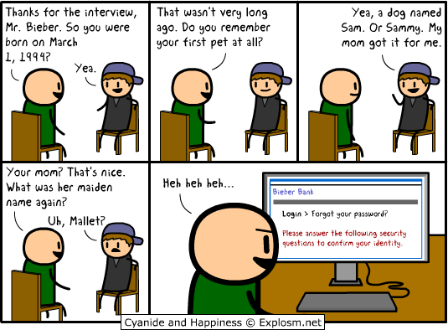
The "Traditional" Approach to Replacing Passwords

Slide 13
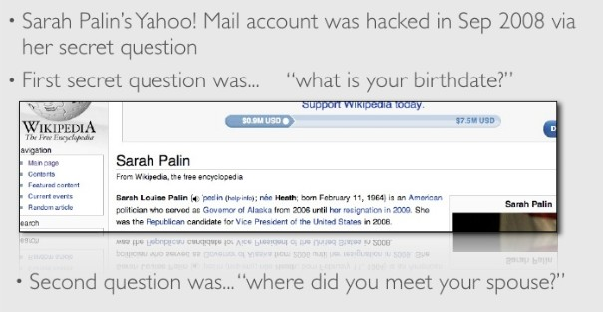
The "Traditional" Approach to Replacing Passwords

Slide 14
BBeehhaavviioorraall BBiioommeettrriiccss ffoorr AAuutthheennttiiccaattiioonn
1144 // 2222

Slide 15
The Keystroke Dynamics - Benchmark Data Set
Based on Killourhy and Maxion (2009), the authors set up their experiment as follows:
Password: .tie5Roanl
Feature sets:
The Enter key was considered to be a part of their password
Keydown-Keydown: time between the key presses of consecutive keys is used as a feature;
Keyup-Keydown: time between the release of one key and the press of the next is used;
Hold: time between the press and release of each key is used
Note that their features are linearly dependent; for example,
Keydown. Keydown = Hold + Keyup − Keydown.
Additionally, their features are all recorded in seconds.

Slide 16
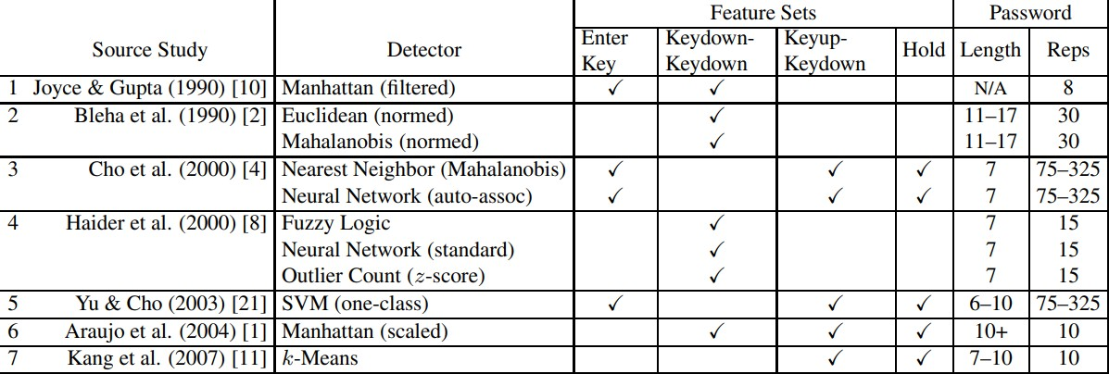
Choice of Features

Slide 17
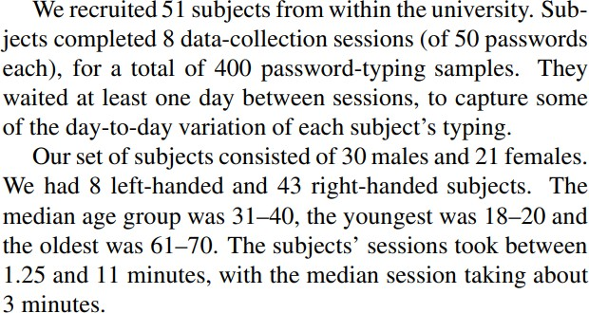
Subject × Sessions

Slide 18
10:00
Non-Graded Class Activity
Use the following link to access the data set.
Download the data set and explore the features.
In plain English, define three different approaches for modeling this dataset and write them below.
Edit me to answer the question above.
Edit me to answer the question above.
Edit me to answer the question above.

Slide 19
In-Class Demo
Starting with the following code, let us create a model to predict whether a user is s002 or not.
!pip install pycaret
import pandas as pd
from pycaret.classification import *
df = pd.read_csv("https://www.cs.cmu.edu/~keystroke/DSL-StrongPasswordData.csv") sub2 = df[df['subject'] == 's002']
sub2 = sub2.drop(columns = ['sessionIndex', 'rep'])

Slide 20
RReeccaapp
2200 // 2222

Slide 21
Summary of Main Points
By now, you should be able to do the following:
Motivating the use of behavioral biometrics for authentication purposes
Explain possible sources of data and application for behavioral biometrics
Model behavioral biometrics data using machine learning techniques

Slide 22
📝 Review and Clarification 📝
Class Notes: Take some time to revisit your class notes for key insights and concepts.
Zoom Recording: The recording of today's class will be made available on Canvas approximately 3-4 hours after the end of class.
Questions: Please don't hesitate to ask for clarification on any topics discussed in class. It's crucial not to let questions accumulate.

