Slide 1




ISA 419: Data-Driven Security
03: Python Functions
Fadel M. Megahed, PhD
Professor
Farmer School of Business Miami University
@FadelMegahed fmegahed fmegahed@miamioh.edu
Automated Scheduler for Office Hours
Spring 2025

Slide 2
Quick Refresher of Last Class
✅ Use pseudocode to map out a problem.
✅ Python syntax, data types, and data structures.
✅ Convert data types using type casting.
✅ Manipulate lists and use methods on lists.

Slide 3
Learning Objectives for Today's Class
Understand the anatomy of a Python function, use arguments correctly, and construct your first function.
Utilize built-in and anonymous functions (map, lambda, filter).
Analyze your second dataset.

Slide 4
TThhee AAnnaattoommyy ooff aa PPyytthhoonn FFuunnccttiioonn
44 // 2244

Slide 5

One Motivation for Functions
Reusability: Functions allow you to reuse code.
Source: Sonika Baniya (2021). First rule of coding: DRY (Don't Repeat Yourself).
5 / 24

Slide 6
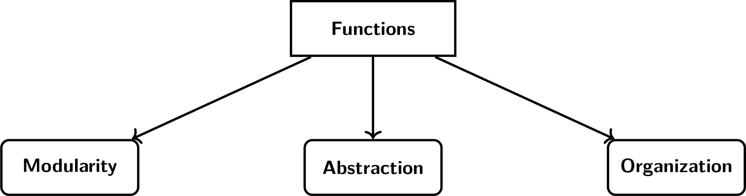
What is a Function?
A function is a block of reusable code that only runs when called.
Image Credits: Created by the author (Fadel M. Megahed) for our ISA 419 course.
6 / 24

Slide 7
04:00
Recall: Python List Functions
Task Q1 Q2
In class02, we introduced the following functions: len(), max(), min(), sum(), sort(), index(), append(), pop(), and remove().
For each of the above functions, what do you expect the function to return?
How is the name of the function related to the action it performs?
7 / 24

Slide 8
The Anatomy of a Python Function
def add_numbers(a, b): #
""" This function sums two numbers """ # result = a + b #
return result #
A: The function definition
B: The docstring
C: The body of the function C: The body of the function
Using the function add_numbers(3, 5)
D: Calling the function
## 8
Footnotes:
Everything within the function, post the definition line, is indented.
Vertical spacing here is for clarity, but not required (and likely violates Python's best practies).
8 / 24

Slide 9
The Anatomy of a Python Function (Cont.)
A: The function definition:
def is a keyword that tells Python you are defining a function.
add_numbers is the name of the function, which should always be followed by parentheses and a colon.
a and b are the parameters of the function.
B: The docstring:
Optional: A docstring is a string that describes what the function does.
C: The body of the function:
This is where the function does its work.
The body is indented.
Typically includes a return statement at the end.
D: Calling the function:
This is where you call the function, i.e., tell Python to execute the code inside your function.

Slide 10
Python Parameters vs Arguments
Parameters are the variables in the function definition.
a and b are the parameters in the
add_numbers function.
Arguments are the values passed to the function when it is called.
3 and 5 are the arguments in the
add_numbers function.
def add_numbers(a, b):
""" This function sums two numbers "" result = a + b
return result
Using the function add_numbers(3, 5)
## 8

Slide 11
Python Parameters and Arguments
Python allows for several methods of passing arguments to a function. These include, but are not limited to the following:
Positional Arguments: The arguments are passed to the function in the order in which they are defined.
Keyword Arguments: The arguments are passed to the function with the parameter name.
Combination of Positional and Keyword Arguments: The arguments are passed to the function in the order in which they are defined, followed by the keyword arguments.

Slide 12
Class Activity: Modify the add_numbers Function ^{03:00}
Modify the function add_numbers to take a list of numbers and return the sum of the numbers.
Hints:
1. Change the function name to sum_numbers
(so you do not have two functions with the same name).
2. Change the parameters to a single parameter named numbers_list. # 3. Capitalize on the fact that the parameter input is now a list.

Slide 13
Functions: Good Practices
Function Name: Choose a descriptive name for your function.
The name should describe what the function does.
Type Hints: You can specify the type of the parameters and the return type.
This is not enforced by Python, but it is a good practice.
For example:
def add_numbers(a: int, b: int) -> int: or
def add_numbers(a: float, b: float) -> float:.
Docstrings: Always include a docstring to describe what the function does.
This is a good practice and is used by Python's built-in help() function.
Return Statement: Always include a return statement.
If you do not include a return statement, the function will return None.

Slide 14
BBuuiilltt--IInn aanndd
AAnnoonnyymmoouuss FFuunnccttiioonnss iinn PPyytthhoonn
mmaa
pp
llaammbbdd ffiillttee ))
((
,,
aa
,,
rr
1144 // 2244

Slide 15
The map Function
The map function applies a given function to each item of an iterable (e.g., list). Its synatx is:
map(function, iterable).
The function is the function we want to apply.
The iterable is what we want to apply the function across.
The map function returns a map object, which is an iterator.
To get the results, you must type convert the map object to a list.
def square(x: float) -> float:
"""This function squares a number"""
return x ** 2
Using the map function numbers = [1, 2, 3, 4, 5]
map_operation = map(square, numbers)
squared_numbers = list(map_operation)
print('The map operation:', map_operation
## The map operation:
## <map object at 0x00000236C3582A40> ##
##
##
## The squared numbers: ## [1, 4, 9, 16, 25]
15 / 24

Slide 16
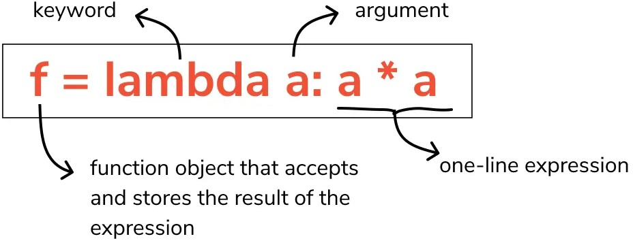
The lambda Function
The lambda function is an anonymous function, defined using the lambda keyword:
Anonymous: They are not declared in the standard manner by using the def keyword.
Compact: They allow writing functions in a concise way, often for short-term/throwaway functions.
Single Expression: The body of a lambda is limited to just one expression. No statements or annotations are allowed; the function body is purely a single expression.
Image Source: John Vastola (2021). Mastering Lambda Expressions in Python: A Hands-On Guide.
16 / 24

Slide 17
The lambda Function (Cont.)
numbers = [1, 2, 3, 4, 5]
map_operation = map(lambda x: x ** 2, numbers) squared_numbers = list(map_operation)
print(
'The map operation:', map_operation, '\n',
'The squared numbers:', squared_numbers, sep ='\n'
)
## The map operation:
## <map object at 0x00000236C3532740> ##
##
## The squared numbers: ## [1, 4, 9, 16, 25]

Slide 18
The filter Function
The filter function constructs an iterator from elements of an iterable for which a function returns True.
Its syntax is: filter(function, iterable).
The filter function returns a filter object, which is an iterator.
To get the results, you must type convert the filter object to a list.
def is_even(x: int) -> bool:
"""This function checks if a number i
return x % 2 == 0
Using the filter function numbers = [1, 2, 3, 4, 5]
filter_step = filter(is_even, numbers)
even_numbers = list(filter_step)
print('The filter operation:', filter_ste 'The even numbers:', even_numbers, sep ='
## The filter operation:
## <filter object at 0x00000236C35B74F0> ##
##
## The even numbers: ## [2, 4]

Slide 19
Evaluating your Understanding so Far: A Kahoot
Let's evaluate your understanding of the material so far
Go to Kahoot and enter the game pin shown on screen.
You will be asked to answer 7 multiple choice questions.
You will receive points for answering each question correctly and quickly, i.e., your points are impacted by your speed in addition to obviously answering each question correctly.
The winner Starbucks
(i.e., the one with the most points after the 7 questions) receives a $10 gift card.

Slide 20
AAnnaallyyzziinngg YYoouurr SSeeccoonndd DDaattaasseett
2200 // 2244

Slide 21
15:00
Analyzing a Simulated Equifax Breach Dataset
Task Task 1 Task 2 Task 3 Task 4 Task 5
Download the simulated_equifax_breach_data.csv file from Canvas.
Load the dataset into Google Colab.
Answer the questions in the next tabs.
You can work in groups of 2-3 students.
21 / 24

Slide 22
RReeccaapp
2222 // 2244

Slide 23
Summary of Main Points
By now, you should be able to do the following:
Understand the anatomy of a Python function, use arguments correctly, and construct your first function.
Utilize built-in and anonymous functions (map, lambda, filter).
Analyze your second dataset.

Slide 24
📝 Review and Clarification 📝
Class Notes: Take some time to revisit your class notes for key insights and concepts.
Zoom Recording: The recording of today's class will be made available on Canvas approximately 3-4 hours after the end of class.
Questions: Please don't hesitate to ask for clarification on any topics discussed in class. It's crucial not to let questions accumulate.

