Slide 1




ISA 419: Data-Driven Security
14: Regression Analysis
Fadel M. Megahed, PhD
Professor
Farmer School of Business Miami University
@FadelMegahed fmegahed fmegahed@miamioh.edu
Automated Scheduler for Office Hours
Spring 2025

Slide 2
Quick Refresher of Last Class
✅ Introduce how LLMs (with prompt engineering) can be used to assist in cyber security analytics.

Slide 3
Learning Objectives for Today's Class
Describe the basic concepts of regression analysis, including the roles of independent and dependent variables.
Assess regression models using metrics like R-squared and Mean Squared Error and interpret the results.
Describe the two modeling mindsets: explanatory and predictive.

Slide 4
WWhhaatt iiss rreeggrreessssiioonn aannaallyyssiiss??
44 // 1188

Slide 5
An Overview of Regression Models
Given: (x₁, y₁), (x₂, y₂), … , (x_{n}, y_{n}).
Learn a function f(x) to predict y given x.
If y is a continuous variable, we do have a regression type problem.
In this class, we will not limit ourselves to simple and multiple linear regression models. Hence, we will also explore: (a) more advanced linear regression models (e.g., LASSO),
non-linear regression models (e.g., polynomial regression ), and (c) machine learning models like decision trees, random forests, etc.
Simple linear regression: single predictor x → y.
Multiple linear regression: multiple predictors x₁, x₂, … , x_{p} → y.

Slide 6
Simple Linear Regression
Simple linear regression is a statistical method that allows us to summarize and study the relationship between a response variable and one predictor variable.
Y_{i} = β₀ + β₁X_{i} + ε_{i}
where:
Y_{i} is the dependent variable for the i^{th} observation.
X_{i} is the independent variable for the i^{th} observation.
β₀ is the intercept, which is the value of Y when X = 0.
β₁ is the slope, which is the change in Y for a one-unit change in X.
ε_{i} is the error term, i.e., the difference between observed value of Y and its predicted value from the model.
It captures the effect of all other factors that influence the dependent variable.
We assume that the error term is ~ N(0, σ²).

Slide 7
Recall ISA 225: A Simple Linear Regression Example^{10:00}
Using any software of your choice, analyze the zeroAccessUFO.csv dataset by answering the following questions:
Plot the relationship between the number of UFO sightings (x =ufo2010) and the number of zeroAccess infections (y =infections).
Use the plot to determine if a linear relationship exists between the two variables.
If a linear relationship exists, fit a simple linear regression model to the data.
Describe the goodness of fit of the model.
What is your conclusion?

Slide 8
"Miami Univeristy Links UFO Sightings to ZeroAccess^{05:00} Infections"
Question 1: What happens if you: (a) add pop to your model to fit a multiple linear regression model? and (b) fit a single linear regression model using pop alone as the predictor?
Question 2: Compute the correlation between pop and ufo2010.
Question 3: Describe what you have learned from these two exercises.
Q1: Edit me in your web browser.
Q2: Edit me.
Q3: Edit me.

Slide 9
OOnn tthhee DDiiffffeerreennccee bbeettwweeeenn RR aanndd PPyytthhoonn
99 // 1188

Slide 10
R and Python Implementations: A Brief Comparison
Aspect | R (using the 'stats' package) | Python (using 'PyCaret')
Primary Library | stats | PyCaret
Modeling Mindset | Explanatory (focus on understanding the relationships between variables) | Predictive (focus on accurately predicting outcomes)
Data Handling | Models often fit on entire dataset without explicit splitting (though splitting can be done manually) | Automatic splitting of data into training and testing sets, with cross-validation implemented on the training set
Implications | Emphasis on the quality of the model fit and understanding variable relationships | Emphasis on the model's predictive performance on unseen data
Model Extraction | Easier to extract and interpret models, facilitating detailed analysis of coefficients and statistical tests | More complex to extract specific model details due to a focus on prediction; models are often part of a larger pipeline
Model Evaluation | Emphasis on statistical tests and model fit statistics (e.g., R-squared, p-values) | Emphasis on predictive performance metrics (e.g., RMSE, R-squared, MAE)
10 / 18

Slide 11
The Two Modeling Mindsets: Explanatory Vs. Predictive
Explanatory Modeling:
Focuses on understanding the relationships between variables.
Emphasizes the quality of the model fit and the understanding of variable relationships.
Easier to extract and interpret models, facilitating detailed analysis of coefficients and statistical tests.
Emphasis on statistical tests and model fit statistics (e.g., R-squared, p-values).
Predictive Modeling:
Focuses on accurately predicting outcomes.
Emphasizes the model's predictive performance on unseen data.
More complex to extract specific model details due to a focus on prediction; models are often part of a larger pipeline.
Emphasis on predictive performance metrics (e.g., RMSE, R-squared, MAE).
11 / 18

Slide 12
The Predictive Modeling Mindset
The 7 steps of machine learning
Note: While this video provides a classification example (i.e., a dichotomous dependent variable), the same steps apply to regression ML models. Hence, I am sharing it with you to illustrate the predictive modeling mindset.
12 / 18

Slide 13
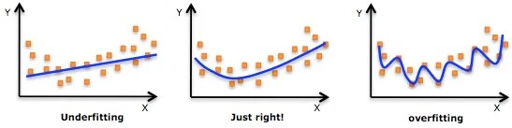
Comments: Preparing the Data for Modeling
Source: Adi Bronshtein. (2017). Train/Test Split and Cross Validation in Python.
13 / 18

Slide 14
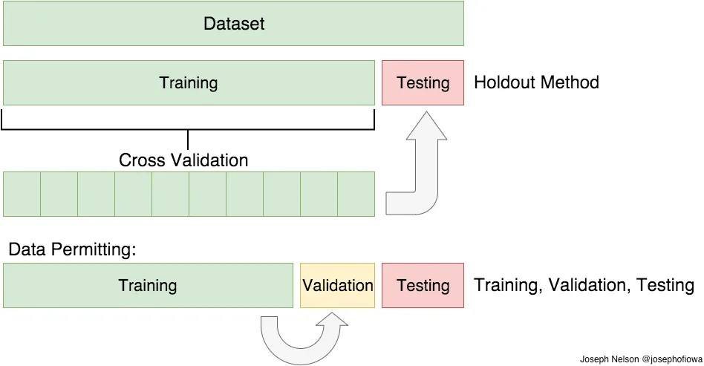
Comments: Preparing the Data for Modeling
Source: Adi Bronshtein. (2017). Train/Test Split and Cross Validation in Python. Figure is by Joseph Nelson.

Slide 15
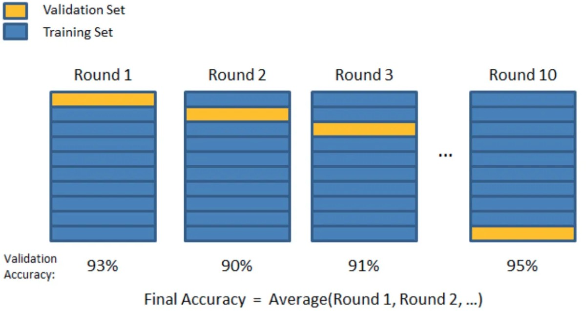
Comments: Preparing the Data for Modeling
Source: Adi Bronshtein. (2017). Train/Test Split and Cross Validation in Python. Figure is by Joseph Nelson.

Slide 16
RReeccaapp
1166 // 1188

Slide 17
Summary of Main Points
By now, you should be able to do the following:
Describe the basic concepts of regression analysis, including the roles of independent and dependent variables.
Assess regression models using metrics like R-squared and Mean Squared Error and interpret the results.
Describe the two modeling mindsets: explanatory and predictive.

Slide 18
📝 Review and Clarification 📝
Class Notes: Take some time to revisit your class notes for key insights and concepts.
Zoom Recording: The recording of today's class will be made available on Canvas approximately 3-4 hours after the end of class.
Questions: Please don't hesitate to ask for clarification on any topics discussed in class. It's crucial not to let questions accumulate.

