Slide 1




ISA 419: Data-Driven Security
05: Cleaning and Combining Data in Pandas
Fadel M. Megahed, PhD
Professor
Farmer School of Business Miami University
@FadelMegahed fmegahed fmegahed@miamioh.edu
Automated Scheduler for Office Hours
Spring 2025

Slide 2
Quick Refresher of Last Class
✅ Describe and create data frames
✅ Import data using pandas
✅ Utilize the head(), tail(), shape(), info(), dtypes(), count(), value_count(), describe(), isnull().sum() functions to quickly explore and summarize your dataset
✅ Use the loc[] and iloc[] to select rows and columns
✅ Use assign() to create new columns on your existing data frame.

Slide 3
Learning Objectives for Today's Class
Ensure that your imported data is technically correct (rename columns and fix dtypes)
Clean data to ensure that your data is consistent
Understand the difference between concatenate, merge, and join.

Slide 4
TTeecchhnniiccaallllyy CCoorrrreecctt DDaattaa
44 // 2299

Slide 5
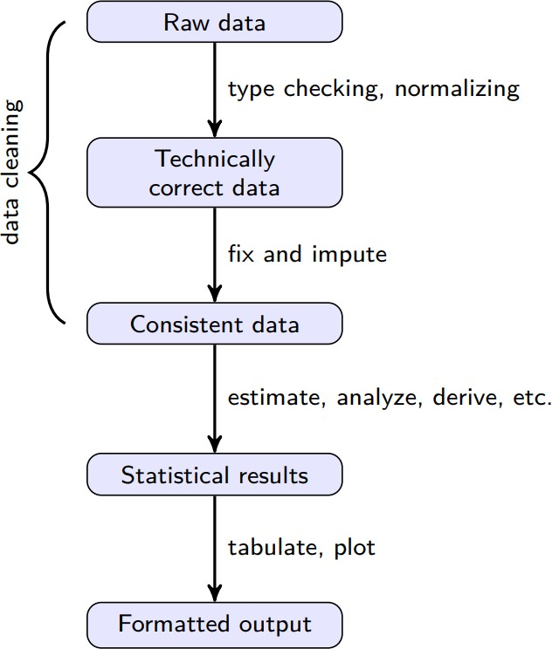
The Data Analysis Value Chain
Source: De Jonge and Van Der Loo (2013), An introduction to data cleaning with R. Please click on the link and read p. 7-8.
5 / 29

Slide 6
Technically Correct Data
Raw data files may lack headers, contain wrong data types (e.g. numbers stored as
strings), wrong category labels, unknown or unexpected character encoding and so on.
Technically correct data is the state in which data can be read into an R data.frame, with correct name, types and labels, without further trouble. However, that does not mean that the values are error-free or complete. --- De Jonge and Van Der Loo (2013)

Slide 7
Functions for Cleaning/Renaming Variables
type | package | function() | description
cleaning names | janitor | clean_names() | Resulting names are unique, consisting only of the _ character, numbers, and letters
renaming pandas df.rename(columns={‘dept2’: ‘econ’, ‘dept3’: ‘isa’}) Will rename the columns dept2 and dept3 to econ and isa

Slide 8
An Example of Cleaning and Renaming Names
import pandas as pd
import janitor
Create a dataframe df = pd.DataFrame(
{'dept 1': [1, 2, 3], 'dept 2': [4, 5, 6], 'dept 3': [7, 8, 9]}
)
df = ( df
clean the column names
.clean_names()
note that the column names are now separated with an underscore
.rename(columns={'dept_2': 'econ', 'dept_3': 'isa'})
)
df.head(n=2)
## | dept_1 | econ | isa
## 0 | 1 | 4 | 7
## 1 | 2 | 5 | 8

Slide 9
Changing Column/Series Data Types
Pandas has a function called astype() that can be used to change the data type of a column. To convert into a different data type, you can use the following syntax:
Int: df['column_name'] = df['column_name'].astype('int')
Categorical: df['column_name'] = df['column_name'].astype('category')
Datetime: df['column_name'] = df['column_name'].astype('datetime64')
Numeric: df['column_name'] = df['column_name'].astype('float')
String: df['column_name'] = df['column_name'].astype('str')
Boolean: df['column_name'] = df['column_name'].astype('bool')
Obviously, these can also be passed via the assign() function in Pandas. For example:
df = df.assign(column_name = df['column_name'].astype('int')).

Slide 10
DDaattaa CClleeaanniinngg
1100 // 2299

Slide 11
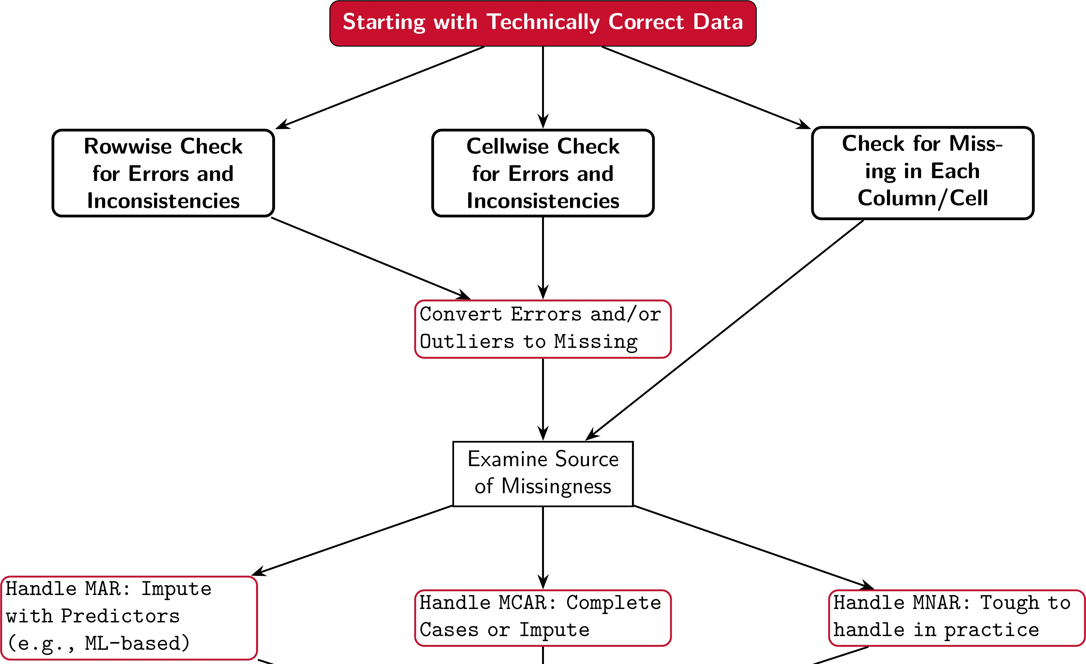
My Opinionated Perspective on Data Cleaning
tinytex::xelatex('../../figures/data_cleaning_process.tex') pdftools::pdf_convert('../../figures/data_cleaning_process.pdf', dpi = 600,
filenames = '../../figures/data_cleaning_process.png')
Reminders: Please do not use mean/median imputation (they are awful). Also, please do not impute or .dropna() until you understand the nature of your missing data.
11 / 29

Slide 12
Additional Thoughts on Data Cleaning
Data cleaning is the process of ensuring that your data is consistent and correct. This involves checking for errors and inconsistencies, handling missing data, and ensuring the final dataset is consistent and ready for analysis.
Data cleaning is a critical step in the data analysis process. If you don't clean your data, you can't trust your results.
Data cleaning is a time-consuming process. It's not uncommon for data scientists to spend 80% of their time cleaning data and only 20% of their time analyzing it.
Data cleaning is an iterative process. You'll often find that you need to go back and clean your data again after you've started analyzing it.

Slide 13
Data Cleaning in Python
Pandas has a number of functions that can be used to clean data. Some of the most common ones include:
drop_duplicates(): Remove duplicate rows from a DataFrame.
dropna(): Remove missing values from a DataFrame.
fillna(): Fill missing values in a DataFrame (use with caution).
str.replace(): Replace values in a Series.
str.strip(): Remove leading and trailing whitespace from a Series.
str.extract(): Extract values from a Series using a regular expression.
str.get_dummies(): Convert a Series to dummy variables.
str.pad(): Pad strings in a Series.
str.zfill(): Pad strings in a Series with zeros.

Slide 14
CCoommbbiinniinngg MMuullttiippllee DDaattaaFFrraammeess
1144 // 2299

Slide 15
A Motivating Example for merge()
A df of IP addresses and counts:
A df of IP addresses and cities:
df1 = pd.DataFrame(
{'ip': ['134.53.10.20', '134.53.355.200', '
'count': [10, 20, 30]}
)
print(df1)
df2 = pd.DataFrame(
{'ip': ['134.53.10.20', '69.12.18.100', '12
'city': ['Oxford', 'Buffalo', 'Coral Gable
)
print(df2)
 | ## ip | count |  |  |  | ## | ip city
 | ## 0 134.53.10.20 | 10 |  |  |  | ## 0 | 134.53.10.20 Oxford
 | ## 1 134.53.355.200 | 20 |  |  |  | ## 1 | 69.12.18.100 Buffalo
 | ## 2 129.171.123.45 | 30 |  |  |  | ## 2 | 129.171.123.45 Coral Gables
What are the differences between the two data frames
Edit me to answer the question.

Slide 16








merge(): API Reference
Getting started | Search Ctrl + K Choose version User API _{Development} Release Guide reference notes
Input/output |  | › API reference › DataFrame › pandas.DataF... pandas.DataFrame.merge DataFrame.merge(right, how='inner', on=None, left_on=None, right_on=None, left_index=False, right_index=False, sort=False, suffixes=('_x', '_y'), copy=None, indicator=False, validate=None) ^{[source]} Merge DataFrame or named Series objects with a database-style join. A named Series object is treated as a DataFrame with a single named column. The join is done on columns or indexes. If joining columns on columns, the DataFrame indexes will be ignored. Otherwise if joining indexes on indexes or indexes on a column or columns, the index will be passed on When performing a cross merge no column specifications to merge on
General functions
Series
DataFrame
pandas.DataFrame
pandas.DataFrame.index
pandas.DataFrame.columns
pandas.DataFrame.dtypes
pandas.DataFrame.info
pandas.DataFrame.select_dt ypes

Slide 17
merge(): Syntax
The merge() function in Pandas is used to merge two DataFrames. It is similar to the
join() function in SQL.
The merge() function takes the following arguments:
left: The first DataFrame to merge.
right: The second DataFrame to merge.
on: The column to merge on.
left_on and right_on can be used if the column names are different.
how: The type of join to perform (e.g., 'inner', 'outer', 'left', 'right').
suffixes: A tuple of strings to append to overlapping column names.
indicator: If True, adds a column to the merged DataFrame indicating the source of each row.
validate: If True, checks that the merge is unique.

Slide 18
merge()
Default merge():
Changing the how to left:
df3 = pd.merge(df1, df2, on='ip') print(df3)
df4 = pd.merge(df1, df2, on='ip', how='left') print(df4)
## ip count city ## 0 134.53.10.20 10 Oxford |  |  |  |  |  |  | ## ## 0 | ip count city 134.53.10.20 10 Oxford
## 1 | 129.171.123.45 | 30 | Coral | Gables |  |  | ## 1 | 134.53.355.200 | 20 | NaN
 |  |  |  |  |  |  | ## 2 | 129.171.123.45 | 30 | Coral Gables
What are the differences between the two data frames?
Edit me to answer the question.

Slide 19
join(): API Reference
Getting started | Search Ctrl + K Choose version User API _{Development} Release Guide reference notes
Input/output |  | › API reference › DataFrame › pandas.DataF... pandas.DataFrame.join DataFrame.join(other, on=None, how='left', lsuffix='', rsuffix='', sort=False, validate=None) ^{[source]} Join columns of another DataFrame. Join columns with other DataFrame either on index or on a key column. Efficiently join multiple DataFrame objects by index at once by passing a list. Parameters: other : DataFrame, Series, or a list containing any combination of them
General functions
Series
DataFrame
pandas.DataFrame
pandas.DataFrame.index
pandas.DataFrame.columns
pandas.DataFrame.dtypes
pandas.DataFrame.info
pandas.DataFrame.select_dt ypes

Slide 20
join(): Syntax
The join() function is similar to the merge() function, but it is used to join DataFrames on their indices. The syntax for the join() function is as follows:
df1.join(df2): Join df1 and df2 on their indices.
df1.join(df2, how='left'): Join df1 and df2 on their indices using a left join.
df1.join(df2, how='right'): Join df1 and df2 on their indices using a right join.
df1.join(df2, how='inner'): Join df1 and df2 on their indices using an inner join.
df1.join(df2, how='outer'): Join df1 and df2 on their indices using an outer join.

Slide 21
concat(): API Reference
Getting started | Search Ctrl + K Choose version User API _{Development} Release Guide reference notes
 |  | › API reference › General functions › pandas.concat pandas.concat pandas.concat(objs, *, axis=0, join='outer', ignore_index=False, keys=None, levels=None, names=None, verify_integrity=False, sort=False, copy=None) ^{[source]} Concatenate pandas objects along a particular axis. Allows optional set logic along the other axes. Can also add a layer of hierarchical indexing on the concatenation axis, which may be useful if the labels are the same (or overlapping) on the passed axis number. Parameters:
Input/output
General functions
pandas.melt
pandas.pivot
pandas.pivot_table
pandas.crosstab
pandas.cut
pandas.qcut
pandas.merge
pandas.merge_ordered

Slide 22
concat(): Syntax
The concat() function can be used to concatenate DataFrames along rows or columns. The syntax for the concat() function is as follows:
pd.concat([df1, df2], axis=0): Concatenate DataFrames along rows, i.e., stack them on top of each other.
pd.concat([df1, df2], axis=1): Concatenate DataFrames along columns, i.e., stack them side by side.
pd.concat([df1, df2], axis=0, ignore_index=True): Concatenate DataFrames along rows, ignoring the index.
pd.concat([df1, df2], axis=1, join='inner'): Concatenate DataFrames along columns, using the intersection of the columns.
pd.concat([df1, df2], axis=1, join='outer'): Concatenate DataFrames along columns, using the union of the columns.

Slide 23
Summary: Merge, Concat, and Join
Pandas has a number of functions that can be used to combine DataFrames. Some of the most common ones include:
merge(): Merge DataFrames using a database-style join. merge() can be used to perform inner, outer, left, and right joins on one or more common columns.
concat(): Concatenate (stack) DataFrames along rows or columns.
join(): Join DataFrames using their indexes.

Slide 24
AA DDeemmoonnssttrraattiioonn ooff CCoommbbiinnii gg DDaattaa FFrraammeess ii aa CCyybbeerr SSeeccuurriittyy CCoonntteexxtt
2244 // 2299

Slide 25
An Overview of our Two Datasets
Our Toxic IP Addresses dataset comes from Stop Forum Spam and contains a list of IP addresses that have been reported as toxic. The dataset contains the following columns:
ip: The IP address.
frequency: The number of times that the IP address number has been reported during the 90 day period.
lastseen: The date/time (UTC) when the IP address was last seen.
I used the geoip2 library to geolocate the IP addresses in the dataset based on the Maxmind GeoLite2 City Database. I saved the results in a CSV file called ip_geolocation.csv, containing five columns:
IP: The IP address.
Country: The country where the IP address is located.
City: The city where the IP address is located.
Latitude: The latitude of the IP address.
Longitude: The longitude of the IP address.
25 / 29

Slide 26
15:00
Analyzing Toxic IPs and their Geolocations
Task Task 1 Task 2 Task 3 Task 4 Task 5
Load the Toxic IP Addresses dataset into a DataFrame called toxic_ips.
Load the IP Geolocation dataset into a DataFrame called geolocation.
Answer the questions in the next tabs.
You can work in groups of 2-3 students.
26 / 29

Slide 27
RReeccaapp
2277 // 2299

Slide 28
Summary of Main Points
By now, you should be able to do the following:
Ensure that your imported data is technically correct (rename columns and fix dtypes)
Clean data to ensure that your data is consistent
Understand the difference between concatenate, merge, and join.

Slide 29
📝 Review and Clarification 📝
Class Notes: Take some time to revisit your class notes for key insights and concepts.
Zoom Recording: The recording of today's class will be made available on Canvas approximately 3-4 hours after the end of class.
Questions: Please don't hesitate to ask for clarification on any topics discussed in class. It's crucial not to let questions accumulate.

