Slide 1




ISA 419: Data-Driven Security
08: Visualizing Data with Pandas
Fadel M. Megahed, PhD
Professor
Farmer School of Business Miami University
@FadelMegahed fmegahed fmegahed@miamioh.edu
Automated Scheduler for Office Hours
Spring 2025

Slide 2
Quick Refresher of Last Week's Class
✅ Ensure that your imported data is technically correct (rename columns and fix dtypes)
✅ Understand how to change the unit of analysis by grouping and aggregating data.
✅ Use the agg() function to do aggregations on grouped data.

Slide 3
Learning Objectives for Today's Class
Create quick visualizations using the plot method from pandas (with an understanding of the effect of different backends).
Utilize auto-viz type plots to create a quick EDA of your data.

Slide 4
PPlloottttiinngg wwiitthh PPaannddaass
44 // 2200

Slide 5
Our Data
We will use the merged_ips data set from a previous class to demonstrate how to plot data in pandas.
import pandas as pd
toxic_ips = pd.read_csv( "https://raw.githubusercontent.com/fmegahed/isa419/main/data/listed_ip_90_all.csv", header = None, names = ['ip', 'frequency', 'lastseen']
)
geolocation = pd.read_csv( 'https://raw.githubusercontent.com/fmegahed/isa419/main/data/ip_geolocation.csv', names = ['ip', 'country', 'city', 'latitude', 'longitude']
)
merged_ips = ( toxic_ips
.merge(right = geolocation, how = 'left', on ='ip')
.dropna()
.assign( lastseen = lambda df: df['lastseen'].astype('datetime64[ns]') )
)
merged_ips.dtypes[0:3]
## ip
## frequency ## lastseen
object int64 datetime64[ns]
5 / 20

Slide 6


Plotting with Pandas
The plot method in pandas is a wrapper around matplotlib (by default) and is a quick way to visualize data.
The plot method is available on both Series and DataFrame objects.
.plot.*
...
Source: The figure is from the Pandas Documentation
6 / 20

Slide 7
Class Activity to Assess your Understanding so Far ^{05:00}
Task Hints Solution
Write Python code to produce a data frame containing the total number of toxic IP frequencies by country.
Then, identify the top 10 countries with the highest toxic IP frequencies.

Slide 8








Plotting with Pandas (Plot kind)
Search Ctrl + K 2.2 (stable) Getting User API _{Development} Release started Guide reference notes
Input/output | › API reference › DataFrame › pandas.DataF... pandas.DataFrame.plot DataFrame.plot(*args, **kwargs) ^{[source]} Make plots of Series or DataFrame. Uses the backend specified by the option plotting.backend . By default, matplotlib is used. Parameters: data : Series or DataFrame The object for which the method is called. x : label or position, default None
General functions
Series
DataFrame
pandas.DataFrame
pandas.DataFrame.index
pandas.DataFrame.columns
pandas.DataFrame.dtypes
pandas.DataFrame.info
pandas.DataFrame.select_dt

Slide 9
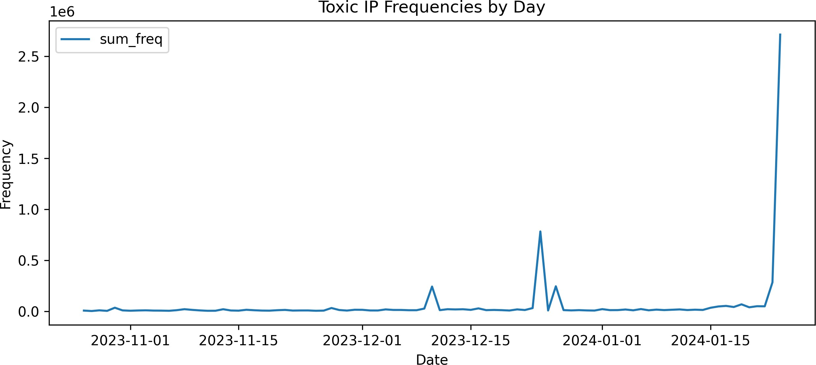
Plotting with Pandas (line Plot)
Data Prep:
Plotting:
Aggregating the frequencies by day daily_freq = (
merged_ips
.groupby(merged_ips['lastseen'].dt.date)
.agg(sum_freq = ('frequency', 'sum'))
.reset_index() # to have last seen as col
.rename(columns = {'lastseen': 'date'})
)
daily_freq.head(n=2)
daily_freq.plot(
x = 'date', y = 'sum_freq', kind = 'line', title = 'Toxic IP Frequencies by Day', xlabel = 'Date', ylabel = 'Frequency', figsize = (10, 4)
)
## | date | sum_freq
## 0 | 2023-10-26 | 8952
## 1 | 2023-10-27 | 4642

Slide 10
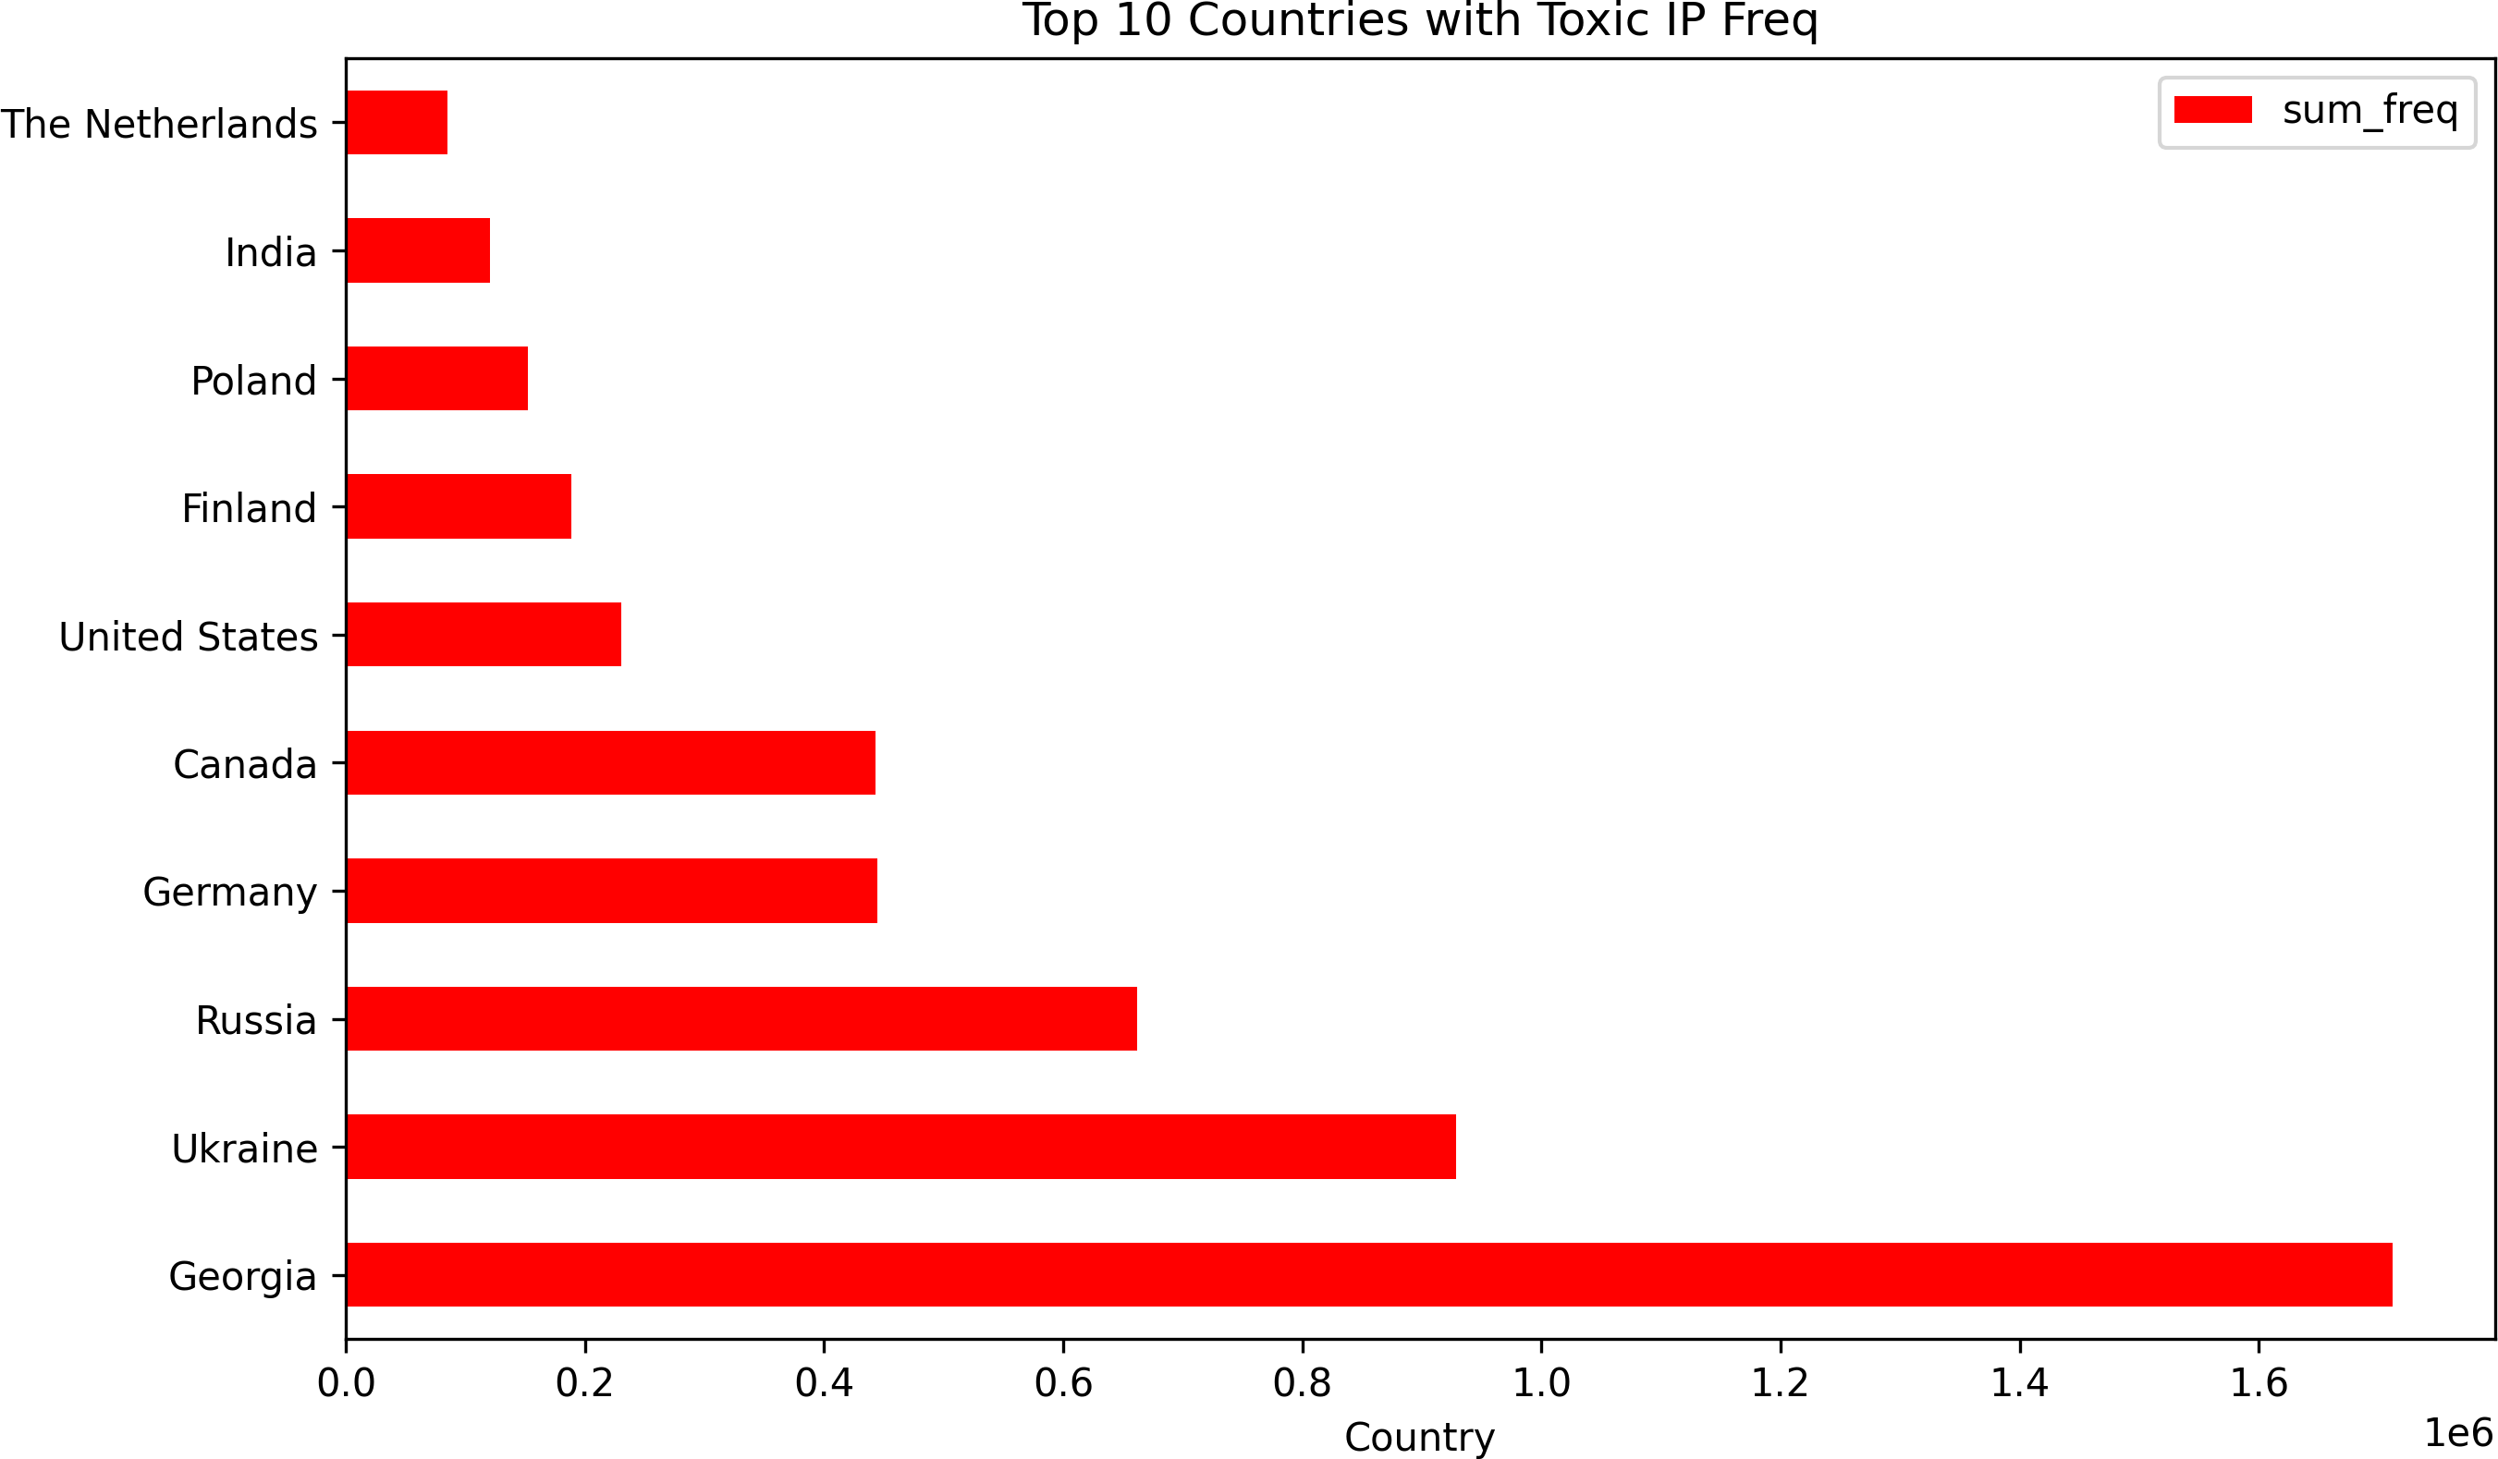
Plotting with Pandas (bar Plot)
Data:
Plotting:
Aggregating the frequencies by country country_freq = (
merged_ips
.groupby('country')
.agg(sum_freq = ('frequency', 'sum'))
.sort_values('sum_freq', ascending = False)
.head(10)
.reset_index()
)
country_freq.head(n=2)
country_freq.plot(
x = 'country', y = 'sum_freq', kind = 'barh', title = 'Top 10 Countries with Toxic IP Freq', xlabel = 'Country', ylabel = 'Frequency', figsize = (10, 6),
color = 'red'
)
## | country | sum_freq
## 0 | Georgia | 1712171
## 1 | Ukraine | 928770

Slide 11
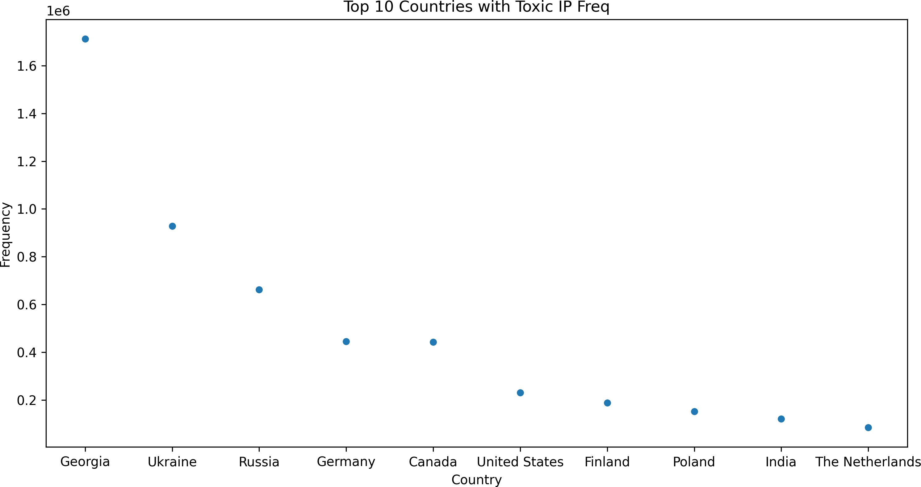
Plotting with Pandas (scatter Plot)
Data:
Plotting:
country_freq.head(n=5)
country_freq.plot(
scatter plots are better with two numeric vars # (this example is for illustration only)
x = 'country', y = 'sum_freq', kind = 'scatter', title = 'Top 10 Countries with Toxic IP Freq',
xlabel = 'Country', ylabel = 'Frequency', figsize = (12, 6)
)
## | country | sum_freq
## 0 | Georgia | 1712171
## 1 | Ukraine | 928770
## 2 | Russia | 661849
## 3 | Germany | 444641
## 4 | Canada | 443046

Slide 12
Class Activity to Assess your Understanding so Far ^{10:00}
Task Task 1 Task 2 Task 3
Read the simulated_attack_data.csv file into a pandas data frame.
Then, answer the questions in the next three tabs.

Slide 13
AAuuttoommaatteedd VViiaassuuaalliizzaattiioonnss iinn PPyytthhoonn
1133 // 2200

Slide 14
The ydata-profiling Package
Data quality profiling and exploratory data analysis (EDA) are crucial steps in any business analytics application.
ydata-profiling automates and standardizes the generation of detailed reports, complete with statistics and visualizations.
The significance of the package lies in how it streamlines the process of understanding and preparing data for analysis in a single line of code!

Slide 15
Usage of ydata-profiling
import pandas as pd
from ydata_profiling import ProfileReport
the next line is needed since I am not using Colab for making the slides profile.to_file("../../figures/sim_attack_data_report.html")
profile = ProfileReport(sim_attack_df, title="Pandas Profiling Report", explorative=True)

Slide 16
Output of ydata-profiling
Pandas Profiling Report
Overview Variables Interactions Correlations Missing values Sample
Overview
Brought to you by YData
Overview
Alerts
5
Reproduction
Dataset statistics
Variable types
Number of variables 11
DateTime 1
Number of observations 1000
Text 2
Missing cells 0
Categorical 2
Missing cells (%) 0.0%
Numeric 6
Duplicate rows 0
16 / 20

Slide 17
10:00
Class Activity
Task
Identify a similar package to ydata-profiling in Python.
Then, use the package to generate a report for the merged_ips data set.
Share the report with your neighboring classmate.
Discuss the insights and visualizations in your approach(es).
17 / 20

Slide 18
RReeccaapp
1188 // 2200

Slide 19
Summary of Main Points
By now, you should be able to do the following:
Create quick visualizations using the plot method from pandas (with an understanding of the effect of different backends).
Utilize auto-viz type plots to create a quick EDA of your data.

Slide 20
📝 Review and Clarification 📝
Class Notes: Take some time to revisit your class notes for key insights and concepts.
Zoom Recording: The recording of today's class will be made available on Canvas approximately 3-4 hours after the end of class.
Questions: Please don't hesitate to ask for clarification on any topics discussed in class. It's crucial not to let questions accumulate.

