Slide 1




ISA 419: Data-Driven Security
09: Visualizing Data in Python
Fadel M. Megahed, PhD
Professor
Farmer School of Business Miami University
@FadelMegahed fmegahed fmegahed@miamioh.edu
Automated Scheduler for Office Hours
Spring 2025

Slide 2
Quick Refresher of Last Class
✅ Create quick visualizations using the plot method from pandas (with an understanding of the effect of different backends).
✅ Utilize auto-viz type plots to create a quick EDA of your data.

Slide 3
Learning Objectives for Today's Class
Utilize standalone data viz packages to construct and tailor your graphs.
Examine the use of network and/or spatial plots in the context of network data

Slide 4
UUttiilliizzee SSttaannddaalloonnee DDaattaa VViizz PPaacckkaaggeess ttoo CCoonnssttrruucctt aanndd TTaaiilloorr yyoouurr GGrraapphhss
44 // 1166

Slide 5
Our Data
We will use the merged_ips data set from a previous class to demonstrate how to plot data in pandas.
import pandas as pd
import numpy as np
np.random.seed(2025) # so we get the same random sample toxic_ips = pd.read_csv(
"https://raw.githubusercontent.com/fmegahed/isa419/main/data/listed_ip_90_all.csv",
header = None, names = ['ip', 'frequency', 'lastseen']
)
geolocation = pd.read_csv( 'https://raw.githubusercontent.com/fmegahed/isa419/main/data/ip_geolocation.csv', names = ['ip', 'country', 'city', 'latitude', 'longitude']
)
merged_ips = ( toxic_ips
.merge(right = geolocation, how = 'left', on ='ip')
.dropna()
.assign( lastseen = lambda df: df['lastseen'].astype('datetime64[ns]') )
.sample(1000) #<< a random sample of 1000 rows for faster plotting
.query('frequency < 100')
)

Slide 6
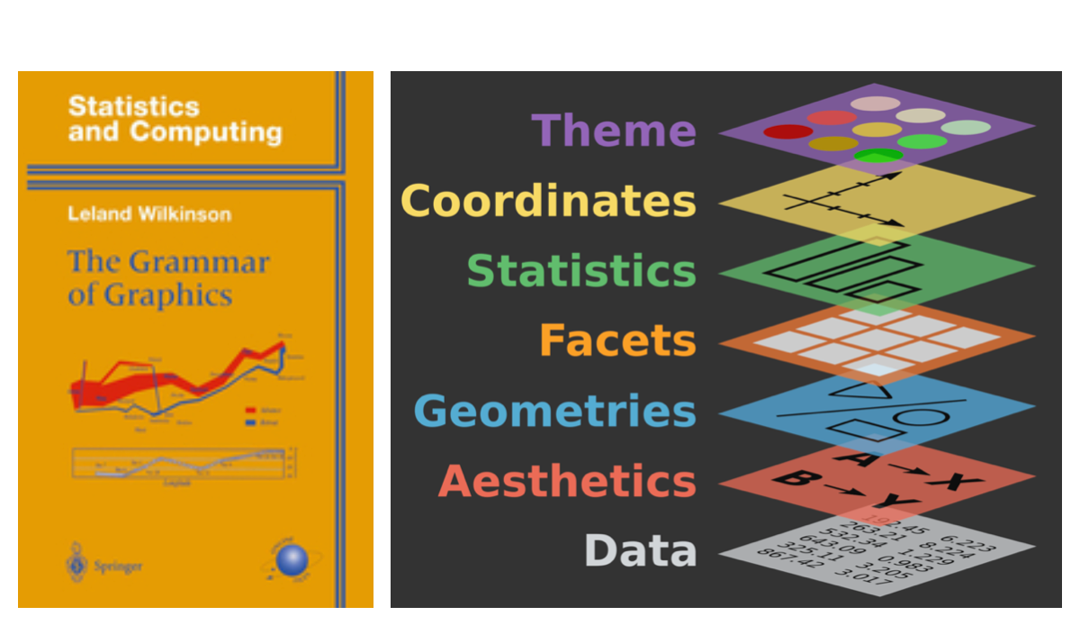
Grammar of Graphics

Slide 7
The Grammar of Graphics with plotnine
from plotnine import ggplot, aes, geom_histogram, labs, theme_minimal
(
ggplot(merged_ips) # data
)

Slide 8
The Grammar of Graphics with plotnine
from plotnine import ggplot, aes, geom_histogram, labs, theme_minimal
(
ggplot(merged_ips, aes(x = 'frequency') ) # data + aesthetics
)

Slide 9
The Grammar of Graphics with plotnine
from plotnine import ggplot, aes, geom_histogram, labs, theme_minimal
(
ggplot(merged_ips, aes(x = 'frequency') ) + # data + aesthetics geom_histogram(bins = 20) # geometry
)

Slide 10
The Grammar of Graphics with plotnine
from plotnine import ggplot, aes, geom_histogram, labs, theme_minimal
(
ggplot(merged_ips, aes(x = 'frequency') ) + # data + aesthetics geom_histogram(bins = 20) + # geometry
labs(title = 'Frequency of Toxic IPs', x = 'Frequency', y = 'Count') + # labels
theme_minimal() # theme
)

Slide 11
05:00
Class Activity
Task Solution
After going through the plotnine Reference and Gallery tabs, create a scatter plot of the
latitude and longitude variables from the merged_ips data set using plotnine.
Add a title to the plot and label the x and y axes.
Use the theme_minimal theme.

Slide 12
EExxaammiinnee tthhee UUssee ooff NNeettwwoorrkkPPlloottss iinn tthhee CCoonntteexxtt ooff NNeettwwoorrkkDDaattaa
1122 // 1166

Slide 13
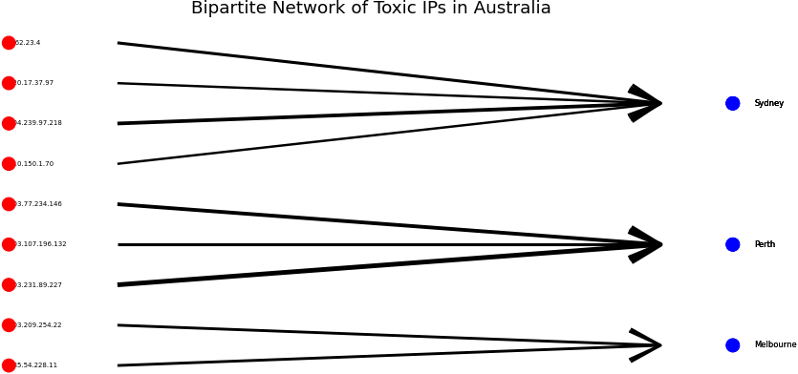
Network Data
Let us create a simple network data set to demonstrate how to plot network data in Python. We will focus on querying the merged_ips data set to only include toxic IPs from Australia. We will create a simple bipartite network with the ip and city variables.
13 / 16

Slide 14
RReeccaapp
1144 // 1166

Slide 15
Summary of Main Points
By now, you should be able to do the following:
Utilize standalone data viz packages to construct and tailor your graphs.
Examine the use of network and/or spatial plots in the context of network data.

Slide 16
📝 Review and Clarification 📝
Class Notes: Take some time to revisit your class notes for key insights and concepts.
Zoom Recording: The recording of today's class will be made available on Canvas approximately 3-4 hours after the end of class.
Questions: Please don't hesitate to ask for clarification on any topics discussed in class. It's crucial not to let questions accumulate.

