Slide 1




ISA 419: Data-Driven Security
21: Touchalytics Lab
Fadel M. Megahed, PhD
Professor
Farmer School of Business Miami University
@FadelMegahed fmegahed fmegahed@miamioh.edu
Automated Scheduler for Office Hours
Spring 2025

Slide 2
Learning Objectives for Today's Class
Examine an Android Phone's behavioral touch feature dataset
Replicate the analysis performed by a InfoSec research paper
Report the code and results in an understandable manner to a general audience
2 / 28

Slide 3
AAnn OOvveerrvviieeww ooff tthhee TToouucchhaallyyttiiccss PPaappeerr
33 // 2288

Slide 4
The Touchalytics Paper
This paper is one of the seminal papers, where smart phone touch features are engineered and used for continuous authentication. The paper has over 1,000 citations, and provides a website that contains:
The raw data (do not forget to examine the readme file)
The extracted features (see the readme)
Matlab Script File for how the features were engineered from the raw data file
PDFs of their published work; for our lab, we are interested in the Touchalytics Paper

Slide 5
Paper's Motivation [1]
There is limited work on continuous authentication for touchscreen devices
Use of smart phone devices typically involves "atomic navigation behavior", which consists of simple and short movements
Is it possible to authenticate users while they perform basic navigation steps on a touchscreen device and without any dedicated and explicit security action that requires attention from the user?

Slide 6
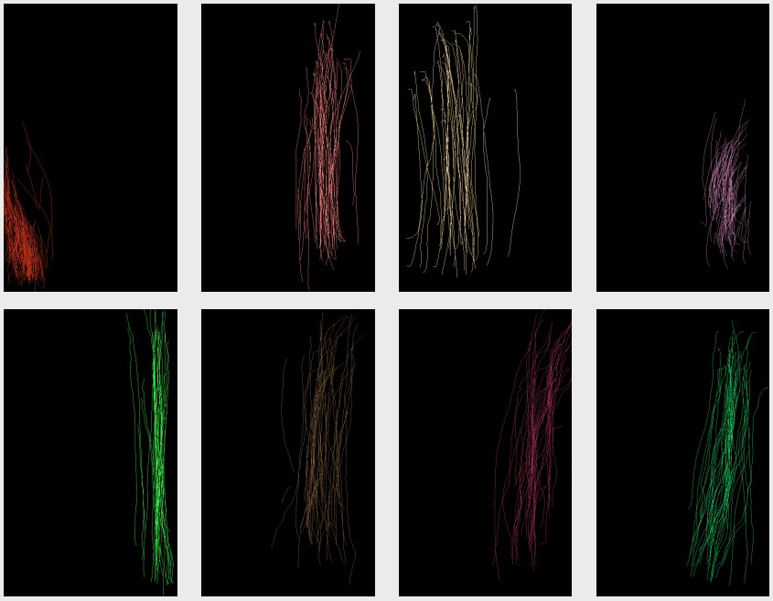
Paper's Motivation [2]
Strokes from eight different users, each reading three different texts on an Android Phone

Slide 7
Paper's General Idea
There are two phases for learning and classifying touch behavior.
Enrollment Phase: Phase where the system relies on a conventional authentication approach (e.g., password). The authors distinguish between two different "trigger-actions":
Sliding horizontally over the screen; for example, to browse through images
Sliding vertically over the screen to move conten up and down
Note that the authors decided to use only on on single touch gestures
Continuous Authentication Phase: During this phase, the system continuously tracks all strokes and the classifier estimates if they were made by the legitimate user. For t consecutive negative classification results, the system resorts back to the initial entry-point based authentication method and challenges the user.

Slide 8
Paper's Goals
The main goal of their study is to analyze how robustly our proposed framework can distinguish users from each other.
What is the probability of rejecting a legitimate user?
What is the probability of accepting an attacker?
How long does the classifier need to make an authentication decision?
How robust is the classification within one session, across multiple sessions, and after one week?

Slide 9
Experimental Protocol
Sessions 1-3 occurred during the same day and separated by a questionnaire. This is followed by a second phase, where users were asked to spot differences between images.
Sessions 6-7 occurred one week post the sessions in the previous bullet.

Slide 10
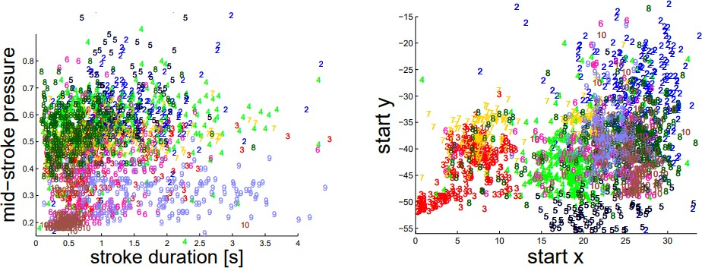
Touch Analytics [1]
Stroke features projected on a 2D-subspace. The user ID is given as a colored number

Slide 11
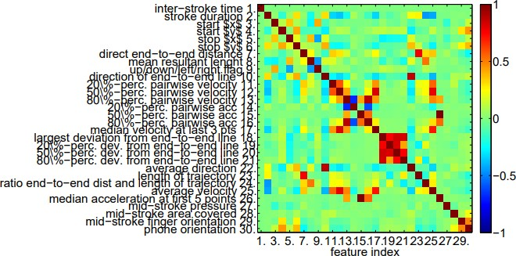
Touch Analytics [2]
Correlation among the 30 features

Slide 12
Classification Schemes: kNN
The kNN (k-Nearest Neighbors) algorithm has the following features:
Supervised learning algorithm
Utilizes feature similarity
Lazy algorithm since it uses the entire training data to make a decision instead of coming up with a discrminative function
The following kNN Slides are based on the edureka.co Blog.

Slide 13
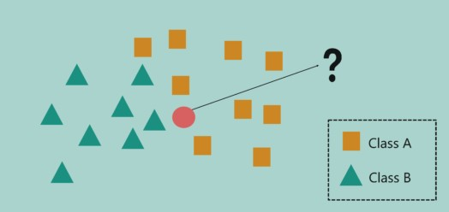
Classification Schemes: kNN

Slide 14
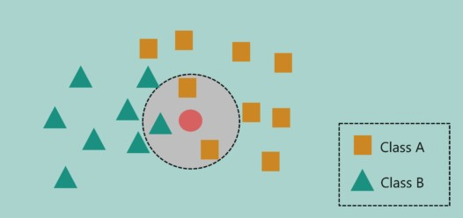
Classification Schemes: kNN

Slide 15
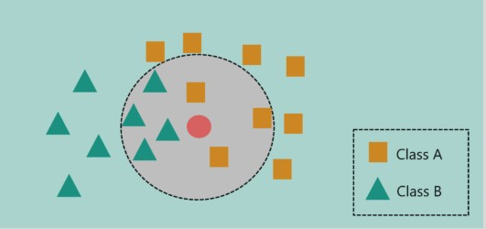
Classification Schemes: kNN

Slide 16
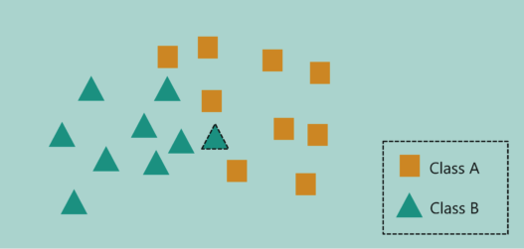
Classification Schemes: kNN

Slide 17
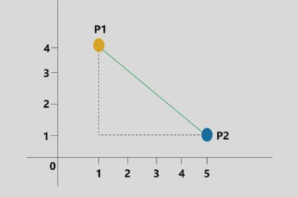
Classification Schemes: kNN

Slide 18
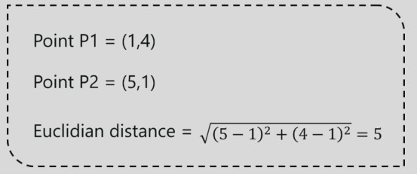
Classification Schemes: kNN

Slide 19
Classification Schemes: kNN
Pseudo Code
Calculate D(x, x_{i}), where i = 1, 2, . . . , n and D is the Euclidean measure between the data points.
The calculated Euclidean distances must be arranged in ascending order.
Initialize k and take the first k distances from the sorted list.
Figure out the k points for the respective k distances.
Calculate k_{i}, which indicates the number of data points belonging to the ith class among k
points i.e. k ≥ 0.
If k_{i} > k_{j}∀i ≠ j; put x in class i.
Note that in the paper, they have used k ∈ [1, 3, 5, 7] to avoid ties.

Slide 20
Classification Schemes: SVM
In this paper, they used it for binary classification. The used a RBF for the kernel, which means that they assumed that the data is not linearly seperable.
The following SVM Slides are based on the edureka.co Blog.

Slide 21
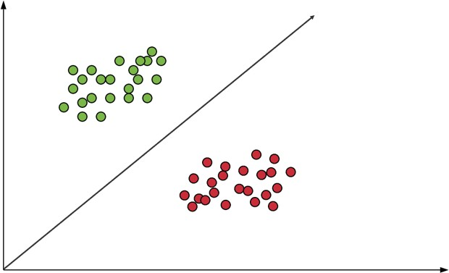
Classification Schemes: SVM

Slide 22
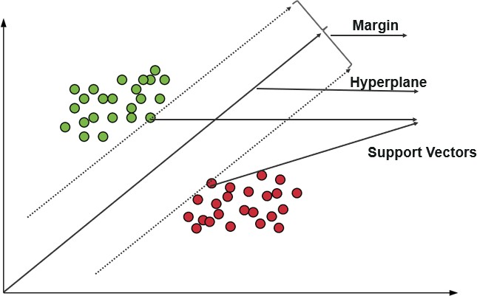
Classification Schemes: SVM

Slide 23
LLaabb IInnssttrruuccttiioonnss
2233 // 2288

Slide 24
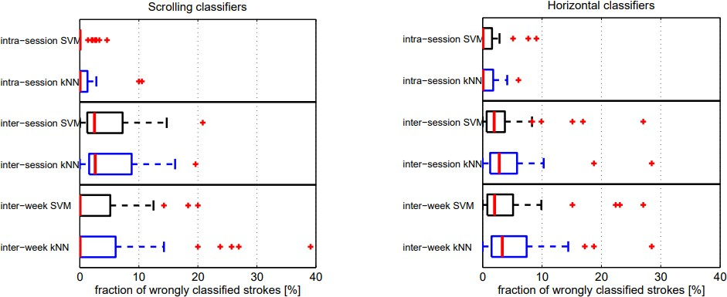
Lab Instructions
For the purposes of Lab 04, I would like you to replicate the analysis performed by @frank2012touchalytics. You can start with the The extracted features and simplify the problem into a binary classification problem, where you will need to recode the data at least 40 times such that for a given user we compare him/her to everyone else.

Slide 25
Lab Instructions
Rubric:
A student will score 80% on the assignment if they can successfully use both kNN and SVM to distinguish one user of their choice from the rest of the group based on the inter-week sessions.
A student will score 100% on the assignment if they can successfully use both kNN and SVM to distinguish one user of their choice from the rest of the group based on two different training approaches: (a) intra-session, (b) inter-session, and/or (c) inter-week sessions.
A student will score 120% on the assignment if they can successfully use both kNN and SVM to distinguish all users from the rest of the group based on all three different training approaches: (a) intra-session, (b) inter-session, and (c) inter-week sessions.
You can work individually or in a group of two. Your submission should include: (a) your Notebook, and (b) a CSV file with results from your code.

Slide 26
RReeccaapp
2266 // 2288

Slide 27
Summary of Main Points
By now, you should be able to do the following:
Examine an Android Phone's behavioral touch feature dataset
Replicate the analysis performed by a InfoSec research paper
Report the code and results in an understandable manner to a general audience

Slide 28
📝 Review and Clarification 📝
Class Notes: Take some time to revisit your class notes for key insights and concepts.
Zoom Recording: The recording of today's class will be made available on Canvas approximately 3-4 hours after the end of class.
Questions: Please don't hesitate to ask for clarification on any topics discussed in class. It's crucial not to let questions accumulate.

