Slide 1




ISA 419: Data-Driven Security
02: Python Programming Basics
Fadel M. Megahed, PhD
Professor
Farmer School of Business Miami University
@FadelMegahed fmegahed fmegahed@miamioh.edu
Automated Scheduler for Office Hours
Fall 2025

Slide 2
Quick Refresher of Last Class
✅ Define information security (Infosec), its main goals, and how it fits within a firm’s overall security protocols
✅ Describe the three main steps in information security: prevention, detection, and response.
✅ Explain why prevention as a sole security measure is deemed to fail.
✅ Describe course structure, goals, and overview.
2 / 34

Slide 3
Learning Objectives for Today's Class
Use pseudocode to map out a problem.
Python syntax, data types, and data structures
Convert data types using type casting
Manipulate lists and use methods on lists
3 / 34

Slide 4
UUssee PPsseeuuddooccooddee ttoo MMaapp oouutt aa CCyybbeerrsseeccuurriittyy PPrroobblleemm
44 // 3344

Slide 5
Background: Why is BUS 104 is a Pre-Req?
From the MU Bulletin
BUS 104. Introduction to Computational Thinking for Business. (2)
As part of the Farmer School of Business first-year integrated core curriculum, this course introduces students to the fundamentals of computational thinking as an aid to data-driven business problem-solving. Topics include: computational thinking as problem solving, representing data through abstractions, and thinking in terms of algorithms (loops, conditions, reusable code, functions and events) to automate finding solutions. The course lays the foundations for students identifying, analyzing, and implementing solutions for data-driven business problems and the communication of results.
Source: Business Analysis (BUS) | Miami University Bulletin.
5 / 34

Slide 6
Background: (Distributed) Denial of Service Attacks
Denial of Service Attacks Explained
Credits: Jeff Crume. (2023) IBM Technology: Denial of Service Attacks Explained.
6 / 34

Slide 7
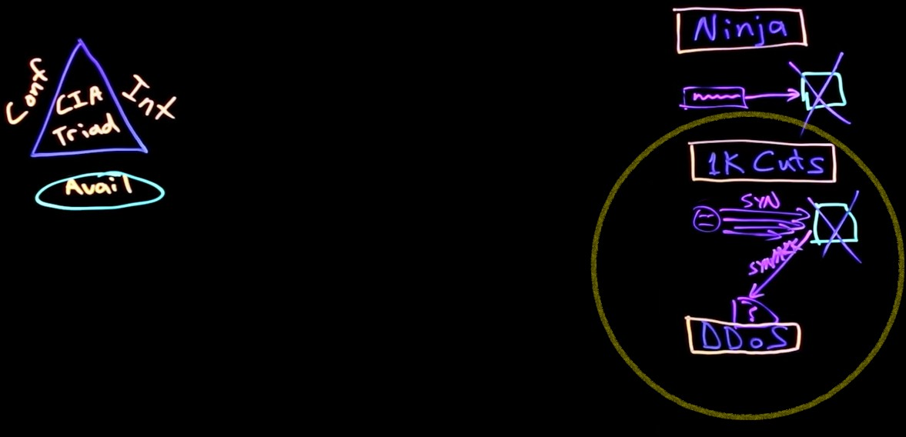
Simplifying our Task Ahead: SYN Flood Attacks
We will focus on the simple SYN flood attack.
Attackers send a succession of SYN requests to a target's system.
Image Source: Captured from the Jeff Crume. (2023) IBM Technology: Denial of Service Attacks Explained video (~ the frame corresponding to 3:47). Then, the image was adjusted by: (a) removing the presenter's picture, and (b) adding a circle around the SYN attack.
7 / 34

Slide 8
10:00
Class Activity: Detecting SYN Flood Attacks
Task Q1 Q2 Q3 Q4 Q5
Toward creating an algorithm for monitoring network traffic and detecting SYN flood attacks, in pairs, please think and answer the following questions.
Write down your answers in each tab, after each question.
8 / 34

Slide 9

Computational Thinking: From Problem to Code/Solution
Image Source: Harimurti, R., & Asto, B. I. (2019, May). The concept of computational thinking toward information and communication technology learning. In IOP Conference Series: Materials Science and Engineering (Vol. 535, No. 1, p. 012004). IOP Publishing. Figure 02.
9 / 34

Slide 10
Pseudocode for Detecting SYN Flood Attacks
BEGIN DDoS_Detection
SET
threshold_limit to a significant number representing unusual traffic time_window to the period of monitoring traffic (e.g., per minute) ip_request_count to an empty data structure (e.g., dictionary)
SET
SET
for each request in network_traffic
GET
ip_address from request request_time from request
GET
if ip_address is not in ip_request_count SET ip_request_count[ip_address] to 1
else
INCREMENT ip_request_count[ip_address] by 1
if ip_request_count[ip_address] exceeds threshold_limit within time_window
FLAG
ip_address as potential DDoS source
necessary action (e.g., block IP, alert admin)
TAKE
if time elapsed > time_window
RESET ip_request_count for each ip_address
END FOR loop END DDoS_Detection
10 / 34

Slide 11

App: Detecting Simulated Attacks based on Pseudocode
DDoS Attack Simulation and Detection
Run Simulation
Simulation Configuration
Threshold Limit
100
Time Window (seconds)
60
Monitoring Period (seconds)
300
Number of Regular Requests
500
Notes: Students are encouraged to "play" with the app's simulation configurations to better understand the pseudo_code. The app can be opened in your browser by navigating to: https://muddos.streamlit.app/.
11 / 34

Slide 12
PPyytthhoonn SSyynnttaaxx,, DDaattaa TTyyppeess && DDaattaa SSttrruuccttuurreess
1122 // 3344

Slide 13
Why are we Discussing Syntax?
Good coding style is like correct punctuation: you can manage without
it, butitsuremakesthingseasiertoread.
-- The tidyverse style guide
Code is read much more often than it is written. The guidelines
provided here are intended to improve the readability of code ...
-- PEP 8 - Style Guide for Python Code
13 / 34

Slide 14
Python Syntax: Key PEP 8 Guidelines
Indentation
Naming Conventions
Use 4 spaces per indentation level.
Do not mix tabs and spaces for indentation.
Example:
Functions and variables:
lower_case_with_underscores
Classes: CapWords (or CamelCase)
Constants:
UPPER_CASE_WITH_UNDERSCORES
Example:
def my_function():
for i in range(10): print(i)
class MyClass: CONSTANT_VALUE = 123
def my_method(self): my_variable = 10
Tip: Consistency with these guidelines improves code readability and maintainability. See PEP 8 - Style Guide for more details.
14 / 34

Slide 15
Python Syntax: Key PEP 8 Guidelines
Comments
Importing Modules
Write clear comments (full sentences)
for tricky parts of the code.
Inline comments should be used
sparingly.
Example:
Imports should be on separate lines.
Order: standard library (e.g., os) ⟶ related third-party (e.g., pandas) ⟶ local application/library specific imports (e.g. from other .py files).
Example:
Calculate the square of x (yes) square = x ** 2 # Square value (No)
import os
import sys
import numpy as np
import pandas as pd
from my_local_module import my_function
Tip: Consistency with these guidelines improves code readability and maintainability. See PEP 8 - Style Guide for more details.
15 / 34

Slide 16
Python's Data Model: "Everything is an Object in Python"
Data model
Objects, values and types
Objects are Python’s abstraction for data. All data in a Python program is represented by objects or by relations between objects. (In a sense, and in confor- mance to Von Neumann’s model of a “stored program computer”, code is also represented by objects.)
Every object has an identity, a type and a value. An object’s identity never changes once it has been created; you may think of it as the object’s address in memory. The i s operator compares the identity of two objects; the i d() function returns an integer representing its identity.
CPython implementation detail: For CPython, id(x) is the memory address where x is stored.
An object’s type determines the operations that the object supports (e.g., “does it have a length?”) and also defines the possible values for objects of that type. The t ype() function returns an object’s type (which is an object itself). Like its identity, an object’s type is also unchangeable. [1 ]
The value of some objects can change. Objects whose value can change are said to be mutable; objects whose value is unchangeable once they are created are called immutable. (The value of an immutable container object that contains a reference to a mutable object can change when the latter’s value is changed; however the container is still considered immutable, because the collection of objects it contains cannot be changed. So, immutability is not strictly the same as having an unchangeable value, it is more subtle.) An object’s mutability is determined by its type; for instance, numbers, strings and tuples are immutable, while dictionaries and lists are mutable.
Source: The embedded page is from 3. Data model - Python 3.12.1 documentation.
16 / 34

Slide 17
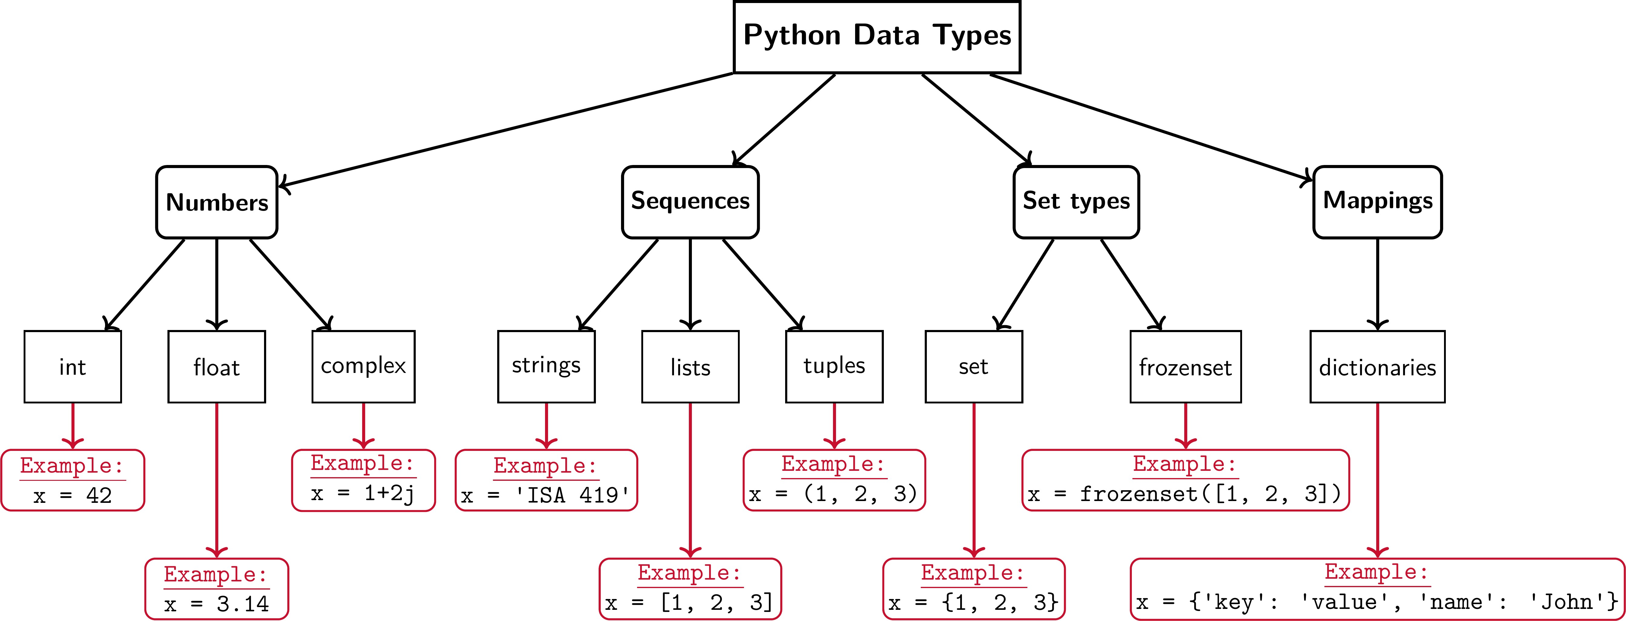
Data Types
An overview of the most common data types in Python. Note that I excluded the None type as well as modules and callables from this flowchart (for the sake of conciseness).
Image Credits: Created by the author (Fadel M. Megahed) for our ISA 419 course, based on the information provided in the Python's Data model documentation.
17 / 34

Slide 18
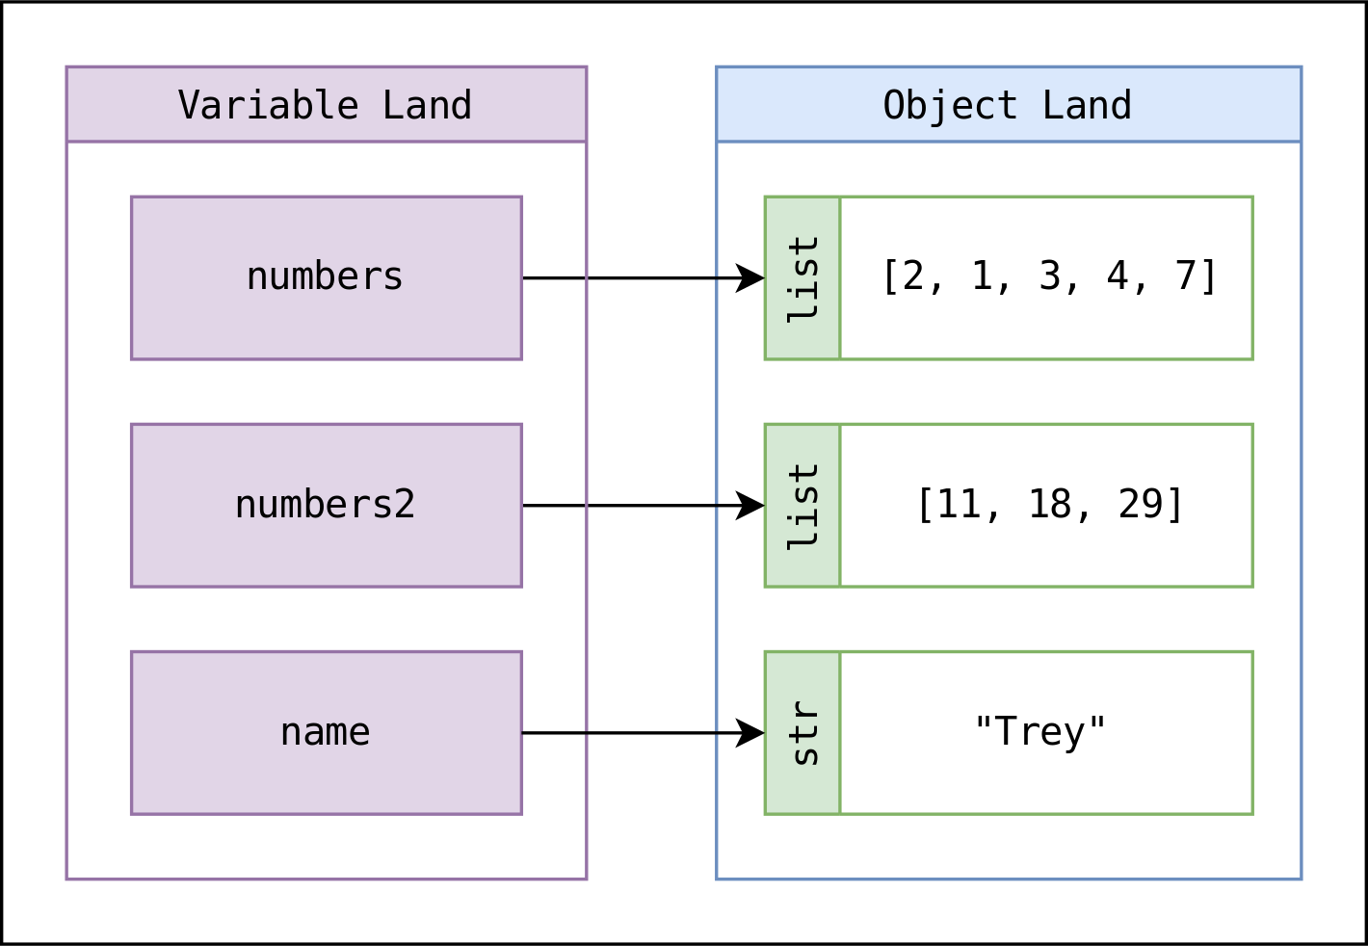
Python Variables are Pointers, Not Buckets
Variables in Python are not buckets containing things; they're pointers (they point to objects).
A pointer just represents the connection between a variable and an objects.
Imagine variables living in variable land and objects living in object land. A pointer is a little arrow that connects each variable to the object it points to.
Assignment statements point a variable to an object.
numbers = [2, 1, 3, 4, 7]
numbers2 = [11, 18, 29] name = "Trey"
Source: The content and the figure in this slide are from Trey Hunter (2022). Variables and objects in Python
18 / 34

Slide 19
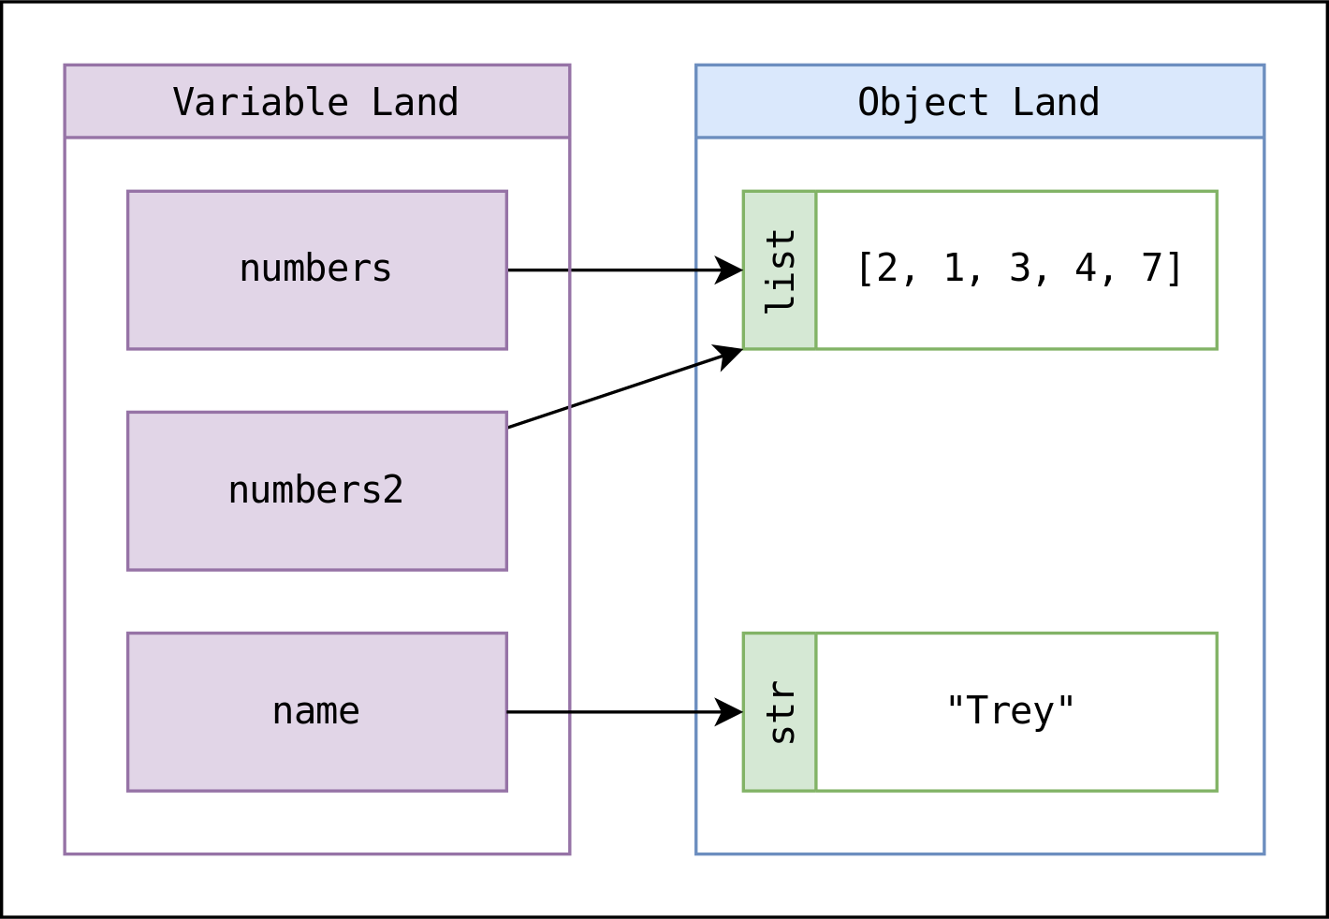
Assignment Points a Variable to an Object
Variables in Python are not buckets containing things; they're pointers (they point to objects).
A pointer just represents the connection between a variable and an objects.
Imagine variables living in variable land and objects living in object land. A pointer is a little arrow that connects each variable to the object it points to.
Assignment statements point a variable to an object.
numbers = [2, 1, 3, 4, 7] numbers2 = numbers
name = "Trey"
Source: The content and the figure in this slide are from Trey Hunter (2022). Variables and objects in Python
19 / 34

Slide 20
Implications: Equality Compares Objects
Python's == operator checks that two objects represent the same data (a.k.a. equality):
The variables my_numbers and your_numbers point to objects representing the same data, but the objects they point to are not the same.
So changing one variable/object does not
change the other:
my_numbers[0] = 7
my_numbers == your_numbers
my_numbers = [2, 1, 3, 4, 7] your_numbers = [2, 1, 3, 4, 7]
my_numbers | == | your_numbers
## True
my_numbers | is | your_numbers
## False
## False
20 / 34

Slide 21
Changing the Object will Change Both Variables
If two variables point to the same object:
my_numbers_again = my_numbers my_numbers is my_numbers_again
## True
Changing the object one variable points to also changes the object the other variable points to:
print('my_numbers_again =', my_numbers_again, 'and my_numbers also =', my_numbers, '.')
my_numbers_again.append(419)
## my_numbers_again = [7, 1, 3, 4, 7, 419] and my_numbers also = [7, 1, 3, 4, 7, 419] .
On a positive note, this does not apply to strings and numbers (both are immutable).
Source: The content in this slide is adapted from Trey Hunter (2022). Variables and objects in Python
21 / 34

Slide 22
CCoonnvveerrtt BBaassiicc DDaattaa TTyyppeess
2222 // 3344

Slide 23
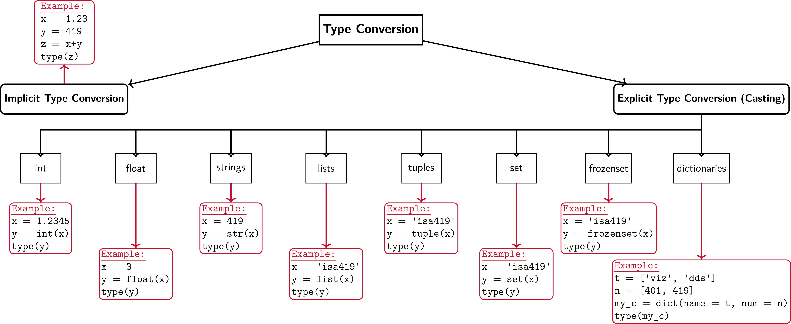
Type Conversions in Python
An overview of type conversions in Python.
Image Credits: Created by the author (Fadel M. Megahed) for our ISA 419 course.
23 / 34

Slide 24
03:00
Class Activity: Type Conversion
Task Observations
Based on the previous chart, use Google Colab (or your preferred Python environment) to run the following two code examples.
Write down your observations in the next tab.
course_a = 'isa419' course_list_a = list(course_a) print(course_list_a) print(type(course_list_a))
course_b = 419
course_list_b = list(course_b) print(course_list_b) print(type(course_list_b))
24 / 34

Slide 25
MMaanniippuullaattee LLiissttss aanndd UUssee MMeetthhooddss oonn LLiissttss
2255 // 3344

Slide 26
Lists in Python
A list is a mutable sequence of elements, i.e., it can be changed after it is created.
Lists are created by placing elements inside square brackets [], separated by commas.
Lists can contain elements of different types, including other lists.
Lists are ordered and indexed (i.e., you can access elements by their position).
26 / 34

Slide 27
Lists: Indexing and Slicing
Indexing: Accessing individual elements in a list.
Starts from 0 (for the first element) and goes up to n-1 (for the last element).
To reference the last element, you can use
-1, and so on.
You can call a particular item out of a list by using its index. For example, my_list[0] will return the first item in the list.
Slicing: Accessing a subset of elements in a list, using the : operator, where: my_list[start:stop:step].
If start not provided, it defaults to 0
If stop is not provided, it defaults to the length of the list.
If step is not provided, it defaults to 1.
my_list[:3] returns the first three elements.
my_list[3:] returns all elements from the fourth to the last.
*my_list[::2] returns every other element, and
my_list[::-1] returns the list in reverse order.
27 / 34

Slide 28
Python List Functions
List Function | Description | Example
len() | Returns the length of the list. | my_list = [1,2,3] length = len(my_list) # length is 3
max() | Returns the maximum value in the list. | my_list = [1,2,3] maximum = max(my_list) # maximum is 3
min() | Returns the minimum value in the list. | my_list = [1,2,3] minimum = min(my_list) # minimum is 1
sum() | Returns the sum of all elements in the list. | my_list = [1,2,3] total = sum(my_list) # total is 6
sort() | Sorts the list in ascending order. | my_list = [3,2,1] my_list.sort() my_list is now [1, 2, 3]
28 / 34

Slide 29
Python List Functions (Cont.)
List Function | Description | Example
index(item) | Returns the index of the first occurrence of item. | my_list = [1,2,3] my_list.index(2) # index is 1
append(item) | Adds item to the end of the list. | my_list = [1,2,3] my_list.append(4) my_list is now [1, 2, 3, 4]
pop(index) | Removes and returns the element at index. | my_list = [1,2,3] popped = my_list.pop(1) # popped is 2, my_list is [1, 3]
remove(item) | Removes the first occurrence of item from the list. | my_list = [1,2,3] my_list.remove(2) my_list is [1, 3]
29 / 34

Slide 30
10:00
Class Activity: List Manipulation
Task Solution
In pairs, build on the code below to:
your path will be different
with open("../../data/simulated_logs.txt", "r") as file: lines = file.readlines()
Strip newline characters from each line log_entries = [line.strip() for line in lines] type(log_entries)
Show how to get the total number of log entries.
Show how to slice the first 5 log entries.
Filter out all log entries that contain the word ERROR.
Count the number of ERROR entries.
30 / 34

Slide 31
RReeccaapp
3311 // 3344

Slide 32
Summary of Main Points
By now, you should be able to do the following:
Use pseudocode to map out a problem.
Python Syntax, Data Types, and Data Structures
Convert data types using type casting
Manipulate lists and use methods on lists
32 / 34

Slide 33
📝 Review and Clarification 📝
Class Notes: Take some time to revisit your class notes for key insights and concepts.
Zoom Recording: The recording of today's class will be made available on Canvas approximately 3-4 hours after the end of class.
Questions: Please don't hesitate to ask for clarification on any topics discussed in class. It's crucial not to let questions accumulate.
33 / 34

Slide 34
🎯 Assignment 🎯
Please work on and submit Assignment 02 prior to our next class.
34 / 34

