Slide 1




ISA 419: Data-Driven Security
16: Machine Learning Regression Models
Fadel M. Megahed, PhD
Professor
Farmer School of Business Miami University
@FadelMegahed fmegahed fmegahed@miamioh.edu
Automated Scheduler for Office Hours
Spring 2025

Slide 2
Quick Refresher of Last Class
✅ Describe the basic concepts of regression analysis, including the roles of independent and dependent variables.
✅ Assess regression models using metrics like R-squared and Mean Squared Error and interpret the results.
✅ Describe the two modeling mindsets: explanatory and predictive.

Slide 3
Learning Objectives for Today's Class
Recognize the differences and similarities between traditional regression and machine learning regression models
Describe advanced techniques like Ridge and Lasso
Explore non-linear models like Decision Trees and Random Forests for regression tasks
Apply machine learning regression models to cyber security data sets

Slide 4
DDiiffffeerreenncceess BBeettwweeeenn TTrraaddiittiioonnaall ((SSttaattiissttiiccaall)) aanndd AAllggoorriitthhmmiicc ((MMaacchhiinnee LLeeaarrnniinngg)) MMooddeelliinngg CCuullttuurreess
44 // 2200

Slide 5
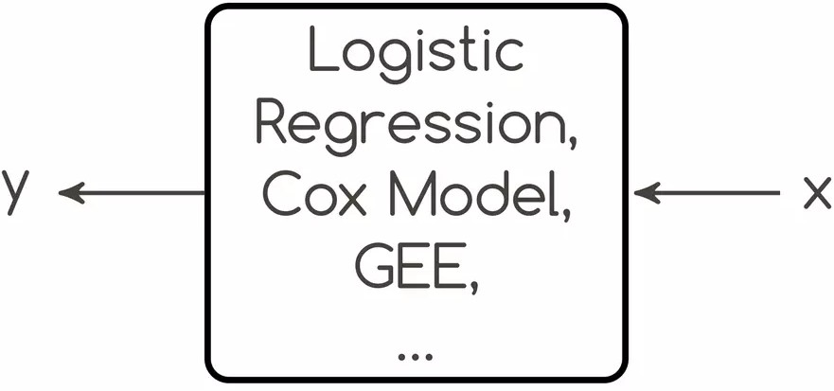
Statistical Modeling Culture
Find a stochastic model of the data-generating process in the form of: Y = f(X, parameters, ϵ)
Assumptions
Problems
Specific stochastic model of the data- generating process
Distributional assumptions about the errors
Linearities
Manual specification of interactions
Conclusions about model, and not about "nature"
Assumptions often violated
Often no model evaluation (no focus on prediction)
Image Source: Chris Molnar. (2014). Statistical Modeling: The Two Cultures - Based on Leo Breiman's paper

Slide 6
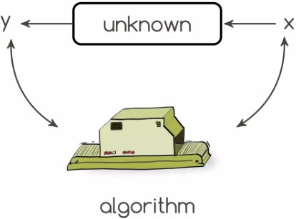
Algorithmic (Machine Learning) Modeling Culture
Find a function f(x) that minimizes the loss L(Y , f(X))
Assumptions
Problems
No assumptions about the data-generating process (true mechanism of generating the data is unknown and not of direct interest).
No assumptions about the distribution of the errors.
Some models are "black boxes".
Stability of the model is not guaranteed (and honestly this is also a problem in statistical modeling).
Image Source: Chris Molnar. (2014). Statistical Modeling: The Two Cultures - Based on Leo Breiman's paper

Slide 7
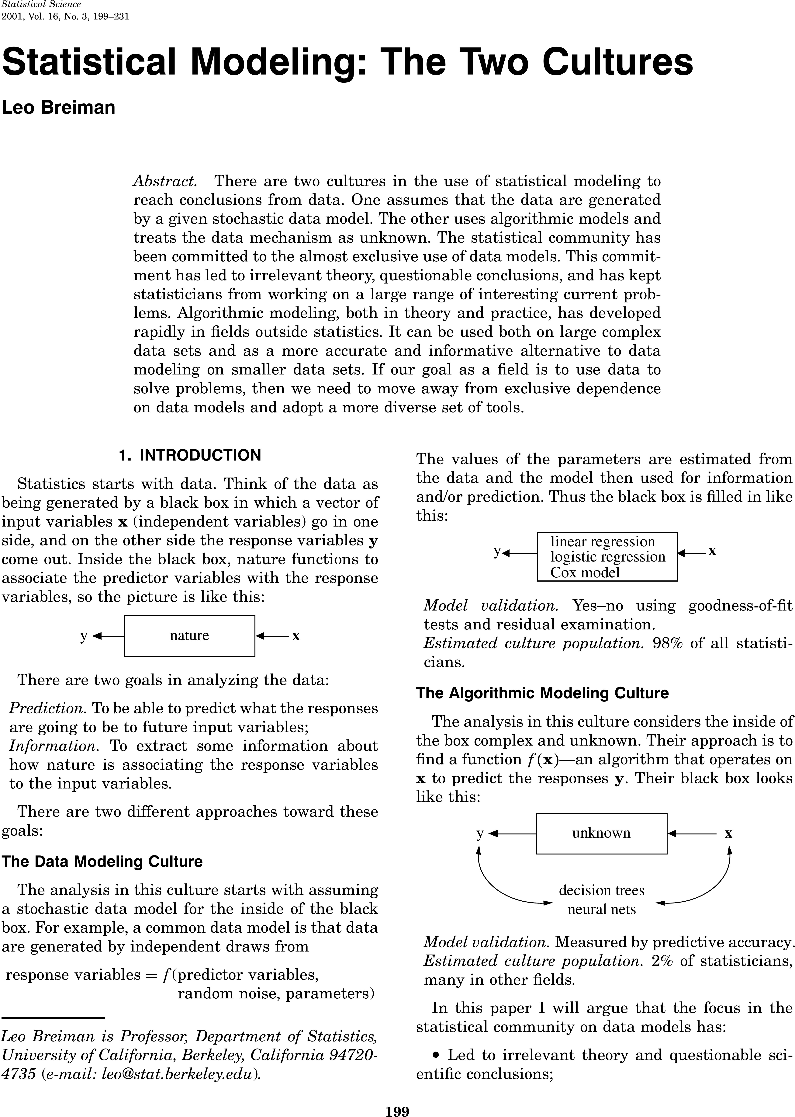
Statistical Modeling: The Two Cultures
Note: You are highly encouraged to read Leo Breiman's paper on the two cultures of statistical modeling. It's a classic and a must-read for anyone interested in data science and machine learning. See Breiman 2001.
7 / 20

Slide 8
AAddvvaanncceedd TTeecchhnniiqquueess ffoorr RReeggrreessssiioonn
88 // 2200

Slide 9
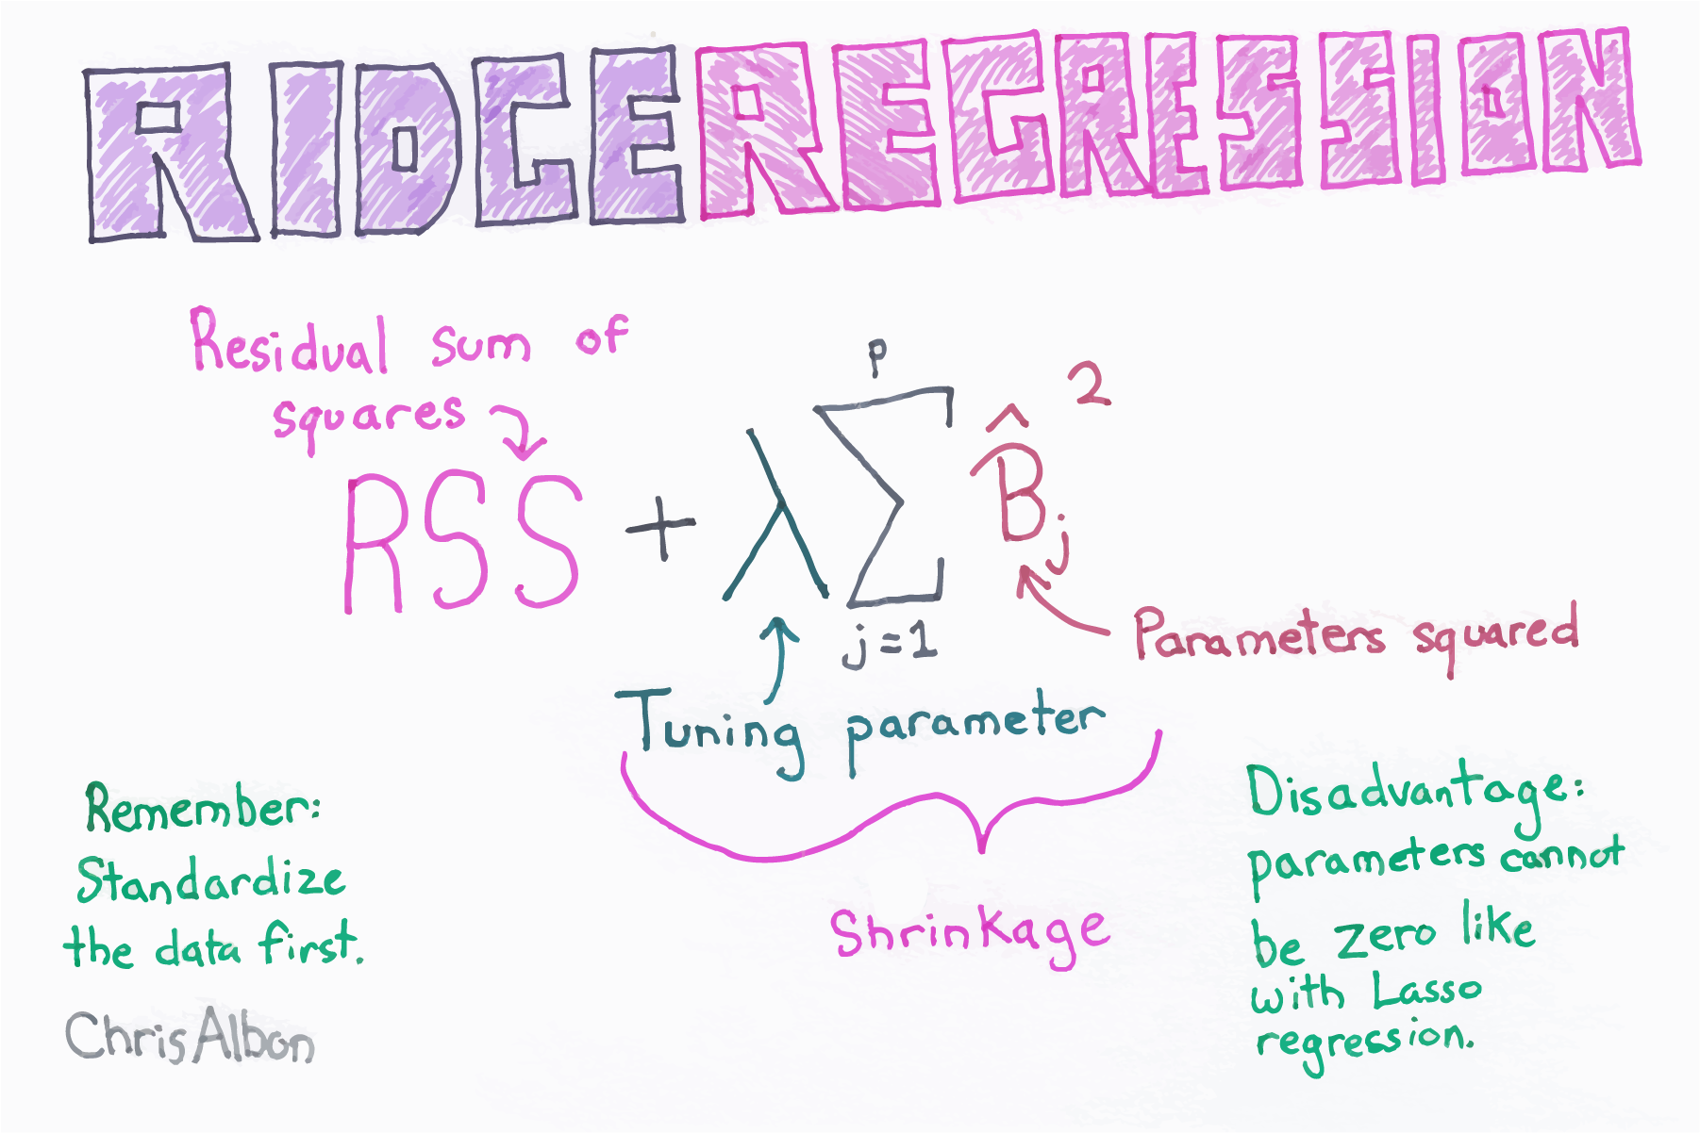
Ridge Regression
Image Source: Chris Albon. (2017). Machine Learning Flashcards. Flashcards were purchased by the author and are not available for free.

Slide 10
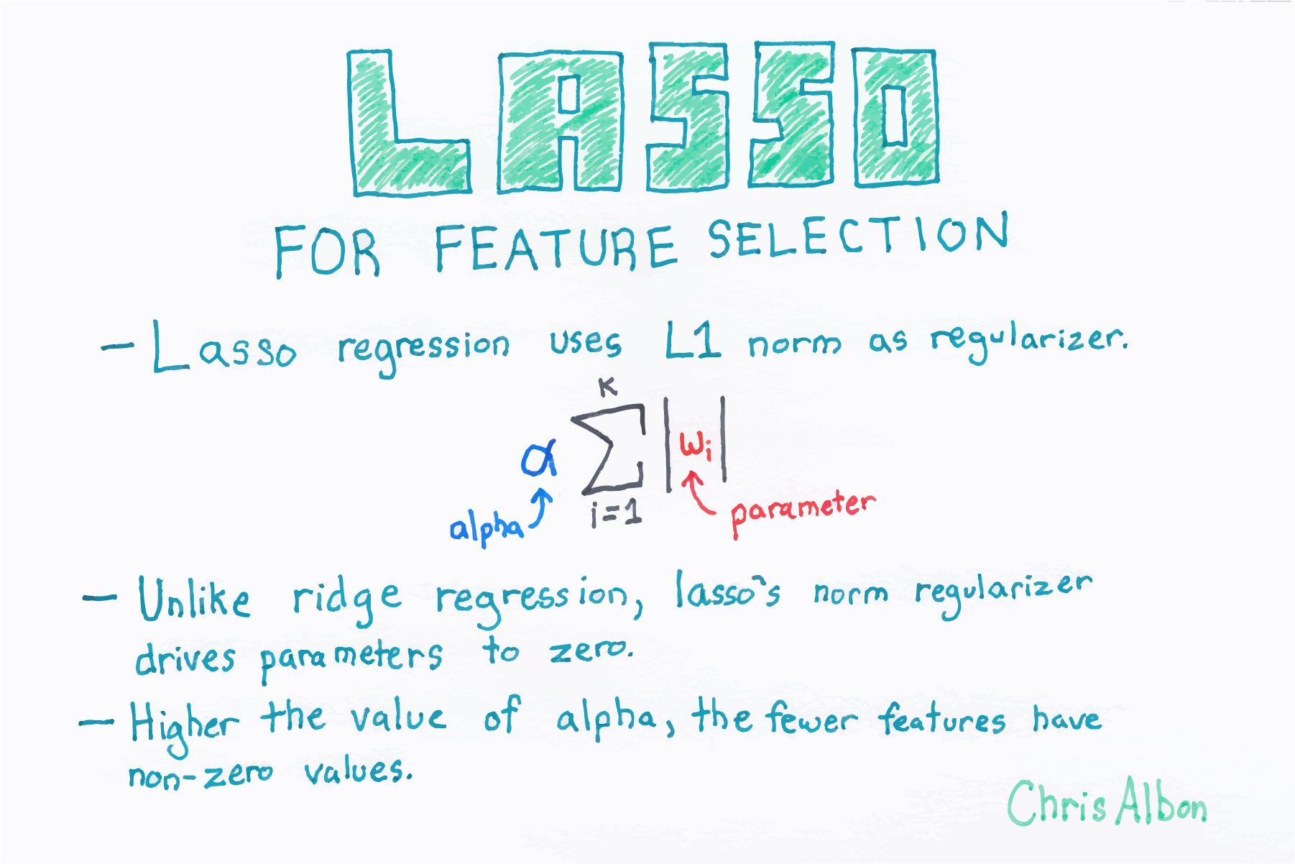
Lasso Regression
Image Source: Chris Albon. (2017). Machine Learning Flashcards. Flashcards were purchased by the author and are not available for free.

Slide 11
NNoonn--LLiinneeaarr MMooddeellss ffoorr RReeggrreessssiioonn
1111 // 2200

Slide 12
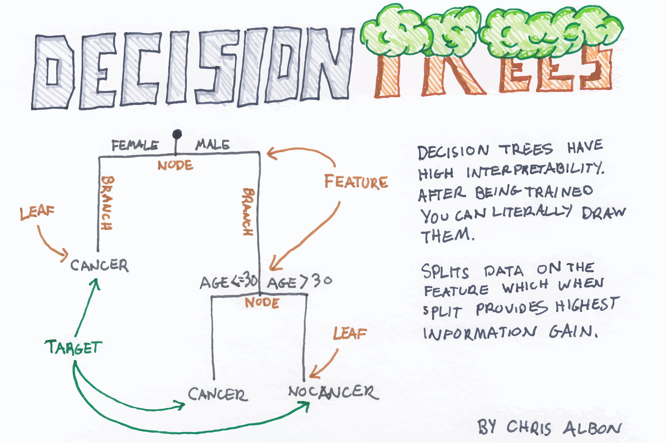
Decision Trees (Classification and Regression Trees)
Image Source: Chris Albon. (2017). Machine Learning Flashcards. Flashcards were purchased by the author and are not available for free.

Slide 13
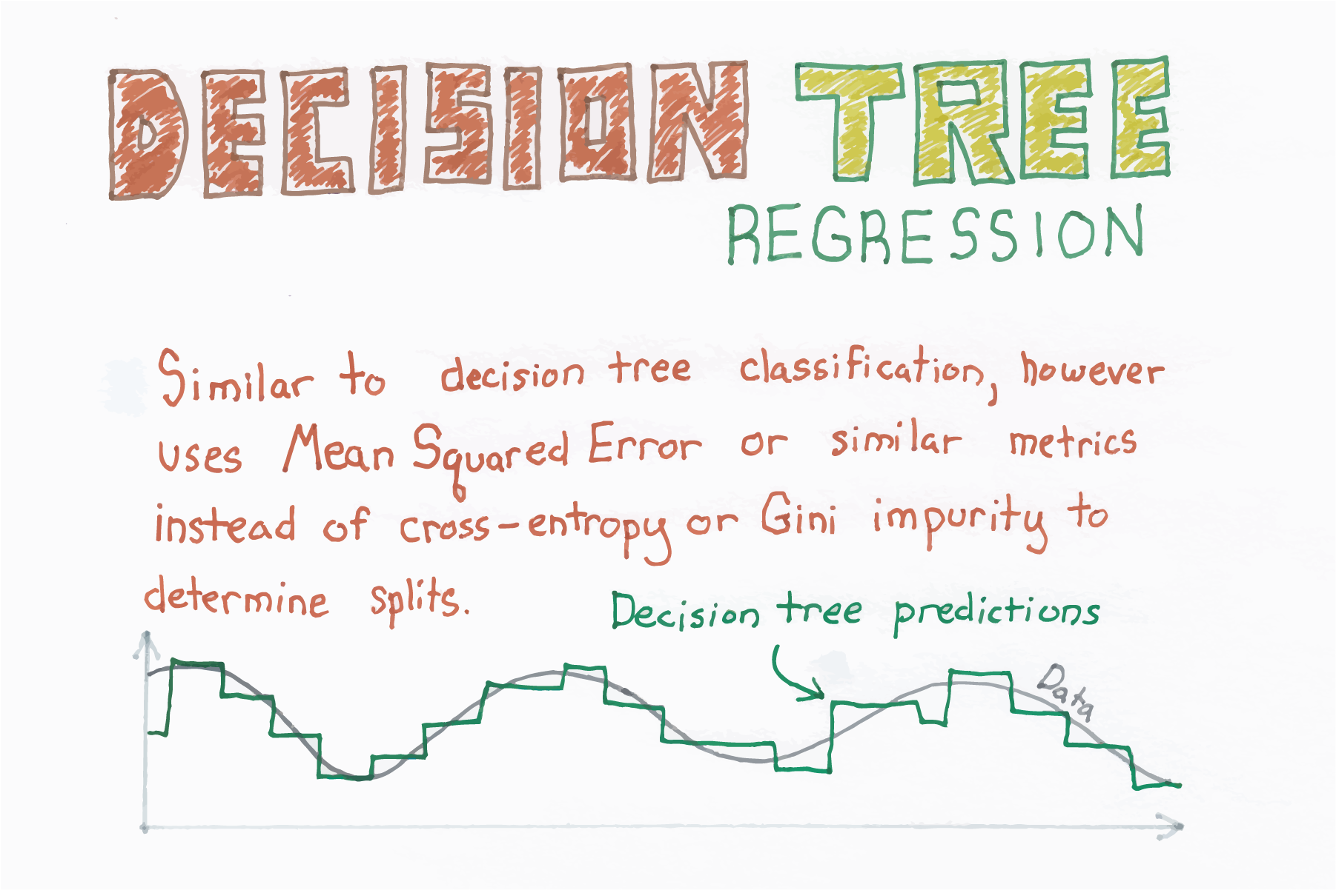
Decision Trees (Classification and Regression Trees)
Image Source: Chris Albon. (2017). Machine Learning Flashcards. Flashcards were purchased by the author and are not available for free.

Slide 14
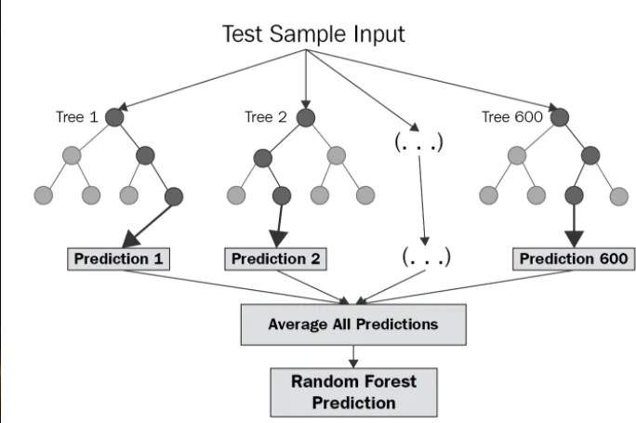
Random Forests
Image Source: Chaya. (2020). Random Forest Regression.

Slide 15
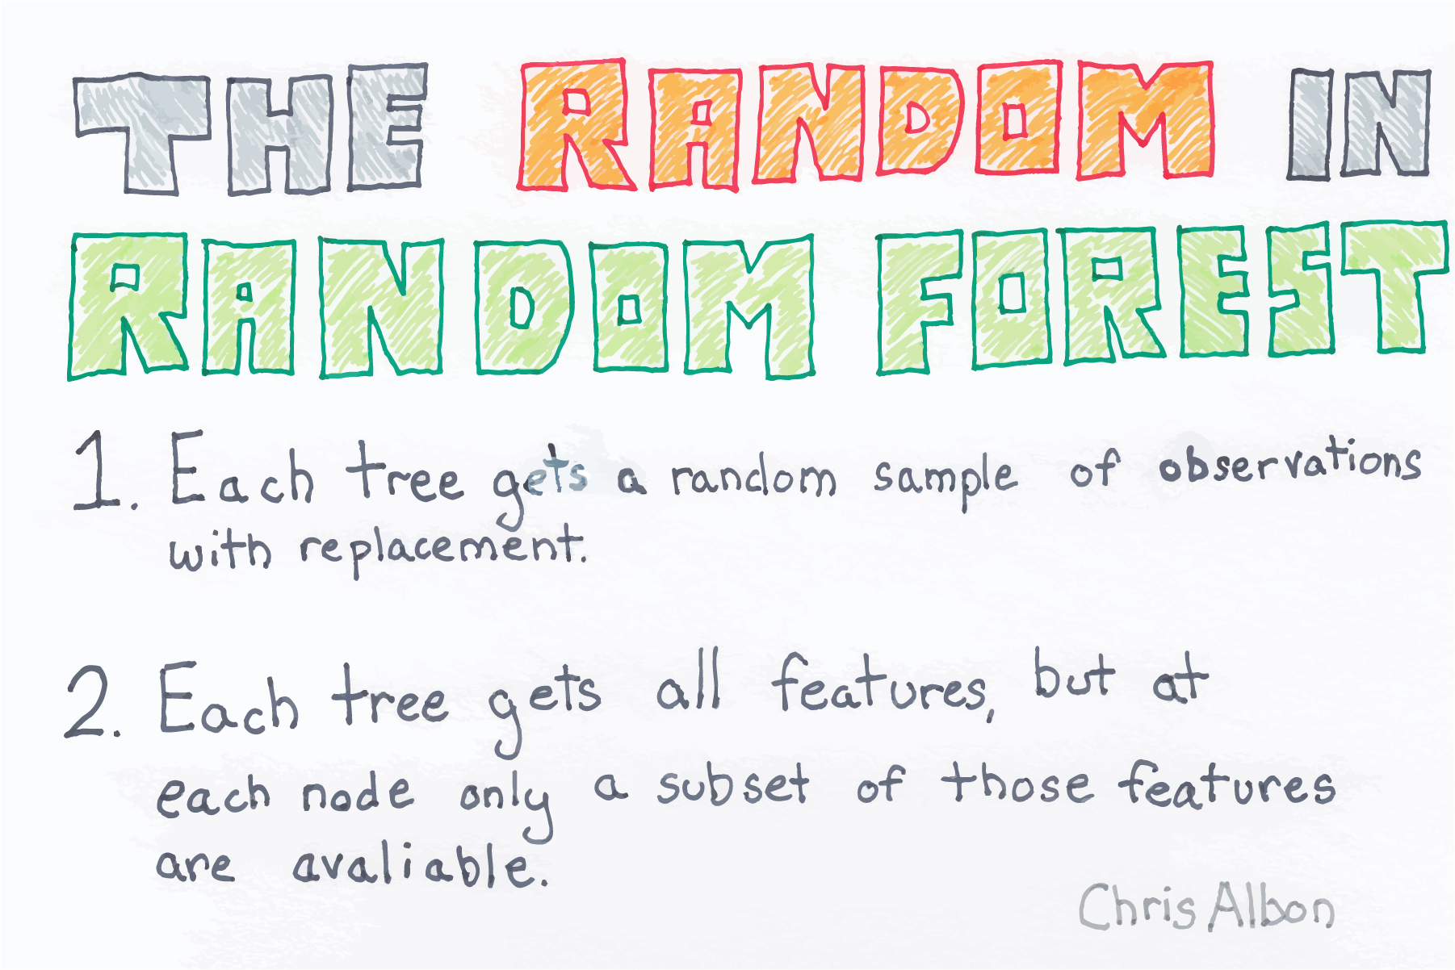
Random Forests
Image Source: Chris Albon. (2017). Machine Learning Flashcards. Flashcards were purchased by the author and are not available for free.

Slide 16
AApppplliiccaattiioonnss ttoo CCyybbeerrsseeccuurriittyy DDaattaasseettss
1166 // 2200

Slide 17
Example: Predicting Flow Duration in IoT Networks
from ucimlrepo import fetch_ucirepo
fetch dataset
rt_iot2022 = fetch_ucirepo(id=942)
data (as pandas dataframes) X = rt_iot2022.data.features y = rt_iot2022.data.targets
df = pd.concat([X, y], axis=1)
subset the features and dataset df = (
df
.sample(frac=0.1, random_state=2025)
.reset_index(drop=True)
.loc[:, ['proto', 'service', 'fwd_pkts_payload.avg', 'bwd_pkts_payload.avg', 'fwd_subflow_
)


Note: The dataset is from the UCI Machine Learning Repository. It contains features of network traffic in IoT networks and the target variable is the flow duration. The goal is to predict the flow duration using the features. For more information, see UCI RT-IoT2022.
17 / 20

Slide 18
RReeccaapp
1188 // 2200

Slide 19
Summary of Main Points
By now, you should be able to do the following:
Recognize the differences and similarities between traditional regression and machine learning regression models
Describe advanced techniques like Ridge and Lasso
Explore non-linear models like Decision Trees and Random Forests for regression tasks
Apply machine learning regression models to cyber security data sets

Slide 20
📝 Review and Clarification 📝
Class Notes: Take some time to revisit your class notes for key insights and concepts.
Zoom Recording: The recording of today's class will be made available on Canvas approximately 3-4 hours after the end of class.
Questions: Please don't hesitate to ask for clarification on any topics discussed in class. It's crucial not to let questions accumulate.

