Slide 1




ISA 444: Business Forecasting
08: Forecasting Environment
Fadel M. Megahed, PhD
Professor
Farmer School of Business Miami University
@FadelMegahed fmegahed fmegahed@miamioh.edu
Automated Scheduler for Office Hours
Spring 2025

Slide 2
Quick Refresher of Last Class
✅ Explain the differences between wide vs. long format
✅ Use seaborn to plot multiple time-series
✅ Convert a data set to Nixtla's long format (unique_id, ds, y)
✅ Use UtilsForecast to visualize multiple series

Slide 3
Learning Objectives for Today's Class
Install and import Nixtla's libraries (StatsForecast, MLForecast, NeuralForecast, UtilsForecast, and TimeGPT) for forecasting
Distinguish fixed window from rolling-origin
Introduce forecast accuracy metrics (MAE, MAPE, RMSE)

Slide 4
TThhee NNiixxttllaavveerrssee OOppeenn--SSoouurrccee FFoorreeccaassttiinngg LLiibbrraarriieess
44 // 2277

Slide 5
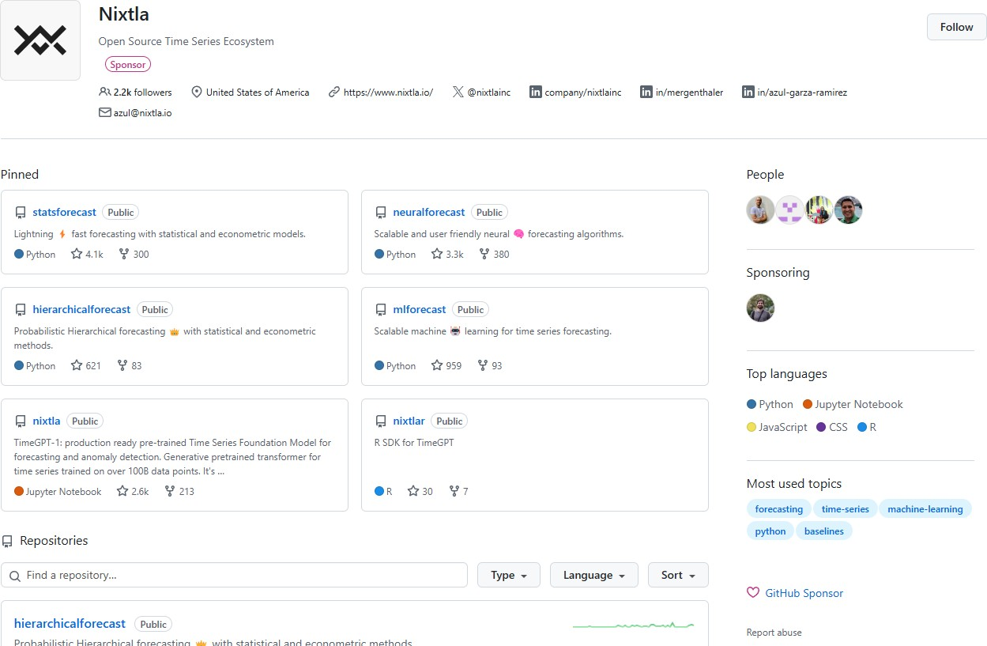
Nixtla's Forecasting Libraries
5 / 27

Slide 6
Nixtla's Forecasting Libraries
Nixtla provides several open-source Python libraries (and a closed source TimeGPT tool accessible via API calls) for scalable forecasting tasks. These libraries are relatively easy to use and can be integrated into your future forecasting workflows:
StatsForecast – Fast & scalable statistical models (ARIMA, ETS, etc.).
MLForecast – Machine learning-based forecasting (e.g., XGBoost, LightGBM).
NeuralForecast – Deep learning models for time series (e.g., NBEATS, NHITS, and TFT).
UtilsForecast – Utility functions for plotting, evaluation, etc.
TimeGPT – an AI transformer-powered forecasting API that requires minimal tuning.
These libraries enable forecasting at scale, which you will need in practice.
Note: These libraries can be installed via pip and are described in detail in nixtlaverse.nixtla.io. Use the left-hand navigation bar to explore the documentation for each library.
6 / 27

Slide 7
FFiixxeedd WWiinnddooww vvss.. RRoolllliinngg--OOrriiggiinn
77 // 2277

Slide 8
The Fixed Window Evaluation Approach
Fixed Window is the simplest approach to splitting your time series data into a training and a testing/holdout set.
The goal is to train your model on the training set and evaluate its performance on the testing set (the last k observations in the data).
Note that this is quite different than traditional machine learning applications for cross sectional data.
The evaluation on the testing/holdout set can serve two purposes:
Model Evaluation: Assess the model's performance on unseen data (since it is not used during training, and hence acts as a proxy for the model's performance on future data).
Model Selection: Compare the performance of different models to select the best one.
Note that using this approach for model selection is reasonable if your models do not involve hyperparameter tuning (otherwise, you may overfit to the testing set).

Slide 9
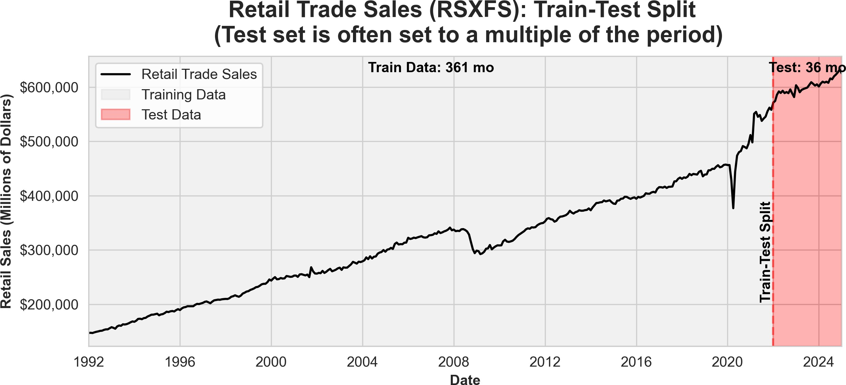
The Fixed Window Evaluation Approach

Slide 10
The Rolling-Origin Evaluation Approach
Rolling-Origin Evaluation is a method for splitting time series data into training and testing sets where the testing sets move forward over time.
The goal is to train the model on a subset of past observations and evaluate its
performance on a future testing set at multiple time steps.
The key difference from a fixed window approach is that the testing set shifts forward, allowing for multiple evaluations:
The training set may expand (expanding window) or remain fixed (rolling window).
This ensures that model performance is assessed across different points in time.
It reduces sensitivity to the initial split point and provides a more robust evaluation of model performance over time.

Slide 11
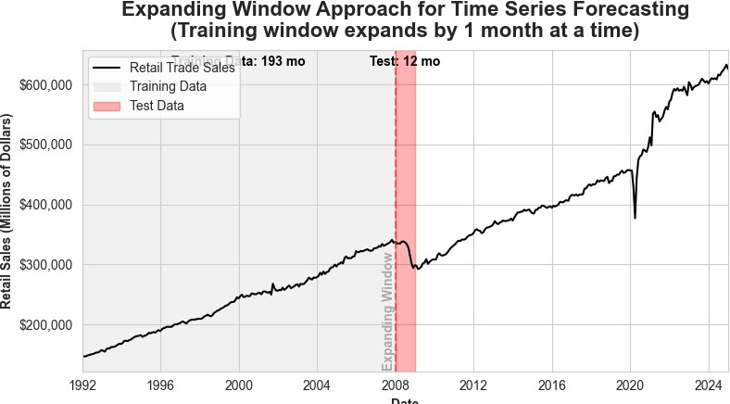
Expanding Window Evaluation (By 1 Month)

Slide 12

Expanding Window Evaluation (By 12 Month)

Slide 13
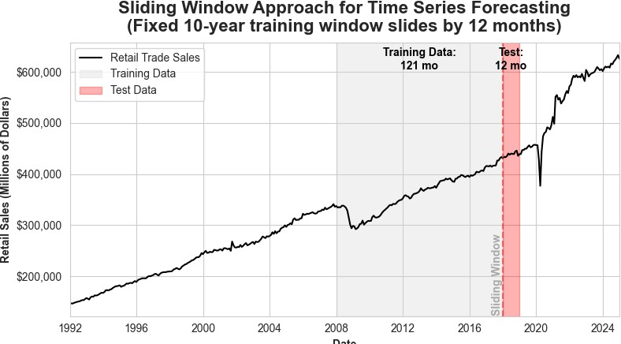
Rolling Non-Expanding Window Evaluation

Slide 14
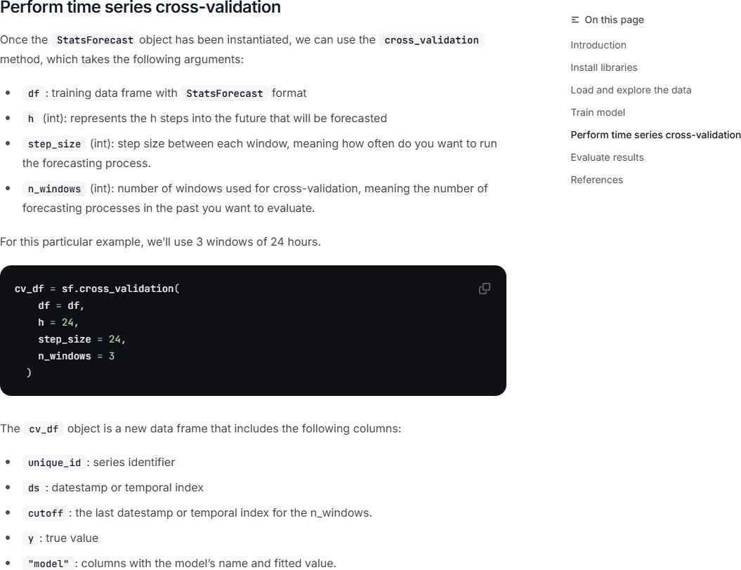
Cross Validation within the Nixtlaverse
Note: The cross_validation method can also be applied to other NixtlaForecast objects (e.g., MLForecast, NeuralForecast) to perform cross-validation for machine learning and deep learning models. See the StatsForecast Cross Validation Tutorial to access the page shown above.
14 / 27

Slide 15
Activity: The cross_validation Method
ross_validation | method from Nixtla implements:
 | 0 | 0
d Window Evaluation
Expanding Rolling Window
Non-Expanding Rolling Window

Slide 16
Recap of Fixed vs. Rolling-Origin
Fixed Window:
Simplest approach to splitting data into training and testing sets.
Testing set is fixed and does not move forward over time.
Provides a single evaluation of model performance.
Rolling-Origin:
Testing set moves forward over time.
Training set may expand or remain fixed.
Provides multiple evaluations of model performance.
Reduces sensitivity to the initial split point.
More robust evaluation of model performance over time.

Slide 17
Recap of Fixed vs. Rolling-Origin
In practice, the rolling-origin approach is preferred for time series forecasting tasks since it mimics the real-world scenario of forecasting future data points. The choice of:
Expanding vs. Rolling Window,
Window Size, and
Step Size depends on the specific forecasting task and the data at hand.

Slide 18
FFoorreeccaasstt AAccccuurraaccyy MMeettrriiccss
1188 // 2277

Slide 19
Model Performance Evaluation in the Nixtlaverse
from utilsforecast.losses import *
evaluate
evaluate (df:~AnyDFType, metrics:List[Callable], models:Optional[List[str]]=None, train_df:Optional[~AnyDFType]=None, level:Optional[List[int]]=None, id_col:str='unique_id', time_col:str='ds', target_col:str='y', agg_fn:Optional[str]=None)
Source: Nixtla's UtilsForecast Evaluation Documentation

Slide 20
Model Performance Evaluation in the Nixtlaverse (Cont.)
 | Type | Default | Details
df | AnyDFType |  | Forecasts to evaluate. Must have id_col, time_col, target_col and models’ predictions.
metrics | List |  | Functions with arguments df, models, id_col, target_col and optionally train_df.
models | Optional | None | Names of the models to evaluate. If None will use every column in the dataframe after removing id, time and target.
train_df | Optional | None | Training set. Used to evaluate metrics such as mase.
level | Optional | None | Prediction interval levels. Used to compute losses that rely on quantiles.
id_col | str | unique_id | Column that identifies each serie.
time_col | str | ds | Column that identifies each timestep, its values can be timestamps or integers.
target_col | str | y | Column that contains the target.
agg_fn | Optional | None | Statistic to compute on the scores by id to reduce them to a single number.
Returns | AnyDFType |  | Metrics with one row per (id, metric) combination and one column per model. If agg_fn is not None, there is only one row per metric.
Source: Nixtla's UtilsForecast Evaluation Documentation

Slide 21
Losses
The most important train signal is the forecast error, which is the difference between the observed value y_{τ} and the prediction y^_{τ} , at time y_{τ} :
e_{τ} = y_{τ} − y^_{τ} τ ∈ {t + 1, … , t + H}
The train loss summarizes the forecast errors in different evaluation metrics.
Source: Nixtla's UtilsForecast Losses Documentation

Slide 22
Scale-Dependent Errors: mae
MAE measures the relative prediction accuracy by averaging the absolute deviations between forecasts and actual values.
1
H
t+H
∑ |y_{τ} − y^_{τ} |
τ=t+1
MAE(y_{τ} , y^_{τ} ) =
Interpretation: Provides a straightforward measure of forecast accuracy; lower MAE indicates better performance.
Characteristic: Does not penalize larger errors more than smaller ones; treats all errors equally.
Source: Nixtla's UtilsForecast Losses Documentation

Slide 23
Scale-Dependent Errors: rmse
RMSE is the square root of the average of the squared differences between forecasts and actual values.
 1
RMSE(y_{τ} , y^_{τ} ) = ⎷
t+H
∑ (y_{τ} − y^_{τ} )
2
τ=t+1
H
Interpretation: Emphasizes larger errors due to squaring; useful when large errors are particularly undesirable.
Characteristic: Penalizes large errors more than MAE (i.e., more sensitive to ourliers compared to MAE).
Source: Nixtla's UtilsForecast Losses Documentation

Slide 24
Percentage Errors: mape
MAPE calculates the average absolute error as a percentage of actual values.
1
H
t+H
∣ y_{τ} − y^ ∣
MAPE(y_{τ} , y^ ) =
∑ ∣ ^{τ} ∣
τ
∣ y_{τ} ∣
τ=t+1
Interpretation: Expresses forecast accuracy as a percentage; lower MAPE indicates better performance.
Characteristic: Can be misleading if actual values are close to zero, leading to extremely high MAPE values.
Source: Nixtla's UtilsForecast Losses Documentation

Slide 25
RReeccaapp
2255 // 2277

Slide 26
Summary of Main Points
By now, you should be able to do the following:
Install and import Nixtla's libraries (StatsForecast, MLForecast, NeuralForecast, UtilsForecast, and TimeGPT) for forecasting
Distinguish fixed window from rolling-origin
Introduce forecast accuracy metrics (MAE, MAPE, RMSE)

Slide 27
📝 Review and Clarification 📝
Class Notes: Take some time to revisit your class notes for key insights and concepts.
Zoom Recording: The recording of today's class will be made available on Canvas approximately 3-4 hours after the session ends.
Questions: Please don't hesitate to ask for clarification on any topics discussed in class. It's crucial not to let questions accumulate.

