Slide 1




ISA 444: Business Forecasting
12: Baseline Forecasts with Exponential Smoothing Methods
Fadel M. Megahed, PhD
Professor
Farmer School of Business Miami University
@FadelMegahed fmegahed fmegahed@miamioh.edu
Automated Scheduler for Office Hours
Spring 2025

Slide 2
Quick Refresher of Last Class
✅ Recognize the importance of baseline forecasts in time series forecasting
✅ Identify common baseline forecasts (Naive, Seasonal Naive, etc.)
✅ Implement baseline models with StatsForecast

Slide 3
Learning Objectives for Today's Class
Understand the mathematical background for exponential smoothing methods, including:
Simple Exponential Smoothing (SES)
Double Exponential Smoothing (Holt)
Triple Exponential Smoothing (Holt-Winters)
Implement these exponential smoothing methods in Python using StatsForecast

Slide 4
EExxppoonneennttiiaall SSmmooootthhiinngg MMeetthhooddss
44 // 2244

Slide 5
Context: Our Previously Discussed Baseline Models
We have expressed our time series as: y₁, y₂, … , y_{T} .
Naive Forecast:
^{y^}T +h∣T
= y_{T}
Historical Average:
y^
₌ 1
∑T
T +h∣T
t=1
y
t
T
Is there a more reasonable middle ground between these two extremes?
Naive: ..........
Historical Average: ..........
.............................................

Slide 6
Simple Exponential Smoothing (SES)
Forecast equation:
^{y^}T +1∣T
= αy_{T} + α(1 − α)y_{T −1} + α(1 − α)²y_{T −2} + α(1 − α)³y_{T −3} + ⋯ ,
where 0 ≤ α ≤ 1 is the smoothing parameter.
Observation | Exponentially decaying weights assigned to observations for:
 | `α = 0.2` | `α = 0.4` | `α = 0.6` | `α = 0.8`
`y_{T} ` | 0.2 | 0.4 | 0.6 | 0.8
`y_{T −1} ` | 0.16 | 0.24 | 0.24 | 0.16
`y_{T −2} ` | 0.128 | 0.144 | 0.096 | 0.032
`y_{T −3} ` | 0.1024 | 0.0864 | 0.0384 | 0.0064
`yT ₋₄ ` | (0.2)(0.8)^4 | (0.4)(0.6)^4 | (0.6)(0.4)^4 | (0.8)(0.2)^4

Slide 7
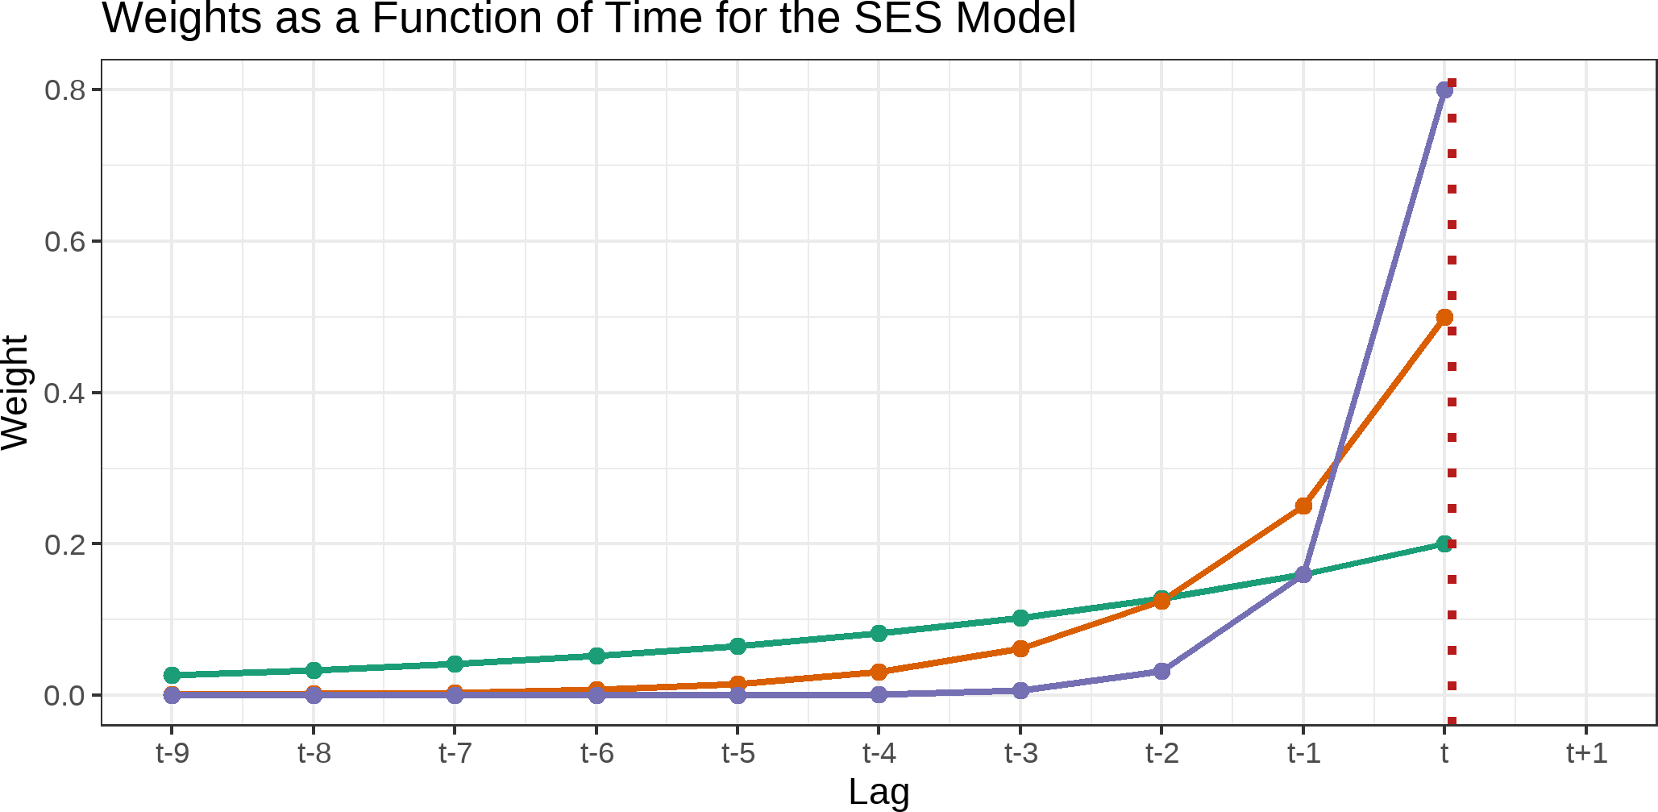
Simple Exponential Smoothing (SES)

Slide 8
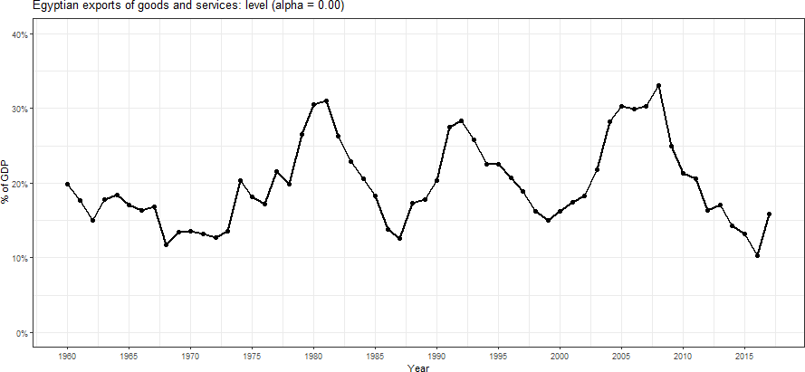
Simple Exponential Smoothing (SES)
Credits: This animation is inspired by Rob J Hyndman's presentation of simple exponential smoothing in his book "Forecasting: Principles and Practice". See here for more details.

Slide 9
Simple Exponential Smoothing (SES)
Component Form:
Forecast equation Smoothing equation
^{y^}t+h∣t ^{= ℓ}t
(mathematically equivalent to equation in Slide 6)
ℓ_{t} = αy_{t} + (1 − α)ℓ_{t−1}
ℓ_{t} is the level (or the smoothed value) of the series at time t
SES is computationally efficient: y^_{t+h∣t} = αy_{t} + (1 − α)y^_{t∣t−1}
The SES implementation assumes no trend and no seasonality since y^_{T +h∣T}
and ℓ_{T} is a constant (last smoothed value).
= ℓ_{T} , for h ≥ 1,
The SES model is equivalent to the ETS(A,N,N) model in the ETS framework (additive error, no trend, no seasonality).

Slide 10
Simple Exponential Smoothing (SES)
Weighted Average Form:
T −1
= ∑ α(1 − α)^{j}y_{T −j} + (1 − α)^{T} ℓ₀
j=0
^{y^}T +1∣T

Slide 11
Smoothing Parameters in SES
There are two parameters for the SES model: α, and ℓ₀.
These parameters are either estimated or set by the user.
The StatsForecast library provides two implementation of SES:
SimpleExponentialSmoothing, where you can set the alpha parameter. It uses the first value of the time series as the initial level (ℓ₀); or
SimpleExponentialSmoothingOptimized, which finds the optimal α parameter by minimizing the sum of squared errors.
Please refer to the SimpleExponentialSmoothing Tutorial and the SimpleExponentialSmoothingOptimized Tutorial for more details on the Nixtla Implementation.

Slide 12
05:00
Class Activity
Description Relevant Info Your Solution Validate [Out of Class]
In the beginning of the semester, I noted that the StatsForecast Python implementation focuses on forecasting at scale, while traditional R implementations focus on model explanation and interpretation.
The SimpleExponentialSmoothingOptimized model in StatsForecast is a good example of this, where the model is optimized to find the best α parameter but it does not directly provide the optimized α value.
Your task is to find the optimized α value from the reported fitted values from their example.
Note that the purpose of this activity is not the mathematical exercise, but to understand the model's output and to be able to explain it to your future colleagues.

Slide 13
Interesting Interpretations of the SES Function
By rearranging the forecast equation, we can express it as:
^{y^}t+1∣t

Forecast for next time period
= αy_{t} + (1 − α)y^_{t∣t−1}
=
^{y^}t∣t−1

Previous estimate
+
α

Smoothing parameter
(y_{t} − y^_{t∣t−1})

Forecast error
^{= y^}t∣t−1

Lag of level
+
α

Smoothing parameter
(y_{t} − y^_{t∣t−1})

Remainder
The forecast for next time period is a weighted sum of the actual observation and previous forecast.
The smoothing parameter α controls how much weight is given to the new observation.
The forecast error (y_{t} − y^_{t∣t−1}) captures how much the previous estimate deviates from the actual.
The previous estimate y^_{t∣t−1} represents the forecast from the prior time step.

Slide 14
Double Exponential Smoothing (Holt)
The SES model is suitable for time series with no trend or seasonality.
The Holt model extends SES to time series with a local (not constant) linear trend, but no seasonality.
The Holt model uses two smoothing parameters: α for the level and β∗ for the trend.
The Holt model is equivalent to the ETS(A,A,N) model in the ETS framework (additive error, additive trend, no seasonality).
The Holt model is implemented in the StatsForecast library as Holt.

Slide 15
Double Exponential Smoothing (Holt)
Forecast
y^t + h ∣ t =

Forecast for t+h
ℓ_{t}

Level (Base Value)
+ h
b_{t}


Predict future value
Trend (Growth Rate)
Level
ℓ_{t}

New level estimate
=
αy_{t}

Weight on new observation
+ (1 − α)(ℓ_{t−1} + b_{t−1})

Weight on past level + trend

Smoothed estimate of series
Trend
b_{t}

New trend estimate
= β∗(ℓ_{t} − ℓ_{t−1}) +

New level change weighted by β∗
(1 − β∗)b_{t−1}

Past trend estimate weighted by (1−β∗)

Smoothed trend estimate

Slide 16
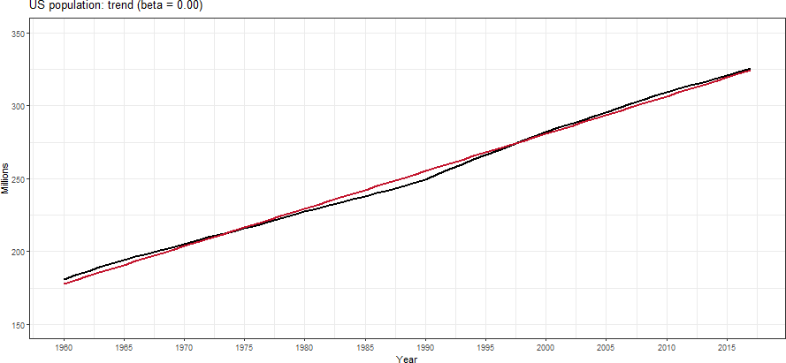
Double Exponential Smoothing (Holt)
Credits: This animation is inspired by Rob J Hyndman's presentation of double exponential smoothing in his book "Forecasting: Principles and Practice". See here

Slide 17
Triple Exponential Smoothing (Holt-Winters)
The Holt-Winters model extends Holt to time series with seasonality.
The Holt-Winters model uses three smoothing parameters: α for the level, β∗ for the trend, and γ for the seasonality.
There are two versions of the Holt-Winters model:
Additive Seasonality: The seasonal component is added to the level and trend.
Multiplicative Seasonality: The seasonal component is multiplied by the level and trend.
The Holt-Winters model is implemented in the StatsForecast library as HoltWinters.

Slide 18
Triple Exponential Smoothing (Holt-Winters [Add])
y^t + h ∣ t =

Forecast for t+h
ℓ_{t}

Level (Base Value)
+ h
b_{t}
+ ^{s}t+h−m(k+1)

Seasonal Effect

Trend (Growth Rate)
ℓ_{t}

Smoothed estimate of level
= α(y_{t} − s_{t−m})

Weight on seasonally adjusted observation
+ (1 − α)(ℓ_{t−1} + b_{t−1})

Weight on past level + trend
b_{t}

Smoothed estimate of trend
= β∗(ℓ_{t} − ℓ_{t−1}) +

New level change weighted by β∗
(1 − β∗)b_{t−1}

Past trend estimate weighted by (1−β∗)
s_{t}

Smoothed estimate of seasonality
= γ(y_{t} − ℓ_{t−1} − b_{t−1}) +

Weight on new seasonal effect
(1 − γ)s_{t−m}

Weight on past seasonal component

Slide 19
Triple Exponential Smoothing (Holt-Winters [Add])
Seasonal component is usually expressed as s_{t} = γ∗(y_{t} − ℓ_{t}) + (1 − γ∗)s_{t−m}.
Substitute in for ℓ_{t}: s_{t} = γ∗(1 − α)(y_{t} − ℓ_{t−1} − b_{t−1}) + [1 − γ∗(1 − α)]s_{t−m}
We set γ = γ∗(1 − α).
The usual parameter restriction is 0 ≤ γ∗ ≤ 1, which translates to 0 ≤ γ ≤ (1 − α).

Slide 20
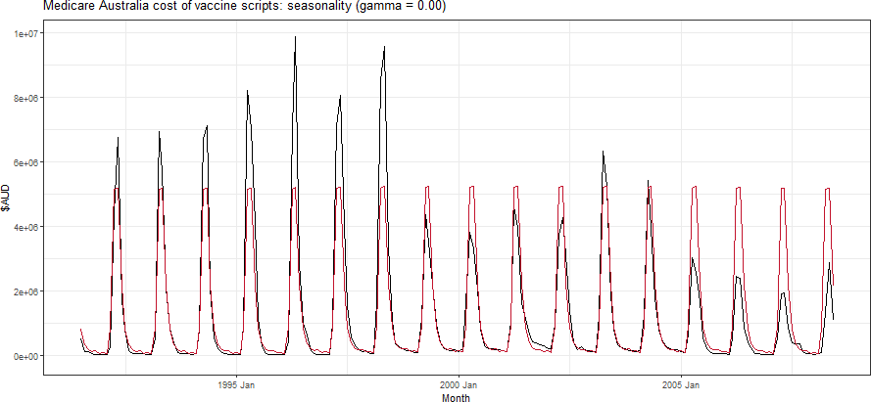
Triple Exponential Smoothing (Holt-Winters [Add])

Slide 21
Triple Exponential Smoothing (Holt-Winters [Mult])
Seasonal variations change in proportion to the level of the series.
^{y^}t+h∣t

Forecast at time t+h
= (ℓ_{t} + hb_{t})

Level + Trend (Growth Adjusted)
^{× s}t+h−m(k+1)

Seasonal Effect
y_{t}
ℓ
=
α
+ (1 − α)(ℓ + b )
t
t−1 t−1

Smoothed estimate of level
st−m

Weight on past level + trend

Seasonally adjusted new observation
= β∗(ℓ_{t} − ℓ_{t−1}) +

New level change weighted by β∗
b_{t}

Smoothed estimate of trend
(1 − β∗)b_{t−1}

Past trend estimate weighted by (1−β∗)
y_{t}
s_{t}

Smoothed estimate of seasonality
= γ
+ (1 − γ)s_{t−m}

Past seasonal component weighted by (1−γ)
(ℓt−1 + ^{b}t−1)

New seasonal adjustment weighted by γ

Slide 22
RReeccaapp
2222 // 2244

Slide 23
Summary of Main Points
By now, you should be able to do the following:
Understand the mathematical background for exponential smoothing methods, including:
Simple Exponential Smoothing (SES)
Double Exponential Smoothing (Holt)
Triple Exponential Smoothing (Holt-Winters)
Implement these exponential smoothing methods in Python using StatsForecast

Slide 24
📝 Review and Clarification 📝
Class Notes: Take some time to revisit your class notes for key insights and concepts.
Zoom Recording: The recording of today's class will be made available on Canvas approximately 3-4 hours after the session ends.
Questions: Please don't hesitate to ask for clarification on any topics discussed in class. It's crucial not to let questions accumulate.

