Slide 1




ISA 444/544: Business Forecasting
15: Stationarity, Differencing and Unit Root Tests
Fadel M. Megahed, PhD
Professor
Farmer School of Business Miami University
@FadelMegahed fmegahed fmegahed@miamioh.edu
Automated Scheduler for Office Hours
Fall 2025

Slide 2
Learning Objectives for Today's Class
Define a stationary time series.
Understand how plotting techniques can help identify non-stationarity.
Understand how we can stabilize a non-stationary time series to achieve stationarity
(differencing to stabilize the mean, and log transformation to stabilize the variance).
Understand how to use unit root tests to test for stationarity.
2 / 33

Slide 3
WWhhaatt iiss SSttaattiioonnaarriittyy??
33 // 3333

Slide 4
Stationarity
Definition: If {y_{t}} is a stationary time series, then for all s, the distribution of (y_{t}, … , y_{t+s})
does not depend on t.
This means that a stationary time series:
is roughly horizontal (i.e., no trend)
has a constant variance (i.e., no heteroskedasticity)
no patterns are predictable in the long-term (i.e., no seasonality)

Slide 5
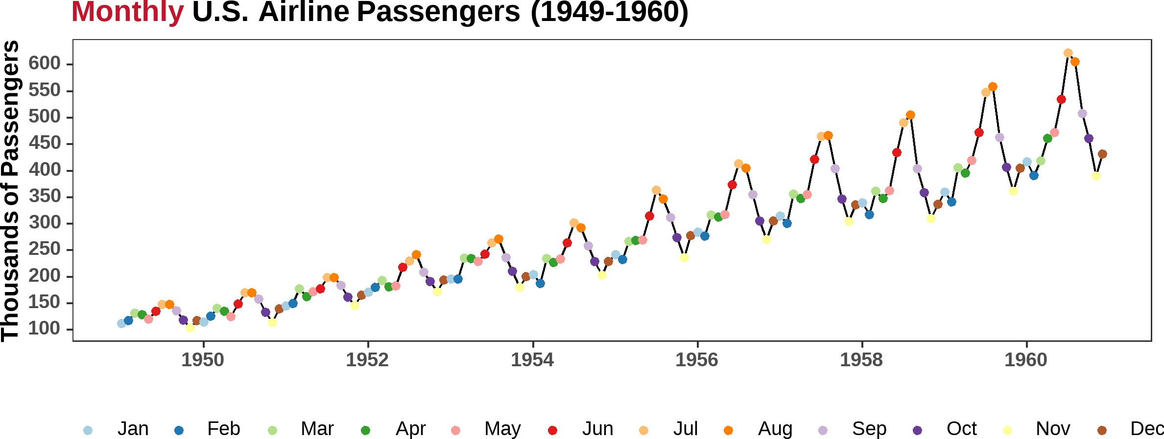
Class Activity: Stationarity or Non-Stationarity?
Task KR Δ KR Strikes House Sales Lynx Beer Travel

Slide 6
How to Identify Non-Stationarity in the Mean
Visual Inspection of the time series plot (line-chart):
Look for trends in the time series plot.
Look for seasonality in the time series plot.
Examine the ACF of the time series:
A slow decay in the ACF plot ⟶ non-stationary.
On the other hand, if the ACF plot drops to zero quickly ⟶ likely stationary.
Note: For non-stationary time series, the value of r₁ is often large and positive.

Slide 7
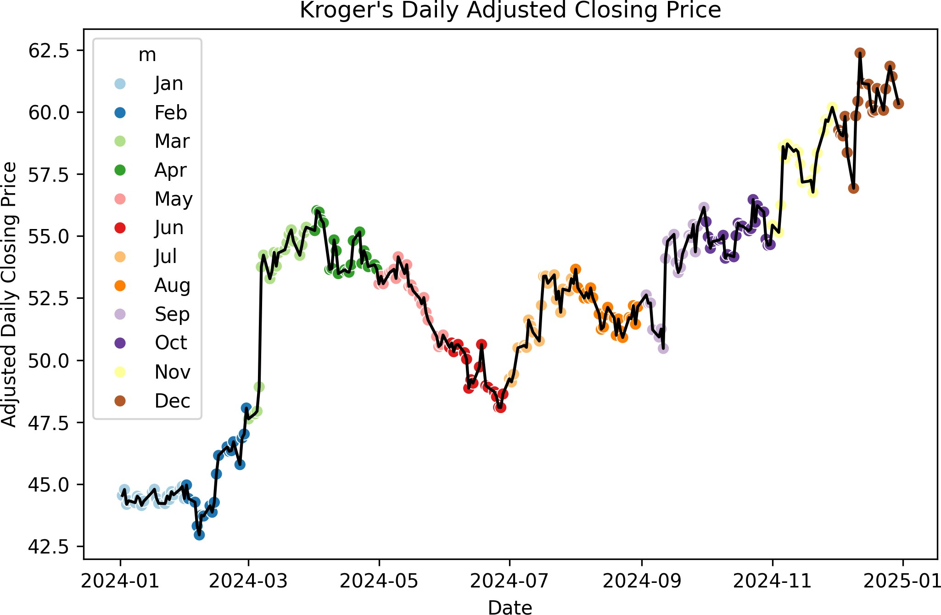
Example: The Non-Stationarity in Kroger Stock Price
import pandas as pd import datetime as dt import seaborn as sns
path = "../../data/kroger_stock_2024.csv" kr = (
pd.read_csv(path)
.assign(
ds=lambda x: pd.to_datetime(x['date']), m=lambda x: x['ds'].dt.month_name().str[:3],
)
)
plt.figure(figsize=(8, 5)) ax = sns.lineplot(
data=kr, x='ds', y='price', color='black'
)
sns.scatterplot(
data = kr, x = 'ds', y = 'price', hue = 'm', s=40, ax=ax, palette='Paired'
)
ax.set(
title="Kroger's Daily Adjusted Closing Price", xlabel="Date",
ylabel="Adjusted Daily Closing Price",
)
7 / 33

Slide 8
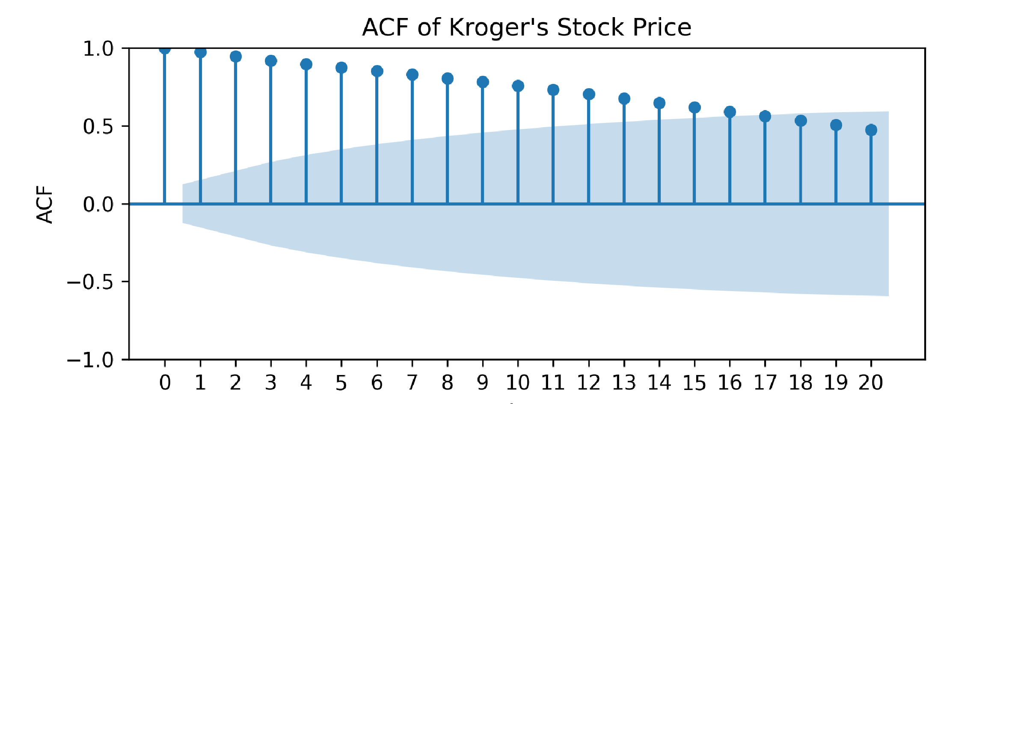
Example: The Non-Stationarity in Kroger Stock Price
from statsmodels.tsa.stattools import acf
from statsmodels.graphics.tsaplots import plot_ac
Using the data from Slide 7
acf_df = pd.DataFrame(
{'lag': range(0, 21),
'acf': acf(kr['price'], nlags=20)
}
##
lag
acf
## | 0 | 0 | 1.0000
## | 1 | 1 | 0.9737
## | 2 | 2 | 0.9467
## | 3 | 3 | 0.9189
## | 4 | 4 | 0.8954
)
Print the first few rows of the ACF df
acf_df.head()
Plot the ACF and beautify the plot plt.figure( figsize=(8, 5) ) plot_acf( kr['price'], lags=20 ) plt.xticks( ticks=range(0, 21) ) plt.xlabel('Lag')
plt.ylabel('ACF')
plt.title("ACF of Kroger's Stock Price") plt.show()



Slide 9
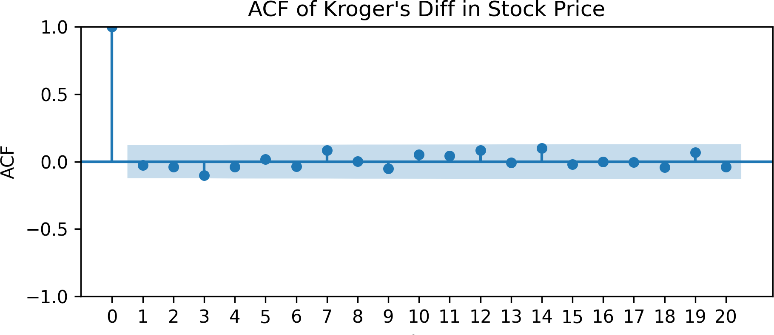
How Does the ACF of a Stationary Time Series Look?
For a stationary time series, the ACF plot will decay (cut off) quickly to zero.
Non-significant autocorrelations are within the blue shaded region, and are statistically not different from zero.
kr['delta'] = kr['price'].diff()
##
lag
acf
## | 0 | 0 | 1.0000
## | 1 | 1 | -0.0274
## | 2 | 2 | -0.0382
## | 3 | 3 | -0.1016
## | 4 | 4 | -0.0387
acf_df = pd.DataFrame(
{'lag': range(0, 21), 'acf': acf(
kr['delta'], nlags=20, missing='drop'
).round(4)
}
)
acf_df.head()
plt.figure( figsize=(8, 5) ) plot_acf(kr['delta'], lags=20, missing='drop') plt.xticks( ticks=range(0, 21) ) plt.xlabel('Lag')
plt.ylabel('ACF')
plt.title("ACF of Kroger's Diff in Stock Price")

Slide 10
MMaatthheemmaattiiccaall BBaacckkggrroouunndd oonn tthhee 9955%% LLiimmiittss ooff tthhee AACCFF PPlloott
((UUnnddeerrssttaannddiinngg hhoo ssttaattssmmooddeellss
ccoommppuutteess ccoonnfifiddeennccee iinntteerrvvaallss))
ww
1100 // 3333

Slide 11
1. Standard Error of ACF for White Noise
For an uncorrelated white noise process, the standard error (SE) of the sample ACF at lag ( k ) is:
1
SE(ρ^ ) ≈
k
√N
Here, ( N ) is the sample size.
Assumes the series is white noise: no autocorrelation beyond lag 0.
The 95% confidence interval (CI) is:
1
±1.96 ×

√
N
Standard Error (SE)
💡 Key idea: More data ⟶ Smaller SE ⟶ Narrower confidence bands.

Slide 12
2. Bartlett’s Formula for SE of ACF
For a stationary time series, the SE must account for autocorrelation:


(1 + 2 ∑ ρ^ )
⎷N
k−1
1
2
SE(ρ^ ) ≈
k
j
j=1

The sum of squared autocorrelations, 2 ∑^{k−1} ρ^² , increases SE, which leads to wider
j=1
j
confidence bands. Hence:
Effect of past lags
If the time series is highly correlated (e.g., a random walk), SE increases.
Differencing reduces autocorrelation, making the sum smaller and the SE lower.

Slide 13
3. Why Do CIs Widen at Larger Lags?
Even though autocorrelations shrink at higher lags, the confidence intervals still widen. Why?


(1 + 2 ∑ ρ^ )
⎷N
k−1
1
2
SE(ρ^ ) ≈
k
j
j=1

Larger lags ⟶ ( 1 + 2 ∑^{k−1} ρ^²
) ⟶ Higher SE.
j=1
j
Cumulative sum increases
Fewer overlapping observations at higher lags ⟶ Increased uncertainty.
Result: Confidence intervals widen at larger lags, even if ρ^_{k} is small.

Slide 14
4. Impact of Differencing on Confidence Limits
When differencing a time series:
Y_{t} = X_{t} − X_{t−1}
Reduces autocorrelation, shrinking the Bartlett sum in SE computation:
k−1
∑ ρ^²

j
j=1
smaller after differencing
Decreases SE, leading to narrower CIs compared to the original series.
Explains why plot_acf() shows:
Wider limits for a trending or non-stationary series.
Narrower limits after differencing.

Slide 15
🔑 Key Takeaways
✅ Original series with strong autocorrelation ⟶ Wider confidence bands
✅ Differenced series with weaker autocorrelation ⟶ Narrower confidence bands
✅ CIs widen at larger lags due to accumulating estimation uncertainty

Slide 16
SSttaabbiilliizziinngg NNoonn--SSttaattiioonnaarryy TTiimmee SSeerriieess
1166 // 3333

Slide 17
Stabilizing the Mean: Differencing
Differencing is a common technique to stabilize the mean of a time series.
The first difference of a time series is the change between consecutive observations in the original series:


Δy_{t} =
y
′
= y − y
t−1
t
t
First
Current value
Difference
minus previous value
The differenced series will have only N − 1 observations since it is not possible to calculate
a difference y′ for the first observation.
1

Slide 18
Second-order Differencing
Occasionally the differenced data will not appear stationary and it may be necessary to difference the data a second time:


y
′′
= y′ − y′
t
t
t−1
Second Difference
 
First Difference of the First Difference
= (y − y
) − (y − y )
t
t−1 t−1 t−2

First Difference at t
First Difference at t−1
+ y .
= y − 2y
t−1
t−2
t
Final expanded form
y′′ will have T − 2 values.
t
In practice, it is unlikely to go beyond second-order differences (a different representation of the data generation process may be needed).

Slide 19
Seasonal Differencing
A seasonal difference is the difference between an observation and the corresponding observation from the previous year.
y′ = y_{t} − y_{t−m}
t
where m = number of seasons.
For monthly data m = 12.
For quarterly data m = 4.
Seasonally differenced series will have (T-m) observations.

Slide 20
Interpretation of Differencing
First differences are the change between one observation and the next.
Seasonal differences are the change between one observation and the same observation in the previous year (i.e., year over year changes or changes between one year to the next).

Slide 21
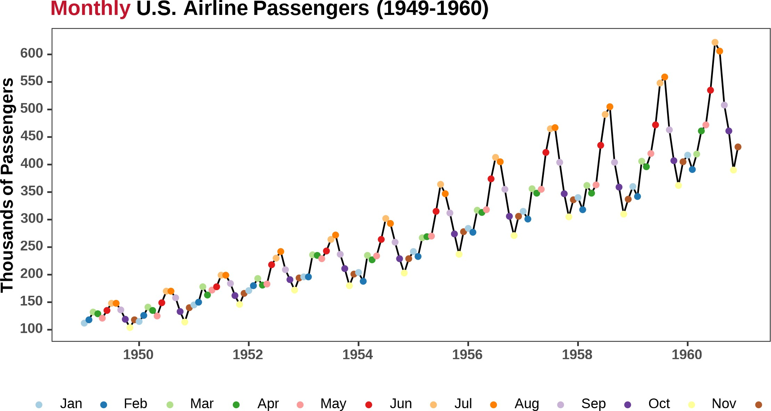
Stabilizing the Variance: Log Transformation
Log transformation is a common technique to stabilize the variance of a time series.

Slide 22
Stabilizing the Variance and the Mean: Log-Differencing
Log-differencing is a combination of log transformation and differencing.

Slide 23
One Final Step: DeSeasonalizing the Time Series

Slide 24
Order Does Not Matter: Seasonal and First Differences
When both seasonal and first differences are applied …
it makes no difference which is done first---the result will be the same.
If y′ = y_{t} − y_{t−12} denotes seasonally differenced series, then twice-differenced series is
t
y∗ = y′ − y′
t t
t−1
= (y_{t} − y_{t−12}) − (y_{t−1} − y_{t−13})
= ^{y}t − ^{y}t−1 − ^{y}t−12 + ^{y}t−13 .
This is equivalent to the first-differenced series of the seasonally differenced series:
y∗ = y′ − y′
t t
t−1
= (y_{t} − y_{t−12}) − (y_{t−1} − y_{t−13})
= yt − yt−1 − yt−12 + yt−13 .

Slide 25
Why Do Seasonal Differencing First?
Hyndman & Athanasopoulos (2022) recommend applying seasonal differencing first because:
If seasonal differencing alone makes the series stationary, we don not need further differencing.
If we first apply regular differencing, the seasonal pattern may remain strong, meaning an extra seasonal differencing step will still be necessary.
Seasonal differencing is often more effective at removing non-stationarity in data with
strong seasonality.

Slide 26
UUnniitt RRoooott TTeessttss
2266 // 3333

Slide 27
Unit Root Tests: ADF Test
Unit root tests are used to determine whether a time series is stationary or non-stationary.
The most common unit root test is the Augmented Dickey-Fuller (ADF) test.
The null hypothesis of the ADF test is that the time series has a unit root (i.e., it is non- stationary).
If the null hypothesis is rejected (e.g., if p < 0.05), the time series is considered stationary.
The ADF test is available in Python through the statsmodels library, and can be accessed using the adfuller() function as follows:
from statsmodels.tsa.stattools import adfuller
Note: See this link for more information on the adfuller() function.

Slide 28
Unit Root Tests: KPSS Test
The Kwiatkowski-Phillips-Schmidt-Shin (KPSS) test is another unit root test used to determine whether a time series is stationary or non-stationary.
The null hypothesis of the KPSS test is that the time series is stationary around a fixed level.
If the null hypothesis is rejected (e.g., if p < 0.05), the time series is considered non- stationary.
The KPSS test is available in Python through the statsmodels library, and can be accessed using the kpss() function as follows:
from statsmodels.tsa.stattools import kpss
Note: See this link for more information on the kpss() function.

Slide 29
CoreForecast's Short Cut Based on R's forecast
Package
In R, the forecast package provides a convenient function ndiffs() to determine the number of differences required to make a time series stationary.
This function uses the KPSS test to determine the number of differences required to make the time series stationary.
In CoreForecast, we can use the num_diffs(x: ndarray, max_d: int = 1) -> int function to determine the number of differences required to make a time series stationary. Similarly, we can use num_seas_diffs(x: ndarray, season_length: int, max_d: int = 1) → int to determine the number of seasonal differences required to make a time series stationary.
Reference: CoreForecast Documentation.

Slide 30
Demo: Determining the Number of Differences Required
Let us examine the airpassengers dataset. Our goal is to make this dataset stationary by making the appropriate transformations.

Slide 31
RReeccaapp
3311 // 3333

Slide 32
Summary of Main Points
By now, you should be able to do the following:
Define a stationary time series.
Understand how plotting techniques can help identify non-stationarity.
Understand how we can stabilize a non-stationary time series to achieve stationarity
(differencing to stabilize the mean, and log transformation to stabilize the variance).
Understand how to use unit root tests to test for stationarity.

Slide 33
📝 Review and Clarification 📝
Class Notes: Take some time to revisit your class notes for key insights and concepts.
Zoom Recording: The recording of today's class will be made available on Canvas approximately 3-4 hours after the session ends.
Questions: Please don't hesitate to ask for clarification on any topics discussed in class. It's crucial not to let questions accumulate.

