Slide 1




ISA 444: Business Forecasting
19: ARIMA Models
Fadel M. Megahed, PhD
Professor
Farmer School of Business Miami University
@FadelMegahed fmegahed fmegahed@miamioh.edu
Automated Scheduler for Office Hours
Spring 2025

Slide 2
Quick Refresher from Last Week
ARMA Models: Models we considered may have three components, an autoregressive component (AR), and a moving average component (MA).
✅ Describe the behavior of the ACF and PACF of an AR(p) process.
✅ Describe the behavior of the ACF and PACF of an MA(q) process.
✅ Describe the behavior of the ACF and PACF of an ARMA (p,q) process.
✅ Fit an ARMA model to a time series, evaluate the residuals of a fitted ARMA model to assess goodness of fit, use the Ljung-Box test for correlation among the residuals of an ARMA model.
✅ Fit an ARIMA model to a time series, evaluate the residuals of a fitted ARMA model to assess goodness of fit, use the Ljung-Box test for correlation among the residuals of an ARIMA model.
2 / 20

Slide 3
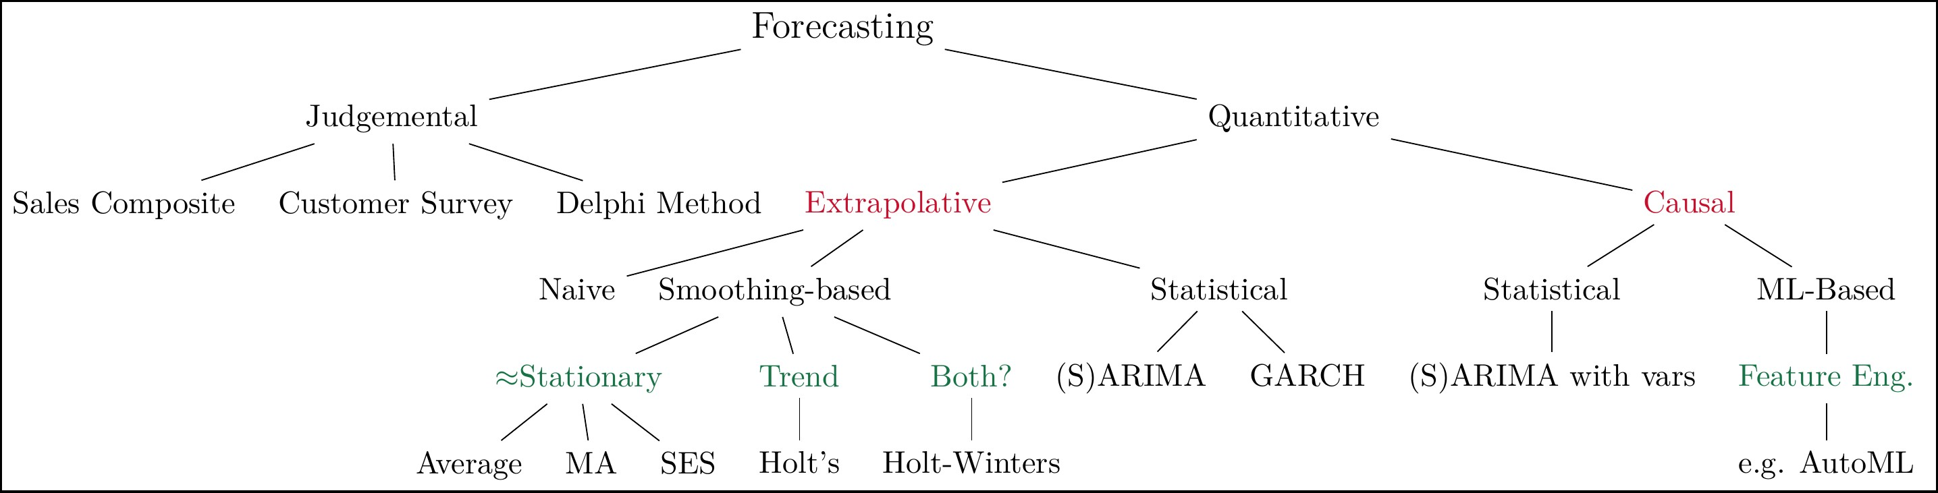
Overview of Univariate Forecasting Methods
A 10,000 foot view of forecasting techniques
Notes: My (incomplete) classification of univariate forecasting techniques, i.e., they exclude popular approaches used in multivariate time series forecasting.
3 / 20

Slide 4
ARMA Processes
Last class, we discussed on how we capitalized on the ACF and PACF plots to identify which ARMA model can be used to model/approximate the observed time-series.
Model | ACF | PACF
AR(p) | Exponentially decays or damped sinusoidal patt | _{ern} Cuts off after lag p
MA(q) ARMA(p,q | Cuts off after lag q ₎ Exponentially decays or damped sinusoidal patt | Exponentially decays or damped sinusoidal pattern Exponentially decays or ern damped sinusoidal pattern
4 / 20

Slide 5
Learning Objectives for Today's Class
Explain how ARIMA models work when compared to ARMA models.
Fit an ARIMA model to a time series, evaluate the residuals of a fitted ARMA model to assess goodness of fit, use the Ljung-Box test for correlation among the residuals of an ARIMA model.
Describe AIC, AICc, and BIC and how they are used to measure model fit.
Describe the algorithm used within the AutoARIMA method within statsforecast to fit an ARIMA model.
Describe the results of the AutoARIMA method within statsforecast to fit an ARIMA model.
5 / 20

Slide 6
AARRIIMMAA MMooddeellss
66 // 2200

Slide 7
ARIMA Models for Nonstationary Processes
When the time series is nonstationary, differencing can be used to transform the series.
The num_diffs() function from coreforecast can be used to determine: (a) whether the ts is stationary, and (b) the number of differences necessary to achieve stationarity.
7 / 20

Slide 8
Our 5-Step ARMA Fitting Process
Plot the data over time.
Do the data seem stationary? If necessary, conduct a test for stationarity.
Once you can assume stationarity, find the ACF plot.
If the ACF plot cuts off, fit an MA(q), where q = the cutoff point.
If the ACF plot dies down, find the PACF plot.
If the PACF plot cuts off, fit an AR(p) model, where p = the cutoff point.
If the PACF plot dies down, fit an ARMA (p,q) model.
You must iterate through p and q using a guess and check method starting with ARMA(1,1) models -- increment each by 1.
Evaluate the model residuals and consider the ACF and PACF of the residuals.
If model fit is good, forecast future values.
Note: Often you will fit multiple models in Step 3 and compare models in Step 4 to select the best fit.
8 / 20

Slide 9
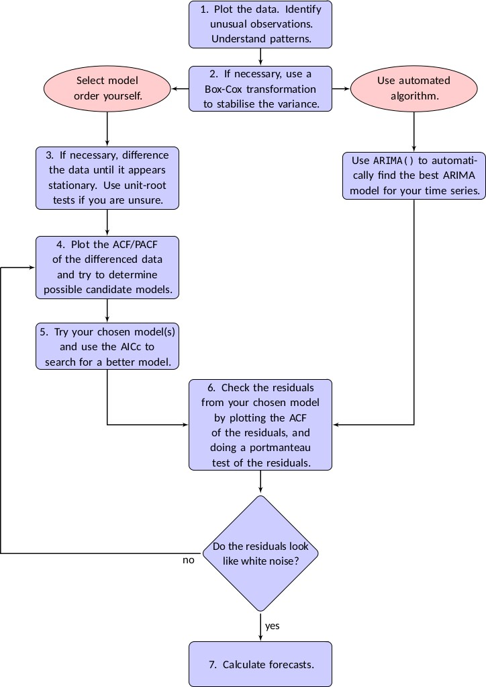
Extending Our 5-Step ARMA Fitting Process
9 / 20

Slide 10
Fitting an Appropriate ARIMA for Modeling GDP
Use the GDP Data to highlight how ARIMA models can be fit and used for forecasting. We will limit the GDP data to the period from 1990-01-01 to 2020-01-01.
10 / 20

Slide 11
GGooooddnneessss ooff FFiitt MMeeaassuurreess
1111 // 2200

Slide 12
Akaike Information Criterion (AIC)
The AIC is a statistical measure used to compare the goodness of fit of different statistical models to a given dataset.
AIC is based on the parsimony principle, favoring simpler models with fewer parameters over more complex ones (while still accounting for the model's ability to fit the data).
This helps to avoid overfitting, which occurs when a model is too complex and fits the noise in the data, rather than the underlying pattern.
The AIC formula is given by: AIC = 2k − 2ln(L), where
k is the number of parameters in the model (including the intercept, if applicable)
L is the likelihood of the model, measuring how well the model fits the observed data
In essence, the AIC balances the trade-off between the goodness of fit (measured by the log-likelihood) and the complexity of the model (measured by the number of parameters). Lower AIC values indicate better model performance, so when comparing multiple models, the one with the lowest AIC is generally considered the best fitting, while also being the simplest.
12 / 20

Slide 13
Corrected Akaike Information Criterion (AICc)
The AICcis a modification of the AIC that provides a more accurate model selection criterion when the sample size is small or the ratio of the sample size to the number of model parameters is low.
Like the AIC, the AICc is used to compare different statistical models and select the one that best fits the data while penalizing model complexity.
AICc = AIC + (2 ∗ k ∗ (k + 1))/(n − k − 1), where
AIC is the original Akaike Information Criterion: AIC = 2k − 2ln(L)
k is the number of parameters in the model (including the intercept, if applicable)
n is the sample size
The second term in the AICc formula represents a correction factor that accounts for the small sample size. As the sample size (n) increases, the correction factor approaches zero, and the AICc converges to the original AIC. Therefore, in cases where the sample size is large, using the AICc instead of AIC won't make a significant difference.
When comparing models, the one with the lowest AICc value is considered the best-fitting model while also being the simplest, similar to the AIC.
13 / 20

Slide 14
Bayesian Information Criterion (BIC)
The BIC helps in model selection by balancing the trade-off between model complexity and goodness of fit. However, the BIC penalizes model complexity more heavily than the AIC.
The formula for BIC is: BIC = −2ln(L) + k ∗ ln(n), where
L is the likelihood of the model, measuring how well the model fits the observed data
k is the number of parameters in the model (including the intercept, if applicable)
n is the sample size
In the BIC formula, the first term represents the goodness of fit (measured by the log-likelihood), and the second term represents the penalty for model complexity.
The penalty term is larger in the BIC than in the AIC, as it is proportional to the natural logarithm of the sample size instead of being a constant value.
When comparing models, the one with the lowest BIC value is considered the best-fitting model while also being the simplest, similar to the AIC and AICc.
The BIC might be preferred over the AIC or AICc, especially when there is a preference for more parsimonious models or when dealing with large sample sizes.
14 / 20

Slide 15
AIC, AICc and BIC Summary
Studies have shown that the:
BIC does well at getting correct model in large samples.
AICc tends to get correct models in smaller samples with a large number of parameters.
Why did we discuss these metrics today?
They were printed with some of the models that we have examined in class.
They are used with the AutoARIMA method.
15 / 20

Slide 16
TThhee AAuuttooAARRIIMMAA MMeetthhoodd
1166 // 2200

Slide 17
The AutoARIMA method
Determine the number of differences, d, using a sequence of KPSS tests.
Determine p and q by minimizing AICc after differencing the data d times. Rather than considering all possible
p and q combinations, a stepwise approach is taken.
The best initial model with lowest AICc is selected from the following four:
ARIMA(2,d,2),
ARIMA(0,d,0),
ARIMA(1,d,0), and
ARIMA(0,d,1).
If d=0, then a constant, c, is included. If d ≥ 1, then the constant is set to 0. The results of this step is called the current model.
Variations on the current model are considered by
Vary p and/or q from current model by ±1
Include/exclude c from current model.
The best model considered so far (current or one of variations) becomes the new current model.
Repeat previous step until no lower AICc can be found.
17 / 20

Slide 18
Live Coding
Let us examine how the AutoARIMA method can be used to model and forecast the GDP Data. We will limit the GDP data to the period from 1990-01-01 to 2020-01-01.
18 / 20

Slide 19
RReeccaapp
1199 // 2200

Slide 20
Summary of Main Points
By now, you should be able to do the following:
Explain how ARIMA models work when compared to ARMA models.
Fit an ARIMA model to a time series, evaluate the residuals of a fitted ARMA model to assess goodness of fit, use the Ljung-Box test for correlation among the residuals of an ARIMA model.
Describe AIC, AICc, and BIC and how they are used to measure model fit.
Describe the algorithm used within the AutoARIMA method to fit an ARIMA model.
Describe the results of the AutoARIMA method.
20 / 20

