Slide 1




ISA 444: Business Forecasting
02: A Python Primer
Fadel M. Megahed, PhD
Professor
Farmer School of Business Miami University
@FadelMegahed fmegahed fmegahed@miamioh.edu
Automated Scheduler for Office Hours
Spring 2025

Slide 2
Quick Refresher of Last Class
✅ Describe the role of forecasting in business.
✅ Describe the key components of a time-series (trend, seasonality, multiple seasonality, and
cycles).
✅ Explain the concept of data-generating process (DGP)
✅ Discuss limits of forecasting
✅ Understand key forecasting terminology

Slide 3
Learning Objectives for Today's Class
Setting up Python (Colab, Anaconda, and/or VS Code)
Practice basic data reading (from CSVs and the Web)
Use panda's datatime, indexing, and slicing capabilities
(Optional) Discuss generative AI usage in Google Colab

Slide 4
SSeettttiinngg UUpp PPyytthhoonn
44 // 3366

Slide 5
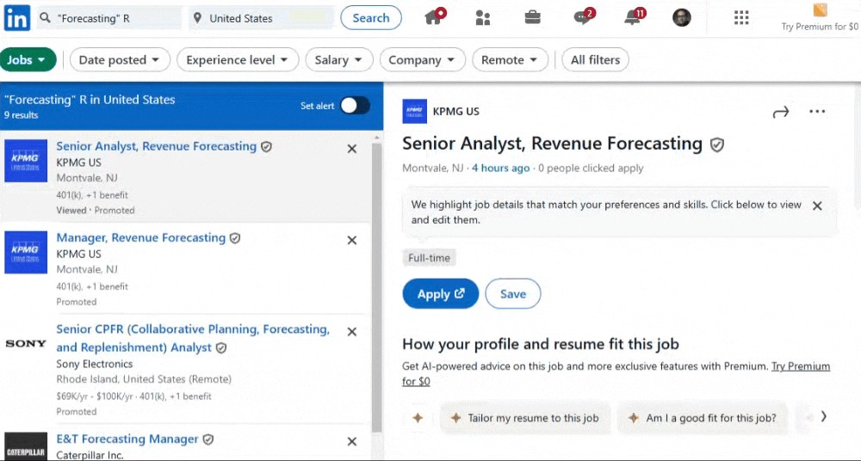
Why Python? Insights from a LinkedIn Job Search
Note: The above image is a screenshot from LinkedIn's job search results for "forecasting" jobs from January 29, 2025. While LinkedIn may not be the best source for job market trends, it does provide a snapshot of the demand for forecasting skills in the job market. The results are clearly in favor of Python (112 jobs) over R (9 jobs). You can replicate the search by clicking on the following links: R Forecasting Jobs and Python Forecasting Jobs.
5 / 36

Slide 6
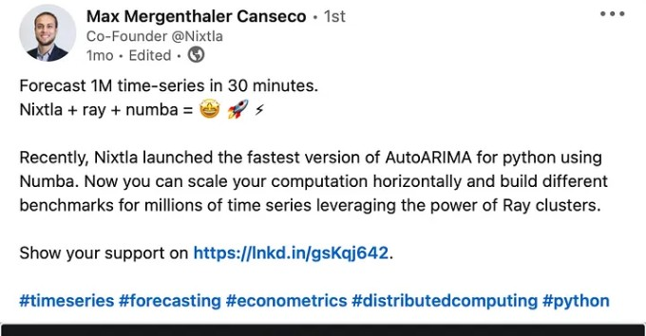
Why Python? Pedagogical Reasons
Image Source: An opinionated article by Valeriy Manokhin Python vs R for time-series forecasting on Medium. While the article is opinionated, it does provide a good overview of the
strengths and weaknesses of Python and R for time-series forecasting.

Slide 7
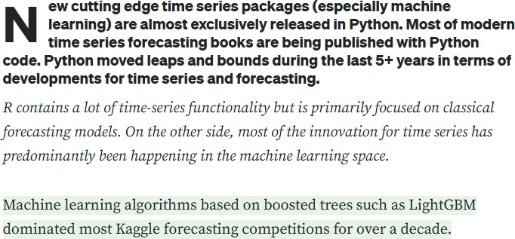
Why Python? Pedagogical Reasons
Image Source: An opinionated article by Valeriy Manokhin Python vs R for time-series forecasting on Medium. While the article is opinionated, it does provide a good overview of the
strengths and weaknesses of Python and R for time-series forecasting.

Slide 8
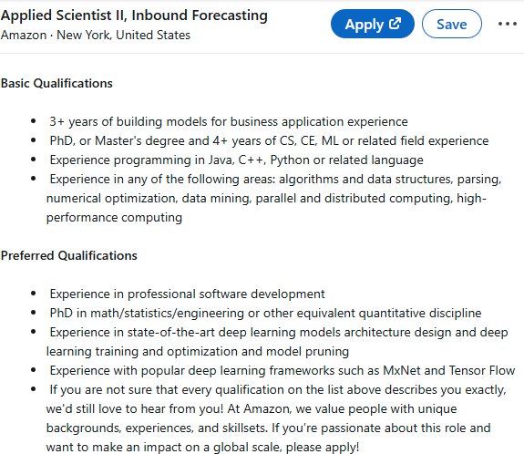
Why Python? Pedagogical Reasons
Image Source: Amazon's preferred qualifications for a mid-senior PhD preferred Applied Scientist II, Inbound Forecasting confirming the importance of Python and the transition to ML-DL in forecasting. So to graduate #BeyondReady graduates, you need to be introduced to the state-of-the-art, which is readily available in Python but not in R.
8 / 36

Slide 9
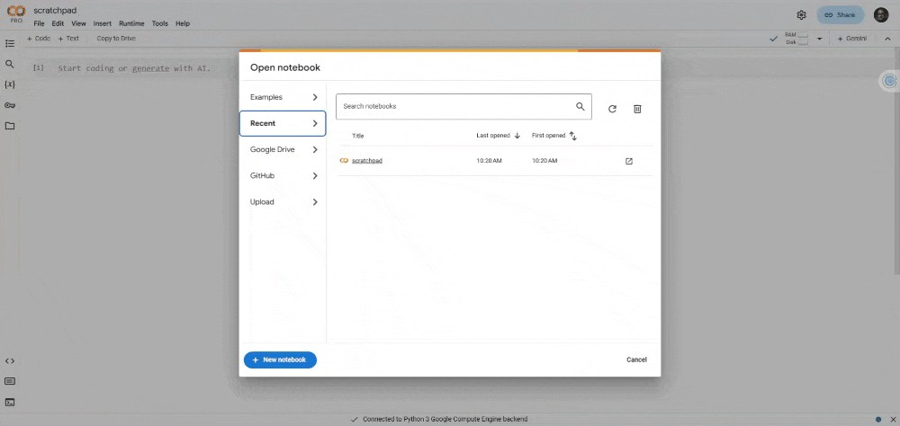
Python via Google Colab: Preferred Choice for our Class
Google Colab is a free cloud service for running Python in a Jupyter notebook environment.
It offers free access to GPUs and TPUs, useful in running deep learning models.
To get started, you can create a new notebook by clicking on New Notebook.
9 / 36

Slide 10
Class Activity: Navigating Colab + Your First Python C⁰o²d:e³⁰
Create a new notebook in Google Colab, run the following code, and observe the output.
import seaborn as sns
import pandas as pd
import matplotlib.pyplot as plt
healthexp = sns.load_dataset('healthexp') # Load the healthexp dataset # Use the relplot function to plot
ax = sns.relplot( data=healthexp, kind='line',
x='Year', y='Life_Expectancy', hue='Country', style='Country', palette='Paired'
)
plt.show() # Show the plot
In separate cells, try the following and observe the output:
Now, remove kind='line' from the code and rerun the cell.
Now, add the following function in a new line before the plt.show() function:
sns.move_legend(ax, loc = "lower center", bbox_to_anchor=(0.5, 0.85), ncol=3)
10 / 36

Slide 11
Python via Anaconda: For Local Use (If you Want)
Anaconda is a free and open-source distribution of Python for scientific computing.
It comes with a package manager (conda) and a collection of pre-installed packages.
To get started, you can download Anaconda from here.
You can create a new environment by running the following command in the terminal:
conda create --name isa444 python=3.12
To activate the environment, run the following command:
conda activate isa444
Then, you can install any required packages (done once) by running:
conda install statsforecast mlforecast neuralforecast # and any other packages you need

Slide 12
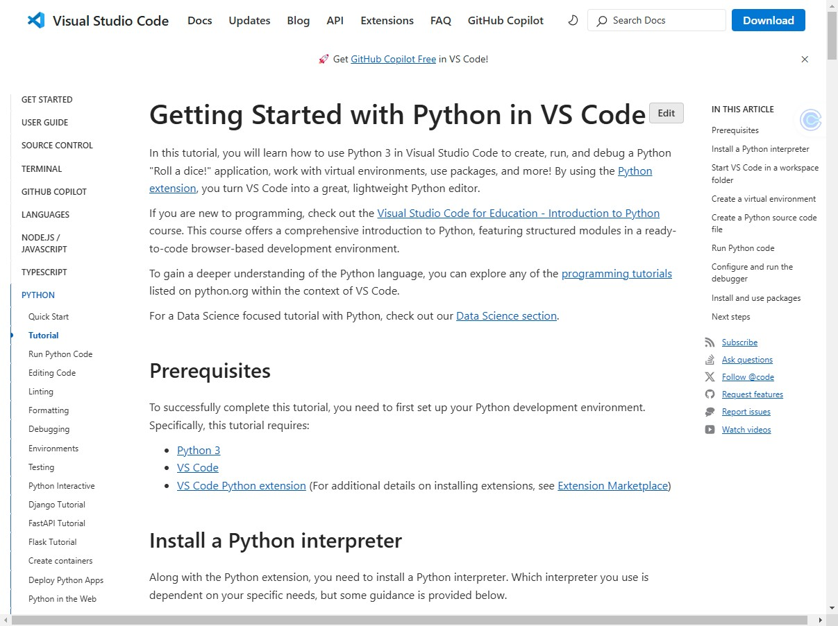
Anaconda + VS Code: For Local Use (If you Want)
Please read through the Getting Started with Python in VS Code for more details.

Slide 13
IImmppoorrttiinngg DDaattaa UUssiinngg PPaannddaass
1133 // 3366

Slide 14






What is Pandas?
Along with polars, it is one of the most popular data analysis and manipulation libraries in Python, designed to make working with 'relational' or 'labeled' data both easy and intuitive.
pandas supports the integration with many file formats or data sources out of the box (csv, excel, sql, json, parquet,…). Importing data from each of these data sources is provided by function with the prefix read_*. Similarly, the to_* methods are used to store data.
CSV
XLS
PARQUET
CSV
XLS
PARQUET
read_*
JSON
{}
to_*
HTML HDF5 JSON
<> {}
HTML HDF5
<>
GBQ
SQL
GBQ
SQL
...
...
Source: The content and image are from the Getting Started with Pandas description in pandas.pydata.org. The image can be directly accessed here.
14 / 36

Slide 15
Things to Consider while Importing Data with Pandas
Check the file extension: Your choice of function will depend on the file extension.
Check the file path:
Local file:
If the file is in the same directory as your code, you can simply provide the file name.
Otherwise, you will need to provide the path to the file.
Remote file: You will need to provide the URL to the file.
Inspect the file: to know which default parameter values must be changed. Things to consider:
Delimiter (in the case of .txt files)
Header (does it exist? if not, what should be used as column names?)
Index Column (if it exists, what is it? if not, what should be used as the index?)
Encoding (to be changed if file is not in English, or has names such as: François, José, Weiß, etc.)
Date Format (if the file has dates, what is the format?)
etc.
15 / 36

Slide 16








Importing Data Using Pandas: CSVs
Getting started | Search Ctrl + K 2.2 (stable) User API _{Development} Release Guide reference notes
 |  | › API reference › Input/output › pandas.read_csv pandas.read_csv pandas.read_csv(filepath_or_buffer, *, sep=<no_default>, delimiter=None, header='infer', names=<no_default>, index_col=None, usecols=None, dtype=None, engine=None, converters=None, true_values=None, false_values=None, skipinitialspace=False, skiprows=None, skipfooter=0, nrows=None, na_values=None, keep_default_na=True, na_filter=True, verbose=<no_default>, skip_blank_lines=True, parse_dates=None, infer_datetime_format=<no_default>, keep_date_col=<no_default>, date_parser=<no_default>, date_format=None, dayfirst=False, cache_dates=True, iterator=False, chunksize=None, compression='infer', thousands=None, decimal='.', lineterminator=None,
Input/output
pandas.read_pickle
pandas.DataFrame.to_pickle pandas.read_table
pandas.read_csv
pandas.DataFrame.to_csv
pandas.read_fwf pandas.read_clipboard
pandas.DataFrame.to_clipbo ard
Source: The content is from the pandas.read_csv() documentation available at pandas.pydata.org.
16 / 36

Slide 17
Importing Data w/ Pandas: CSVs [Example 1: Local]
import pandas as pd
rRead the CSV file (the path will depend on where the file is located)
hotel = pd.read_csv('../../data/01_hotel_occupancy.csv')
Display the first 5 rows of the dataset
hotel.head()
## | date | hotel_occupancy | month | month_name
## 0 | 2022-01-01 | 3512 | 1 | January
## 1 | 2022-02-01 | 3794 | 2 | February
## 2 | 2022-03-01 | 4032 | 3 | March
## 3 | 2022-04-01 | 4294 | 4 | April
## 4 | 2022-05-01 | 4776 | 5 | May

Slide 18
Importing Data w/ Pandas: CSVs [Example 2: Remote]
import pandas as pd Read the CSV file from the web unrate = pd.read_csv('https://fred.stlouisfed.org/graph/fredgraph.csv?bgcolor=%23e1e9f0&char
Display the first 5 unrate.head() | rows of | the | dataset
## observation_date | UNRATE
## 0 1948-01-01 | 3.4
## 1 1948-02-01 | 3.8
## 2 1948-03-01 | 4.0
## 3 1948-04-01 | 3.9
## 4 1948-05-01 | 3.5

Slide 19
Live Demo: Importing Data Using Pandas on Colab
For "Local" Files, Colab allows you to upload these files directly to the environment or
mount Google Drive to access files. For this demo, I will walk you through both methods.
In the future, I will use the "Upload" method since it is quicker.
For "Remote" Files, you can use the URL directly to read the file.
Your environment will be reset after ~ 12 hours of inactivity. So, save your work. Note that you must save your notebook to Google Drive.
Also, remember to install any required packages using !pip install package_name if they are not already installed.
Once your environment is reset, you will need to reinstall the packages and re-upload (or remount) the data. Why does Google do this? Insert your explanation here.

Slide 20
05:00
Class Activity: Duke Energy Hourly Load Data
Download the Historical Hourly Loads by Class 2024 data from here.
Inspect the file to understand its structure; noting that I want you to read the Total Usage
sheet. Things to note when inspecting:
What is the file extension? Edit me. Insert your answer here.
How many sheets are in the file? Edit me. Insert your answer here.
What is the name of the sheet you want to read? Edit me. Insert your answer here.
Which row should be used as the header? Edit me. Insert your answer here.
Upload the file to your existing Google Colab notebook for today's class.
Read the file using Pandas by consulting their API on Input/Output.

Slide 21
UUssiinngg PPaannddaass ffoorr DDaattaa MMaanniippuullaattiioonn
2211 // 3366

Slide 22
Dateime Manipulation with Pandas
Pandas has a powerful datetime manipulation capability.
It allows you to convert strings to datetime objects, extract parts of the date, perform arithmetic operations on dates, and filter data based on dates.
You can create a Timestamp object using the pd.to_datetime() function, or by using the datetime library in Python.
import pandas as pd
duke = ( pd.read_excel(
'../../data/Actual_Hourly_Loads_by_Class_2023_2 sheet_name='Total Usage', header=1
)
.assign(
datetime = lambda x: pd.to_datetime(x['REPORT DAY']) +
pd.to_timedelta(x['HOUR ENDING']-1, unit='h')
)
[['datetime', 'TOTAL']]
)
duke.head(n=1)
## datetime ## 0 2023-01-01
TOTAL 1862129.01

Slide 23
Datetime Manipulation with Pandas: Without Chaining
Pandas has a powerful datetime manipulation capability.
It allows you to convert strings to datetime objects, extract parts of the date, perform arithmetic operations on dates, and filter data based on dates.
You can create a Timestamp object using the pd.to_datetime() function, or by using the datetime library in Python.
import pandas as pd
df = pd.read_excel( '../../data/Actual_Hourly_Loads_by_Class_2023_2 sheet_name='Total Usage', header=1
)
df['datetime'] = pd.to_datetime(df['REPORT DAY']) + df = df[['datetime', 'TOTAL']]
df.head(n=1)
## datetime ## 0 2023-01-01
TOTAL 1862129.01

Slide 24
💡 Why Method Chaining? Detailed Interpretation
The parentheses in this code enable method chaining, allowing multiple transformations to be applied to the DataFrame sequentially without intermediate variables. This improves readability and keeps the workflow structured.
The first step reads the data using pd.read_excel(), then .assign() creates a datetime column by combining REPORT DAY with HOUR ENDING, and finally, column selection ([['datetime', 'TOTAL']]) ensures only relevant data is retained.
This approach is similar to piping (%>% or |>) in , where each function operates on the output of the previous step, promoting a clear, left-to-right flow of transformations.
Without parentheses, each step would require separate assignments, making the code longer and less efficient.

Slide 25
💡 Why Method Chaining? Fadel's Perspective
Improves readability
Avoids intermediate variables
Mimics R’s dplyr piping

Slide 26
Indexing and Slicing with Pandas
Indexing is the process of selecting specific rows and columns from a DataFrame.
Slicing is the process of selecting a subset of the data based on specific criteria. We can slice data based on row numbers, column names, or conditions.
Pandas provides several methods for indexing and slicing data, including .loc[], .iloc[], and .query().
.loc[] is used for label-based indexing, while .iloc[] is used for positional indexing.
df.loc[0:5, 'A':'C'] selects rows 0 to 5 and columns A to C, and
df.iloc[0:5, 0:3] selects the first 5 rows and first 3 columns.
.query() is used to filter data based on specific conditions. We will discuss this in more detail in the next slides.

Slide 27
Filtering/Querying Data with Pandas: Syntax
import pandas as pd
duke = ( pd.read_excel(
'../../data/Actual_Hourly_Loads_by_Class_2023_20240507.xlsx',
sheet_name='Total Usage', header=1
)
.assign(
datetime = lambda x: pd.to_datetime(x['REPORT DAY']) +
pd.to_timedelta(x['HOUR ENDING']-1, unit='h')
)
[['datetime', 'TOTAL']]
)
duke.head(n=1)
.query("TOTAL >= 3055456.7") # use query to filter data
## datetime
## 3591 2023-05-30 15:00:00
TOTAL 3087982.04

Slide 28
Filtering/Querying Data with Pandas: Syntax w/ Objects
import pandas as pd
total_cutoff= 3055456.7 duke = (
pd.read_excel( '../../data/Actual_Hourly_Loads_by_Class_2023_20240507.xlsx', sheet_name='Total Usage', header=1
)
.assign(
datetime = lambda x: pd.to_datetime(x['REPORT DAY']) +
pd.to_timedelta(x['HOUR ENDING']-1, unit='h')
)
[['datetime', 'TOTAL']]
)
duke.head(n=1)
.query("TOTAL >= @total_cutoff") # use query to filter with @ for object
## datetime
## 3591 2023-05-30 15:00:00
TOTAL 3087982.04

Slide 29
Querying Data w/ Pandas: No Spaces in Col Names
import pandas as pd duke = ( pd.read_excel( '../../data/Actual_Hourly_Loads_by_Class_2023_20240507.xlsx', sheet_name='Total Usage', header=1 ) .assign( datetime = lambda x: pd.to_datetime(x['REPORT DAY']) + pd.to_timedelta(x['HOUR ENDING']-1, unit='h') )
 | [['datetime', | 'HOUR ENDING', | 'TOTAL']]
 | .query("`HOUR | ENDING` == 8") | use backticks ` ` for spaces in col names
 | )
 | duke.head(n=1)
 | ## ## 7 2023-01-01 | datetime HOUR 07:00:00 | ENDING TOTAL 8 1807402.51

Slide 30
Filtering/Querying Data with Pandas: Multiple Conditions
import pandas as pd
duke = ( pd.read_excel(
'../../data/Actual_Hourly_Loads_by_Class_2023_20240507.xlsx',
sheet_name='Total Usage', header=1
)
.assign(
datetime = lambda x: pd.to_datetime(x['REPORT DAY']) +
pd.to_timedelta(x['HOUR ENDING']-1, unit='h')
)
[['datetime', 'TOTAL']]
.query("TOTAL >= 3055456 and datetime >= '2023-05-31'") # use and for multiple conditions
)
duke.head(n=1)
## datetime
## 3613 2023-05-31 13:00:00
TOTAL 3091924.35

Slide 31
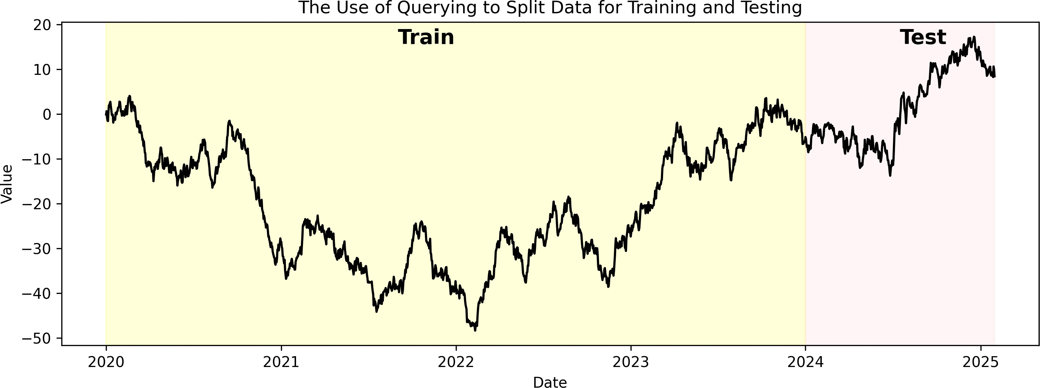
How Filtering/Querying is Used in Forecasting?
Filtering and querying are essential in forecasting to select relevant data for analysis.
For example, we can use data prior to 2024 for training a forecasting model, and data from 2024 for testing the model to evaluate its performance.

Slide 32
Kahoot Competition #02
To assess your understanding and retention of the topics covered so far, you will compete in a Kahoot competition (consisting of 5 questions):
Download and inspect the 01_hotel_occupancy.csv
Go to https://kahoot.it/
Enter the game pin, which will be shown during class
Provide your first (preferred) and last name
Answer each question within the allocated time window (fast and correct answers provide more points)
Winning the competition involves having as many correct answers as possible AND taking the shortest duration to answer these questions. The winner of the competition will receive a
0.15 bonus on Assignment 02. Good luck!!!
P.S: The Kahoot competition will have no negative impact on your grade. It is a fun way of assessing your knowledge, motivating you to ask questions about topics covered that you do not have a full understanding of it, and providing me with some data that I can use to pace today's class.
32 / 36

Slide 33
Summary of Main Points
By now, you should be able to do the following:
Setting up Python (Colab, Anaconda, and/or VS Code)
Practice basic data reading (from CSVs and the Web)
Use panda's datatime, indexing, and slicing capabilities
(Optional) Discuss generative AI usage in Google Colab

Slide 34
📝 Review and Clarification 📝
Class Notes: Take some time to revisit your class notes for key insights and concepts.
Zoom Recording: The recording of today's class will be made available on Canvas approximately 3-4 hours after the session ends.
Questions: Please don't hesitate to ask for clarification on any topics discussed in class. It's crucial not to let questions accumulate.

Slide 35
📖 Required Readings 📖
Read the following sections from the Pandas Documentation:
10 Minutes to Pandas
Pandas I/O
Indexing and Selecting Data
Time Series / Date functionality
Comparison with SQL
Additionally, you should keep a copy of Pandas Cheat Sheet for a quick reference to the most important functions and methods in Pandas.

Slide 36
🎯 Assignment 🎯
Go over your notes and complete Assignment 02 on Canvas.

