Slide 1




ISA 444/544: Business Forecasting
11: Forecasting Environment and Baseline Forecasts
Fadel M. Megahed, PhD
Raymond E. Glos Professor in Business Farmer School of Business
Miami University
@FadelMegahed fmegahed fmegahed@miamioh.edu
Automated Scheduler for Office Hours
Fall 2025

Slide 2
Learning Objectives for Today's Class
Install and import Nixtla's libraries (StatsForecast, MLForecast, NeuralForecast, UtilsForecast, and TimeGPT) for forecasting
Distinguish fixed window from rolling-origin
Introduce forecast accuracy metrics (MAE, MAPE, RMSE)
Recognize the importance of baseline forecasts in time series forecasting
Identify common baseline forecasts (Naive, Seasonal Naive, etc.)
Implement baseline models with StatsForecast
2 / 37

Slide 3
TThhee NNiixxttllaavveerrssee OOppeenn--SSoouurrccee FFoorreeccaassttiinngg LLiibbrraarriieess
33 // 3377

Slide 4
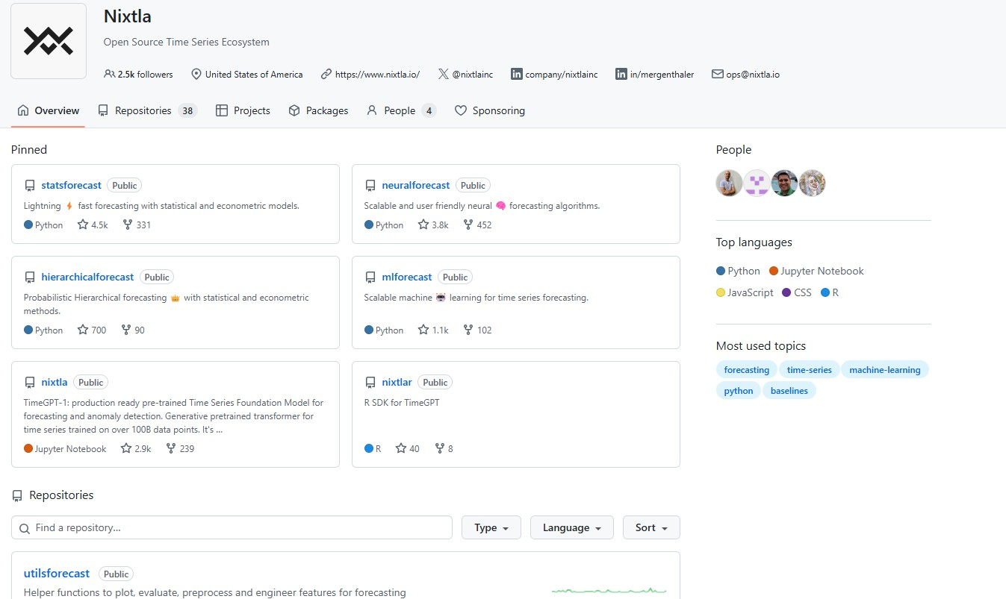
Nixtla's Forecasting Libraries
4 / 37

Slide 5
Nixtla's Forecasting Libraries
Nixtla provides several open-source Python libraries (and a closed source TimeGPT tool accessible via API calls) for scalable forecasting tasks. These libraries are relatively easy to use and can be integrated into your future forecasting workflows:
StatsForecast – Fast & scalable statistical models (ARIMA, ETS, etc.).
MLForecast – Machine learning-based forecasting (e.g., XGBoost, LightGBM).
NeuralForecast – Deep learning models for time series (e.g., NBEATS, NHITS, and TFT).
UtilsForecast – Utility functions for plotting, evaluation, etc.
TimeGPT – an AI transformer-powered forecasting API that requires minimal tuning.
These libraries enable forecasting at scale, which you will need in practice.
Note: These libraries can be installed via pip and are described in detail in nixtlaverse.nixtla.io. Use the left-hand navigation bar to explore the documentation for each library.
5 / 37

Slide 6
FFiixxeedd WWiinnddooww vvss.. RRoolllliinngg--OOrriiggiinn
66 // 3377

Slide 7
The Fixed Window Evaluation Approach
Fixed Window is the simplest approach to splitting your time series data into a training and a testing/holdout set.
The goal is to train your model on the training set and evaluate its performance on the testing set (the last k observations in the data).
Note that this is quite different than traditional machine learning applications for cross sectional data.
The evaluation on the testing/holdout set can serve two purposes:
Model Evaluation: Assess the model's performance on unseen data (since it is not used during training, and hence acts as a proxy for the model's performance on future data).
Model Selection: Compare the performance of different models to select the best one.
Note that using this approach for model selection is reasonable if your models do not involve hyperparameter tuning (otherwise, you may overfit to the testing set).
7 / 37

Slide 8
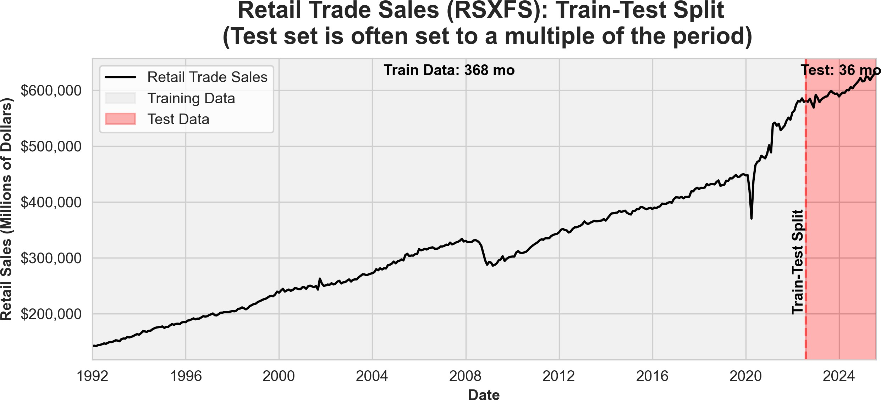
The Fixed Window Evaluation Approach
8 / 37

Slide 9
The Rolling-Origin Evaluation Approach
Rolling-Origin Evaluation is a method for splitting time series data into training and testing sets where the testing sets move forward over time.
The goal is to train the model on a subset of past observations and evaluate its
performance on a future testing set at multiple time steps.
The key difference from a fixed window approach is that the testing set shifts forward, allowing for multiple evaluations:
The training set may expand (expanding window) or remain fixed (rolling window).
This ensures that model performance is assessed across different points in time.
It reduces sensitivity to the initial split point and provides a more robust evaluation of model performance over time.
9 / 37

Slide 10
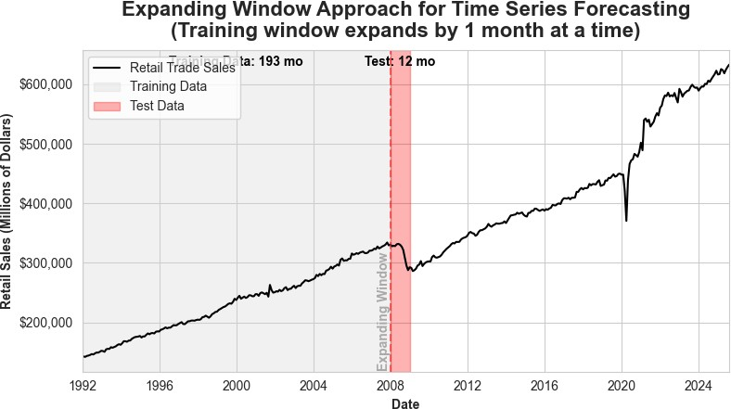
Expanding Window Evaluation (By 1 Month)
10 / 37

Slide 11

Expanding Window Evaluation (By 12 Month)
11 / 37

Slide 12
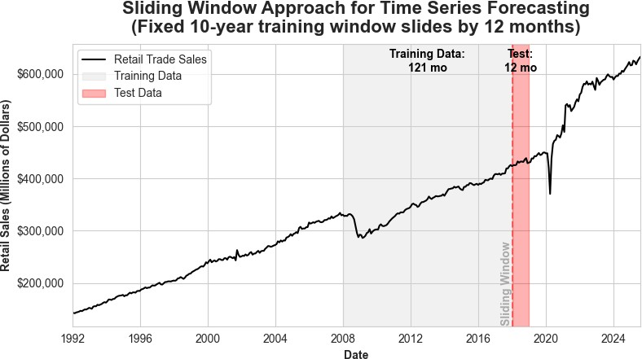
Rolling Non-Expanding Window Evaluation
12 / 37

Slide 13
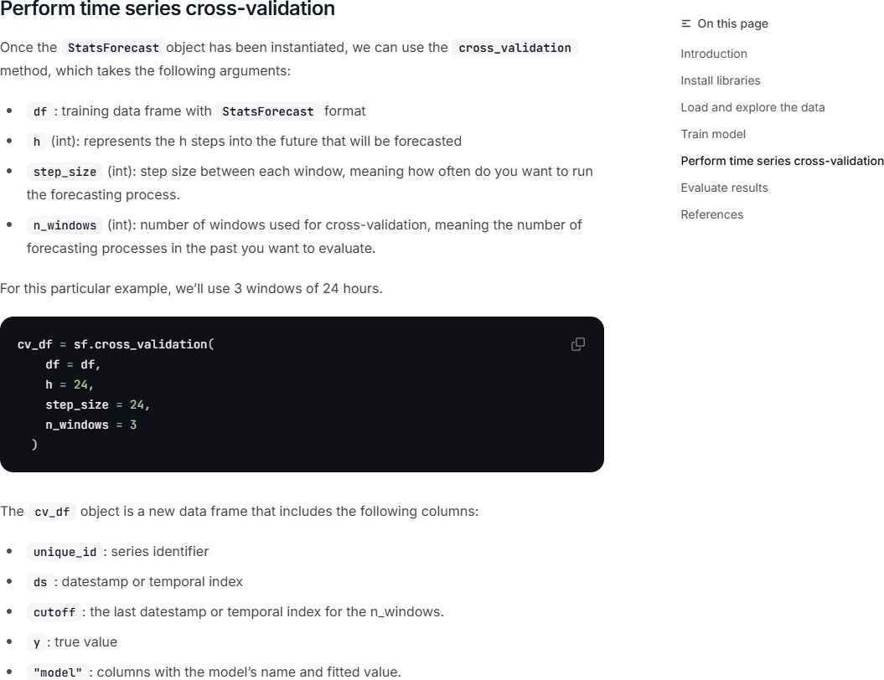
Cross Validation within the Nixtlaverse
Note: The cross_validation method can also be applied to other NixtlaForecast objects (e.g., MLForecast, NeuralForecast) to perform cross-validation for machine learning and deep learning models. See the StatsForecast Cross Validation Tutorial to access the page shown above.
13 / 37

Slide 14
Activity: The cross_validation Method
ross_validation method from Nixtla implements:
0
0
0
ixed Window Evaluation
Expanding Rolling Window
Non-Expanding Rolling Window
14 / 37

Slide 15
Recap of Fixed vs. Rolling-Origin
Fixed Window:
Simplest approach to splitting data into training and testing sets.
Testing set is fixed and does not move forward over time.
Provides a single evaluation of model performance.
Rolling-Origin:
Testing set moves forward over time.
Training set may expand or remain fixed.
Provides multiple evaluations of model performance.
Reduces sensitivity to the initial split point.
More robust evaluation of model performance over time.
15 / 37

Slide 16
Recap of Fixed vs. Rolling-Origin
In practice, the rolling-origin approach is preferred for time series forecasting tasks since it mimics the real-world scenario of forecasting future data points. The choice of:
Expanding vs. Rolling Window,
Window Size, and
Step Size depends on the specific forecasting task and the data at hand.
16 / 37

Slide 17
FFoorreeccaasstt AAccccuurraaccyy MMeettrriiccss
1177 // 3377

Slide 18
Model Performance Evaluation in the Nixtlaverse
from utilsforecast.losses import *
evaluate
evaluate (df:~AnyDFType, metrics:List[Callable], models:Optional[List[str]]=None, train_df:Optional[~AnyDFType]=None, level:Optional[List[int]]=None, id_col:str='unique_id', time_col:str='ds', target_col:str='y', agg_fn:Optional[str]=None)
Source: Nixtla's UtilsForecast Evaluation Documentation
18 / 37

Slide 19
Model Performance Evaluation in the Nixtlaverse (Cont.)
 | Type | Default | Details
df | AnyDFType |  | Forecasts to evaluate. Must have id_col, time_col, target_col and models’ predictions.
metrics | List |  | Functions with arguments df, models, id_col, target_col and optionally train_df.
models | Optional | None | Names of the models to evaluate. If None will use every column in the dataframe after removing id, time and target.
train_df | Optional | None | Training set. Used to evaluate metrics such as mase.
level | Optional | None | Prediction interval levels. Used to compute losses that rely on quantiles.
id_col | str | unique_id | Column that identifies each serie.
time_col | str | ds | Column that identifies each timestep, its values can be timestamps or integers.
target_col | str | y | Column that contains the target.
agg_fn | Optional | None | Statistic to compute on the scores by id to reduce them to a single number.
Returns | AnyDFType |  | Metrics with one row per (id, metric) combination and one column per model. If agg_fn is not None, there is only one row per metric.
Source: Nixtla's UtilsForecast Evaluation Documentation
19 / 37

Slide 20
Losses
The most important train signal is the forecast error, which is the difference between the observed value y_{τ} and the prediction y^_{τ} , at time y_{τ} :
e_{τ} = y_{τ} − y^_{τ} τ ∈ {t + 1, … , t + H}
The train loss summarizes the forecast errors in different evaluation metrics.
Source: Nixtla's UtilsForecast Losses Documentation
20 / 37

Slide 21
Scale-Dependent Errors: mae
MAE measures the relative prediction accuracy by averaging the absolute deviations between forecasts and actual values.
1
t+H
MAE(y_{τ} , y^_{τ} ) = _{H} ∑ |y_{τ} − y^_{τ} |
τ=t+1
Interpretation: Provides a straightforward measure of forecast accuracy; lower MAE indicates better performance.
Characteristic: Does not penalize larger errors more than smaller ones; treats all errors equally.
Source: Nixtla's UtilsForecast Losses Documentation
21 / 37

Slide 22
Scale-Dependent Errors: rmse
RMSE is the square root of the average of the squared differences between forecasts and actual values.
 1
RMSE(y_{τ} , y^_{τ} ) = ⎷
t+H
∑ (y_{τ} − y^_{τ} )²
τ=t+1
H
Interpretation: Emphasizes larger errors due to squaring; useful when large errors are particularly undesirable.
Characteristic: Penalizes large errors more than MAE (i.e., more sensitive to ourliers compared to MAE).
Source: Nixtla's UtilsForecast Losses Documentation
22 / 37

Slide 23
Percentage Errors: mape
MAPE calculates the average absolute error as a percentage of actual values.
1
H
t+H
∣ y_{τ} − y^ ∣
MAPE(y_{τ} , y^ ) =
∑ ∣ ^{τ} ∣
τ
∣ y_{τ} ∣
τ=t+1
Interpretation: Expresses forecast accuracy as a percentage; lower MAPE indicates better performance.
Characteristic: Can be misleading if actual values are close to zero, leading to extremely high MAPE values.
Source: Nixtla's UtilsForecast Losses Documentation
23 / 37

Slide 24
IImmppoorrttaannccee ooff BBaasseelliinnee FFoorreeccaassttss
2244 // 3377

Slide 25
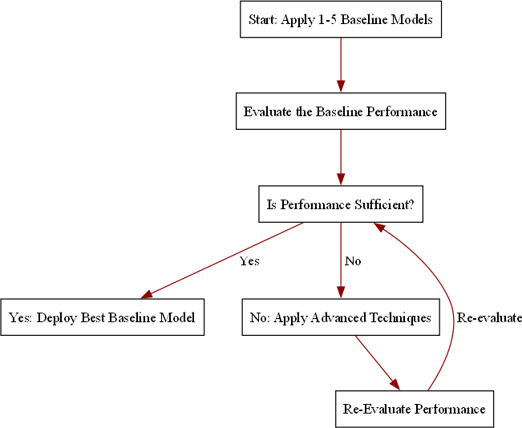
Why do we need Baseline Forecasts?
Baseline forecasts are simple, yet powerful.
Baseline forecasts serve as important benchmarks:
They provide a performance "floor"
for more complex models.
Help assess if advanced models can add meaningful value.
They are easy to interpret and require minimal computational resources.
25 / 37

Slide 26
CCoommmmoonn BBaasseelliinnee FFoorreeccaassttss
2266 // 3377

Slide 27
Historic Mean/Average
Historic Mean/Average: The simplest baseline forecast is to use the average of the historical data as the forecast for all future periods.
Mathematical Representation: y^ =
1 ∑t
t+h i=1
y_{i}
t
Assumptions about the Data Generating Process (DGP):
Future values will be similar to the past.
The data generating process is relatively stationary (fixed mean with random noise), with no seasonality and no trends (obviously since the mean is fixed).
27 / 37

Slide 28
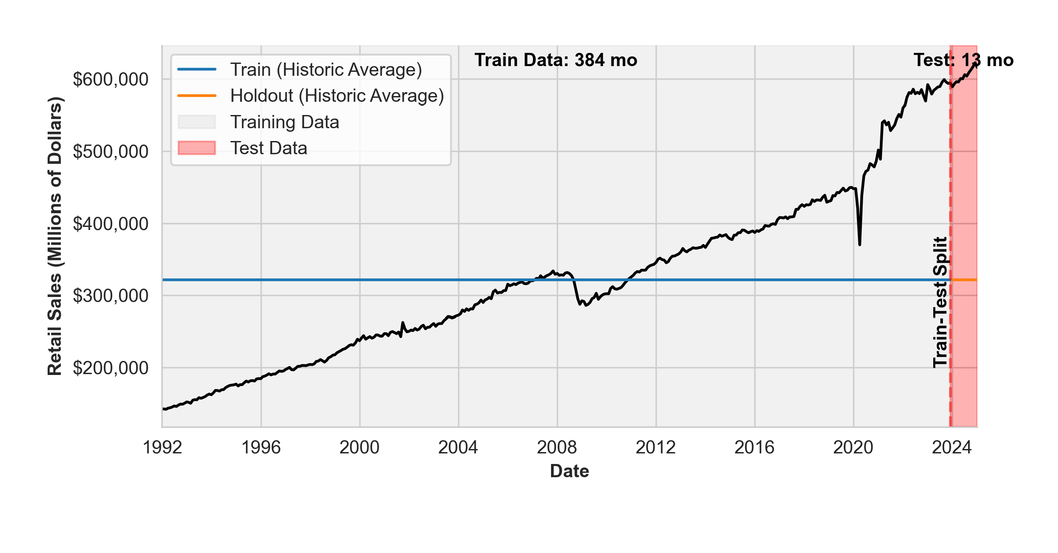
Historic Mean/Average: Fixed Window
Notes: The plot above shows the historic average forecast for the retail trade data. The light gray region represents the training data, while the red region represents the test data. The vertical dashed line indicates the split point between the training and test data. The training data is used to fit the model, while the test data is used to evaluate the model's performance.
Obviously, the historic average forecast is a straight line, as it is the same for all future periods. Furthermore, it is a terrible choice for this dataset since it clearly has a positive trend.
28 / 37

Slide 29
Naive Forecast
Naive Forecast: The naive forecast assumes that the future value will be the same as the last observed value.
Mathematical Representation: y^_{t+h} = y_{t}
Assumptions about the Data Generating Process (DGP):
Future values will be similar to the most recent past value.
The data generating process can either be relatively stationary or follow a random walk.
29 / 37

Slide 30
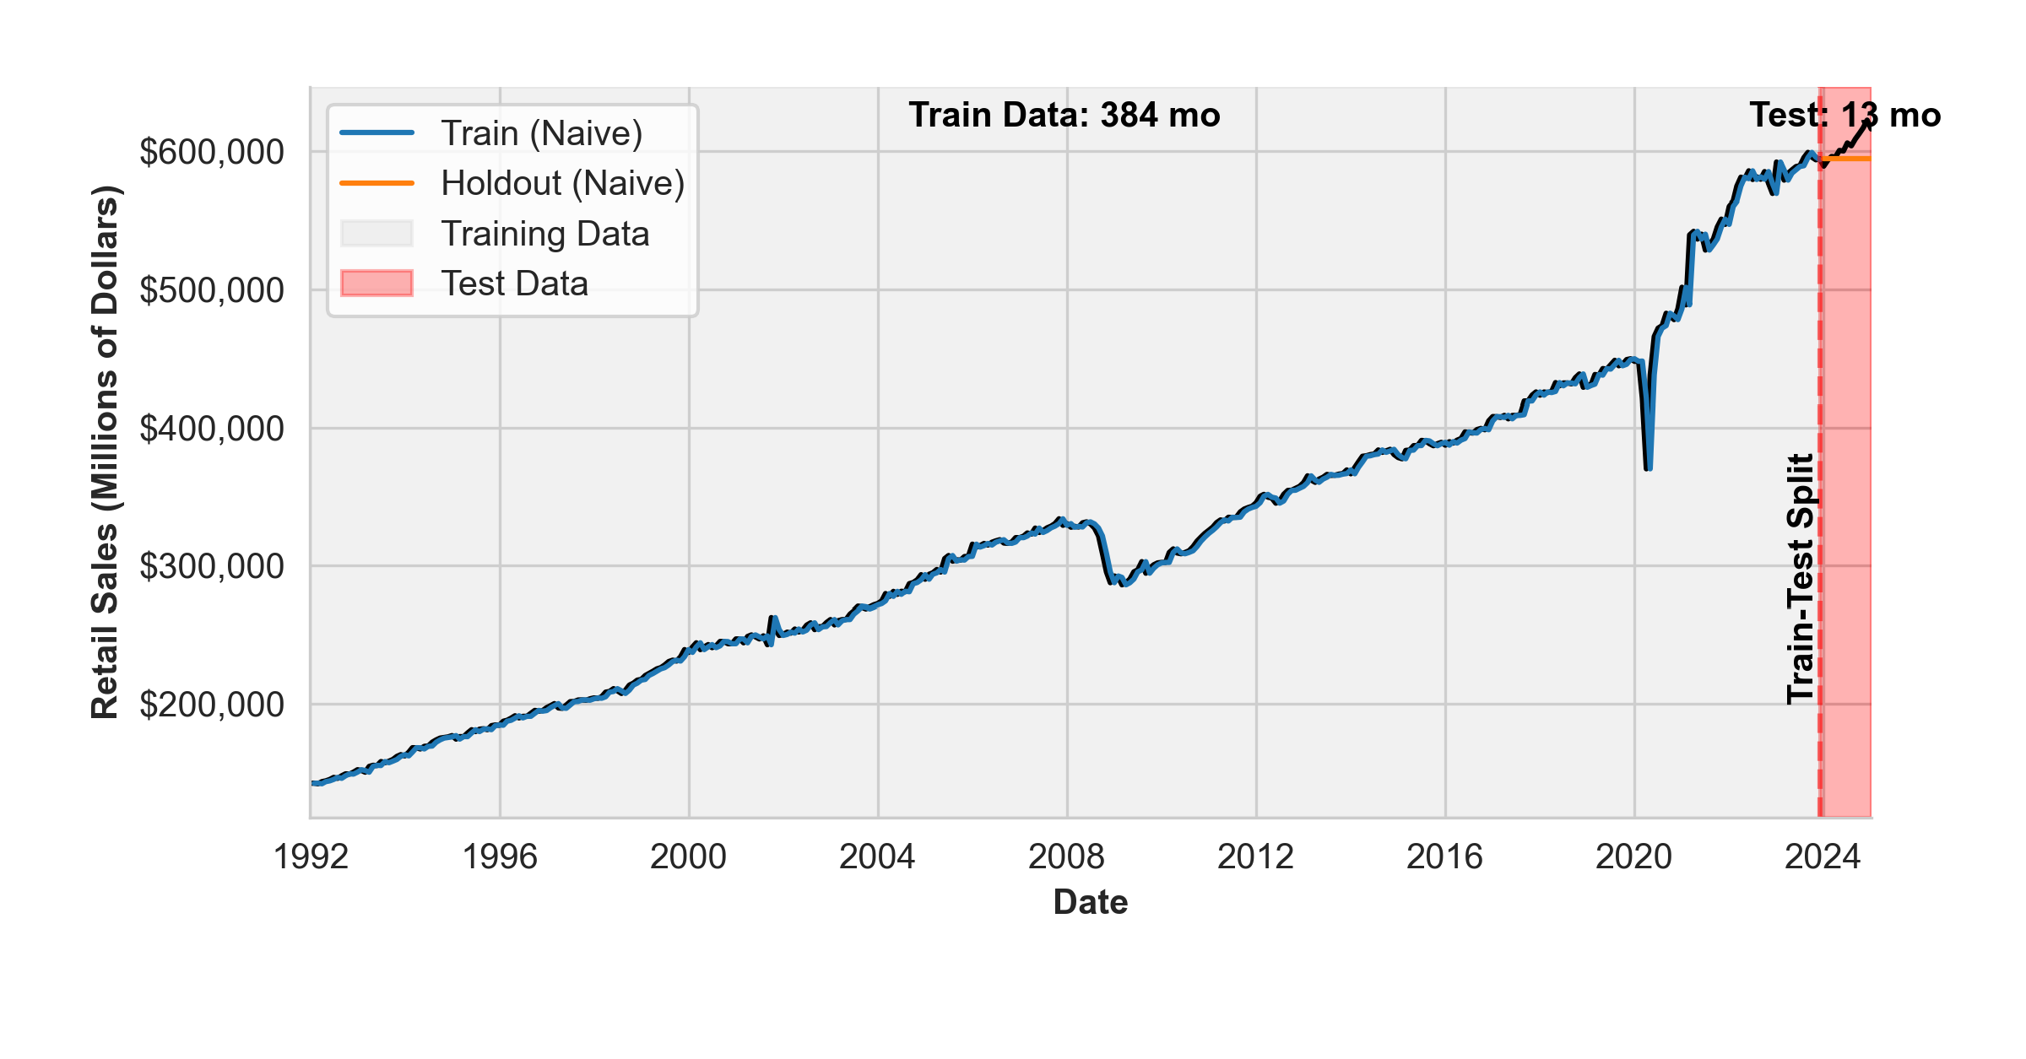
Naive Forecast: Fixed Window
Notes: The plot above shows the naive forecast for the retail trade data. The light gray region represents the training data, while the red region represents the test data. The vertical dashed line indicates the split point between the training and test data. The training data is used to fit the model, while the test data is used to evaluate the model's performance.
The naive forecast lags the training data, and is a straightline for the holdout dataset since we do not update the naive forecast for the fixed window approach. Similar to the historic average forecast, the naive forecast is a terrible choice for this dataset since it clearly has a positive trend.
30 / 37

Slide 31
Seasonal Naive Forecast
Seasonal Naive Forecast: The seasonal naive forecast assumes that the future value will be the same as the last observed value from the same season.
Mathematical Representation: y^_{t+h} = y_{t+h−m}, where m is the seasonal period.
Assumptions about the Data Generating Process (DGP):
Future values will be similar to the most recent past value from the same season.
The data generating process will be seasonal but with no trends.
31 / 37

Slide 32
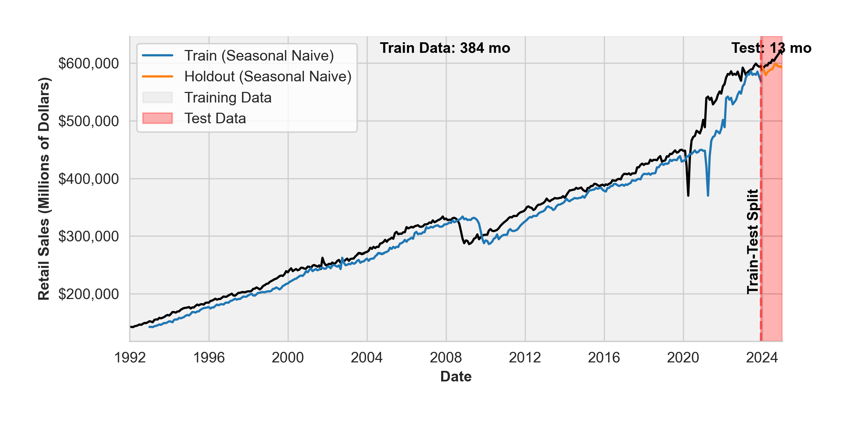
Seasonal Naive Forecast: Fixed Window
Notes: The plot above shows the seasonal naive forecast for the retail trade data. The light gray region represents the training data, while the red region represents the test data. The vertical dashed line indicates the split point between the training and test data. The training data is used to fit the model, while the test data is used to evaluate the model's performance.
The seasonal naive forecast lags the training data, and is worse than the naive model (since now the data lags by 12 months instead of 1 month); it would be better if the data is seasonal with no trends.
32 / 37

Slide 33
IImmpplleemmeennttiinngg BBaasseelliinn MMooddeellss wwii
SSttaattssFFoorreeccaasstt
3333 // 3377

Slide 34
Live Demo
We will now implement the historic average, naive, and seasonal naive forecasts using the StatsForecast library. Our in-class implementation will highlight both the fixed window and rolling-origin approaches.
34 / 37

Slide 35
RReeccaapp
3355 // 3377

Slide 36
Summary of Main Points
By now, you should be able to do the following:
Install and import Nixtla's libraries (StatsForecast, MLForecast, NeuralForecast, UtilsForecast, and TimeGPT) for forecasting
Distinguish fixed window from rolling-origin
Introduce forecast accuracy metrics (MAE, MAPE, RMSE)
Recognize the importance of baseline forecasts in time series forecasting
Identify common baseline forecasts (Naive, Seasonal Naive, etc.)
Implement baseline models with StatsForecast
36 / 37

Slide 37
📝 Review and Clarification 📝
Class Notes: Take some time to revisit your class notes for key insights and concepts.
Zoom Recording: The recording of today's class will be made available on Canvas approximately 3-4 hours after the session ends.
Questions: Please don't hesitate to ask for clarification on any topics discussed in class. It's crucial not to let questions accumulate.
37 / 37

