Slide 1




ISA 444: Business Forecasting
10: Baseline Forecasts
Fadel M. Megahed, PhD
Professor
Farmer School of Business Miami University
@FadelMegahed fmegahed fmegahed@miamioh.edu
Automated Scheduler for Office Hours
Spring 2025

Slide 2
Quick Refresher of Last Class
✅ Install and import Nixtla's libraries (StatsForecast, MLForecast, NeuralForecast, UtilsForecast, and TimeGPT) for forecasting
✅ Distinguish fixed window from rolling-origin
✅ Introduce forecast accuracy metrics (MAE, MAPE, RMSE)
2 / 17

Slide 3
Learning Objectives for Today's Class
Recognize the importance of baseline forecasts in time series forecasting
Identify common baseline forecasts (Naive, Seasonal Naive, etc.)
Implement baseline models with StatsForecast
3 / 17

Slide 4
IImmppoorrttaannccee ooff BBaasseelliinnee FFoorreeccaassttss
44 // 1177

Slide 5
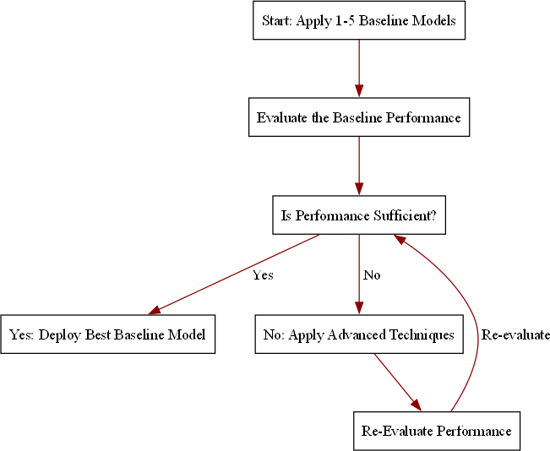
Why do we need Baseline Forecasts?
Baseline forecasts are simple, yet powerful.
Baseline forecasts serve as important benchmarks:
They provide a performance "floor"
for more complex models.
Help assess if advanced models can add meaningful value.
They are easy to interpret and require minimal computational resources.
5 / 17

Slide 6
CCoommmmoonn BBaasseelliinnee FFoorreeccaassttss
66 // 1177

Slide 7
Historic Mean/Average
Historic Mean/Average: The simplest baseline forecast is to use the average of the historical data as the forecast for all future periods.
Mathematical Representation: y^ =
1 ∑t
t+h
y_{i}
t i=1
Assumptions about the Data Generating Process (DGP):
Future values will be similar to the past.
The data generating process is relatively stationary (fixed mean with random noise), with no seasonality and no trends (obviously since the mean is fixed).
7 / 17

Slide 8
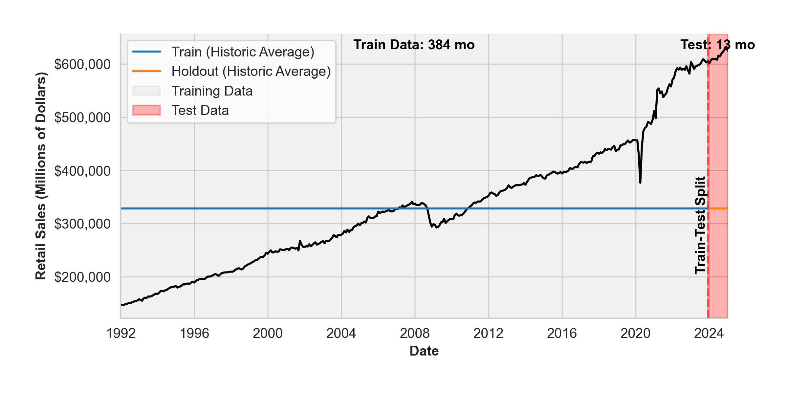
Historic Mean/Average: Fixed Window
Notes: The plot above shows the historic average forecast for the retail trade data. The light gray region represents the training data, while the red region represents the test data. The vertical dashed line indicates the split point between the training and test data. The training data is used to fit the model, while the test data is used to evaluate the model's performance.
Obviously, the historic average forecast is a straight line, as it is the same for all future periods. Furthermore, it is a terrible choice for this dataset since it clearly has a positive trend.
8 / 17

Slide 9
Naive Forecast
Naive Forecast: The naive forecast assumes that the future value will be the same as the last observed value.
Mathematical Representation: y^ = y_{t}
t+h
Assumptions about the Data Generating Process (DGP):
Future values will be similar to the most recent past value.
The data generating process can either be relatively stationary or follow a random walk.
9 / 17

Slide 10
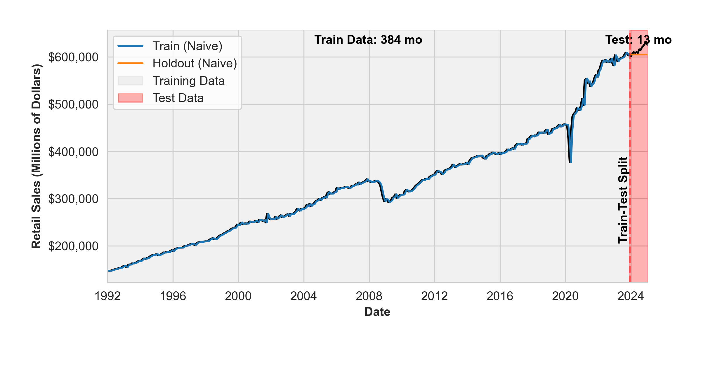
Naive Forecast: Fixed Window
Notes: The plot above shows the naive forecast for the retail trade data. The light gray region represents the training data, while the red region represents the test data. The vertical dashed line indicates the split point between the training and test data. The training data is used to fit the model, while the test data is used to evaluate the model's performance.
The naive forecast lags the training data, and is a straightline for the holdout dataset since we do not update the naive forecast for the fixed window approach. Similar to the historic average forecast, the naive forecast is a terrible choice for this dataset since it clearly has a positive trend.
10 / 17

Slide 11
Seasonal Naive Forecast
Seasonal Naive Forecast: The seasonal naive forecast assumes that the future value will be the same as the last observed value from the same season.
Mathematical Representation: y^ = y_{t+h−m}, where m is the seasonal period.
t+h
Assumptions about the Data Generating Process (DGP):
Future values will be similar to the most recent past value from the same season.
The data generating process will be seasonal but with no trends.
11 / 17

Slide 12
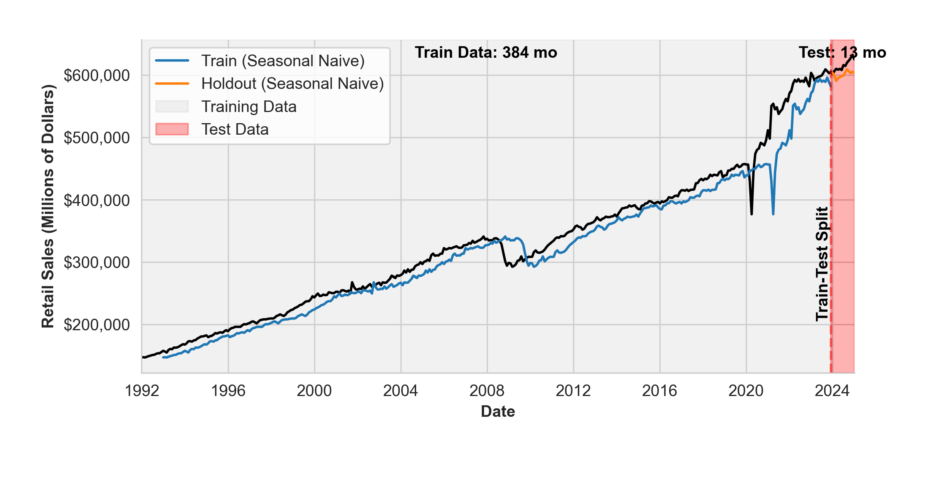
Seasonal Naive Forecast: Fixed Window
Notes: The plot above shows the seasonal naive forecast for the retail trade data. The light gray region represents the training data, while the red region represents the test data. The vertical dashed line indicates the split point between the training and test data. The training data is used to fit the model, while the test data is used to evaluate the model's performance.
The seasonal naive forecast lags the training data, and is worse than the naive model (since now the data lags by 12 months instead of 1 month); it would be better if the data is seasonal with no trends.
12 / 17

Slide 13
IImmpplleemmeennttiinngg BBaasseelliinn MMooddeellss wwii
SSttaattssFFoorreeccaasstt
1133 // 1177

Slide 14
Live Demo
We will now implement the historic average, naive, and seasonal naive forecasts using the StatsForecast library. Our in-class implementation will highlight both the fixed window and rolling-origin approaches.
14 / 17

Slide 15
RReeccaapp
1155 // 1177

Slide 16
Summary of Main Points
By now, you should be able to do the following:
Recognize the importance of baseline forecasts in time series forecasting
Identify common baseline forecasts (Naive, Seasonal Naive, etc.)
Implement baseline models with StatsForecast
16 / 17

Slide 17
📝 Review and Clarification 📝
Class Notes: Take some time to revisit your class notes for key insights and concepts.
Zoom Recording: The recording of today's class will be made available on Canvas approximately 3-4 hours after the session ends.
Questions: Please don't hesitate to ask for clarification on any topics discussed in class. It's crucial not to let questions accumulate.
17 / 17

