Slide 1




ISA 444: Business Forecasting
03: Plotting a Single Time Series in Python
Fadel M. Megahed, PhD
Professor
Farmer School of Business Miami University
@FadelMegahed fmegahed fmegahed@miamioh.edu
Automated Scheduler for Office Hours
Spring 2025

Slide 2
Quick Refresher of Last Class
✅ Setting up Python (Colab, Anaconda, and/or VS Code)
✅ Practice basic data reading (from CSVs and the Web)
✅ Use panda's datatime, indexing, and slicing capabilities
✅ (Optional) Discuss generative AI usage in Google Colab

Slide 3
Learning Objectives for Today's Class
Generate and interpret simple line charts.
Create seasonal plots and subplots.

Slide 4
GGeenneerraattee aanndd IInntteerrpprreett SSiimmppllee LLiinnee CChhaarrttss
44 // 2255

Slide 5
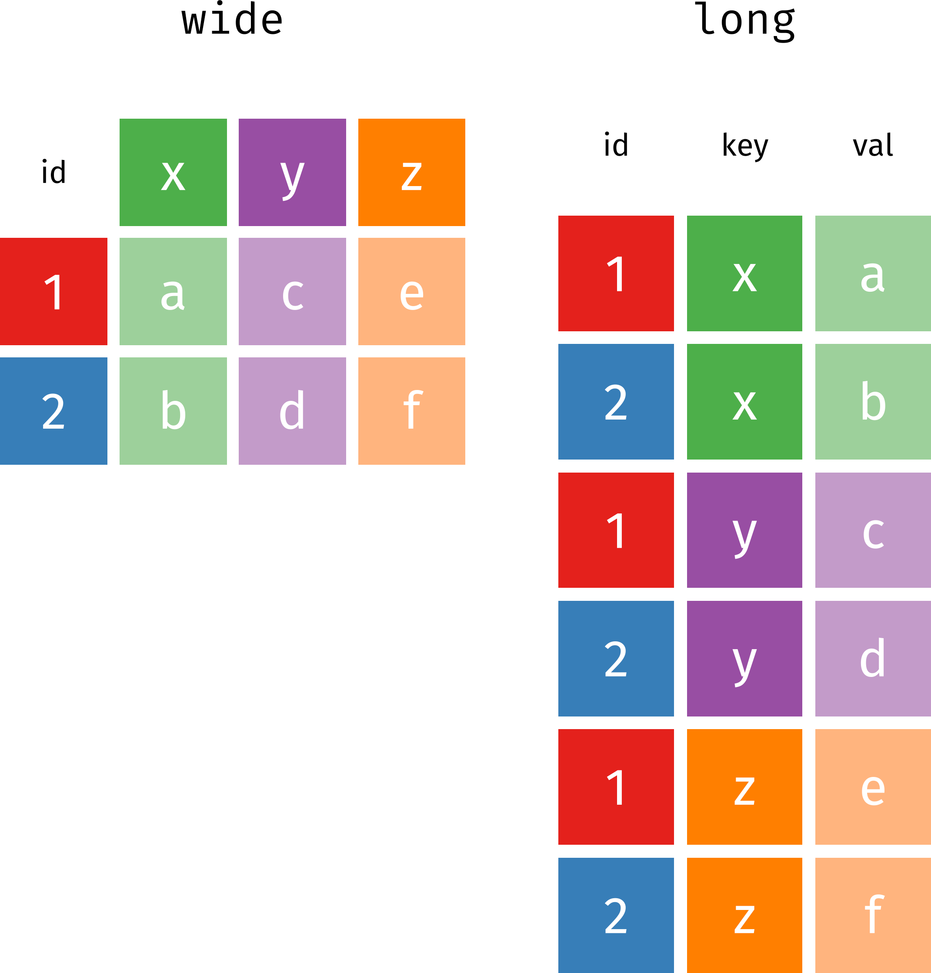
Basics: Tabular Data Formats - Wide vs. Long
Source: Image is from Garrick Aden-Buie's excellent tidyexplain GitHub Repository
5 / 25

Slide 6
Basics: Tabular Data Formats - Wide vs. Long
Wide Format
Wide Format
country | 1999 | 2000
Afghanistan | 745 | 2666
Brazil | 37737 | 80488
China | 212258 | 213766
country | year | cases | population
Afghanistan | 1999 | 745 | 19987071
Afghanistan | 2000 | 2666 | 20595360
Brazil | 1999 | 37737 | 172006362
Brazil | 2000 | 80488 | 174504898
China | 1999 | 212258 | 1272915272
China | 2000 | 213766 | 1280428583
6 / 25

Slide 7
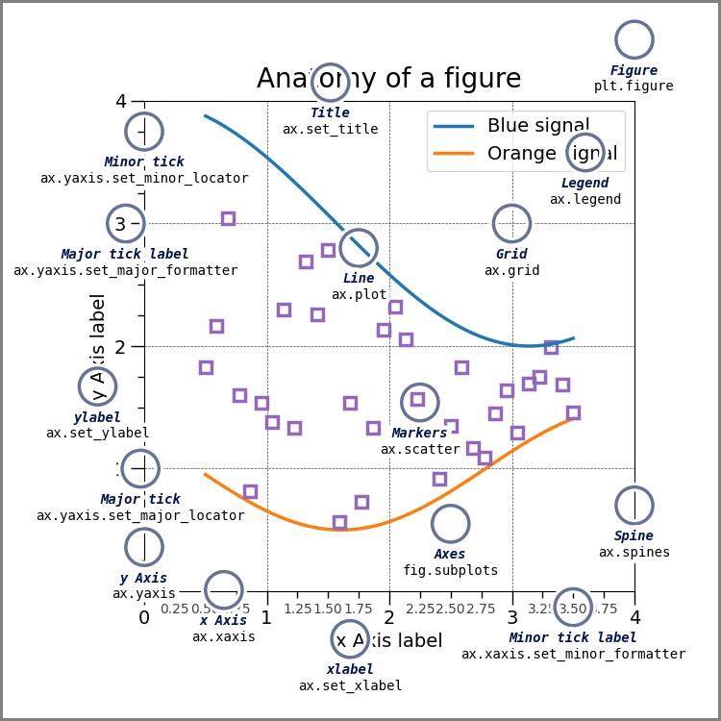
Basics: The Anatomy of a Chart
Source: Image is from the Matplotlib Documentation

Slide 8
Making Charts in Python: Three Possible Approaches
Matplotlib: The most basic and flexible plotting library in Python.
Panadas: A wrapper around Matplotlib that makes it easier to create simple plots directly from DataFrames.
Seaborn: A high-level interface to Matplotlib that makes it easier to create attractive and informative statistical graphics.

Slide 9
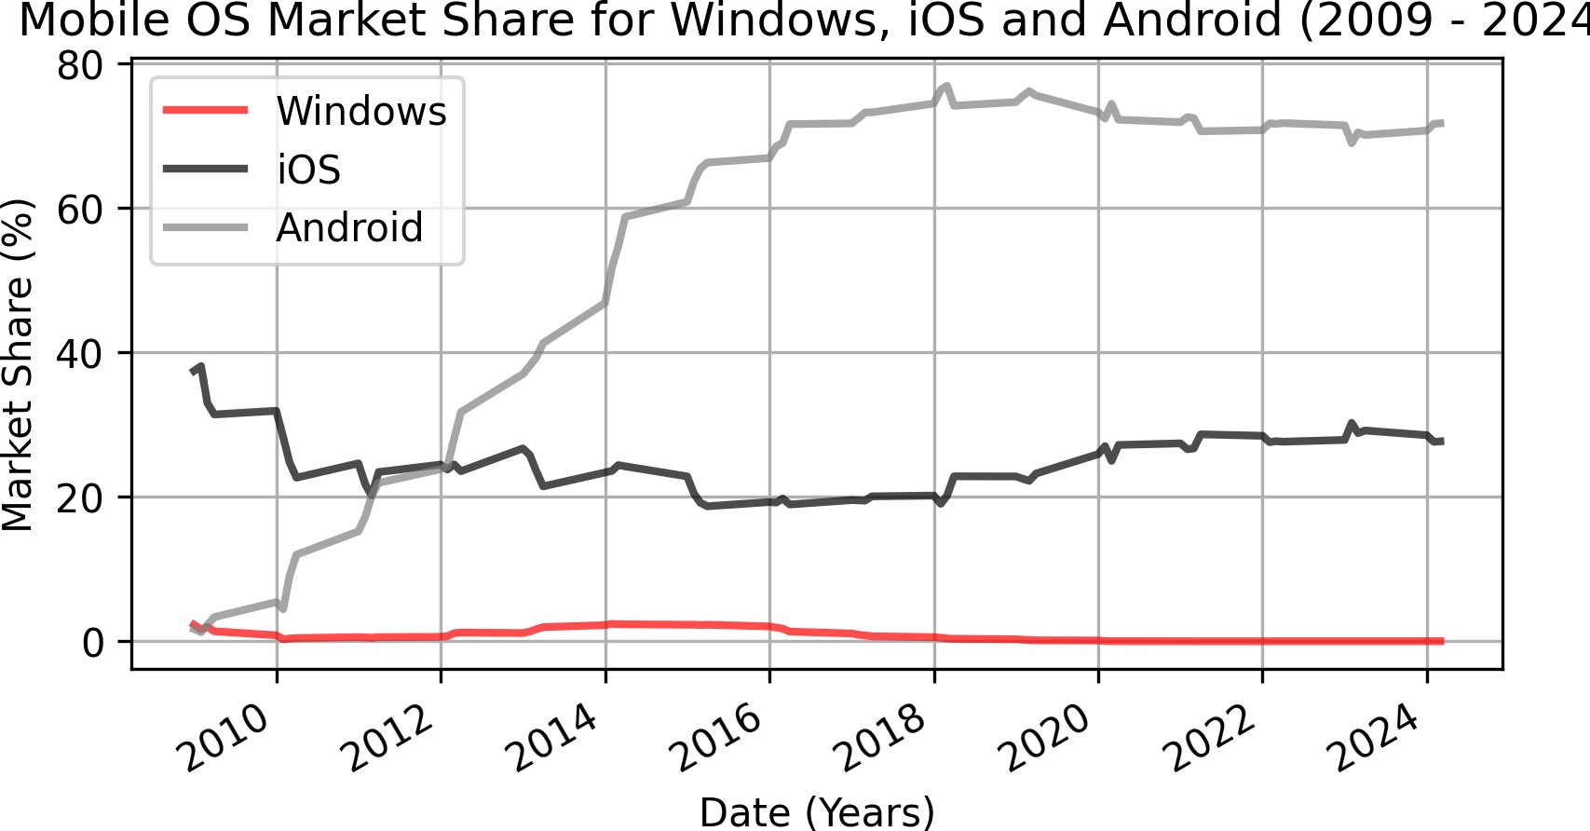
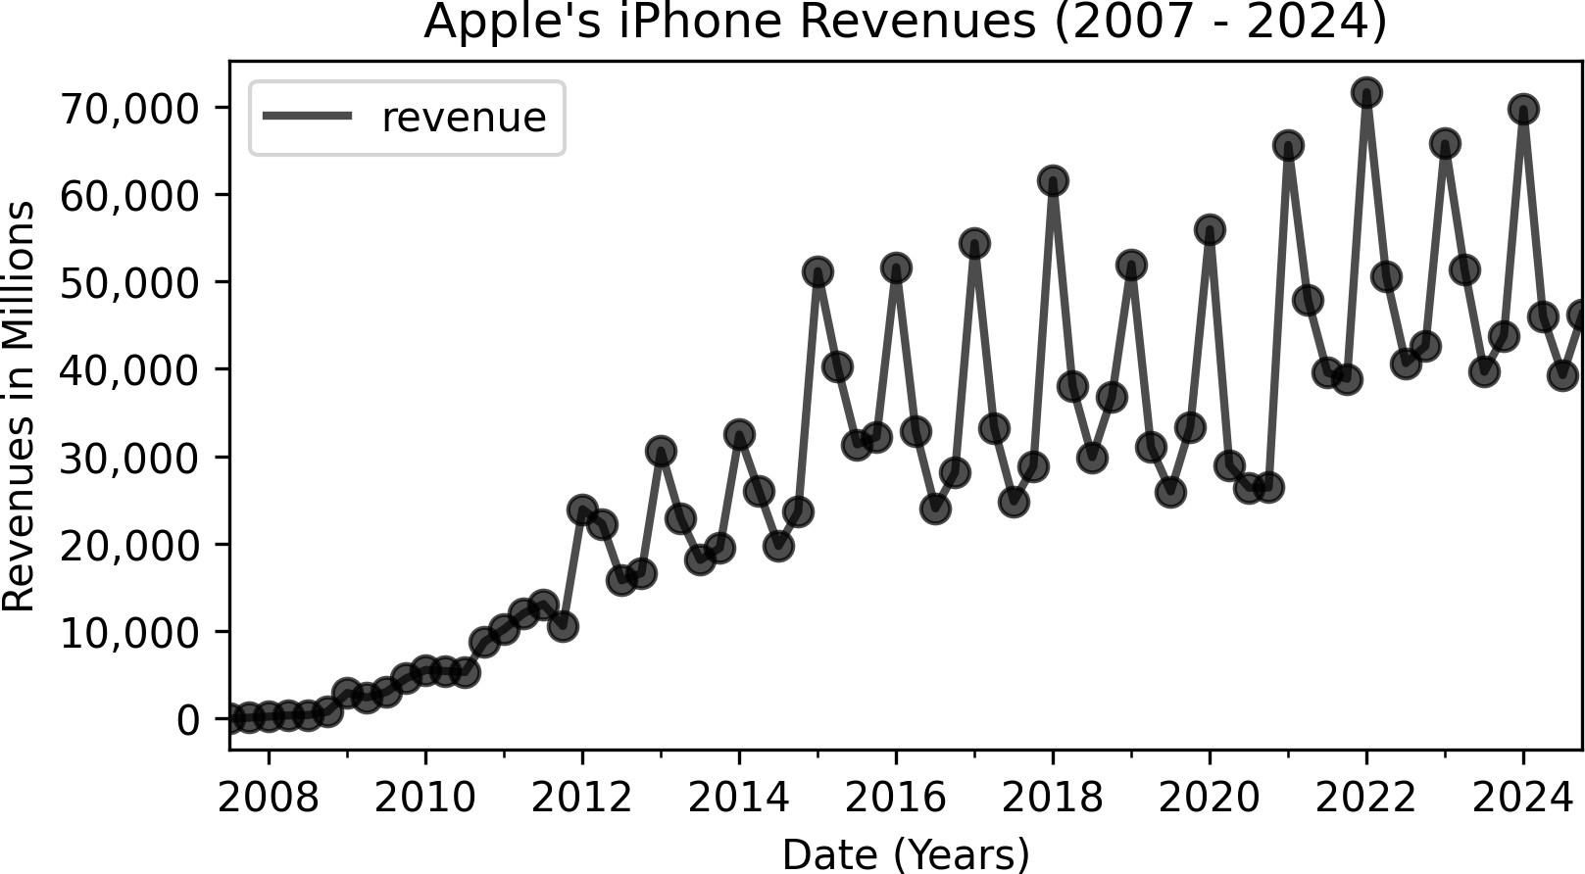
Recall: Microsoft's Missed Opportunity in Mobile Phones
Since Q1 2009, Windows' Mobile OS's market share <= 2.5%, and is now at 0.02% (StatCounter).
Apple's Mobile iOS market share > 19%, and is now at 27.69% (StatCounter).
Apple's iPhone revenues from 2007 to 2024 was $2.037 trillion (per statista).
Assuming Microsoft could have captured just 5% of Apple's market revenue → $102 billion.
This estimate excludes app store and brand value, which will make the missed opportunity even larger.

Slide 10
05:00
So, Let's Explore Apple's IPhone Revenues
Description Questions Class Results Python Code
Dataset: Load Apple's iPhone revenue data from 2007 to 2024. Click here to download the data.
Use pandas to read the data into a DataFrame.
Answer the questions in the following tab.

Slide 11








Plotting the Data using Pandas
Getting started | Search Ctrl + K 2.2 (stable) User API _{Development} Release Guide reference notes
Input/output |  | › API reference › DataFrame › pandas.DataF... pandas.DataFrame.plot DataFrame.plot(*args, **kwargs) ^{[source]} Make plots of Series or DataFrame. Uses the backend specified by the option plotting.backend . By default, matplotlib is used. Parameters: data : Series or DataFrame The object for which the method is called.
General functions
Series
DataFrame
pandas.DataFrame
pandas.DataFrame.index
pandas.DataFrame.columns
pandas.DataFrame.dtypes
pandas.DataFrame.info
pandas.DataFrame.select_dt
Source: Pandas API for the Plot Method

Slide 12
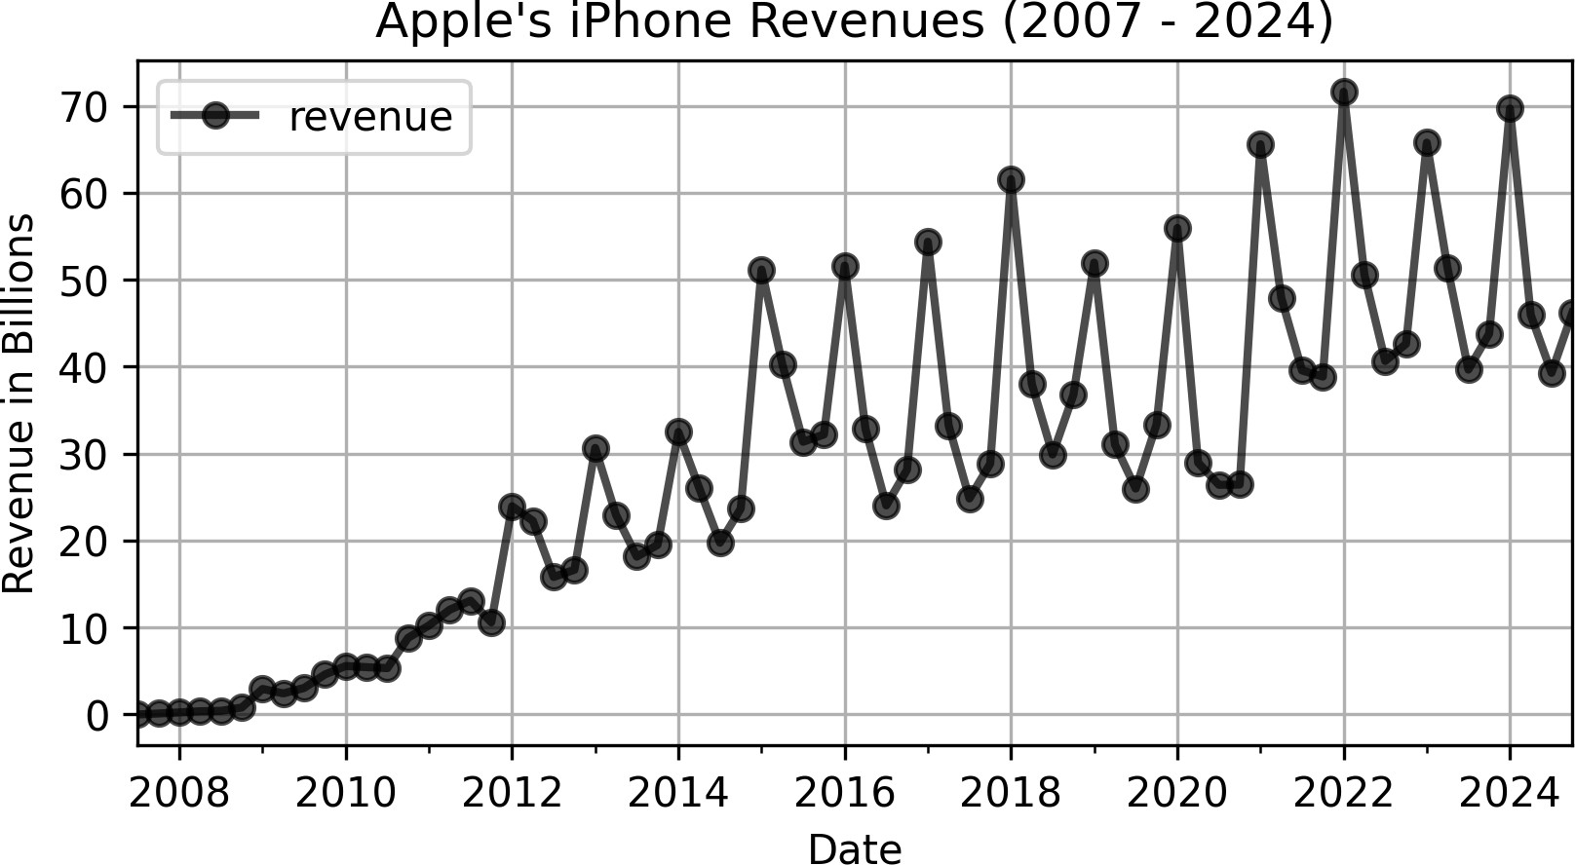
03:00
Use Pandas API to Make a Simple Line Chart
Use the Pandas Plot API to create a simple line chart of Apple's iPhone revenues from 2007 to 2024.
How close is the chart to the one you created in Python?
Hint: The additional **kwargs (keyword arguments) for the plot method can be found from matplotlib.pyplot.plot API Reference.

Slide 13
CCrreeaattee SSeeaassoonnaall PPlloottss aanndd SSuubbpplloottss
1133 // 2255

Slide 14
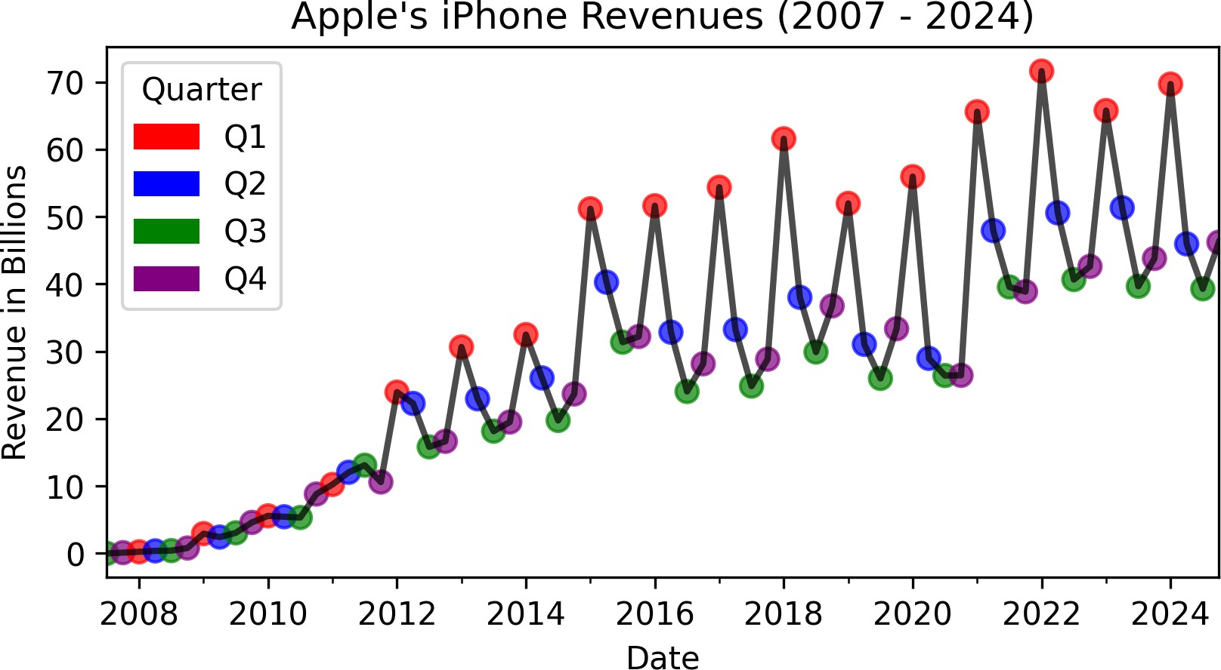
Demo: Lets Improve the Previous Plot Using Pandas
In a live demo, we will make the following improvements to the previous plot:
Color the data points by quarter.
Add a custom legend for the quarters.

Slide 15
The Equivalent Seaborn Implementation
import pandas as pd
import matplotlib.pyplot as plt
import seaborn as sns
apple_rev = pd.read_csv("../../data/statistic_id263402_apple-iphone-sales-revenue-2007-2024.csv") apple_rev = apple_rev.assign(
date=lambda df: pd.to_datetime(df['date']),
quarter=lambda df: df['date'].dt.quarter,
revenue=lambda df: df['revenue'].str.replace(',', '').astype(int) / 1e3
)
plt.figure(figsize=(6, 3.625)) # Create the figure
ax = sns.lineplot(data=apple_rev, x='date', y='revenue', color='black', linewidth=2, alpha=0.7) sns.scatterplot(
data=apple_rev, x='date', y='revenue', hue='quarter', # variable to color by
palette={1: 'red', 2: 'blue', 3: 'green', 4: 'purple'}, # custom color palette
s=100, # Marker size; adjust as desired
edgecolor='black', # Optional: add a black edge around markers
)
Customize the axes and title, and show the plot ax.set_title("Apple's iPhone Revenues (2007 - 2024)") ax.set_xlabel("Date")
ax.set_ylabel("Revenue in Billions")
plt.show()

Slide 16
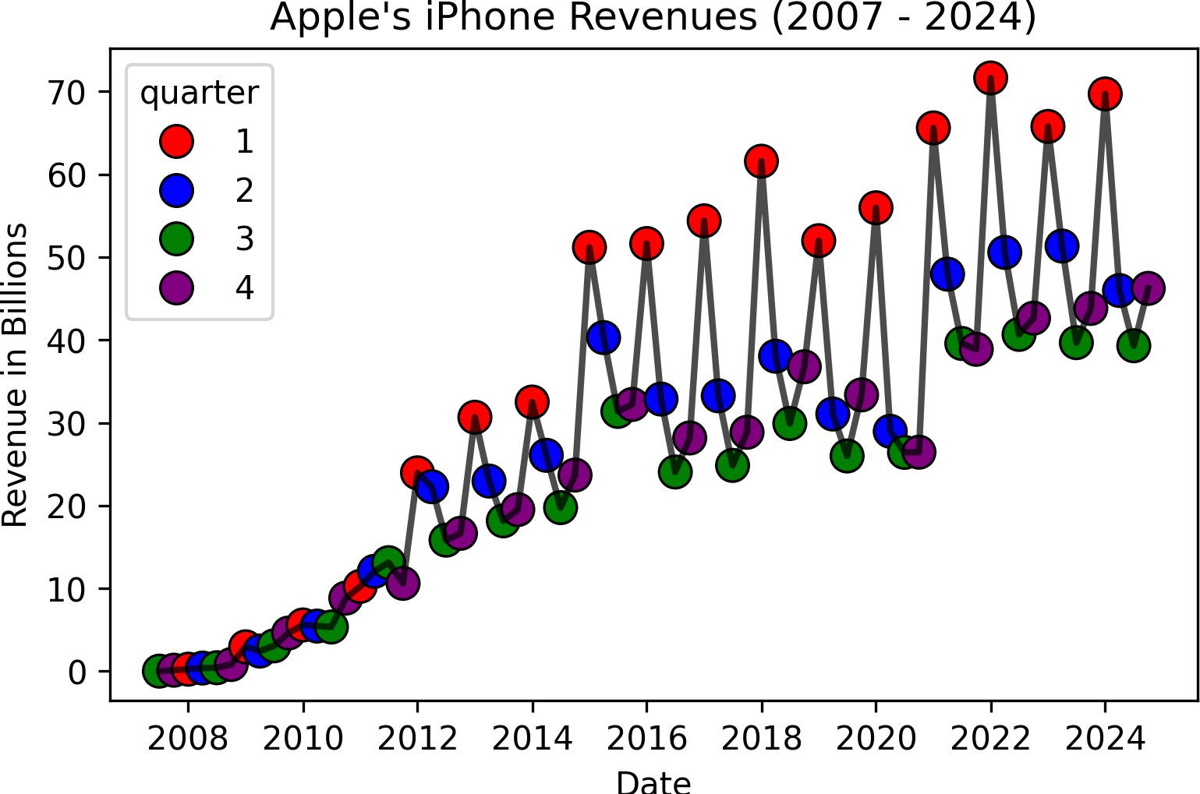
The Equivalent Seaborn Implementation

Slide 17
03:00
What Observations Can You Make from the Chart?
Edit me
...
...

Slide 18
Other Types of Seasonal Plots
Seasonal Plot (By Month/Quarter): A line chart where the data is plotted against the season.
Seasonal Subseries Plot: A line chart where each season is plotted separately.
Multiple Box Plots: A box plot for each season.

Slide 19
Seasonal Plot (By Month/Quarter)
import pandas as pd
import matplotlib.pyplot as plt
apple_rev = (
pd.read_csv("../../data/statistic_id263402_apple-iphone-sales-revenue-2007-2024.csv")
.assign(
date = lambda x: pd.to_datetime(x['date']), quarter = lambda x: x['date'].dt.quarter, year = lambda x: x['date'].dt.year,
revenue = lambda x: x['revenue'].str.replace(r',', '').astype(int)/1e3
)
.query('year >= 2019')
)
s = sns.relplot( kind="line",
data=apple_rev, x="quarter", y="revenue", hue="year", marker="o",
row = "year", # optional: separate by year
)
beautify the plot (will not work with row = 'year') s.ax.set_xticks(range(1, 5)) s.ax.set_xticklabels(['Q1', 'Q2', 'Q3', 'Q4']) sns.move_legend(s, "upper center", ncols = 3)
plt.show()

Slide 20
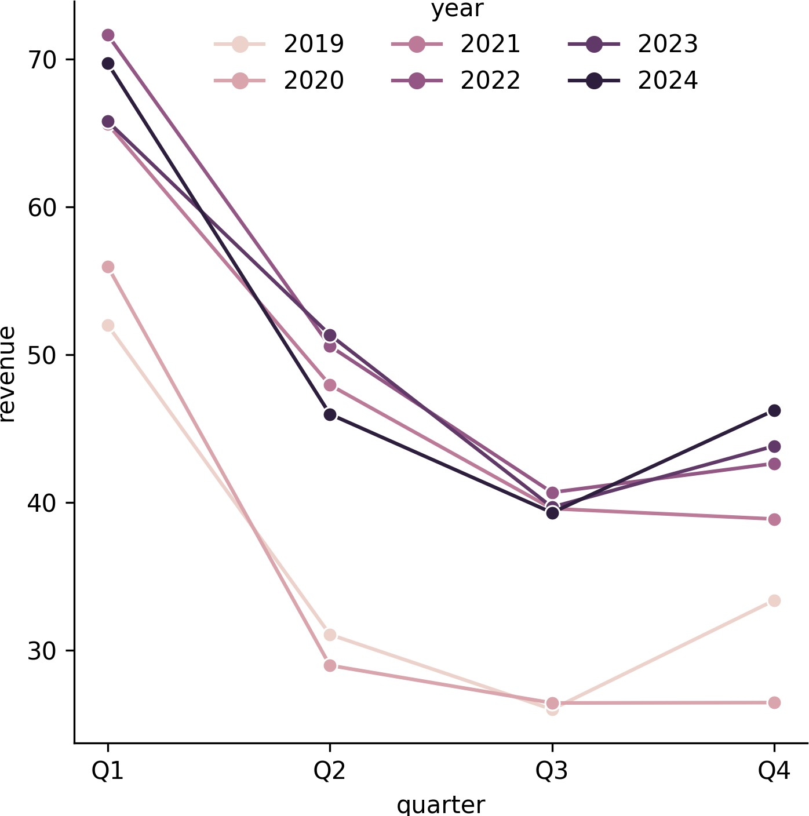
Seasonal Plot (By Month/Quarter)

Slide 21
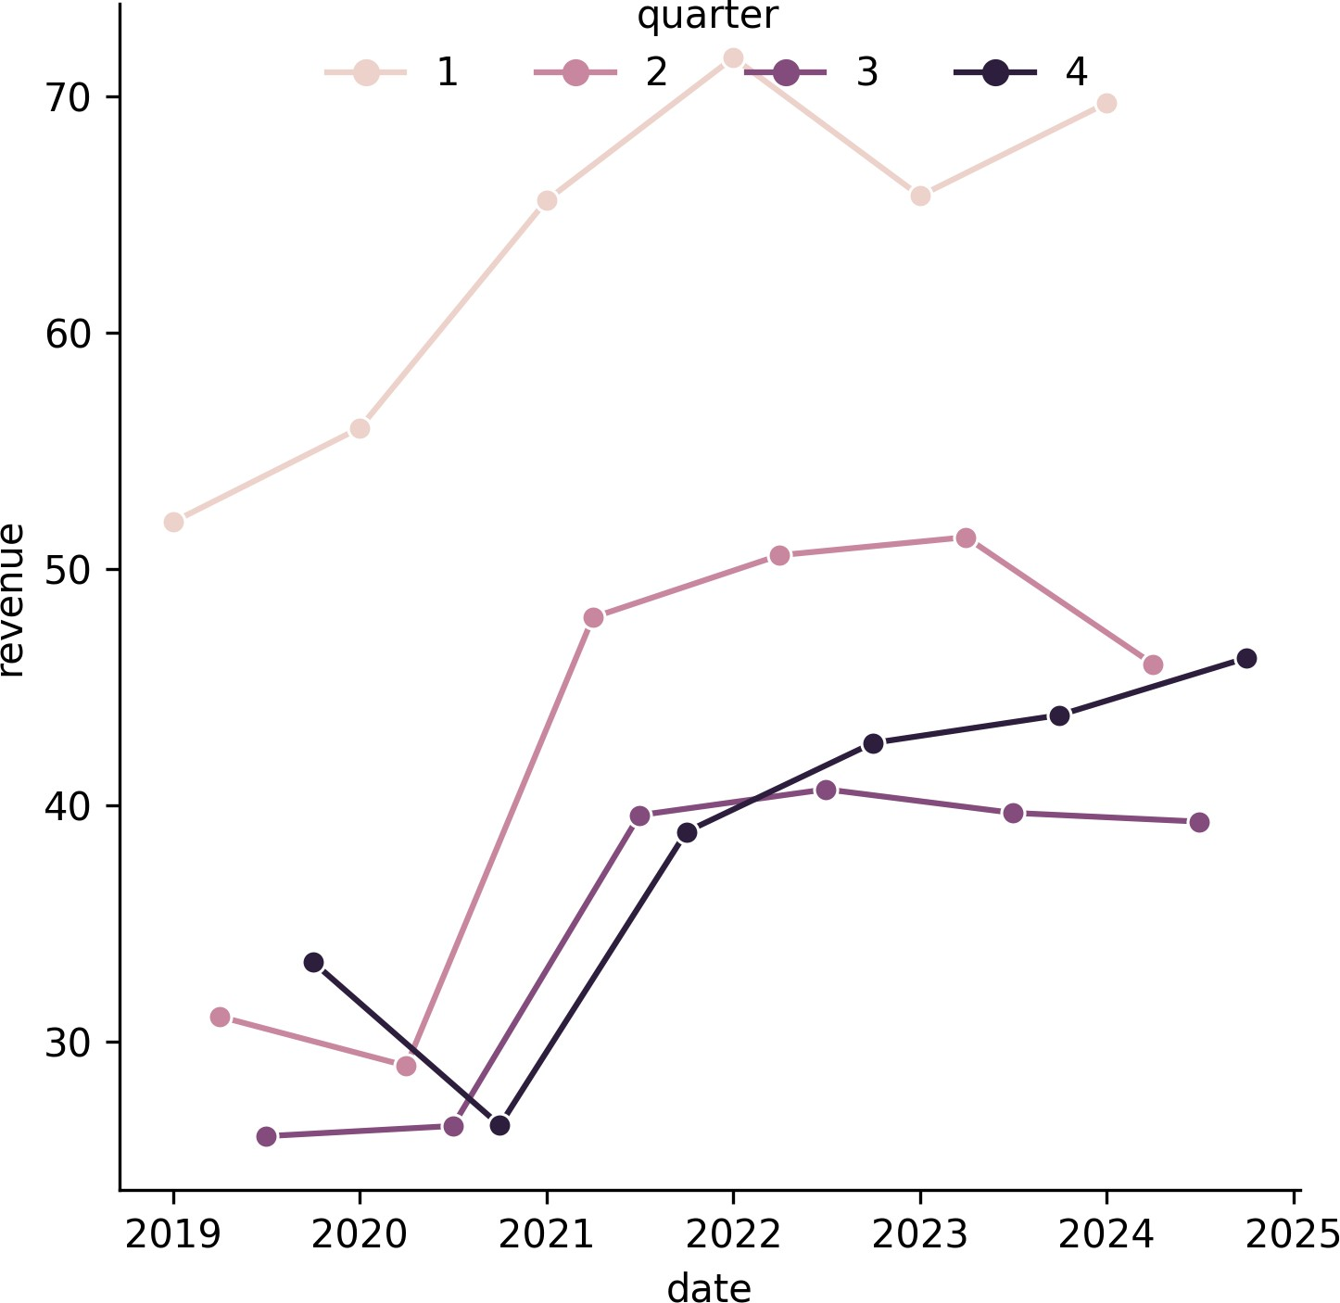
03:00
Seasonal Subseries Plot
Description
Chart to Make

Slide 22
RReeccaapp
2222 // 2255

Slide 23
Summary of Main Points
By now, you should be able to do the following:
Generate and interpret simple line charts.
Create seasonal plots and subplots.

Slide 24
📝 Review and Clarification 📝
Class Notes: Take some time to revisit your class notes for key insights and concepts.
Zoom Recording: The recording of today's class will be made available on Canvas approximately 3-4 hours after the session ends.
Questions: Please don't hesitate to ask for clarification on any topics discussed in class. It's crucial not to let questions accumulate.

Slide 25
📖 Required Readings 📖
Reference the following pages:
Pandas Plot API
An Introduction to Seaborn
An Introduction to Seaborn for data viz with Python

