Slide 1




ISA 444: Business Forecasting
07: Visualizing Many Time-Series
Fadel M. Megahed, PhD
Professor
Farmer School of Business Miami University
@FadelMegahed fmegahed fmegahed@miamioh.edu
Automated Scheduler for Office Hours
Spring 2025

Slide 2
Quick Refresher of Last Class
✅ Describe and compute centered moving averages
✅ Estimate trend-cycle via moving averages
✅ Perform classical decomposition (trend-cycle, seasonal, residual/remainder)
✅ Understand STL / MSTL as alternatives to classical decomposition

Slide 3
Learning Objectives for Today's Class
Explain the differences between wide vs. long format
Use seaborn to plot multiple time-series
Convert a data set to Nixtla's long format (unique_id, ds, y)
Use UtilsForecast to visualize multiple series

Slide 4


Wide Vs. Long Format

Slide 5
Wide Format
Date | Temperature (°F) | Muggy Days | Rainy/Snowy Days
2024-01-01 | 31 | 0.0 | 7
2024-02-01 | 34 | 0.0 | 6
2024-03-01 | 44 | 0.0 | 9
2024-04-01 | 54 | 0.1 | 10
2024-05-01 | 64 | 3.4 | 12
2024-06-01 | 72 | 12.3 | 11
2024-07-01 | 76 | 18.2 | 11
2024-08-01 | 74 | 15.5 | 9
2024-09-01 | 67 | 7.0 | 7
2024-10-01 | 55 | 0.9 | 7
2024-11-01 | 45 | 0.0 | 7
2024-12-01 | 35 | 0.0 | 8

Slide 6
Characteristics of Wide TS Data
Each row represents a single observation
Each column represents a different time series
Easy to read and understand (but not appropriate for analysis if you are using the nixtlaverse group of Python packages)

Slide 7
Long Format
Date | Variable | Value
2024-01-01 | Muggy Days | 0.0
2024-01-01 | Rainy/Snowy Days | 7.0
2024-01-01 | Temperature (°F) | 31.0
2024-02-01 | Muggy Days | 0.0
2024-02-01 | Rainy/Snowy Days | 6.0
2024-02-01 | Temperature (°F) | 34.0
2024-03-01 | Muggy Days | 0.0
2024-03-01 | Rainy/Snowy Days | 9.0
2024-03-01 | Temperature (°F) | 44.0
2024-04-01 | Muggy Days | 0.1
2024-04-01 | Rainy/Snowy Days | 10.0
2024-04-01 | Temperature (°F) | 54.0

Slide 8
Characteristics of Long TS Data
Observations are now split into multiple rows
Variable ids/labels are stored in a single column, and their corresponding values are stored in another column
Easy to analyze and visualize (especially with the nixtlaverse group of Python packages)

Slide 9
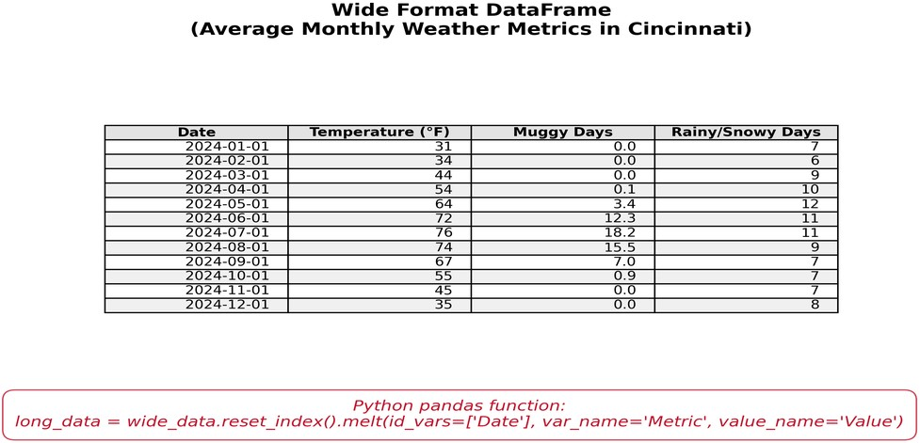
A Visual Comparison

Slide 10
05:00
Class Activity: From Wide to Long Format
Description Starter Code Notes
In this activity, you will extract the adjusted closing prices of five stocks (AAPL, MSFT, GOOGL, AMZN, TSLA) from Yahoo Finance. Once you extract the data, you should report the following:
Summary statistics of the adjusted closing prices for each stock.
Convert the data from wide to long format, and report the shape of the long format data.
Save the long format data to a CSV file.
Hint: Read and convert the column names prior to converting the data to long format.

Slide 11



Visualizing Multiple Time-Series Using Seaborn

Slide 12
Recall: Seaborn's relplot Function
seaborn.relplot
s eaborn.objects.Plot |  | seaborn.relplot(data=None, *, x=None, y=None, hue=None, size=None, style=None, units=None, weights=None, row=None, col=None, col_wrap=None, row_order=None, col_order=None, palette=None, hue_order=None, hue_norm=None, sizes=None, size_order=None, size_norm=None, markers=None, dashes=None, style_order=None, legend='auto', kind='scatter', height=5, aspect=1, facet_kws=None, **kwargs) Figure-level interface for drawing relational plots onto a FacetGrid. This function provides access to several different axes-level functions that show the relationship between two variables with semantic mappings of subsets. The kind parameter selects the underlying axes-level function to use: s catterplot() (with kind="scatter" ; the default) l ineplot() (with kind="line" ) Extra keyword arguments are passed to the underlying function, so you should refer to the documentation for each to see kind-specific options.
s eaborn.objects.Dot
s eaborn.objects.Dots
s eaborn.objects.Line
s eaborn.objects.Lines
s eaborn.objects.Path
s eaborn.objects.Paths
s eaborn.objects.Dash
s eaborn.objects.Range
s eaborn.objects.Bar
s eaborn.objects.Bars
s eaborn.objects.Area

Slide 13
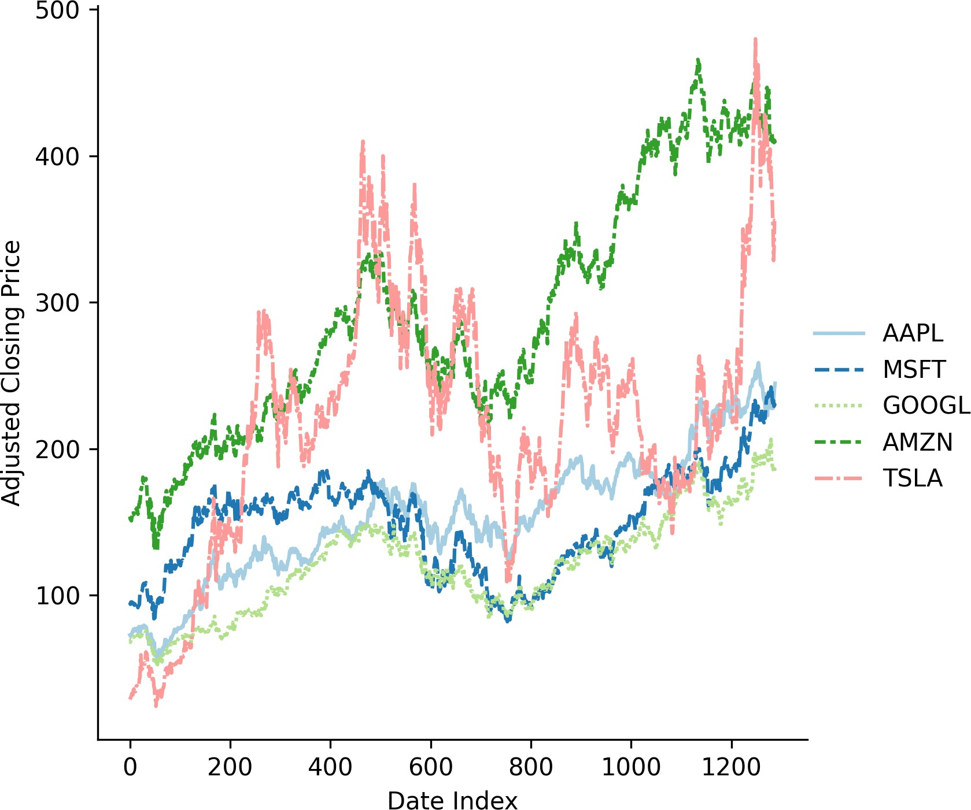
Seaborn's relplot Function with Wide Data
import datetime as dt import yfinance as yf import pandas as pd import seaborn as sns
Download the stock data for the following companies
stock_data = ( yf.download(
['AAPL', 'MSFT', 'GOOGL', 'AMZN', 'TSLA'],
start='2020-01-01',
end= (dt.datetime.now().date() - dt.timedelta(days=1))
)
Keep only the adjusted closing price
[['Adj Close']].reset_index()
)
Overwrite the multi-index column names w/ single level
stock_data.columns = (
['Date', 'AAPL', 'MSFT', 'GOOGL', 'AMZN', 'TSLA'] )
Plot the closing prices
sns.relplot(
data=stock_data, kind='line', palette ='Paired'
)

Slide 14
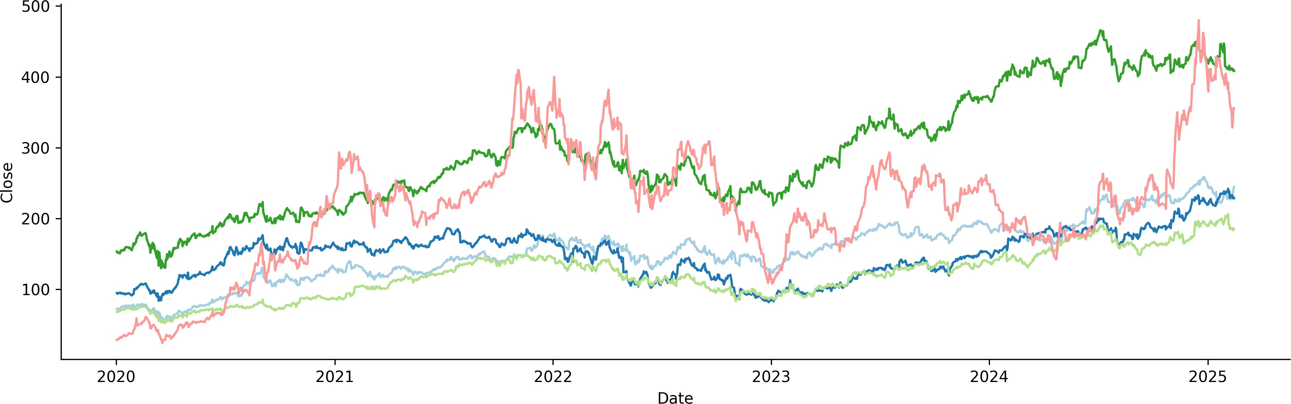
Seaborn's relplot Function with Long Data

Slide 15
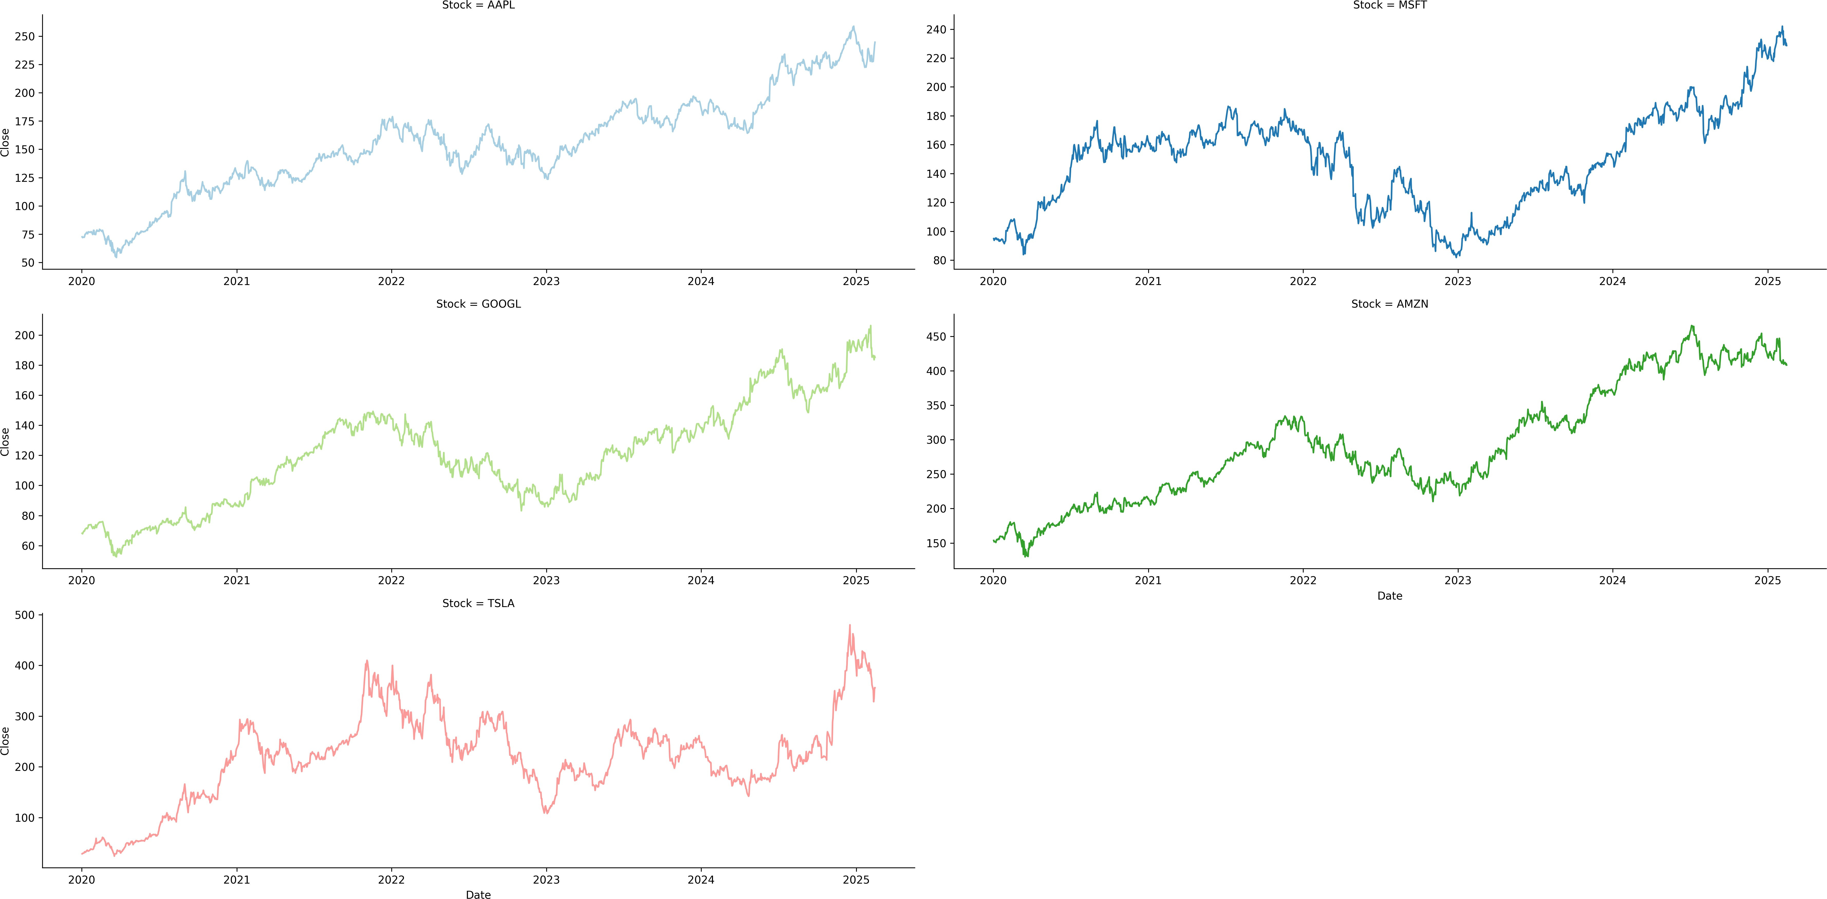
Seaborn's relplot Function with Long Data (Facets)

Slide 16
03:00
Activity: Reflect on the Previous Seaborn Plots
Whether you are plotting multiple lines in a single plot or using facets, the relplot function is quite versatile. However, this approach is only suitable for a few (in my opinion ≤ 9 time series). So what options, do we have if we have more than 9 time series?
I think there are three alternative charting approaches (I am not talking about specific libraries). Can you guess what they are?
In the next three minutes, edit the bullet points below to reflect the three alternative charting approaches.
...
...
...

Slide 17


Advanced Visualizations with Seaborn

Slide 18
Approach 1: Sample
Sample a subset of the time series to plot. This approach is useful when you have a large number of time series and you want to visualize a representative sample.
Key Point: The sample should be representative of the entire data set.

Slide 19
Approach 1: Sample (Code Example)
import pandas as pd import seaborn as sns import random
Start with the long format data and sample two stocks # Plot the adjusted closing prices
fig = sns.relplot(
data=stock_data.query('Stock in @sampled_stocks'),
x='Date', y='Close', kind='line', legend=False, hue='Stock', col='Stock', palette='Paired', col_wrap=2, facet_kws={'sharey': False, 'sharex': False}
random.seed(2025) # for reproducibility
sampled_stocks = stock_data['Stock'].unique().tolist()
sampled_stocks = random.sample(sampled_stocks, 2)
)
plt.tight_layout() # improves title visibility

Slide 20
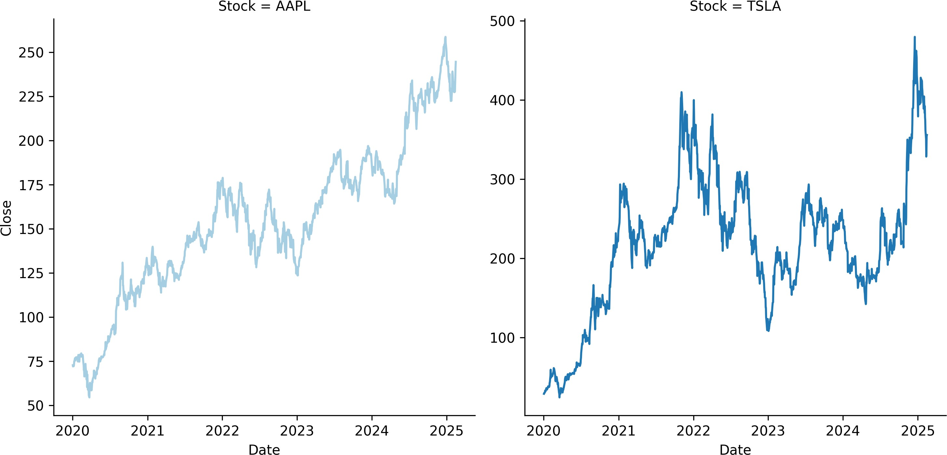
Appraoch 1: Sample (Result)

Slide 21
Approach 2: Animated Plots
Animate the time series data. This approach is useful when you have a large number of time series and you want to visualize all of them.
Key Point: Animated plots can be interactive and engaging.

Slide 22
Approach 2: Animated Plots (Code Example)
import matplotlib.pyplot as plt
import pandas as pd
import seaborn as sns
import imageio.v2 as imageio
Start with long format data
stocks = stock_data['Stock'].unique().tolist()
image_paths = []
for stock in stocks: sns.relplot(
data=stock_data.query('Stock == @stock'), kind ='line',
x='Date', y='Close', color ='black', height = 4, aspect = 3
)
plt.title(f"Adjusted Closing Price of {stock} (2020-2025)", fontsize=14) plt.xlabel("Date", fontsize=12)
plt.ylabel("Adjusted Closing Price", fontsize=12)
plt.tight_layout() plt.savefig(f'../../figures/{stock}_animated_plot.png') image_paths.append(f'../../figures/{stock}_animated_plot.png')
Create a GIF from the images
images = [imageio.imread(path) for path in image_paths] imageio.mimsave('../../figures/animated_stock_lineplot.gif', images, fps=0.25)

Slide 23
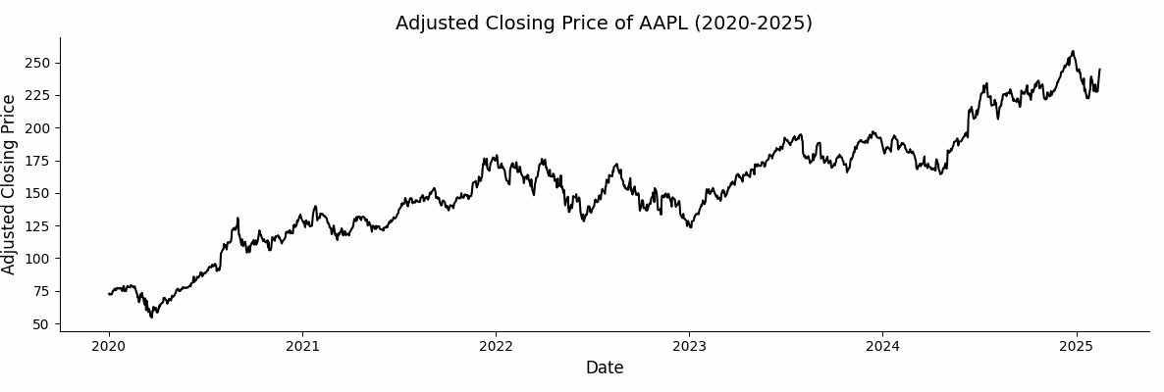
Approach 2: Animated Plots (Result)

Slide 24
Approach 3: Spaghetti Plot
Plot all time series on a single plot. This approach is useful when you have a large number of time series and you want to visualize all of them.
Key Points:
Use light gray for the lines to de-emphasize individual time series.
Use bold colors for the lines of specific time series (or summary statistics across all time series) to emphasize them.

Slide 25
Approach 3: Spaghetti Plot (Code Example)
import pandas as pd
import matplotlib.pyplot as plt
import seaborn as sns
for each stock, plot the closing price over time as a light gray line
for stock, group in stock_data.groupby("Stock"):
ax = sns.lineplot(data=group, x='Date', y='Close', color='lightgray', alpha=0.5)
Calculate and overlay percentiles across all time series for each date
quantiles = stock_data.groupby('Date')['Close'].quantile([0.05, 0.5, 0.95]).unstack()
Plot the median, 5th, and 95th percentiles
sns.lineplot(data=quantiles, x=quantiles.index, y=0.5, color='black', label='Median', ax = ax) sns.lineplot(data=quantiles, x=quantiles.index, y=0.05, color='blue', label='5%', ax=ax) sns.lineplot(data=quantiles, x=quantiles.index, y=0.95, color='red', label='95%', ax=ax)

Slide 26
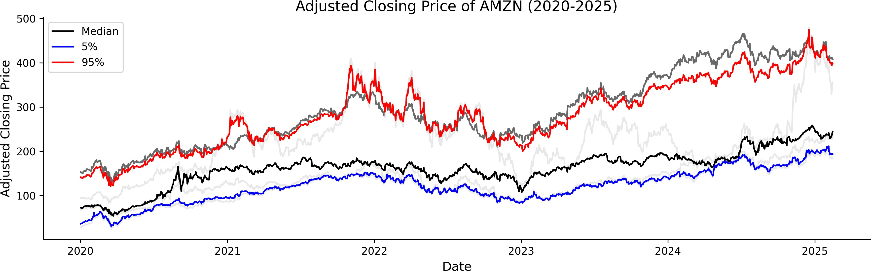
Approach 3: Spaghetti Plot (Result)

Slide 27


Nixtla's Long Format

Slide 28
08:00
Class Activity: Convert Data to Nixtla's Format
Data: This COVID-19 data set contains the daily cumulative number of confirmed cases for each county.
Objectives:
Read the data set.
Filter the data to include only the 88 counties in Ohio, and dates from 2020-04-01 to 2022-12-31.
Convert the data to Nixtla's long format (unique_id, ds, y), where the:
unique_id column is used to identify each county.
ds column is used to represent the date.
y column is used to represent the cumulative number of confirmed cases.
Use the plot_series method from the UtilsForecast to visualize the data. See here to learn about how to import and here to see the arguments of the plot_series method.

Slide 29


Recap

Slide 30
Summary of Main Points
By now, you should be able to do the following:
Explain the differences between wide vs. long format
Use seaborn to plot multiple time-series
Convert a data set to Nixtla's long format (unique_id, ds, y)
Use UtilsForecast to visualize multiple series

Slide 31
📝 Review and Clarification 📝
Class Notes: Take some time to revisit your class notes for key insights and concepts.
Zoom Recording: The recording of today's class will be made available on Canvas approximately 3-4 hours after the session ends.
Questions: Please don't hesitate to ask for clarification on any topics discussed in class. It's crucial not to let questions accumulate.

