Slide 1




ISA 444: Business Forecasting
01: Introduction to Time Series Analysis and Forecasting
Fadel M. Megahed, PhD
Professor
Farmer School of Business Miami University
@FadelMegahed fmegahed fmegahed@miamioh.edu
Automated Scheduler for Office Hours
Spring 2025

Slide 2
Learning Objectives for Today's Class
Describe the role of forecasting in business.
Describe the key components of a time-series (trend, seasonality, multiple seasonality, and
cycles).
Explain the concept of data-generating process (DGP)
Discuss limits of forecasting
Understand key forecasting terminology
2 / 42

Slide 3
CCoouurrssee MMoottiivvaattiioonn
33 // 4422

Slide 4
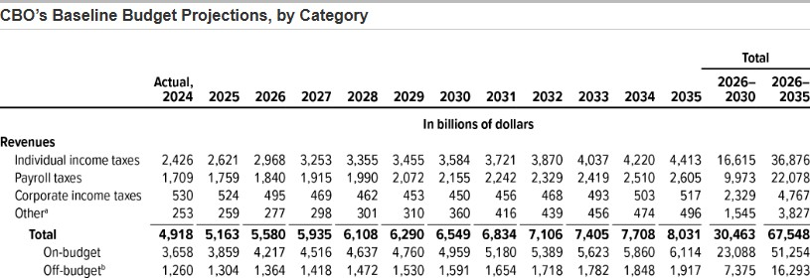





Forecasting Impacts Everything and Everyone
Businesses: Sales forecasts set revenue targets, inventory projections optimize supply chains, and staffing plans ensure workforce readiness during demand fluctuations.
Gov.: Tax revenue and social programs forecasts aid budgeting and resource allocation.
Individuals: Financial forecasts
Source: Congressional Budget Office
OXFORD
WEATHER
0°C
clear sky
support budgeting, saving, and retirement planning.
Weather: Forecast inform agriculture, disaster prep, and daily decisions.
Tue
Wed
Thu
Fri
Sat
Sun
Mon
4°C
-2°C
5°C
-1°C
5°C
-1°C
12°C
3°C
5°C
1°C
11°C
3°C
3°C
-2°C
Source: Weather Widget's Forecast

Slide 5
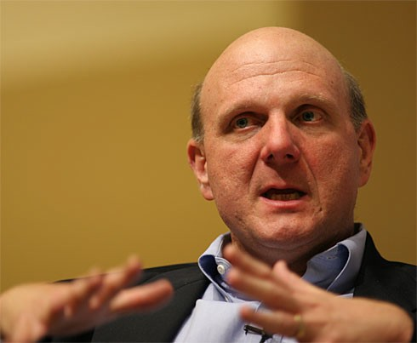
Microsoft's Missed Opportunity with Mobile Phones
Q: People get passionate when Apple comes out
with something new—the iPhone; of course ... Is that something you'd want them to feel about Microsoft?
A: It's sort of a funny question. Would I trade 96% of
the market for 4%? (Laughter.)
I want to have products that appeal to everybody. There's no chance that the iPhone is going to get any significant market share. No chance. It's a $500 subsidized item. They may make a lot of money.
But if you actually take a look at the 1.3 billion phones that get sold, I'd prefer to have our software in 60% or 70% or 80% of them, than I would 2% or 3%, which is what Apple might get.
Steve Ballmer, Former CEO of Microsoft in his infamous interview with USA Today 2007

Slide 6
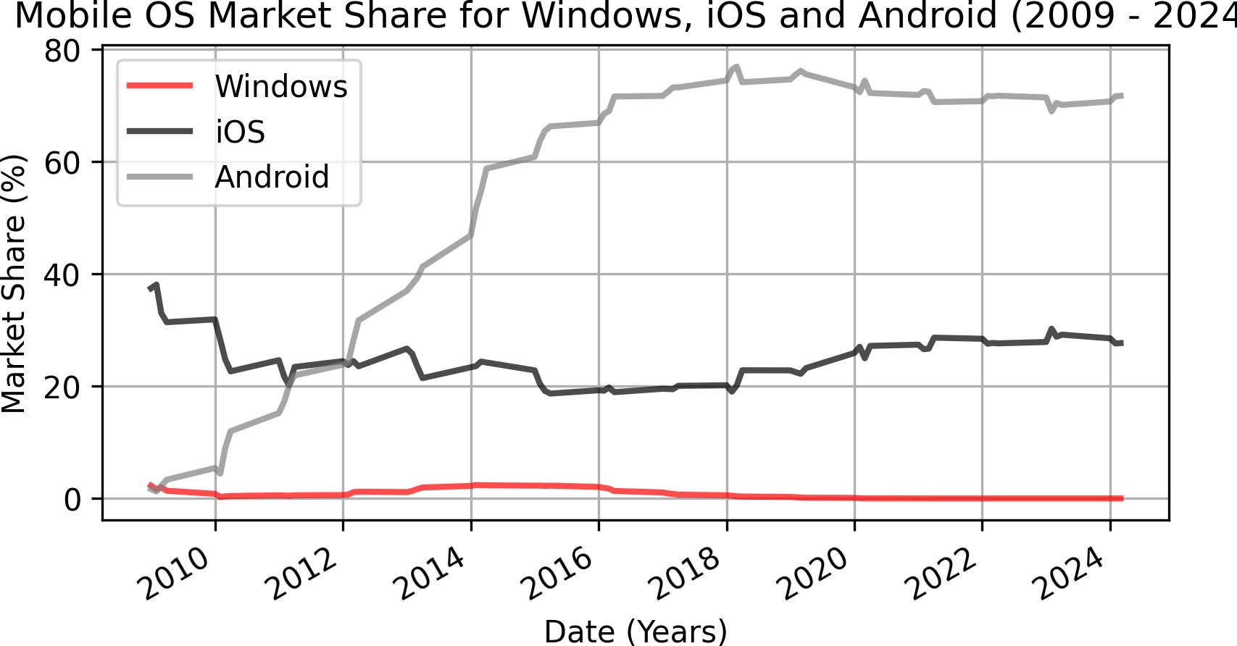
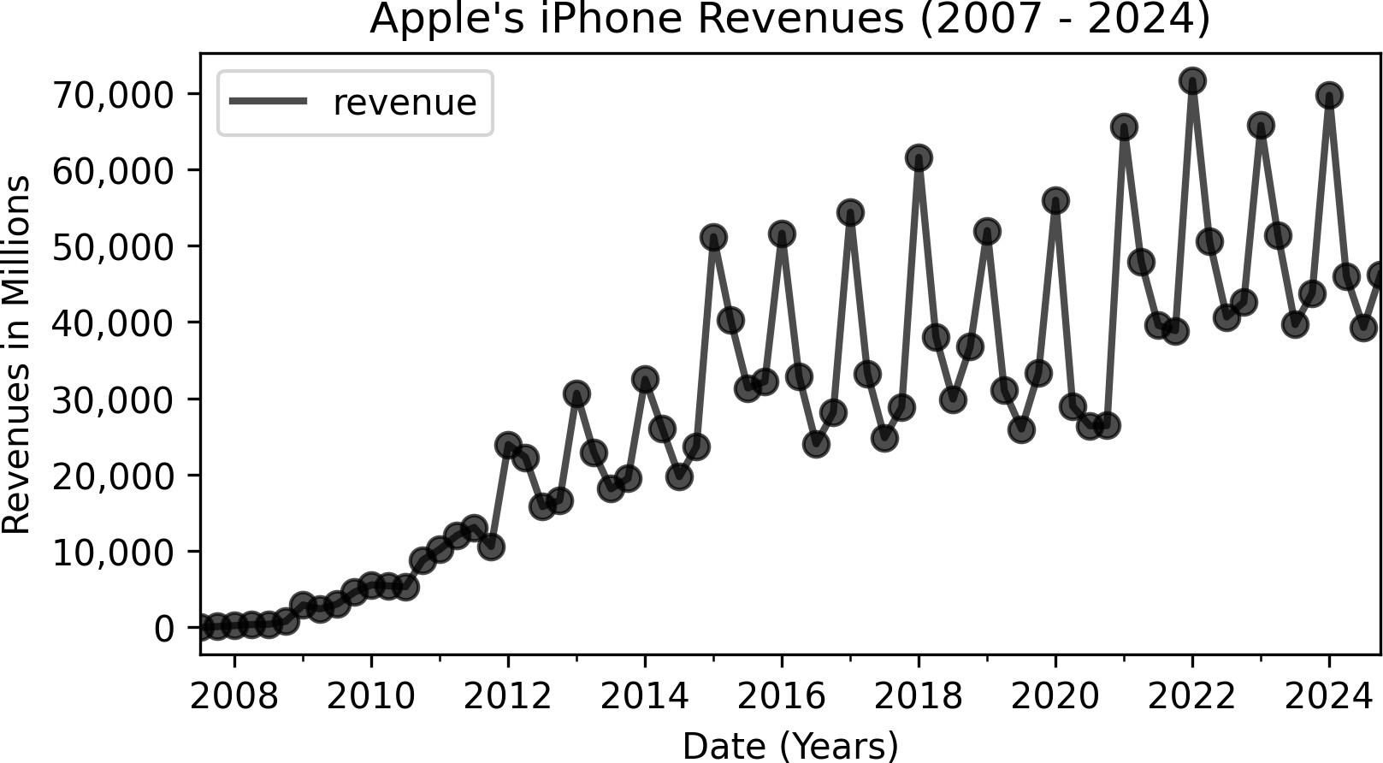
Microsoft's Missed Opportunity: Back of a Napkin Calc.
Since Q1 2009, Windows' Mobile OS's market share <= 2.5%, and is now at 0.02% (StatCounter).
Apple's Mobile iOS market share > 19%, and is now at 27.69% (StatCounter).
Apple's iPhone revenues from 2007 to 2024 was $2.037 trillion (per statista).
Assuming Microsoft could have captured just 5% of Apple's market revenue → $102 billion.
This estimate excludes app store and brand value, which will make the missed opportunity even larger.

Slide 7
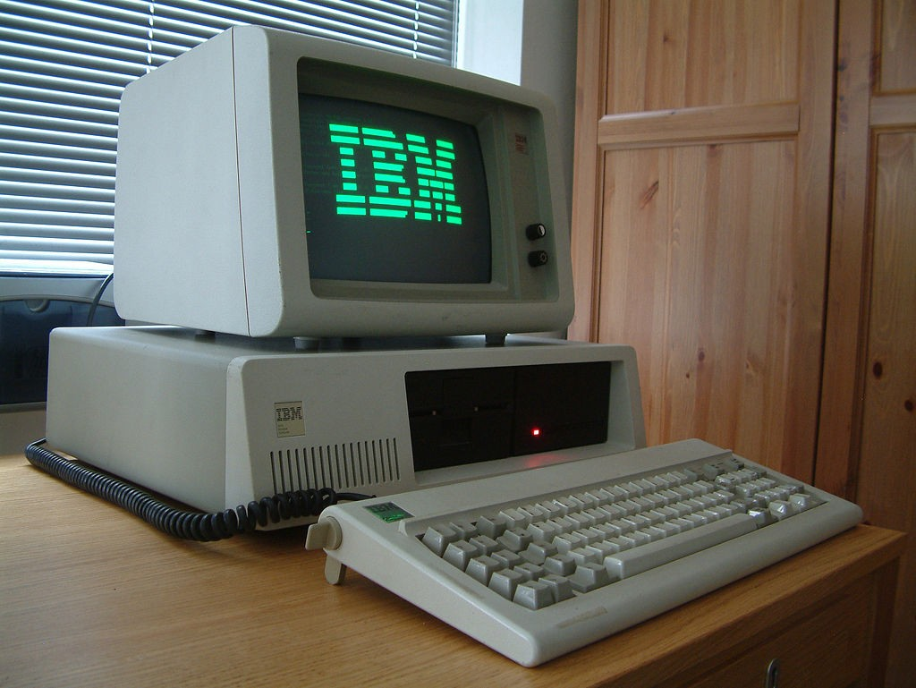
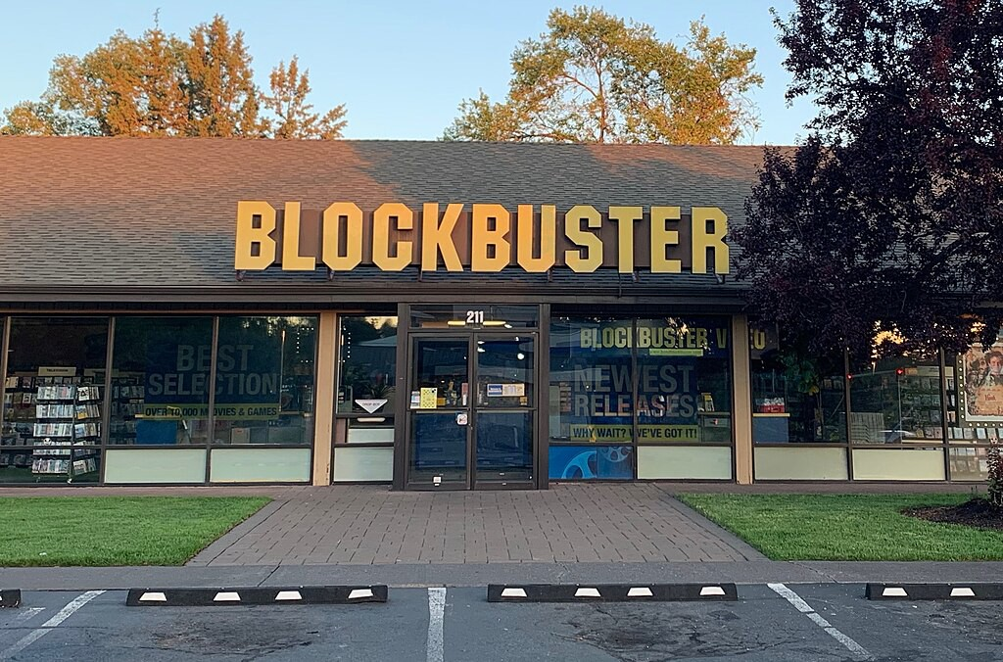
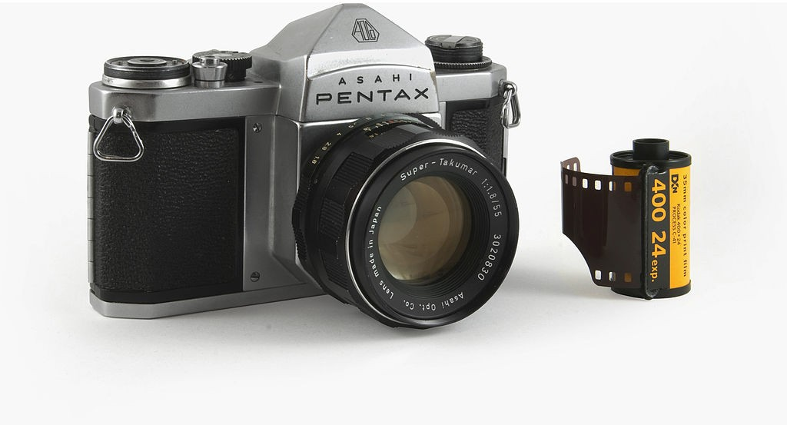
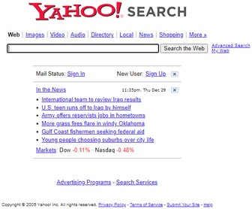
Other Real-World Forecasting Failures in Tech
IBM: Missed the PC revolution.
Blockbuster: Missed the streaming revolution.
Kodak: Missed the digital camera revolution.
Yahoo: Missed the search engine revolution.

Slide 8
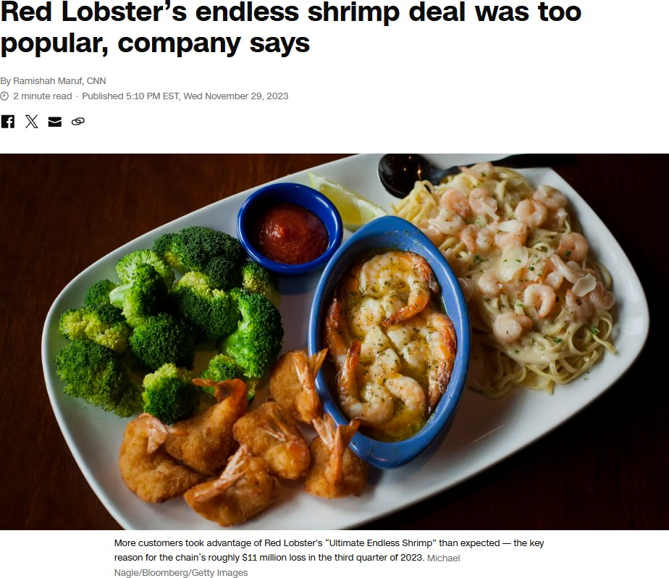
Non-Tech Failures: Red Lobster's Endless Shrimp

Slide 9
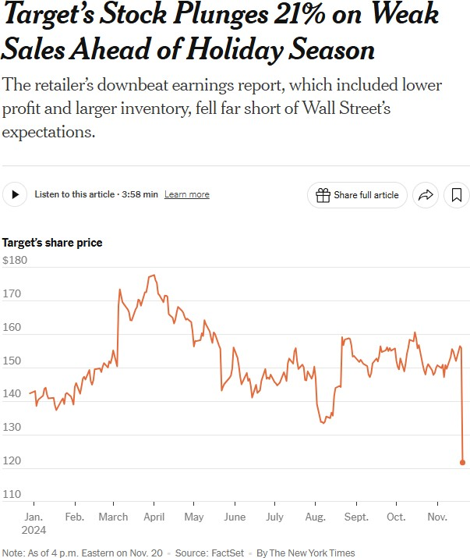
Non-Tech Failures: Target's Overestimation

Slide 10
Why Do These Stories Matter?
(1) Forecasting Errors = Real Money Lost
Microsoft: $102 billion in potential mobile phone revenues.
Target: Overestimation leads to unsold stock or overservicing (e.g., Target's Stock Plunging by 21% due to lower profit and larger inventories).
Red Lobster: $11M in losses due to underestimating demand for their endless shrimp deal.
(2) Course Relevance:
This class will teach you how to identify trends, seasonality, and cycles, and how to apply forecasting tools and models so you can avoid these pitfalls in your future roles. The goal is to allow you to make data-driven forecasts, not just gut-based decisions, and more importantly, be able to quantify the uncertainty in your forecasts.

Slide 11
08:00
Can you Avoid Common Forecasting Mistakes?
Description Your Logic Your Sol Class Results Fadel's Logic Fadel's Sol
Scenario: You are a business analyst at a hotel chain.
Problem: You are tasked with forecasting hotel occupancy for the next 11 months.
Data: You have access to the hotel's monthly room occupancy data from 2022 to January of 2025. Download the file here.
Task: Without the use of any AI tools, create a forecast for the hotel's occupancy for the next 11 months. The forecast can be made in Excel, R, or Python. Document the process and the rationale behind your forecasts.
Non-graded Class Activity: Input your logic for the 11-month forecast, and your quantitative forecast for February 2025 in the next 2 tabs, respectively.

Slide 12
TTyyppeess ooff DDaattaa OOvveerr TTiimmee aanndd tthhee CCoommppoonneennttss
ooff aa TTiimmee SSeerriieess
1122 // 4422

Slide 13

Cross-Sectional Data
Cross-sectional data captures multiple variables at a single point in time for each observation; e.g., all the variables within a given observation in the DoL's LCA Disclosure Data for 2024 Q4 were collected simultaneously.
Show 4 entries Search:
Date ▲ ▼ | Job Title | ▲ Employer ▲ ▼ ▼ | WORKSITE_STATE ▲ ▼ |  | Salary ▲ ▼
2022-04-14 | Sr. Programmer/Analyst | Illumina, Inc. | OH |  | $142,294
2022-07-19 Senior SAP Application Consultant, FICO NTT DATA Business Solutions Inc. OH $173,400
2022-08-10 | Metallurgical Engineer | General Aluminum Mfg. Company | OH |  | $74,000
2023-03-13 Lecturer The Ohio State University OH $50,944
Showing 1 to 4 of 184 entries
Previous
1
2
3
4
5 …
46
Next

Slide 14
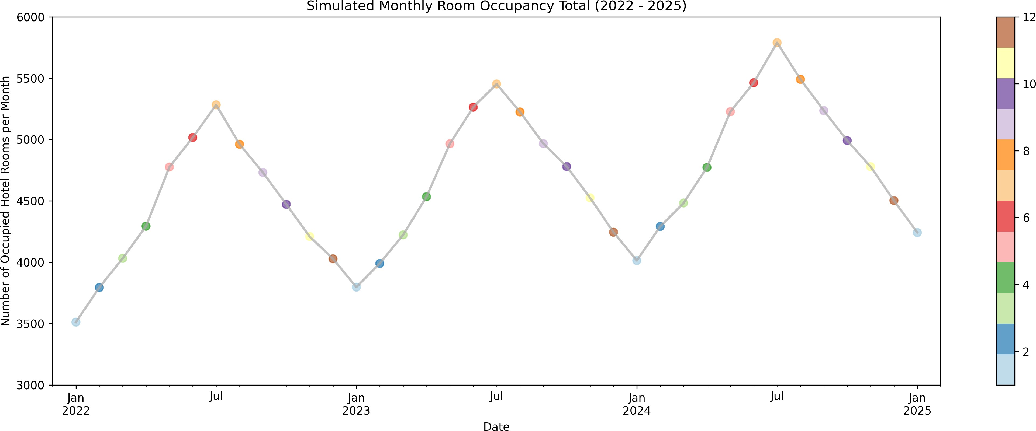
Time Series Data
Time series data captures a single variable at multiple points in time; e.g., the daily stock prices for Apple or our simulated monthly hotel room occupancy dataset.

Slide 15

Panel Data
Panel data captures multiple variables at multiple points in time for each observation; e.g., the Panel Study of Income Dynamics or the World Bank's World Development Indicators.
 |  | iso3c▲ ▼ | date▲ ▼ | NY.GDP.MKTP.KD.ZG▲ ▼ | SH.DYN.NMRT▲ ▼ | SH.HIV.INCD.ZS▲ ▼ |  | SH.MED.BEDS.ZS▲ ▼ | SH.MED.
1 |  | CHN | 2014 | 7.4 | 5.8 |  |  | 3.6
2 CHN 2015 |  |  |  | 7 5.3 3.8
3 |  | CHN | 2016 | 6.8 | 4.8 |  |  | 4.1
4 CHN 2017 |  |  |  | 6.9 4.4 4.3
5 |  | CHN | 2018 | 6.7 | 4.1 |  |  | 4.6
6 CHN 2019 |  |  |  | 6 3.7 4.8
7 |  | CHN | 2020 | 2.2 | 3.5 |  |  | 5
Showing 1 to 7 of 30 entries
Previous
1
2
3
4
5
Next
Source: Data queried from the World Bank Data using the wbstats
in R. The printed results show a snapshot of 7 variables (out of a much larger panel dataset). You can think of panel
15 / 42
data as a cross-sectional dataset with a longitudinal/time component.

Slide 16
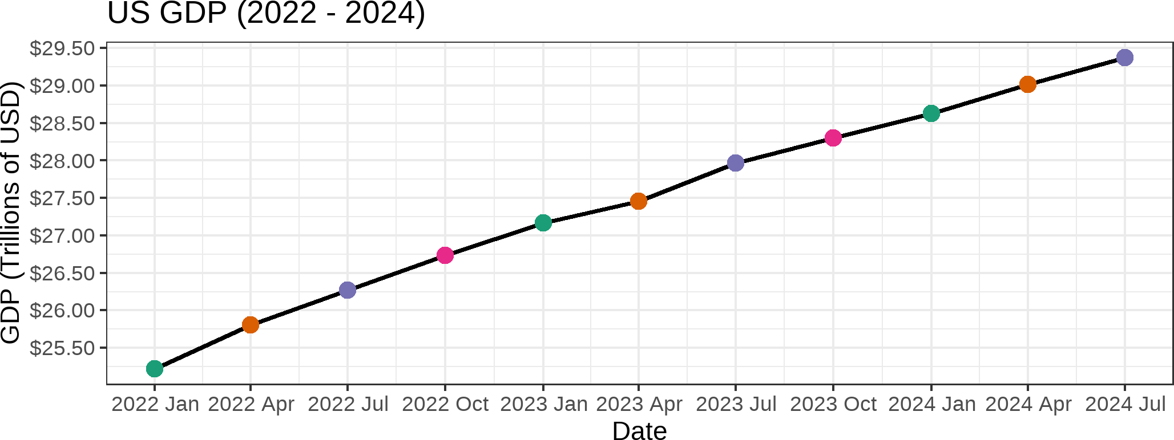
Components of Time Series Data: Trend
Trend: A long-term increasing or decreasing pattern over time.
Example: The US GDP has a long-term upward trend.

Slide 17
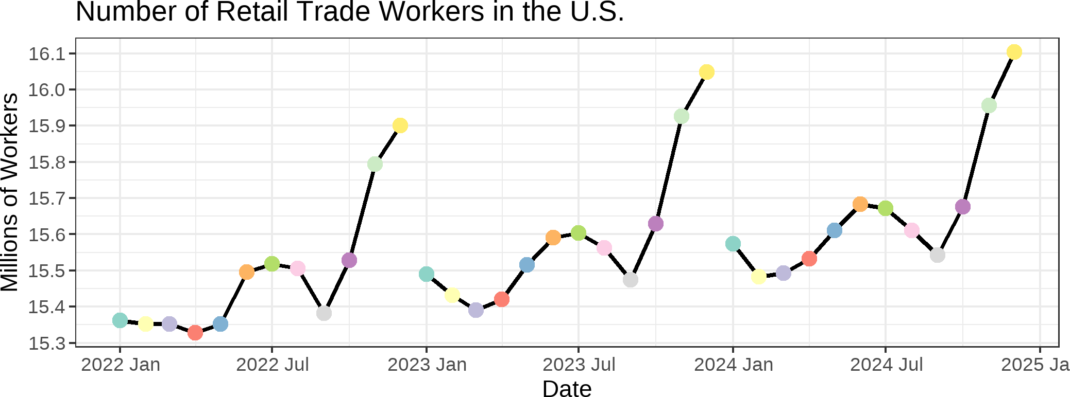
Components of Time Series Data: Seasonality
Seasonality refers to the property of a time series that displays REGULAR patterns that repeat at a constant frequency (m). For example, the number of retail trade workers has a seasonal pattern (with an upward trend).

Slide 18
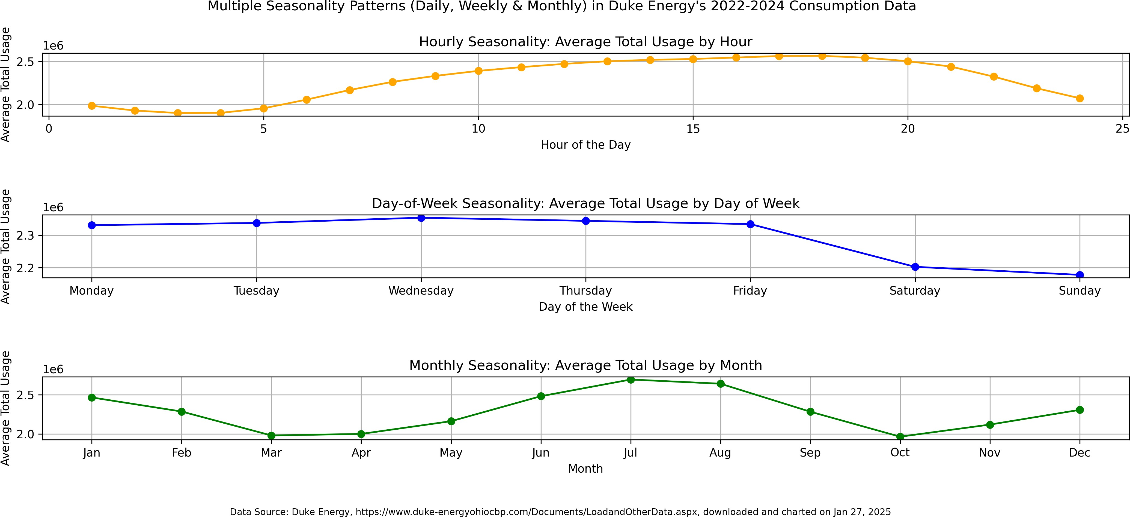
Components of Time Series Data: Multiple Seasonality
Multiple seasonality refers to the property of a time series that displays multiple seasonal patterns that repeat at different frequencies.

Slide 19
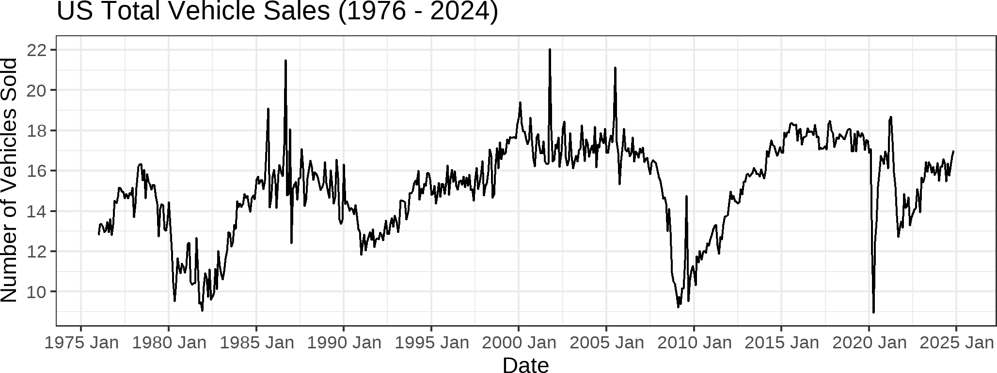
Components of Time Series Data: Cycles
Cycles refer to the property of a time series that displays irregular patterns that repeat at irregular frequencies. For example, the US Total Vehicle Sales has business cycles that are influenced by economic conditions and advancements in vehicle technologies.

Slide 20
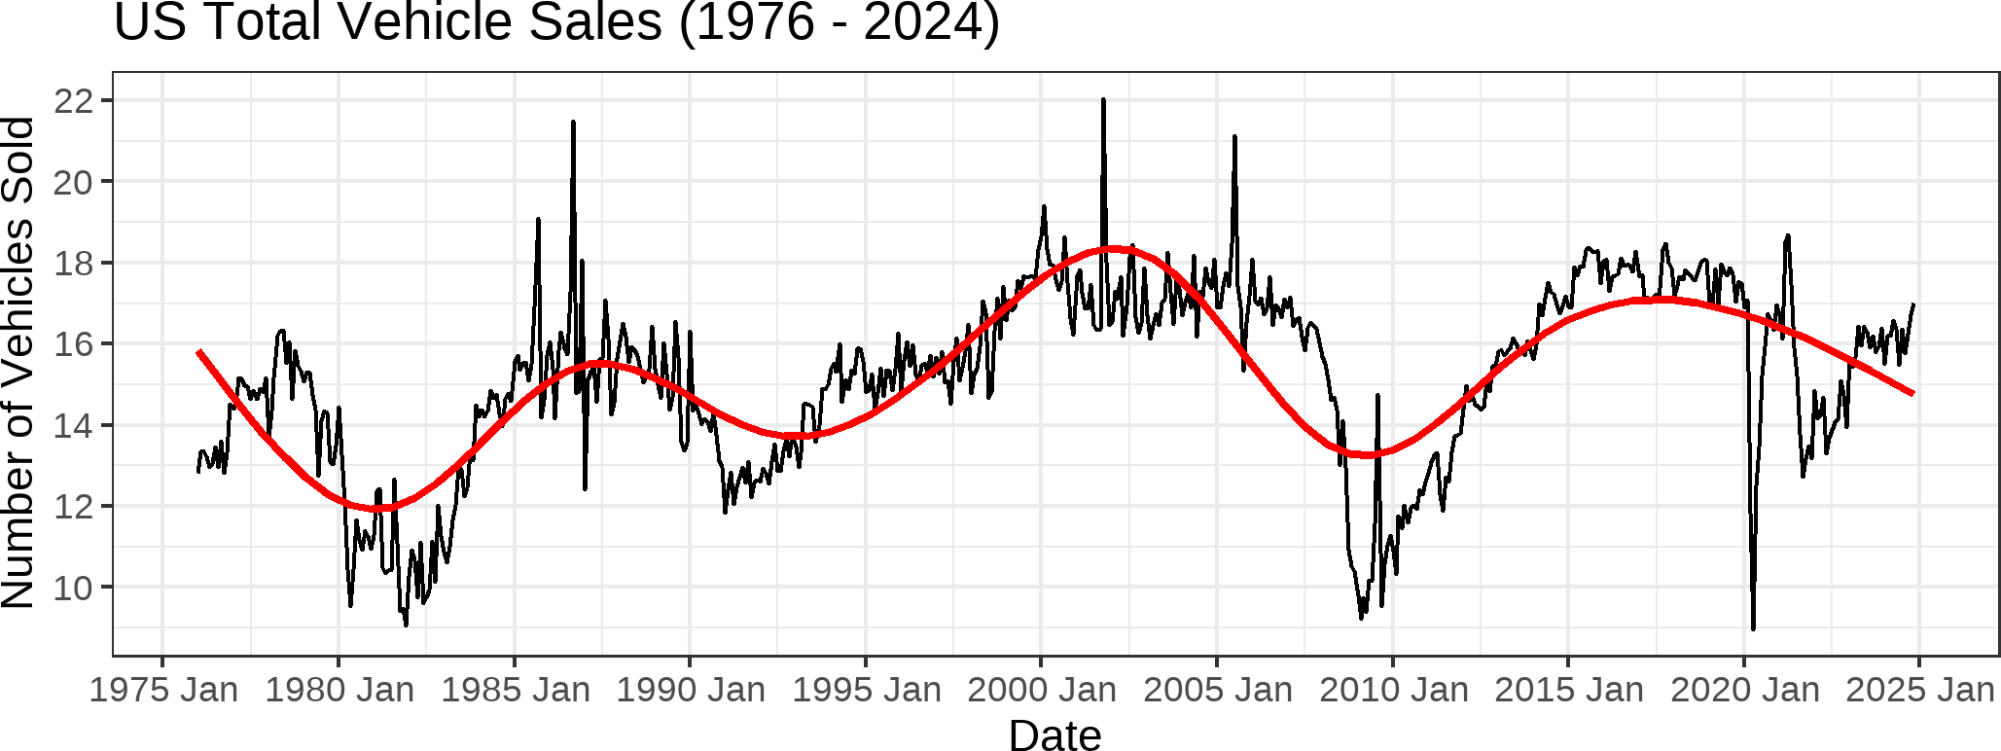
Components of Time Series Data: Cycles
Cycles refer to the property of a time series that displays irregular patterns that repeat at irregular frequencies. For example, the US Total Vehicle Sales has business cycles that are influenced by economic conditions and advancements in vehicle technologies.

Slide 21
Kahoot Competition #01
To assess your understanding and retention of the topics covered so far, you will compete in a Kahoot competition (consisting of 5 questions):
Go to https://kahoot.it/
Enter the game pin, which will be shown during class
Provide your first (preferred) and last name
Answer each question within the allocated 20-second window (fast and correct answers provide more points)
Winning the competition involves having as many correct answers as possible AND taking the shortest duration to answer these questions. The winner of the competition will receive a
0.15 bonus on Assignment 01. Good luck!!!
P.S: The Kahoot competition will have no impact on your grade. It is a fun way of assessing your knowledge, motivating you to ask questions about topics covered that you do not have a full understanding of it, and providing me with some data that I can use to pace today's class.
21 / 42

Slide 22
TThhee DDaattaa GGeenneerraattiinngg PPrroocceessss
2222 // 4422

Slide 23
The Idea of a Data Generating Process (DGP)
A time series is defined as a sequence of observations recorded at regular time intervals.
Any time series is generated by some kind of mechanism, which is often referred to as a
data generating process (GDP). For example, the hotel occupancy dataset is impacted by:
season, holidays, economic conditions, and marketing campaigns;
number of rooms, room rates, and customer satisfaction;
weather, local events, and competition; and
number of rooms already booked, room cancellations, and no-shows.
The DGP is the underlying theoretical mechanism that generates the data we observe.
Accounts for both systematic patterns (e.g., trend, seasonality) and randomness.
But: In real-world settings, there is often no perfectly known DGP.
Any formula or model we write is an approximation of the unknowable “truth.”
23 / 42

Slide 24
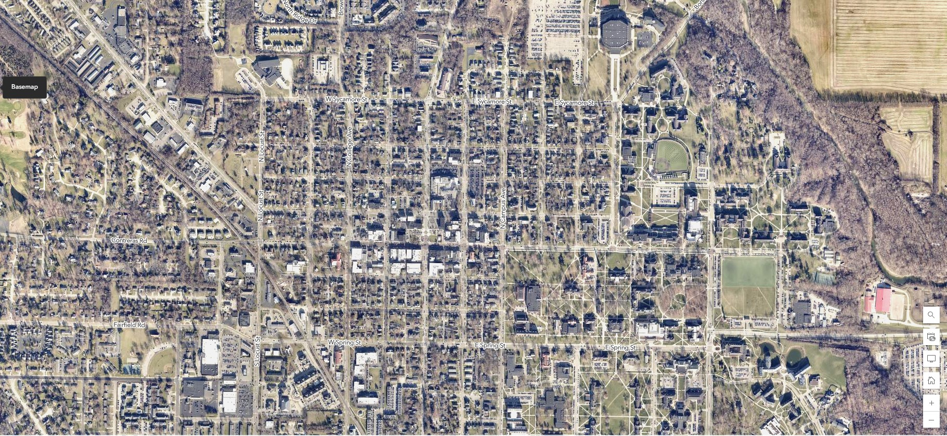
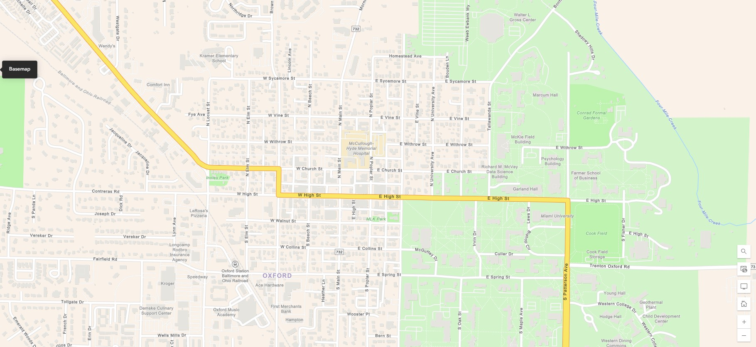
Model vs. Reality — The Map Analogy for DGPs
A map ≠ the territory:
We use maps to navigate, but they are always simplified.
Similarly, a forecast model ≠ reality
—it is a purposeful simplification.
Different maps for different needs:
A tourist map highlights landmarks, while a transportation map focuses on roads to inform navigation.
Each addresses specific questions, just as we build different forecasting models for different objectives.
24 / 42

Slide 25
Why Use DGPs If They Do not Actually Exist?
Guiding Principle:
Thinking in terms of a hypothetical DGP helps us design or select reasonable model structures.
E.g., we incorporate domain insights: “Does our hotel occupancy data show strong seasonality?”
Clarifying Assumptions:
Even if the DGP is not known, stating assumptions (e.g., no trend, constant variance) makes our models testable and improvable.
Iterative Refinement:
As new data contradict our assumptions, we adjust our “map” of reality.
In forecasting, we continually update models to capture changing conditions.

Slide 26
Key DGP Takeaways
All Models Are Wrong…
...but some are useful for forecasting, planning, or decision-making.
The DGP Is a Useful Fiction
We talk about it to structure our thinking.
We never truly “see” it; we only see data.
Practical Implication
A good model is close enough to guide accurate forecasts.
Remain aware of model limitations and be ready to adapt.

Slide 27
""WWhhaatt CCaann((aanndd CCaannnnoott)) WWee FFoorreeccaasstt??""
2277 // 4422

Slide 28
02:00
Rank these Scenarios in Terms of Forecastability
Description Scenarios Class Results
Rank each scenario (in the next tab) from easiest (1) to hardest (6) to predict.
Submit your ranking by clicking here

Slide 29
Perfect (or Near-Perfect) Forecasts
Examples
Sunset Times:
Based on precise astronomical calculations.
We can predict sunset to the exact minute, tomorrow or even a year from now.
Tides:
Governed by well-modeled gravitational forces of the Moon and Sun.
Highly predictable for centuries into the future.
Why So Certain?
These phenomena follow deterministic (or near-deterministic) physical laws.
Little to no stochastic “noise” in the process.

Slide 30
Partially Predictable — Weather & Markets
Weather
S&P 500
Tomorrow’s Forecast: Quite accurate (initial conditions + physical models).
1 Year Ahead: Chaos and changing conditions degrade accuracy significantly.
Tomorrow’s Close: Some short-term signals exist, but accuracy is limited (especially if you are attempting to beat the market; accuracy is relatively high if you just want to be in the ball park of the adjusted close).
1 Year Ahead: Many unknown macro shocks, making precise forecasts very uncertain.

Slide 31

Unpredictable — Lottery Numbers
No Predictable Pattern
Draws are engineered to be random.
No matter how much data you collect, you can’t outpredict chance.
Why “Un-forecastable”?
The Data-Generating Process (DGP) is effectively pure noise by design.
No structural or deterministic component to model.

Slide 32
Relating It Back to the DGP
Different Types of DGPs
Deterministic (or nearly so): Sunset times, tidal schedules.
Complex & Partly Stochastic: Weather, financial markets.
Pure Randomness: Lottery draws.
Key Lesson
All these processes have a DGP—some are more “knowable” than others.
Forecastability depends on how much of that DGP is deterministic vs. random and how well we can model it.

Slide 33
KKeeyy FFoorreeccaassttiinngg TTeerrmmss
3333 // 4422

Slide 34

Forecasting
Forecasting is the process of using historical data and patterns to predict future values or events.
The objective of most time series analyses is to provide forecasts of future values of the time series.
34 / 42

Slide 35
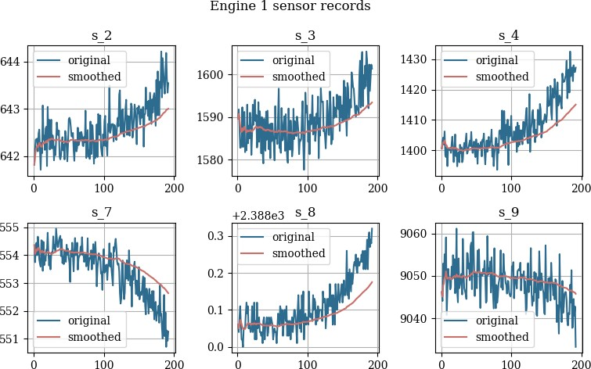
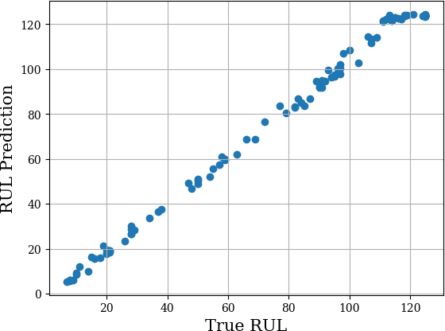
Explanatory Forecasting
In addition to past data, explanatory forecasting uses additional variables to predict future values of the variable(s) of interest. To make the forecasts, we need to include both historical and future predictions for each of the explanatory variables. For example,
Forecasting electricity demand using weather forecasts, time of day, day of week, etc.
Image Sources: Nixtla's demo for forecasting the remaining useful life of an engine using exogenous sensor data. See here for more details.
35 / 42

Slide 36
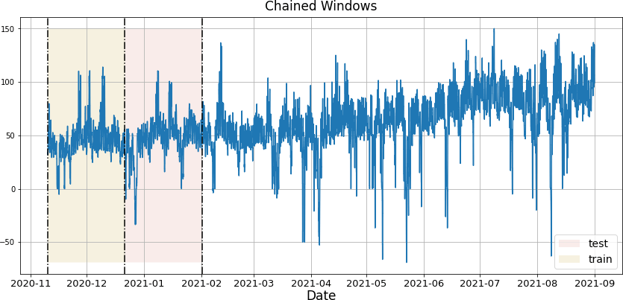
Backtesting
Backtesting is the practice of evaluating a forecasting model by applying it to historical data and comparing the predictions with the actual outcomes.
A way to see how the model would have performed in the past.
Backtesting is the time series equivalent of a train-test split in ML; not random though.
Image Source: Chained Windows from Nixtla's GitHub Repo for statsforecast.
36 / 42

Slide 37
Insample vs. Out-of-Sample Metrics
In-Sample Metrics:
Metrics calculated on the same data used to train the model.
Can be misleading, as the model has already seen this data.
Out-of-Sample Metrics:
Metrics calculated on data not seen by the model during training (i.e., test/holdout/out- of-sample data).
More reliable indicators of how the model will perform on new data.
37 / 42

Slide 38
RReeccaapp
3388 // 4422

Slide 39
Summary of Main Points
By now, you should be able to do the following:
Describe the role of forecasting in business.
Describe the key components of a time-series (trend, seasonality, multiple seasonality, and
cycles).
Explain the concept of data-generating process (DGP)
Discuss limits of forecasting
Understand key forecasting terminology

Slide 40
📝 Review and Clarification 📝
Class Notes: Take some time to revisit your class notes for key insights and concepts.
Zoom Recording: The recording of today's class will be made available on Canvas approximately 3-4 hours after the session ends.
Questions: Please don't hesitate to ask for clarification on any topics discussed in class. It's crucial not to let questions accumulate.

Slide 41
📖 Required Readings 📖
🐍 Python Prep
Getting Started with Conda
Data Structures
🤖 LLM: Prep
A Very Gentle Introduction to Large Language Models without the Hype

Slide 42
🎯 Assignment 🎯
Go over your notes and complete Assignment 01 on Canvas.

