Slide 1




ISA 444: Business Forecasting
06: Centered Moving Average and Seasonal Decomposition
Fadel M. Megahed, PhD
Professor
Farmer School of Business Miami University
@FadelMegahed fmegahed fmegahed@miamioh.edu
Automated Scheduler for Office Hours
Spring 2025

Slide 2
Quick Refresher of Last Class
✅ Generate and interpret simple line charts
✅ Create seasonal plots and subplots
✅ Describe a lag and create lag scatter plots
✅ Plot and interpret the autocorrelation function (ACF) for a time-series

Slide 3
Learning Objectives for Today's Class
Describe and compute centered moving averages
Estimate trend-cycle via moving averages
Perform classical decomposition (trend-cycle, seasonal, residual/remainder)
Understand STL / MSTL as alternatives to classical decomposition

Slide 4


Motivation and Context

Slide 5
Recall: Time Series Components
Trend: Long-term increase or decrease in the data
Seasonal: Regular pattern of up and down fluctuations influenced by calendar or time of day (e.g., quarterly, monthly, day of the week, hourly)
Cyclical: Repeating up and down movements that are not of a fixed period (e.g., business cycles, economic cycles), typically over multiple years

Slide 6
Time Series Decomposition
Decomposition is the process of breaking down a time series into its constituent components: trend-cycle, seasonal, and residual/remainder.
Mathematically, we can write a time series y_{t} as a function of these components:
y_{t} = f(T_{t}, S_{t}, R_{t}),
where:
T_{t}: Trend-cycle component
S_{t}: Seasonal component
R_{t}: Remainder component
f(): Some function that combines the components
The decomposition can be additive or multiplicative.

Slide 7
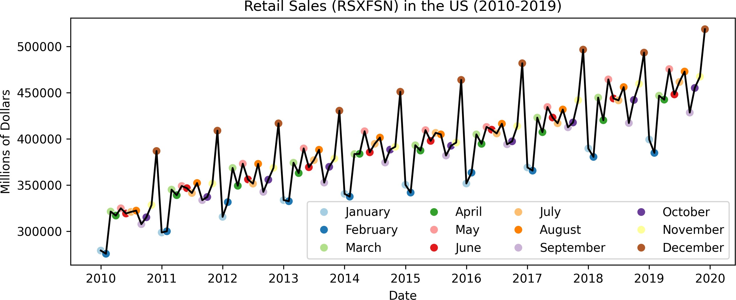
Seasonality: Additive Models
Definition: An additive model is appropriate when the trend is approximately linear, and the
seasonal components stays constant over time.
It can be written as: y_{t} = T_{t} + S_{t} + R_{t}.

Slide 8
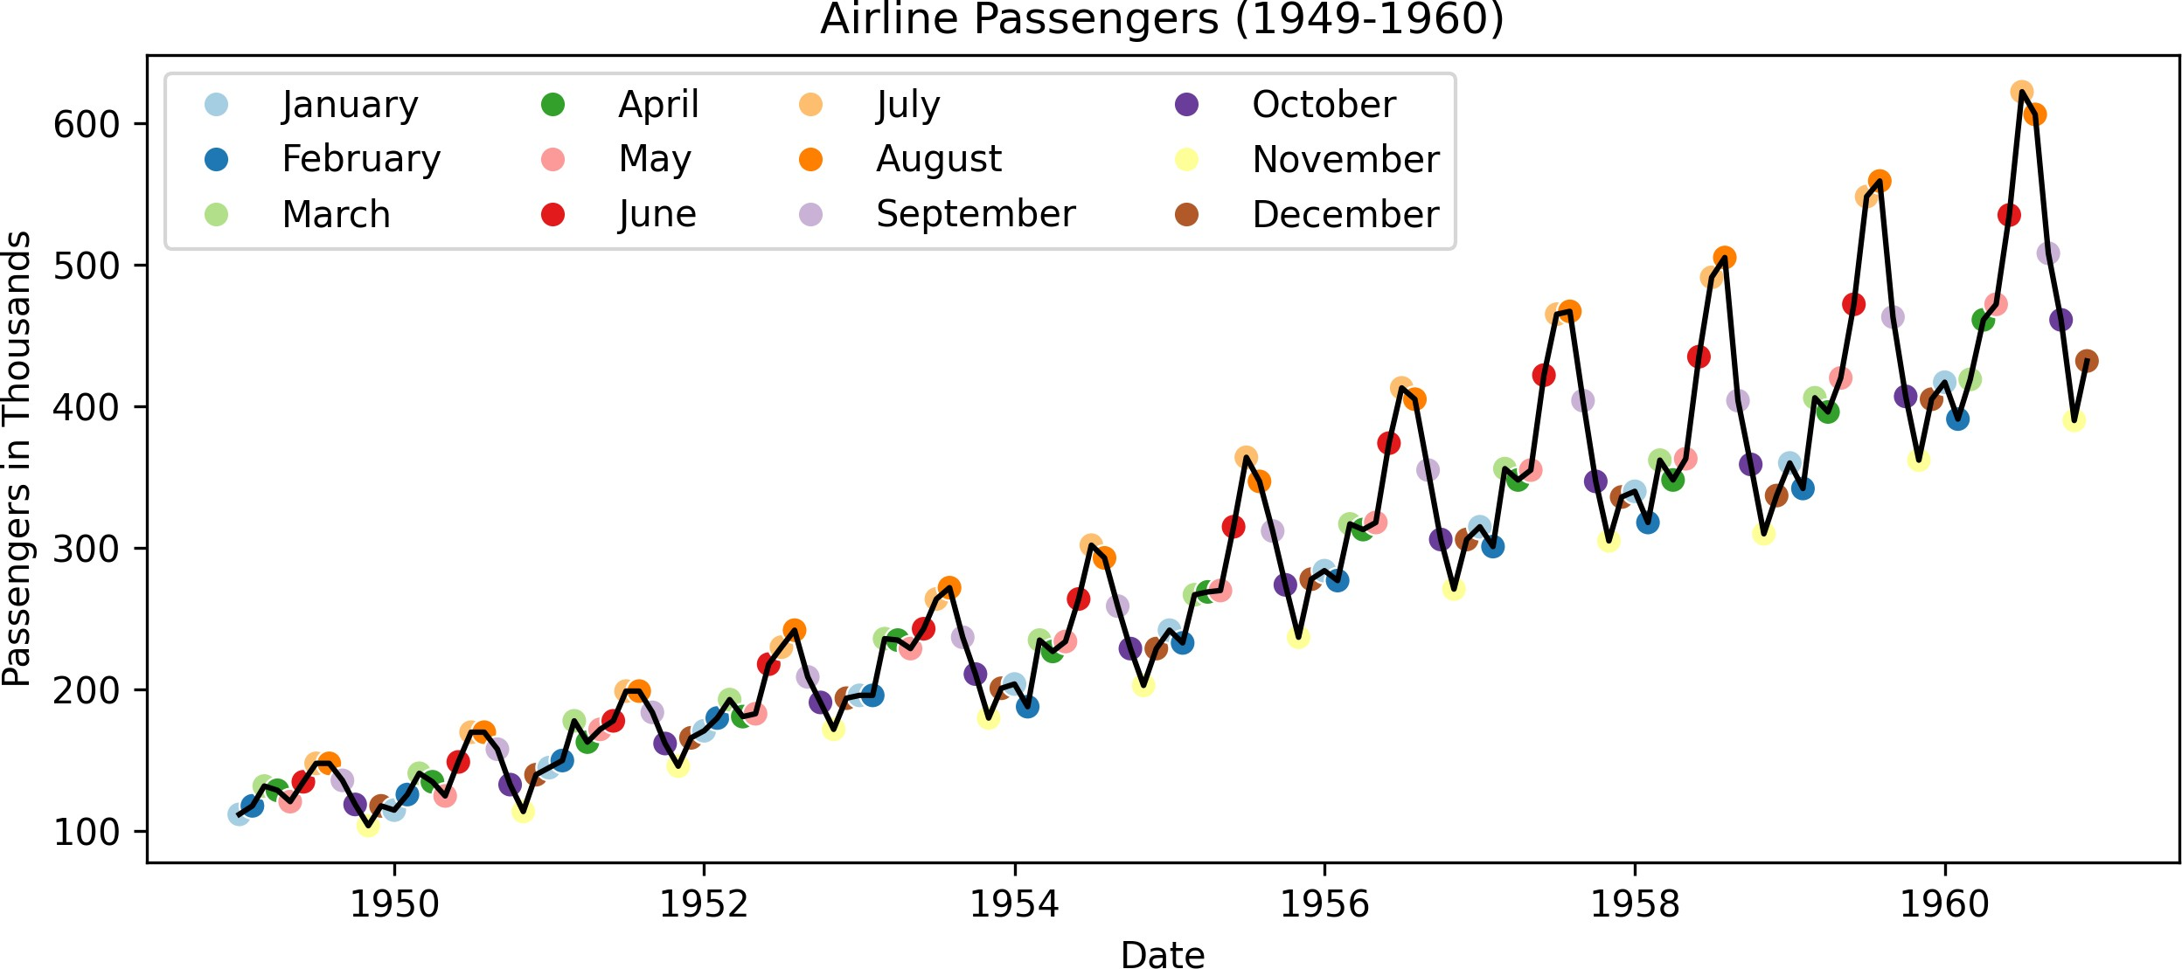
Seasonality: Multiplicative Models
Definition: A multiplicative model is appropriate when the trend is nonlinear (e.g., exponential), and/or the seasonal component changes proportionally with the level of the time series.
It can be written as: y_{t} = T_{t} × S_{t} × R_{t}.

Slide 9
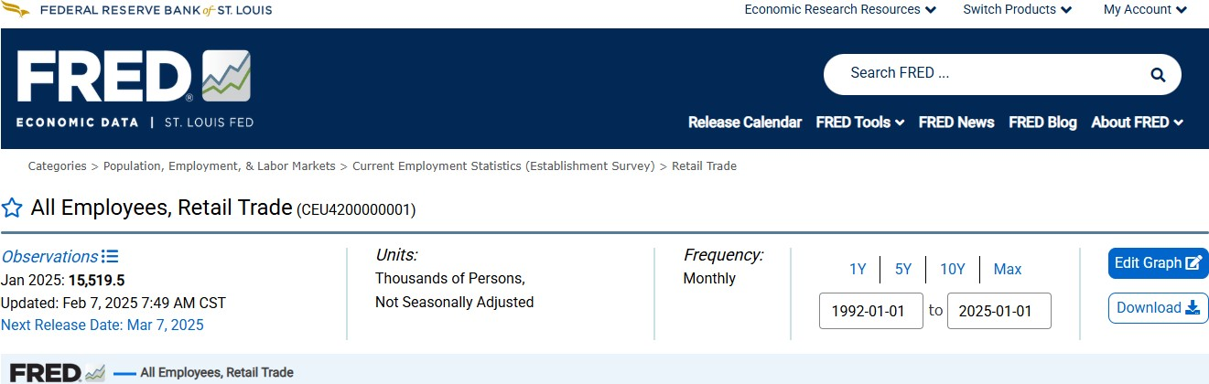
Motivating Example: US Retail Trade Employment
Data Plot Decomp Decomp Trend-Cyc DeTrend SeasAdj Notes
The data contains the total employment in U.S. retail trade sector from 1992 to 2025.
The data is monthly and not seasonally adjusted.

Slide 10


Centered Moving Averages

Slide 11
Relation of Moving Averages to Classical Decomposition
The classical method of time series decomposition originated in the 1920s and was widely used until the 1950s.
It still forms the basis of many time series decomposition methods, so it is important to understand how it works.
The first step in a classical decomposition is to use a moving average method to estimate the trend-cycle, so we begin by discussing moving averages.
Source: Hyndman, R.J., & Athanasopoulos, G. (2021) Forecasting: principles and practice, 3rd edition, OTexts: Melbourne, Australia. https://otexts.com/fpp3/. Accessed on February 12, 2025. Chapter 3.3
11 / 40

Slide 12
Moving Average (MA) Smoothing
Moving averages are used to smooth out short-term fluctuations and highlight longer-term trends or cycles.
In classical decomposition, the trend-cycle component is estimated using a centered moving average.
A centered moving average is calculated by taking the average of values on either side of the data point in question.
Mathematically,a centered moving average of order m can be written as:
1
m
k
∑ y_{t+j},
j=−k
T^_{t} =
where m = 2k + 1 is the number of values in the moving average.

Slide 13
03:00
Activity: Centered Moving Average
Let's consider the following series: y_{t} = {4, 7, 7, 10, 13, 13, 16}
Calculate a centered moving average of order 3, and input it in the CMA3 column below.
Note each cell in the table is editable, but please only edit the CMA3 column.
_{t}▲ ▼ | y_t▲ ▼ | cma3 ▲ ▼
1 | 4
2 7
3 | 7
4 10
5 | 13
6 13
7 | 16

Slide 14
Centered Moving Averages in Python
y_t = [4, 7, 7, 10, 13, 13, 16]
df = (
pd.DataFrame({"t": range(1, len(y_t) + 1), "y_t": y_t})
.assign(
cma3 = lambda x: x['y_t'].rolling(window = 3, center = True).mean(), cma4r = lambda x: x['y_t'].rolling(window = 4, center = True).mean(), cma4l = lambda x: x['cma4r'].shift(-1)
)
)
df.head(7)
## | t | y_t | cma3 | cma4r | cma4l
## 0 | 1 | 4 | NaN | NaN | NaN
## 1 2 7 6.0 NaN
## 2 3 7 8.0 7.00
## 3 4 10 10.0 9.25
## 4 5 13 12.0 10.75
## 5 6 13 14.0 13.00
## 6 7 16 NaN NaN
7.00
9.25
10.75
13.00
NaN NaN
Which of the two CMA4 cols is correct? Edit me
14 / 40

Slide 15
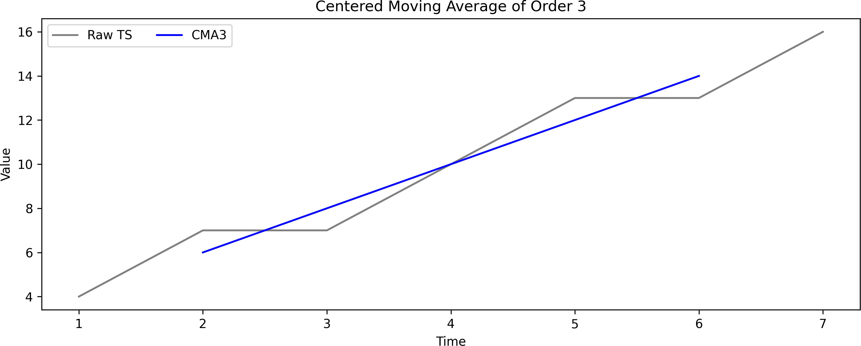
Centered Moving Averages as Trend-Cycle Estimators

Slide 16
Moving Average of Moving Averages
When m is even, we often resort to using a moving average of moving averages to center the moving average. Let us revisit our previous example:
df = (
pd.DataFrame({"t": range(1, len(y_t) + 1), "y_t": y_t})
.assign(
cma3 = lambda x: x['y_t'].rolling(window = 3, center = True).mean(), cma4r = lambda x: x['y_t'].rolling(window = 4, center = True).mean(), cma4l = lambda x: x['cma4r'].shift(-1),
cma4_2 = lambda x: x['cma4l'].rolling(window = 2, center = True).mean(), cma4_2_alt = lambda x: (x['cma4r'] + x['cma4l'])/2
)
)
df.head(7)
## | t | y_t | cma3 | cma4r | cma4l | cma4_2 | cma4_2_alt
## 0 | 1 | 4 | NaN | NaN | NaN | NaN | NaN
## 1 | 2 | 7 | 6.0 | NaN | 7.00 | NaN | NaN
## 2 | 3 | 7 | 8.0 | 7.00 | 9.25 | 8.125 | 8.125
## 3 | 4 | 10 | 10.0 | 9.25 | 10.75 | 10.000 | 10.000
## 4 | 5 | 13 | 12.0 | 10.75 | 13.00 | 11.875 | 11.875
## 5 | 6 | 13 | 14.0 | 13.00 | NaN | NaN | NaN
## 6 | 7 | 16 | NaN | NaN | NaN | NaN | NaN

Slide 17
Moving Average of Moving Averages (Cont.)
When a 2-MA follows a moving average of an even order (such as 4), it is called a “centered moving average of order 4”.
This is because the results are now symmetric.
To see that this is the case, we can write the 2 × 4-MA (named as cma4_2 or cma4_2_alt in our Python code) as follows:
= [ (y + y )]
_{T}^
1 1
1
+ y + y + y ) + (y + y + y
t
t−2 t−1
t
t+1 t−1 t t+1 t+2
2 4 4
1 1 1 1 1
= ₈ yt−2 + ₄ yt−1 + ₄ yt + ₄ yt+1 + ₈ yt+2.
It is now a weighted average of observations that is symmetric.
Source: Hyndman, R.J., & Athanasopoulos, G. (2021) Forecasting: principles and practice, 3rd edition, OTexts: Melbourne, Australia. https://otexts.com/fpp3/. Accessed on February 12, 2025. Chapter 3.3
17 / 40

Slide 18
Centered Moving Averages for Trend-Cycle Estimation
📊 Key Idea:
Centered moving averages (CMAs) help estimate the trend-cycle by smoothing seasonal fluctuations.
Example: 2 × 4 - MA
_{T}^
= ¹ y
+ ¹ y
+ ¹ y + ¹ y + ¹ y
t
8
t−2
4
t−1
t
t+1
t+2
4 4
8
✅ Balances data across quarters
✅ Averages out seasonal /quarterly variation

Slide 19
Choosing the Right Moving Average
Seasonal Period (m) | Recommended MA
Even (e.g., 12 months, 4 quarters) | 2 × m - MA
Odd (e.g., 7 days) | m-MA
✔ 2 × 12 - MA for monthly seasonality in annual data
✔ 2 × 4 - MA for quarterly seasonality in annual data
✔ 7-MA for weekly seasonality in daily data
⚠ Beware!
Using the wrong MA order retains seasonal noise instead of extracting the trend.

Slide 20
05:00
Activity: Trend-Cycle Estimation Using CMAs
Data Plot Printout
Download the CEU4200000001, capturing the total employment in U.S. retail trade sector from 1992 to 2025.
The data is monthly and not seasonally adjusted.
Use an appropriate moving average to estimate the trend-cycle component.
Recreate the plot of raw series and the trend-cycle component from the next tab.

Slide 21


Classical Decomposition

Slide 22
Classical Decomposition
Additive decomposition: y_{t} = T_{t} + S_{t} + R_{t} = T^_{t} + S^_{t} + R^_{t}
Multiplicative decomposition: y_{t} = T_{t} × S_{t} × R_{t} = T^_{t} × S^_{t} × R^_{t}
Estimate T^ using (2 × m)-MA if m is even. Otherwise, estimate T^ using m-MA
Compute de-trended series using: (a) y_{t} − T^_{t} for additive decomposition, and (b) y_{t}/T^_{t} for multiplicative decomposition.
Once de-trended, we are left with the S_{t} and R_{t} components. Specifically:
Additive model: y_{t} − T^_{t} = (T^_{t} + S^ + R^ ) − T^ = S^ + R^
t t t t t
y_{t}
T^_{t}×S^_{t}×R^_{t}
= S^ × R^
Multiplicative model: =
t
t
_{T}^
_{T}^
t
t
Source: Hyndman, R.J., & Athanasopoulos, G. (2021) Forecasting: principles and practice, 3rd edition, OTexts: Melbourne, Australia. https://otexts.com/fpp3/. Accessed on February 12,
2025. Chapter 3.4 Slides

Slide 23
Estimating Seasonal Component
The seasonal component can be estimated by averaging the detrended series for that season across all years.
For example, if we have monthly data, we can estimate the seasonal index for January by averaging all the January values in the detrended series. Do this for each month to get the seasonal index.
Adjust the seasonal indices to ensure that that:
for additive: S ⁽¹⁾ + S ⁽²⁾ + … + S ⁽¹²⁾ = 0
for multiplicative: S ⁽¹⁾ + S ⁽²⁾ + … + S ⁽¹²⁾ = m
The seasonal component is then obtained by repeating the seasonal indices for each year in the data.
Source: Hyndman, R.J., & Athanasopoulos, G. (2021) Forecasting: principles and practice, 3rd edition, OTexts: Melbourne, Australia. https://otexts.com/fpp3/. Accessed on February 12,
2025. Chapter 3.4 Slides

Slide 24
Estimating the Remainder Component
Additive decomposition: R^_{t} = y_{t} − T^_{t} − S^_{t}
Multiplicative decomposition: R^_{t} = y_{t}/(T^_{t}S^_{t})

Slide 25
Classical Decomposition in Python (Ref)
statsmodels.tsa.seasonal.seasonal_decompose
statsmodels.tsa.seasonal.seasonal_decompose( x,
model='additive', filt=None, period=None, two_sided=True, extrapolate_trend=0
)
[source]
Seasonal decomposition using moving averages.
Parameters
x : array_like
Time series. If 2d, individual series are in columns. x must contain 2 complete cycles.
model : {“additive” “multiplicative”} optional

Slide 26
Classical Decomposition in Python (Code-Add)
from statsmodels.tsa.seasonal import seasonal_decompose
retail_empl = ( pd.read_csv("https://fred.stlouisfed.org/graph/fredgraph.csv?bgcolor=%23ebf3fb&chart_type=line&drp=0
.rename(columns = {"observation_date": "date", "CEU4200000001": "CEU4200000001"})
.assign(
date = lambda x: pd.to_datetime(x["date"]),
)
)
Set the date as index and set the frequency of the data
retail_empl = retail_empl.set_index("date") retail_empl = retail_empl.asfreq("MS")
Decompose the time series
res = seasonal_decompose( retail_empl["CEU4200000001"], model = "additive")
Extract the trend, seasonal, and residual components
res_df = pd.DataFrame({
"observed": res.observed, "trend": res.trend, "seasonal": res.seasonal, "residual": res.resid
})
Plot the decomposed time series fig = res.plot() fig.set_size_inches(10, 4.75) fig.tight_layout()

Slide 27
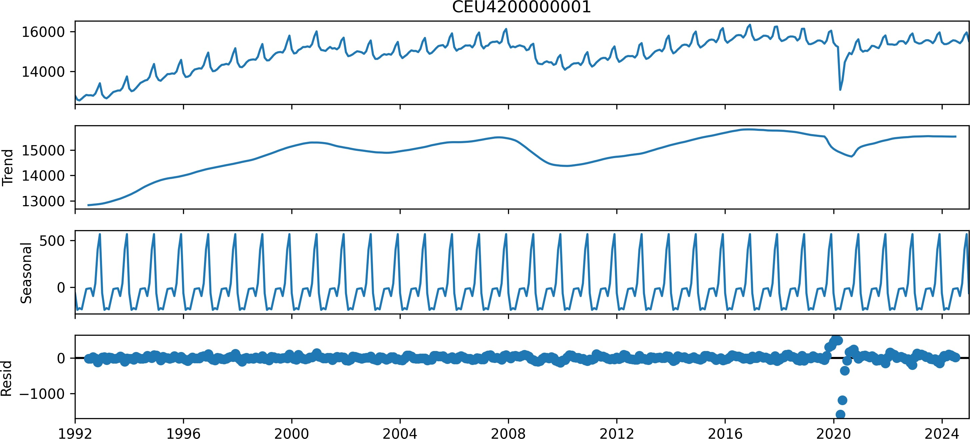
Classical Decomposition in Python (Output-Add)
Comment: You can have more control over the plot by plotting the data frame res_df directly. See this example from StackOverflow, while noting that their decomposition is equivalent to our
res object. You can also convert the data into a long format using pd.melt, then .reset_index() to convert date into a column, and plot it using sns.relplot.
27 / 40

Slide 28
Classical Decomposition in Python (Code-Mult)
from statsmodels.tsa.seasonal import seasonal_decompose
retail_empl = ( pd.read_csv("https://fred.stlouisfed.org/graph/fredgraph.csv?bgcolor=%23ebf3fb&chart_type=line&drp=0
.rename(columns = {"observation_date": "date", "CEU4200000001": "CEU4200000001"})
.assign(
date = lambda x: pd.to_datetime(x["date"]),
)
)
Set the date as index and set the frequency of the data
retail_empl = retail_empl.set_index("date") retail_empl = retail_empl.asfreq("MS")
Decompose the time series
res = seasonal_decompose( retail_empl["CEU4200000001"], model = "multiplicative")
Extract the trend, seasonal, and residual components
res_df = pd.DataFrame({
"observed": res.observed, "trend": res.trend, "seasonal": res.seasonal, "residual": res.resid
})
Plot the decomposed time series fig = res.plot() fig.set_size_inches(10, 4.75) fig.tight_layout()
28 / 40

Slide 29
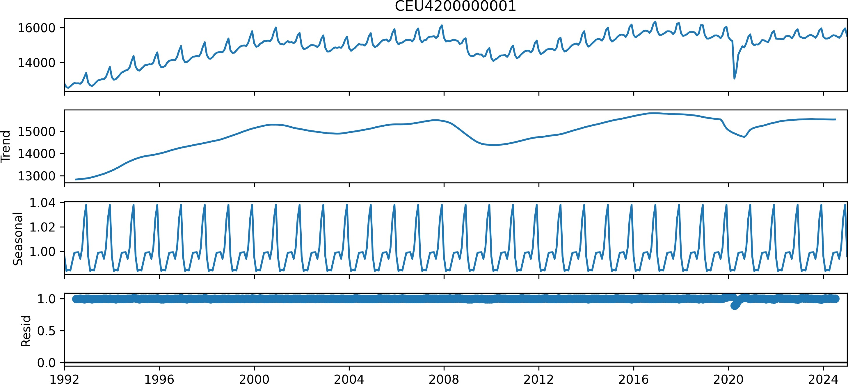
Classical Decomposition in Python (Output-Mult)
Comment: You can have more control over the plot by plotting the data frame res_df directly. See this example from StackOverflow, while noting that their decomposition is equivalent to our
res object. You can also convert the data into a long format using pd.melt, then .reset_index() to convert date into a column, and plot it using sns.relplot.
29 / 40

Slide 30
Comments on the Classical Decomposition
Estimate of trend is unavailable for first few and last few observations.
The seasonal component repeats from year to year, which may not be realistic (especially for long time-series).
Since the trend-cycle is estimated using an average-based method, it is not robust to outliers.
Newer methods are designed to overcome these problems.
Source: Hyndman, R.J., & Athanasopoulos, G. (2021) Forecasting: principles and practice, 3rd edition, OTexts: Melbourne, Australia. https://otexts.com/fpp3/. Accessed on February 12, 2025. Chapter 3.4 Slides
30 / 40

Slide 31


STL Decomposition

Slide 32
Seasonal-Trend Decomposition using LOESS (STL)
STL is a very flexible method for decomposing time series.
It can handle any type of seasonality, and allows for non-constant seasonal patterns.
It is robust to outliers.
However, it:
cannot handle trading day or calendar adjustments, and
it is only additive (take logs to get multiplicative decomposition).

Slide 33
STL Decomposition in Python (Ref)
statsmodels.tsa.seasonal.STL
class statsmodels.tsa.seasonal.STL( endog,
period=None, seasonal=7, trend=None, low_pass=None, seasonal_deg=1, trend_deg=1, low_pass_deg=1, robust=False, seasonal_jump=1, trend_jump=1, low_pass_jump=1
)
Season-Trend decomposition using LOESS.

Slide 34
STL Decomposition in Python (Code)
from statsmodels.tsa.seasonal import STL
retail_empl = ( pd.read_csv("https://fred.stlouisfed.org/graph/fredgraph.csv?bgcolor=%23ebf3fb&chart_type=line&drp=0
.rename(columns = {"observation_date": "date", "CEU4200000001": "CEU4200000001"})
.assign(
date = lambda x: pd.to_datetime(x["date"]),
)
)
retail_empl = retail_empl.set_index("date") retail_empl = retail_empl.asfreq("MS")
Decompose the time series
stl = STL(retail_empl["CEU4200000001"], seasonal = 13, robust = True) res = stl.fit()
Extract the trend, seasonal, and residual components
res_df = pd.DataFrame({
"observed": res.observed, "trend": res.trend, "seasonal": res.seasonal, "residual": res.resid
})
Plot the decomposed time series fig = res.plot() fig.set_size_inches(10, 4.75) fig.tight_layout()

Slide 35
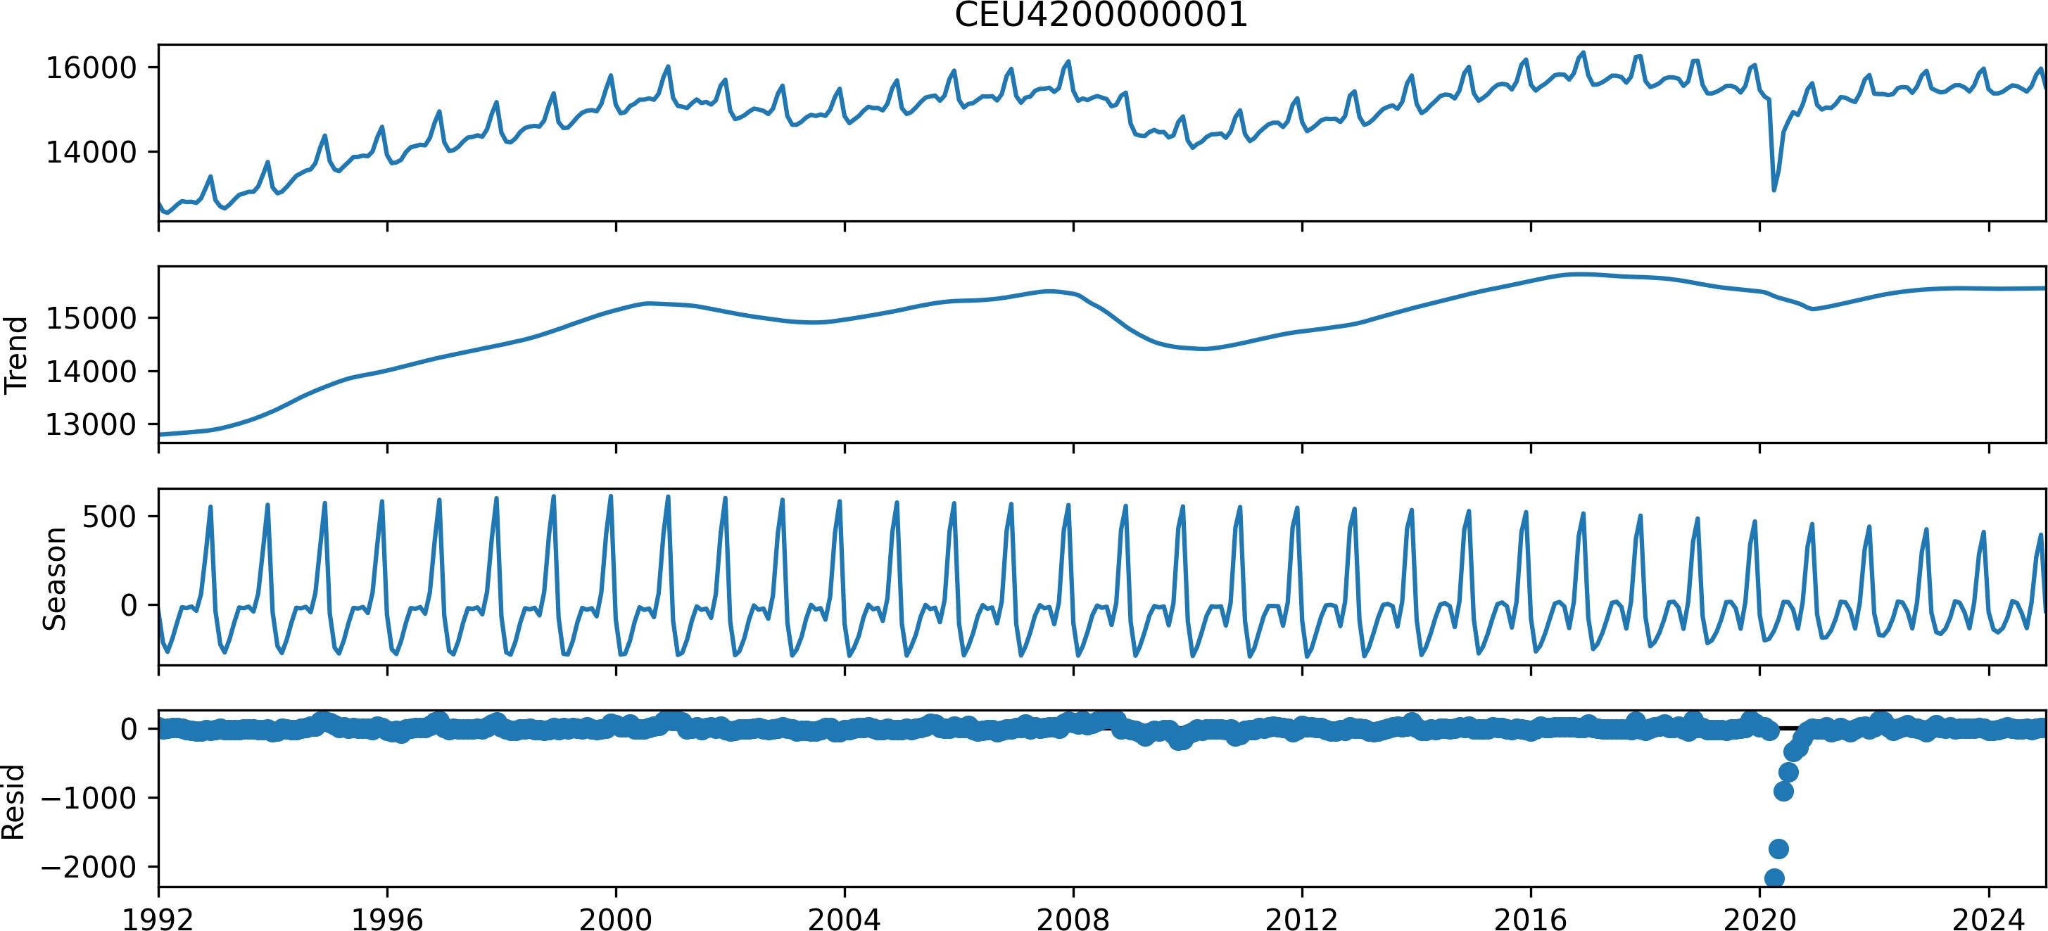
STL Decomposition in Python (Out)

Slide 36
02:00
STL Decomposition vs Classical Decomposition
In two minutes, examine the differences between the output figures from the classical decomposition (additive) and the STL decomposition.
Edit me
...
...
...
...
...

Slide 37


Recap

Slide 38
Summary of Main Points
By now, you should be able to do the following:
Describe and compute centered moving averages
Estimate trend-cycle via moving averages
Perform classical decomposition (trend-cycle, seasonal, residual/remainder)
Understand STL / MSTL as alternatives to classical decomposition

Slide 39
📝 Review and Clarification 📝
Class Notes: Take some time to revisit your class notes for key insights and concepts.
Zoom Recording: The recording of today's class will be made available on Canvas approximately 3-4 hours after the session ends.
Questions: Please don't hesitate to ask for clarification on any topics discussed in class. It's crucial not to let questions accumulate.

Slide 40
🎯 Assignment 🎯
In preparation for the assignment, you are encouraged to thoroughly read the following:
MSTL API Reference from the statsmodels package.
Multi-Seasonal Time Series Decomposition using MSTL in Python, a Towards Data Science Blog, which demonstrates how the MSTL method works and can be implemented on a similar dataset.
Skim through the MSTL Research Paper.
Once you read the references and went over our class notes, you are now ready to examine and complete Assignment 04.

