Slide 1




ISA 401: Business Intelligence & Data Visualization
03: Importing and Exporting Data in R
Fadel M. Megahed, PhD
Raymond E. Gloss Professor in Business Farmer School of Business
Miami University
@FadelMegahed fmegahed fmegahed@miamioh.edu
Automated Scheduler for Office Hours
Fall 2025

Slide 2
Quick Refresher from Last Class
✅ Describe why we are using in this course?
✅ Understand the syntax, data structures and functions
✅ Utilize the project workflow in and create your second script.

Slide 3
Going Over Assignment 02 Solutions
Let us go over the solutions for assignment 02 together.

Slide 4
Learning Objectives for Today's Class
Subset data in .
Read text-files, binary files (e.g., Excel, SAS, SPSS, Stata, etc), json files, etc.
Export data from .

Slide 5
SSuubbsseettttiinngg DDaattaa
55 // 3300

Slide 6
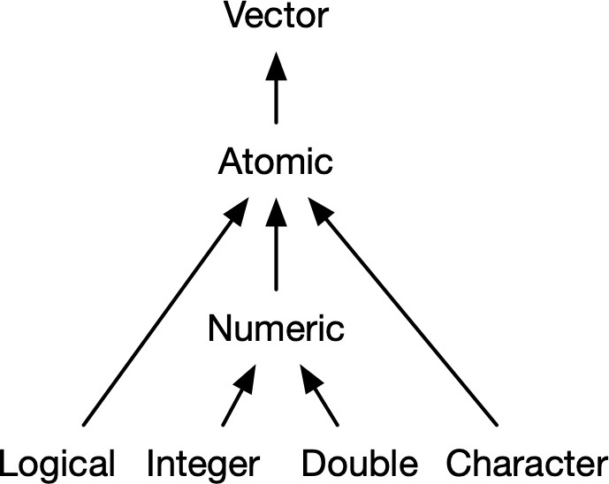
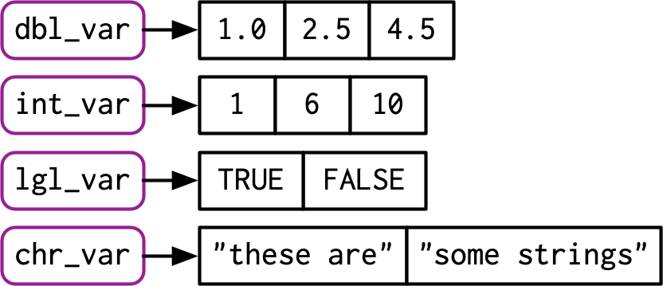
Recall: Atomic Vectors (1D)
Atomic vectors are 1D data structures in R, where all elements must have the same type.
Since they are 1D data structures, they are subsetted using [element_no(s)].
x_vec = rnorm(3) x_vec
## [1] -1.2298822 0.1002175 -0.3265876
x_vec[2]
## [1] 0.1002175
x_vec[c(1,3)]
Sources: Images are from Hadley Wickham's Advanced R Book, Chapter 3 on Vectors.
6 / 30

Slide 7
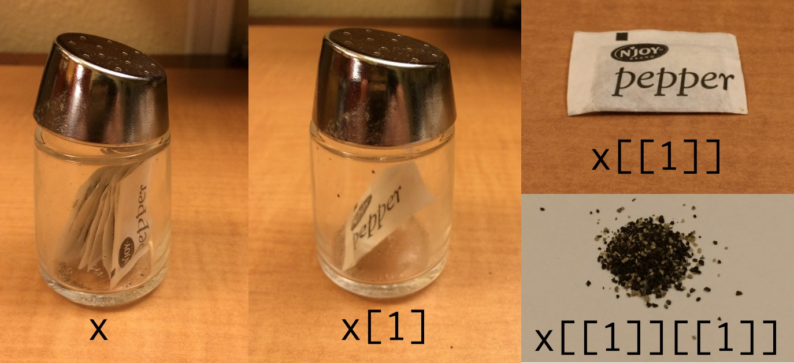
Recall: Lists
lst <- list( 1:5, "a", c(TRUE, FALSE, TRUE), c(2.3, 5.9) )
Subset by [] Subset by [[]]
lst[4]
lst[[4]]
## [[1]]
## [1] 2.3 5.9
## [1] 2.3 5.9
Sources: Image is from Hadley Wickham's Tweet on Indexing lists in R.
7 / 30

Slide 8
Recall: Matrices (2D)
A matrix is a 2D data structure made of one/homogeneous data type.
A 2 × 2 numeric matrix A 3 × 4 character matrix
x_mat = matrix( sample(1:10, size = 4), n
x_char = matrix( sample(letters, size = 1 x_char
 
 
x_mat # printing it nicely print('-----------------')
## [,1] [,2] [,3] [,4]
## [1,] "r" "f" "w" "o"
## [2,] "h" "p" "z" "x"
## [3,] "e" "k" "m" "j"
x_mat[1, 2] # subsetting
## [,1] [,2]
## [1,] 7 9
## [2,] 1 6
## [1] " "
## [1] 9
x_char[1:2, 2:3] # subsetting
## [,1] [,2]
## [1,] "f" "w"
## [2,] "p" "z"
8 / 30

Slide 9
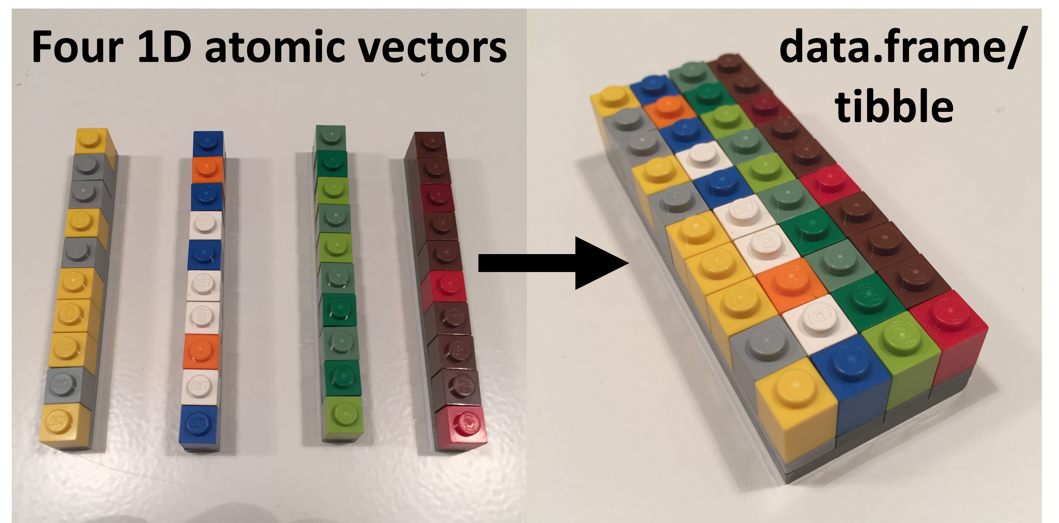
Tibbles
dept = c('ACC', 'ECO', 'FIN', 'ISA', 'MG nfaculty = c(18L, 19L, 14L, 25L, 22L)
fsb_tbl <- tibble::tibble( department = dept,
count = nfaculty,
percentage = count / sum(count)) fsb_tbl
M
 
## # A tibble: 5 × 3
## department count percentage
## <chr> |  |  | <int> | <dbl>
## | 1 | ACC | 18 | 0.184
## | 2 | ECO | 19 | 0.194
## | 3 | FIN | 14 | 0.143
## | 4 | ISA | 25 | 0.255
## | 5 | MGMT | 22 | 0.224
Source: The image is from the excellent lego-rstats GitHub Repository by Jenny Bryan
9 / 30

Slide 10
Subsetting Tibbles
to 1d
with [[]] or $
fsb_tbl[["count"]] # column name
## [1] 18 19 14 25 22
fsb_tbl[[2]] # column position
## [1] 18 19 14 25 22
fsb_tbl$count # column name
## [1] 18 19 14 25 22
Source: Slide is based on Earo Wang's STAT 220 Slides.

Slide 11
Subsetting Tibbles
by columns
with [] or [, col]
fsb_tbl["count"]
fsb_tbl[2] # for data.frames -
 
## # A tibble: 5 × 1 ## count
## <int>
## | A tibble: 5 | × 1
## | count
## | <int>
## | 1 18
## 1 | 18
## 2 | 19
## 3 | 14
## 4 | 25
## 5 | 22
## | 2 | 19
## | 3 | 14
## | 4 | 25
## | 5 | 22
Source: Slide is based on Earo Wang's STAT 220 Slides.

Slide 12
Subsetting Tibbles
by rows
with [row, ]
fsb_tbl[c(1, 3), ]
fsb_tbl[-c(2, 4), ]
## # A tibble: 2 × 3
## department count percenta
## # A tibble: 3 × 3
## department count percenta
## <chr> ## 1 ACC
## 2 FIN
<int>
18
14
<db 0.1
0.1
## <chr> ## 1 ACC
## 2 FIN
## 3 MGMT
<int>
18
14
22
<db 0.1
0.1
0.2




Source: Slide is based on Earo Wang's STAT 220 Slides.

Slide 13
Subsetting Tibbles
by rows and
columns
with [row, col]
fsb_tbl[1:3, 2:3] ## ## fsb_tbl[-4, 2:3] # same as above
## ## fsb_tbl[1:3, c("count". | "percentage")] | same result
## ## fsb_tbl[c(rep(TRUE, 3), | FALSE), 2:3] # | same as above
## # A tibble: 3 × 2 ## count percentage ## <int> <dbl>
## 1 18 0.184 ## 2 19 0.194 ## 3 14 0.143
Source: Slide is based on Earo Wang's STAT 220 Slides.

Slide 14
Subsetting Tibbles
Use [[ to extract 1d vectors from 2d tibbles
Use [ to subset tibbles to a new tibble
numbers (positive/negative) as indices
characters (column names) as indices
logicals as indices
fsb_tbl[["count"]] # will produce 1-D vector fsb_tbl$count # will produce 1D vector
Resulting in tibbles fsb_tbl[, 2] fsb_tbl[1:3, 2:3]
Source: Slide is based on Earo Wang's STAT 220 Slides.

Slide 15
DDaattaa iimmppoorrtt ⬇⬇
1155 // 3300

Slide 16

Reading Plain-Text Rectangular
(a.k.a. flat or spreadsheet-like files)
delimited text files with read_delim()
.csv: comma separated values with read_csv()
.tsv: tab separated values read_tsv()
.fwf: fixed width files with read_fwf()

Slide 17
Some Details on Reading CSV Data Files
read_csv() arguments with ?read_csv()
readr::read_csv( file,
col_names = TRUE, col_types = NULL,
locale = default_locale(),
na = c("", "NA"),
quoted_na = TRUE, quote = "\"", comment = "", trim_ws = TRUE, skip = 0,
n_max = Inf,
guess_max = min(1000, n_max), progress = show_progress(), skip_empty_rows = TRUE
)

Slide 18

Demo: Reading CSV Data
In this hands-on demo, you will learn how to:
Import CSV files into your environment based on:
files that are located on your , see Canvas for downloading an example CSV
files that are hosted on the web.
Data in Webpages : we will cover the following example in class:
FRED Data: e.g., Unempolyment Rate (UNRATE)
GitHub Repositories, e.g.,
SuperBowl Ads
Women's Rights Around the World - focusing on WomenTotal.csv

Slide 19


Advanced: Reading CSVs with the vroom
Faster delimited reader at 1.4GB/sec
vroom is a relatively new tidyverse package that can read and
write delimited files very efficiently.
It is recommended for large CSV files, see tidyverse blog for a detailed introduction on the package.
if(require(vroom)==FALSE) install.packages('vroom') fast_df <- vroom::vroom("your_file.csv")

Slide 20


03:00
Reading Proprietary Binary Files
Microsoft Excel (with extensions .xlsfor MSFT Excel 2003 and earlier OR .xlsx for MSFT Excel 2007 and later)
Non-Graded Class Activity
Activity Your Solution My Solution
Please refer to our discussion in class

Slide 21


Reading Proprietary Binary Files
Several functions from the haven can be used to read and write formats used by other statistical packages. Example functions include:
SAS
.sas7bdat with read_sas()
Stata
.dta with read_dta()
SPSS
.sav with read_sav()
Please refer to the help files for each of those packages for more details.

Slide 22
JSON Files
JSON (JavaScript Object Notation) is an open standard file format and data
interchange format that uses human-readable text to store and transmit data objects consisting of attribute–value pairs and arrays... It is a common data format with diverse uses ... including that of web applications with servers. --- Wikipedia's Definition of JSON
object: {}
array: []
value: string/character, number, object, array, logical, null

Slide 23
JSON Files
JSON
R list
{
"firstName": "Mickey", "lastName": "Mouse", "address": {
"city": "Mousetown", "postalCode": 10000
}
"logical": [true, false]
}
list(
firstName = "Mickey", lastName = "Mouse", address = list(
city = "Mousetown", postalCode = 10000
),
logical = c(TRUE, FALSE)
)

Slide 24
Demo
We will use the jsonlite to read an example from one of the awesome-json-datasets.
Please note the following from the demo:
Setting up the package, which should be a one-time event if you are using the same computer.
Which function are we using from the package to read the json data?
What is the type of object returned by the function?
How are we converting the object to a tibble?

Slide 25
DDaattaa eexxppoorrtt ⬆⬆
2255 // 3300

Slide 26
From Read to Write
read_*() to write_*()
Here are some ideas: do they come from the same package?
readr::write_csv(example_tbl, file = "example.csv") haven::write_sas(example_tbl, path = "example.sas7bdat") jsonlite::write_json(example_tbl, path = "example.json")
26 / 30

Slide 27
RReeccaapp
2277 // 3300

Slide 28
Summary of Main Points
By now, you should be able to do the following:
Subset data in .
Read text-files, binary files (e.g., Excel, SAS, SPSS, Stata, etc), json files, etc.
Export data from .

Slide 29
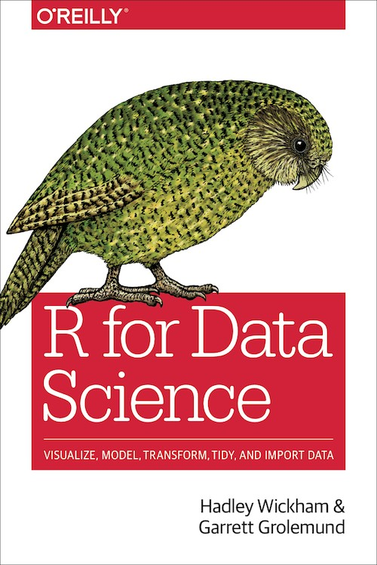
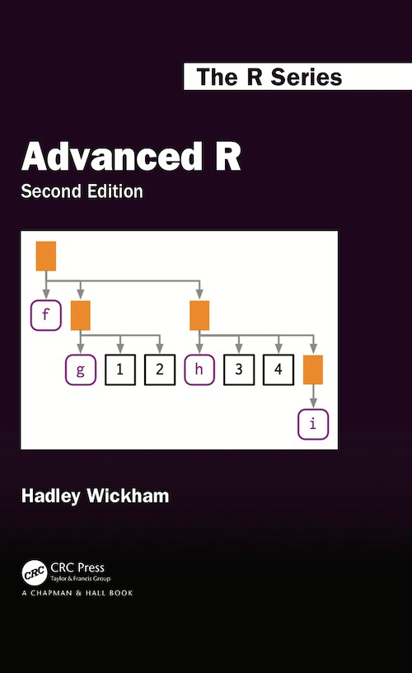
Supplementary Reading
Tibbles
Data import
Subsetting

Slide 30

Things to Do to Prepare for Our Next Class
Go over your notes and complete Assignment 03 on Canvas.
Before attempting the assignment, you are encouraged to:
Go over this slide deck as well as the slide deck from last class
Read the supplementary reading for today's class (see previous slide)
While attempting the assignment, you are encouraged to:
Google ( )/ChatGPT/ChatISA any that you need.
Examine any functions by utilizing on its help document using the ?function_name

