Slide 1




ISA 444: Business Forecasting
04: Plotting a Single Time Series in Python (Cont.)
Fadel M. Megahed, PhD
Professor
Farmer School of Business Miami University
@FadelMegahed fmegahed fmegahed@miamioh.edu
Automated Scheduler for Office Hours
Spring 2025

Slide 2
Quick Refresher of Last Class
✅ Generate and interpret simple line charts
✅ Create seasonal plots and subplots

Slide 3
Learning Objectives for Today's Class
Describe a lag and create lag scatter plots.
Plot and interpret the autocorrelation function (ACF) for a time-series.

Slide 4
DDeessccrriibbee aa llaagg aanndd ccrreeaattee llaagg ssccaatttteerr pplloottss
44 // 1177

Slide 5
What is a Lag?
A lag refers to a time delay between an event and its observable effect or measurement.
In time series data, a lag is simply a previous observation in the series. For example:
Lag 1: Refers to the value immediately preceding the current value.
Lag 2: Refers to the value two time periods before the current value, and so on.

Slide 6
What is a Lag (Cont.)?
Imagine a time series of daily sales:
Day 1: $100
Day 2: $150
Day 3: $120
For Day 3, the lag 1 value is the sales from Day 2 ($150). Similarly, the lag 2 value is from Day 1 ($100).
In mathematical notation, y_{t} represents the value at time t, then:
y_{t−1} is the lag 1 value of y_{t}
y_{t−2} is the lag 2 value of y_{t}

Slide 7
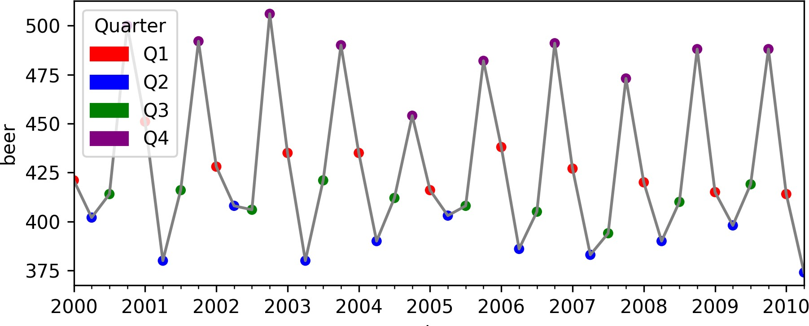
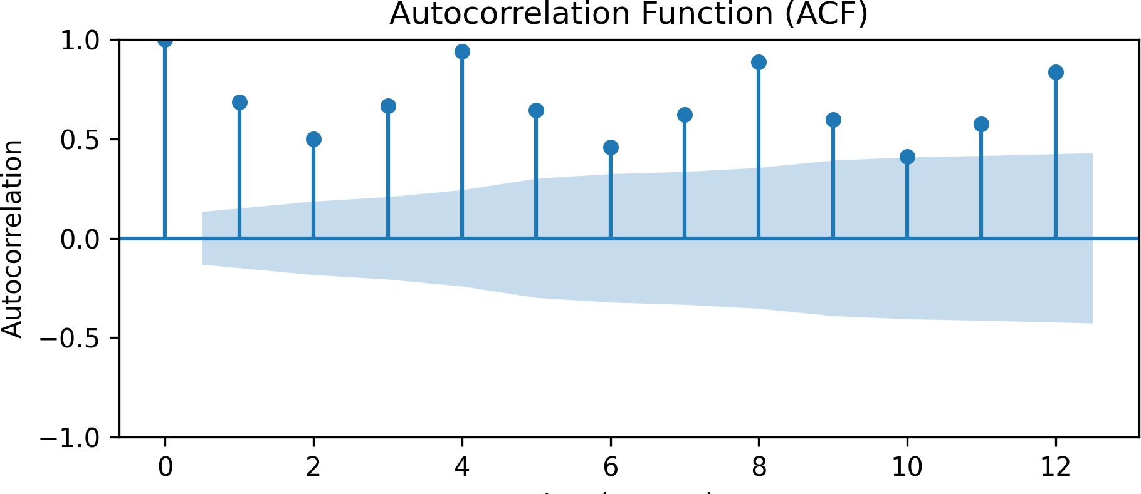
Importance of Lags
Lags are important in time series analysis because they can help us understand the relationship between past and present values. They are used in Forecasting:
Autoregressive models Models such as AR (AutoRegressive) and ARIMA models use past values (lags) of the series to predict future values. For example, an AR(1) model uses predicts y_{t} solely based on y_{t−1}.
Seasonality: Lags help capture seasonal patterns in data.

Slide 8
Importance of Lags
Lags are important in time series analysis because they can help us understand the relationship between past and present values. Hence, they are used in:
Causal Analysis:
Cause and Effect: In many business scenarios, past events (lags) can be predictors for current outcomes; e.g., past advertising spend might affect current sales.
Policy Evaluation: Understanding the delayed impact of policies or changes (e.g., price changes, marketing campaigns) is essential.

Slide 9
Importance of Lags (Cont.)
Lags are important in time series analysis because they can help us understand the relationship between past and present values. Hence, they are used in:
Data Preparation and Feature Engineering:
Feature Creation: In machine learning models, creating lag features from time series data can help the model understand historical patterns and trends.
Smoothing and Differencing: Lags are also used in techniques like differencing to stabilize the mean of a time series, which is a common preprocessing step.

Slide 10
Implementing Lags in Python
In Python, we can create lags using the shift() method in pandas.
import pandas as pd
df = (
pd.DataFrame(
{'date': pd.date_range(start='2025-01-01', periods=5, freq='D'), 'sales': [100, 150, 120, 200, 180] }
)
.assign(
lag1 = lambda x: x['sales'].shift(1), lag2 = lambda x: x['sales'].shift(2)
)
)
df.head(3)
## | date | sales | lag1 | lag2
## 0 2025-01-01 |  | 100 | NaN | NaN
## 1 2025-01-02 |  | 150 | 100.0 | NaN
## 2 2025-01-03 |  | 120 | 150.0 | 100.0

Slide 11
05:00
Class Activity: Plot the aus_beer Time Series
Load the aus_beer.csv dataset from Canvas.
Create a line plot of the beer column.
Color the plot by quarter.
Add a legend to the plot.

Slide 12
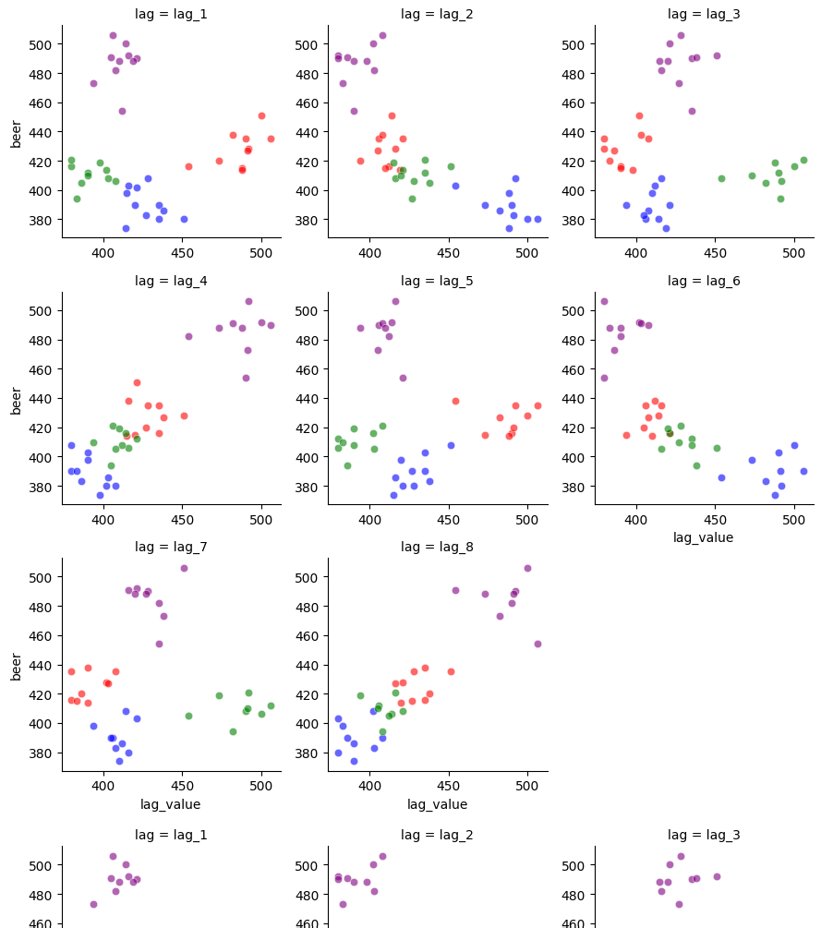
Demo: Creating and Interpreting Lag Scatter Plots
In this demo, we will:
Create lag scatter plots for a time series.
Interpret the relationship between the current value and its lagged values.

Slide 13
PPlloott aanndd iinntteerrpprreett tthhee AACCFF ffoorr aa TTiimmee SSeerriieess
1133 // 1177

Slide 14
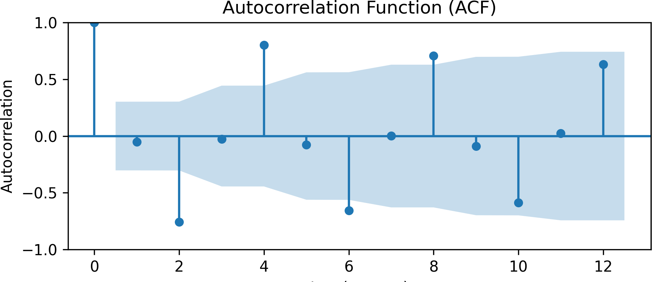
What is the Autocorrelation Function (ACF)?
The Autocorrelation Function (ACF) is a measure of the correlation between a time series and a lagged version of itself.
from statsmodels.graphics.tsaplots import import matplotlib.pyplot as plt
df = pd.read_csv('../../data/aus_beer.csv
plot_acf(df['beer'], lags=12) plt.title('Autocorrelation Function (ACF) plt.xlabel('Lag (quarter)') plt.ylabel('Autocorrelation')
plt.show()
14 / 17

Slide 15
RReeccaapp
1155 // 1177

Slide 16
Summary of Main Points
By now, you should be able to do the following:
Describe a lag and create lag scatter plots.
Plot and interpret the ACF of a time-series.

Slide 17
📝 Review and Clarification 📝
Class Notes: Take some time to revisit your class notes for key insights and concepts.
Zoom Recording: The recording of today's class will be made available on Canvas approximately 3-4 hours after the session ends.
Questions: Please don't hesitate to ask for clarification on any topics discussed in class. It's crucial not to let questions accumulate.

