Slide 1




ISA 444/544: Business Forecasting
16: PACF and AutoRegressive Moving Average Models
Fadel M. Megahed, PhD
Raymond E. Glos Professor Farmer School of Business Miami University
@FadelMegahed fmegahed fmegahed@miamioh.edu
Automated Scheduler for Office Hours
Fall 2025

Slide 2
Quick Refresher of Last Class
✅ Define a stationary time series.
✅ Understand how plotting techniques can help identify non-stationarity.
✅ Understand how we can stabilize a non-stationary time series to achieve stationarity
(differencing to stabilize the mean, and log transformation to stabilize the variance).
✅ Understand how to use unit root tests to test for stationarity.

Slide 3
Learning Objectives for Today's Class
Explain the Partial Autocorrelation Function (PACF).
Explain the Autoregressive (AR) model, and how to identify the order of the AR model using the PACF.
Explain the Moving Average (MA) model, and how to identify the order of the MA model using the ACF.
Explain the Autoregressive Moving Average (ARMA) model.
Understand how to fit AR, MA, and ARMA models using the ARIMA() method from the statsforecast Python package.

Slide 4
RReevviissttiinngg tthhee AAuuttooccoorrrreellaattiioonn FFuunnccttiioonn ((AACCFF)) aanndd EExxaammiinniinngg tthhee PPaarrttiiaall AAuuttooccoorrrreellaattiioonn FFuunnccttiioonn ((PPAACCFF))
44 // 3355

Slide 5
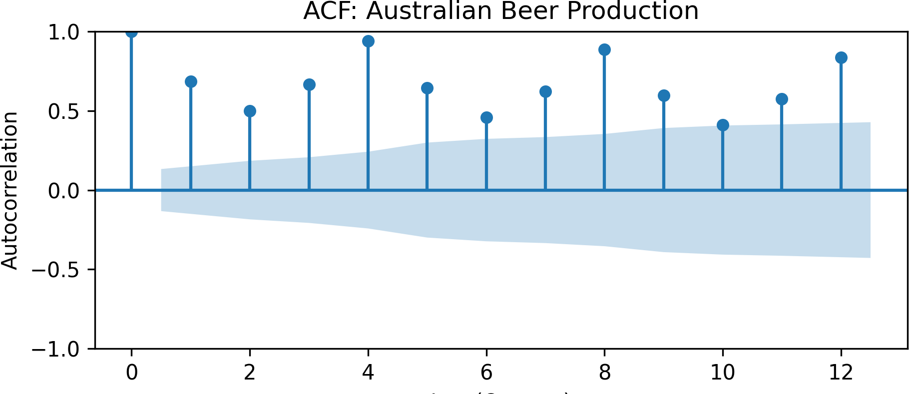
Autocorrelation Function (ACF)
The autocorrelation is the correlation between a time series and a lagged version of itself.
The ACF is a function that captures the autocorrelation of a time series at different lags, which can help in detecting stationarity and seasonality.
ρ_{k} =
Cov(Yt, Y_{t−k})
V ar(Y_{t})
import matplotlib.pyplot as plt import pandas as pd |  | ## ## | 1 | lag 1 | acf 0.68361
from statsmodels.tsa.stattools import acf from statsmodels.graphics.tsaplots import plot_acf |  | ## | 4 | 4 | 0.93997
df = pd.read_csv('../../data/aus_beer.csv')
acf_df = pd.DataFrame({
'lag': range(0, 13), 'acf': acf(df['beer'], nlags=12) }) acf_df.iloc[[1,4], : ] # subsetting lag 1 and 4 plot_acf(df['beer'], lags=12) plt.title('ACF: Australian Beer Production') plt.xlabel('Lag (Quarter)') plt.ylabel('Autocorrelation')
5 / 35

Slide 6
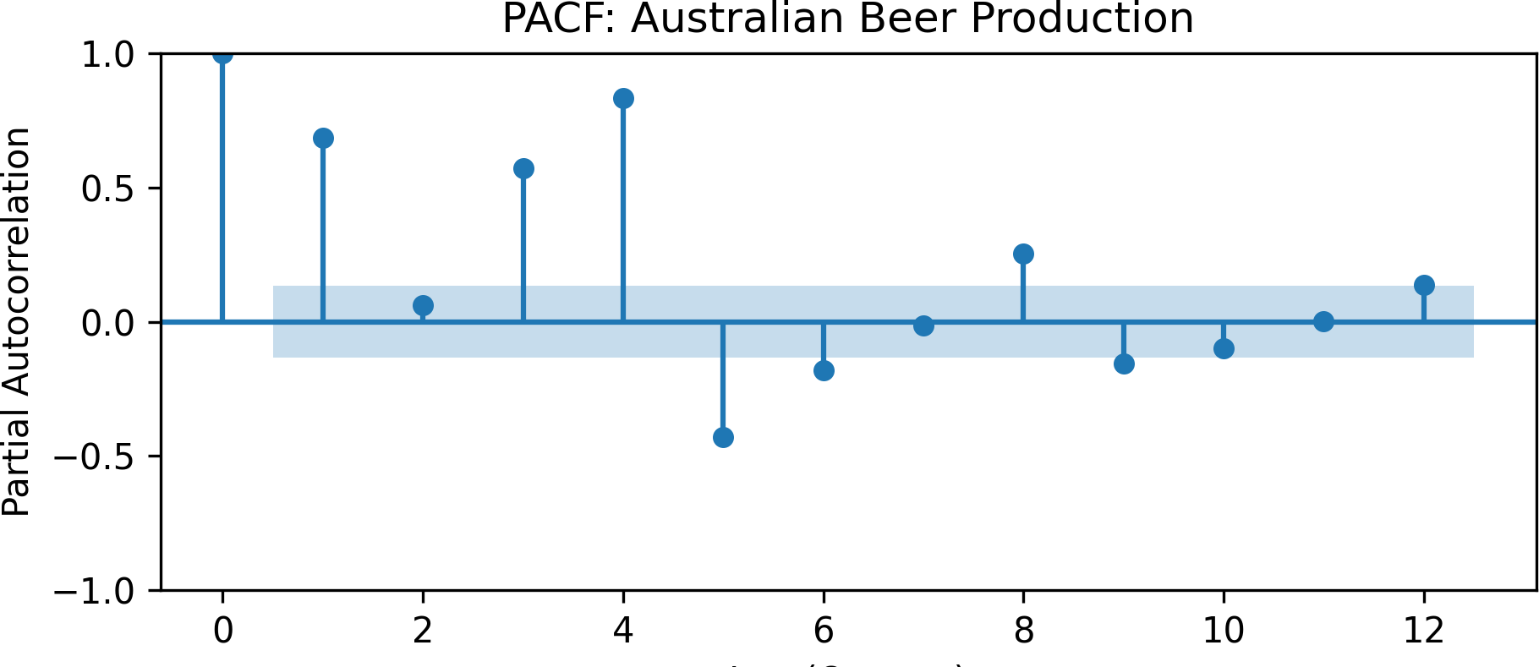
Partial Autocorrelation Function (PACF)
The Partial Autocorrelation Function (PACF) is a function that captures the autocorrelation of a time series at different lags, while excluding the effect of intermediate lags.
Cov(Y_{t}, Y_{t−k}|Y_{t−1}, Y_{t−2}, … , Y_{t−k+1})
ϕk,k =
V ar(Y_{t})
import matplotlib.pyplot as plt
import pandas as pd
from statsmodels.tsa.stattools import pacf
from statsmodels.graphics.tsaplots import plot_pacf
df = pd.read_csv('../../data/aus_beer.csv') pacf_df = pd.DataFrame({
'lag': range(0, 13),
'pacf': pacf(df['beer'], nlags=12)
})
pacf_df.iloc[[1,4], : ] # subsetting lag 1 and 4
plot_pacf(df['beer'], lags=12) plt.title('PACF: Australian Beer Production') plt.xlabel('Lag (Quarter)') plt.ylabel('Partial Autocorrelation')
## lag pacf ## 1 1 0.686760
## 4 4 0.877843

Slide 7
Comments on the PACF Computation in statsmodels
statsmodels uses the Yule-Walker equations, with sample-size adjustment, by default.
statsmodels.tsa.stattools.pacf
statsmodels.tsa.stattools.pacf( x,
nlags=None, method='ywadjusted', alpha=None
)
[source]
Partial autocorrelation estimate.
Parameters
x : array_like
Observations of time series for which pacf is calculated.

Slide 8
Comments on the PACF Computation in statsmodels
The use of the Yule-Walker (yw) equations in statsmodels is a common approach to computing the PACF.
The sample-size adjustment in statsmodels is used to correct for the bias in the sample autocorrelation function estimates.
The default in statsmodels is to use the sample-size adjustment, hence yw is sample-size adjusted.
Levinson-Durbin (ld) showed that the Yule-Walker equations can be rewritten as a set of linear equations that can be solved using a recursive algorithm. Hence,
ld is a computationally efficient implementation of yw, and
ldb is computationally efficient implementation of ywm.
On the other hand, the pacf() in (stats package) uses the biased implementation the Yule-Walker as its default, i.e., is equivalent to ywm or ldb in statsmodels.

Slide 9
Verifying PACF Computations in statsmodels &
import numpy as np
import pandas as pd
from statsmodels.tsa.stattools import pacf
generate a random time series
np.random.seed(2025)
ts = np.random.normal(size=100, loc=50, scale=10)
computing the PACF using different methods
pacf_df = pd.DataFrame({ 'lag': range(13),
'yw': pacf(ts, nlags=12, method='yw'), 'ld': pacf(ts, nlags=12, method='ld'), 'ywm': pacf(ts, nlags=12, method='ywm'),
'ldb': pacf(ts, nlags=12, method='ldb')
})
print the results
pacf_df
save the original ts to reuse in R
pd.DataFrame({'ts': ts}).to_csv( '../../data/sim_ts.csv', index=False)
save the PACF results to reuse in R
pacf_df.to_csv( '../../data/pacf_results.csv', index=False)
## | lag |  | yw | ld | ywm | ldb
## | 0 | 0 | 1.000000 | 1.000000 | 1.000000 | 1.000000
## | 1 | 1 | -0.117735 | -0.117735 | -0.116558 | -0.116558
## | 2 | 2 | 0.026043 | 0.026043 | 0.025514 | 0.025514
## | 3 | 3 | 0.106935 | 0.106935 | 0.103698 | 0.103698
## | 4 | 4 | -0.058773 | -0.058773 | -0.056358 | -0.056358
## | 5 | 5 | 0.026731 | 0.026731 | 0.025363 | 0.025363
## | 6 | 6 | -0.056340 | -0.056340 | -0.052902 | -0.052902
## | 7 | 7 | -0.043437 | -0.043437 | -0.040357 | -0.040357
## | 8 | 8 | 0.103929 | 0.103929 | 0.095361 | 0.095361
## | 9 | 9 | -0.032238 | -0.032238 | -0.029049 | -0.029049
## | 10 | 10 | -0.137204 | -0.137204 | -0.123049 | -0.123049
## | 11 | 11 | 0.114837 | 0.114837 | 0.100998 | 0.100998
## | 12 | 12 | 0.052926 | 0.052926 | 0.046414 | 0.046414

Slide 10
Verifying PACF Computations in statsmodels &
Computations and Combining Results
ts = read.csv('../../data/sim_ts.csv')
pacf_results = read.csv('../../data/pacf_results.csv')
r uses biased implementation of Yule-Walker and does not include lag 0
pacf_r = pacf(ts$ts, lag.max=12, plot=FALSE) pacf_results$r = c(0, pacf_r[[1]]) # prefix w/ lag 0
pacf_results[2:6,]
The Combined Results from statsmodels and
## | lag | yw | ld | ywm | ldb | r
## | 1 | -0.11773516 | -0.11773516 | -0.11655781 | -0.11655781 | -0.11655781
## | 2 | 0.02604330 | 0.02604330 | 0.02551390 | 0.02551390 | 0.02551390
## | 3 | 0.10693456 | 0.10693456 | 0.10369764 | 0.10369764 | 0.10369764
## | 4 | -0.05877317 | -0.05877317 | -0.05635773 | -0.05635773 | -0.05635773
## | 5 | 0.02673134 | 0.02673134 | 0.02536253 | 0.02536253 | 0.02536253

Slide 11
Assumptions of the Yule-Walker Equations
For using the Yule-Walker equations to compute the PACF, the following assumptions are made:
The time series is stationary.
The time series is in type AR(p) form, but the order p is unknown.
Having the prediction p, we use the appropriate AR(p) model to estimate the coefficients (i.e., the obtained correlation coefficients are preliminary).
We will find the estimators for ϕ₁, ϕ₂, … , ϕ_{p} later using the maximum likelihood method via fitting the AR(p) model.
Source: Łukasz Balbus (2020). Lecture Notes on Econometrics. University of Zielona Góra, Zielona Góra, Poland. Available at: https://staff.uz.zgora.pl/lbalbus/Zdalne%20EDiF%2010.11.2020.pdf.
11 / 35

Slide 12
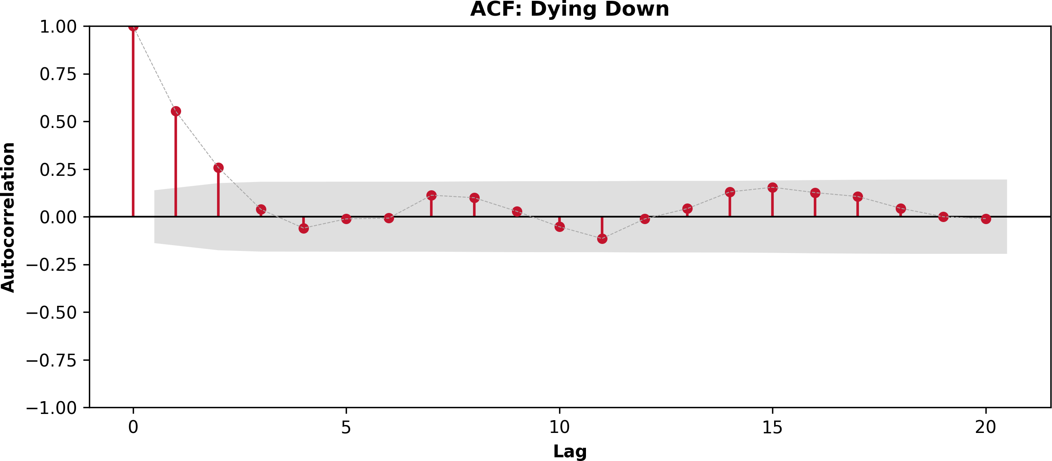
ACF Patterns to Look for: Dying Down
Dying Down: The ACF will exponentially decay to zero relatively quickly ⟶ this is a sign of a possible AR Data Generating Process (DGP).

Slide 13
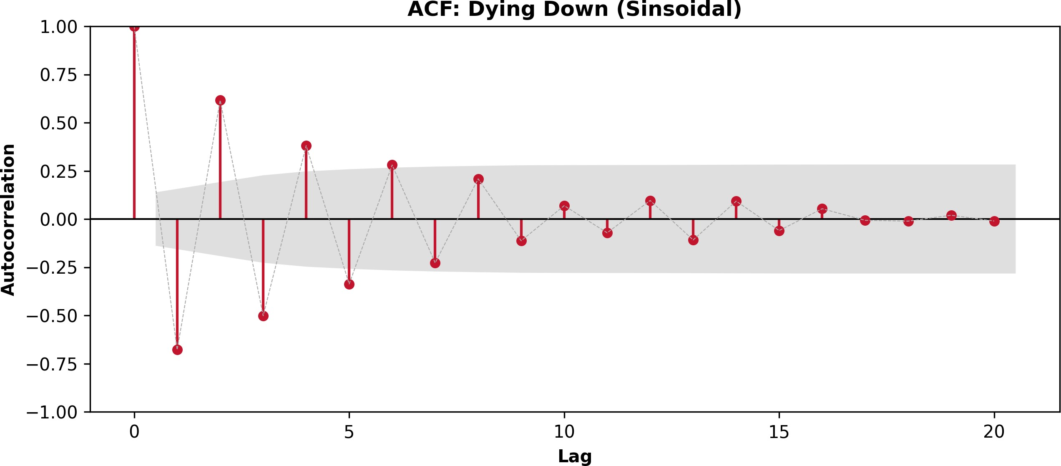
ACF Patterns to Look for: Dying Down (Sinsoidal)
Dying Down (Sinsoidal): The ACF will exponentially decay to zero with some oscillations
⟶ a possible AR DGP, with at least one negative correlation coefficient.

Slide 14
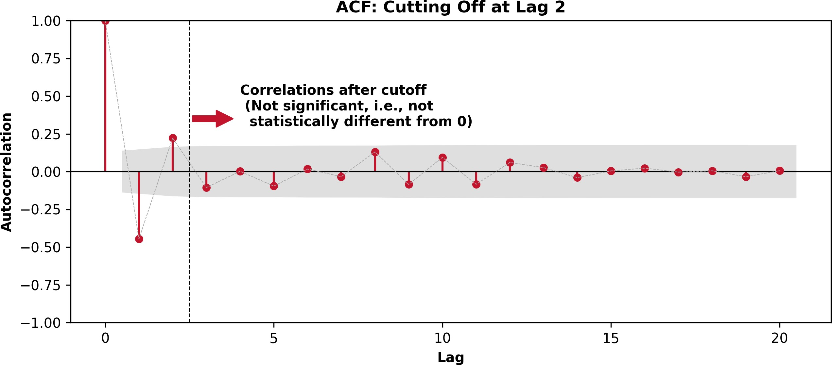
ACF Patterns to Look for: Cutting Off
Cutting Off: The ACF will cut off after a certain lag ⟶ a possible MA DGP.

Slide 15
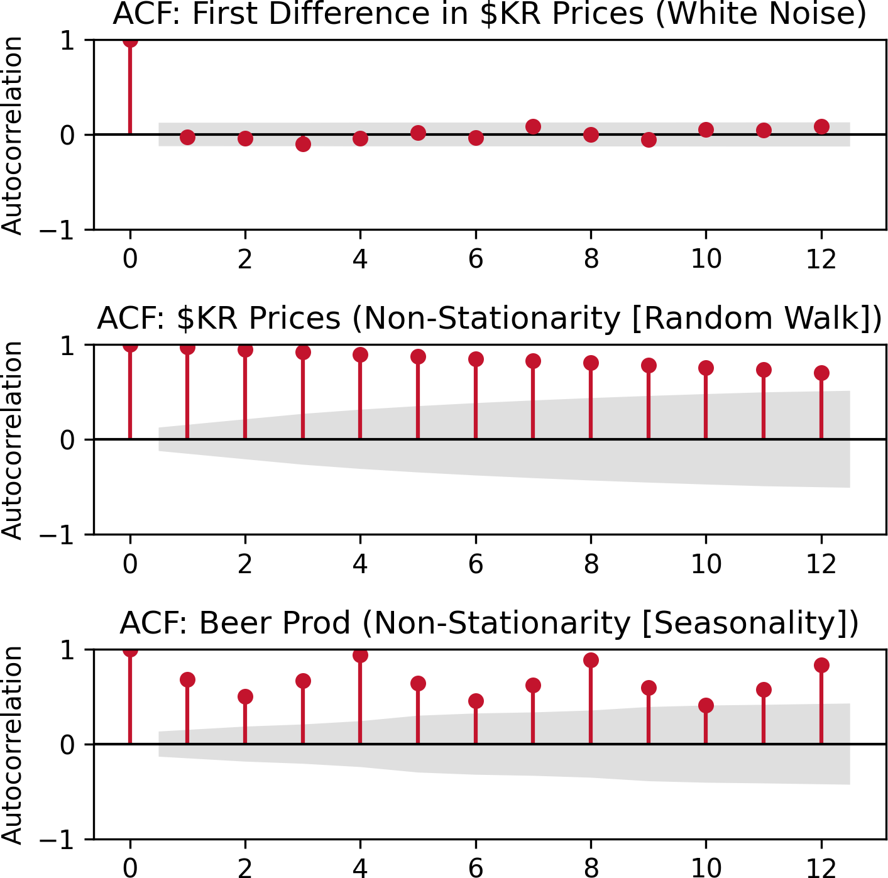
ACF Patterns and Data Generating Processes
White Noise: ACF will show no pattern.
Random Walk: ACF will slowly decay.
Seasonal Patterns: ACF will show a pattern at regular intervals.

Slide 16
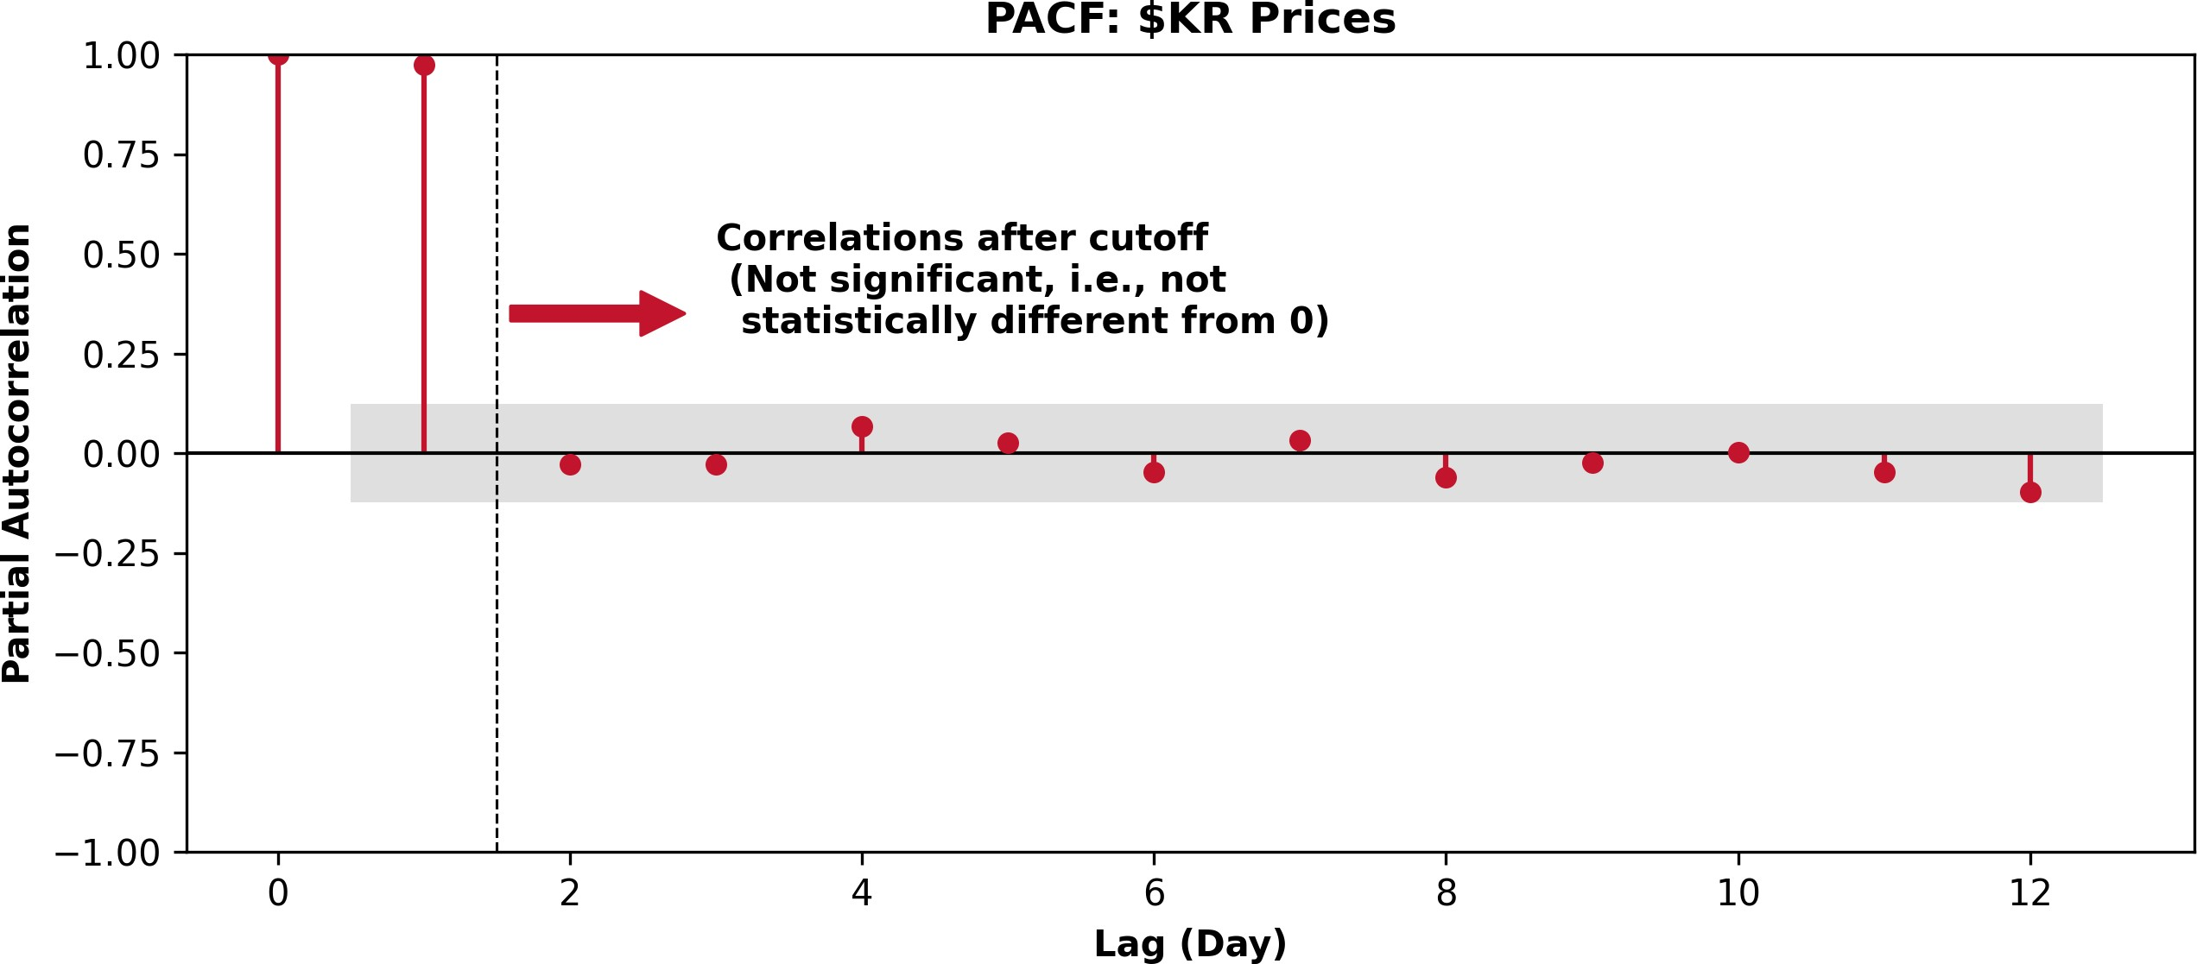
PACF Patterns to Look For: Cutting Off
If the PACF cuts off after the ACF has decayed down, this is indicates that an AR DGP is suitable. Let us consider the PACF of Kroger's stock price.

Slide 17
AAuuttoorreeggrreessssiivvee ((AARR)) MMooddeellss
1177 // 3355

Slide 18
AR Model
In an autoregressive model, we forecast the variable of interest using a linear combination of past values of the variable. The term autoregressive indicates that it is a regression of the variable against itself. Thus, an autoregressive model of order p, denoted as AR(p), can be written as:
y_{t} = c + ϕ₁y_{t−1} + ϕ₂y_{t−2} + ⋯ + ϕ_{p}y_{t−p} + ϵ_{t},
where ϵ_{t} is white noise.
Note: The AR model looks similar to a linear regression model that uses the dependent relationship between an observation and its lagged observations. The difference lies in how their coefficients are estimated in practice.
AR models ⟶ often utilize MLE while taking into account the time series structure.
Linear regression ⟶ uses ordinary least squares (OLS).

Slide 19
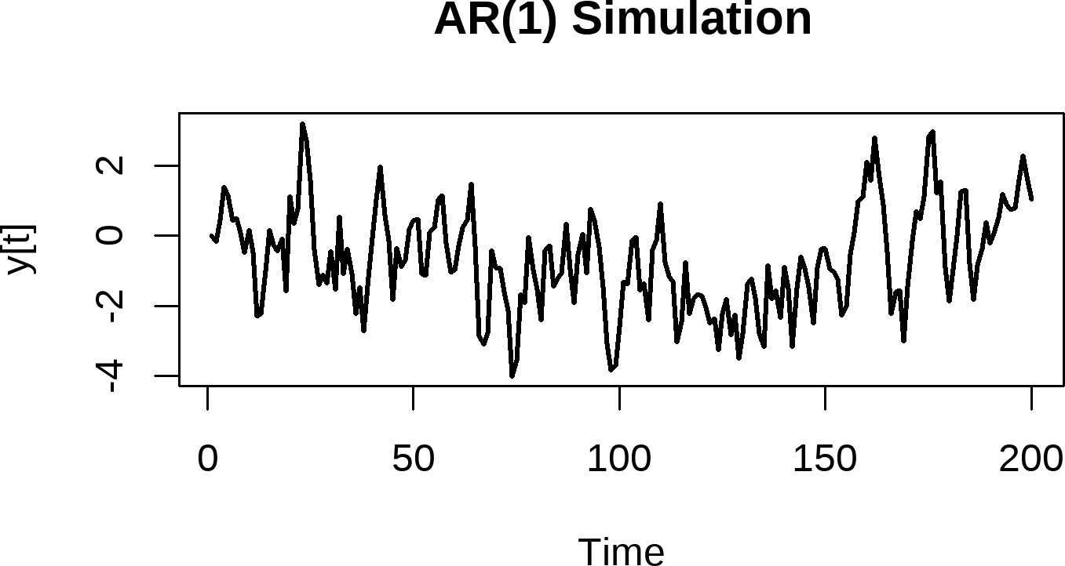
AR (MLE) vs. Linear Regression (OLS)
Since you used for linear regression, let's illustrate the differences between AR and linear regression using base .
Let us simulate the following AR(1) process: y_{t} = −0.2 + 0.7y_{t−1} + ϵ_{t}, where ϵ_{t} ∼ N(0, 1).
set.seed(2025)
Simulate y[t] = -0.2 + 0.7 * y[t-1] + error,
n = 200
y = 0
phi = 0.7
intercept = -0.2
errors = rnorm(n, mean = 0, sd = 1)
for (t in 2:n) {
y[t] = intercept + phi*y[t - 1] + errors[t]
}
plot(
y, type = "l", lwd = 2, xlab = "Time", ylab = "y[t]", main = "AR(1) Simulation"
)
write.csv(
data.frame(y), '../../data/ar1_simulation.csv'
)

Slide 20
Simulation: Examining the ACF and PACF
Let us examine the ACF and PACF of our simulated data.

Slide 21
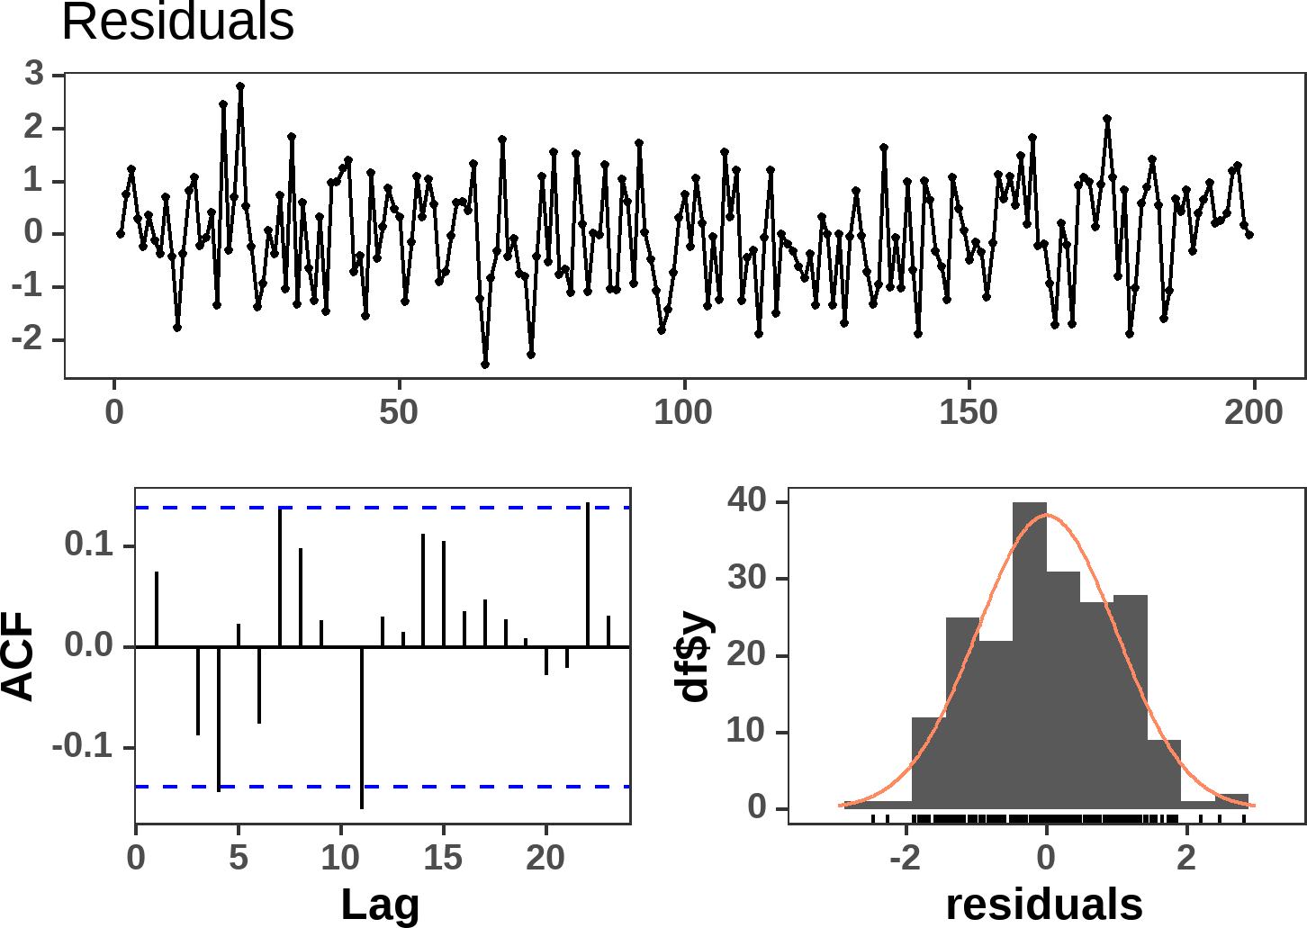
Simulation: The Linear Regression Model (Per ISA291)
df = data.frame(y = y) df$lag1 = dplyr::lag(df$y, 1) df_reg = na.omit(df)
lm_model = lm(y ~ lag1, data = df_reg) stargazer::stargazer(lm_model, type = 'html')
 | Dependent variable:
 | y
lag1 | 0.733***
 | (0.049)
Constant | -0.178**
 | (0.078)
Observations | 199
_{R}2 | 0.535
Adjusted R² | 0.532
Residual Std. Error | 0.993 (df = 197)
F Statistic | 226.325*** (df = 1; 197)
Note: | *p<0.1; **p<0.05; ***p<0.01

Slide 22
Simulation: The AR(1) Model Results
from statsforecast.models import ARIMA from statsforecast import StatsForecast df = (
pd.read_csv('../../data/ar1_simulation.csv')
.assign(
unique_id = 'simulated_data',
ds = pd.date_range(start='2024-01-01', periods=200,
)
)
typical statforecast workflow
models = [ARIMA(order=(1,0,0))]
sf = StatsForecast(models=models, freq='D') sf.fit(df)
getting the model coefficients
first 0 is for unique_id (only 1 unique_id) and # second 0 is for the ARIMA model (only 1 model) phi1 = sf.fitted_[0][0].model_.get('coef')['ar1']
intercept = sf.fitted_[0][0].model_.get('coef')['interc
print(
'The AR(1) model equation is:\n',
'y[t] = {:.3f} + {:.3f} * y[t-1] + e[t]'
.format(intercept, phi1)
)
## StatsForecast(models=[ARIMA]) ## The AR(1) model equation is:
## y[t] = -0.758 + 0.730 * y[t-1] + e[t]
The AR(1) and the linear regression model are quite similar, but are not identical in this case. The differences arise from the estimation methods used in each model.



Slide 23
Determining the Order of the AR Model
We can usually tell from the ACF that there is an autoregressive (AR) component to the data because the ACF plot tends to geometrically decrease in magnitude (i.e., "die down").
The order of an AR Process refers to how many lags you include in the autoregressive model.
Because the ACF of the AR model is a mixture, the ACF is not useful for determining the order of the AR process.
Thus, the ACF helps us to know that we have an AR model, but not which AR model to fit!
The Partial Autocorrelation Function (PACF) is used to determine the order of the AR model.
For an AR(p) model, the PACF between y_{t} and y_{t−k} should be 0 ∀ k > p.
The PACF will cut off after lag p.

Slide 24
MMoovviinngg AAvveerraaggee ((MMAA)) MMooddeellss
2244 // 3355

Slide 25
The Moving Average (MA) Model
Rather than using past values of the forecast variable in a regression, a moving average model uses past forecast errors in a regression-like model,
y_{t} = c + ϵ_{t} + θ₁ϵ_{t−1} + θ₂ϵ_{t−2} + ⋯ + θ_{q}ϵ_{t−q} ,
where:
ϵ_{t} is white noise; ϵ_{t} ∼ N (0, σ²).
Unlike AR models, past values of y_{t} do not appear; instead, y_{t} depends on past errors.
The errors ϵ_{t} are unobservable, meaning they must be inferred from the data.

Slide 26
How do we Estimate θ if ϵ_{t} is Unobserved?
Maximum Likelihood Estimation (MLE)
MLE estimates the parameters by maximizing the likelihood function assuming the residuals ϵ_{t}
follow a normal distribution. The process is:
Assume an initial set of MA parameters θ₁, θ₂, … , θ_{q} .
Use an interative algorithm* (e.g., Expectation-Maximization, Kalman Filtering, or numerical optimization) to estimate the most likely error terms ϵ_{t}.
Maximize the likelihood of the observed data given those estimated errors.
Nonlinear Least Squares (NLS)
Instead of directly computing errors, we minimize the sum of squared residuals using a nonlinear function of parameters.
This requires iterative numerical techniques (e.g., gradient descent or Newton-Raphson).

Slide 27
Forecasting with MA Model if ϵ_{t} Is Unobserved?
One-Step-Ahead Forecast (t+1):
Since ϵ_{t} is unknown in the future, we assume E[ϵ_{t+h}] = 0.
The forecast equation uses the most recent residuals ϵ_{t}, ϵ_{t−1}, …:
y^_{t+1} = c + θ^ ϵ^ + θ^ ϵ^ + ⋯ + θ^ ϵ^
1 t 2 t−1 q t+1−q
Multi-step Forecasts (t+h)
For longer horizons, all future errors are assumed to be zero (i.e., E[ϵ_{t+h}] = 0 for h ≥ 1).
This causes the forecast to revert to the mean ( c ) over time, as past shocks/errors fade out.

Slide 28
Determining the Order of the MA Model
The order of an MA Process refers to how many lags you include in the moving average model.
The ACF of an MA process will show a sharp cut-off after lag q (the order of the MA model).
This cutting off is theoretically related to the population autocorrelation function of the MA(q) process at lag k:
ρ(k) = {
(θ_{k}+θ₁θ_{k+1}+⋯+θ_{q−k}θ_{q} ) ,
k = 1, 2, … , q k > q
1+θ²+⋯+θ²
.
1
q
0,
While the equation looks quite complex, the key takeaway is that the ACF is not significant (will cut off after lag q) for an MA(q) process.

Slide 29
AAuuttoorreeggrreessssiivvee MMoovviinngg AAvveerraaggee ((AARRMMAA)) MMooddeellss
2299 // 3355

Slide 30
Autoregressive Moving Average (ARMA) Models
Sometimes, if a really high order seems needed for an AR process, it may be better to add one or more MA term. This results in a mixed autoregressive moving average (ARMA) model.
In general, an ARMA(p,q) model is given as

y_{t} = δ + ϕ₁y_{t−1} + ϕ₂y_{t−2} + ⋯ + ϕ_{p}y_{t−p} +
ϵ_{t} + θ₁ϵ_{t−1} + ⋯ + θ_{q}ϵ_{t−q}

Linear combination of Lagged forecast errors up to q lags


Linear combination of Lags of Y up to p lags
Predicted
constant
series
The ACF and PACF of the ARMA(p,q) process exhibit exponential decay exponential decay/ damped sinusoidal patterns. This makes identifying the order of the ARMA(p,q) difficult.
Model | ACF | PACF
AR(p) | Exponentially decays or damped sinusoidal patt | _{ern} Cuts off after lag p
MA(q) ARMA(p,q) | Cuts off after lag q Exponentially decays or damped sinusoidal patt | Exponentially decays or damped sinusoidal pattern Exponentially decays or ern damped sinusoidal pattern

Slide 31
Fitting AR, MA, and ARMA Models
Plot the data over time.
Do the data seem stationary? If necessary, conduct a test for stationarity.
Once you can assume stationarity, find the ACF plot.
If the ACF plot cuts off, fit an MA(q), where q = the cutoff point.
If the ACF plot dies down, find the PACF plot.
If the PACF plot cuts off, fit an AR(p) model, where p = the cutoff point.
If the PACF plot dies down, fit an ARMA (p,q) model.
You must iterate through p and q using a guess and check method starting with ARMA(1,1) models -- increment each by 1.
Evaluate the model residuals and consider the ACF and PACF of the residuals.
If model fit is good, forecast future values.
Note: Often you will fit multiple models in Step 3 and compare models in Step 4 to select the best fit.

Slide 32
Fitting AR, MA, and ARMA Models in Python
Let us examine the viscosity data. For this demo, we will only fit ARMA models on the entire series, and examine the residuals to see the goodness of fit.
However, it should be noted that you are also expected to utilize the cross-validation method to evaluate the model's predictive performance (which we do not do in this demo to save time).

Slide 33
RReeccaapp
3333 // 3355

Slide 34
Summary of Main Points
By now, you should be able to do the following:
Explain the Autoregressive (AR) model, and how to identify the order of the AR model using the PACF.
Explain the Moving Average (MA) model, and how to identify the order of the MA model using the ACF.
Explain the Autoregressive Moving Average (ARMA) model.
Understand how to fit AR, MA, and ARMA models using the ARIMA() method from the statsforecast Python package.

Slide 35
📝 Review and Clarification 📝
Class Notes: Take some time to revisit your class notes for key insights and concepts.
Zoom Recording: The recording of today's class will be made available on Canvas approximately 3-4 hours after the session ends.
Questions: Please don't hesitate to ask for clarification on any topics discussed in class. It's crucial not to let questions accumulate.

