Slide 1

The Black&WhiteStone Group
Tactical Ops Fund Proposal
Francesco Melpignano

Slide 2
Premise
• Buy: Percentage of movie budget
• Payout: Share of Gross Domestic Profit
• Fund Strategy: High Risk
Genre Based
Notes:
Buy into budget of movie, get equivalent % payout of GDR
OPS fund: thesis: high risk, high reward, -> by genre

Slide 3

Initial Insight
• Data: BOM, IMDB, The-Numbers, RottenTomatoes
Bacon #, Metacritic, n=3500
• Try and predict highest grossing genre
• Too hard!
Notes:
Tried to predict highest grossing
Was getting decent r2, but hard to make real conclusions
No shit sherlock effect
-easy to get good results
-identifiability
-correlating to budget, num_theaters
Trailer views before release are best

Slide 4
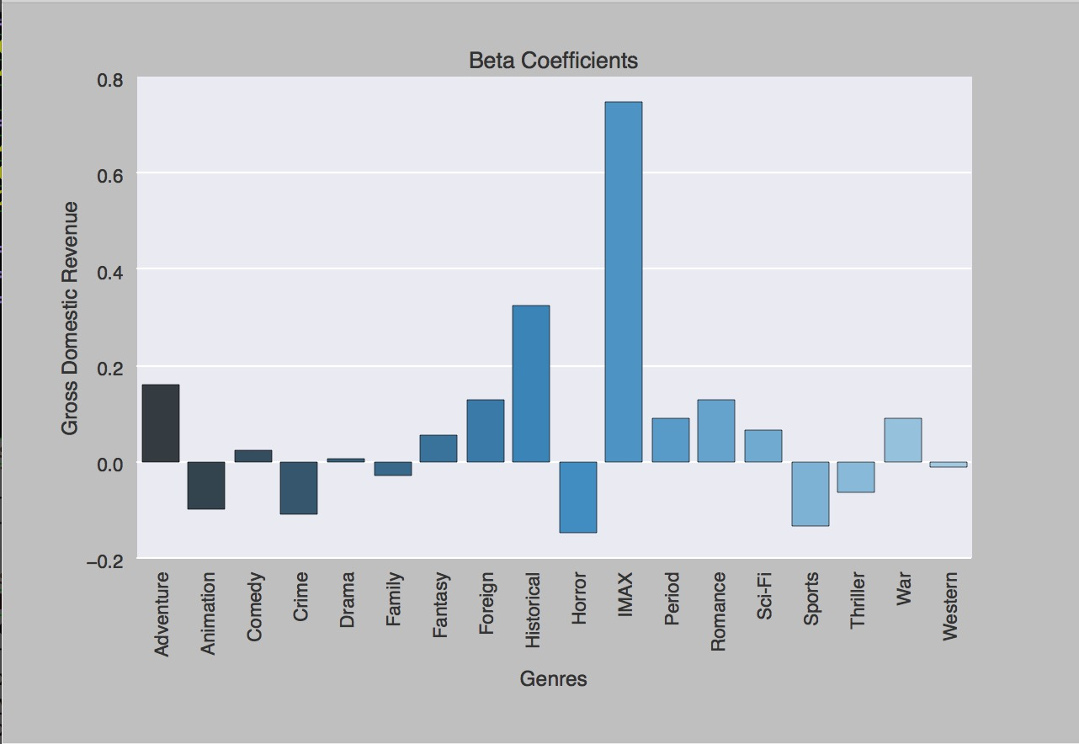
Notes:
No real insight
-imax big outlier
-KB #

Slide 5

Domestic Gross : Budget
• More relevant measure to us
• Trends start to arise
Notes:
Ratio: interesting finding
-consistent w intution
Ratio -> adjusts for inflation
-the avatar of 1980 will never look the same on paper

Slide 6
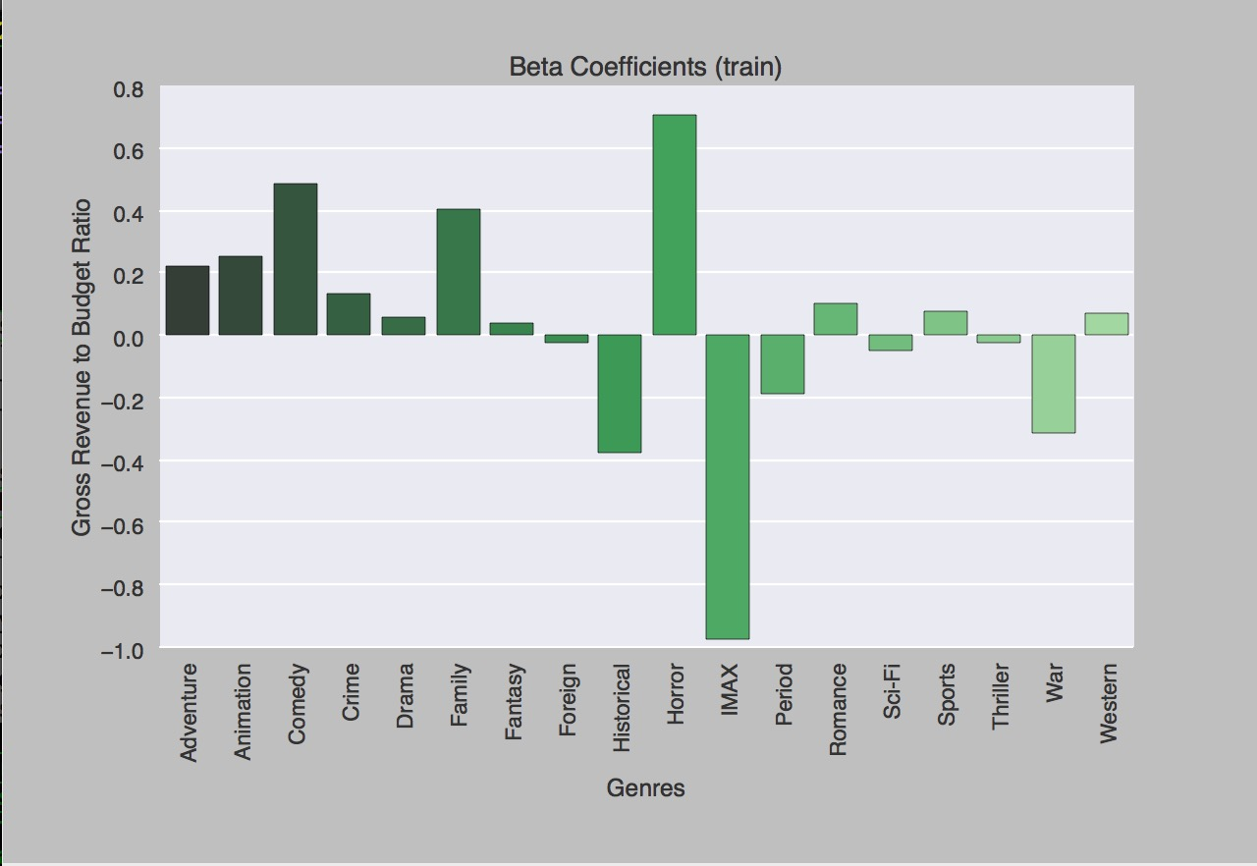

Slide 7
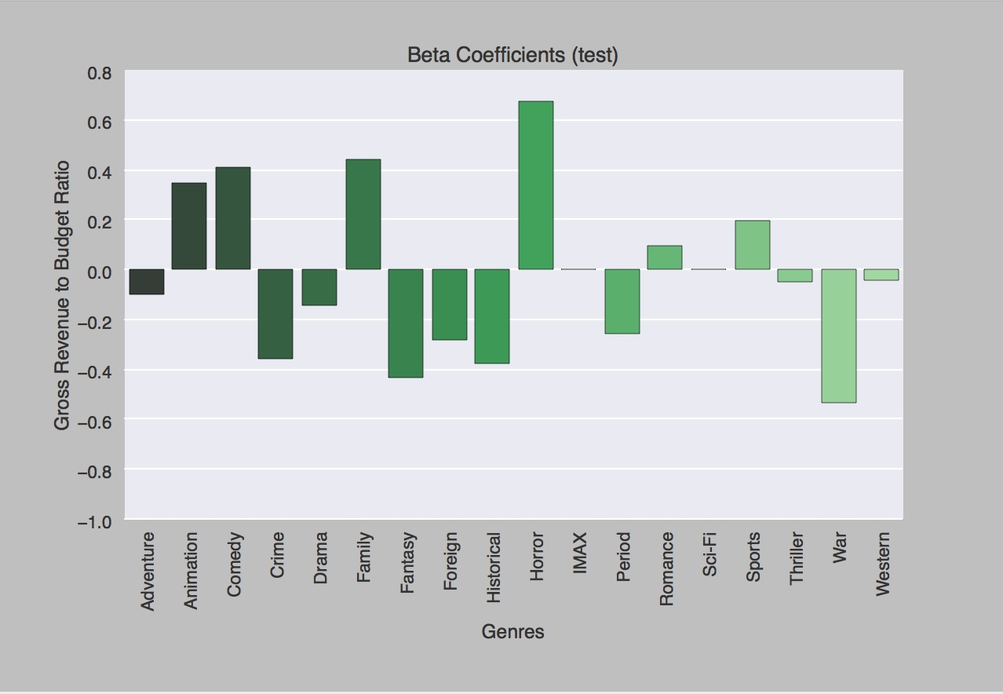

Slide 8

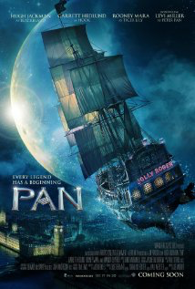


Recommendations
• 1. Horror (1.5x)
• 2. Comedy (1.6x)
• 3. Family (2x)
• ?Animation?
Notes:
Horror
-low budget films, but big potential
-saw, paranormal activity
Comedy
-over 70% - explain critic dilemma
-ex tomboy
Family
-even if not good due to low budget/production people will still go
-parents will always take their kids to movies
Animation:
was better back in the day, but now production costs are super high bc of graphics -> early disney movies did well

Slide 9
What’s Next??
Notes:
Microsegmenting genres

Slide 10



Thank you!!

Slide 11
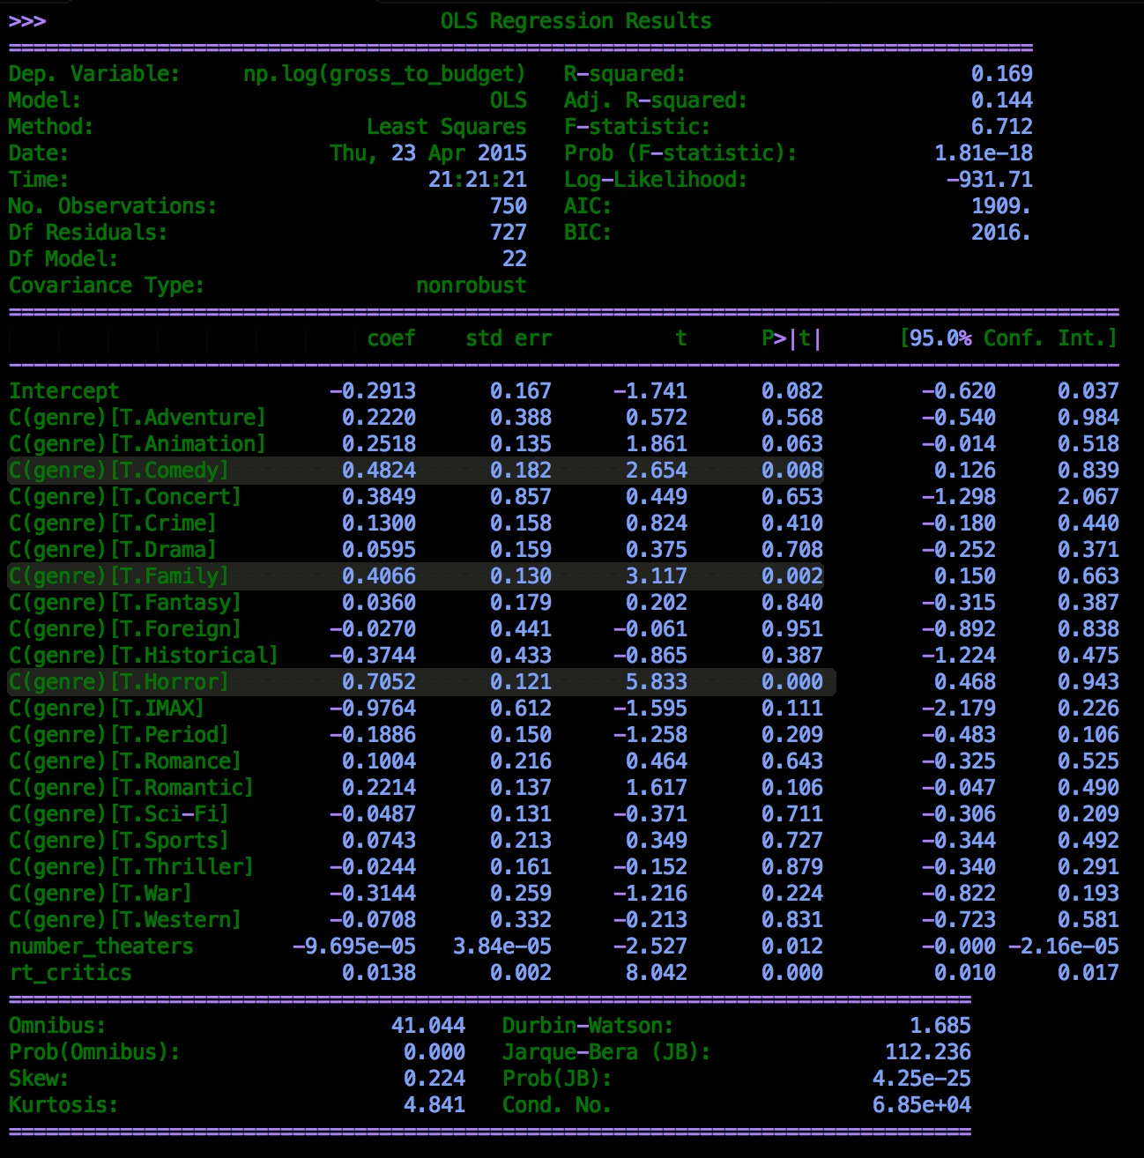

Slide 12
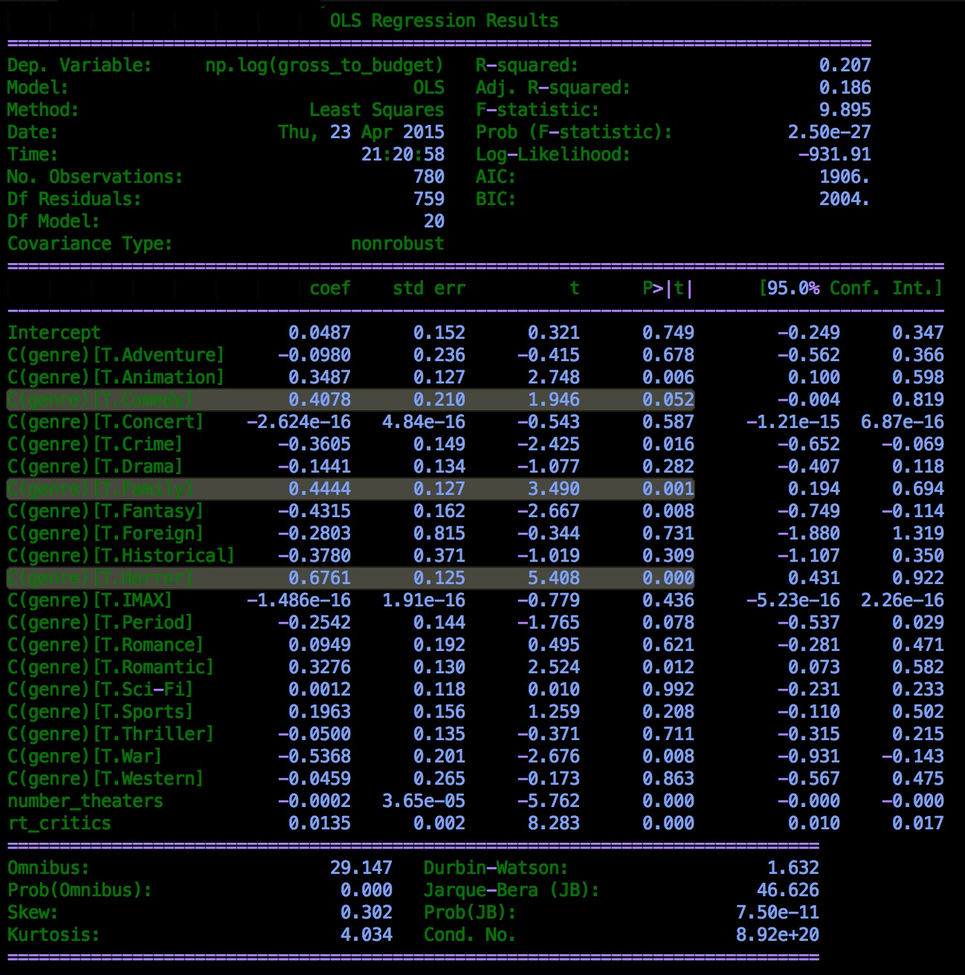

Slide 13
