Slide 1
Difference-in-Difference with a Continuous Treatment
Brant Callaway, Andrew Goodman-Bacon, Pedro Sant’Anna
IDB, 2026
*Views do not represent those of the Federal Reserve System or the Federal Reserve Bank of Minneapolis.

Slide 2
What about continuous treatments?
Variation in treatment intensity/dose/level is:
  Common
  Often the only variation
  Or maybe the “best” variation
3/5 of my DD papers!
Think federal policies!
Think “near vs. far” instead of “shock vs. no shock”

Slide 3

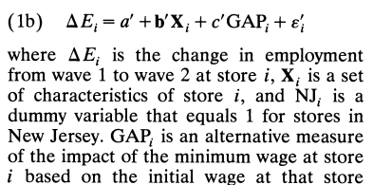
What about continuous treatments?
Variation in treatment intensity/dose/level is:
  Common
  Often the only variation
  Or maybe the “best” variation
“Dose-response effects” are:
  Evidence for internal validity

Slide 4
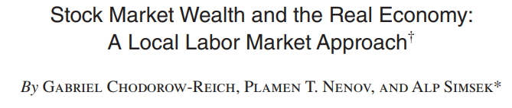
What about continuous treatments?
Variation in treatment intensity/dose/level is:
  Common
  Often the only variation
  Or maybe the “best” variation
“Dose-response effects” are:
  Evidence for internal validity
  Of interest per se

Slide 5
What do you want to know?

Slide 6
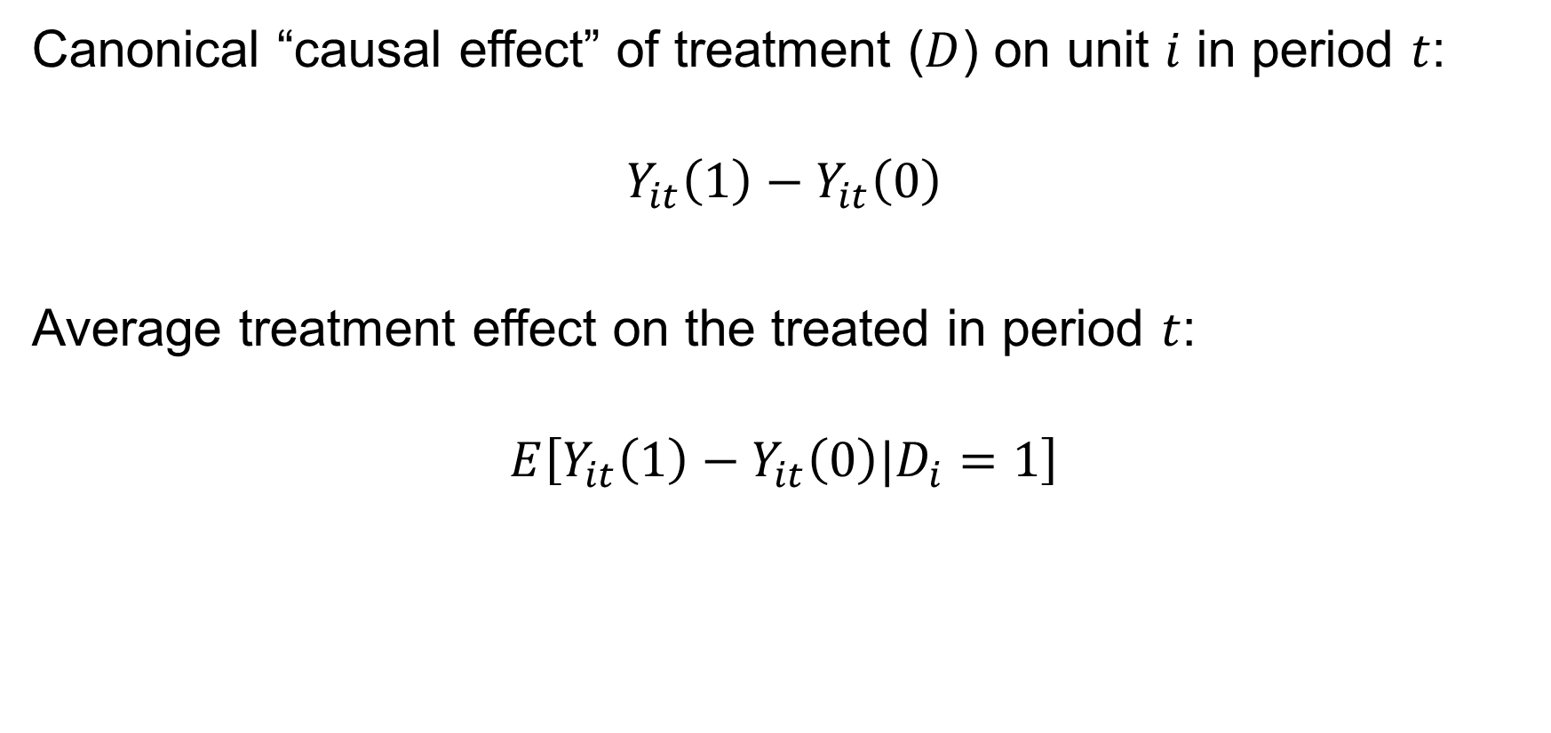
Building Blocks: Levels
Canonical “causal effect” of treatment ($D$) on unit $i$ in period $t$:
$$Y_{it}\left(1\right)−Y_{it}\left(0\right)$$
Average treatment effect on the treated in period $t$:
$$E\left[Y_{it}\left(1\right)−Y_{it}\left(0\right)|D_{i}=1\right]$$

Slide 7
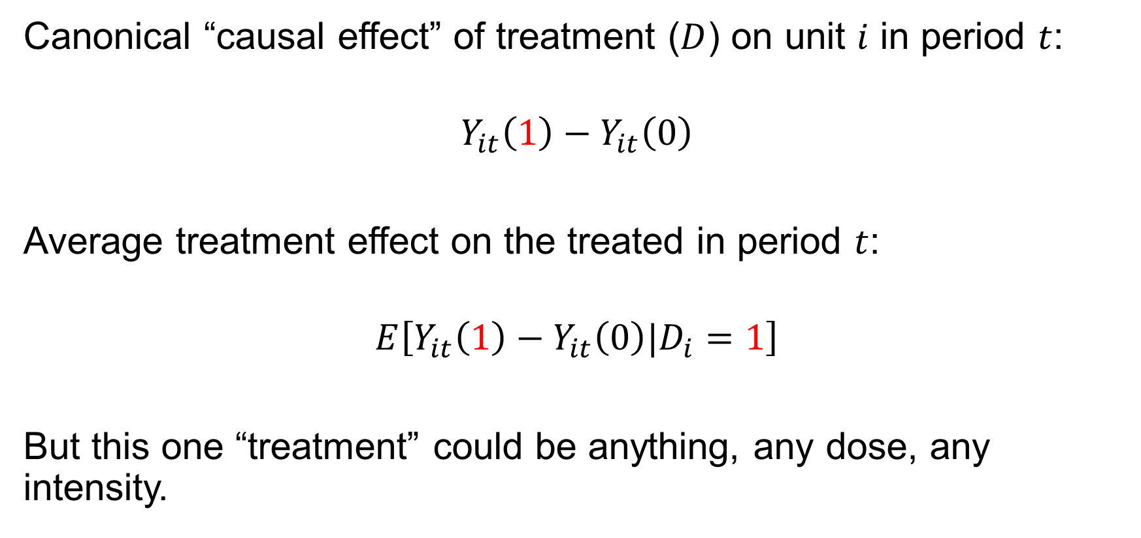
Building Blocks: Levels
Canonical “causal effect” of treatment ($D$) on unit $i$ in period $t$:
$$Y_{it}\left(1\right)−Y_{it}\left(0\right)$$
Average treatment effect on the treated in period $t$:
$$E\left[Y_{it}\left(1\right)−Y_{it}\left(0\right)|D_{i}=1\right]$$
But this one “treatment” could be anything, any dose, any intensity.

Slide 8
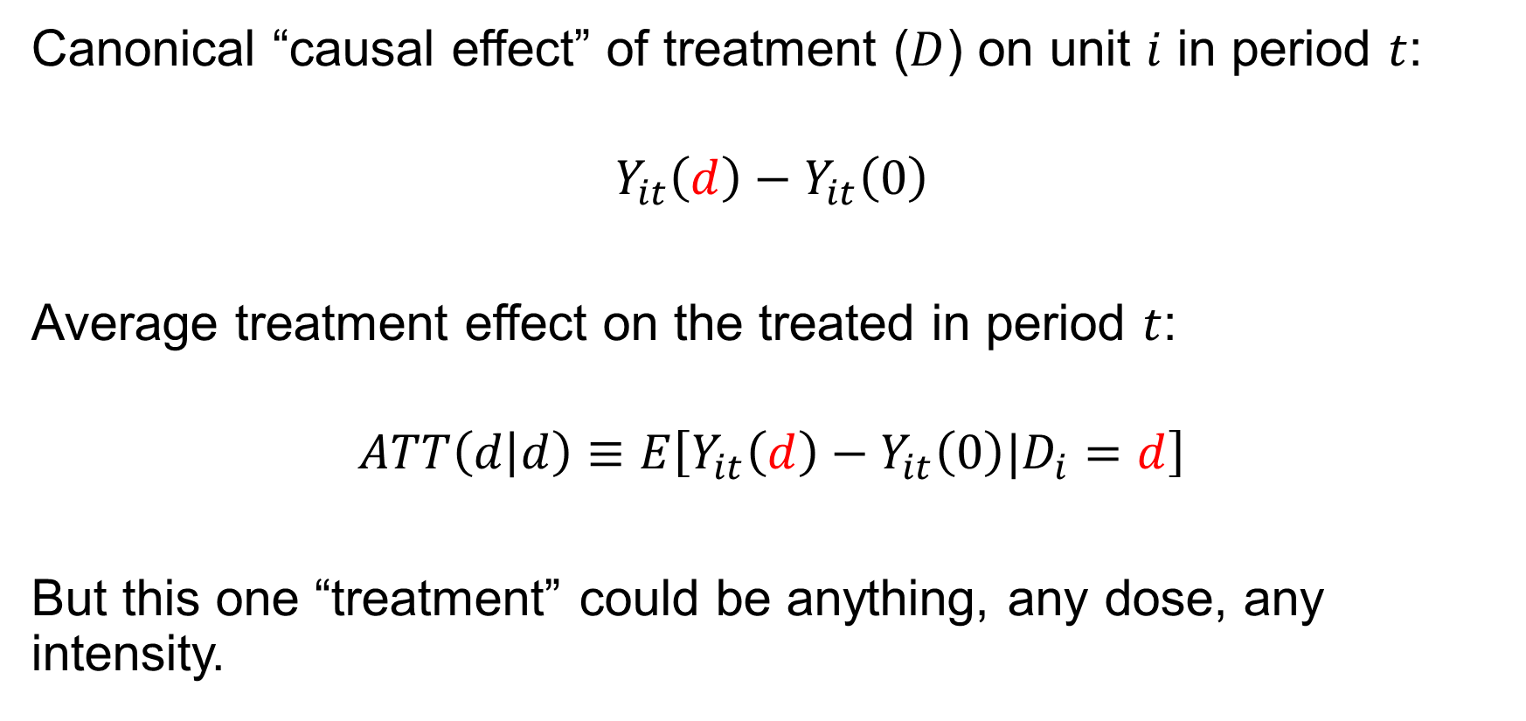
Building Blocks: Levels
Canonical “causal effect” of treatment ($D$) on unit $i$ in period $t$:
$$Y_{it}\left(d\right)−Y_{it}\left(0\right)$$
Average treatment effect on the treated in period $t$:
$$ATT\left(d | d\right)≡E\left[Y_{it}\left(d\right)−Y_{it}\left(0\right)|D_{i}=d\right]$$
But this one “treatment” could be anything, any dose, any intensity.

Slide 9

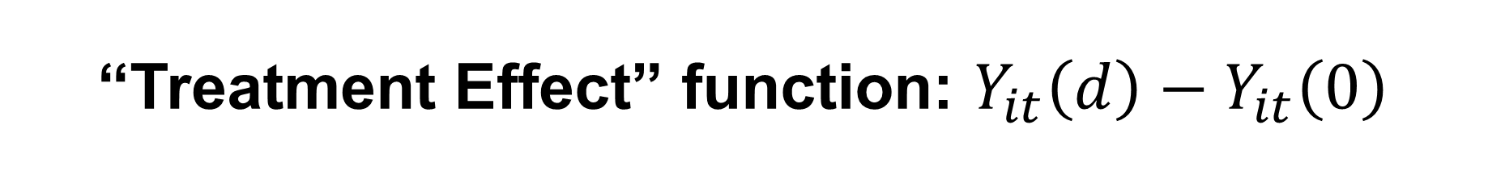


“Treatment Effect” function: $Y_{it}\left(d\right)−Y_{it}\left(0\right)$
$$Y_{t}\left(d\right)−Y_{t}\left(0\right)$$
The effect of aspirin dosage on my pain relief
$$Y_{it}\left(d\right)−Y_{it}\left(0\right)$$
$$d$$

Slide 10


“Treatment Effect” function: $Y_{it}\left(d\right)−Y_{it}\left(0\right)$
$$Y_{t}\left(d\right)−Y_{t}\left(0\right)$$
The effect of aspirin dosage on your pain relief
$$Y_{it}\left(d\right)−Y_{it}\left(0\right)$$
The effect of aspirin dosage on my pain relief
$$Y_{it}\left(d\right)−Y_{it}\left(0\right)$$
$$d$$

Slide 11


“Treatment Effect” function: $Y_{it}\left(d\right)−Y_{it}\left(0\right)$
$$Y_{t}\left(d\right)−Y_{t}\left(0\right)$$
The effect of aspirin dosage on your pain relief
$$Y_{it}\left(d\right)−Y_{it}\left(0\right)$$
The effect of aspirin dosage on my pain relief
$$Y_{it}\left(d\right)−Y_{it}\left(0\right)$$
The effect of aspirin dosage on
some other guy’s pain relief
$$Y_{it}\left(d\right)−Y_{it}\left(0\right)$$
$$d$$

Slide 12


“Treatment Effect” function: $Y_{it}\left(d\right)−Y_{it}\left(0\right)$
$$Y_{t}\left(d\right)−Y_{t}\left(0\right)$$
Suppose they all choose dose $a$
$$d$$
$$a$$

Slide 13
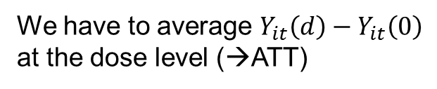

“Treatment Effect” function: $Y_{it}\left(d\right)−Y_{it}\left(0\right)$
$$Y_{t}\left(d\right)−Y_{t}\left(0\right)$$
We have to average $Y_{it}\left(d\right)−Y_{it}\left(0\right)$
at the dose level (→ATT)
Suppose they all choose dose $a$
$$ATT\left(d | a\right)≡E\left[Y_{t}\left(d\right)−Y_{t}\left(0\right)|D=a\right]$$
$$d$$
$$a$$

Slide 14




Average Treatment Effects on the Treated: ATT(d|d)
$$Y_{t}\left(d\right)−Y_{t}\left(0\right)$$
What is the effect of 3 aspirin on the
headache of people who actually took 2?
$$ATT\left(d | a\right)≡E\left[Y_{t}\left(d\right)−Y_{t}\left(0\right)|D=a\right]$$
$$ATT(b|a)$$
$$ATT(a|a)$$
$$d$$
$$a$$
$$b$$

Slide 15





Average Treatment Effects on the Treated: ATT(d|d)
$$Y_{t}\left(d\right)−Y_{t}\left(0\right)$$
What is the effect of 2 aspirin on the headache of people who actually took 3?
$$ATT\left(d | b\right)≡E\left[Y_{t}\left(d\right)−Y_{t}\left(0\right)|D=b\right]$$
$$ATT(b|b)$$
$$ATT(a|b)$$
$$ATT\left(d | a\right)≡E\left[Y_{t}\left(d\right)−Y_{t}\left(0\right)|D=a\right]$$
$$ATT(b|a)$$
$$ATT(a|a)$$
$$d$$
$$a$$
$$b$$

Slide 16
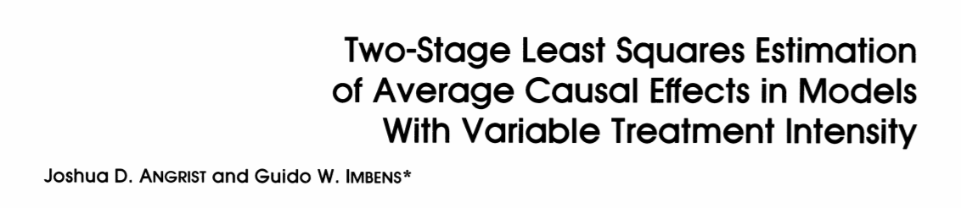

Building Blocks: Slopes
$$ATT\left(d | d\right)≡E\left[Y_{it}\left(d\right)−Y_{it}\left(0\right)|D_{i}=d\right]$$
→The effect of one treatment level versus an “adjacent” treatment level:
No treatment is not the only counterfactual!

Slide 17
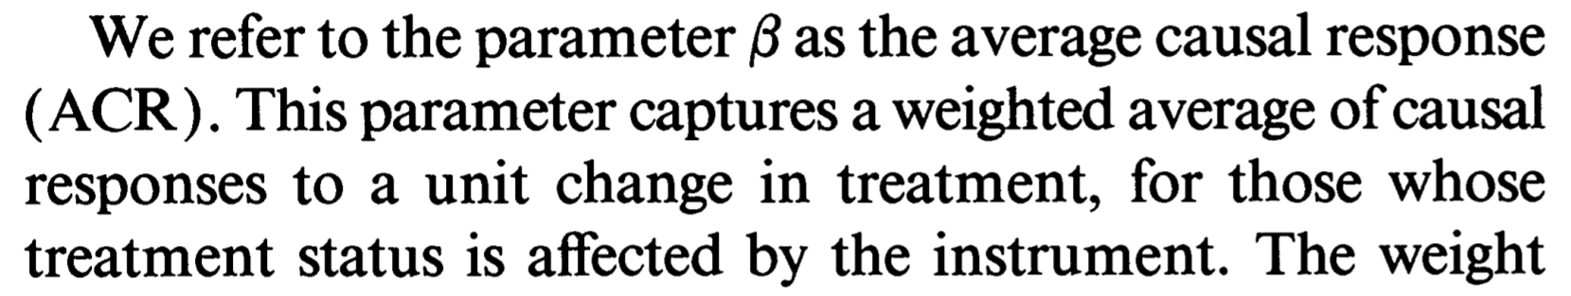
Building Blocks: Slopes
$$ATT\left(d | d\right)≡E\left[Y_{it}\left(d\right)−Y_{it}\left(0\right)|D_{i}=d\right]$$
→The effect of one treatment level versus an “adjacent” treatment level:
No treatment is not the only counterfactual!

Slide 18
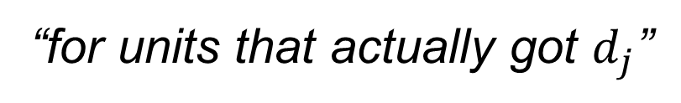

Building Blocks: Slopes
Discrete/multi-valued treatment:
$$ACRT\left(d_{j} | d_{j}\right)≡E\left[Y_{it}\left(d_{j}\right)−Y_{it}\left(d_{j−1}\right)|D_{i}=d_{j}\right]$$
Continuous treatment:
$$ACRT\left(d | d\right)≡{\left.\frac{∂E\left[Y_{it}\left(l\right)|D_{it}=d\right]}{∂l}\right|}_{l=d}$$
“for units that actually got $d_{j}$”
“the causal effect of the j^{th} dose increment for unit i”

Slide 19










Average Causal Responses on the Treated, Discrete: $ACRT(d_{j}|d_{j})$
$$Y_{t}\left(d\right)−Y_{t}\left(0\right)$$
$$ATT\left(d | b\right)≡E\left[Y_{t}\left(d\right)−Y_{t}\left(0\right)|D=b\right]$$
$$ACRT(b|b)$$
$$ACRT\left(a | b\right)$$
$$ATT\left(d | a\right)≡E\left[Y_{t}\left(d\right)−Y_{t}\left(0\right)|D=a\right]$$
$$ACRT(b|a)$$
$$ACRT(a|a)$$
$$d$$
$$a=1$$
$$b=2$$

Slide 20





Average Causal Responses on the Treated, Discrete: $ACRT(d_{j}|d_{j})$
$$Y_{t}\left(d\right)−Y_{t}\left(0\right)$$
What is the effect of the 2nd aspirin on the headache of people who actually took 2?
$$ATT\left(d | b\right)≡E\left[Y_{t}\left(d\right)−Y_{t}\left(0\right)|D=b\right]$$
$$ACRT(b|b)$$
$$ACRT\left(a | b\right)$$
$$ATT\left(d | a\right)≡E\left[Y_{t}\left(d\right)−Y_{t}\left(0\right)|D=a\right]$$
$$ACRT(b|a)$$
$$ACRT(a|a)$$
$$d$$
$$a=1$$
$$b=2$$

Slide 21

Average Causal Responses on the Treated, Discrete: $ACRT(d_{j}|d_{j})$
$$Y_{t}\left(d\right)−Y_{t}\left(0\right)$$
What is the effect of the 2nd aspirin on the headache of people who actually took 1?
$$ATT\left(d | b\right)≡E\left[Y_{t}\left(d\right)−Y_{t}\left(0\right)|D=b\right]$$
$$ACRT(b|b)$$
$$ACRT\left(a | b\right)$$
$$ATT\left(d | a\right)≡E\left[Y_{t}\left(d\right)−Y_{t}\left(0\right)|D=a\right]$$
$$ACRT(b|a)$$
$$ACRT(a|a)$$
$$d$$
$$a=1$$
$$b=2$$

Slide 22
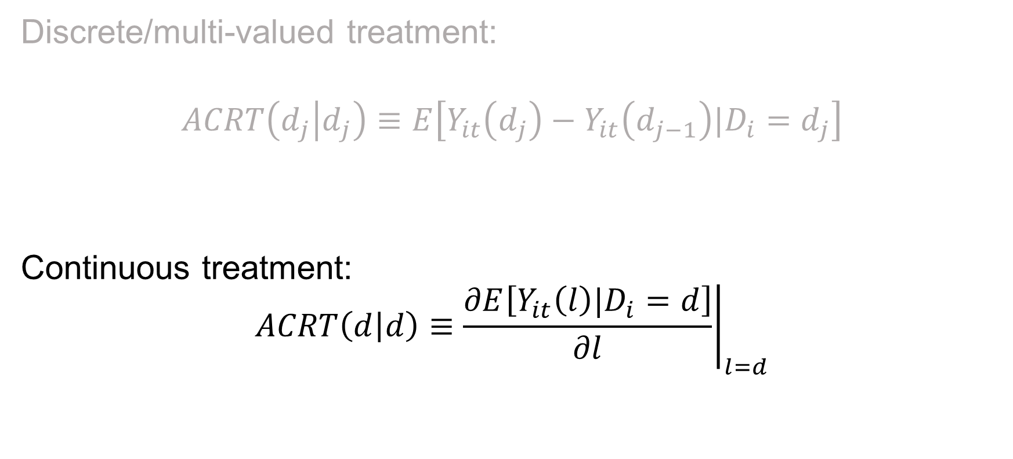
Building Blocks: ACRTs
Discrete/multi-valued treatment:
$$ACRT\left(d_{j} | d_{j}\right)≡E\left[Y_{it}\left(d_{j}\right)−Y_{it}\left(d_{j−1}\right)|D_{i}=d_{j}\right]$$
Continuous treatment:
$$ACRT\left(d | d\right)≡{\left.\frac{∂E\left[Y_{it}\left(l\right)|D_{i}=d\right]}{∂l}\right|}_{l=d}$$

Slide 23


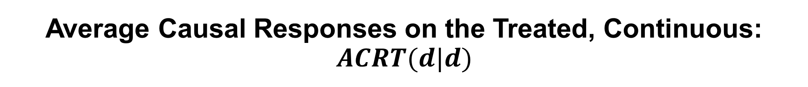






Average Causal Responses on the Treated, Continuous: $ACRT(d|d)$
$$Y_{t}\left(d\right)−Y_{t}\left(0\right)$$
$$ACRT(b|b)$$
$$ATT\left(d | b\right)≡E\left[Y_{t}\left(d\right)−Y_{t}\left(0\right)|D=b\right]$$
$$ACRT(a|b)$$
$$ACRT(b|a)$$
$$ACRT(a|a)$$
$$ATT\left(d | a\right)≡E\left[Y_{t}\left(d\right)−Y_{t}\left(0\right)|D=a\right]$$
$$d$$
$$a$$
$$b$$

Slide 24
Comment 1: This is a lot of causal parameters
Potential Treatment:
Treated
ATT
ATU
Treated
With 2x2 DiD (and no conditioning on X), there are…2 average parameters
Actual Treatment:
Untreated

Slide 25






































Comment 1: This is a lot of causal parameters
Potential Treatment:
$$d_{1}$$
$$d_{2}$$
$$d_{3}$$
$$…$$
$$d_{J−1}$$
$$d_{J}$$
$$d_{1}$$
$$ATT(d_{1}|d_{1})$$
$$ATT(d_{2}|d_{1})$$
$$ATT(d_{3}|d_{1})$$
$$ATT(d_{J−1}|d_{1})$$
$$ATT(d_{J}|d_{1})$$
$$d_{2}$$
$$ATT(d_{1}|d_{2})$$
$$ATT(d_{2}|d_{2})$$
$$ATT(d_{3}|d_{2})$$
$$ATT(d_{J−1}|d_{2})$$
$$ATT(d_{J}|d_{2})$$
Actual Treatment:
$$d_{3}$$
$$ATT(d_{1}|d_{3})$$
$$ATT(d_{2}|d_{3})$$
$$ATT(d_{3}|d_{3})$$
$$ATT(d_{J−1}|d_{3})$$
$$ATT(d_{J}|d_{3})$$
$$⋮$$
$$⋱$$
$$d_{J−1}$$
$$ATT(d_{1}|d_{J−1})$$
$$ATT(d_{2}|d_{J−1})$$
$$ATT(d_{3}|d_{J−1})$$
$$ATT(d_{J−1}|d_{J−1})$$
$$ATT(d_{J}|d_{J−1})$$
$$d_{J}$$
$$ATT(d_{1}|d_{J})$$
$$ATT(d_{2}|d_{J})$$
$$ATT(d_{3}|d_{J})$$
$$ATT(d_{J−1}|d_{J})$$
$$ATT(d_{J}|d_{J})$$

Slide 26











































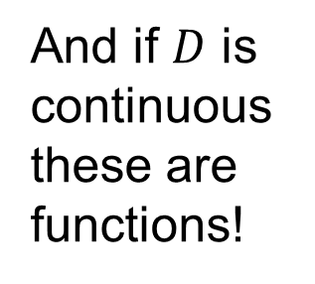






Comment 1: This is a lot of causal parameters
Potential Treatment:
$$d_{1}$$
$$d_{2}$$
$$d_{3}$$
$$…$$
$$d_{J−1}$$
$$d_{J}$$
$$ACRT(d_{2}|d_{1})$$
$$ACRT(d_{3}|d_{1})$$
$$ACRT(d_{J}|d_{1})$$
$$d_{1}$$
$$ATT(d_{1}|d_{1})$$
$$ATT(d_{2}|d_{1})$$
$$ATT(d_{3}|d_{1})$$
$$ATT(d_{J−1}|d_{1})$$
$$ATT(d_{J}|d_{1})$$
$$ACRT(d_{2}|d_{2})$$
$$ACRT(d_{3}|d_{2})$$
$$ACRT(d_{J}|d_{2})$$
$$d_{2}$$
$$ATT(d_{1}|d_{2})$$
$$ATT(d_{2}|d_{2})$$
$$ATT(d_{3}|d_{2})$$
$$ATT(d_{J−1}|d_{2})$$
$$ATT(d_{J}|d_{2})$$
$$ACRT(d_{J}|d_{3})$$
And if $D$ is continuous these are functions!
$$ACRT(d_{2}|d_{3})$$
$$ACRT(d_{3}|d_{3})$$
Actual Treatment:
$$d_{3}$$
$$ATT(d_{1}|d_{3})$$
$$ATT(d_{2}|d_{3})$$
$$ATT(d_{3}|d_{3})$$
$$ATT(d_{J−1}|d_{3})$$
$$ATT(d_{J}|d_{3})$$
$$⋮$$
$$⋱$$
$$ACRT(d_{2}|d_{J−1})$$
$$ACRT(d_{3}|d_{J−1})$$
$$ACRT(d_{J}|d_{J−1})$$
$$d_{J−1}$$
$$ATT(d_{1}|d_{J−1})$$
$$ATT(d_{2}|d_{J−1})$$
$$ATT(d_{3}|d_{J−1})$$
$$ATT(d_{J−1}|d_{J−1})$$
$$ATT(d_{J}|d_{J−1})$$
$$ACRT(d_{2}|d_{J})$$
$$ACRT(d_{3}|d_{J})$$
$$ACRT(d_{J}|d_{J})$$
$$d_{J}$$
$$ATT(d_{1}|d_{J})$$
$$ATT(d_{2}|d_{J})$$
$$ATT(d_{3}|d_{J})$$
$$ATT(d_{J−1}|d_{J})$$
$$ATT(d_{J}|d_{J})$$

Slide 27




Comment 2: The distinction matters!
$$Y_{t}\left(d\right)−Y_{t}\left(0\right)$$
$$ACR\left(b | b\right)=ACR\left(b\right)<0$$
$$ATE\left(b\right)>0$$
$$ATE(d)$$
$$d$$
$$b$$

Slide 28
What are you willing to believe?

Slide 29

Parallel Trends
For all $d∈𝒟$:
$$E\left[Y_{it}\left(0\right)−Y_{it−1}\left(0\right)\right]=E\left[Y_{it}\left(0\right)−Y_{it−1}\left(0\right)|D_{i}=d\right]$$
Extension of binary parallel trends (when $D∈\{0,1\}$).

Slide 30

Identifying ATT
This is just like traditional 2x2 DD
$E\left[ΔY_{it}|D_{i}=d\right]−E\left[ΔY_{it}|D_{i}=0\right]$
$$=E\left[Y_{it}\left(d\right)−Y_{it−1}\left(0\right)|D_{i}=d\right]−E\left[Y_{it}\left(0\right)−Y_{it−1}\left(0\right)|D_{i}=0\right]$$
$=E\left[Y_{it}\left(d\right)−Y_{it}\left(0\right)|D_{i}=d\right]$
$=ATT\left(d | d\right)$
No Anticipation
PT

Slide 31
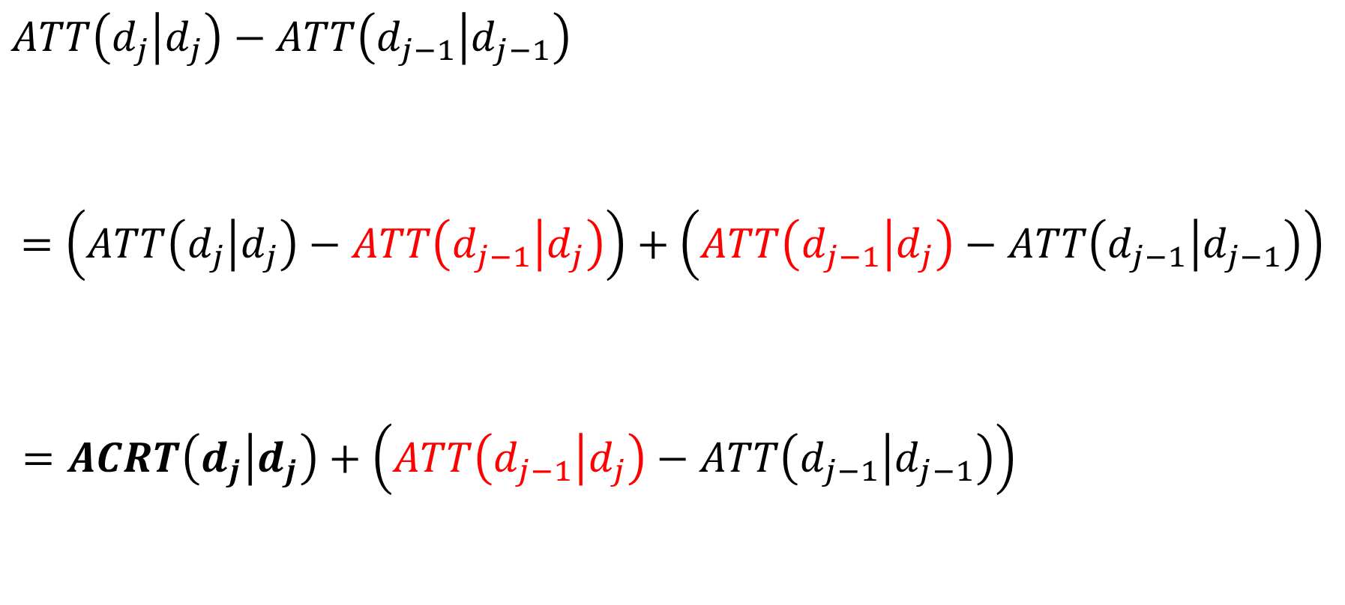

Identifying ACRT
(No Ant. + PT)
“Compare the effect of $d_{j}$ to the effect of $d_{j−1}$”
$ATT\left(d_{j} | d_{j}\right)−ATT\left(d_{j−1} | d_{j−1}\right)$
$$=\left(ATT\left(d_{j} | d_{j}\right)−ATT\left(d_{j−1} | d_{j}\right)\right)+\left(ATT\left(d_{j−1} | d_{j}\right)−ATT\left(d_{j−1} | d_{j−1}\right)\right)$$
$$=ACRT\left(d_{j} | d_{j}\right)+\left(ATT\left(d_{j−1} | d_{j}\right)−ATT\left(d_{j−1} | d_{j−1}\right)\right)$$
Interpretable causal effect
“Selection bias” (heterogeneous effects at $d_{j−1}$)

Slide 32





Identifying ACRT
$$Y_{t}\left(d\right)−Y_{t}\left(0\right)$$
$$ATT\left(d | b\right)≡E\left[Y_{t}\left(d\right)−Y_{t}\left(0\right)|D=b\right]$$
$$ATT(b|b)$$
$$ACRT(b|b)$$
This is the counterfactual we need
$$ATT(a|b)$$
$$ATT\left(d | a\right)≡E\left[Y_{t}\left(d\right)−Y_{t}\left(0\right)|D=a\right]$$
bias
$$ATT(a|a)$$
But this is the one we get from the lower-dose units
$$d$$
$$a=1$$
$$b=2$$

Slide 33
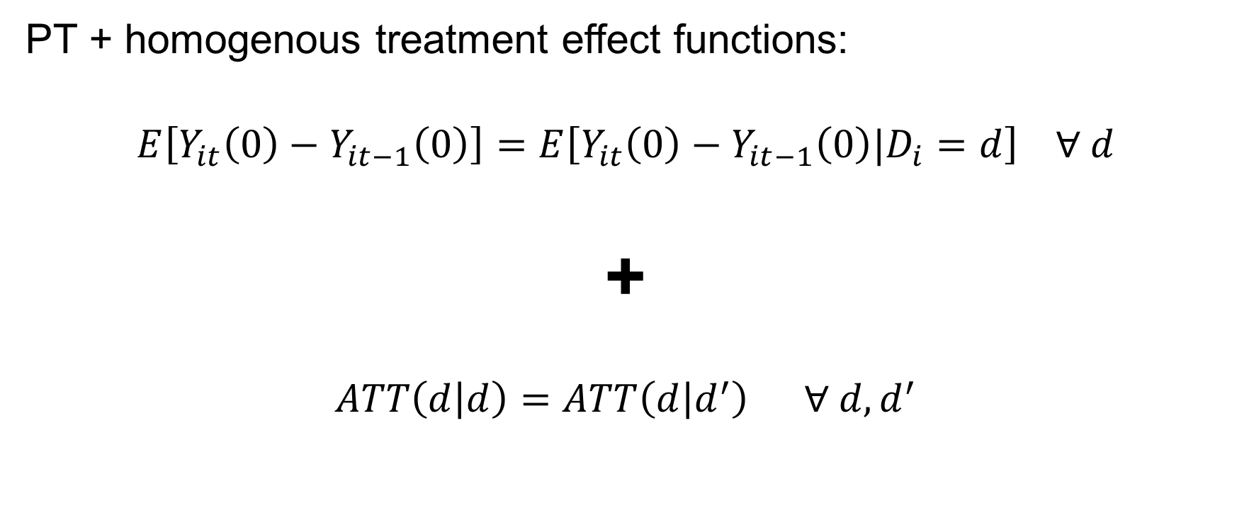
Strong Parallel Trends
PT + homogenous treatment effect functions:
$$E\left[Y_{it}\left(0\right)−Y_{it−1}\left(0\right)\right]=E\left[Y_{it}\left(0\right)−Y_{it−1}\left(0\right)|D_{i}=d\right] ∀ d$$
+
$$ATT\left(d | d\right)=ATT\left(d | d^{′}\right) ∀ d, d^{′}$$
Groups don’t change differentially
for non-treatment-related reasons
Nor would they have change for treatment
effect reasons had they gotten the lower dose

Slide 34
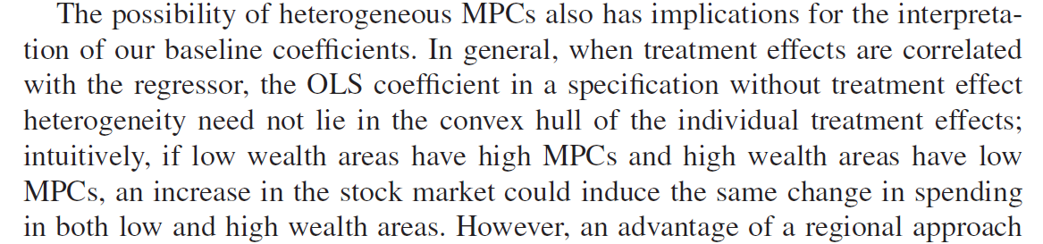
We (almost) never say this
*also Saez, Slemrod, Giertz 2012 JEL.

Slide 35





Identifying ACR under SPT: “same curve”
$$Y_{t}\left(d\right)−Y_{t}\left(0\right)$$
Good:
Identifies $ACR(d)$ and $ATE(d)$
(…not $ATT(d|d)$and $ACRT(d|d)$!)
Bad:
We were never willing to assume
SPT in binary designs—too strong!
inching closer to IV independence
assumption/quasi-randomness
$$ATE(d)$$
$$ATE(b|b)$$
$$ACR (b|b)$$
$$ATE(a|a)$$
$$d$$
$$a=1$$
$$b=2$$

Slide 36
TWFE: 2 Periods

Slide 37
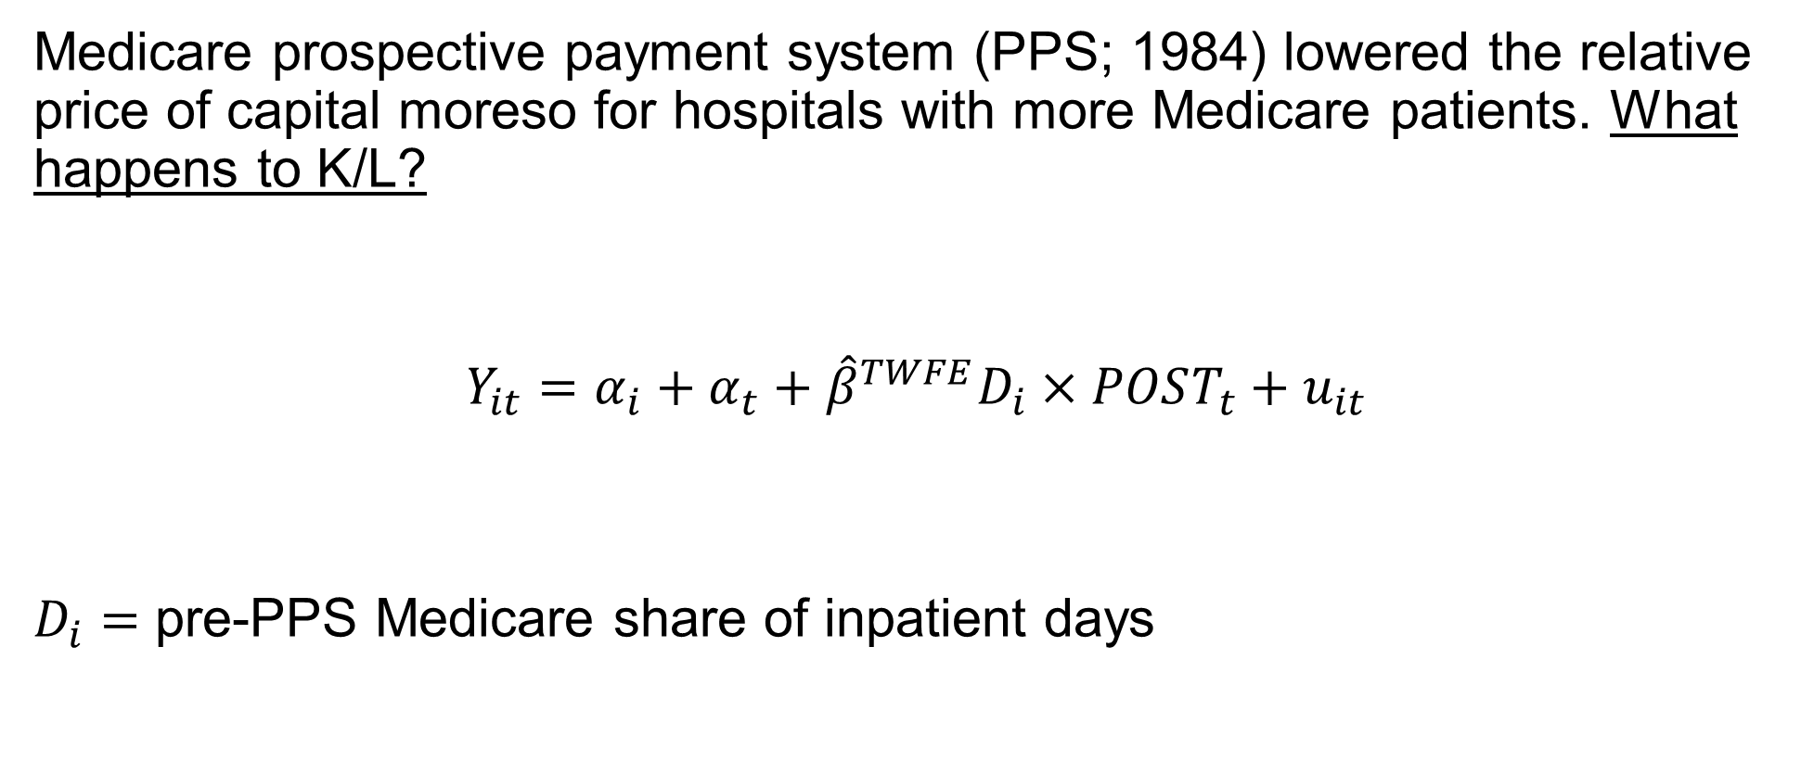
Acemoglu and Finkelstein (2008)
Medicare prospective payment system (PPS; 1984) lowered the relative price of capital moreso for hospitals with more Medicare patients. What happens to K/L?
$$Y_{it}=α_{i}+α_{t}+{\hat{β}}^{TWFE}D_{i}×POST_{t}+u_{it}$$
$D_{i}=$ pre-PPS Medicare share of inpatient days
1.13 ← it goes up!

Slide 38
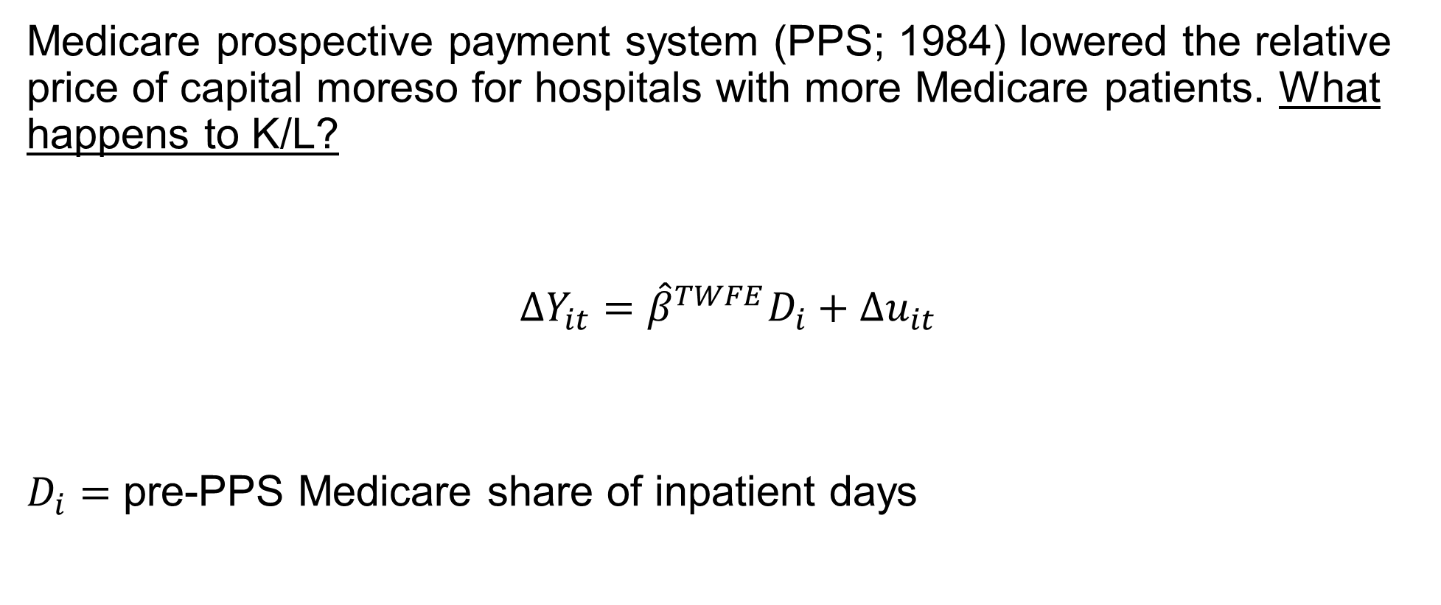
Acemoglu and Finkelstein (2008)
Medicare prospective payment system (PPS; 1984) lowered the relative price of capital moreso for hospitals with more Medicare patients. What happens to K/L?
$$ΔY_{it}={\hat{β}}^{TWFE}D_{i}+{Δu}_{it}$$
$D_{i}=$ pre-PPS Medicare share of inpatient days
1.13

Slide 39
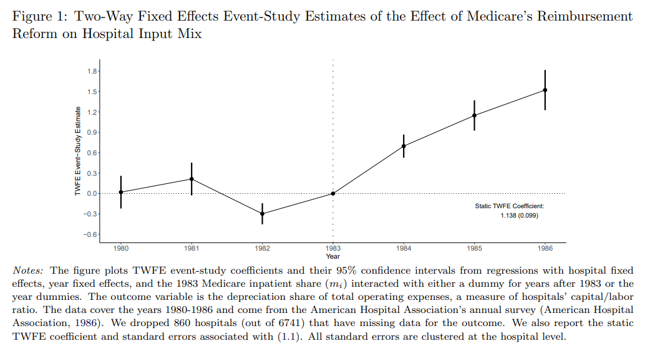
Acemoglu and Finkelstein (2008)
1.13

Slide 40

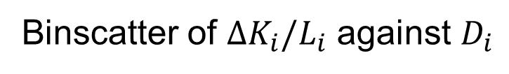
A simple scatter plot
Binscatter of $ΔK_{i}/L_{i}$ against $D_{i}$
${\hat{β}}^{TWFE}$ = 1.13
How to interpret 1.13?
ACR vs ATT?
Under PT vs SPT?
Aggregation?

Slide 41

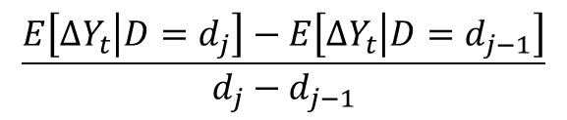
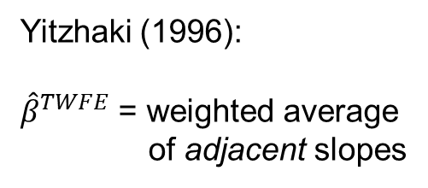
A simple scatter plot
Yitzhaki (1996):
${\hat{β}}^{TWFE}$ = weighted average
of adjacent slopes
${\hat{β}}^{TWFE}$ = 1.13 (0.35)
“Wald DDs”
$$\frac{E\left[ΔY_{t} | D=d_{j}\right]−E\left[ΔY_{t} | D=d_{j−1}\right]}{d_{j}−d_{j−1}}$$

Slide 42

Two-way fixed effects, discrete (ACR)
$${\hat{β}}^{TWFE}=\sum_{d_{j}∈𝒟_{+}}{w^{acr}\left(d_{j}\right)\frac{E\left[ΔY_{t} | D=d_{j}\right]−E\left[ΔY_{t} | D=d_{j−1}\right]}{d_{j}−d_{j−1}}}$$
Where:
$$w^{acr}\left(d_{j}\right)=\frac{\left(E\left[D|D>d_{j}\right]−E\left[D\right]\right)P\left(D>d_{j}\right)}{V(D)}$$
And $w^{acr}\left(d_{j}\right)≥0$and $\sum_{d_{j}∈𝒟_{+}}{w^{acr}\left(d_{j}\right)}=1$.
and that are hump-shaped
and centered on E[D]
Weights are non-negative and sum to one.

Slide 43

How should we interpret 1.13?*
$$1.13=\sum_{d_{j}∈𝒟_{+}}{w^{acr}\left(d_{j}\right)\left[ACRT\left(d_{j} | d_{j}\right)+\left(ATT\left(d_{j−1} | d_{j}\right)−ATT(d_{j−1}|d_{j−1})\right)\right]}$$
$$=\sum_{d_{j}∈𝒟_{+}}{w^{acr}\left(d_{j}\right)ACRT\left(d_{j} | d_{j}\right)}+\sum_{d_{j}∈𝒟_{+}}{w^{acr}\left(d_{j}\right)\left(ATT\left(d_{j−1} | d_{j}\right)−ATT(d_{j−1}|d_{j−1})\right)}$$
*Under PT and in terms of ACRT parameters.

Slide 44
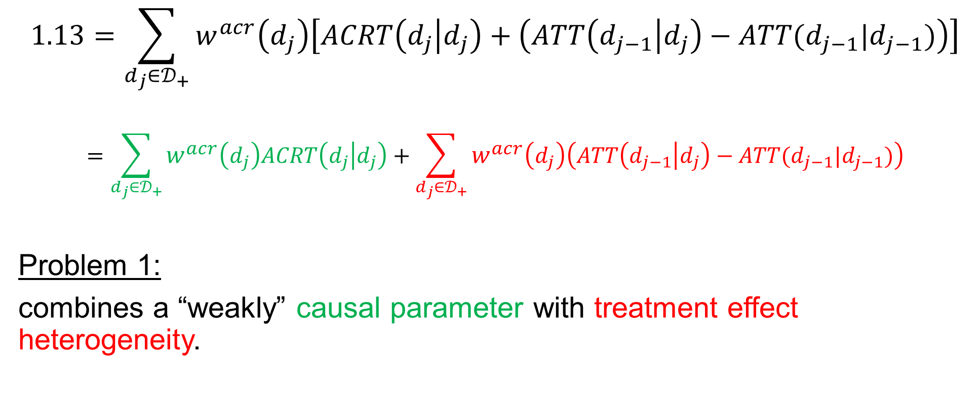
How should we interpret 1.13?*
$$1.13=\sum_{d_{j}∈𝒟_{+}}{w^{acr}\left(d_{j}\right)\left[ACRT\left(d_{j} | d_{j}\right)+\left(ATT\left(d_{j−1} | d_{j}\right)−ATT(d_{j−1}|d_{j−1})\right)\right]}$$
$$=\sum_{d_{j}∈𝒟_{+}}{w^{acr}\left(d_{j}\right)ACRT\left(d_{j} | d_{j}\right)}+\sum_{d_{j}∈𝒟_{+}}{w^{acr}\left(d_{j}\right)\left(ATT\left(d_{j−1} | d_{j}\right)−ATT(d_{j−1}|d_{j−1})\right)}$$
Problem 1:
combines a “weakly” causal parameter with treatment effect heterogeneity.
*Under PT and in terms of ACRT parameters.

Slide 45

Without SPT, each $\hat{ACRT}(d|d)$ is biased

Slide 46
With SPT, $w^{acr}\left(d_{j}\right)$-weighted average of ACR(d)
This is the ATE(d) function
${\hat{β}}^{TWFE}$ = 1.13 (0.35)
These are all ACRs and there is a real hump-shape response…
(which is not consistent with the 2-factor production theory!)

Slide 47
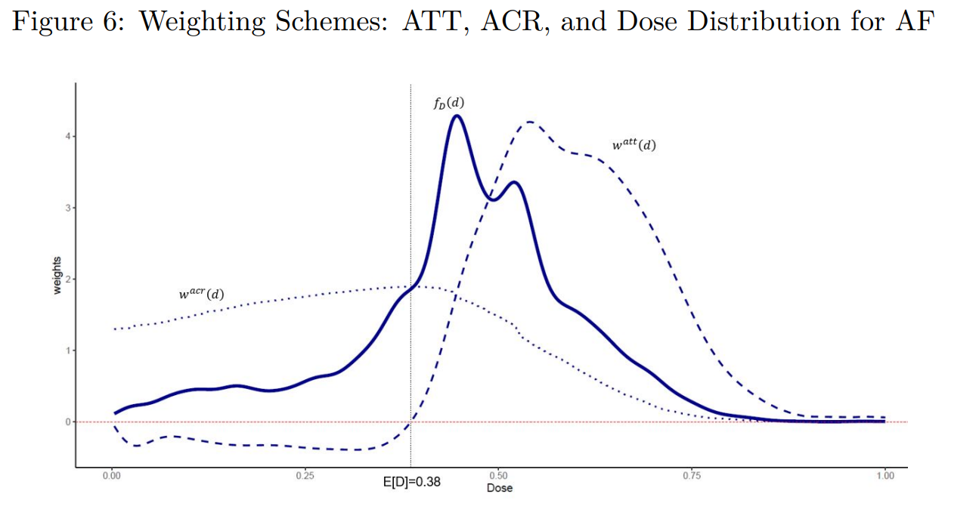
Not enough weight up here (where slopes are flat!)
If we just change the weighting, the summary ACR parameter falls to 0.8!
Too much weight down here (where slopes are steep!)

Slide 48
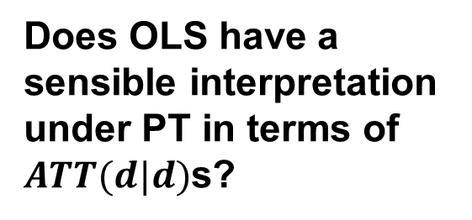
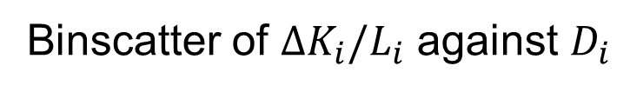




The simple scatter plot again
Binscatter of $ΔK_{i}/L_{i}$ against $D_{i}$
OLS = 1.13 (0.35)
Does OLS have a sensible interpretation under PT in terms of $ATT(d|d)$s?
$$ATT(0.06|0.06)$$
$$ATT(0.4|0.4)$$
$$ATT(0.72|0.72)$$
$$Y_{t}\left(0\right)−Y_{t−1}\left(0\right)$$

Slide 49

Two-way fixed effects, discrete (ATT)
$${\hat{β}}^{TWFE}=\sum_{d_{j}∈𝒟_{+}}{w^{att}\left(d_{j}\right)\left[E\left[ΔY_{t} | D=d_{j}\right]−E\left[ΔY_{t} | D=0\right]\right]}$$
Where:
$$w^{att}\left(d_{j}\right)=\frac{\left(d_{j}−E\left[D\right]\right)P\left(D=d_{j}\right)}{V(D)}$$
And $w^{att}\left(d_{j}\right)>0 if d_{j}>E[D\}$and $\sum_{d_{j}∈𝒟_{+}}{w^{att}\left(d_{j}\right)}=0$.
Equal zero at E[D],
Over-weight extreme doses
Weights are negative for below
average doses and sum to zero.

Slide 50
Much more weight on high doses relative to their share.
Negative weights down here.

Slide 51
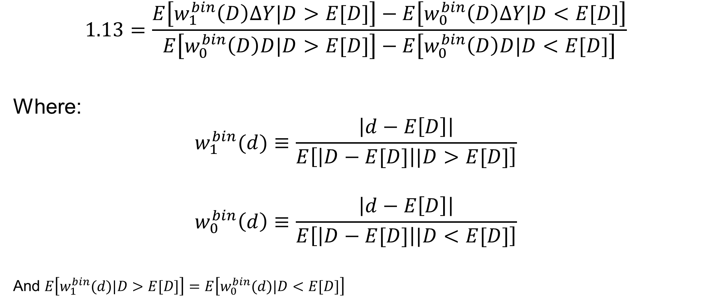
TWFE binarizes and rescales
$$1.13=\frac{E\left[w_{1}^{bin}\left(D\right)ΔY|D>E[D]\right]−E\left[w_{0}^{bin}\left(D\right)ΔY|D<E[D]\right]}{E\left[w_{0}^{bin}\left(D\right)D|D>E[D]\right]−E\left[w_{0}^{bin}\left(D\right)D|D<E[D]\right]}$$
Where:
$$w_{1}^{bin}(d)≡\frac{\left|d−E\left[D\right]\right|}{E\left[\left|D−E[D]\right||D>E[D]\right]}$$
$$w_{0}^{bin}\left(d\right)≡\frac{\left|d−E\left[D\right]\right|}{E\left[\left|D−E[D]\right||D<E[D]\right]}$$
And $E\left[w_{1}^{bin}(d)|D>E[D]\right]=E\left[w_{0}^{bin}(d)|D<E[D]\right]$
Below-mean
dose control
group
Scales by a dose difference (producing a slope)
Weights by dose size

Slide 52
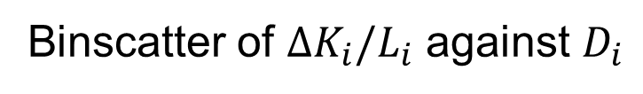

Negative weights in ATT interpretation
Binscatter of $ΔK_{i}/L_{i}$ against $D_{i}$
$$E\left[D\right]=0.38$$
Even this is basically an ACR estimator!

Slide 53
Non-Parametric Estimation
(No way around the assumptions, but good methods for estimating functions and aggregating them)

Slide 54


A quick recap
This is just your data. Can’t do anything about that!
This is a theoretical thing. You believe it or not!
Lots of raw info: this scatter plot represents many 2x2 ATT(d|d) estimators and ACRT(d) estimators
Causal identification: PT→ATT(d|d), SPT→ACR(d)
Estimation failure: OLS weights behave strangely, no matter how you look at it.
$$\hat{ATT}(0.4|0.4)$$
$$\hat{ACRT}(0.15|0.15)$$
OK, so summarizing the cloud with the best-fitting line isn’t great, what to do instead?

Slide 55
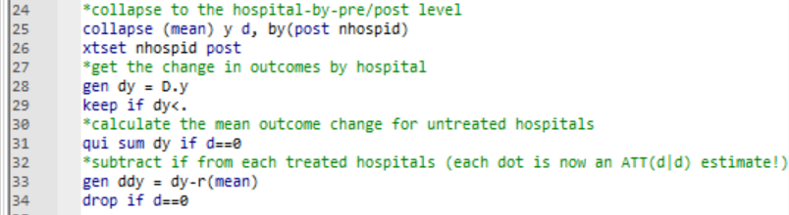
Summarize the cloud nonparametrically
Make the cloud:

Slide 56
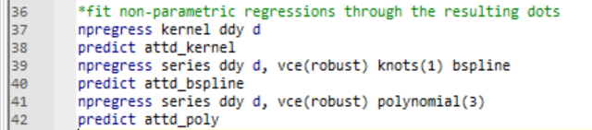
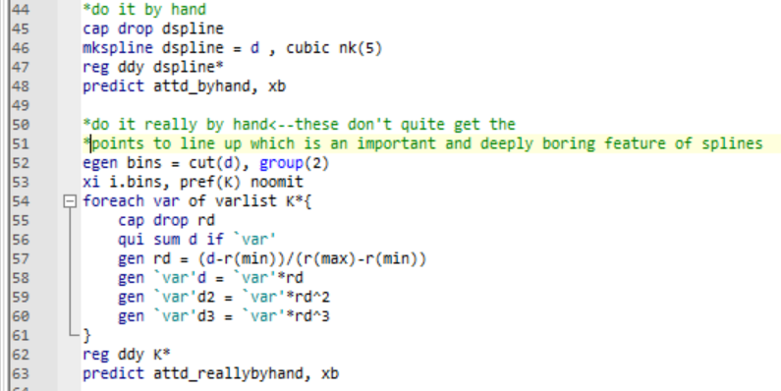
Summarize the cloud nonparametrically
Canned NP method:
Making the splines by hand (boring and error prone):

Slide 57
Summarize the cloud nonparametrically
Canned NP method:
Making the splines by hand (boring and error prone):

Slide 58
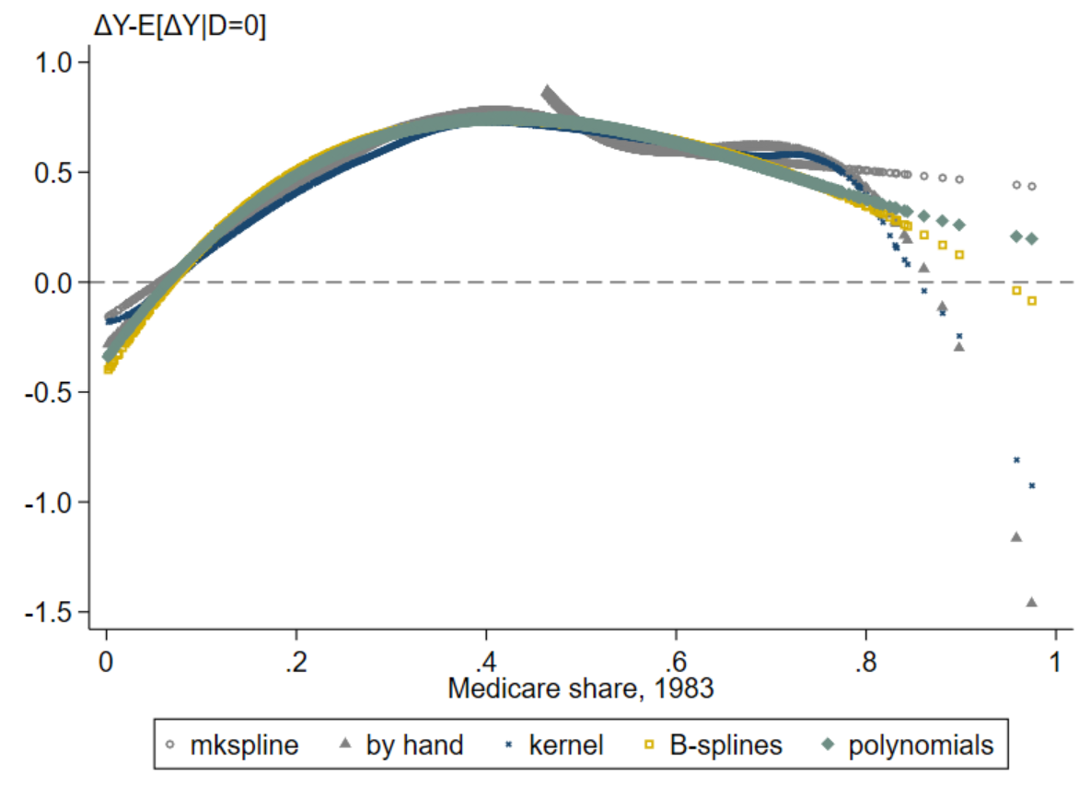
Summarize the cloud nonparametrically
They all show the same thing (hump-shaped relationship) with some noise at the endpoint
One issue with NP methods is picking parameters (how many knots? What polynomial order? What kernel?)
So…

Slide 59
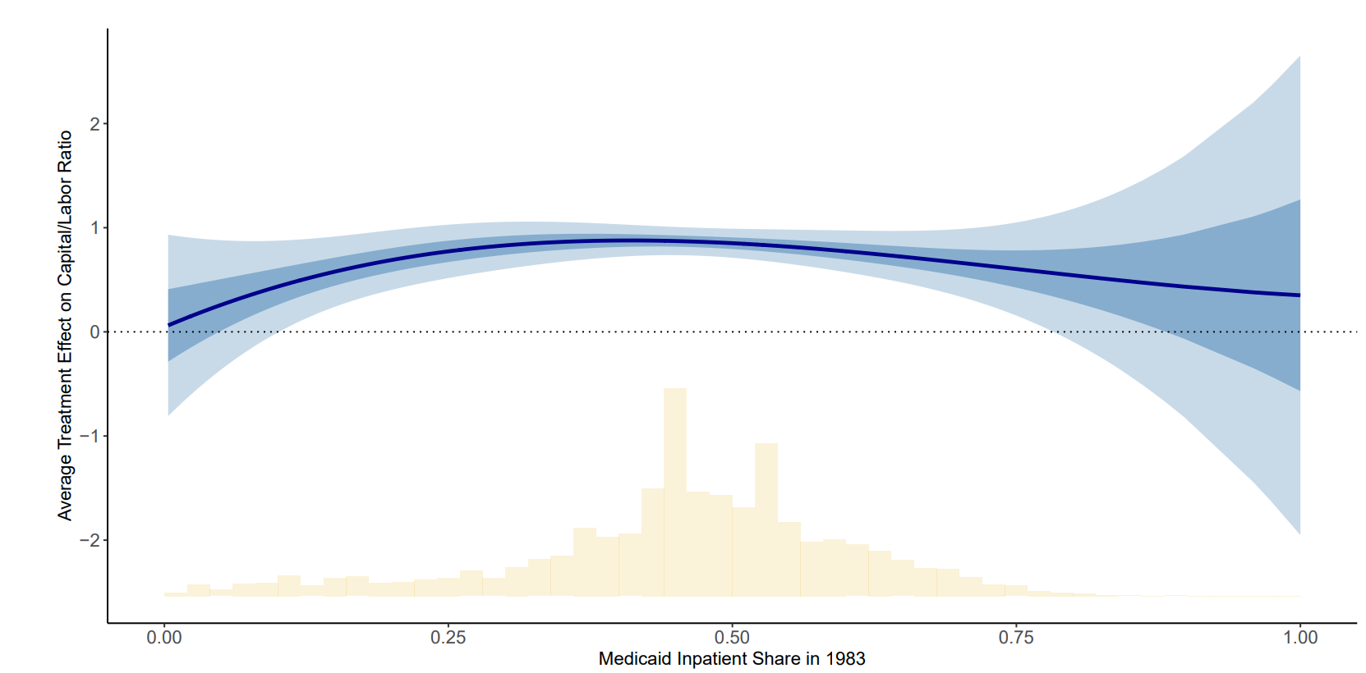
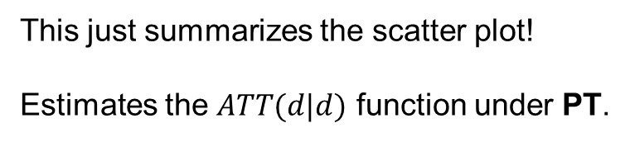

Non-Parametric Estimates of $ATT(d|d)$ for Medicare PPS
This just summarizes the scatter plot!
Estimates the $ATT(d|d)$ function under PT.
“Adaptive Estimation and Uniform Confidence Bands for Nonparametric Structural Functions and Elasticities” Chen, Christensen, Kankanala (2021)

Slide 60
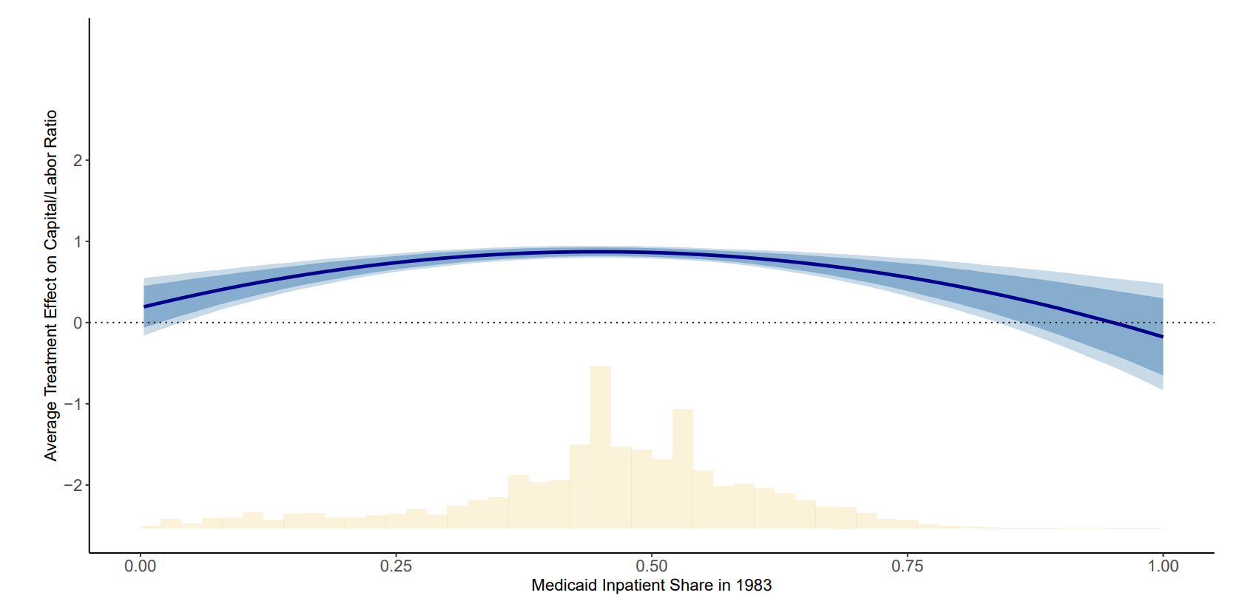
Non-Parametric Estimates of $ATT(d|d)$ for Medicare PPS
This just summarizes the scatter plot!
Estimates the $ATT(d|d)$ function under PT.
“Adaptive Estimation and Uniform Confidence Bands for Nonparametric Structural Functions and Elasticities” Chen, Christensen, Kankanala (2021)

Slide 61
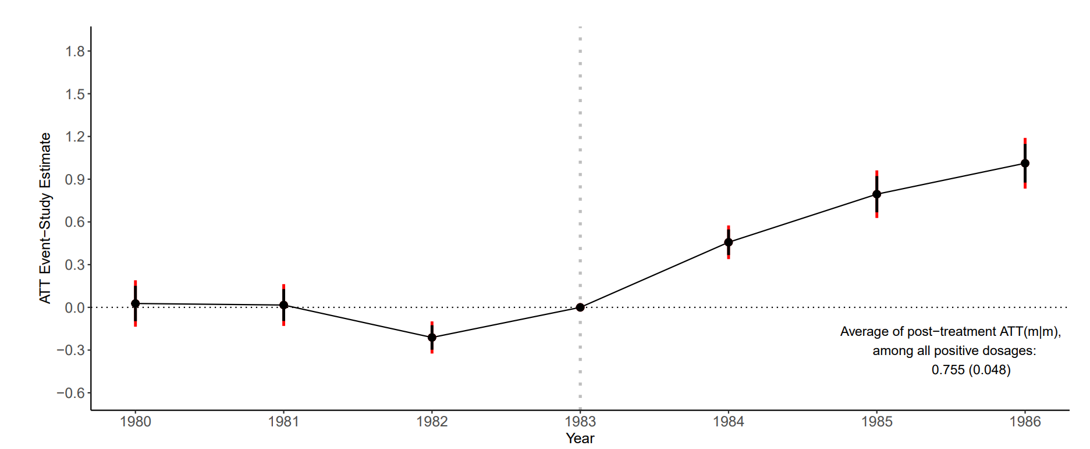
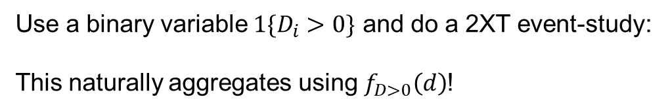

Aggregating: Event-Study Estimates of $ATT_{t}^{∗}$ for Medicare PPS
Use a binary variable $1\{D_{i}>0\}$ and do a 2XT event-study:
This naturally aggregates using $f_{D>0}\left(d\right)$!

Slide 62
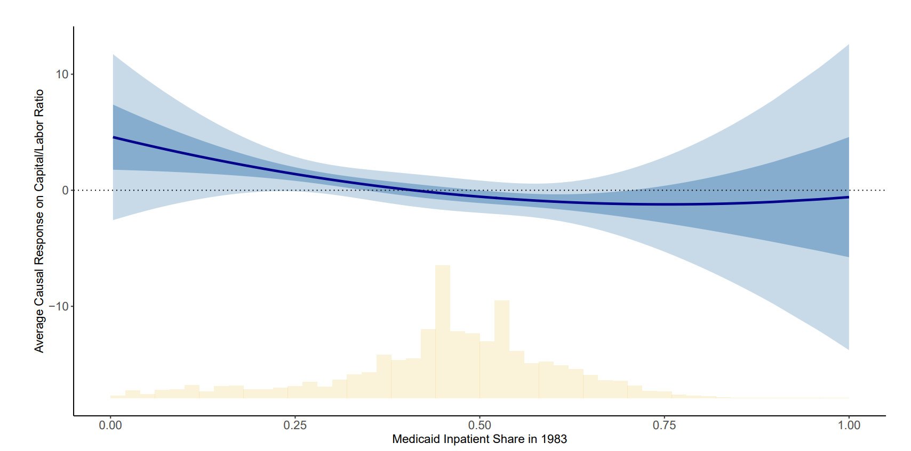

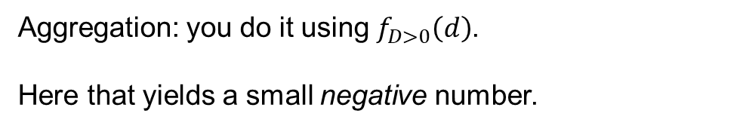
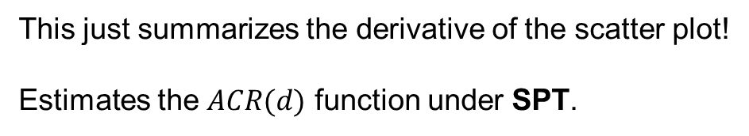
Non-Parametric Estimates of $ACR(d)$ for Medicare PPS
This just summarizes the derivative of the scatter plot!
Estimates the $ACR(d)$ function under SPT.
Aggregation: you do it using $f_{D>0}\left(d\right)$.
Here that yields a small negative number.
“Adaptive Estimation and Uniform Confidence Bands for Nonparametric Structural Functions and Elasticities” Chen, Christensen, Kankanala (2021)

Slide 63
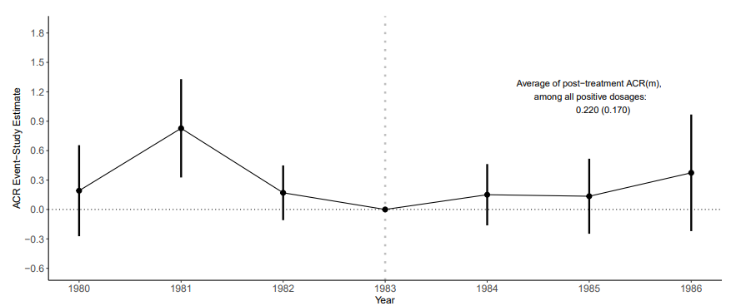

Aggregating: Event-Study Estimates of $ACR_{t}^{∗}$ for Medicare PPS

Slide 64
What do continuous treatments do?
Define more causal parameters…
with different identifying assumptions…
and a new reason to estimate flexibly.

Slide 65
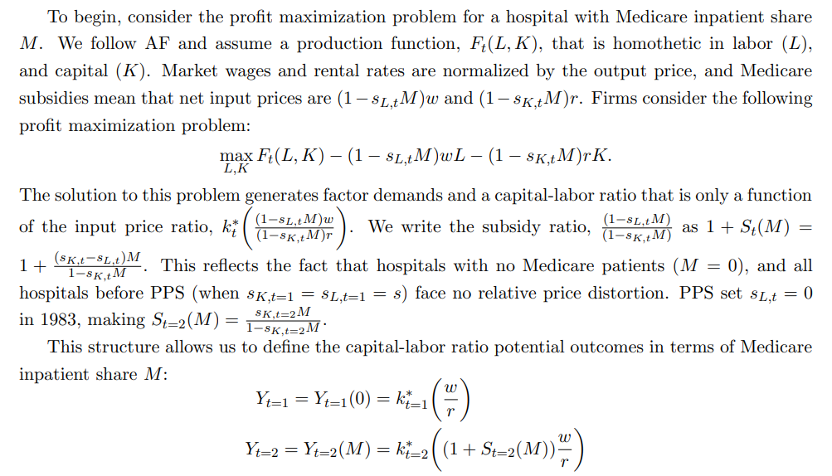
What can be a “treatment”?
M is fixed:
“Characteristic”
not a
“treatment”
(Holland 1986)
Policy maps
M→prices
Subsidy ratio is
manipulable
(sensible as a
“treatment”)
Causal effects of subsidies
not M per se
Shorthand in terms of M

Slide 66
Staggered and Continuous Treatments

Slide 67


What does fracking do for local economies?
“Shale plays”: geologic formations with natural gas (maybe) embedded in the rock
Prospecitvity/suitability: ease with which that gas can be extracted.
*Bartik, Currie, Greenstone, Knittel (2019)

Slide 68


Staggered/Continuous DiD and choices
Continuous dose $D_{i}$ begins at time $G_{i}$ (multiple periods $T>2$):
a huge number of parameters!
$E\left[Y_{t}\left(g,d\right)−Y_{t}\left(∞, 0\right) | G=g,D=d\right]≡ATT(g,d,t|g,d)$
“The average effect in period t of having “d” suitability starting
in period g versus no-fracking”
${\left.\frac{∂E\left[Y_{t}\left(g,l\right) | G=g,D=d\right]}{∂l}\right|}_{l=d} ≡ACRT(g,d,t|g,d)$
“The average effect in period t of ‘d’ suitability vs ‘d-1’ starting
in period g?”
A functional parameter
for every $G$
and every $t$!

Slide 69

Estimation choices
Brute force approach:
Non-parametrically estimate $ATT\left(g,d,t | g,d\right)$ (under PT) or $ATE(g,d,t|g)$ and $ACR(g,d,t|g)$ (under Strong PT) then average.
Note 1: What comparison group to use to get $E\left[Y_{t}\left(∞, 0\right) | G=g,D=d\right]$?
$D=0$ and $G=g$? All $D=0$? $D=d$ and $G>t$? All $G>t$?
Note 2: Small groups.
NP estimators won’t perform when $n_{g}$ is small.
Note 3: Calculating the weights.
Requires objects like $P(G=g|D=d)$ which may not be well-behaved
(0 or 1) or require additional NP estimation.
This is basically how binary staggered estimators work
Choice about PT and estimator
Practical limits on the choices you can make

Slide 70



Aggregation choices
Brute force output: $\hat{ATT}\left(g,d,t | g,d\right)$, $\hat{ATE}(g,d,t|g)$ or $\hat{ACR}(g,d,t|g)$
There is no “right” aggregation; you choose:
Dynamic Q: “How do the average effects of fracking evolve over time? (Does the boom persist?)“
Balanced dynamic parameter(s): $ATT^{∗}\left(e\right)≡\sum_{g}{P(G=g|D>0)ATT^{∗}\left(g,g+e | g\right)}$
Dose-response Q: Does fracking matter most where the best drilling happens?
Dose-response parameter(s): $ATT^{∗}\left(d|d\right)≡\sum_{g}{P(G=g|D>0)ATT^{∗}\left(g,d | g,d\right)}$
2. Then average across $g$(note event-time balance and weights)
1. Average across dose distribution for each $g$:
$$ATT^{∗}\left(g,g+e | g\right)≡E[ATT\left(g,d,g+e | g,d\right)|G=g]$$

Slide 71


$${\hat{ATT}}^{∗}\left(e\right)$$

Slide 72


Aggregation choices
Brute force output: $\hat{ATT}\left(g,d,t | g,d\right)$, $\hat{ATE}(g,d,t|g)$ or $\hat{ACR}(g,d,t|g)$
There is no “right” aggregation; you choose:
Dynamic Q: “How do the average effects of fracking evolve over time? (Does the boom persist?)”
Balanced dynamic parameter(s): $ATT^{∗}\left(e\right)≡\sum_{g}{P(G=g|D>0)ATT^{∗}\left(g,g+e | g\right)}$
Dose-response Q: “Does fracking matter most where the best drilling happens?”
Dose-response parameter(s): $ATT^{∗}\left(d|d\right)≡\sum_{g}{P(G=g|D>0)ATT^{∗}\left(g,d | g,d\right)}$
2. Then average across $g$
1. Average over “some” post-periods for each $g$:$ATT^{∗}\left(g,d | g,d\right)≡\sum_{t=g}^{T}{\frac{ATT\left(g,d,t | g,d\right)}{T−(g−1)}}$

Slide 73


$${\hat{ATT}}^{∗}\left(d|d\right)$$

Slide 74

Intermediate aggregation choices
Dynamic dose-response Q: “How do the average effects of fracking evolve over time for ‘high’ and ‘low’ suitability areas?”
Full dynamic/partial dose-response parameter(s):
$$ATT^{∗}\left(e,h\right)≡\sum_{g}{P(G=g|D∈h)E[ATT\left(g,d,g+e | g,d\right)|G=g, D>h] }$$
$$ATT^{∗}\left(e,l\right) ≡\sum_{g}{P(G=g|D∈l)E[ATT\left(g,d,g+e | g,d\right)|G=g, D≤h]}$$
Just aggregate over part of the dose distribution

Slide 75



${\hat{ATT}}^{∗}\left(h,e\right)$ and ${\hat{ATT}}^{∗}\left(l,e\right)$
Above-median
treated dose
$${\hat{ATT}}^{∗}\left(l,e\right)$$
Below-median
treated dose

Slide 76

Intermediate aggregation choices
Dynamic dose-response Q: “Does fracking matter most where the best drilling happens in the shorter-run vs the longer-run?”
Partially dynamic/full dose-response parameter(s):
$$ATT^{∗}\left(d,SR|d\right)≡\sum_{g}{P\left(G=g | D>0\right)\left[\sum_{t=g}^{g+SR}{\frac{ATT\left(g,d,t | g,d\right)}{\#\{SR\}}}\right]}$$
$$ATT^{∗}\left(d,LR|d\right)≡\sum_{g}{P(G=g|D>0)\left[\sum_{t=g+SR+1}^{g+LR}{\frac{ATT\left(g,d,t | g,d\right)}{\#\{LR\}}}\right]}$$
Average over parts of the post-period (SR and LR)

Slide 77


${\hat{ATT}}^{∗}\left(d,SR|d\right)$ and ${\hat{ATT}}^{∗}\left(d,LR|d\right)$
3-4 years after fracking
0-2 years after fracking

Slide 78

Aggregation choices affect estimation choices
$$ATT^{∗}\left(h,e\right)≡\sum_{g}{P\left(G=g | D>h\right)E\left[ATT\left(g,d,g+e | g,d\right) | G=g, D>h\right] }$$
$$=\sum_{g}{P\left(G=g | D>h\right)\int_{x=h}^{∞}{E[Y_{g+e}−Y_{g−1}|G=g,D=x]\text{−}E\left[Y_{g+e}−Y_{g−1} | G∈𝒢^{comp},D∈𝒟^{comp}\right]f_{D_{>h}|g}\left(x\right)dx}}$$
$$=\sum_{g}{P\left(G=g | D>h\right)\left[\int_{x=h}^{∞}{E[Y_{g+e}−Y_{g−1}|G=g,D=x]f_{D_{>h}|g}\left(x\right)dx}−E\left[Y_{g+e}−Y_{g−1} | G∈𝒢^{comp},D∈𝒟^{comp}\right]\right]}$$
$$=\sum_{g}{P\left(G=g | D>h\right)\left[E[Y_{g+e}−Y_{g−1}|G=g,D>h]−E\left[Y_{g+e}−Y_{g−1} | G∈𝒢^{comp},D∈𝒟^{comp}\right]\right]}$$
This is a binary DiD estimand for group g using $D>h$ as the treatment group.
Can estimate with any binary DiD tool; no need for brute force NP estimation!

Slide 79

Aggregation choices affect estimation choices
$$ATT^{∗}\left(d,E|d\right)≡\sum_{g}{P\left(G=g | D>0\right)\left[\sum_{t=g}^{g+E}{\frac{E[Y_{t}−Y_{g−1}|G=g,D=d]\text{−}E\left[Y_{t}−Y_{g−1} | G∈𝒢^{comp},D∈𝒟^{comp}\right]}{E+1}}\right]}$$
$$≡\sum_{g}{P\left(G=g | D>0\right)\left[E[{\overline{Y}}_{t}^{E}−Y_{g−1}|G=g,D=d]\text{−}E\left[{\overline{Y}}_{t}^{E}−Y_{g−1} | G∈𝒢^{comp},D∈𝒟^{comp}\right]\right]}$$
This is a single ATT(d|d) estimand for outcomes averaged between $g$ and $g+E$. Can estimate with a single NP procedure (CGBS 2024)!

Slide 80
The role of choices in complex DiD designs
The design largely defines the “building blocks”, perhaps many.
The building blocks largely define the assumptions, which yield estimators.
Researchers questions drive aggregation choices.
Those aggregation choices can feedback and simplify estimation choices.

