Slide 1




Do CCT Programs Really (Reduce) Mortality:
10 Year Evidence of Mexico
Felipe Menares
Office of Strategic Planning and Development Effectiveness

Slide 2
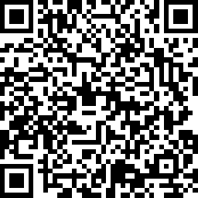
We’d love your feedback on today’s Half‑Baked Lunch
Scan the QR code and answer a quick survey
Office of Strategic Planning and Development Effectiveness

Slide 3
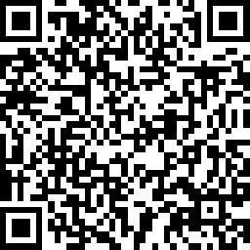
QR MAYO 28
We’d love your feedback on today’s Half‑Baked Lunch
Scan the QR code and answer a quick survey
Office of Strategic Planning and Development Effectiveness

Slide 4
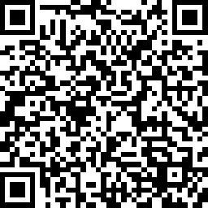
QR JUNIO 04
We’d love your feedback on today’s Half‑Baked Lunch
Scan the QR code and answer a quick survey
Office of Strategic Planning and Development Effectiveness

Slide 5
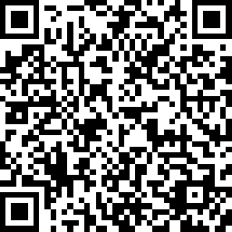
QR JUNIO 11
We’d love your feedback on today’s Half‑Baked Lunch
Scan the QR code and answer a quick survey
Office of Strategic Planning and Development Effectiveness

Slide 6
QR MARZO 12 Nudging households
We’d love your feedback on today’s Half‑Baked Lunch
Scan the QR code and answer a quick survey
Office of Strategic Planning and Development Effectiveness

Slide 7
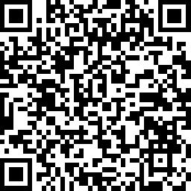
QR ABRIL 09-CANCELADO
We’d love your feedback on today’s Half‑Baked Lunch
Scan the QR code and answer a quick survey
Office of Strategic Planning and Development Effectiveness

Slide 8
QR ABRIL 23-CANCELADO Y CAMBIADO
We’d love your feedback on today’s Half‑Baked Lunch
Scan the QR code and answer a quick survey
Office of Strategic Planning and Development Effectiveness

Slide 9
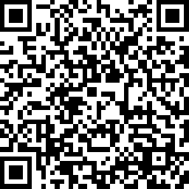
QR APRIL 23
We’d love your feedback on today’s Half‑Baked Lunch
Scan the QR code and answer a quick survey
Office of Strategic Planning and Development Effectiveness

Slide 10
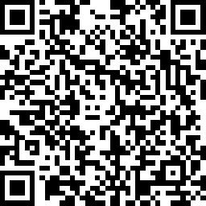
QR MAYO 14
We’d love your feedback on today’s Half‑Baked Lunch
Scan the QR code and answer a quick survey
Office of Strategic Planning and Development Effectiveness

Slide 11
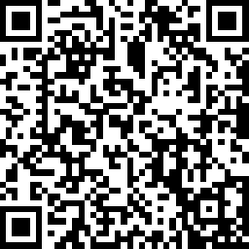
QR MAYO 21
We’d love your feedback on today’s Half‑Baked Lunch
Scan the QR code and answer a quick survey
Office of Strategic Planning and Development Effectiveness

