Slide 1
Cell proportion estimation
Update 31 April 2026

Slide 2
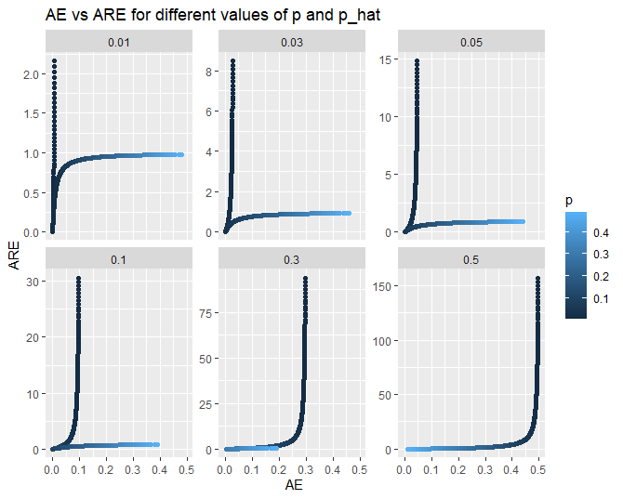

Accuracy Metrics
Absolute Error (AE): $|p −\hat{p|}$
Error is small for small proportions
Absolute Relative Error (ARE): $\frac{|p −\hat{p}|}{p}$
Error becomes large for small proportions

Slide 3
Initial simulation study
Simple simulations:
1 donor
1 proportion to estimate
No overdispersion
→ Binomial distribution

Slide 4
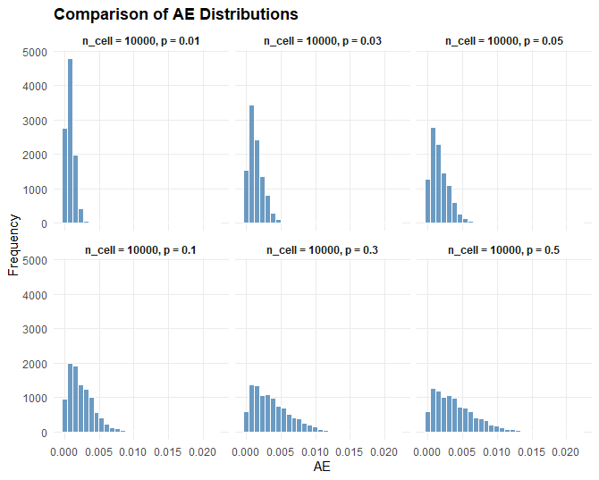
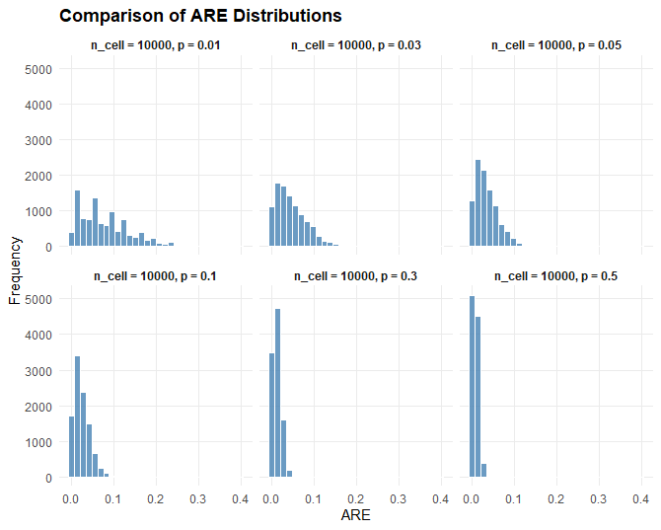
Distribution of ARE and AE are dependent on p

Slide 5
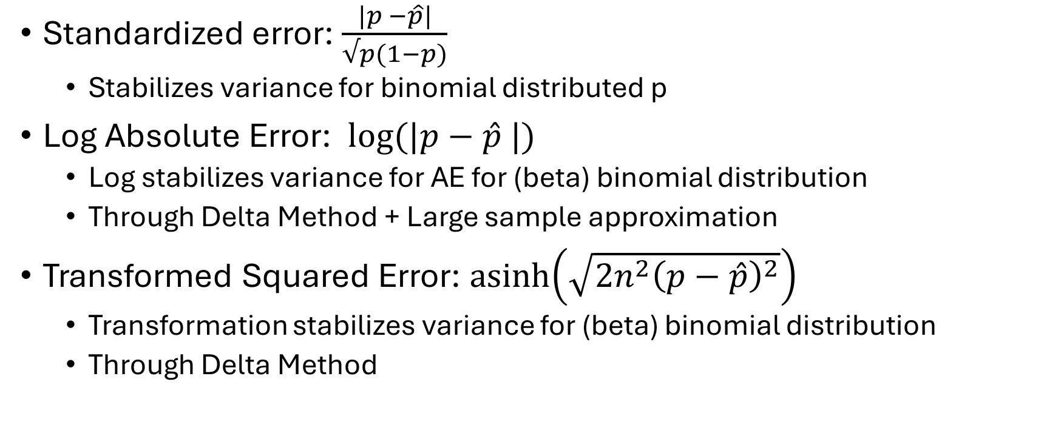
Other possible error metrics
Standardized error: $\frac{|p −\hat{p}|}{√p(1−p)}$
Stabilizes variance for binomial distributed p
Log Absolute Error: $log⁡(|p−\hat{p} |)$
Log stabilizes variance for AE for (beta) binomial distribution
Through Delta Method + Large sample approximation
Transformed Squared Error: $\operatorname{asinh}\left(\sqrt{2n^{2}{\left(p−\hat{p}\right)}^{2}}\right)$
Transformation stabilizes variance for (beta) binomial distribution
Through Delta Method

Slide 6
Advantages of variance stabilization
Comparison over different values of p becomes possible
When combining over multiple proportions: higher variance proportions will dominate the error.

Slide 7
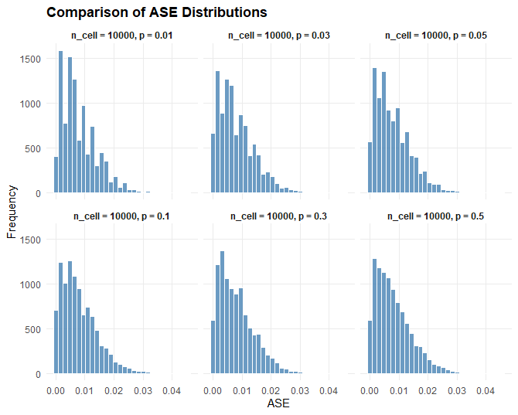
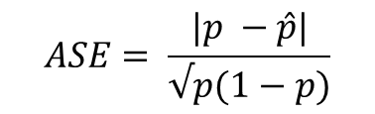
Absolute Standardized Error
ASE distribution independent on p
Breaks down for small values of p
Might not handle Beta binomial as well
$$ASE= \frac{|p −\hat{p}|}{√p(1−p)}$$

Slide 8
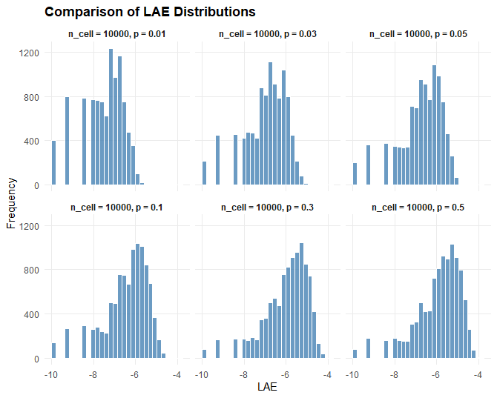

Log Absolute Error
Log Stabilizes Variance
Problematic when Absolute Error = 0
Solution: add small perturbation
$$LAE=log⁡(|p −\hat{p}|)$$

Slide 9
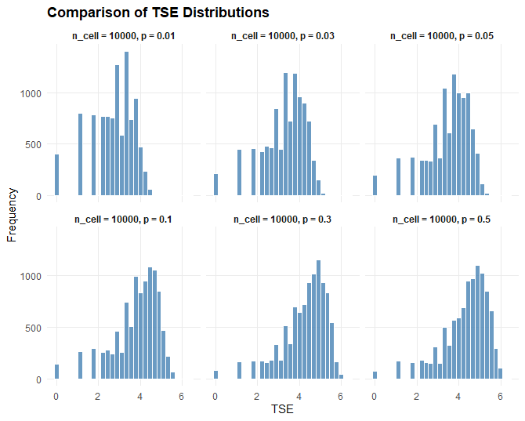

Transformed Square Error
Transformation Stabilizes Variance
No problems for error = 0
$$TSE=\operatorname{asinh}\left(\sqrt{2n^{2}{\left(p−\hat{p}\right)}^{2}}\right)$$

Slide 10


Distributional characteristics of error metrics
$$\frac{|p −\hat{p}|}{√p(1−p)}$$
$$\frac{|p −\hat{p}|}{p}$$
$$\operatorname{asinh}\left(\sqrt{2n^{2}{\left(p−\hat{p}\right)}^{2}}\right)$$
$$|p −\hat{p|}$$
$$log⁡(|p−\hat{p} |)$$
n_cell | p | mean_AE | var_AE | q95_AE | mean_ARE | var_ARE | q95_ARE | mean_ASE | var_ASE | q95_ASE | mean_LAE | var_LAE | q95_LAE | mean_TSE | var_TSE | q95_TSE
10000 | 0,01 | 0,000789 | 3,53E-07 | 0,0019 | 0,078877 | 0,003532 | 0,19 | 0,007927 | 3,57E-05 | 0,019096 | -7,51015 | 0,934939 | -6,2659 | 2,76607 | 0,844102 | 3,98436
10000 | 0,03 | 0,001377 | 1,08E-06 | 0,0034 | 0,045887 | 0,001197 | 0,1133 | 0,008070 | 3,7E-05 | 0,019931 | -6,96545 | 1,00984 | -5,68398 | 3,29914 | 0,945093 | 4,56604
10000 | 0,05 | 0,001717 | 1,66E-06 | 0,0042 | 0,034346 | 0,000666 | 0,084 | 0,007879 | 3,5E-05 | 0,019271 | -6,75464 | 1,07003 | -5,47267 | 3,5081 | 1,0071 | 4,77731
10000 | 0,1 | 0,002389 | 3,26E-06 | 0,0058 | 0,02389 | 0,000326 | 0,058 | 0,007963 | 3,62E-05 | 0,019333 | -6,43339 | 1,11476 | -5,1499 | 3,82573 | 1,06436 | 5,10005
10000 | 0,3 | 0,003663 | 7,54E-06 | 0,009 | 0,012209 | 8,38E-05 | 0,03 | 0,007992 | 3,59E-05 | 0,01964 | -6,00518 | 1,12441 | -4,71053 | 4,25039 | 1,08908 | 5,5394
10000 | 0,5 | 0,003992 | 9,2E-06 | 0,0098 | 0,007984 | 3,68E-05 | 0,0196 | 0,007984 | 3,68E-05 | 0,0196 | -5,93085 | 1,16852 | -4,62537 | 4,32457 | 1,13328 | 5,62455
For this simulation, the standardized error produced the most stable distribution
Will this still be the case when introducing overdispersion?

Slide 11
Next steps
Include multiple proportions
Introduce overdispersion
Combine with Scopit-type

