Slide 1
GAP — how close did you get, and how fast?
One score in [0, 1] (higher is better): did the optimizer reach a value near the best possible, and did it get there early?
What it measures
Formula (higher = better, 0–1)
Quality — how close the best result got to the best possible value y*.
Speed — how early in the run that best value was first reached.
R = clip( (y0 - y_best) / (y0 - y*), 0, 1)
speed = (T - t*) / T
GAP = ( R + speed ) / ( 1 + (T-1)/T )
y0 = starting best · y_best = best found · y* = best possible (oracle) · t* = trial the best was first reached · T = number of optimization trials (the budget)
Plain idea
It rewards an optimizer that jumps to a near-best answer EARLY. GAP looks only at the single best value and the moment it first appeared — not the ups and downs along the way.
The curve = how far you've improved over time. GAP reads its final height (≈0.85) and how early it got there — a snapshot, not the path.
Notes:
GAP = quality + speed in one number. R measures how far you closed the gap to the oracle optimum y*; the speed term rewards reaching that best value early. Key point: GAP only looks at the single best value and when it first appeared.

Slide 2
PA-GAP — was progress steady the whole way?
Path-Aware GAP scores the WHOLE journey, not just the final value: it averages how much you'd improved at every trial.
What it measures
Formula (higher = better)
Whole path — it sums up improvement at every step, not only the end.
Early counts more — each trial is weighted, with earlier progress worth more.
R_t = clip( (y0 - best_t)/(y0 - y*), 0, 1)
w_t = (T - (t-1)) / T (early weight)
PA-GAP = (1/T) · Σ_t R_t · w_t
0 <= PA-GAP <= (T+1)/(2T) ~ 0.5
Plain idea
best_t = best-so-far at trial t · R_t = improvement so far (0–1) · T = number of optimization trials (the budget)
Two methods can reach the same final value but score differently: the one that improves EARLY and holds it wins. Because early trials weigh most, even a perfect run caps near 1/2 (its maximum is (T+1)/(2T)) — so PA-GAP scores look smaller than GAP's 0–1.
PA-GAP adds up the shaded area under the whole curve (early trials weighted more) — it rewards the journey, not just the endpoint.
Notes:
PA-GAP is path-aware: it averages the improvement ratio over every trial, weighting earlier trials more. It rewards steady, early progress. GAP and PA-GAP can disagree (a big early jump scores high on GAP; gradual progress scores higher on PA-GAP) — which is why the benchmark reports both.

Slide 3
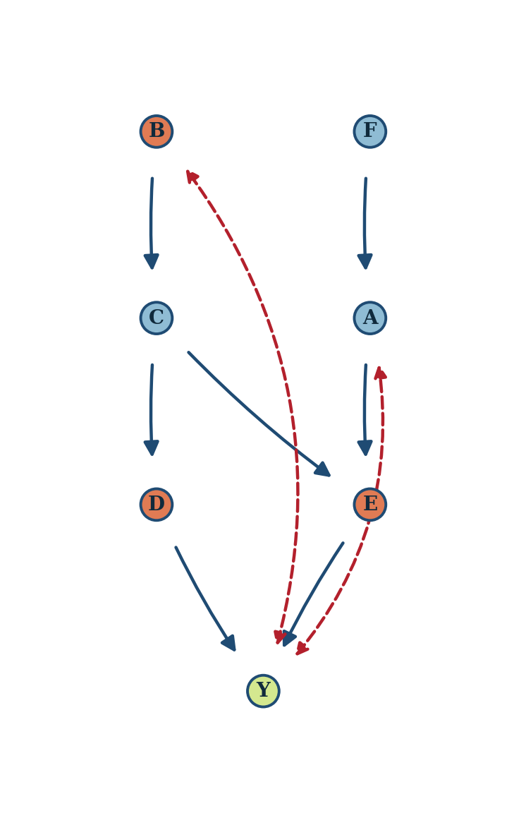
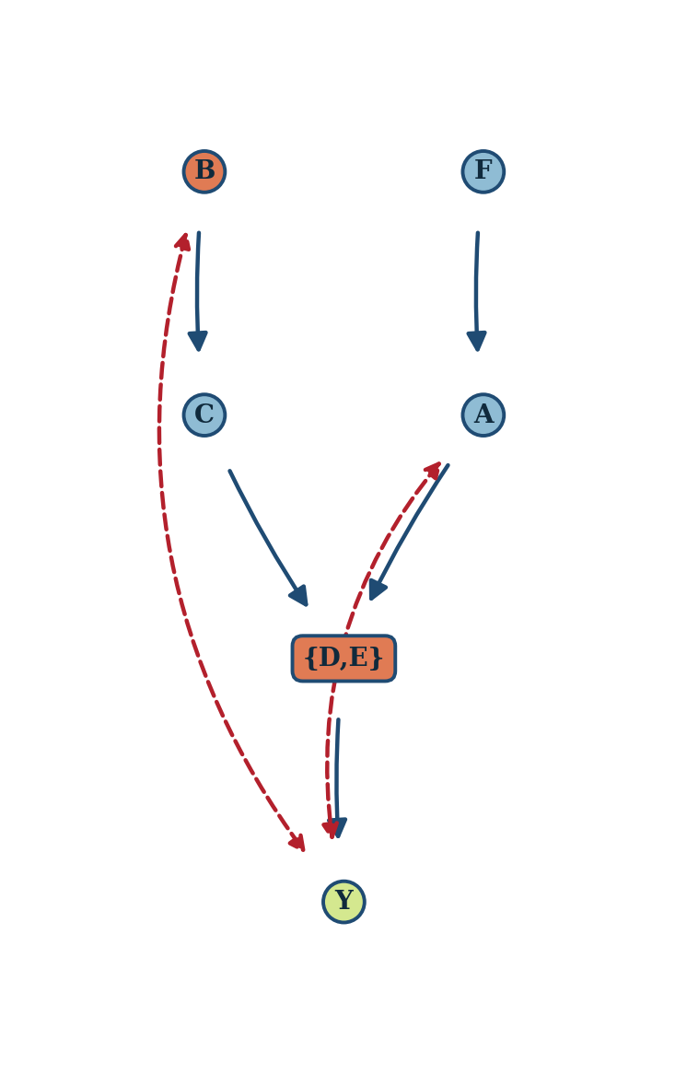
What QCBO operates on: from DAG to quotient
QCBO groups the manipulable variables into clusters and reasons over the quotient graph — the cluster-level causal graph — instead of the full DAG.
→
merge {D, E}
Full causal DAG (Synthetic / CompleteGraph)
Quotient C-DAG (what QCBO uses)
manipulable
other variable
target Y
cluster (quotient)
latent confounder

Slide 4
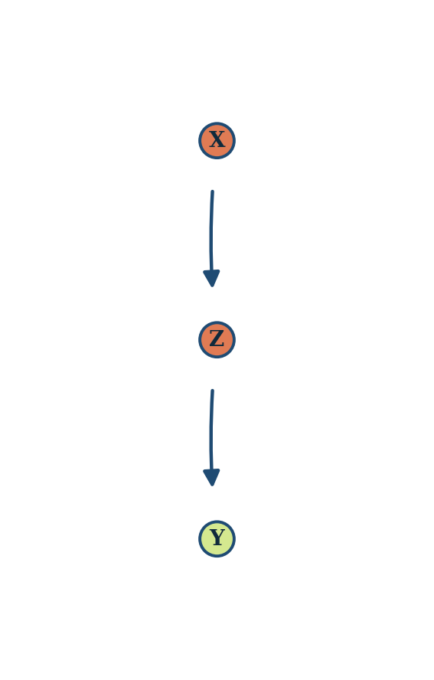
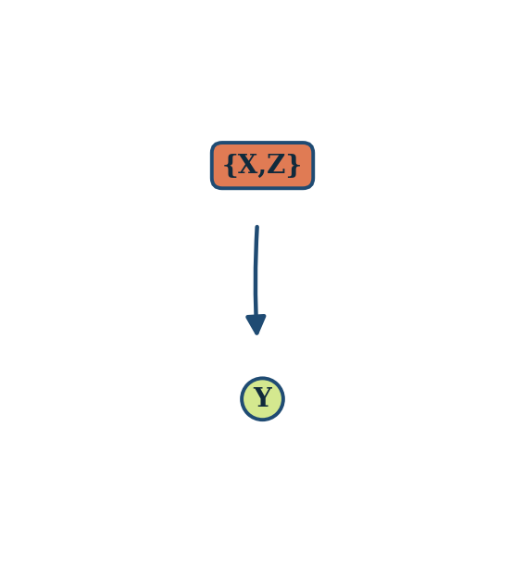
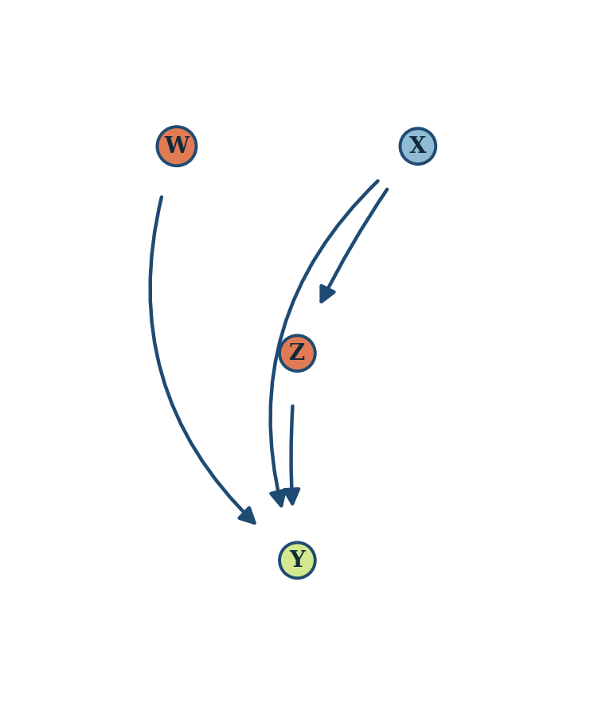
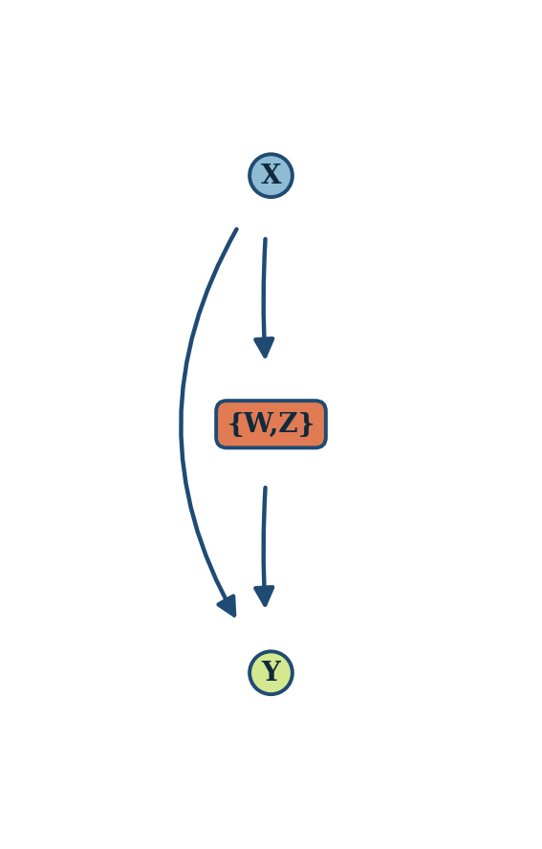
Benchmark structures and their quotients (1 / 3)
ToyGraph / Synth-2
cluster {X, Z}
→
Chain-hard
cluster {Z, W}
→
fine DAG → quotient C-DAG (orange = manipulable, box = cluster, dashed red = latent confounder)

Slide 5
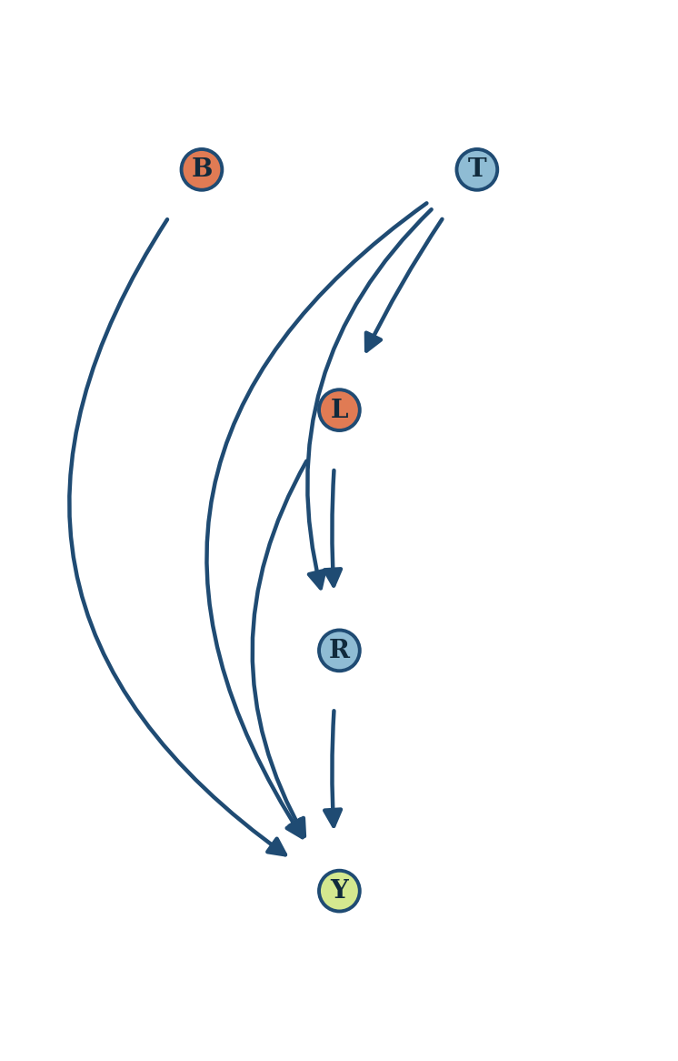
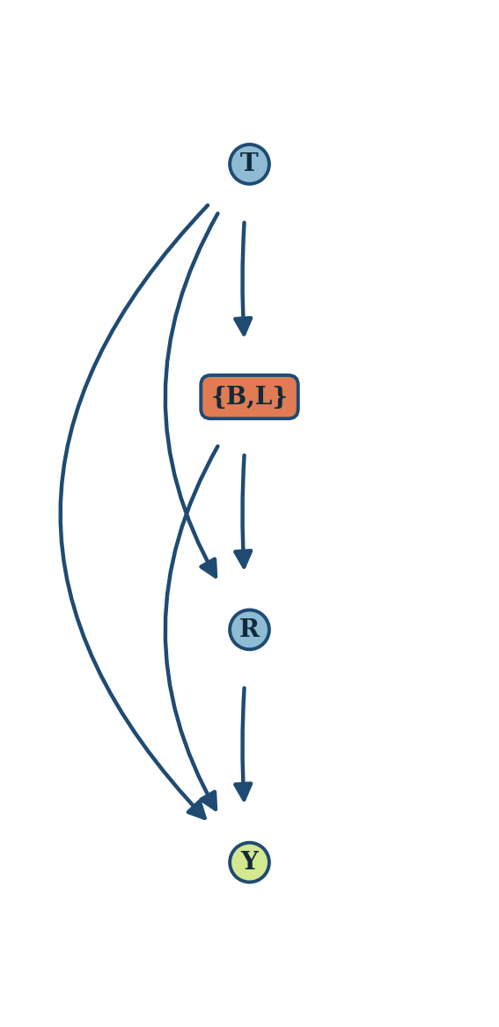
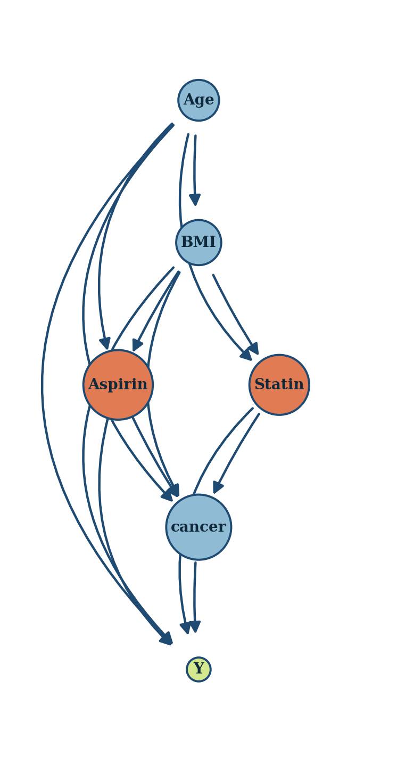
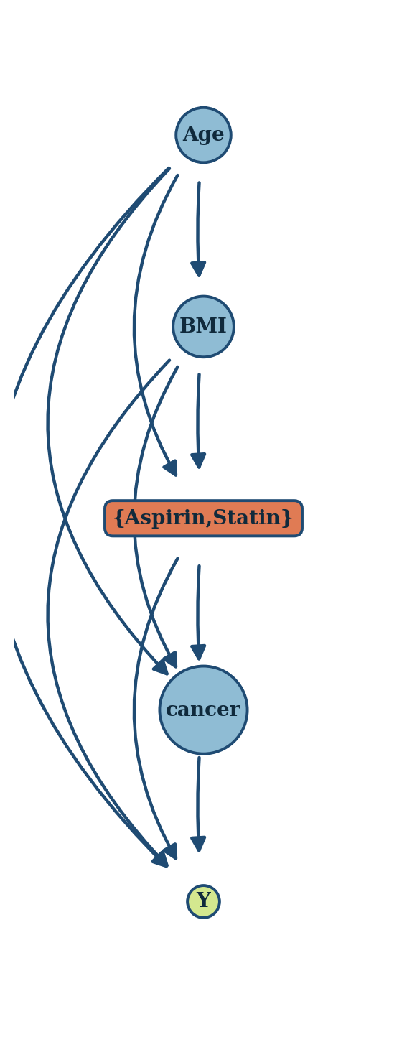
Benchmark structures and their quotients (2 / 3)
Epidemiology
cluster {L, B}
→
Healthcare
cluster {Aspirin, Statin}
→
fine DAG → quotient C-DAG (orange = manipulable, box = cluster, dashed red = latent confounder)

Slide 6
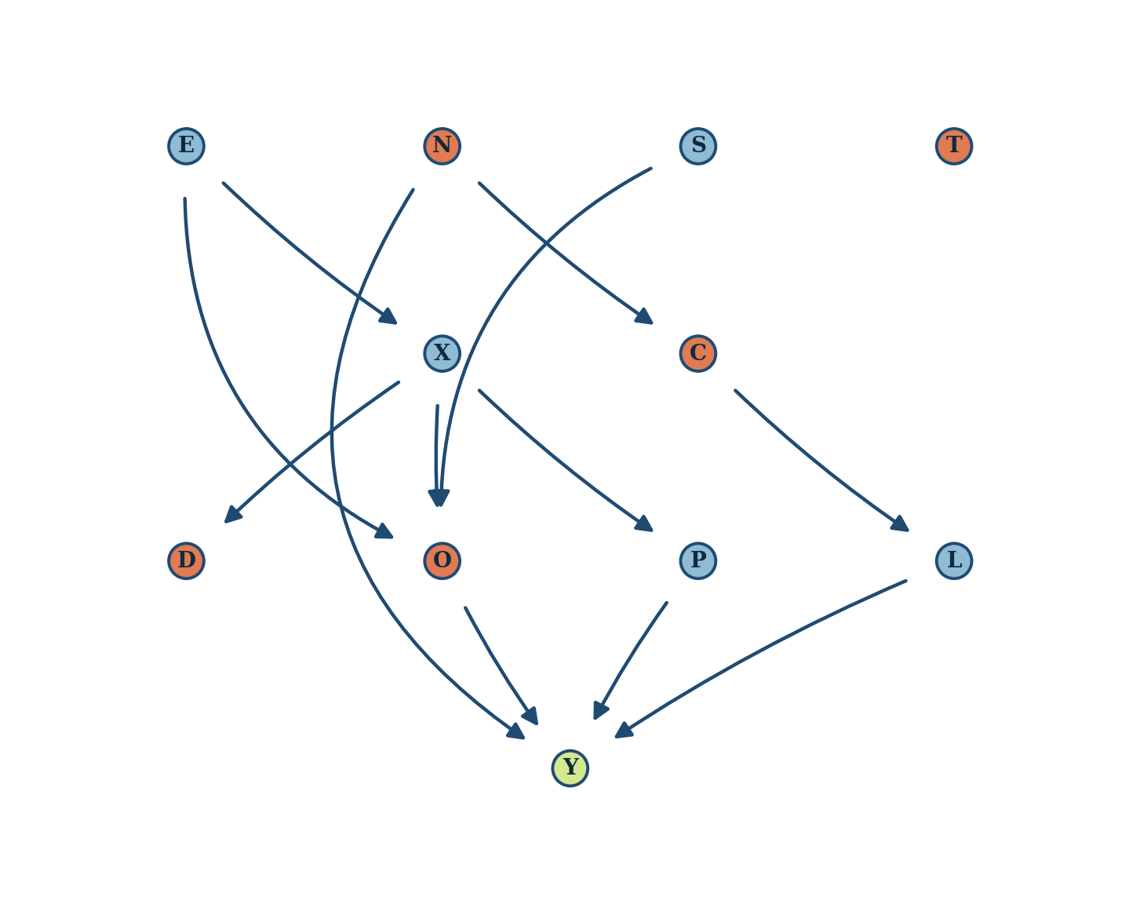
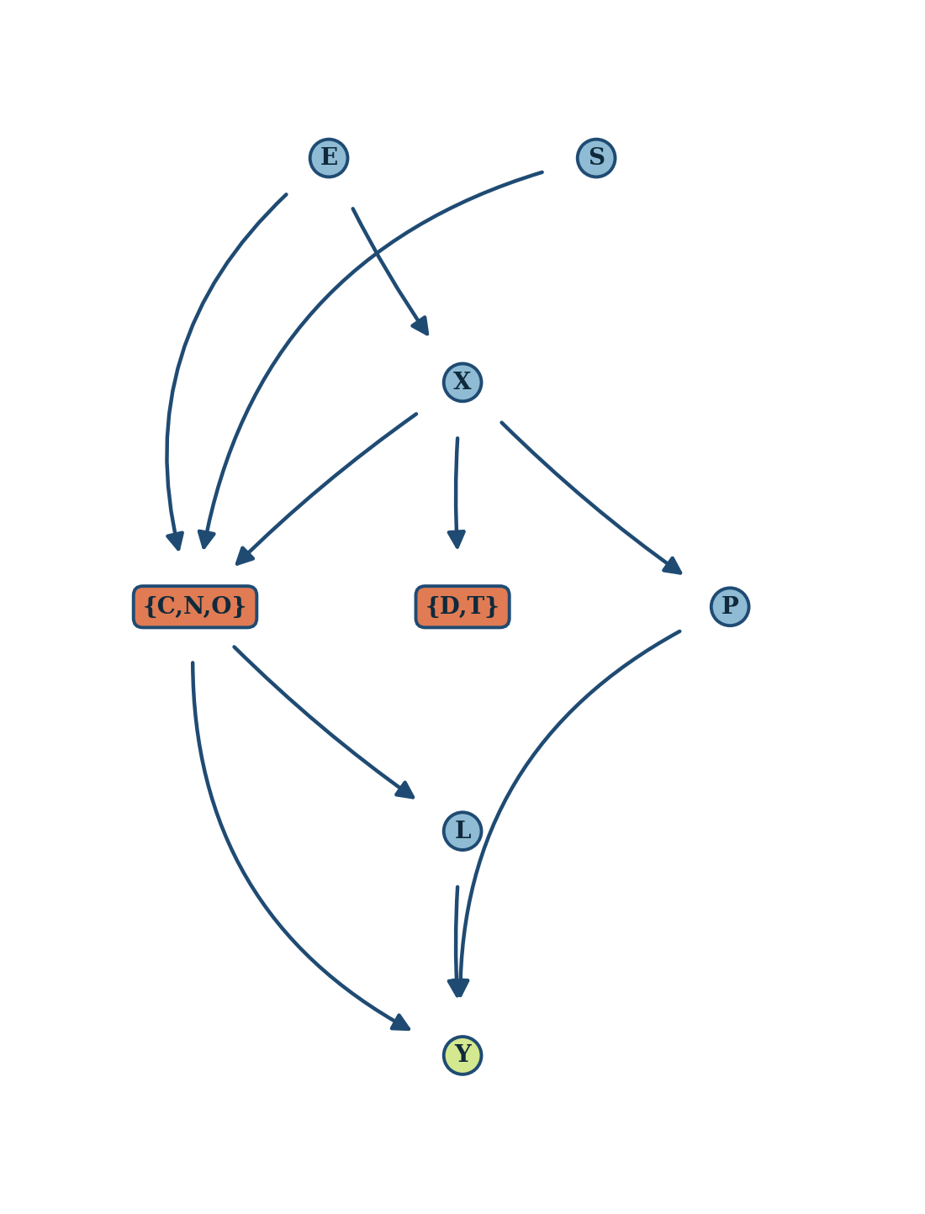
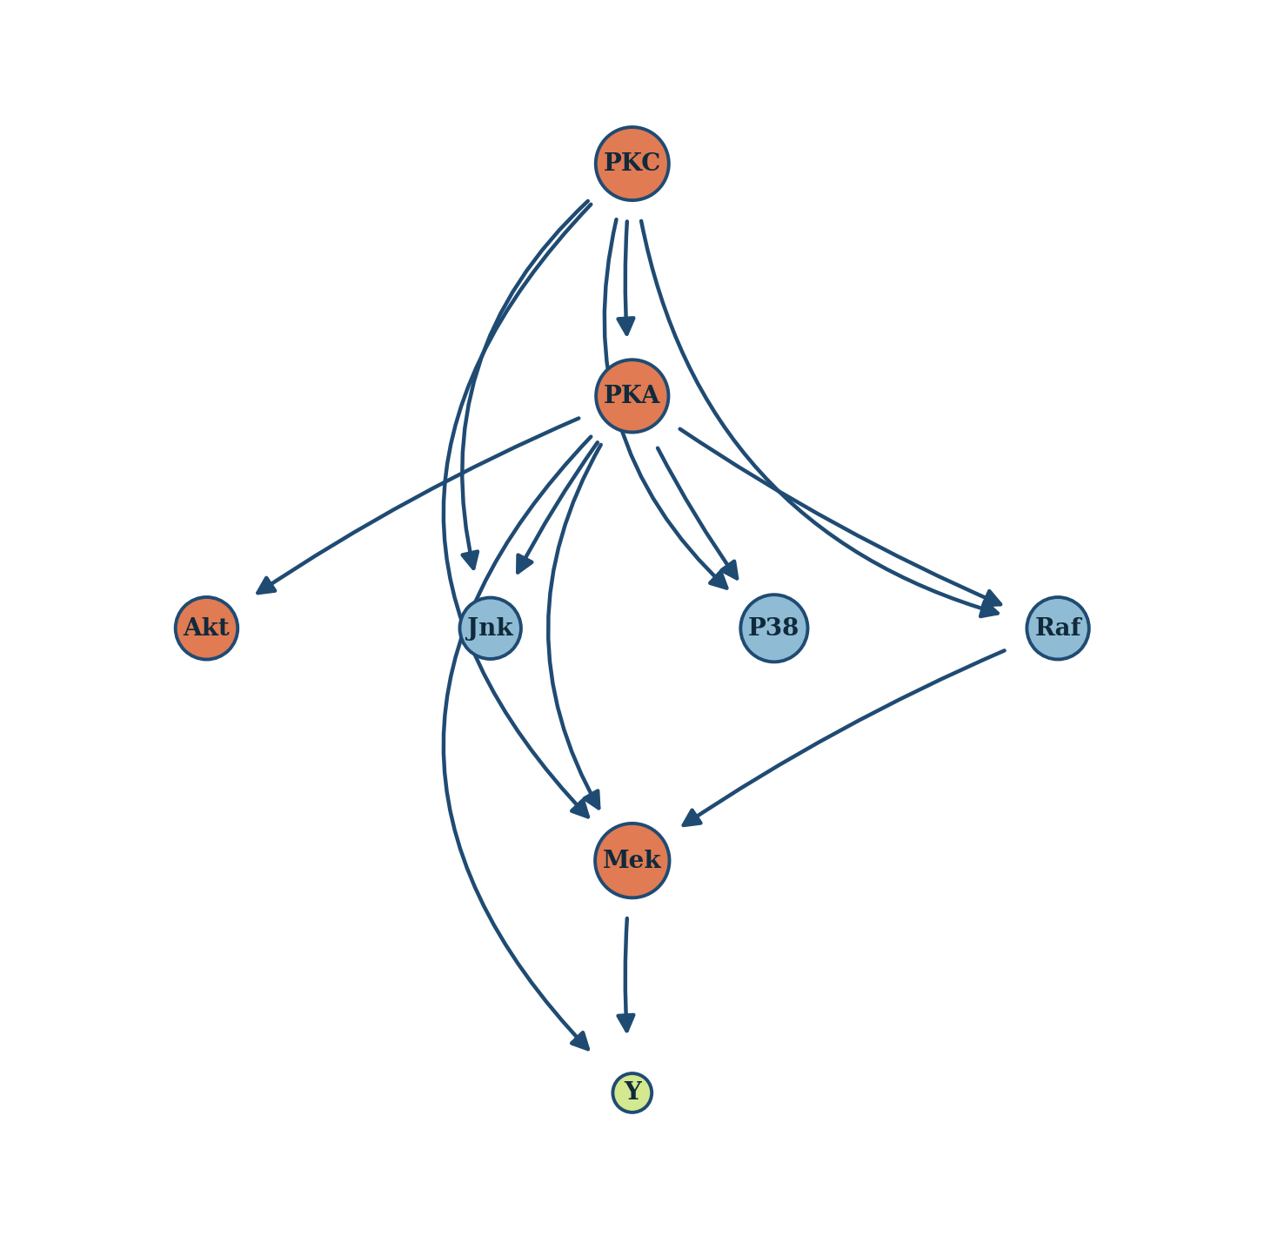
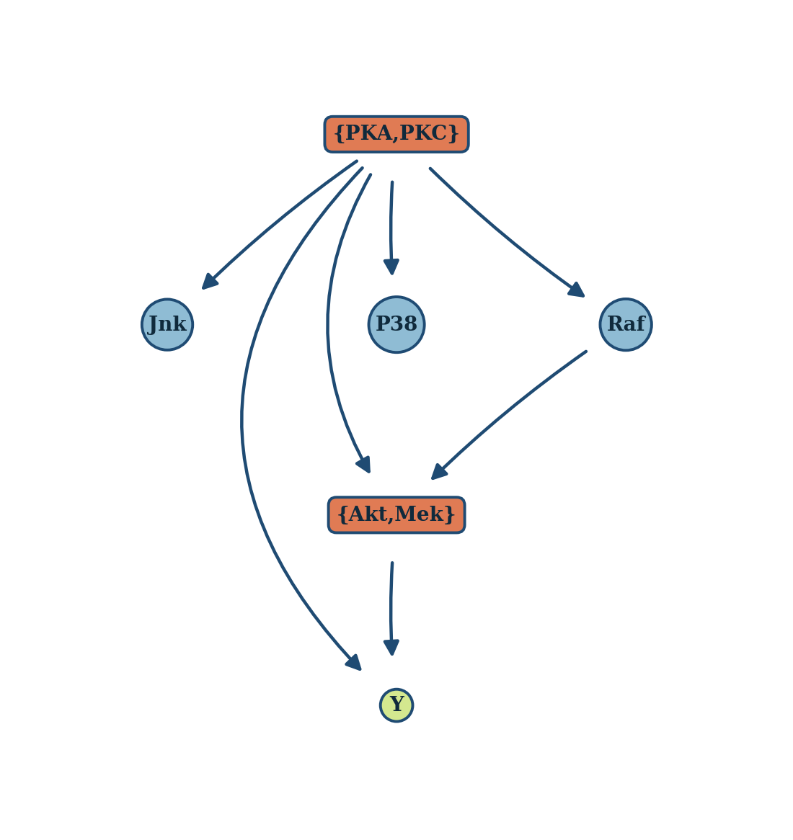
Benchmark structures and their quotients (3 / 3)
Ecology
clusters {C,N,O}, {D,T}
→
Protein
clusters {Akt,Mek}, {PKA,PKC}
→
fine DAG → quotient C-DAG (orange = manipulable, box = cluster, dashed red = latent confounder)

Slide 7
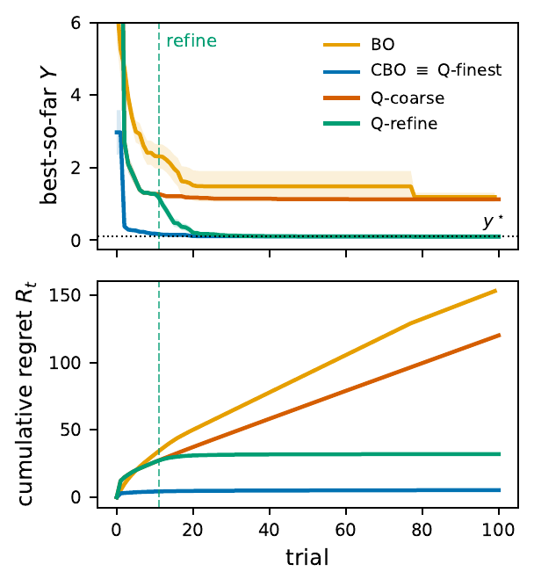
Hierarchical QCBO: refine the partition when the plateau says so
WIP
Why 1 — full-DAG CBO always self-corrects. A wrong edge only biases priors; interventional data override it, and its arm space always contains an optimum. So coarse guarantees are worth finite budget, never limiting value.
Why 2 — a lossy partition is paid forever. On ClusterBench10L the optimum do(X1, X3) splits cluster C1: fixed-coarse plateaus 1.03 above y* and its cumulative regret grows by 1.03 per trial — linear in T.
The idea in 3 steps
1 · Commit coarse
2 · Plateau trigger
3 · Warm start
Run QCBO at partition Pi: intra-cluster invariance + a focused arm space.
Incumbent gain < 1e-3 over 5 trials -> split its cluster via the declared hierarchy (default singletons); re-check quotient validity.
Prop. 4: superset arm space, shared arms keep identical functionals -> carry all data by arm; init only new arms.
ClusterBench10L, 10 seeds. Trigger at trial 11 ± 1; final Y 0.101 (= CBO's 0.103) vs coarse 1.128; cumulative regret 32 (bounded) vs coarse 120 (linear).
Survives: invariance for never-split clusters (phase-scoped) · a split can be refused (validity) · price -> bounded transient. Honest: CBO keeps the best regret constant (5.3); the win is vs fixed-coarse.
hierarchical C-DAGs now · discovering the hierarchy / local structure from the run's own interventional data -> next paper
Notes:
WIP slide. Framing: full-DAG CBO self-corrects eventually, so coarse guarantees are finite-budget; and when the partition is lossy, fixed-coarse pays the price forever (linear cumulative regret). Hierarchical QCBO makes the partition a starting resolution: plateau trigger -> split incumbent's cluster -> warm start (Prop. 4). Honest positioning: it does NOT beat CBO's regret constant; it removes fixed-coarse's linear term and keeps invariance for clusters never split. Rollback rule + hierarchy discovery = next paper.

