Slide 1





AutoPrep: Natural Language Question-Aware Data Preparation with a Multi-Agent Framework
Research 36: Data Cleaning and Preparation II
Meihao Fan¹
Ju Fan¹
Nan Tang²
Lei Cao³
Guoliang Li⁴
Xiaoyong Du¹
¹Renmin University of China
²HKUST (GZ)
³University of Arizona
⁴Tsinghua University
Notes:
Hello everyone，I am Meihao Fan from RenMin university of China,
Today I will give a presentation of the paper <AutoPrep: Natural Language Question-Aware Data Preparation with a Multi-Agent Framework>. This paper is a joint work by authors from Renmin University of China, The Hong Kong University of Science and Technology, University of Arizona and Tsinghua University.

Slide 2
Tabular Question Answering
Tabular Question Answering (TQA) refers to the task of answering natural language (NL) questions based on the provided table
Direct Prompting [1-2]
Code Generation [3-4]
[1] Large language models are few (1)-shot table reasoners. Arxiv. 2022
[2] Chain-of-thought prompting elicits reasoning in large language models . NeurIPS. 2022
[3] Binding Language Models in Symbolic Languages. ICLR. 2023
[4] ReAcTable: Enhancing ReAct for Table Question Answering. VLDB. 2024
Previous TQA methods are model-centric,
focusing on enhancing model’s reasoning capabilities.
Notes:
Tabular Question Answering, refers to the task of answering natural language (NL) questions based on provided tables
For example, the figure illustrates a typical TQA case. It requires to generate the answer Italia for the question“which country has the most medals in February” based on the data provided by the table.
Previous TQA methods are model centric, which is focused on enhancing model’s reasoning capabilities over tables, such as Direct Prompting method and Code generation method.

Slide 3
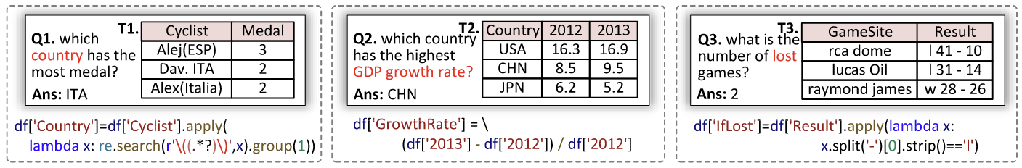
Data Prep Issues in TQA method
However, we find that in TQA, data prep issues are most important
Tables are usually from Web or SpreedSheet, demanding meticulous data preparation (or data prep) to produce the accurate answer.
Missing Semantics
Direct Prompting
Code Generation
TQA with Data Prep
To answer the question, we need to first extract the country values. We find that 3 medals were won by Alej from ESP, 2 medals for ITA, and 2 for Italia. Thus, the answer is ESP
SELECT Country, SUM(Medal) AS Total FROM T GROUP BY Country ORDER BY Total DESC LIMIT 1;
Cyclist
Medal
Country
Data Prep
Alej(ESP)
3
ESP
Dav. ITA
2
ITA
Alex(Italia)
2
ITA
Direct Prompting / Code Generation
Answer: ITA
Execution
Notes:
However, we find that in TQA, data prep issues are most important because tables are usually from Web or SpreedSheet, demanding meticulous data preparation (or data prep) to produce accurate answers.
First, Missing Semantics issue. This issue refer to a case where required semantic information for NL question is not explicitly presented in the table. For example, we can not directly answer the question Q1 based on T1, since the country information need to be extracted from the column Cyclist.
We provide examples here to illustrate that, although current TQA methods are logically correct for the question, it still fails to generate the correct answer due to the data prep issues.
Thus, it is natural to first perform data prep on the table, then extract the answers.

Slide 4
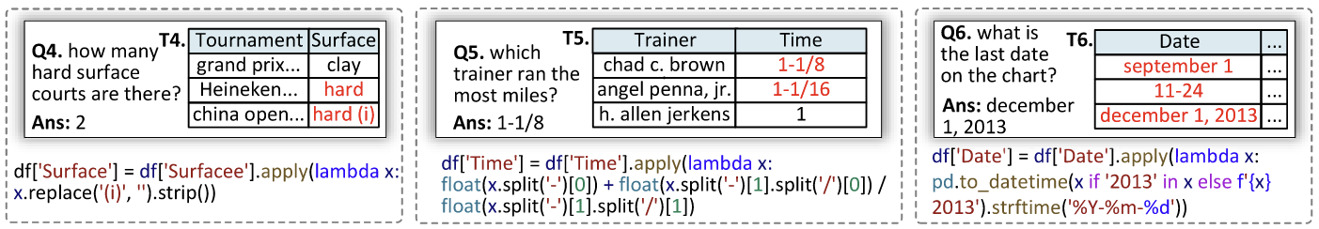
Data Prep Issues in TQA method
However, we find that in TQA, data prep issues are most important
Tables are usually from Web or SpreedSheet, demanding meticulous data preparation (or data prep) to produce the accurate answer.
Missing Semantics
Value Inconsistency
Notes:
Second, Value Inconsistency issue. Sometimes, the data in the table is integrated from heterogenous sources, which requires question-dependent normalization. For example, the question Q-five requires to sort by the column “Time”, but values in the column are string, which can not be compared correctly.

Slide 5
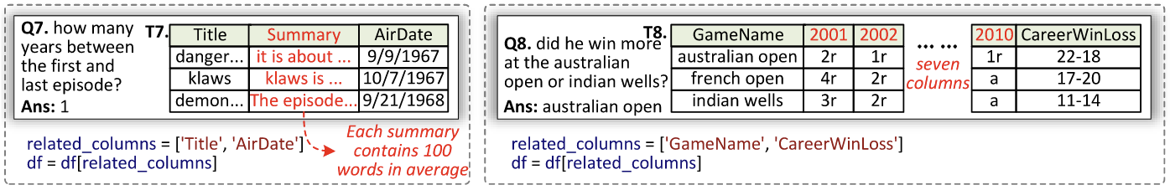
Data Prep Issues in TQA method
However, we find that in TQA, data prep issues are most important
Tables are usually from Web or SpreedSheet, demanding meticulous data preparation (or data prep) to produce the accurate answer.
Missing Semantics
Value Inconsistency
Irrelevant Columns
Notes:
Third, irrelevant columns issue. Usually, most of the columns in a table are irrelevant for answering questions. Thus, it may bring issues like Maximum Input Token Limit and Lost in the Middle to LLM-based method.
To address these data prep issues, it requires to refer to both table and the question, which can not be addressed by the traditional data prep focusing only the data.

Slide 6
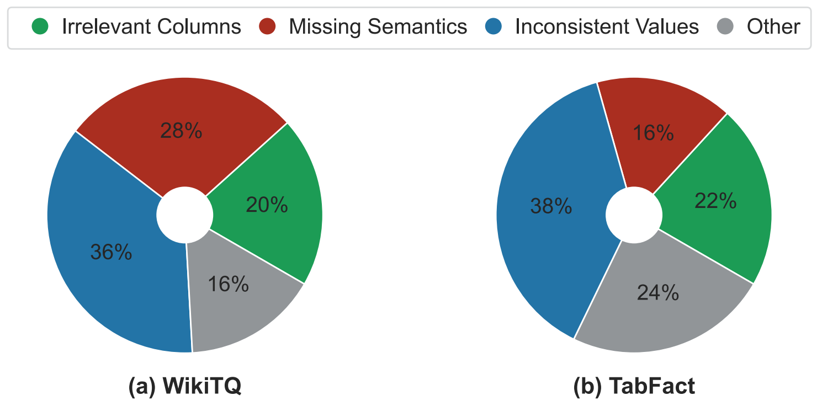
Performance bottleneck lies in Data Qualities
The bottleneck of current TQA methods is data prep issues instead of model’s reasoning capability
Most TQA errors stem from inadequately addressing data prep issues (84% and 76%)
We propose to study a new problem: question-aware data prep for TQA
Notes:
We conduct an error analysis of an LLM-based approach across two TQA tasks and find that the bottleneck of current TQA methods is data prep issues instead of model’s reasoning capability.
As shown in the figure, very limited errors are stem from the reasoning capabilities of LLMs, illustrated by a small subset of the “Other” category. And most TQA errors stem from inadequately addressing data prep issues, which is 84 percent for WikiTQ and 76 percent for TabFact.
Thus, we propose to study a new problem in this paper, which is named as question-aware data prep for TQA

Slide 7
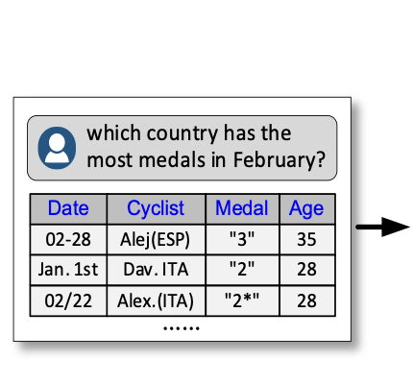
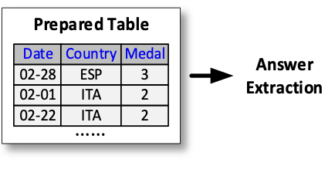
Question-aware Data Prep for TQA
Question-aware Data Prep for TQA
Input: A table T and a question Q
Output: A sequence of high-level data prep operations based on T and Q, e.g., Derive, Normalize.
These high-level operations will be implemented by codes to get a clean table, which helps TQA method to extract the final answer
Derive, Normalize, Filter,…
Notes:
Question-aware data prep for TQA inputs with a table T and a question Q, and requires to generate a sequence of high-level data prep operations based on T and Q, such as Derive and Normalize.
These high-level operations will be implemented by codes to get a clean table, which helps TQA method to extract the final answer

Slide 8
Key Challenge of Question-Aware Data Prep
However, building such a system is challenging due to the semantic alignment between the table and the question
How to generate correct high-level data prep operations?
How to generate correct codes to implement them?
A naive question-aware data prep method.
Inaccurate logical operations: ②④
Low-quality physical operations: ①③⑤
Notes:
However, building such a system is challenging due to the semantic alignment between the table and the question.
First, how to …
Ans how to …
The Figure on the right shows a failure example of a naïve question-aware data prep method. It has two main limitations.
First, it can not generate correct logical operations. For example, in Circle two, it wrongly convert the irrelevant column age to numerical. Also, in Circle five, although it tries to extract the country values from the column Cyclist, it fails to consider all cases of inconsistent values.

Slide 9
Our Proposed AutoPrep Framework
Inspired by DBMS, AutoPrep separates high-level (logical) data prep(DP) operations from the concrete codes (physical) for execution
Phase 1: Task Planning. Design a Planner agent to generate all data prep tasks and plan them in sequence, i.e., a chain of logical operations (e.g., Derive)
Notes:
To address these challenges, we propose a multi-agent data prep framework for TQA, named AutoPrep. Inspired by DBMS, AutoPrep separates high-level (logical) data prep(DP) operations from the concrete codes (physical) for execution
First, it designs Design a Planner agent to generate all data prep tasks and plan them in sequence

Slide 10
Our Proposed AutoPrep Framework
Inspired by DBMS, AutoPrep separates high-level (logical) data prep(DP) operations from the concrete codes (physical) for execution
Phase 1: Task Planning. Design a Planner agent to generate all data prep tasks and plan them in sequence, i.e., a chain of logical operations (e.g., Derive)
Phase 2: Task Programming & Execution. Assign the Programmer agent to implement each logical operation and an Executor agent for execution with iterative debugging
Notes:
Secondly, after generating the logical operation, it assigns the …

Slide 11
Our Proposed AutoPrep Framework
Inspired by DBMS, AutoPrep separates high-level (logical) data prep(DP) operations from the concrete codes (physical) for execution
Phase 1: Task Planning. Design a Planner agent to generate all data prep tasks and plan them in sequence, i.e., a chain of logical operations (e.g., Derive)
Phase 2: Task Programming & Execution. Assign the Programmer agent to implement each logical operation and an Executor agent for execution with iterative debugging
Main Idea: decompose the complex problem into smaller, manageable sub-tasks
Notes:
Finally, it outputs a prepared clean table and utilizes a standard TQA method such as NL2SQL or CoT prompting to generate the final answer.
The main idea behind the design is to decompose the complex problem into smaller and manageable sub-tasks.

Slide 12
The Planner
Challenge: How to align the semantics between the question and the table for data prep task generation?
The Direct Prompting baseline
Incorrect operation: Filter
Missing operation: Normalize(Date)
Notes:
The Planner agent has a challenge that is how to …
The figure on the left shows a direct prompting baseline method. It fails because it generates incorrect logical operations and misses out important operations
Firstly, The Filter operation retains the Country column simply because the question mentions “which country” but Incorrectly filters out Cyclist column, which contains the country information.
Secondly, It ignore the data prep operations to normalize the format of date to extract the month value

Slide 13
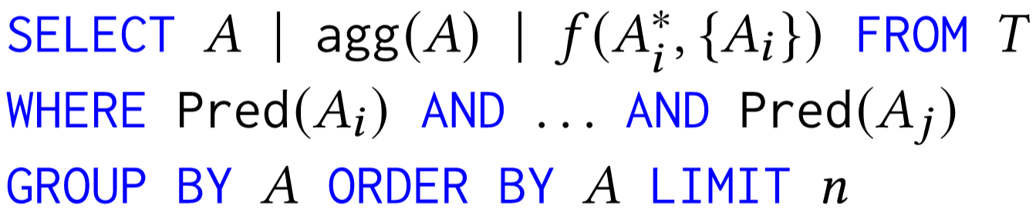
The Planner
We propose a novel Chain-of-Clauses (CoC) reasoning method.
Phase 1: Analysis Sketch Generation. Generate the analysis sketch to illustrate the question answering process over the table
Phase 2: Logical Operation Generation. Extract each clause and prompting LLMs with corresponding data to generate logical operations
SQL-augmented (integrated with UDF) Analysis Sketch Definition
Notes:
In this paper, we design the Planner with a novel …, consisting of two phases.
First, we ...
The figure on the right illustrates how the analysis sketch looks like.
Next, as shown in the left Figure, after generating the analysis sketch, we extract each clause in the sketch and prompting llms with corresponding data to generate logical operations

Slide 14
The Programmer
Challenge: It is hard to address the heterogeneous challenge of tables from web or real-world scenarios which have a large amount of inconsistent data
Name
Country
Medal
Date
Alej
CN
3
6, April, 2013
Dav
ITA
2
2013-11-24
Alex
Italia
2
December 1, 2013
if row['Country'] == 'CN‘:
row['Country'] = 'China'
elif row['Country'] == 'ITA‘:
row['Country'] = 'Italy'
...
possi_formats = ['%d, %B, %Y’,
'%Y-%m-%d’, ...]
for format in possi_formats:
try:
df['Country’] = pd.to_datetime(
df['Date'], format=format)
...
Notes:
The Programmer in AutoPrep has one challenge, that is, it’s hard to address,….
As shown in the example, the method usually fails to convert all inconsistent country values or date values to a consistent format, contributing to an inadequatly prepared table

Slide 15
The Programmer
Challenge: It is hard to address the heterogeneous challenge of tables from web or real-world scenarios which have a large amount of inconsistent data
Name
Country
Medal
Date
We introduce a tool-augmented method, enhancing LLMs’ code generation capabilities with predefined API functions
Alej
CN
3
6, April, 2013
Dav
ITA
2
2013-11-24
Alex
Italia
2
December 1, 2013
if row['Country'] == 'CN‘:
row['Country'] = 'China'
elif row['Country'] == 'ITA‘:
row['Country'] = 'Italy'
...
possi_formats = ['%d, %B, %Y’,
'%Y-%m-%d’, ...]
for format in possi_formats:
try:
df['Country’] = pd.to_datetime(
df['Date'], format=format)
...
format_datetime(
df,
'Date’,
'%Y-%m-%d')
normalize_country(df, 'Country')
Notes:
In this paper, we introduce a tool-augmented method, enhancing LLMs’ code generation capabilities with predefined API functions.

Slide 16
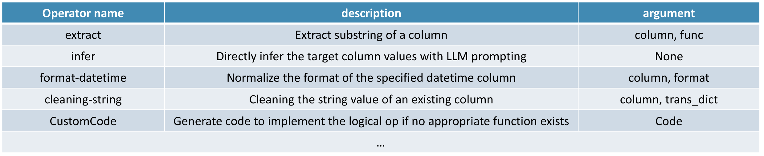
The Programmer & Executor
Tool-augmented physical operation generation with iterative debugging
Prompt the Programmer with the logical operation and related data, to select and complete a function for implementation
Translate the function to codes for execution. Any execution errors will be diagnosed by an Executor agent, which will then be passed back for refinement.
Several physical operations with typical arguments
Notes:
This figure illustrates how the programmer and executor work in AutoPrep.
First, given a logical operation, it prompts the Programmer with related data to select and complete a function to implement it.
Then, we translate the function to codes for execution. Any execution errors will be diagnosed by an executor agent, which will be passed back for physical operation refinement.

Slide 17
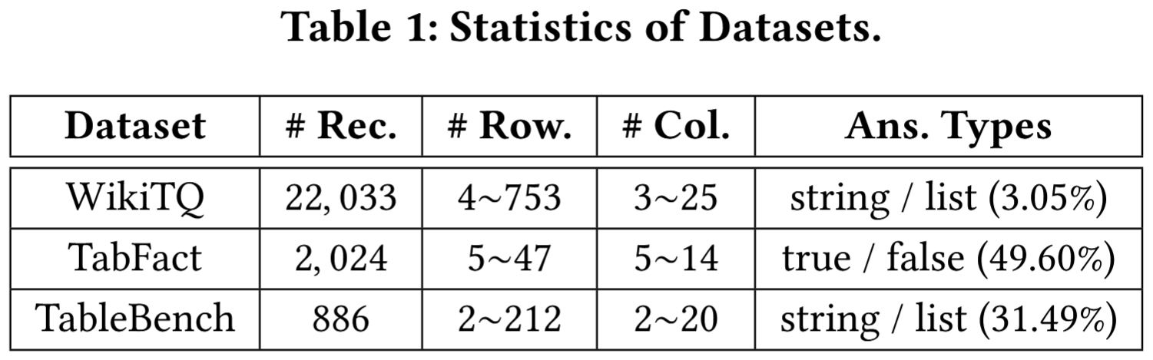
Experimental Setup
Datasets
WikiTQ: answers a question based on a table
TabFact: deduces a statement True or False based on a table
TabBench: involves multi-hop fact checking and numerical reasoning over a table
Baselines over 4 different LLM backbones
TQA Methods w/o Data Prep: End2EndQA, Chain-of-Thought, NL2SQL, NL2Py
Data Prep Baselines: Offline Data Prep, In-context Learning Prep
SOTA TQA methods with Data Prep: Binder, AutoTQA, ReAcTable, Chain-of-Table (CoTable)
Evaluation Metric
Accuracy. We adopt Binder[1] evaluator to avoid mismatches like: 7.45 and 7.4499.
Cost. We record both the time and API cost for all methods.
1
Notes:
In the Experiment, we evaluate our method on three datasets, named WikiTQ, TabFact and TabBench. The statistics are shown in the right table.
We compare with three types of baselines over 4 different LLM backbones, named …
We use two metric for evaluation. First, we adopt Binder evaluator to calculate the accuracy of all methods. Second, we record both the time and API cost for all methods.

Slide 18
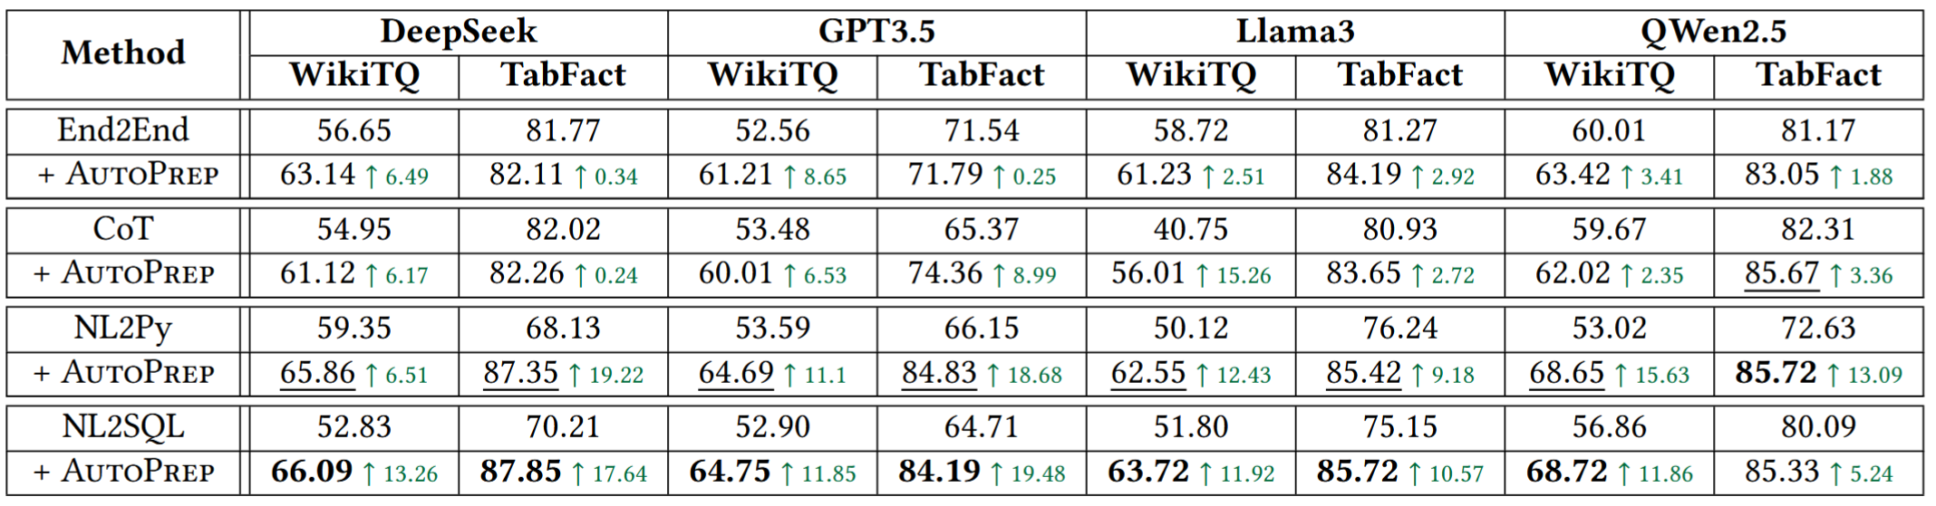
Improvement of Data Prep for TQA
Takeaway: (Work As Plug-in) Performance improves for all datasets across all baselines when integrated with question-aware data prep by AutoPrep
Notably, NL2SQL shows the most substantial gains, achieving an average improvement by 12.22 on WikiTQ and 13.23 on TabFact.
Notes:
We first evaluate all TQA baselines with/or without the data preparation of AutoPrep. The main takeaway is:
The results clearly show the significance of data prep in TQA task.

Slide 19
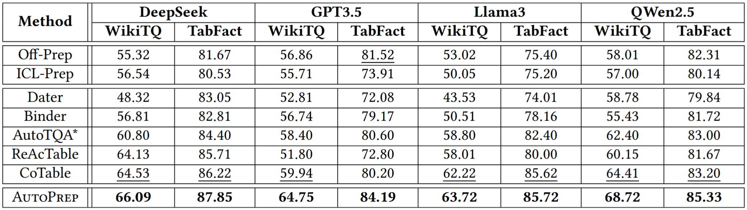
Data Prep Method Comparison
Takeaway: AutoPrep achieves the (Best Performance) over all datasets with different LLM backbones
Firstly, compared with Chain-of-Table method, AutoPrep achieve new SOTA performance with an impressive average improvement of 3.05 and 1.96
Secondly, compared with Off-Prep, AutoPrep achieves remarkable improvement by 10.02 and 5.55 on average
1
Notes:
We also compare AutoPrep with other data prep methods for TQA. The main takeaway is AutoPrep achieves the (Best Performance) over all datasets with different LLM backbones.
First, compared with Chain-of-Table method, AutoPrep achieve new SOTA performance.
Second, compared with Off-Prep, AutoPrep achieves remarkable improvement, indicating the significance of question-aware data prep.

Slide 20
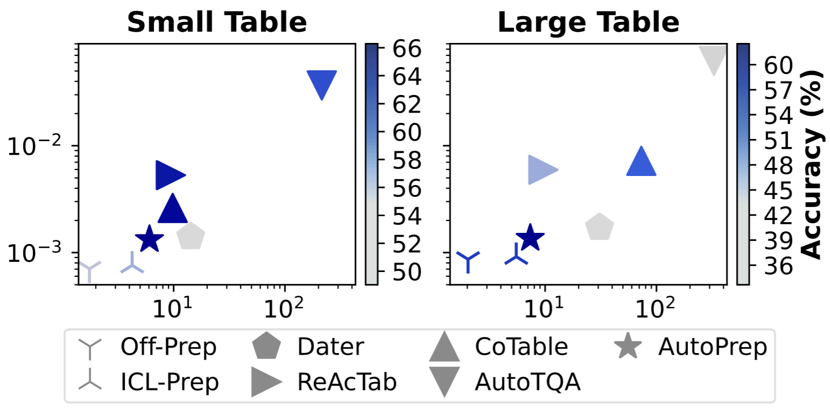
Evaluation on Efficiency
Takeaway: AutoPrep achieves the (Highest Efficiency)
It achieves obviously higher accuracy than all data prep methods (improved by at least 9.36 and 5.77 points)
It requires obviously fewer cost than previous SOTA TQA methods
Money ($)
Time (s)
1
Notes:
Next, We compare AutoPrep with other TQA methods on three metrics, time, API cost in dollars and accuracy. In the figure, each scatter represents different methods. The one with darker color achieves higher accuracy.
As shown in the Figure, AutoPrep achieves the highest efficiency.

Slide 21
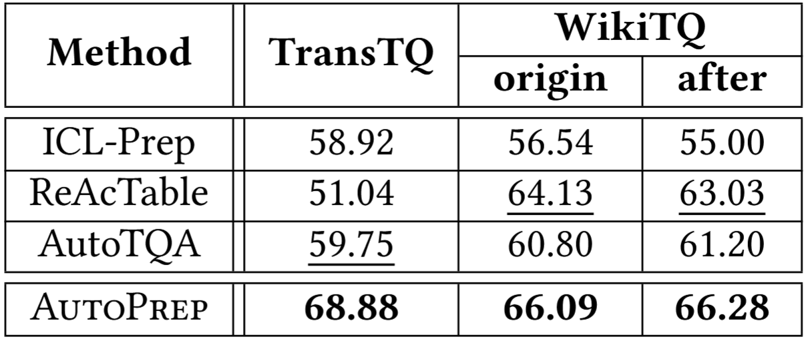
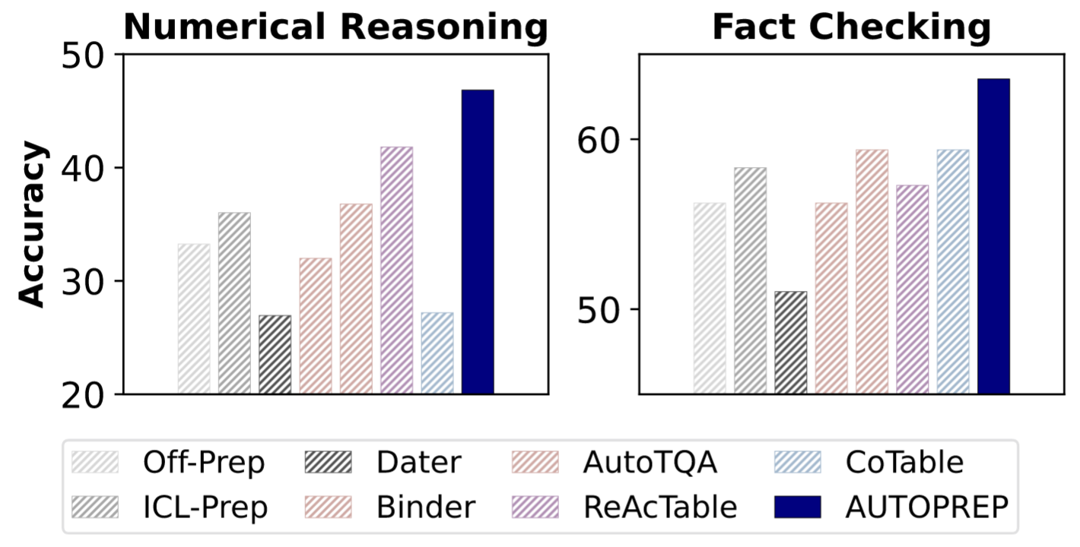
In-Depth Exploration of System Capabilities
Takeaway: AutoPrep achieves the (Best Extensibility)
After integrating a new logical operation Transform, AutoPrep performs the best without degrading performance on the original WikiTQ dataset
Takeaway: AutoPrep achieves the (Best Generalization) on a new dataset TabBench
AutoPrep outperforms all methods on both FC and NR subsets
* TransTQ dataset requires complicated table transformation operation for data prep
Notes:
We compared AutoPrep with other methods by extensibility and generalization.
Specifically, we evaluate on a more complex dataset that require Table Transformation operations.
The experimental results show that: AutoPrep achieves the (Best Extensibility)
After integrating a new logical operation Transform, AutoPrep performs the best without degrading performance on original WikiTQ dataset

Slide 22
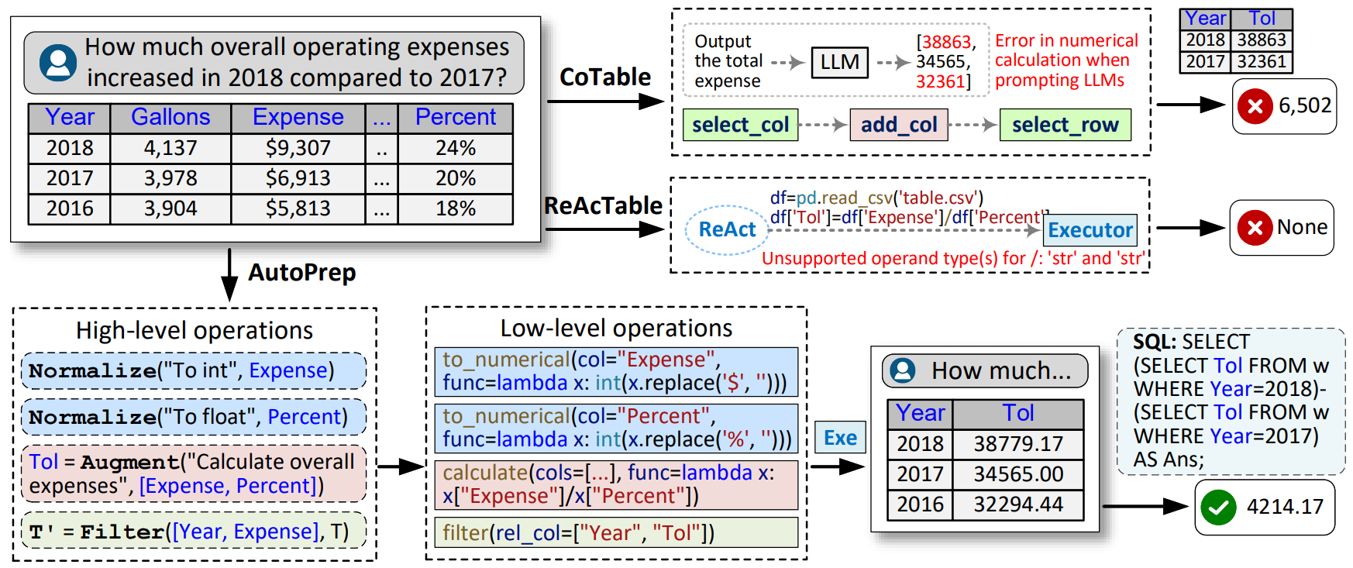
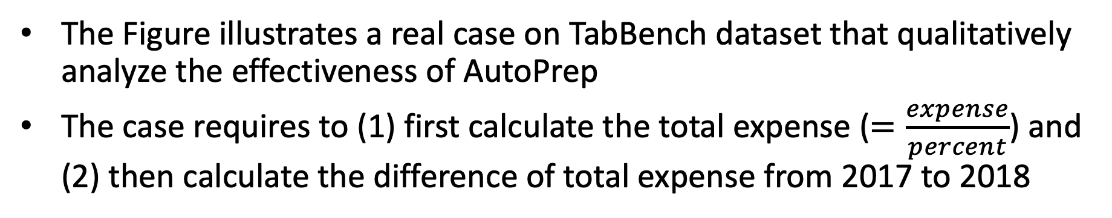
Case Study
The Figure illustrates a real case on TabBench dataset that qualitatively analyze the effectiveness of AutoPrep
The case requires to (1) first calculate the total expense ($=\frac{expense}{percent}$) and (2) then calculate the difference of total expense from 2017 to 2018
CoTable directly prompts LLMs to output the total expense without utilizing codes for calculation. Thus, it generates wrong values
ReAcTable uses codes but occur execution errors due to inadequately addressing data prep issues
AutoPrep extracts all data prep issues with Chain-of-Clauses method and generates correct codes to prepare the table with Tool-augmented method
1

Slide 23
Conclusion
We have introduced AutoPrep¹, an LLM-based multi-agent framework to support question-aware data prep for TQA task.
We propose a Chain-of-Clauses reasoning method to accurately generate data prep tasks. We also propose a Tool-augmented method to generate codes for effective table processing.
Experiments demonstrate that (1) AutoPrep can work as a plug-in to improve the performance of other TQA methods and (2) AutoPrep achieves new SOTA performance for TQA task
[1] Code is available at https://github.com/ruc-datalab/AutoPrep/ Contact us at fanj@ruc.edu.cn
Notes:
In summary,

Slide 24


THANK YOU
Q & A
Notes:
That's all, Thank you for listening.

