Slide 1
Experimental Setup
Dataset — CIFAR-100
Architecture
Training
50 000 train / 10 000 test 100 classes, 32 × 32 px SimCLR augmentation: · Random crop + h-flip · Colour jitter · Gaussian blur · Random grayscale Two augmented views · Positive pair in constrastive learning
Encoder: ResNet-18 · 3×3 stride-1 first conv (preserves 32px resolution) · Output: 512-d vector Projector (optional) · Linear · BatchNorm (optional) · ReLU · Linear · BatchNorm (optional)
Loss: NT-Xent (Temperature = 0.1) · 2(B-1) negatives Optimiser: SGD · Momentum 0.9 · Weight decay 1e-4 · (excl. BN & biases) Schedule: · Warmup 10 ep -> cosine annealing · 256 batch size · 200 epochs

Slide 2
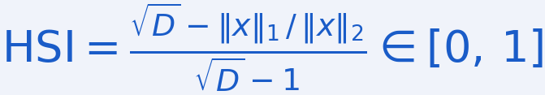
Metrics
Downstream Accuracy
kNN Accuracy (k = 20)
Linear Probe (Top-1 / Top-5)
• 0 = random; 1 = perfect - tests geometric clustering of features • Majority class among 20 nearest neighbours • No training, no linear assumption - pure geometry • Reports Top-1 and Top-5
• Tests whether class info is linearly readable from frozen features • Single linear layer on encoder output • Good accuracy = no non-linear decoding needed • Reports Top-1 and Top-5
Sparsity Metrics
Activation histograms
Zero Fraction
Hoyer Sparsity Index
• Tracks the distribution of activations • Overview over the feature geometry
• Fraction of activations that are very small • High = many neurons off for a given input • Measures input-specific hard sparsity
• 0 = uniform activity; 1 = single active unit • L1/L2 ratio - normalised to [0, 1]

Slide 3
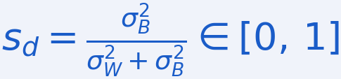
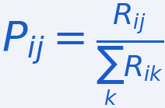

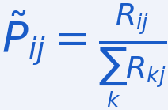
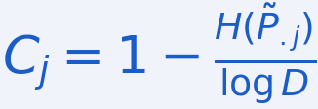
Representation Structure Metrics
• Low within-class variance indicates tightly clustered representations • High between-class variance indicates separated representations • The ratio between / (within + between) quantifies the amount of variability explained by class difference (bounded [0,1])
• 1 => full variance explained: perfect predictor
• 0 => zero variance explained: just noise
Separability
Disentanglement
Completeness
• How strongly does a feature predict class identity?
• Within-class variance
• Feature-specific variance between classes • 0 = no class signal; 1 = pure class signal • Averaged over all features for a scalar score
• Does each latent feature only represent one class? • R: (Latent x Class) matrix of relative importance • R_ij: importance of feature i for class j • Here: Variance explained ratio as importance for every feature/class • D = 1 - per-feature entropy of normalized relative importances • Low entropy => Feature variance only explained by a single class => High Disentanglement
• Is each class only explained by a single latent feature? • Mirrored to disentanglement: 1 - per-class entropy of normalized relative importances • Low entropy => Only a single feature indicates this class identity well => High completeness
Eastwood & Williams, ICLR 2018 — "A Framework for the Quantitative Evaluation of Disentangled Representations"

Slide 4
Evaluation
Projector | KNN 1 | Linear 1 | Hoyer-Sparsity | Zero % | Separability | Disentanglement | Completeness
None | 0,5254 | 0,5769 | 0,8225 | 0,8356 | 0,1681 | 0,5965 | 0,4470
MLP | 0,5473 | 0,5879 | 0,4612 | 0,2357 | 0,2307 | 0,3059 | 0,2154
MLP+BN | 0,5557 | 0,6114 | 0,4277 | 0,1931 | 0,2147 | 0,2942 | 0,2124
Projector (proj_out) | Hoyer-Sparsity | Zero % | Separability | Disentanglement | Completeness
MLP | 0,2200 | 0 | 0,2025 | 0,1715 | 0,1474
MLP+BN | 0,1822 | 0 | 0,1822 | 0,2129 | 0,1909

Slide 5
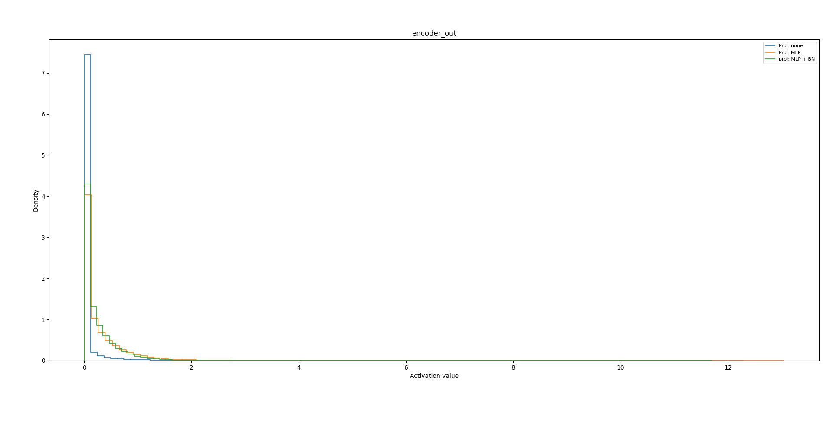
Activations

Slide 6
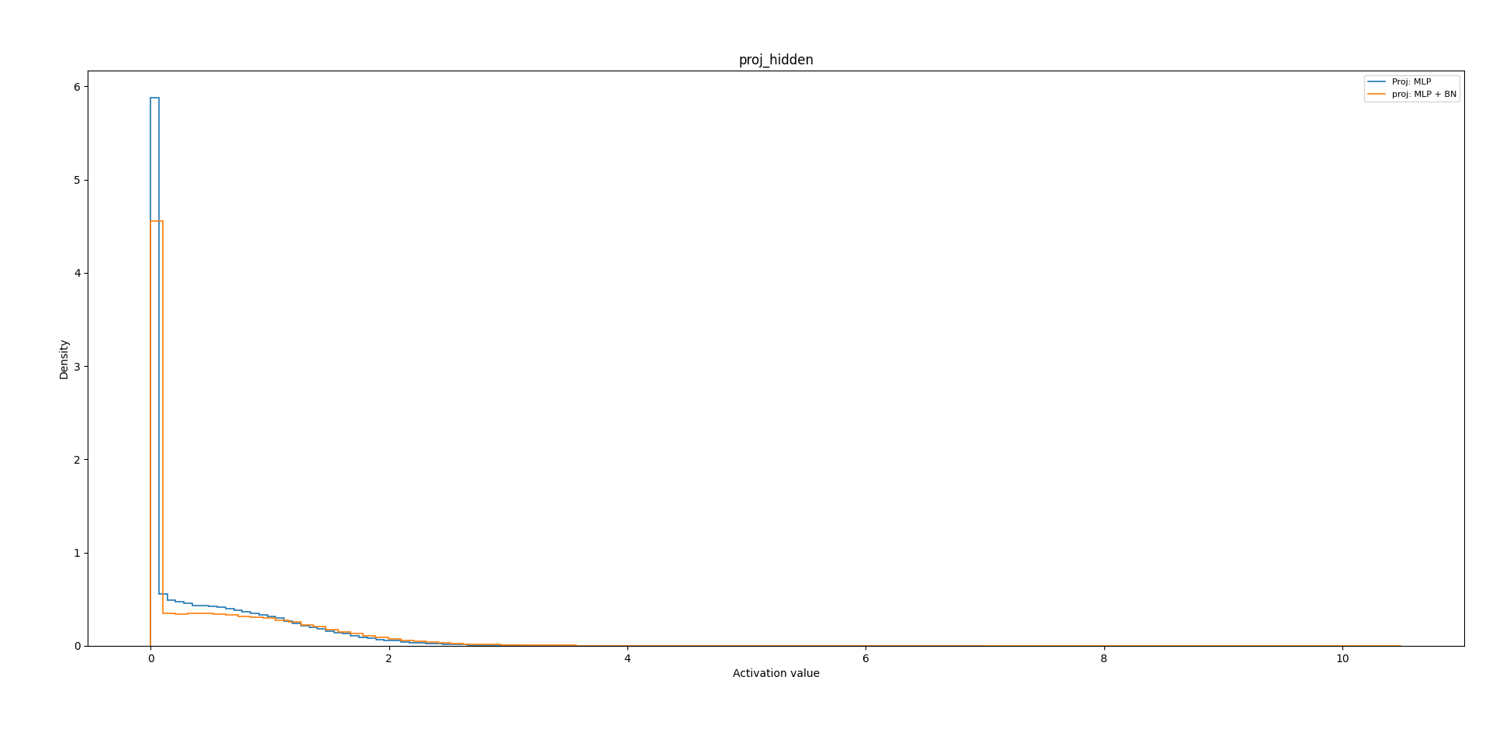
Activations

Slide 7
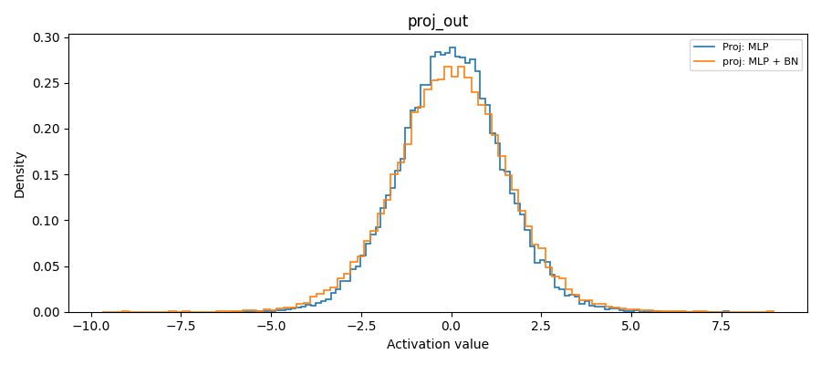
Activations

Slide 8
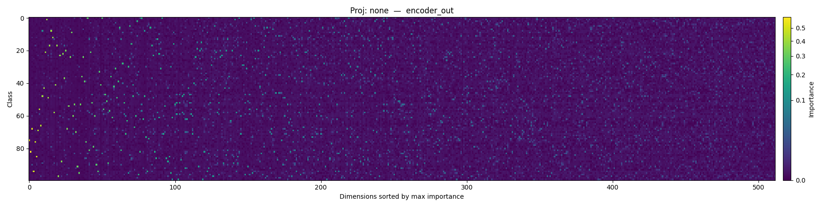
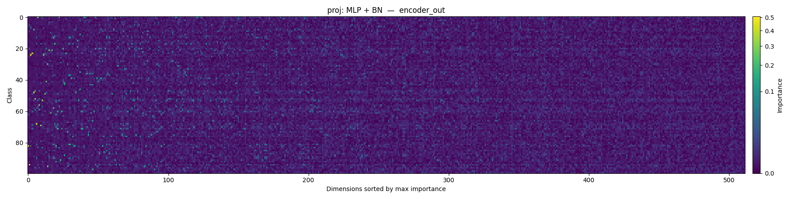
Relative Importance Matrix

Slide 9
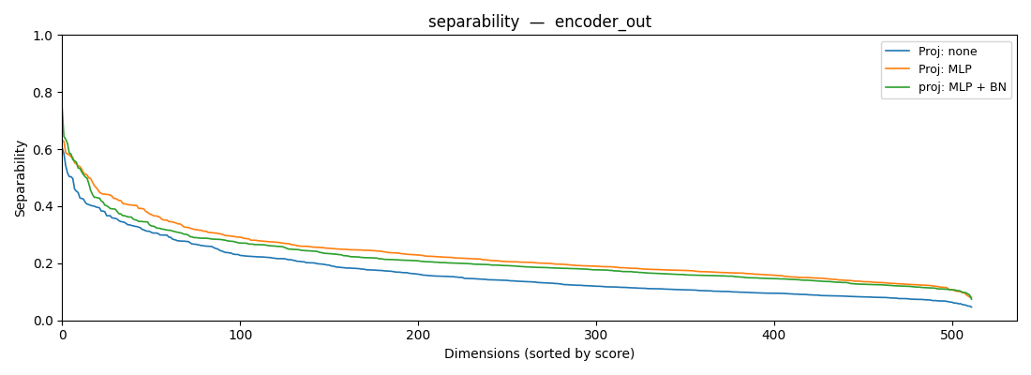
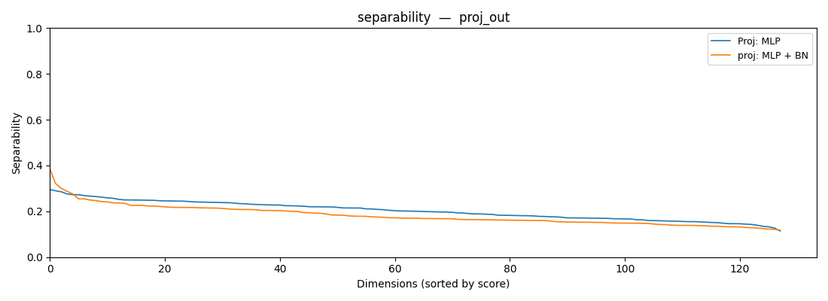

Slide 10
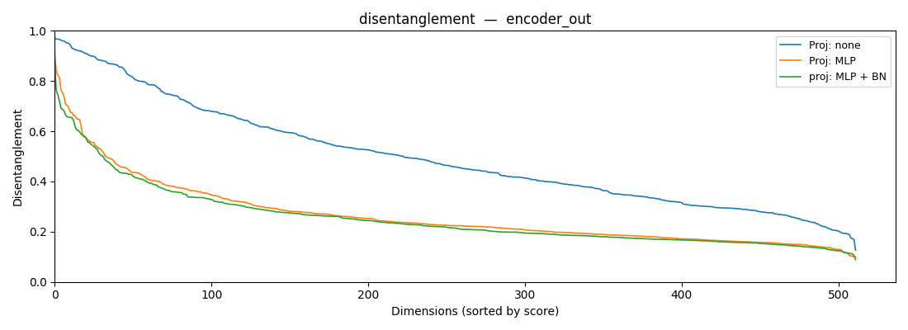
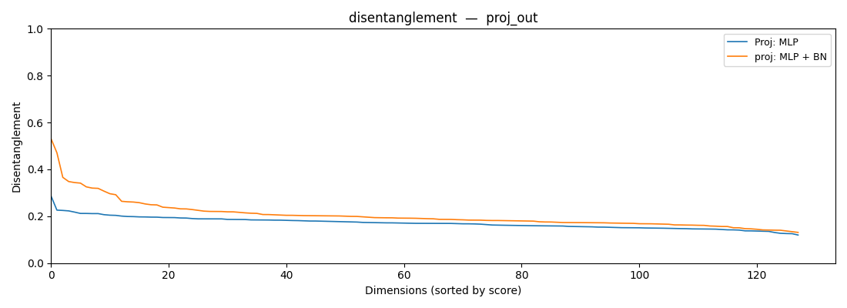
Disentanglement

Slide 11
