Slide 1
Smartmet Alert Weather Warning System Mikko Visa, Roope Tervo

Slide 2
General
Meteorological workstation for creating analysis, forecasts and now also warnings for end production.
Implemented with Java programming language.
Enables displaying observations, radar & satellite images, and model data on top of different map layers as background data for the meteorologist.
As an output of users work Smartmet II returns GML documents which support OGC standard. These are then utilized in production of several different products.
Smartmet II takes advantage of Java webstart. The user does not need to install the software on his/her computer. To use it the user needs only internet access and Java Runtime Environment (Java7 currently)

Slide 3
Basic Ideas
Plugin-based architecture
The framework takes care of time and area selection
Data layers, selected by the user, are displayed on top of each other on the map panel
All requested information is inspected in the same projection so that comparision of the data is easy
Meteorologists make their analysis and interpretations on top of the data layers
Launch + loading and saving the data is network-based

Slide 4
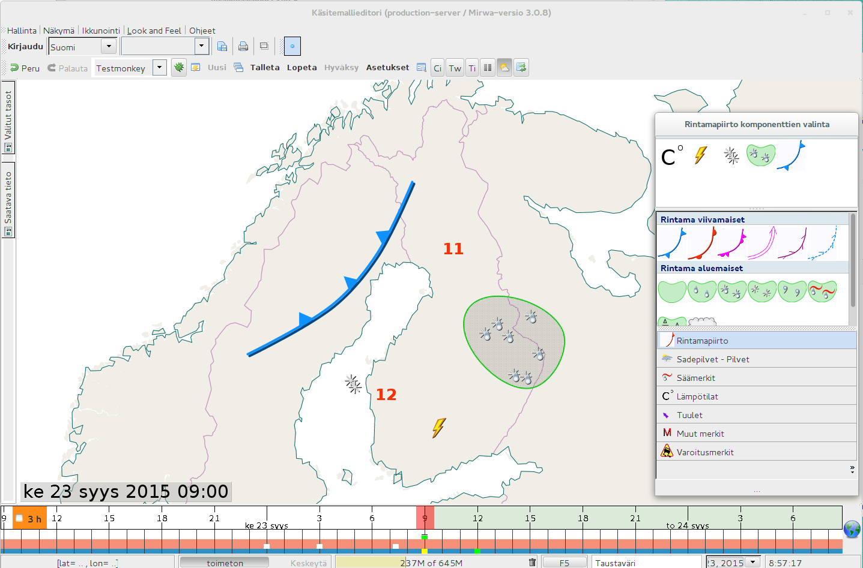

Slide 5
Backends

Slide 6
Data sources
MetOcean Data Server Brainstorm
Q3 plugin (Model data, SYNOP observations)
TimeSeries plugin (Used for best guesses for forest fire and wave height)
MapServer (WMS)
Background maps
Radar images
Satellite images

Slide 7
Warnings Plugin

Slide 8
Introduction
New tool for meteorologists, in use since 04/2015
Implemented as an interactive GUI plugin to Smartmet II
Used to create and edit warning data and to launch generation of warning products and their delivery
Archive of old warnings available (searchable with warning type, severity, area and time)
Also includes a warning text editor
With this tool a meteorologist can edit automatically created warning texts and launch generation of warning text products and their delivery

Slide 9
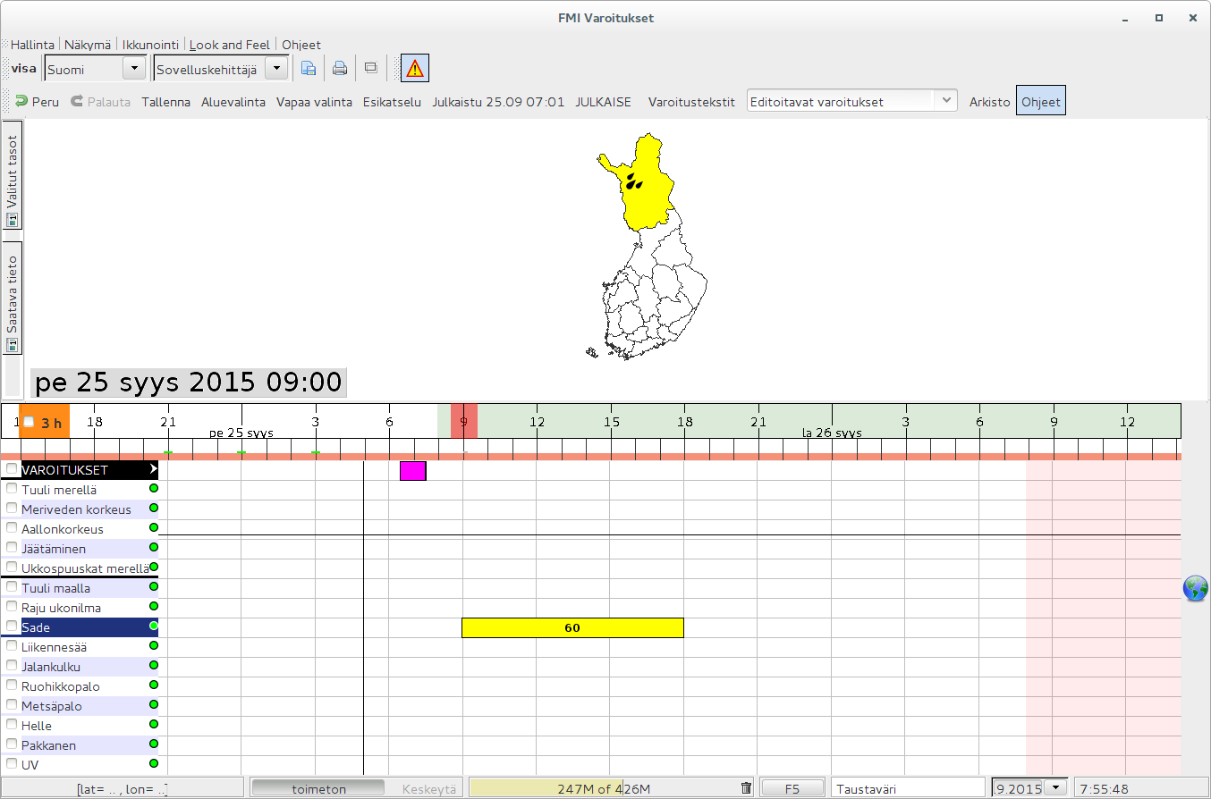

Slide 10
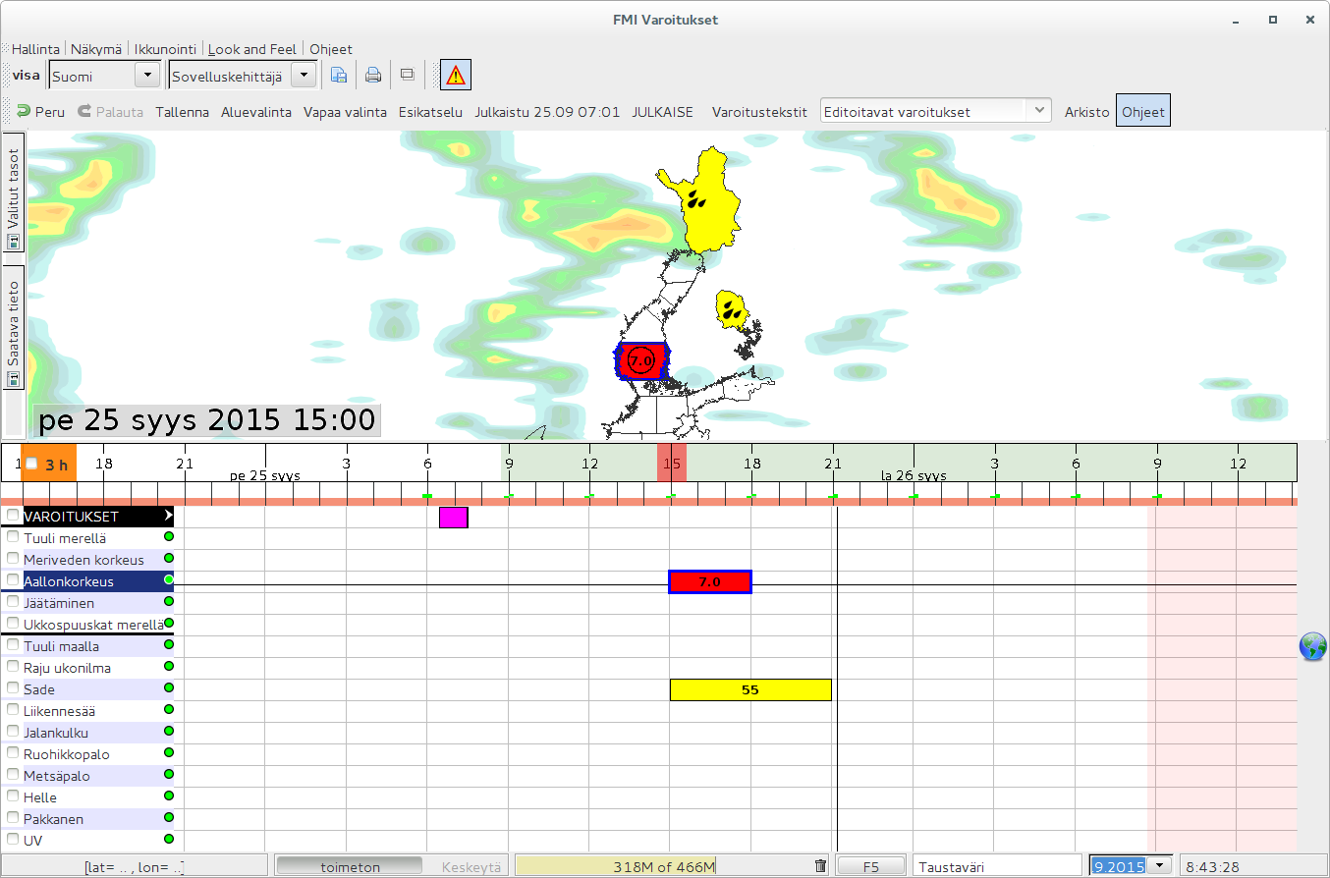

Slide 11
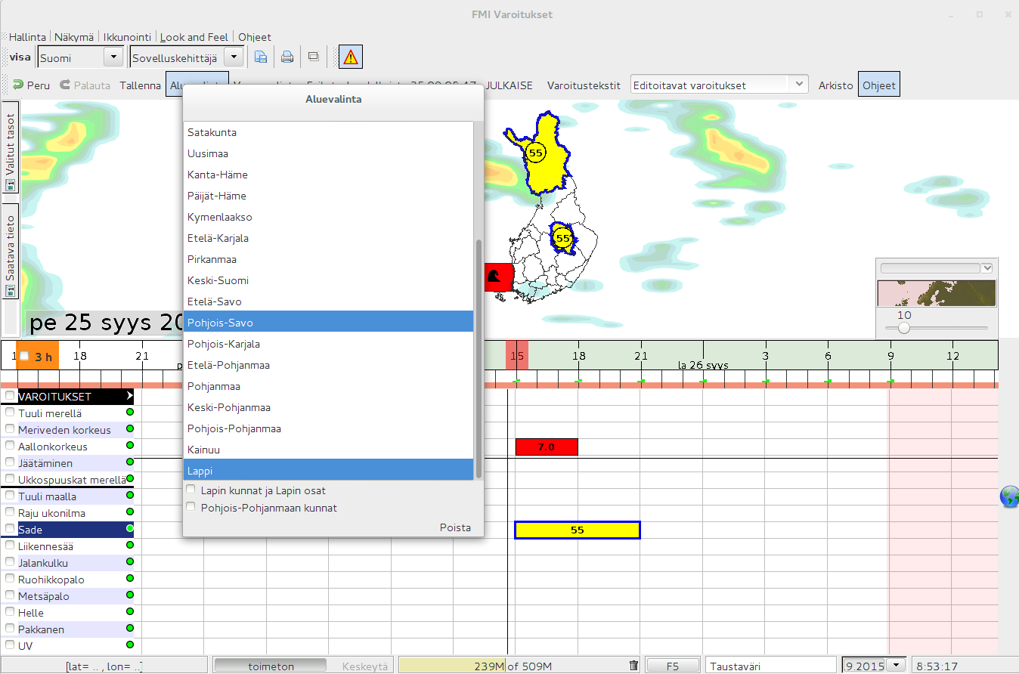

Slide 12
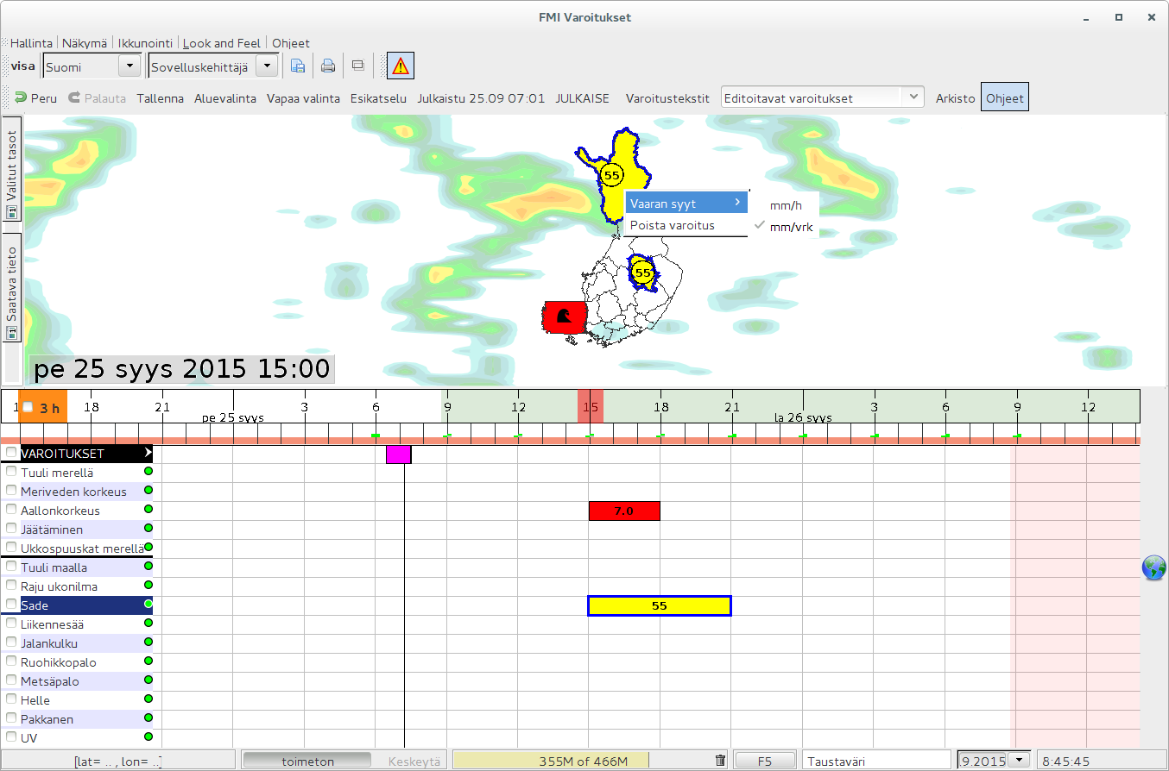

Slide 13
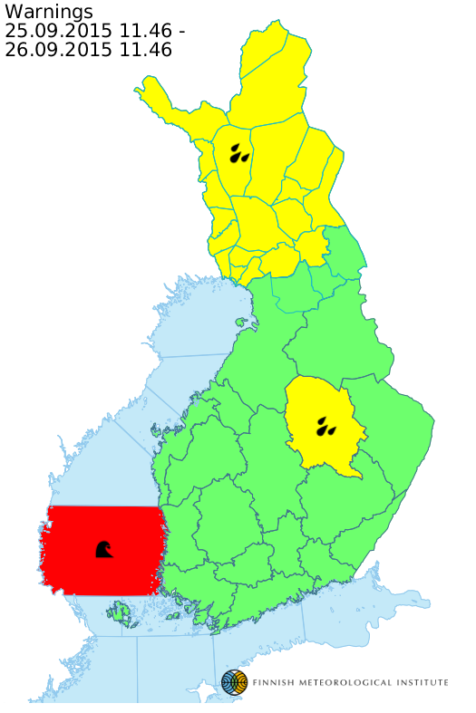

Slide 14
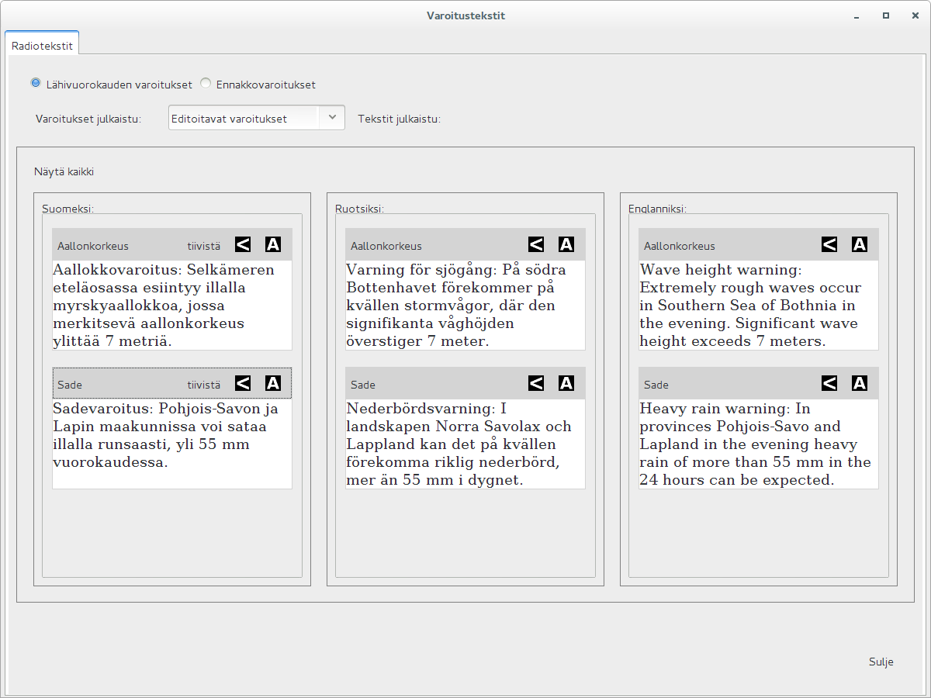

Slide 15
Output production

Slide 16
Output
Currently WOML is saved to MongoDB (temporary solution)
WOML = Weather Objects Modelling Language
https://agora.fmi.fi/display/WOML/
Defines meteorological phenomena or other objects in a semantically meaningful way by using GML feature model as the basis of the language
In progress: WOML input to PostGIS database
Initial plan was through Geoserver via WFS-T but Geoserver WFS-T does not support complex features (does output them though)
Result: Smartmet II output requestable from standard WFS and WMS interfaces

Slide 17
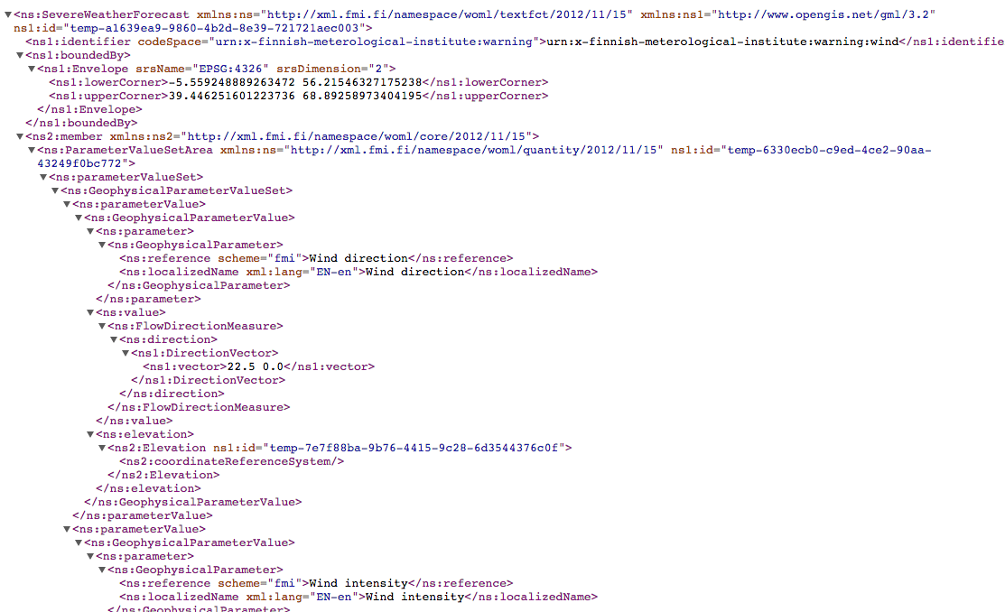

Slide 18
Products
The following warning products are generated from WOML:
Bitmap graphics to be displayed for example at the FMI public web site and in FMI mobile applications
XML syntaxes
CAP (MeteoAlarm)
CAP 1.2
Several FMI specific XML syntaxes (clients) is saved to MongoDB
GeoServer WFS
Mobile application
Media clients
Fmi.fi application
Warning texts
Warning text products are generated separately from other warning products
Warning text suggestions are created automatically from the published warning data
Meteorologists can edit automatically generated texts before publishing them

Slide 19
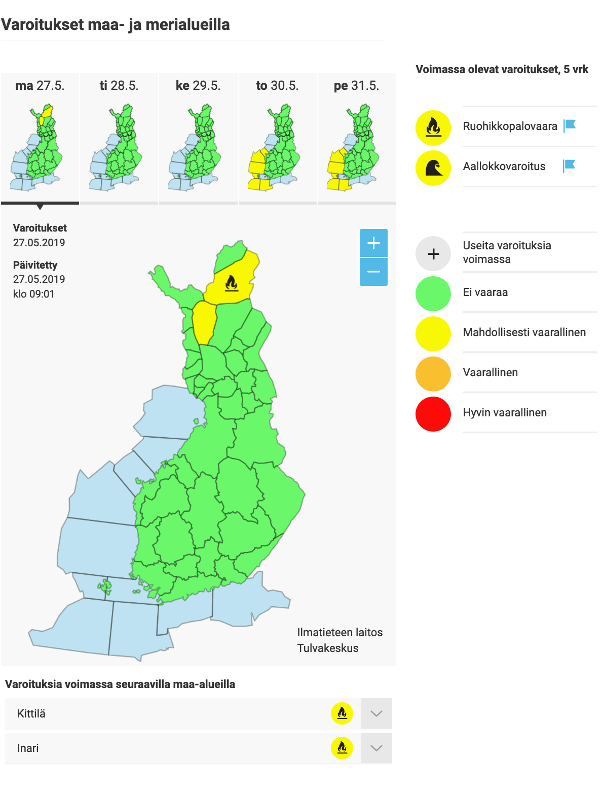
Products

