Slide 1
Predicting Weather Caused Train Delays Finnish Meteorological Institute

Slide 2

Project
Target to predict disruption of rail traffic caused by weather related phenomena’s
Time range: 2 days ahead (with time step of 1 hour)
Covering Finland
Problem restricted strictly to weather – delays of other trains are not considered in prediction
Clients are about to get new online train delay forecasting system
Project timeline 01/2018-10/2018
Project partners
IL, LiVi, Trafi, VR

Slide 3
Label Data
Possible labels for training
Trains delayed between stations
Trains delayed at end station of the route (minutes reported to every station to time stamp when train passed the station)
Trains delayed at whole route calculated from all stations
Trains delayed at whole route calculated from end stations
514 trainstation

Slide 4
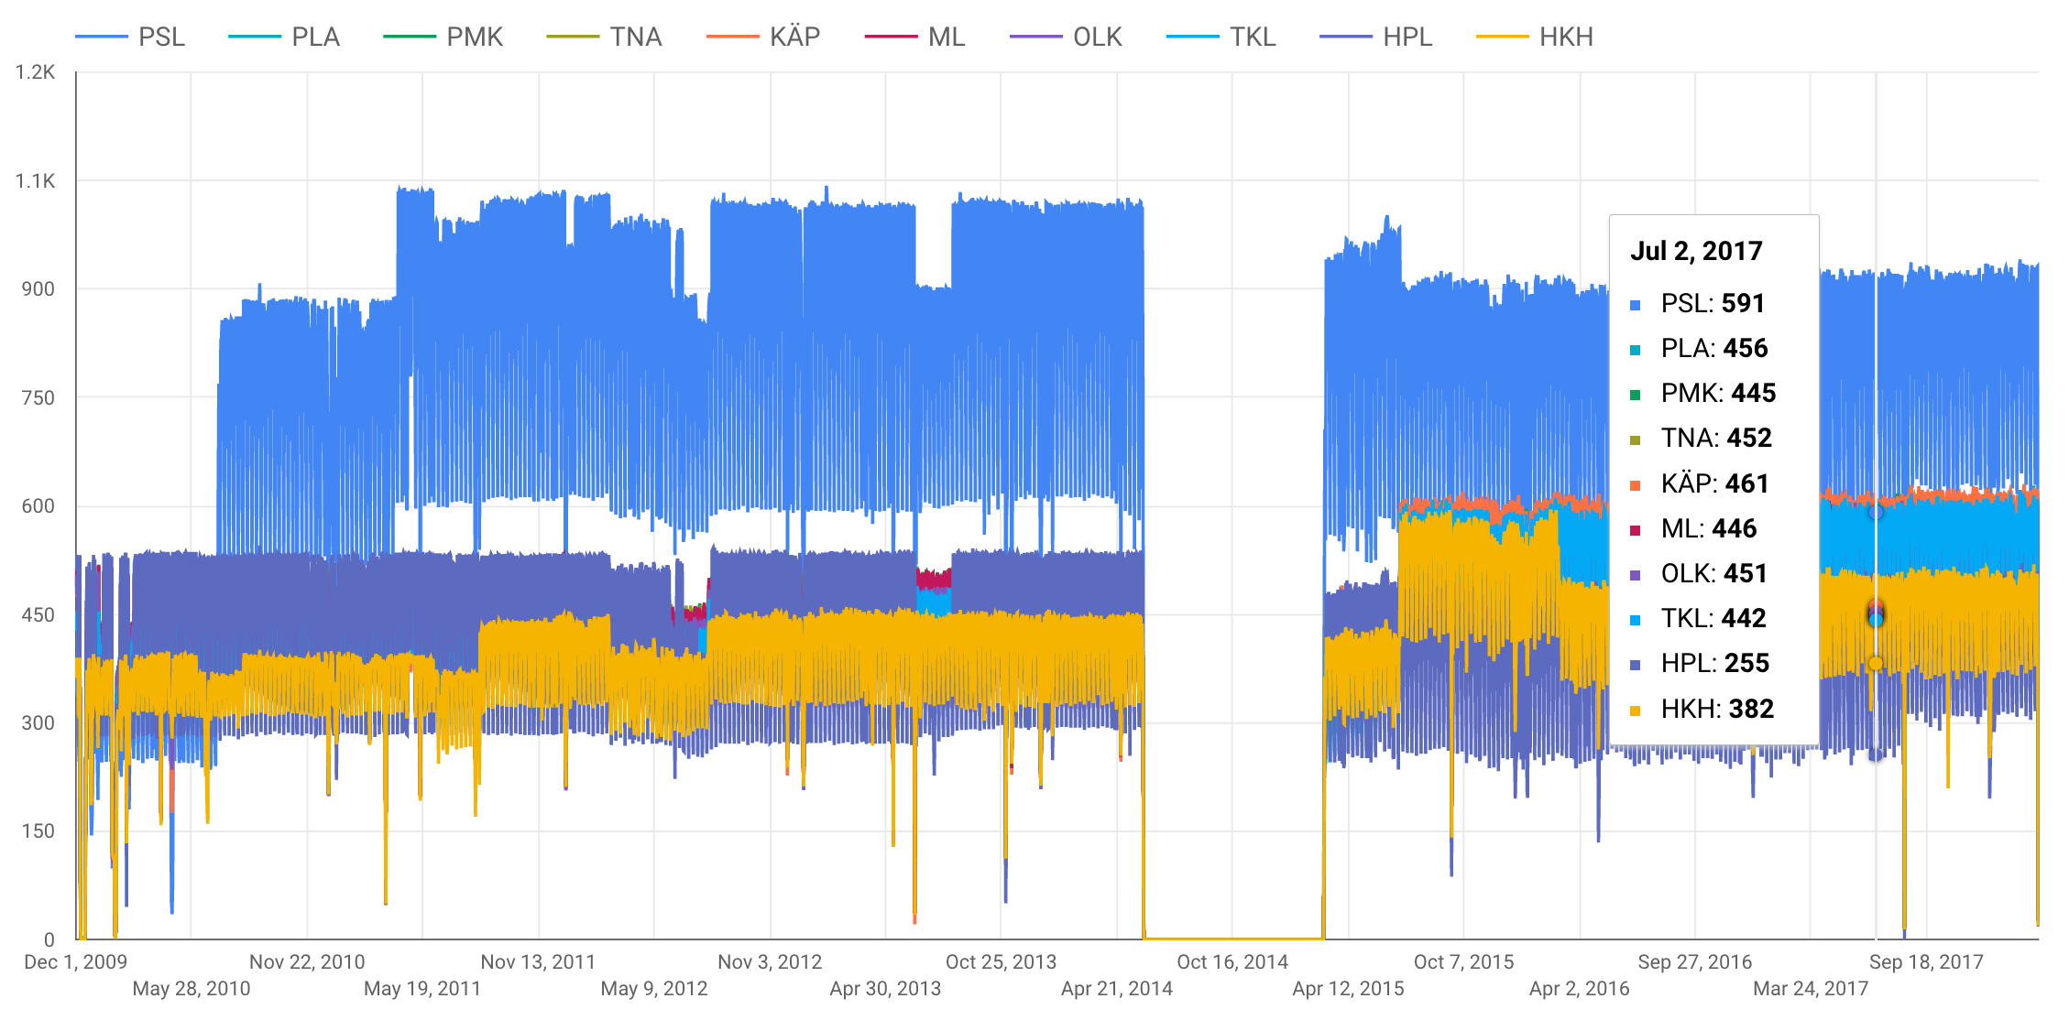
Label Data

Slide 5
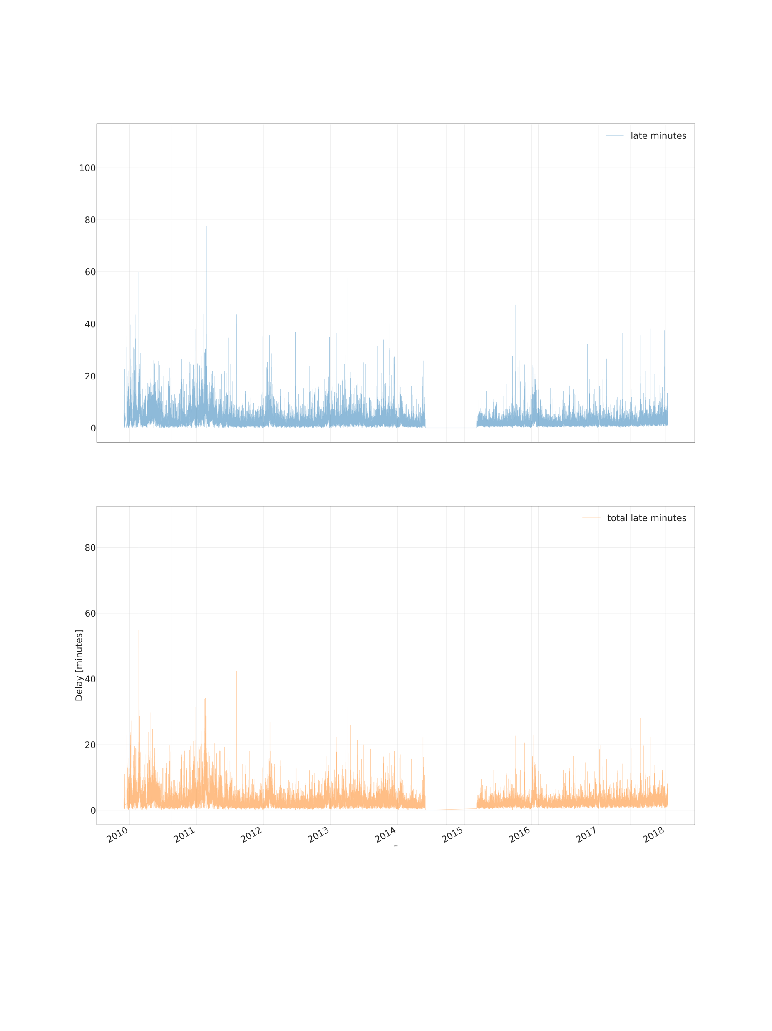
Label Data Mean delay between stations, passenger trains

Slide 6
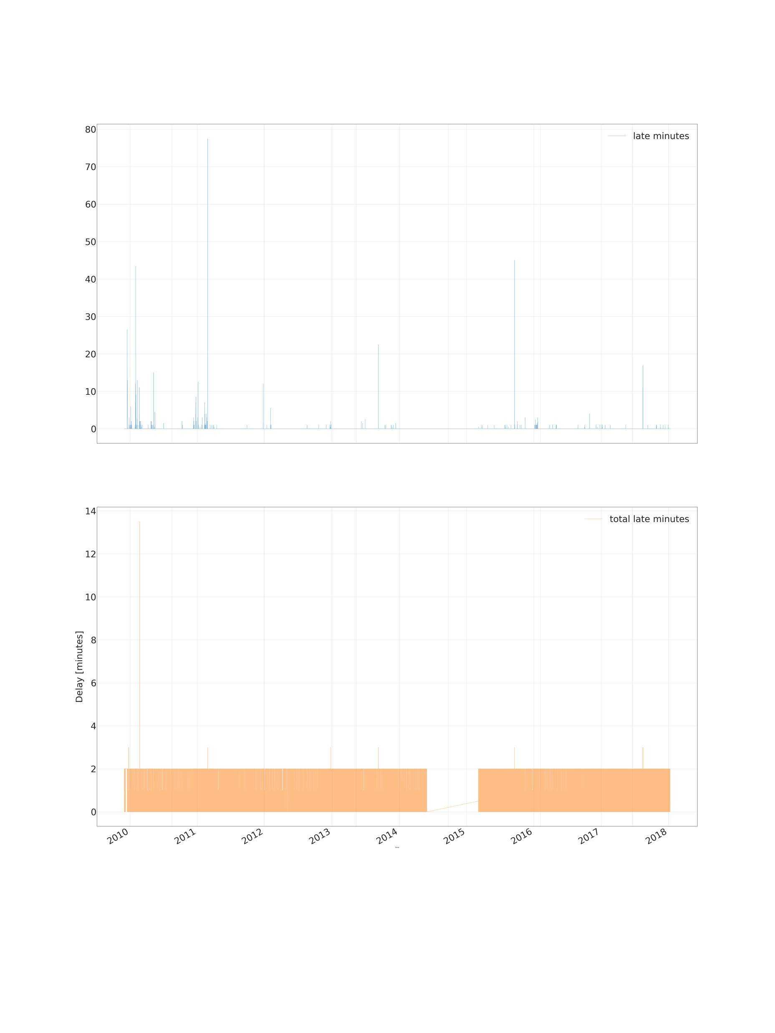
Label Data Median delay between stations, passenger trains

Slide 7
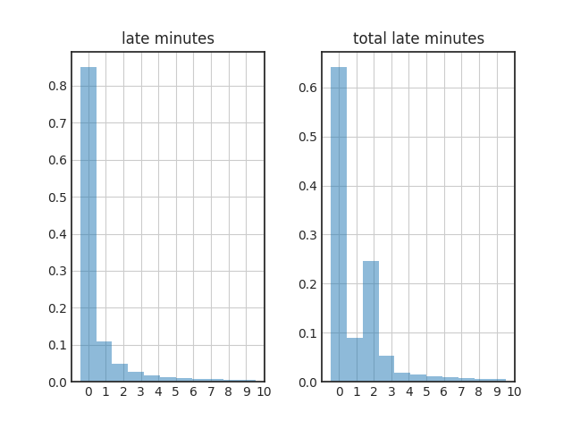
Label Data Histogram of delays, passenger trains

Slide 8

Label Data Heatmap of delays, passenger trains, 2010

Slide 9

Label Data Heatmap of delays, passenger trains, 2011

Slide 10
Feature Data
Features for training:
19 weather observation parameters near train stations
Four train types (intercity, commuter, cargo, other)
We consider only passenger trains
Training with data from 2010 to 2018
Dataset size 27 132 093 rows
Features for prediction
The same weather parameters as in training fetched from Harmonie numerical weather prediction model

Slide 11
Data pre-processing
Weather observation fetched for every train station for every hour when train has passed the station
Observations fetched with 100 km radius from train station using aggregation functions (min/max/mean/count) to minimize amount of missing values
Calculated 3h and 6h precipitation accumulation sums
Tried with and without imputation and normalisation

Slide 12
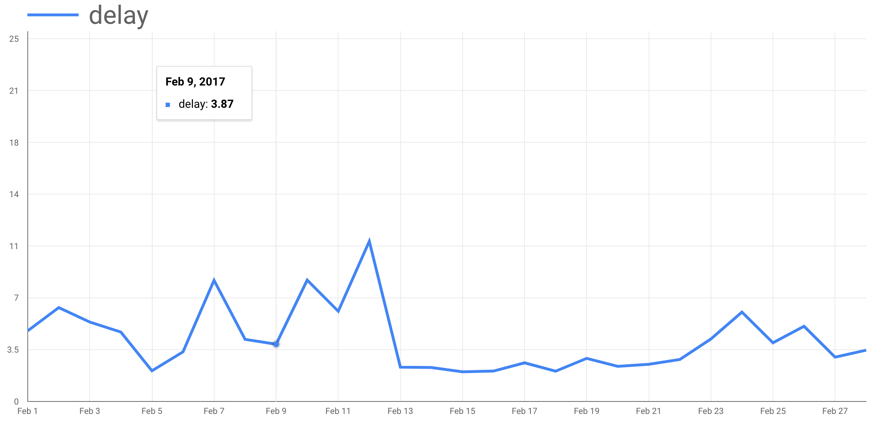
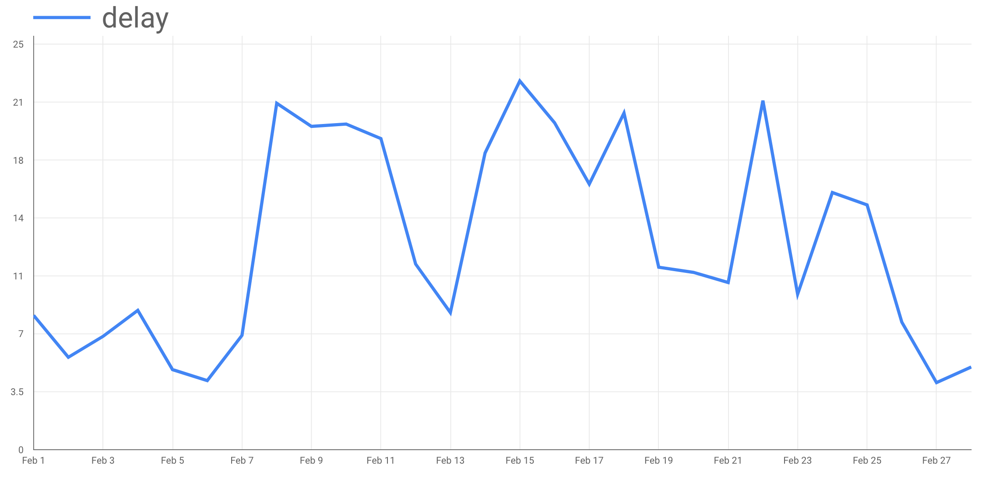
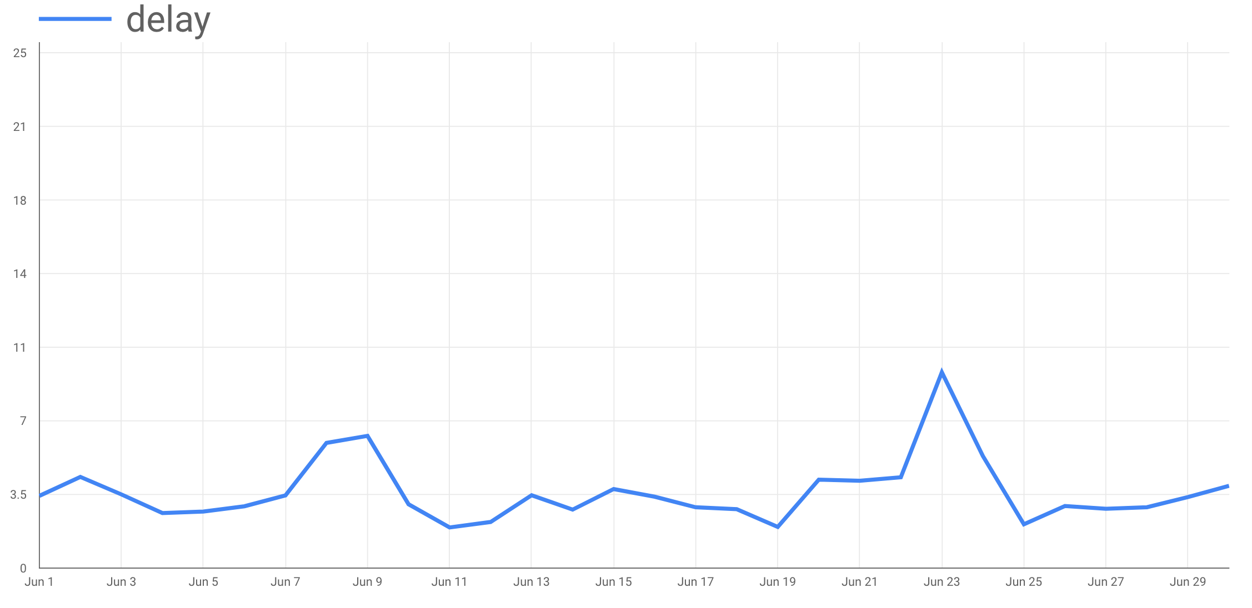
Train, validation and test data
Separated three selected months for testing model performance
Rest of the dataset splitted randomly to train and validation dataset with ratio 70/30 %
02/2017
02/2011
06/2016

Slide 13
Method
Few different ML methods considered
LR / RFR / LSTM / other?
Random search used for finding optimal hyper parameters of LR and RFR

Slide 14
Tools
Labels (train statistics) got as csv
Features (weather observations) fetched from http data server
Labels and features stored in Google Big Query
Prediction model implemented with SciKit (LR, RFR) and TensorFlow (LSTM)
Spark used for distribution
Fetching data
Possibly also for tuning LSTM

Slide 15
Data Train delay data
https://www.dropbox.com/s/oxpqnj2a6l1revn/gratu%202010-14.zip?dl=0
https://www.dropbox.com/s/wuogtxj31ans5fd/2015-18.zip?dl=0

