Slide 1
TRAINS Finnish Meteorological Institute

Slide 2

Project
Target to predict disruption of rail traffic caused by weather related phenomena’s
Time range: 2 days ahead (with time step of 1 hour)
Covering Finland
Project timeline 01/2018-10/2018
Project partners
IL, LiVi, Trafi, VR

Slide 3
Method
Few different ML methods considered
…
Features for training:
28 weather observation parameters near train stations
Possible labels for training
Total minutes summed from all trains:
Trains delayed between stations
Trains running late at every station
(Trains delayed at whole route calculated from all stations
Trains delayed at whole route calculated from end stations)
Training with data from 2010 to 2018
Training dataset size: ~ 30 000 000 rows
Features for prediction
The same weather parameters as in training fetched from Harmonie numerical weather prediction model

Slide 4
Tools
Following list is highly evolving
Labels (train statistics) got as csv
Features (weather observations) fetched from http data server
Labels and features stored in PostGIS
Prediction model implemented with TensorFlow
Spark used for distribution
Fetching data
Possibly also for training

Slide 5
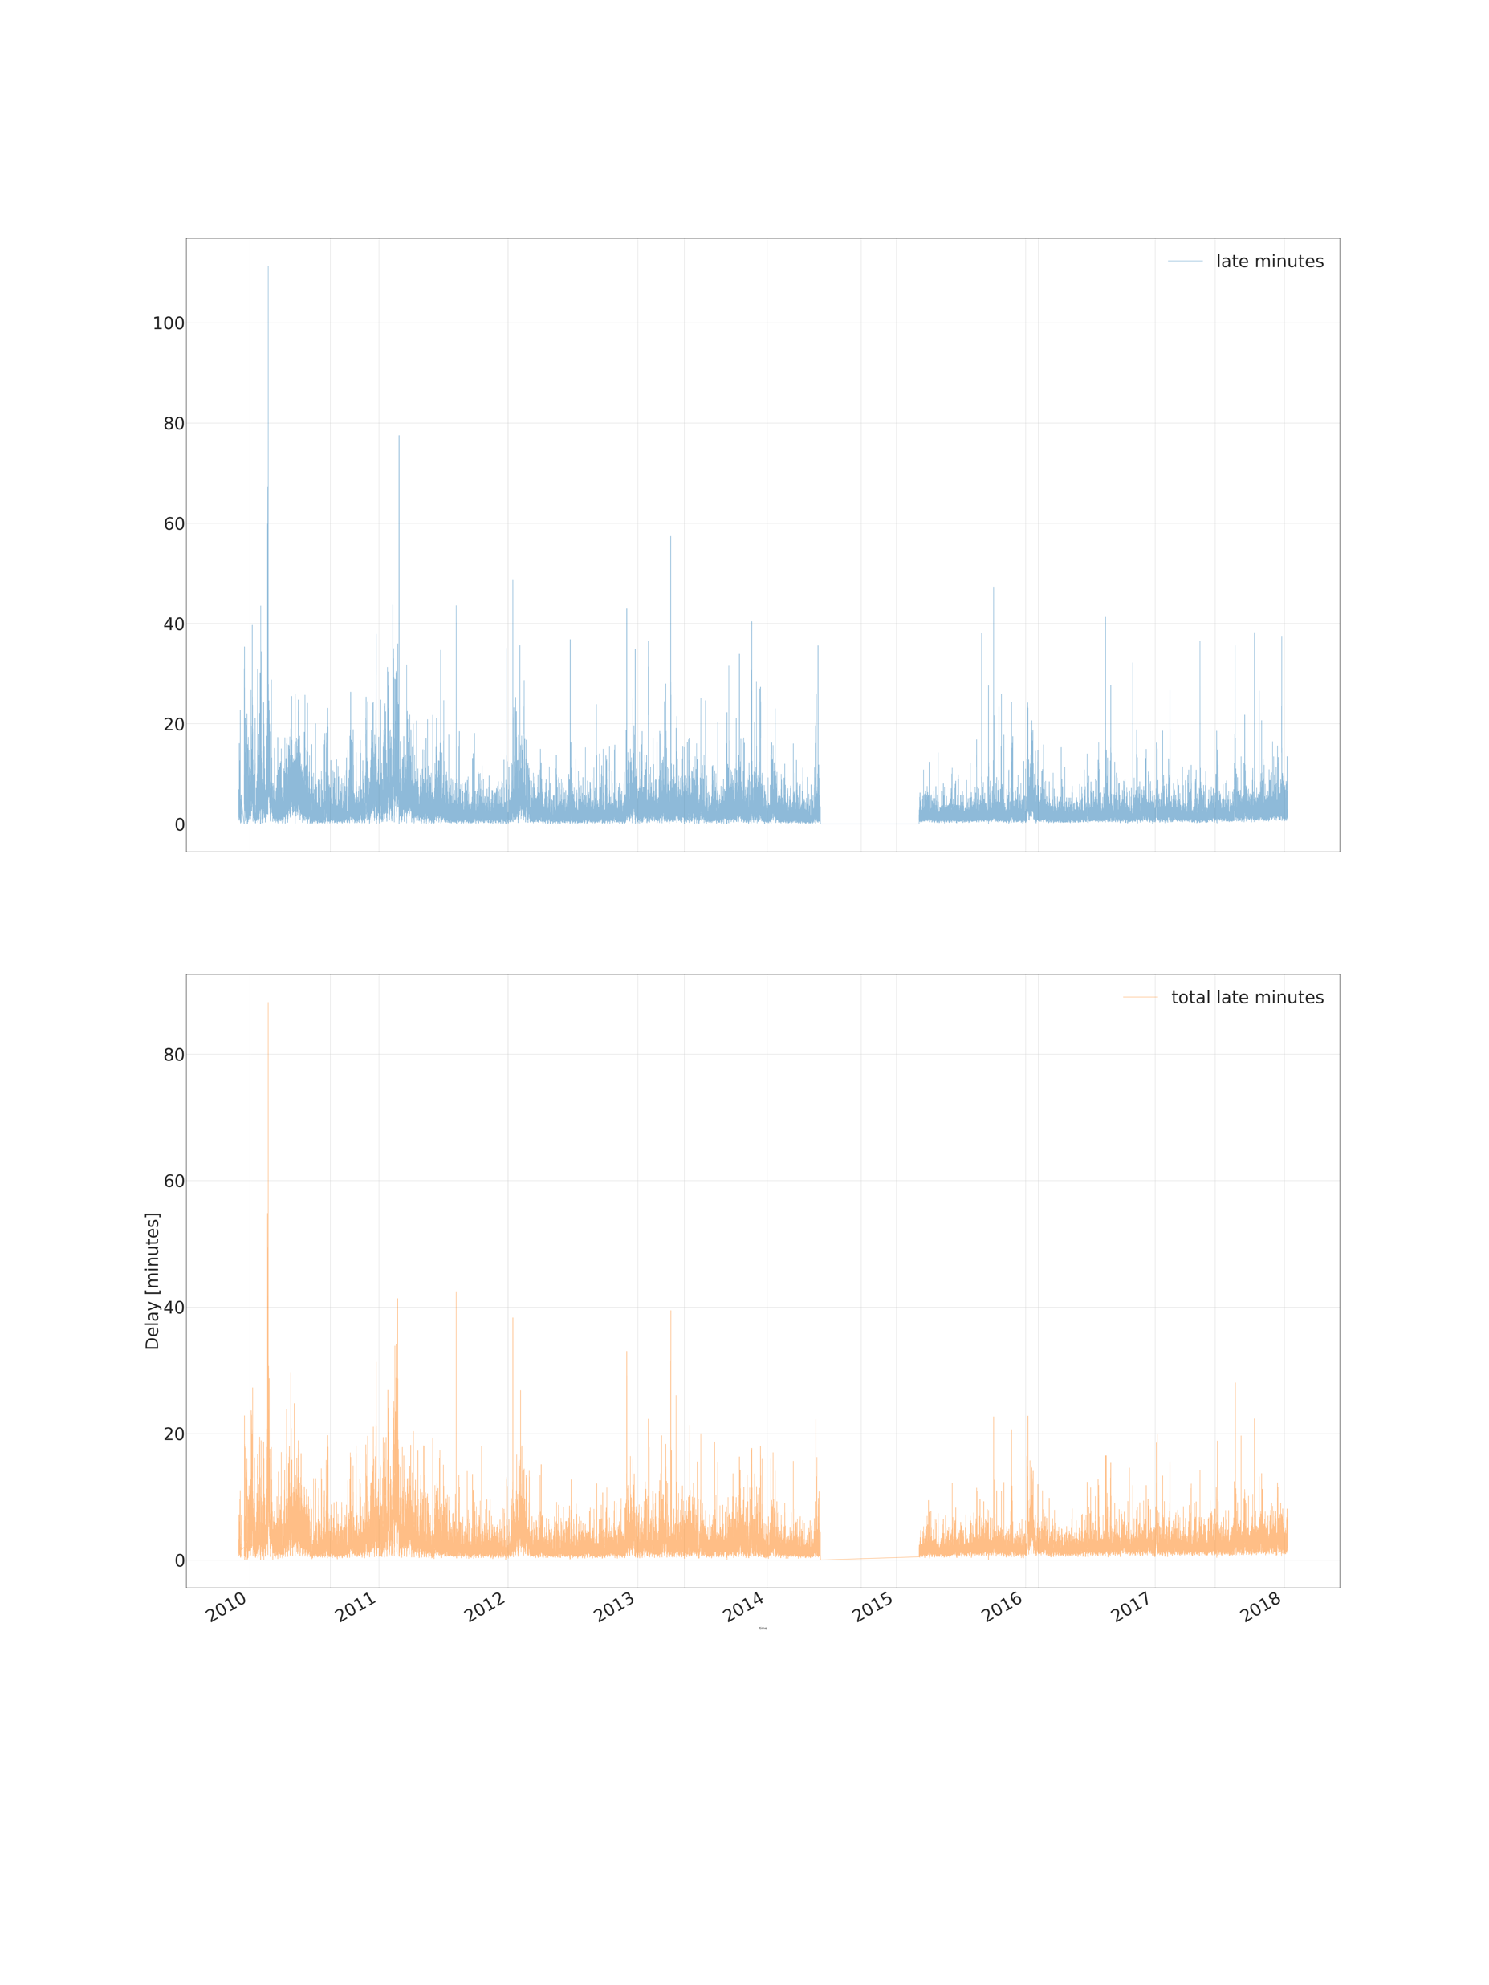
Data Mean delay between stations, passenger trains

Slide 6
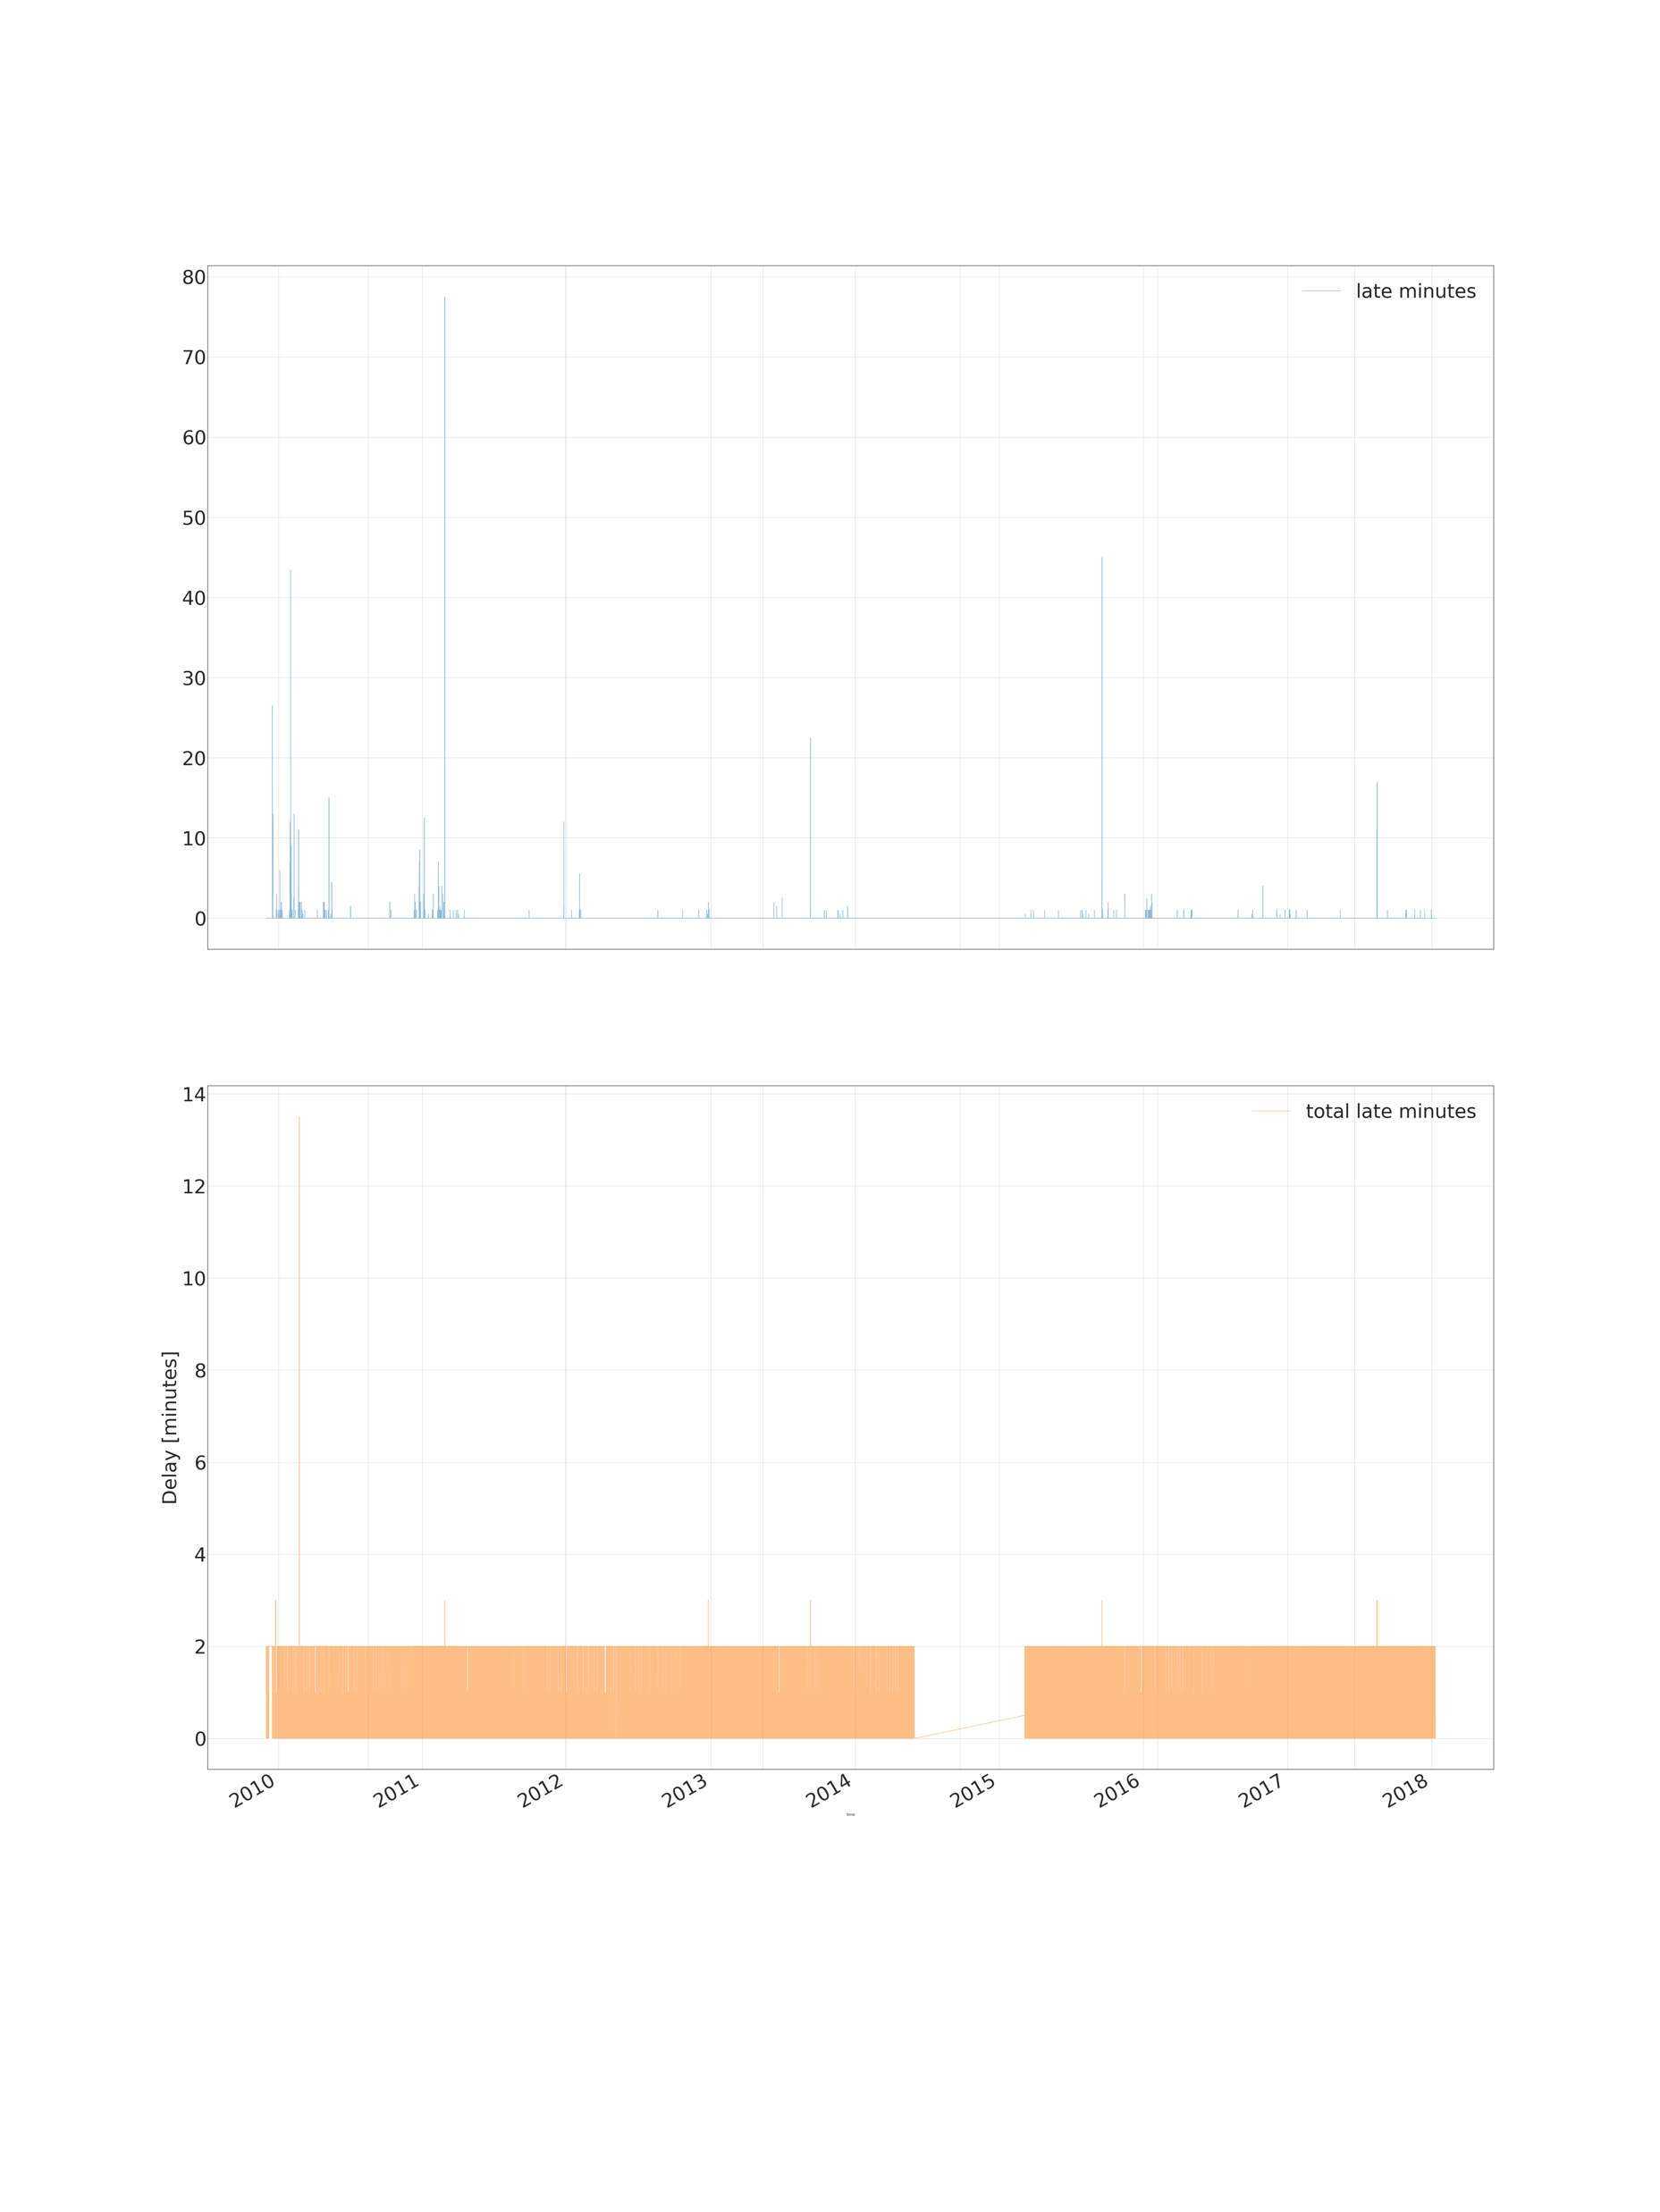
Data Median delay between stations, passenger trains

Slide 7
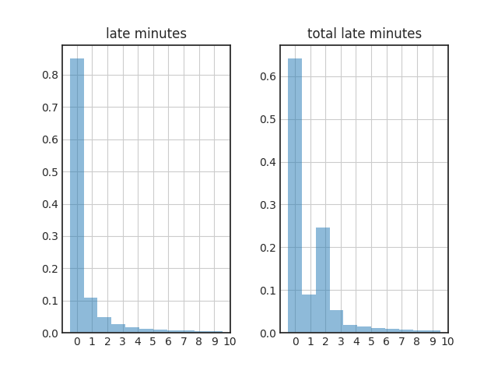
Data Histogram of delays, passenger trains

Slide 8

Data Heatmap of delays, passenger trains, 2010

Slide 9

Data Heatmap of delays, passenger trains, 2011

Slide 10
Data Weather paramaters
time;time
place;place
lat;lat
lon;lon
pressure;pressure
temperature;max_temperature
temperature;min_temperature
temperature;mean_temperature
dewpoint;max_dewpoint
dewpoint;min_dewpoint
dewpoint;mean_dewpoint
humidity;max_humidity
humidity;min_humidity
humidity;mean_humidity
winddirection;mean_winddirection
winddirection;sdev_winddirection
windspeedms;max_windspeedms
windspeedms;min_windspeedms
windspeedms;mean_windspeedms
windgust;max_windgust
windgust;min_windgust
windgust;mean_windgust
PrecipitationInstantTotal;max_precipitation1h
snowdepth;max_snowdepth
totalcloudcover;max_n
visibility2;min_vis
cloudbase;min_clhb
flashmultiplicity;flashmultiplicity
time;time
place;place
lat;lat
lon;lon
mean(mean_t(pressure:60:0));pressure
max(max_t(temperature:60:0));max_temperature
min(min_t(temperature:60:0));min_temperature
mean(mean_t(temperature:60:0));mean_temperature
max(max_t(dewpoint:60:0));max_dewpoint
min(min_t(dewpoint:60:0));min_dewpoint
mean(mean_t(dewpoint:60:0));mean_dewpoint
max(max_t(humidity:60:0));max_humidity
min(min_t(humidity:60:0));min_humidity
mean(mean_t(humidity:60:0));mean_humidity
mean(mean_t(winddirection:60:0));mean_winddirection
sdev(sdev_t(winddirection:60:0));sdev_winddirection
max(max_t(windspeedms:60:0));max_windspeedms
min(min_t(windspeedms:60:0));min_windspeedms
mean(mean_t(windspeedms:60:0));mean_windspeedms
max(max_t(windgust:60:0));max_windgust
min(min_t(windgust:60:0));min_windgust
mean(mean_t(windgust:60:0));mean_windgust
max(precipitation1h);max_precipitation1h
max(max_t(snowdepth:60:0));max_snowdepth
max(max_t(n:60:0));max_n
min(min_t(vis:60:0));min_vis
min(min_t(clhb:60:0));min_clhb

Slide 11
Data Train delay data
https://www.dropbox.com/s/oxpqnj2a6l1revn/gratu%202010-14.zip?dl=0
https://www.dropbox.com/s/wuogtxj31ans5fd/2015-18.zip?dl=0

