Slide 1
CIS 6375 Distributed Systems Security Summer 2016
Dr. Eduardo B. Fernandez
Dept. of Computer Science and Eng.
Florida Atlantic University
http://faculty.eng.fau.edu/fernande/
ed@cse.fau.edu
Notes:
Dr. Fernandez is a Professor of Computer Science and Engineering at Florida Atlantic University, Boca Raton, FL.
He has a MSEE from Purdue University and a Ph.D. in Computer Science from UCLA.
He is the author of one of the first books published on database security and has written numerous papers on different aspects of security. He has also published a good number of papers on object-oriented design and fault-tolerant systems.
He has been a consultant for many companies, including IBM, Siemens, Harris, Motorola, and others.

Slide 2
Do we have a problem?
Almost every week we have a major security incident.
Companies: Target, Sony (twice), Home Depot, Goodwill, JP Morgan, Chick-fil-A, Neiman Marcus, Michaels,…
Government: IRS, DOE, OPM,…
Physical systems: German steel mill
Medical systems: several, e.g. Anthem
Point of sale: Target, Michaels, Home Depot, …

Slide 3
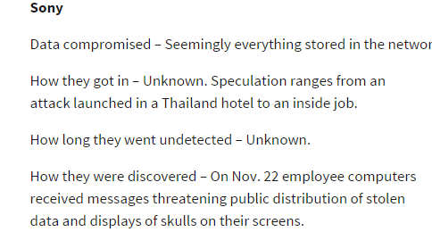
The top incidents of 2014 http://www.networkworld.com/article/2861023/security0/worst-security-breaches-of-the-year-2014-sony-tops-the-list.html?phint=newt%3Dnetworkworld_security_alert&phint=idg_eid%3Dc30d380502694c47d2c45cb7576fbd6b#tk.NWWNLE_nlt_security_2014-12-19

Slide 4
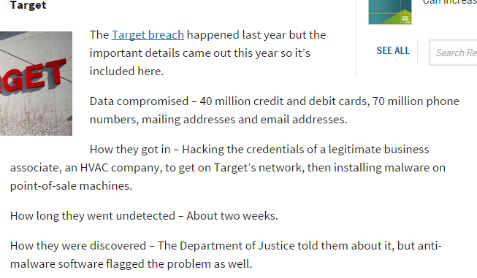

Slide 5
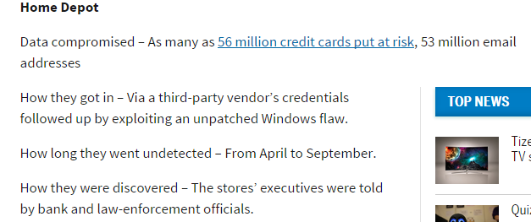

Slide 6
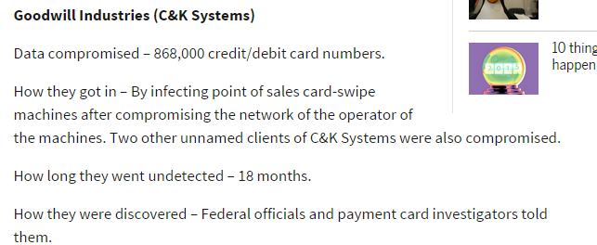

Slide 7
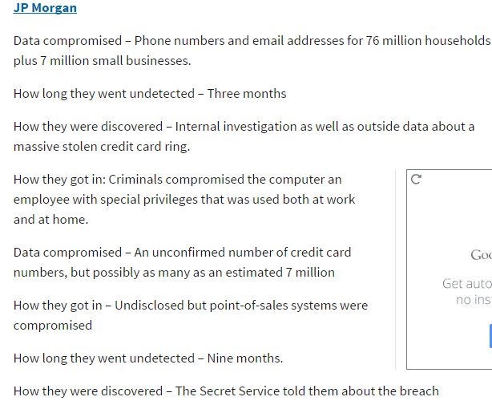

Slide 8
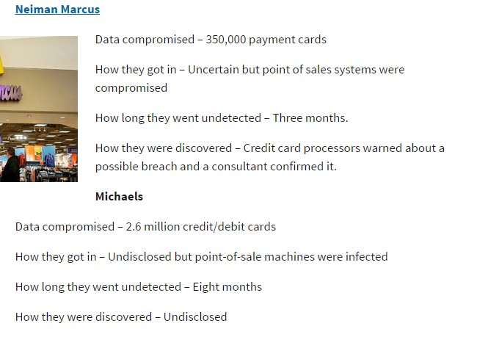

Slide 9
Attacks to medical devices http://www.healthcareinfosecurity.com/medical-device-hacks-dangers-a-7464/op-1
It's only a matter of time before a patient is killed or injured due to a targeted cyber-attack against a medical device - or even as the result of an unintentional cyber vulnerability. That was the reality-check warning from experts participating in a medical device cybersecurity workshop hosted by the Food and Drug Administration on Oct. 21.
Using a laptop computer to remotely tamper with a Web-enabled implanted medical device, such as a pacemaker, has the potential to be as deadly as using a gun in an assassination attempt, says Jason Lay, manager of cyberthreat information at the U.S. Department of Health and Human Services. "We know this possibility is very real.“
In addition to potential premeditated murder scenarios, patients could be harmed in other circumstances, such as a cybersecurity attack by a nation state on an unprotected medical device that's used as an entry point to steal an academic medical center's intellectual property, says Ray Strucker, special agent in the FDA's criminal investigations office.

Slide 10
Even guardians of Internet Security are targets
The Web site of ManTech Int., a $2.6 billion computer security company that won a major F.B.I. contract, sells its services this way:
“Whether an intrusion is conducted by a skilled outsider with criminal intent, an adolescent hacker seeking a thrill or a disgruntled employee bent on revenge or espionage, the potential risks to the organization are enormous.”
A band of Internet vigilantes, Anonymous, sneaked into ManTech’s computers to demonstrate the company’s insecurity. The group released what it said were internal company documents and taunted the company online: “It’s really good to know that you guys are taking care of protecting the United States from so-called cyber threats.

Slide 11
Attack to German steel mill http://www.theregister.co.uk/2014/12/22/hackers_pop_german_steel_mill_wreck_furnace/
Hackers have caused "serious damage" after breaching a German steel mill and wrecking one of its blast furnaces.
The hack of the unnamed mill, detailed in the annual report of the German Federal Office of Information Security, was pulled off after a victim fell for a phishing email.
Hackers then pivoted to the production network, a feat that should not be possible according to best practice that requires separation between industrial control systems and the public internet.
"The result was that a blast furnace could be shut down“
"The attackers were knowledgeable in conventional IT security and had extensive knowledge of applied control and production processes.“
The attacks likely demonstrated the mill had not employed sufficient separation of internet-facing and critical production networks.

Slide 12
Hackers’ $81 Million Sneak Attack on World Banking http://www.nytimes.com/2016/05/01/business/dealbook/hackers-81-million-sneak-attack-on-world-banking.html
Swift — the Society for Worldwide Interbank Financial Telecommunication — is billed as a supersecure system that banks use to authorize payments from one account to another.
But last week, for the first time since hackers captured $81 million from Bangladesh’s central bank in February, Swift acknowledged that the thieves have tried to carry out similar heists at other banks on its network by sneaking into the beating heart of the global banking system.
The admission that the attack was not a one-time event in a developing country but perhaps part of a broader threat has thrust Swift into a spotlight, raising questions about how securely money is being moved around the world. Some financial security experts point out the Swift system is only as safe as its weakest link.

Slide 13
Costs of a data breach
An attack on Google cost that company about $500,000 in 2005.
In a recent study, the average cost of a data breach for a company was $3.75 M in 2014, and the average cost for each stolen or lost record was $154.
Done by Ponemon Institute, sponsored by IBM

Slide 14
Showing in the movies
“Blackhat,” starts with a malware attack on a Chinese nuclear reactor.
Mr. Wang plays the M.I.T.-trained Chinese military official tasked with finding the culprit; Mr. Hemsworth plays his old programming-whiz college roommate, now incarcerated, whose prison sentence is commuted in exchange for helping solve the puzzle.
“The imitation game”, about Alan Turing, showing how he broke the German code.

Slide 15
Semi-technical Literature
Richard A. Clarke, “Cyber war”, ecco (Harper Collins) 2010.
Proposes a defensive backbone: hardening electric grids, increasing DoD networks, …
Thinks we need additional regulation
Bruce Schneier, “Data and Goliath: The Hidden Battles to Collect Your Data and Control Your World”, W.W. Norton & Co., 2015

Slide 16
http://www.networkworld.com/article/2893365/security0/shortage-of-security-pros-worsens.html?phint=newt%3Dnetworkworld_security_alert&phint=idg_eid%3Dc30d380502694c47d2c45cb7576fbd6b#tk.NWWNLE_nlt_security_2015-04-20
High salaries reflect the demand for security experts. The average IT starting salary is expected to climb 5.7% in 2015, according to Robert Half Technology (RHT). Five out of six security titles in RHT’s annual salary guide are getting larger-than-average bumps in pay for new hires:
Chief security officer: starting pay ranges from $134,250 to $204,750, a gain of 7.1% compared to 2014;
Data security analyst: $106,250 - $149,000, up 7.4%;
Systems security administrator: $100,000 - $140,250, up 6%;
Network security administrator: $99,250 - $138,500, up 5.3%;
Network security engineer: $105,000 - $141,500, up 6.7%; and
Information systems security manager: $122,250 - $171,250, up 6.6%

Slide 17
About this course
Its objective is to provide a conceptual overview, how attacks and defenses relate to the system architecture (holistic view)
The Internet is complex, is evolving rapidly, and global understanding is fundamental for security
Emphasis on important new developments: web services, clouds, wireless systems, standards, patterns
An engineering, not theoretical, approach.
Use of patterns and UML to provide some precision

Slide 18
Another similar opinion
The mantra of any good security engineer is: “Security is not a product, but a process.
It's more than designing strong cryptography into a system; it's designing the entire
system such that all security measures, including cryptography, work together. “
– Bruce Schneier

Slide 19
Critical thinking
Emphasis on analysis to understand the complete picture, look at a combination of specific components—architectural view—and see the resultant effect on security
Synthesis: what should we add or change in a system to get a given degree of security; how to build secure systems.
Critical thinking, no blind application of rules
Design-oriented problems do not have algorithms or unique solutions

Slide 20
About me
Professor of Computer Science at Florida Atlantic University, Boca Raton, FL., USA
Worked at IBM for 8 years (L.A. Scientific Center).
Wrote the first book on database security (Addison-Wesley, 1981) and two books on security patterns (2006 and 2013)
Author of many research papers
Consultant to IBM, Siemens, Lucent, Huawei,…

Slide 21
Chilean-Italian-American
Born in Chile
My mother was Italian, born in Cingoli, Macerata, Marche
My father was of Spanish origin
I have lived in the US since 1973
My wife is Chinese (from Shanghai)
My two daughters (17 and 25)were born in the US

Slide 22
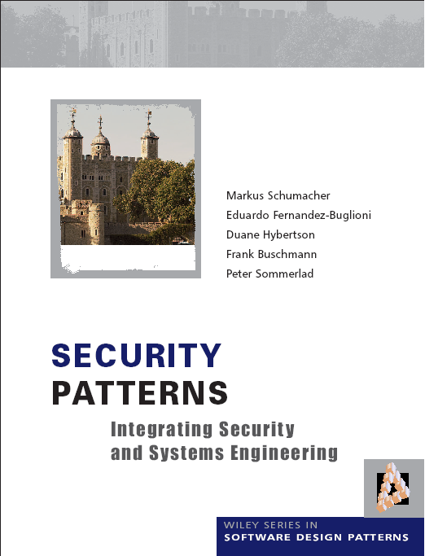

Slide 24
Course details I
Prerequisite: general background on operating systems, architecture, and languages. Some UML
Content: Most practical information systems are distributed systems. This comes from the need to provide access to corporate information to distributed employees and customers and to adapt to application needs. This course considers the security issues of such systems together with possible solutions. We consider as reference context Internet-based systems. We use UML and patterns to describe architectures. We discuss security in new types of systems such as web services, cloud computing, and cyber-physical systems. We analyze threats in these systems. We present a methodology to build secure distributed systems.. We consider attacks and defenses. Use of security patterns to describe systems.
Textbooks: E.B.Fernandez, The Design of Secure Systems, class notes
My book on patterns. Papers and notes
All can be found in Blackboard, except my book on patterns.
General Reference: W. Stallings and L. Brown, Computer security:
Principles and practice (3rd. Ed.), Prentice Hall 2015.

Slide 25
Course details II
E-mail: ed@cse.fau.edu
Web page: http://www.cse.fau.edu/~ed
Telephone: +1-561-843-4352 (only for emergencies)
Goals: Security problems in the combination of the Internet with Intranets. Need to protect all architectural levels. Understanding of how to coordinate hardware and software to provide protection against internal and external attacks.
Grading: Homework assignments (2) 30%
Take-home Final exam 70%

Slide 26
Objectives
Understanding of the security problems introduced in the combination of the Internet with Intranets, mobile devices, and sensors.
Understanding of how all aspects of a computer system contribute to security.
Providing a perspective on how a variety of mechanisms should work together to defend a system
Developing ability to evaluate and compare diverse systems or mechanisms with respect to their security.
Basic understanding of the theoretical and conceptual aspects that are needed to build secure systems
Basic use of patterns and UML
Critical discussion of socio-technical aspects of security

Slide 27
Approaches to security
Formal Models and cryptography
Theoretical
Analysis of
Security
Verification
UML/OCL models
Security patterns
Certification
Model-driven
Security
Vulnerability analysis
Code examination
Code-based
Security
Certification

Slide 28
Approaches to security
Theoretical models based on model checking do not prove security because they make many assumptions which may not be true in practice.
Cryptographic methods are effective but only for specific aspects: system or message authentication, secure transmission of messages, storage protection. They cannot stop attacks based on code or system flaws.
Code-based methods cannot find all vulnerabilities and many attacks exploit system interactions, not code flaws.
Model-based security builds a strong structure where parts of the system may be compromised but the essential parts of the system can be protected (submarine effect).

Slide 29
Need for a holistic view
Need for a holistic view, not disjoint pieces. Disjoint mechanisms cannot prevent threat that are combinations of legal actions
Security should be based on institution policies
Methods based on local protection, e.g., cryptography , are very important to enforce the high-level restrictions but are not adequate in isolation.
Code-based security is incomplete, security is a systems problem
Notes:
Without institution policies security is hopeless. In that case security will become a series of patches and isolated measures with enormous holes in between.
This is the case of many places now.

Slide 30
Outline
1. Introduction and review: Motivation and definitions. Internet and Intranet-- Structure, growth, possibilities. Environment for security. Effect of new technologies. Related subjects. The Internet and its threats. Vulnerabilities and threats: Viruses, worms, denial of service, attackers.
Institution, legislation, and privacy policies. Compliance. Forensic policies. Security models: Access matrix, multilevel, mandatory, discretionary models. Role-Based Access Control. Patterns for models.

Slide 31
Outline II
2.. Distributed systems security.
3. Security patterns. Misuse/threat patterns. Other types of patterns. Overview of UML.
4. Methodologies for building secure distributed applications. Secure Solution Frames
5 Distributed architectures. Secure versions of patterns: Broker, MVC.
Agents. P2P systems. Middleware.
6. SOA and Web services: architectures, attacks, and standards. Web services patterns. Identity. Misuse patterns. XSS and other attacks
7. Security in cloud computing. Threats and defenses. Patterns and misuse patterns. Access Control, Infrastructure security. OpenStack security.
8. Cyber-physical systems. Threat modeling. Smart grid, vehicles. The Internet of Things. Fog computing.

Slide 32
Value of information
We rely on information for our credit, health, professional work, business, education,…
Data is valuable for individuals and institutions
This value attracts criminals, terrorists, and vandals
Illegal access (reading, modification, or destruction) to information can produce serious problems

Slide 33
The security problem
Unauthorized data disclosure (confidentiality or secrecy).
Unauthorized data modification (integrity). May result in inconsistencies or erroneous data. Data destruction may bring all kinds of losses.
Denial of service—Users or other systems may prevent the legitimate users from using their system. Denial of service is an attack on the availability of the system.
Lack of accountability—Users should be responsible for their actions and should not be able to deny what they have done (non-repudiation).

Slide 34
The meaning of security
Security implies providing these objectives in the presence of attacks
Security requires technical, managerial, and physical countermeasures (defenses)
We only consider technical aspects here
A related aspect is privacy, a legal and ethics concern

Slide 35
Attacks and defenses
The generic attacks are realized in two basic ways: by direct attacks from a person trying to exploit a vulnerability or flaw in the system, or using malware, software that contains code that exploits one or more of these flaws
Security defenses may operate in one or more of three modes and we need to combine them:
Prevent or mitigate an attack. Prevention means completely stopping the attack while mitigation implies partial defense or reducing its effects
If we cannot stop or mitigate the attack, at least we should be able to know that an attack is happening, i.e., we should detect the attack. Detection is also useful to stop an attack because it can alert other mechanisms to take action
After the attack has happened we need to have ways to recover from its effects and analyze it so we can improve the system

Slide 36
Countermeasures (defenses)
Identification and Authentication (I&A)—Identification is a user or system action where the user provides an identity. Authentication implies some proof that a user or system is the one he/it claims to be. The result of authentication may be a set of credentials, which later can be used to prove identity and may describe some attributes of the authenticated entity (See Chapter 4).
Authorization and Access control (A & A)—Authorization defines permitted access to resources depending on the accessor (user, executing process), the resource being accessed, and the intended use of the resource. Access control requires some mechanism to enforce authorization (See Chapter 2).
Logging and Auditing (L&A)—Implies keeping a log of actions that may be relevant for security. These functions can be used to collect evidence for prosecution (forensics) and to improve the system by analyzing why the attack succeeded.
Hiding of information—It is usually performed by the use of cryptography but steganography is another option.The idea is to hide the information in order to protect it. ( Chapter 3).
Intrusion detection—Intrusion Detection Systems (IDS) alert the system when an intruder is trying to attack the system (Chapter 7).

Slide 37
Basic security architecture
Authentication must happen first
Authorization rules define what is allowed or not allowed (who can see what and how)
Lower architectural levels enforce authentication and authorization
Cryptography protects communications, stored data, and provides non-repudiation and authentication
Logging for future auditing
You have to know where to apply these mechanisms
Too much is expensive and slow; too little is insecure

Slide 38
Related aspects
Assurance is a measure of the trust we put on a system as being able to provide the required degree of security
Risk analysis is the study of possible attacks and their impact in terms of money and time. We need it to perform some risk analysis in order to decide on the investment on systems and personnel to provide security. We need to enumerate the threats to the system to know how much effort and money we should invest to make the system secure
Governance refers to the responsibilities of the institution directors to define policies and regulations to handle their information. Typically, directors focus on increasing the value of their assets but don’t pay much attention to their security. According to statistics, more than 50% of the businesses in the world spend 5% or less in their security budget.

Slide 39
More Related topics
Reliability and fault tolerance—Controlling the effect of accidental errors
Dependability—confidence that the system will follow its specifications
Survivability—ability to provide service in the presence of disruptions
Privacy—an individual right, not a technical issue

Slide 40
Socio-technical issues
Ethical aspects
Balancing security with privacy: Snowden case
The threat of data mining
Is open-source code more secure?
Should we hire hackers?
The Sony case
Cyberwar threat

Slide 41
Some causes for the security problem
No use of good software development methodologies, e.g. no object-oriented programming. Emphasis on fast methods.
Lack of modularity. Systems that cannot be decomposed as a marketing strategy. These systems lack well-defined interfaces.
No use of secure system design principles. The approach to develop secure code in many places is to look for specific vulnerabilities in the code, a very difficult task.
Correction by patching. When a vulnerability is detected, the vendor issues a patch to stop it. This has the side effects of disturbing the execution of current applications and possibly creating new vulnerabilities.
Unnecessary complexity. Systems are built with more functions that are needed for most applications.
Outsourcing. To reduce costs many companies outsource code development and maintenance to other companies, usually in countries with lower salaries.
No sanctions against companies that expose customers’ data
Myths and misconceptions about security.

Slide 42
Some misconceptions
It is the user’s fault
It is the security administrator’s fault
Attackers are all outside
Cryptography and firewalls are enough
Patches for your system will solve the problem
See Oppliger, IEEE Computer June 2012.

Slide 43
Distributed systems
A distributed system contains autonomous computational units that interact (interoperate) with each other through messages and are connected through some type of network.
Why are distributed systems important? Most practical information and control systems are distributed systems. Examples: the Internet, intranets in companies, wireless networks, aircraft control systems, distributed databases, and distributed file servers

Slide 44
Architectures
The architecture of a system defines the system in terms of components (units) and of interactions between these units. Architecture includes: system topology and organization, decomposition into components, assignment of functionality to components, component interactions, system properties (nonfunctional requirements, e.g. performance, security), correspondence between requirements and units.
The architecture of a system is a basic determinant of its security; code flaws can be corrected or patched, architectural deficiencies cannot.

Slide 45
Security environments or contexts
Early systems were isolated and single user --few security problems
Mainframes brought many users but we knew them (registered)—complexity and attacks increased
Distributed systems increased the problem by scattering the users

Slide 46
Environments II
The Internet opened up our systems to unknown users—exponential growth in attacks
Wireless devices increase the problem because of their number and ubiquity
The widespread use of sensors will make security even worse

Slide 47
The web (WWW)
Universal Resource Locators (URLs) for addressing and linking
Hypertext Markup Language (HTML) for information
Hypertext Transfer Protocol (HTTP) for information transfer (client/server model)
5/3/2016
47

Slide 48
Basic Architectural components
Web browsers -- can request HTML documents, provide URL caching , support directories
Web servers -- receive user requests , find and return documents
Files or DBMS store documents
Documents -- pages or sets of pages
Notes:
The architectural structure of the web is also relatively simple:
Browsers: simple and standardized user interfaces
Servers -- Combinations of hardware and software to service requests for pages
Documents stored in files or DBMSs (Database Management Systems)-- In fact, we can see the whole corporate database as information that can be incorporated in web documents

Slide 49
Basic Internet architecture
Data
Web
browser’s
HTML
Web
servers
HTTP
users
Notes:
This is the basic functional architecture.
The web browser represents the client side.
The web server is the server side and accepts requests for pages.
The HTTP protocol is a basic protocol for transmission of pages
The pages may reside on files or in database management systems

Slide 50
Web documents
Hypertext /multimedia
Passive or active (contain links to programs)
Fixed or dynamic (assembled on request)
Potentially all institution data can be considered documents
Notes:
Documents can include links to other documents (hypertext) and different types of media (multimedia)
Passive documents are pages that include only text or images
Active documents incorporate exceuting programs and can display animation, perform calculations, etc.
Fixed pages have a predefined structure
Dynamic pages are variable and contain variable information

Slide 51
XML
XML is a metalanguage to define the meaning and structure of documents. A subset of SGML (Standard Generalized Markup Language). Basic ideas: use tags in data items to define their meaning, relate data items through nesting and references.

Slide 52
Internet impact
Used practically everywhere in the world
More than 300 million pages
Changes in information access and dissemination
New ways of institution operation
New user activities
New architectures
Notes:
Not many countries are left without access to the Internet
If you spend the rest of your life surfing the web you could not even look at all the pages
The Internet has had a profound effect on the way we use information
Enormous impact on business
New activities, not possible before and old activities performed in a better way
Different and more complex system architectures

Slide 53
Changes in information access
Larger variety of data : hypermedia documents, applets, components, relational databases, OO databases, …
New ways of accessing : direct downloading of content, remote forms filling, remote updates,...
Notes:
The way of accessing information has changed :
Documents or other types of content can be downloaded from anywhere in the web
Documents have a large variety, they come from anywhere: home PCs, corporate DBMSs, ...

Slide 54
New ways of operating
Mobile employees
Partners
Customer access to products, orders,…
Global business
Contractors
Notes:
Corporations have changed their was of doing busines. Not all of these are the result of the Internet but the Internet makes easier these ways of operating .
Employees on the road can access (read and write) corporate databases
A company may work on partnership in some business with one of its competitors.
Customers want to see the status of their orders
A company may have subsidiaries in many countries with different standards and laws
Increasing use of contractors

Slide 55
New user activities
Remote conferencing
Remote course taking
Cooperative work
Web shopping
Scheduling of activities
Synchronization of mobile users with business activities
Notes:
Some of these activities could not be done without the Internet, others can now be done better.
Remote conferencing with access to images, animation, …
Remote course taking is becoming popular : assignments posted in the web
Cooperative work: I can write papers with people in other countries
Shopping is taking flight this Christmas season

Slide 56
Hospitals on line
Insurance companies -- enroll patients on line, status of claims, benefits information
Medical labs -- laboratory results
Doctors -- advice to patients, consult with other doctors
Records on line--patients can access their records
Notes:
Health-providing institutions and insurance companies have extended their reach.
A user can access his insurance information and get enrolled in different programs online, can check staus of his claims, .benefits limits and restrictions,…
Some medical labs are putting exam results online
Patients can put their records in the Internet and if they are traveling a doctor in another country can access them in seconds.

Slide 59
Enterprise architectures

Slide 60
Components
There is no consensus in its definition. In some views, a component is a unit of independent deployment, a unit of third party composition, and has no persistent state
Other definitions add contractually specified interfaces. Others say it must have state
Require specific supporting frameworks
Examples: J2EE, .NET, CORBA

Slide 61
Web Services
A Web Service is a type of component that is available on the web and can be incorporated in applications or used as a standalone service
Require a standard supporting framework
The web is becoming a marketplace of web services

Slide 63
Architectures
Web services (eServices) are a part of the application layer
Web services are built out of XML, a lower-level data layer
A SOAP layer is used for XML message transmission
Internet layers and web server layers provide support for these layers

Slide 65
Changes to the environment I
Sensors
Sensors can be used to detect fires, flooding, burglaries, and many other events. Some use RFID devices, others are more elaborate. They introduce many useful functions but also new security problems such as repeated interrogations to provoke battery drainage. RFIDs are low-cost sensors. They are very useful to keep track of inventory and locate physical items and many companies are starting to use them. They can also be used for automatic tolls in highways and in implanted medical devices. They bring up, however, serious privacy and other security issues.
Peer-To-Peer systems (P2P)
P2P systems are based on the idea of systems without predefined roles that send or receive information from each other. They use bidirectional web services, grid computing, or similar approaches. In a P2P system all the nodes are able to find and consume, or offering and fulfilling information and processing services.

Slide 66
Changes II
Portable devices
These include cellular phones, PDAs, laptops, even iPods. They are usually wireless and in number they surpass by far the traditional computer systems. All these devices can be sources of vulnerabilities and malware specially oriented to them has started to appear. Their loss or theft provides a new source of attacks. The wireless medium in itself provides new ways to attack the systems. Because their location can be tracked there are also new privacy concerns.
Embedded systems
A computer system which is part of a larger system to which it adds some intelligence. Examples are computers in cars, cell phones, airplanes, washing machines, and voltage controllers in power transmission lines. They introduce new attacks such as attacks that disrupt system timing [Koo04].
Cyber-physical systems
A cyber-physical system (CPS) integrates computing and communication capabilities with the monitoring and control of entities in the physical world. Such control systems are normally distributed, real-time, and usually include embedded devices, sensors, and wireless links

Slide 67
Changes III
The Internet of Things (IoT)--the interconnection through the Internet of uniquely identifiable and addressable embedded devices. A thing can be a washing machine, a person with a heart monitor, a farm animal with a biochip, an automobile that has built-in sensors to alert the driver when tire pressure is low -- or any other natural or man-made object that can be assigned an IP address and provided with the ability to transfer data over a network.
Machine to Machine Communication (M2M)--technologies that allow both wireless and wired systems to communicate with other devices of the same type

Slide 68
Changes IV
Cloud computing.
Pools of virtual resources can be shared by users who pay for what they use. This is an attractive platform for small institutions with variable number of customers, which don’t need to make heavy investments to support their growth. Because the cloud is accessed through the Internet the usual security problems are present plus some new ones.
Open source software
Open-source software is making inroads in areas such as operating systems, web servers, and compilers. Their relative security is a controversial aspect, some believe they are more secure, others consider them less secure [Cow03] (See exercise 1.4).
Outsourcing of software development
Many companies send the development, maintenance, or servicing of their products to countries with lower salaries. This practice introduces or exacerbates security problems, such as the possible introduction of malware in the software

Slide 69
Threats
Definitions
Types of misuse
Internet vulnerabilities
Attacks

Slide 70
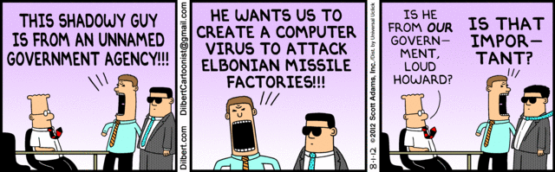

Slide 71
Securing systems
We need to understand the threats to the system to decide how to defend it
Excess of security mechanisms results in loss of performance, extra complexity, and higher costs
The objective is to provide an appropriate defense according to the value of our assets

Slide 72
Types of Threats
Direct attacks to the operating system
Direct attacks to the database system
Directs attacks to the application
Denial of service
Almost no attacks to the messages in the network
Malware: Trojan horses, viruses, worms
Repudiation

Slide 73
Definitions
A vulnerability is a situation or state that may be exploited by an attack (a code flaw, an unprotected port,…)
An attack is an attempt to misuse the system (violate confidentiality or integrity,…)
A defense (safeguard, countermeasure) is a way to block or mitigate (reduce) an attack
A misuse is a violation of some security property

Slide 74
Types of misuse
The outcome of misuse can be loss of confidentiality or integrity, theft of services, denial of service, defamation,…
An attack has a perpetrator, who has a motivation. The attack has a method of operation (modus operandi) to accomplish a mission with respect to a target (victim). The damage of a mission can be loss of assets, money, lives

Slide 75
Attackers
Insiders -- According to studies about half of the attacks to a system come from insiders [Neu99]. I think he means successful attacks.
Hackers -- Usually try to show off their ability by penetrating systems
Spies -- Industrial or government spionage
Organized crime—a large number of attacks with purposes of lucre, mostly confidentiality attacks
Terrorists—attacks to infrastructure systems, with purposes of disruption and destruction

Slide 76
Attack methods
Preparation—Information gathering, scanning, planting malicious code, masquerading (spoofing)
Activation—perpetrator-controlled, timed, victim activated
Mission—active (affects integrity and availability), and passive misuse (eavesdropping, inference), denial of service

Slide 77
Attack stages
<<actor>>
:Attacker
target1:
:Data
target2:
prepare Attack
activate Attack
read
modify/destroy
propagate

Slide 78
Threat/Misuse patterns
Describe threats and misuses from the point of view of the attacker.
We will use sequence diagrams (and more) to describe how an attacker performs a misuse, they describe attack scenarios
The pattern tries to show how the attacker works (modus operandi) so we can apply defenses to stop it
The objects in the sequence diagram represent architectural units of the target system

Slide 79
Malicious code (malware)
Trojan Horses—A Trojan Horse is an apparently useful program that has harmful hidden functions
Viruses – A virus is a program that attaches itself to another program, propagates, and usually causes some data destruction.
Worms—A worm is a program that propagates itself without infecting the host.

Slide 80
More varieties
Spyware—collect passwords, credit card numbers, or general info. (adware)
Spam—wholesale sending of messages, can be used to propagate viruses
Phishing—enticing users to disclose information
Some malware are combinations of the basic types and can combine worms with spam or spyware, these are called blended threats

Slide 81
More varieties
A bot or zombie is a computer that can be controlled by another through the introduction of a Trojan Horse or another type of malware.
Rootkit: Any software that takes control of an operating system, allowing illegal administrative functions. They alter parts of the operating system kernel and hide their presence.
A zero-day attack is an attack that takes advantage of a vulnerability just discovered (maybe only by the hacker) and for which there is no patch or detection method yet.
An advanced persistent threat (APT) is a set of stealthy and continuous hacking processes, often orchestrated by humans targeting a specific entity, usually organizations and/or nations for business or political motives.

Slide 82
Detection
Some malicious code is polymorphic (modifies itself during propagation), some comes encrypted (harder to understand), some just propagate, some destroy or leak information, some have delayed missions, some insert backdoors (for later attacks)
Metamorphic malware uses code obfuscation approaches such as code transposition, module rearrangement, and extra code, to produce variants of a core/base malware that are thus harder to detect. The variants have the same functionality as the core but different signatures, which makes them harder to identify by a signature-based detector
Detecting any malicious code is an undecidable problem (there is no general algorithm), but specific versions can be detected (antivirus products need to be periodically updated)

Slide 83
Incidents
The “salami slice” approach, where the attacker takes small amounts of money from many accounts [Whi77].
Three people in Miami were indicted for the theft of 130 million credit card numbers [Sto09].
A virus invaded Facebook in December 2009 and sent many messages offering merchandise in the name of some of the members.
In late 2009 a malicious program attacked Nokia phones and made small charges to the owner’s account. Phones can do more and more functions and with them come a variety of possible attacks.
A massive attack against Google was performed by Chinese hackers in January 2010, attempting to compromise the accounts of government opposition activists.
The two Sony attacks, 2013 and 2014

Slide 84
Hardware malware
So far, mainly software-based attacks have been considered and investigated, while hardware-based attacks have attracted comparatively little interest.
The design and production process of integrated circuits is mostly decentralized due to financial and logistical reasons. Therefore, a high level of trust has to be established between the parties involved in the hardware development lifecycle.
During the complex production chain, malicious attackers can insert non- specified functionality by exploiting untrusted processes and backdoors.
Hidden, non-specified functionality can be introduced into hardware systems. We have a new type of threat, the hardware Trojan.

Slide 85
Bloatware P. McDaniel, Computingnow.computer.org
Smart phones come now with over 60 apps., which cannot be deleted (bloatware)
These applications affect the system negatively even if not used
Some applications constantly poll or update data running background processes
Privacy effect: spyware, track user location
Security effect: more code to attack
The practice is not new, Windows uses this approach
Application developers pay the phone companies to put their apps in the phones
Lenovo is putting this software in the PC microcode (firmware)

Slide 87
Some common types of attacks
Viruses and worms
Web site defacing and hijacking
Distributed Denial of Service (DDoS)
Illegal database access
Identity-related attacks
Cyberterrorism

Slide 88
Web site defacing and hijacking
Alteration of the web pages of some institution
Visitors may be hijacked to other sites, sometimes impostor sites
Political motivation or lucre
Take advantage of web server weaknesses, e.g., CGI scripts or lack of isolation of pages; also through OS

Slide 89
Dist. Denial of Service
Multiplication of messages towards some site
Requires previously inserted software by perpetrator (slaves), activated together
A site may become inaccessible
Political motivation or vandalism
Uses flaws or features of network protocols and OS flaws

Slide 90
Illegal database access
Illegal access to web-connected databases
Stealing of information, e.g., credit card numbers.
Economic reasons
Exploit poor database authorization, implementation, or alternate routes

Slide 91
Identity-related attacks
Assume somebody’s identity to buy goods
Defamation—false information about somebody
May be the result of phishing or from compromising a database
One of the most common attacks
Not always computer based (garbage scavenging is common)

Slide 92
Cyberwar and terrorism
Massive attack to the computer systems of some country or institution or to the Internet itself
Carried out by organized groups or a government
May use all the other attacks or ad hoc attacks

Slide 93
Stuxnet
The Stuxnet worm that disrupted Iran's ability to enrich uranium into bomb-grade nuclear fuel was jointly created by Israel and the U.S., according to the New York Times.
The NYT claimed that Israel's covert nuclear facility at Dimona was used to test the worm's effectiveness on centrifuges like the ones Iran employs at its Natanz complex, which has been plagued by technical problems.
Stuxnet, which first came to light in June 2010 but may have been aimed at Iran as early as mid-2009, has been extensively analyzed by security researchers, most notably by Symantec, and by Ralph Langner of the German firm Langner Communications GmbH.
It was the first example of a cyber-attack doing real damage to a physical system

Slide 94
Highway traffic disruption
Weaknesses in 802.11p vehicular wireless networks could make them targets for terrorists seeking to wreak havoc on the nation's highways, according to a briefing in the Black Hat DC conference of 2012
The technology, commonly used for electronic toll collection, will someday be used for controlling traffic flow and warning drivers of highway dangers – a system that could be exploited if not implemented properly, says Rob Havelt, director of penetration testing at security vendor Trustwave's SpiderLabs, who presented a briefing called "Hacking the Fast Lane: Security Issues with 802.11p, DSRC and WAVE".
"It would make killing a lot of people easy," he says of 802.11p systems for traffic control that aren't designed and deployed with an eye toward security. The standard itself is secure, he says, but systems using it are complex and that can lead to insecurity.
For instance, one role of these systems is to warn drivers of potential hazards in the road ahead. If the system is hacked and this information is false, that could lead to drivers reacting in dangerous ways that could cause pileups and traffic jams.

Slide 96
OO and UML
UML is an object-oriented language for specifying, constructing, visualizing, and documenting a software design.
Basically a notation and its corresponding meaning, not a process.
Object Management Group (OMG) standard (www.omg.org)
We will use it to describe systems

Slide 97
UML free tools
UMLet, http://www.umlet.com/
UMLet is a free, open-source UML tool with a simple user interface: draw UML diagrams fast, produce sequence and activity diagrams from plain text, export diagrams to eps, pdf, jpg, svg, and clipboard, share diagrams using Eclipse, and create new, custom UML elements. UMLet runs stand-alone or as Eclipse plug-in on Windows, OS X and Linux. (Also, check out its sister tool PLOTlet to create chart grids.)
ArgoUML, http://argouml.tigris.org/
ArgoUML is an open source UML modeling tool and includes support for all standard UML 1.4 diagrams. It runs on any Java platform and is available in ten languages. ArgoUML 0.26 and 0.26.2 were downloaded over 80,000 times and are in use all over the world. ArgoUML is distributed under the Eclipse Public License (EPL) 1.0.

Slide 98
Textbooks
[And08] R. Anderson, Security Engineering (2nd. Ed.), Wiley, 2008.
[Bis03] M. Bishop, Computer Security: Art and science, Addison-Wesley 2003.
[Bus96] F. Buschmann, R. Meunier, H. Rohnert, P. Sommerland, and M. Stal., Pattern- oriented software architecture, Wiley 1996.
[Gol06] D. Gollmann, Computer security (2nd Ed.), Wiley, 2006.
[Pfl15] C.P.Pfleeger, S.L. Pfleeger, J. Margulies, Security in computing, 5th Ed., Pierson, 2014.

Slide 99
More refs.
Anton Uzunov, E. B Fernandez, Katrina Falkner, “Security Solution Frames and Security Patterns for authorization in distributed, collaborative systems”, Computers & Security, 2015, doi: 10.1016/j.cose.2015.08.003
Anton Uzunov, E. B Fernandez, Katrina Falkner, “ASE: A Comprehensive Pattern- Driven Security Methodology for Distributed Systems”, Journal of Computer Standards & Interfaces , Volume 41, September 2015, Pages 112-137, http://www.sciencedirect.com/science/article/pii/S0920548915000276
E.B.Fernandez, Raul Monge, and Keiko Hashizume, “Building a security reference architecture for cloud systems”, Requirements Engineering. Doi: 10.1007/s00766-014-0218-7, 2015

