Slide 1
Chapter 3. Security and misuse patterns
E. B. Fernandez

Slide 2
Uses for patterns
Security patterns are a useful tool to build secure architectures
They require appropriate methodologies to use them, good catalogs and tools
They provide a good way to handle security in a holistic way, necessary for complex systems
Patterns are also valuable for evaluating existing systems and for teaching security concepts
Reference architectures built from patterns can simplify secure application development or can be used to build secure architectures that conform to some type of application, e.g. clouds

Slide 3
Patterns II
Patterns cannot prevent attacks that happen through code flaws but can make their effect much less harmful
Patterns can be made more formal using OCL
Security patterns are now accepted by many companies, Microsoft, Sun, Siemens, and IBM have books, papers, and web pages on this subject.

Slide 4
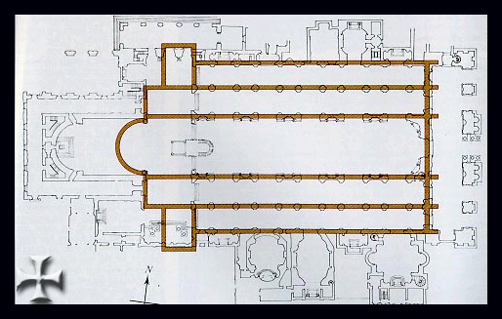
San Giovanni in Laterano

Slide 5
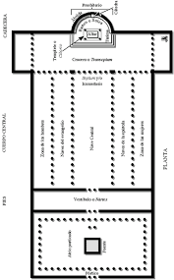
Santa Maria Maggiore

Slide 6
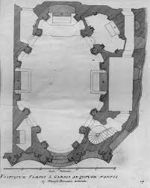
San Carlo alla Quattro Fontane

Slide 7
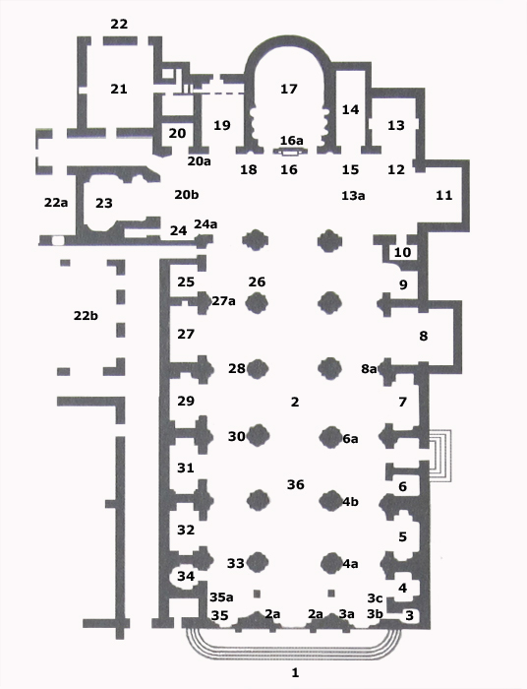
Santa Maria sopra Minerva

Slide 8
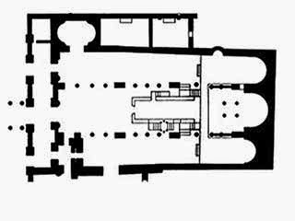
Santa Maria in Cosmedin: 3 apses!

Slide 9
Patterns are ideas
A pattern is not a plug-in or a component
A pattern is an idea that includes essential aspects of a system: apse, transept, nave, altar, pulpit, confessionary,…for a Catholic church (context)
An example of abstraction of details
There are many interpretations or implementations of a pattern
To use a pattern in a design it must be tailored to the constraints of the application

Slide 10
Implied authorization
For convenience we may need to group or structure subjects, protection objects, and some access types in such a way that they may imply others in some ordering structure. In this case, a rule component may be implied by another rule and this must be taken into account when evaluating access.
The concept of implied authorization was introduced in [Fer75b] and subsequently has been applied in some research projects and used in the later versions of the Windows operating system (starting with NT Version 4.0) and the .NET component authorization. It has also been applied to object-oriented databases where access rights can be inherited along generalization or aggregation hierarchies. Used also in the NIST RBAC standard.

Slide 11
Conceptual models in applications
We can apply security patterns to define application constraints and policies
Policies are not just for security, they can define regulations or business rules
We show an example of medical policies

Slide 12
Some policies for medical information
Patients can see their records, consent to their use, must be informed of their use
A doctor or other medical employee is responsible for use of record (custodian)
Records of patients with genetic or infectious diseases must be related

Slide 14
Regulations
Sarbanes-Oxley Act (SOX) (Federal regulation): SOX establishes standards for all US publicly-traded companies in order to protect shareholders and the general public from accounting errors and fraudulent practices in the enterprise (SOX, 2015). SOX enforces control on user management, system development, program and infrastructure management, monitoring, backup, auditing, and disaster recovery.

Slide 15
Analogy: Sarbanes Oxley policies

Slide 16
OCL (Object Constraint Language)
Similar to Z and SQL, 1st order predicate calculus
Adds precision to UML constraints
Implementation oriented
Important for safety-critical applications

Slide 18
Abstract Security Patterns (ASPs)
Describe a conceptual security mechanism that realizes one or more security policies able to handle (stop or mitigate) a threat or comply with a security-related regulation or institutional policy.
Some of the ASPs correspond to basic security mechanisms, e.g., Access control (Authorization and Reference Monitor), Security Logger/Auditor, and Authenticator.
Others specify more detailed aspects, e.g. Access Control/Authorization models include the Access Matrix, Role-Based Access Control (RBAC), and Multilevel models .
Starting from ASPs, when building the lifecycle of a complete application we can use a hierarchy of patterns going from abstract security patterns to platform-oriented versions of these patterns and their code realizations.

Slide 19
Authenticator ASP

Slide 20
Authentication hierarchy

Slide 21
Credential-based Authentication

Slide 22
Certificate-based Authentication

Slide 23
Security services

Slide 24
Uses of ASPs
Combine them with patterns describing security principles or good general design principles. For example, the Abstract Authorizer can be combined with Need-to-Know; Single Point of Access can be combined with Firewall.
Can be used to check for security coverage in a design. One of the problems with protecting complex systems is that it is hard for the designers to see if all the high-level security threats have been considered. This is much easier when we work at the application level, we can enumerate threats and find the corresponding security patterns.
Can guide the search for new patterns (pattern mining). An abstract pattern defines a range of patterns and one can see if corresponding patterns exist at all the lower levels, including different environments, e.g. web services or cloud computing.
Can serve as abstract prototypes for similar concrete patterns. Starting from an abstract pattern it is easy to see what security constraints must at least be applied at a specific architectural level. Fr example, from an ASP for VPNs we can derive TLS and IPSec VPNs.

Slide 25
Use of ASPs II
Can serve as ways to connect and relate different families of patterns. For example, a Communication Channel can use Intrusion Detection.
There are patterns for enterprise models to define global security concerns. These patterns include among others: Asset Valuation, Threat Assessment, Security Needs Identification, and others. ASPs can be used to implement their concerns because they are expressed in terms of application functional activities.
We can make generalization hierarchies with patterns, and define patterns which are more and more concrete. For example, starting from a Communication Channel pattern, a Secure Channel denotes a channel where some security measure has been applied, and a Cryptographically-Protected Secure Channel defines a more specific secure communication. We can build SSFs this way.
We can build Domain models or Reference Architectures using ASPs. As indicated DMs and RAs are abstract architectures so they should be built using ASPs.

Slide 26
Security Solution Frames
Sets of related patterns that partition the solution space horizontally into separated but related concerns: Pattern Families, and vertically according to levels of abstraction.
Families treat one part needed to fully realize a tactic.
A pattern may belong to more than one family.

Slide 27
SSF metamodel

Slide 28
Canonical abstraction levels
Conceptual analysis—contains one or more ASPs to describe the conceptual security solution
Abstract architecture—contains patterns that determine a high-level, abstract architecture for the solution
Solution design—contains patterns refining the abstract architecture using more concrete software components
Practical implementation details—contains patterns about specialized aspects of some technology

Slide 29
Solution relationships
requires: where solution A requires solution B for its realization
supports: where solution B supports solution A in its realization
depends on: where the realization of solution A is dependent in some fashion on the way solution B is realized.
derives from: where solution B specializes or derives certain characteristics from solution A, having a more specialized context of application.
alternative: where solution B can be used in place of solution A
clashes: where either solution B inhibits the effectiveness of solution A or solutions A and B are altogether incompatible and cannot be realized simultaneously.

Slide 31
Secure Inventory
Inventory describes an stock with different quantities of items in different status and stored in different places (Stockrooms)
Items can be parts or products
Five stakeholders (roles) participate in keeping the inventory of items
Five instantiations of RBAC define the rights of the roles

Slide 33
Tactics
A way to apply security to architectures is based on the idea of tactics
Tactics are “measures” or “decisions” taken to improve some quality factor
Another definition: “architectural building blocks from which architectural patterns are created. Each tactic corresponds to a design decision with respect to a quality factor.
Architectural tactics can also be seen as decisions that codify and record best practices for achieving some quality attribute. Tactics are usually expressed in words, but there has been some attempts to formalize them.

Slide 34
Producing secure or reliable architectures from tactics

Slide 35
From policies to patterns

Slide 36
Policy hierarchies

Slide 37
Tactics (improved hierarchy)

Slide 38
Realizations for tactics
Tactic | Security pattern realization
Verify message integrity | Secure Channel with Dig. Signature
Verify storage integrity | Authenticator and Authorizer, Dig. Signature
Maintain audit trail | Security Logger/Auditor
Identify intrusions by signature | Signature(Knowledge)-based IDS
Identify intrusions by behavior | Behavior-based IDS
Authenticate subject | Authenticator (Remote), credential
Authorize subject | Policy, Role and Attribute-Based Access Control
Manage security information | Authorizer, Generation and distribution of public keys
Filter data | Filter, Packet Filter Firewall
Verify origin of message | Digital Signature with hashing
Establish secure channel | Secure Channel
Hide data by encryption | Symmetric and Asymmetric Encryption
Hide data by steganography | Steganographic Encoding
Alert subjects | Abstract IDS
Apply institution policies | Policy-based Enforcement
Audit actions | Security Logger/Auditor

Slide 39
The financial institution

Slide 40
A secure financial institution

Slide 41
POSA template
Intent (thumbnail)
Example
Context
Problem and forces
Solution: in words, UML models (static and dynamic)
Implementation
Example resolved
Known uses
Consequences
See also (related patterns)

Slide 42
Anatomy of a security pattern
Every pattern starts with a thumbnail of the problem it solves and a brief description of how it solves the problem.
The Packet Filter Firewall filters incoming and outgoing network traffic in a computer system based on packet inspection at the IP level.

Slide 43
Context section
We define the context or environment where the pattern solution is applicable:
Context
Computer systems on a local network connected to the Internet and to other networks with different levels of trust. A host in a local network receives and sends traffic to other networks. This traffic has several layers or levels. The most basic level is the IP level, made up of packets consisting of headers and bodies (payloads). The headers include the source and destination addresses as well as other routing information, the bodies include the message payloads.

Slide 44
Problem Section I
Now a generic description of what happens when we don’t have a good solution: We also indicate the forces that affect the possible solution. We may list all attacks that we want to stop with this solution.
Problem
Some of the hosts in other networks may try to attack the local network through their IP-level payloads. These payloads may include viruses or application-specific attacks. We need to identify and block those hosts.
:

Slide 45
Forces
We need to communicate with other networks so isolating our network is not an option. However, we do not want to take a high risk.
The protection mechanism should be able to reflect precisely the security policies of the institution. A too coarse defense may not be useful.
Any protection mechanism should be transparent to the users. Users should not need to perform special actions to be secure.
The cost and overhead of the protection mechanism should be relatively low or the system may become too expensive to run.
Network administrators deploy and configure a variety of protection mechanisms; hence it is important to have a clear model of what is being protected.
The attacks are constantly changing; hence it should be easy to make changes to the configuration of the protection mechanism.
It may be necessary to log input and/or output requests for auditing and defense purposes.

Slide 46
Solution section
The solution section describes the idea of the pattern. A descriptive figure may help to visualize the solution.
Solution
A Packet Filter Firewall intercepts all traffic coming/going from a port P and inspects its packets (Figure 1). Those coming from or going to untrusted addresses are rejected. The untrusted addresses are determined from a set of rules that implement the security policies of the institution. A client from another network can only access the Local Host if a rule exists authorizing traffic from its address. Rules may be positive (allow traffic from some address) or negative (block traffic). Additionally, if a request is not satisfied by any of the Explicit Rules, then a Default Rule is applied.

Slide 47
Idea of the solution

Slide 48
Structure of the solution

Slide 49
Filtering a client’s request

Slide 50
Implementation section
What one should consider when implementating the pattern is the objective of the next section. This can be a set of general recommendations or a sequence of what to do to use the pattern. It may include some sample code if appropriate.
Implementation
Define an institution policy about network access, classifying sites according to our trust in them.
Convert this policy into a set of access rules. This can be done manually, which may be complex for large systems. An alternative is using an appropriate commercial product. .
Note that the idea of a single point of access is virtual, there may be several physical firewalls deployed at different places. This means it is necessary to install firewalls at all external boundaries (routers or gateways).
Write the rules in each firewall. Again, products such as Solsoft and others automatically propagate the rules to each registered firewall.
Configure the corresponding firewalls according to standard architectures. A common deployment architecture is the Demilitarized Zone (DMZ).

Slide 51
Known uses section
To accept this solution as a pattern we should find at least three examples of its use in real systems.
Known Uses
This architecture can be found in commercial firewall products such as: ARGuE (Advanced Research Guard for Experimentation), OpenBSD Packet Filtering Firewall (the basic firewall architecture for the Berkeley Software Distribution system) and the Linux Firewall, the basic firewall architecture used with the Linux operating system.

Slide 52
Consequences--advantages
The Consequences section indicates the advantages and disadvantages of the solution embodied in this pattern. The advantages should match the forces in the Problem section.
Consequences
The Packet Filter Firewall Pattern has the following advantages:
A firewall transparently filters all the traffic that passes through it, thus lowering the risk of communicating with potentially hostile networks.
It is possible to express the institution filtering policies through its filtering rules, with different levels of protection for different parts of the network.
It is easy to update the rule set to counter new threats.
Because it intercepts all requests, a firewall allows systematic logging of incoming and outgoing messages. Because of this, a firewall facilitates the detection of possible attacks and helps to hold local users responsible of their actions when interacting with external networks.
Low cost, it is included as part of many operating systems and simple network devices such as routers.
Good performance. It only needs to look at the headers of IP packets, not at the complete packet.
It can be combined with Intrusion Detection Systems (IDS) for greater effectiveness. In this case, the IDS can tell the firewall to block suspicious traffic. This can also be useful to control Distributed Denial of Service (DDoS) attacks.

Slide 53
Consequences--disadvantages
The firewall’s effectiveness and speed may be limited due to its rule set (order of precedence). Addition of new rules may interfere with existing rules in the rule set; hence, a careful approach should be taken in adding and updating access rules.
The firewall can only enforce security policies on traffic that goes through the firewall. This means that one must make changes to the network to ensure that there are no other paths into its hosts.
An IP-level firewall cannot stop attacks coming through the higher levels of the network. For example, a hacker could put malicious commands or data in header data not used for routing and in the payload.
Each packet is analyzed independently, which means that it is necessary to analyze every packet. This may reduce performance.
A packet filter cannot recognize forged addresses (IP spoofing) because it only examines the header of the IP packet. This can be corrected (at some extra cost) using Link Layer filtering, where each IP address is correlated to its hardware address.

Slide 54
Related patterns section (See also)
Finally, we relate our pattern to other known patterns. Those may be complementary patterns, variations of our pattern, or extensions of it.
The Authorization pattern [Fer01] defines the standard security model for the Packet Filter Firewall Pattern. This pattern is also a special case of the Single-Point-of-Access [Sch06] and it is the basis for other, more complex, types of firewalls (described in the other patterns in this language). The DMZ pattern [Sch06] defines a way to configure this pattern in a network. This pattern can also be combined with the Stateful Inspection Firewall.

Slide 55
Relationships between domain models and application models

Slide 56
Conceptual models and applications
A Conceptual Model describes functional relationships between entities; it realizes a set of use cases (textual descriptions) into a more precise representation. A Domain Model describes functional relationships between entities related to a specific domain, e.g. finance or electrical engineering. An Application Model describes the functional aspects of an application and may combine parts of several domain models (takesFrom) as well as its own set of conceptual entities. Domain models and application models are conceptual models. A conceptual model may include analysis patterns and ad hoc functional units (not patterns). Some analysis patterns are Semantic Analysis Patterns (SAPs), which correspond to a small set of coherent use cases. The Policy-enhanced Domain Model (PEDM) and the Policy-enhanced Application Model (PEAM) correspond to domain and application models where we have superimposed policies for security or reliability. In particular, the PEAM inherits policies from some domain models and may add its own policies.

Slide 57
Metamodel for requirements and patterns

Slide 58
Example of going from threats to patterns.

Slide 59
Validation of security
Policies are high-level guidelines defining how an institution conducts its activities in its business, professional, economic, social, and legal environment. The institution security policies include laws, rules, and practices that regulate how an institution uses, manages and protects resources. Regulations are institution, local or government policies that must be reflected in the implemented system. Industry regulations are called standards.
A Threat can be neutralized by a Security Policy. Similarly, a Failure can be neutralized by a Reliability Policy. Policies may include also Regulations and Institution Policies. Security and reliability policies are realized by Security and Reliability Patterns, respectively. A Policy Realization Pattern is a pattern that realizes a type of policy and consists of a few classes and associations. Security and Reliability patterns are special cases of Policy Realization patterns.
The set of use cases in the application, UC_{A}, are the union of some of the use cases in the domain model, UC_{Di}, and a set of new use cases, UC_{new}.
Since we relate threats to use cases, new use cases mean new threats.
The metamodel of the figure in slide 57 applies both to domain models and to application models. When applied to a domain model we enumerate threats/failures based on the use cases of the domain model; when applied to the application model its threats are the union of the threats in the domain model and the threats in the new use cases.

Slide 60
Validation II
Can we certify an application by using security patterns? We can show that the application includes a pattern able to stop each expected threat by a simple matching of threats/failures to patterns. Threats can be stopped through policies. If we have a pattern for each policy, we can consider the system secure at the model level, although there may still remain code vulnerabilities. However, code-based attacks are limited by a good architectural design; for example, a virus compromising an email unit, cannot reach its address book if it has some access control for the address book.
Formally, if T = set of threats for a system, Py = set of policies that stop or mitigate T, and Pt = set of patterns that realize Py, we have then: T → Py → Pt, for all t in T → there exists Py → Pt that is, if for all the threats in the system, we can find a set of policies that can be realized as a set of patterns that neutralize those threats, we consider the system to be secure.

Slide 61
Misuse patterns
A misuse pattern describes how an attack intending a misuse of information is performed from the point of view of the attacker. It defines the environment where the attack is performed, countermeasures to stop it, and it provides forensic information in order to trace the attack once it happens
Example: Worm pattern

Slide 62
Worm misuse pattern
Intent
Propagate to as many places as possible (or to specific systems), usually indicating its presence, and maybe performing some damage.
Context
Sites connected through the Internet or another type of network. The Internet provides a variety of services such as email, file transfer, and web services (Figure 1). Any of these services can be used for propagation. Both fixed and wireless networks can be used by the worm. Portable storage devices such as memory sticks can also propagate worms.
Problem
A worm tries to take advantage of any input to invade a system. Users might open attachments carrying worms and some ports of a system may be unprotected or have vulnerabilities; all of these give the worm a chance to invade. Mail systems and file transfer systems for example, include lists of addresses which can be used by the worm to find places where to propagate. Many systems do not control access to their system directories and do not restrict Internet traffic, which facilitates a worm invasion.

Slide 63
Forces I
Objectives. Its objectives may be political, monetary, or vandalism. A political worm typically tries to produce damage to an antagonist; a monetary worm tries to reach many places to collect information or drop spyware; a vandal worm tries to destroy or damage information.
Reach. Try to reach as many places as possible or to specific sites. For most worms, reaching many places is a basic objective.
Presence manifestation. Try to show its presence in the system so victims know about it. Exceptions to this are cases where the objective is to drop spyware.
Credit. To embed an identification or mark so that the creator can take credit for it.
Misuse. Perform some destruction and/or other misuses (confidentiality, integrity, or availability). The misuse may be delayed (time bomb).

Slide 64
Forces II
Obfuscation. Try to hide its structure to make harder its detection and removal.
Collateral damage. In addition to specific misuses, the worm may require costly operations for its removal, stopping or disrupting business activities. Its propagation may affect the normal traffic in the network.
Latency. Its propagation must be as fast as possible to avoid detection and countermeasures.
Activation. This can be done by enticing offers which may tempt users to open email attachments or download procedures (social engineering). Other possibilities are invading through unprotected ports or taking advantage of vulnerabilities

Slide 65
Solution
Attach a core portion of the worm to email messages or to files. When the user opens the message attachments or executes the file the core of the worm starts executing. Alternatively, invade through an unprotected or flawed port. Download remaining portions from complementary network sites. Use some procedure to hide the structure of the worm. Perform its mission and propagate. Figure 2 shows the propagation of a typical worm; speed comes from a tree-like propagation.
Structure
Figure 3 shows a class diagram of the units involved. Class Node represents any node in the network, defined by its address (URL in the Internet). Any node can be the origin of a worm and any node can be its target (and be invaded). Some nodes are complementary sites from which commands or other parts of the worm may be retrieved. Class Worm represents the worm itself, including procedures for initial setup, to bring complementary parts, to hide the worm, to perform its mission, and to propagate.

Slide 66
Worm propagation

Slide 67
Class diagram

Slide 68
Worm propagation

Slide 69
Variants
A passive worm requires a user to activate an executable program and it usually propagates through email. Melissa, ILOVEYOU, Anna Kournikova, and Bagle are examples of this type.
An active worm takes advantage of some system flaw to provoke a buffer overflow or another attack to get in through some port. It may scan looking for unprotected ports. Code Red is an active worm. Storm can be active or passive [Smi08].
A virus attaches itself to some program (infects an executable file) and when the user executes this program it gets activated. Jerusalem, Christmas, and Chernobyl are examples of viruses.
Some worms have several versions with different purposes; for example, Storm has variants that perform different types of misuses, including targeted spam and DDoS attacks [Smi08].
Some worms are multimode (multivector) worms, which can use a variety of ways to invade their targets; for example the Storm virus infects computers using multiple payloads [Smi08].

Slide 70
Known uses
ILOVEYOU [ILO, wor09]. This was an email attachment worm that appeared in 2000. It relied in social engineering to entice users to open the attachment. It also used specific weaknesses of Microsoft Windows. It propagated using the addresses in the address book of the mail system.
Bagle. It was a mass-mailing worm written in assembly language [bag] and affecting all versions of Windows. After activation, it copies itself to the Windows system directory and downloads a SMTP engine to mail its core to other nodes as an attachment (see the Implementation section for its typical behavior).
Code Red [Ber01]. It appeared in July of 2001. It propagated through port 80, indicated its presence by defacing web pages, propagated using a random IP address generator, and later would activate a denial of service attack from infected sites.
Nimda [nim]. Nimda is a multivector worm that can use several ways to propagate: email, visiting an infected site, seeking out vulnerable servers to upload files, or through the network.
Slapper [Arc03]. Can launch denial of service attacks. Propagates finding addresses in files. The nodes invaded by the worm communicate using a P2P protocol to collaborate in their misuses.

Slide 71
Countermeasures
Policy about attachments: Users should be trained to recognize trustable attachments and they should be forbidden to open unknown or suspicious attachments.
Need-to-know policy to define access by system processes to resources. For example, address lists should use authorization to control access to their contents.
Control of network communications: Connections should be established with only trusted addresses (control through the firewalls). This policy may avoid downloads from complementary sites.
Intrusion detection: An IDS can detect some attacks in real time and alert the firewall to stop it.
Use of antivirus software: Can help detect and clean worms after the fact
Backups. Checkpointing files and keeping backup images of them is a fundamental precaution against data destruction or unauthorized modification.
Specialized hardware. Process communication controls in the operating system can be enforced through specialized hardware [Shi00]. It is possible to define partitions in the operating system that can be enforced by hardware and will prevent a worm from performing its actions.

Slide 72
A metamodel for threats and attacks

Slide 73
Malware patterns
A vulnerability is a weakness in a system that can be exploited by a threat
Threats include scanning, probing, injection,…
Attacks realize threats by exploiting vulnerabilities on assets
An asset is something valuable to a company or person
Attack patterns describe the steps needed to perform a specific security attack in a generic fashion
Misuse patterns describe a complete way to perform a misuse on a system relating it to architectural units; they are complete software patterns, capture design decisions, provide defenses and forensics

Slide 74
Example
A query injection is a threat to a DBMS containing banking information
If there is no input validation (a vulnerability), an SQL injection (SQLi) attack can realize this threat
This threat could lead to a misuse: unauthorized reading of the balance of a bank account (or of many accounts)

Slide 75
SQL attack: assume that the SQL statement template is:

Slide 76
The user adds a statement and gets the salaries for all employees

Slide 77
Modifying the database
SELECT SALARY FROM EMPLOYEE
WHERE EID=‘123’; DROP TABLE EMPLOYEE
Deletes all employees!

Slide 78
Some SQL-based incidents
From November 2004 to January 2005, a hacker by the name of “Hung” used a form of SQL Injection to hack into the databases of Information Security, a well-known magazine, in order to obtain member and commercial information.
In May 2006 a series of Chinese-based websites were attacked using SQL injection. The source of the attacks was a server farm in China.
In August 2009 Albert Gonzales and his associates hacked into databases of a credit card processor and retrieved over 130 million credit card account numbers.

Slide 79
Defenses I
Input validation--Inputs to SQL strings should be constrained and sanitized in terms of the value that should be provided. For example, an input with an integer as its type should have an integer value passed through it and the information passed from the URL should be limited so that important database information is not imparted to possible hackers.
Checking for valid value ranges within the data will also limit SQL injection because, while a controller of a system might have an idea that a passed value can only have a range of 100-200, an attacker would be less likely to know of such a condition.
Using stored procedures with parameter values will prevent improper values from being submitted through the system. When a value is passed into a variable in a stored procedure, the procedure no longer recognizes the value as part of the SQL query even if the value is concatenated with the executing SQL query .

Slide 80
Defenses II
Type checking- basically making sure that if a number is supposed to be passed through a certain variable then a check is placed so that no other value type can be placed within that same variable.
Firewalls – database servers should be located behind a firewall so as to minimize direct access to the database. Firewalls can be installed on the database server or application server. The firewall examines the grammar and structure of SQL statements being send to the database. Certain grammars can be whitelisted or blacklisted.
Web Application Servers – can add an extra layer between web users and the database.
Encryption of specific fields

Slide 81
Other defenses (Imperva)
Detect SQL injection attack. Using a combination of application layer knowledge (application profile) and a preconfigured database of attack vector formats. We must normalize the inspected input to avoid evasion attempts.
Identify access patterns of automated tools. In practice, SQLi attacks are mostly executed using automatic tools. Various mechanisms exist to detect usage of automatic clients, like rate-based policies and enforcement of valid client response to challenges.
Create and deploy a blacklist of hosts that initiated SQLi attacks. This measure increases the ability to quickly identify and block attackers. Since we observed that the active period of host initiating SQLi is short, it is important to constantly update the list from various sources.

Slide 82
Evaluating degree of security
Verify that all misuse cases have been controlled by some security pattern
If we enumerate all the threats we just need to verify that the architecture includes a security pattern that can neutralize all the threats
If T={t₁,…t_{i}…}is the set of threats, and SP= {sp₁…sp_{j}…} is the set of security patterns, we have: ∀ t_{i} ∈ T ⇒ ∃ sp_{j} ∈ SP, ∋ sp_{j} controls t_{i}
If MP=[ap₁,…ap_{i},…}, where ap_{i} is an attack pattern used by the MP, if ∃ sp_{j} ∋ sp_{j} stops ap_{i}, the misuse case cannot occur.
An attack (threat) pattern describes a specific step leading to a misuse; e.g., using a stolen credential to have access to a DBMS where we can perform a misuse by using SQL injection.

Slide 83
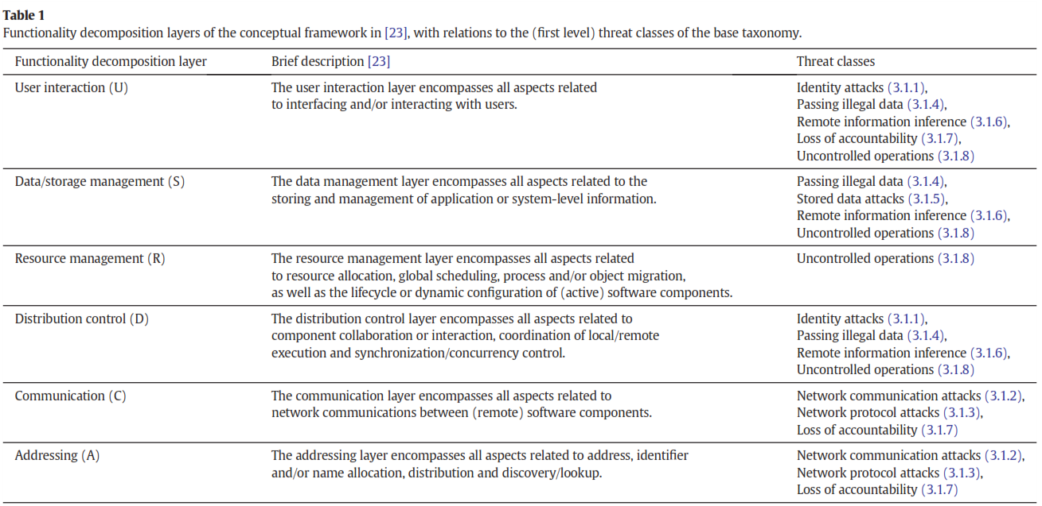

Slide 84
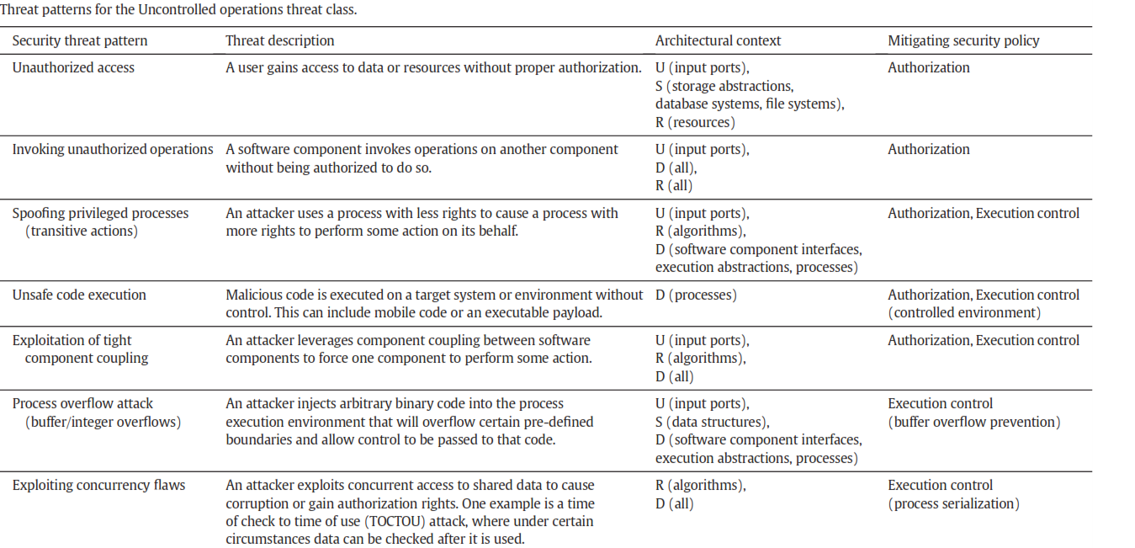

Slide 85
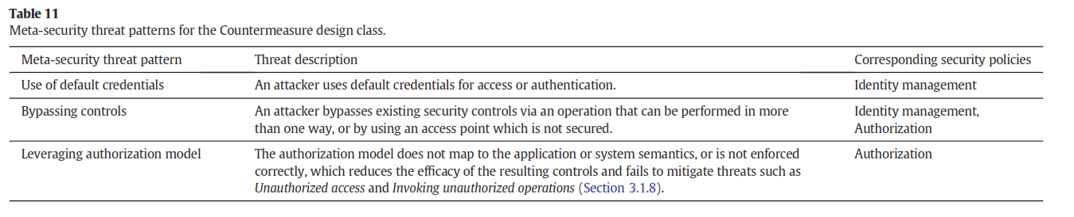

Slide 86
Other pattern variations
Privacy patterns—describe privacy policy definition, negotiation, and enforcement
Cyber-Physical security patterns---describe security mechanisms for physical systems: access to buildings, secure SCADA systems
Dependability patterns---combine security and fault tolerance/safety/reliability

Slide 87
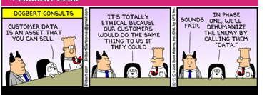

Slide 88
References
E B. Fernandez, Ernest Alder, Richard Bagley, and Swati Paghdar,
"A Misuse Pattern for Retrieving Data from a Database Using SQL Injection" , RISE'12,Workshop on Redefining and Integrating Security Engineering, part of the ASE Int. Conf. on Cyber Security, Washington, DC, December 12-14
E. B.Fernandez, Nobukazu Yoshioka, Hironori Washizaki, and Joseph Yoder, "Abstract security patterns for requirements specification and analysis of secure systems'', Procs. of the WER 2014 conference, a track of the 17th Ibero-American Conf. on Soft. Eng.(CIbSE 2014), Pucon, Chile, April 2014
Anton Uzunov, E. B Fernandez, Katrina Falkner, “Security solution frames and security patterns for authorization in distributed, collaborative systems”, Computers & Security, 55, 2015, pp. 193-234, doi: 10.1016/j.cose.2015.08.003
Jaime Muñoz-Arteaga, E.B. Fernandez, and Hector Caudel,
"Misuse pattern: Spoofing web services", Procs. of Asian PLoP 2011.
Uzunov and E.B.Fernandez, “An Extensible Pattern-based Library and Taxonomy of Security Threats for Distributed Systems”- Special Issue on Security in Information Systems of the Journal of Computer Standards & Interfaces. 2013.
http://dx.doi.org/10.1016/j.csi.2013.12.008

