Slide 1
Chapter4: Methodologies for building secure distributed applications
Prof. E.B.Fernandez

Slide 2
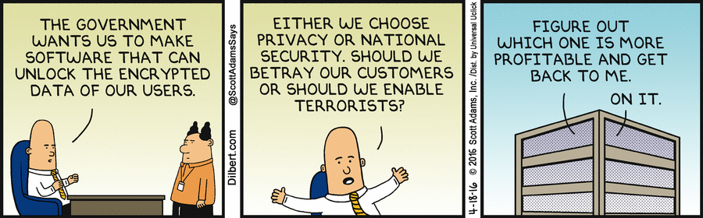

Slide 3
The design of secure systems
We not only have to satisfy functional specs but nonfunctional specs.
Security is a nonfunctional aspect
We cannot show absence of security flaws
We must use good development methods and have some evaluation tests

Slide 4
Kernel-based approach
Security Kernel: includes all security-related functions and can be proved secure
A security kernel is a TCB (Trusted Computing Base)
Verification: possible only for relatively simple systems
Requires special languages and special operating systems
Several of these systems were built in the early 70’s
Not practical for general systems

Slide 5
Use of kernels
DBMS
DBMS Kernel
Sec. Kernel
OS
Kernel

Slide 6
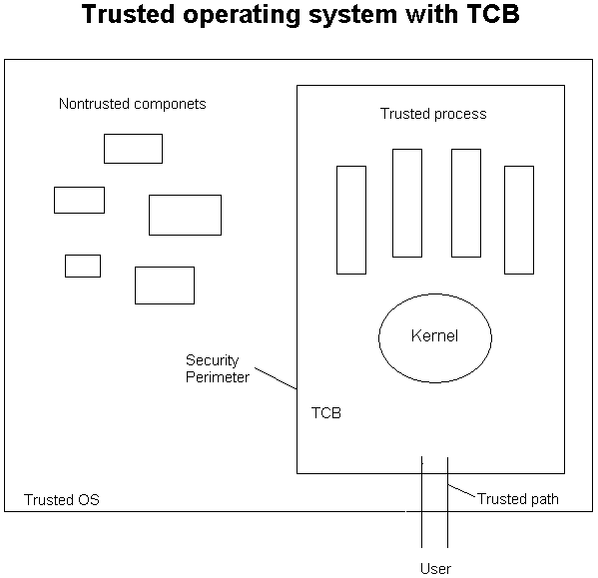

Slide 7
A methodology for secure architectures
Stages
Financial institution example

Slide 8
What is a security methodology?
--Methodology: systematic way of doing something
--Security methodology: systematic way of introducing security into a
software system during the development life-cycle
--Advantages analogous to those of software engineering process vs. ad-hoc development
--Partial or comprehensive; covering early phases of the development life-
cycle especially important
--A security methodology SM = (SP, CF)
--SP is a security process, the activities and/or steps take to secure
a software system
--CF is a conceptual security framework consisting of conceptual
artifacts that include a set of security solutions and a set of
threats
--Can be specific (e.g. Web services) or generic

Slide 9
Security principles for application design
Security constraints must be defined at the highest layer, where their semantics are clear, and propagated to the lower levels, which enforce them.
All the layers of the architecture must be secure.
We can define patterns at all levels. This allows a designer to make sure that all levels are secured, and also makes easier propagating down the high-level constraints.
We must apply security at all development stages (tactic-based approaches start from design)

Slide 10
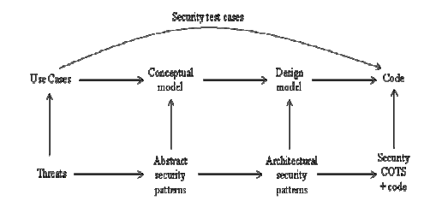
From use cases to secure systems

Slide 11
Security along the life cycle

Slide 12
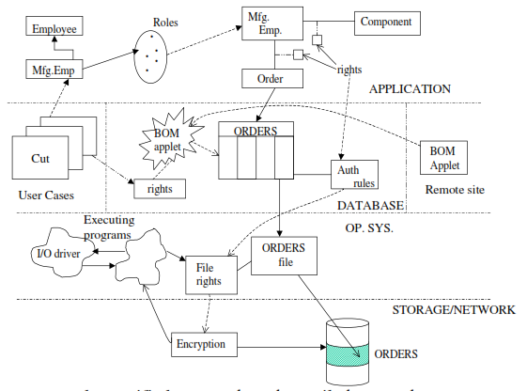
Mappings between architectural levels

Slide 13
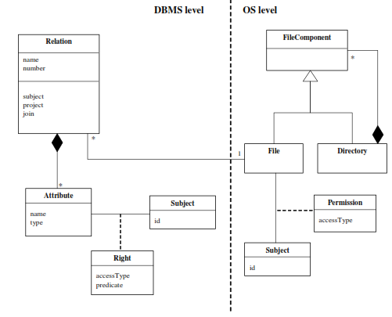
Mapping DBMS to OS

Slide 14
A methodology for secure systems design [Fer13]
Domain analysis stage: A domain model (DM) is defined. Legacy systems are identified and their security implications analyzed. Domain and regulatory constraints are identified. Policies must be defined up front, in this phase. A Reference Architecture (RA) is defined from the DM. We can analyze threats and regulations and define Policy-Enhanced models. We relate threats and regulations to use cases. We study each action within a use case and see which threats are possible and which regulations apply. We then determine which policies would stop these attacks or enforce the regulations. From the use cases we can also determine the needed rights for each actor and thus apply a need-to-know policy.
Requirements stage: Each application uses a subset of the use cases of some DMs and includes some new use cases. We repeat the threat/regulation analysis for the new use cases. We eliminate threats based on risk analysis.

Slide 15
Example: Applying security policies and tactics to stop threats
Consider a financial company that provides investment services to its customers. Customers can open and close accounts in person or through the Internet. Customers who hold accounts can send orders to the company for buying or selling commodities (stocks, bonds, real estate, art, etc.). Each customer account is in the charge of a custodian (a broker), who carries out the orders of the customers. Customers send orders to their brokers by email or by phone. A government auditor visits periodically to check for application of laws and regulations.

Slide 16
Analysis stage
Analysis patterns are used to build the conceptual model. Security patterns describe security mechanisms to mitigate threats. We can build a conceptual model where repeated applications of a security model pattern realize the needed defenses and define rights determined from use cases.
We can use Semantic Analysis Patterns (SAPs) to reuse related sets of use cases, e.g., Secure Inventory, Secure Student Registration

Slide 17
Use case analysis leads to policies
T1. T3. Mutual authentication. Every interaction across system nodes is authenticated.
T2. Verify source of information.
T4. Logging. Since the manager is using his legitimate rights we can only log his actions for auditing at a later time.
T5. T6. Separation of administration from use of data. For example, a manager can create accounts but should have no rights to withdraw or deposit in the account.
T7. Protection against denial of service. We need some redundancy in the system to increase its availability.
T8. Authorization. If the user is not explicitly authorized he should not be able to move money from any account.
Policies can be realized with abstract security patterns

Slide 18
Abstract Security Patterns
An ASP is a security pattern that describes a conceptual semantic restriction in a domain which can be a defense to a threat or a way to comply with a regulation, with no implementation aspects.
An ASP describes the essential functions that must be present to handle a threat or regulation in an implementation-independent way.
For example this is the Intent section of an Authenticator pattern: “When a user or system (subject) identifies itself to the system, how do we verify that the subject intending to access the system is who it says it is? Present some information that is recognized by the system as identifying this subject. Once recognized, the subject receives a token as proof.”

Slide 19
Use cases can also be used to find actor rights (authorization rules)
Use cases describe all possible uses of the system
All use cases define all possible and legal accesses
Each actor can be given its needed rights to perform its functions

Slide 21
Role rights for financial institution
Customers can open/close accounts
Customers can initiate trade
Broker can perform trade
Auditor can inspect (read) trade transactions

Slide 22
Methodology summary
Use case activities define threats
Threats must be stopped or mitigated by applying policies
Use cases define needed actor rights
Access matrix or RBAC models formalize these rights
We get a secure conceptual model using analysis patterns and ASPs

Slide 23
Design stage
When we have the possible attacks to a system, design mechanisms are selected to stop these attacks.
User interfaces should correspond to use cases and may be used to enforce the authorizations defined in the analysis stage. Secure interfaces enforce authorizations when users interact with the system.
Components can be secured by using authorization rules for components.
Distribution provides another dimension where security restrictions can be applied.

Slide 24
Twin peaks
To define each refinement of the architecture we can use RAs which in each stage become more concrete. These concrete architectures introduce architectural artifacts that can also be attacked and therefore must be protected. We refine the goal-based threats to produce a design model which is effectively a SRA. This is refined to produce a new architecture and the cycle repeats.
In each iteration the misuse patterns that describe attacks indicate the architectural units that are used to perform the attack; these units are the places where we can collect evidence of attacks and where we can assess the damage that was done by the attack. Models of this type can be used for automatic generation of attacks to see if evidence can be collected from them using some specific method; dealing with known threats also helps reduce data collection for forensics.

Slide 25
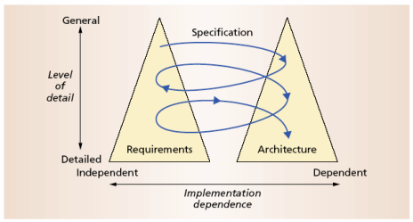
The Twin Peaks Model
Bashar Nuseibeh

Slide 26
Twin peaks iterations

Slide 27
Design stage patterns
We can map from the application level to the lower levels
The next diagram shows the application, distribution, database/communication, and operating system/communication levels

Slide 30
Security is applied along the distribution path
Proxies and adapters apply authorization (Customer access to Accounts)
Proxies and adapters apply authentication (Branch office and central office mutual authentication)
Logging can be applied in the Transaction view (not shown)
Broker communications can be encrypted
Messages from Customers for trade can be signed

Slide 31
Middleware patterns

Slide 32
Secure Broker
Secure Broker extends Broker to provide secure interactions between distributed components.
The Broker architectural pattern can be used to structure distributed software systems with decoupled components that interact by remote service invocations. A broker is responsible for coordinating communication, such as forwarding requests, as well as for transmitting results and exceptions [Bus96].
Proxies insulate their callers, Client and Server, from the implementation details of communications. The Bridge class implements a similar concept for communications between Brokers. There are two basic use cases for Broker, illustrating its role in structuring transparent communications between clients and servers: Server Registration and Client Requests Service.

Slide 33
Implementation stage
Requires reflecting in the code the security rules defined in the design stage.
Because these rules are expressed as classes, associations, and constraints, they can be implemented as classes in object-oriented languages.
In this stage we can also select specific security packages or COTS components, e.g., a firewall product, a cryptographic package
Some of the patterns identified earlier in the cycle can be replaced by COTS components (these can be tested to see if they include a similar pattern).

Slide 34
J2EE, .NET
Web Services
REST Services
code
Functional
Classes
Security/Reliability
COTS components
NFR
Classes

Slide 35
Deployment for financial institution
firewalls
VPN
Customers
authorization
.
Web Server
Web Application
Server
.
Internet
.
certificates
IDS
Databases
message
encryption
certificates
ATMs,
Browsers
authorization
encryption
Brokers
Auditors

Slide 36
A voting system

Slide 37

ASE: a security methodology for distributed systems [Uzu15]
Many methodologies exist with different paradigms
Very important class is methodologies that use security patterns
ASE: a security methodology using patterns and related constructs designed specifically for general distributed systems
An extension of my methodology [Fer13]

Slide 38

Major elements of CF: Decomposition Framework
A 3 level framework for decomposing distributed software architectures
High-level modeling abstractions – consistent concepts
Functionality decomposition layers – isolation
Technical realization abstractions – detail

Slide 39

Major elements of CF: Security patterns and security solution frames
Security patterns are software patterns that encapsulate successful security designs
Can be simple or compound
Security solution frames encapsulate and organize security patterns into different levels of abstraction (vertically) and different facets of a root security policy (horizontrally)

Slide 40
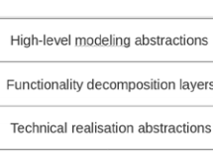
Framework for distributed systems

Slide 41
Security solution frames (SSFs)
SSFs are solution structures that encapsulate and organize security patterns; they realize security requirements.
SSFs can facilitate the work of designers by collecting together all the relevant patterns to realize some security requirements, guiding the designer from an abstract conceptual level to a concrete implementation-oriented level.

Slide 42
SSF: Authentication hierarchy

Slide 43
List of SSFs
Security solution frame | Description and security tactics realized
Authorization | Encapsulates security patterns allowing for custom conceptual authorization models to be built and realized using different enforcement architectures [22]. Tactic realized: Authorize Users.
Identity management | Encapsulates patterns concerned with managing (assigning, establishing, validating) identities of users and/or processes in a distributed system (partially in [23]). Tactic realized: Authenticate Users.
Secure communication | Encapsulates security patterns for enabling two or more parties to communicate securely over a message channel [23]. Tactics realized: Protect Communications (Maintain Data Confidentiality & Maintain Integrity in a communications context).
Filtering (*) | Shall encapsulate patterns for network- and application-level filtering of information, including firewalls and custom data filters. Tactic realized: Limit Exposure.
Storage security (*) | Shall encapsulate patterns for secure storage of information, including patterns for storing passwords, information dispersal, database security and others. Tactics realized: Keep Data Secure (Maintain Data Confidentiality & Maintain Integrity in a storage context).
Logging and monitoring (*) | Shall encapsulate patterns for logging and monitoring events in a distributed system, ranging from creating simple log files to the deployment of intrusion-detection systems (network monitoring). Tactics realized: Intrusion Detection & Audit Trail.
Execution control (*) | Shall encapsulate patterns for controlling and managing the execution of processes or, more generally, execution abstractions in a distributed system, including for process serialization / concurrency management, safe handling of mobile code, process isolation, improved resource availability and others. Tactics realized: Limit Access & Safeguard Process (*).
Security information management | Encapsulates patterns concerned with the management of security information such as policies, credentials, cryptographic keys etc. (partially in [23] and in [22]). Tactic realized: Manage Security Information.

Slide 44
Solution relationships
requires: where solution A requires solution B for its realization
supports: where solution B supports solution A in its realization
depends on: where the realization of solution A is dependent in some fashion on the way solution B is realized.
derives from: where solution B specializes or derives certain characteristics from solution A, having a more specialized context of application.
alternative: where solution B can be used in place of solution A
clashes: where either solution B inhibits the effectiveness of solution A or solutions A and B are altogether incompatible and cannot be realized simultaneously.

Slide 45
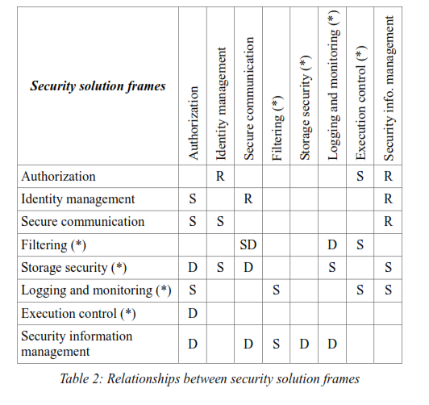

Slide 46
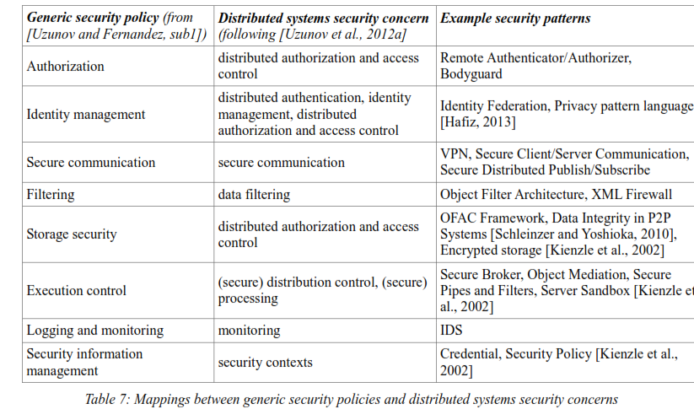

Slide 47

Major elements of CF: Threat taxonomies/libraries
Threat taxonomies/libraries consist of threat patterns, which can be customized and instantiated in different architectural contexts to define specific threats to a system.
Allow developers to quickly and efficiently consider a range of relevant threats during threat modeling.

Slide 48
Threat classes
Functionality decomposition layer | Relevant threat classes
User interaction | Identity attacks, Passing illegal data, Remote information inference, Repudiation, Uncontrolled operations
Data / storage management | Passing illegal data, Stored data attacks, Remote information inference, Uncontrolled operations
Resource management | Uncontrolled operations
Distribution control | Identity attacks, Passing illegal data, Remote information inference, Uncontrolled operations
Communication | Network communication attacks, Network protocol attacks, Repudiation
Addressing | Network communication attacks, Network protocol attacks, Repudiation

Slide 49
Second level process patterns
Security process pattern | Shorthand name | Gr | Intent
Security Requirements Determination | SecReq | P | Specify both prescriptive and resultant security requirements for the target system.
Countermeasure Introduction | CounterIntro | P | Introduce security countermeasures by converting problem-space requirements into solution-space goals and policies, and incorporating these into relevant models of the target system.
Security Implementation | SecImpl | P | Transfer the security-related (standalone or enriched functional) models into concrete software units.
Security Administration | SecAdmin | P | Configure all component parts of the (implemented) security infrastructure, setting appropriate policies for the individual controls.
Adversary Modeling | AdvMod | S | Model attackers and their potential attacks (e.g. in the form of threats) to a system.
Countermeasure Identification | CounterIdentif | S | Map problem-space security requirements to solution-space abstractions.
Security Modeling | SecMod | S | Incorporate security countermeasures (e.g. via the application of security patterns, security aspects etc.) as appropriate representations into a system's models.
Security Verification | SecVerif | S | Verify that the introduced constructs (design, code etc.) provide the necessary level of security and adequately protect the system against relevant threats.
Coding | Cod | S | Implement security countermeasures as concrete software subsystems in conjunction with the functionality of the whole system via manual coding.
Structured countermeasure identification | structured | T | Use a systematic approach to maps requirements to well-known sets of security solutions/countermeasures.
Instantiation | instantiate | T | Instantiate countermeasures into relevant architectural models.
Modeling | model | T | Model countermeasures directly as part of a system's (functional) architecture.
Semi-automated verification | semi-automated | T | Use tool-support to help verify some of the models or code excerpts.
Attack scenarios | attacks | T | Determine a set of attacks or scenarios that can be used to analyze any security-enhanced models.
Refinement | refine | T | Perform the same activity at a finer level of granularity, introducing new or variant strategies, or improving upon previous consequences/results.

Slide 50
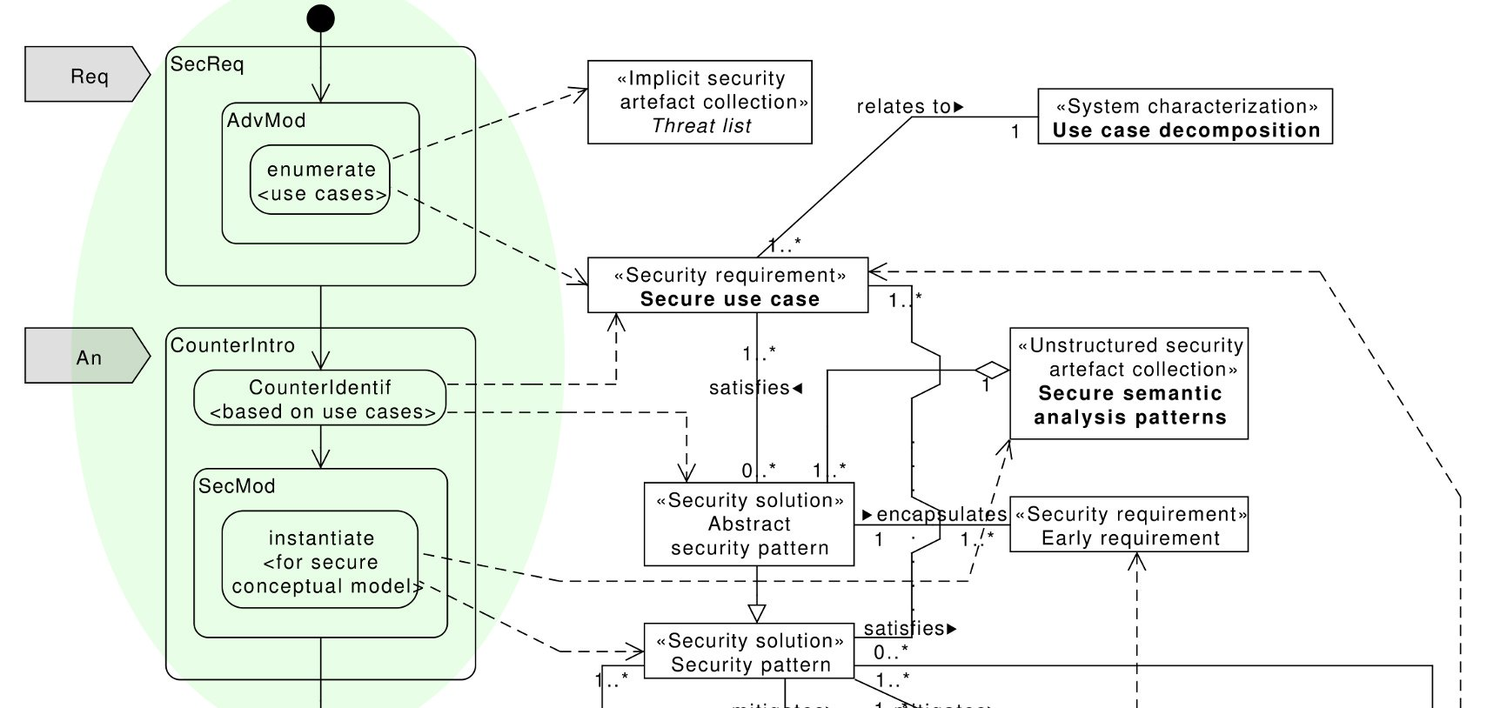
ASE security process overview: Requirements Analysis phase

Slide 51
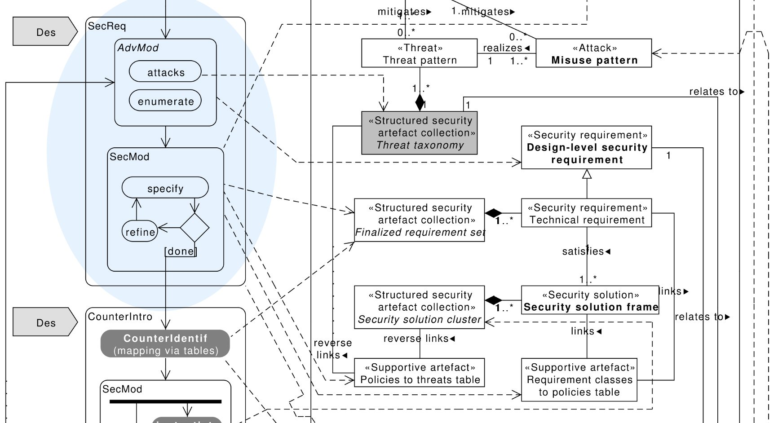
ASE security process overview: Design phase (1/2)

Slide 52
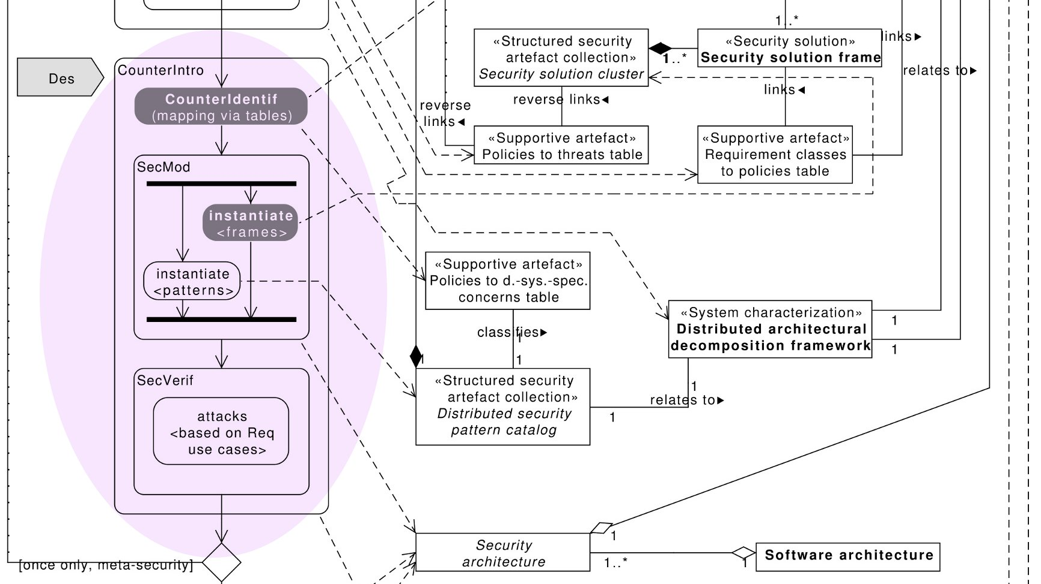
ASE security process overview: Design phase (2/2)

Slide 53
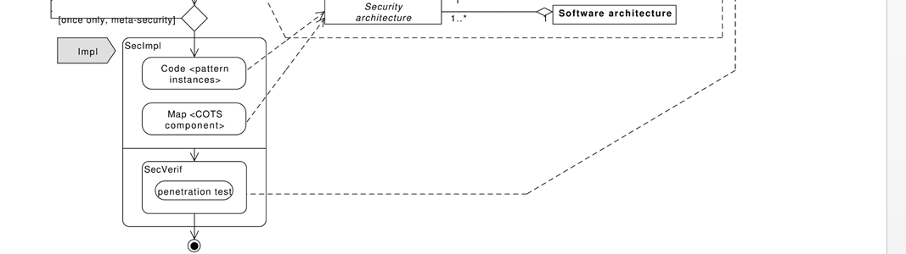
Implementation phase

Slide 54
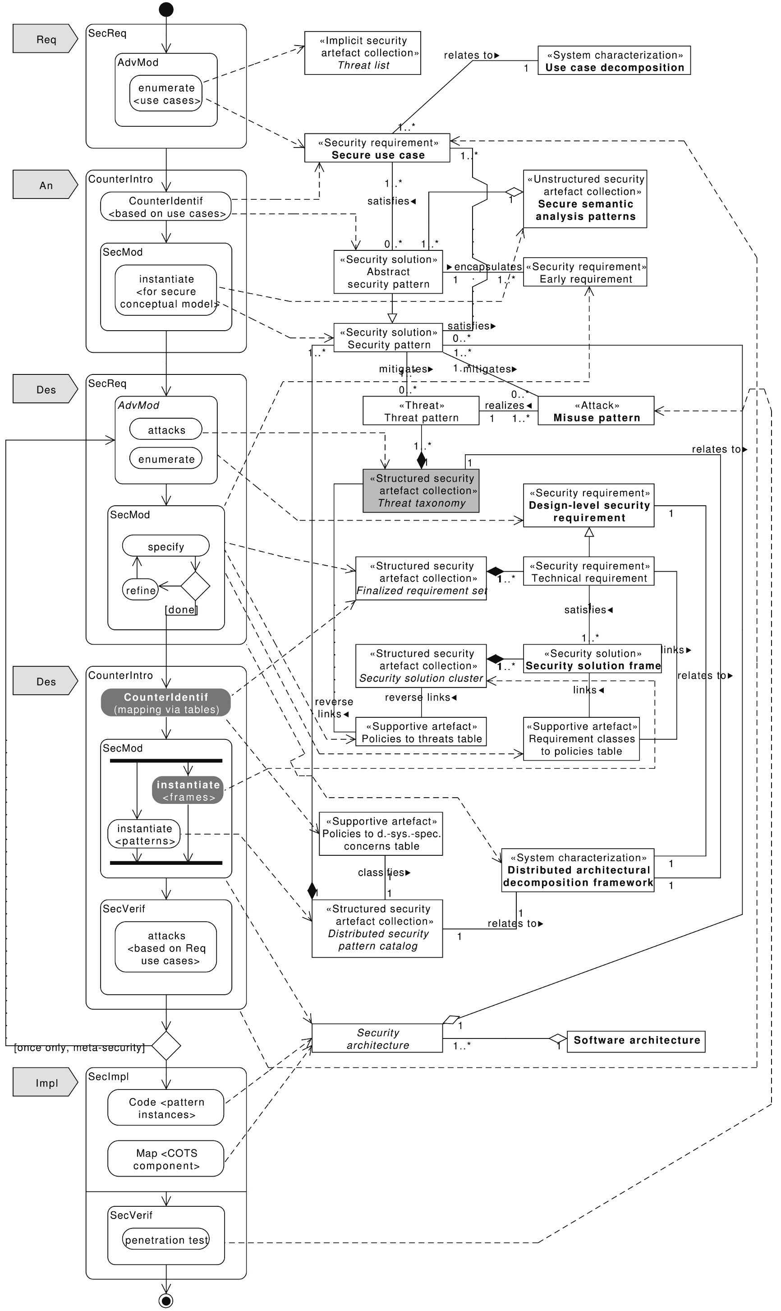

Slide 55


Summary and future directions
This presentation: outlined ASE, a pattern-based security methodology designed specifically for general distributed systems

Slide 56
References
[Uzu15]Anton Uzunov, E. B Fernandez, Katrina Falkner, “ASE: A Comprehensive Pattern-Driven Security Methodology for Distributed Systems”, Journal of Computer Standards & Interfaces , Volume 41, September 2015, Pages 112-137, http://www.sciencedirect.com/science/article/pii/S0920548915000276
Anton Uzunov, E. B Fernandez, Katrina Falkner, “Security solution frames and security patterns for authorization in distributed, collaborative systems”, Computers & Security, 55, 2015, pp. 193-234, doi: 10.1016/j.cose.2015.08.003
A.Uzunov and E.B.Fernandez, “An Extensible Pattern-based Library and Taxonomy of Security Threats for Distributed Systems”- Special Issue on Security in Information Systems of the Journal of Computer Standards & Interfaces. 2013. http://dx.doi.org/10.1016/j.csi.2013.12.008
Anton Uzunov, E. B Fernandez, Katrina Falkner, “ASE: A Comprehensive Pattern- Driven Security Methodology for Distributed Systems”, Journal of Computer Standards & Interfaces , Volume 41, September 2015, Pages 112-137, http://www.sciencedirect.com/science/article/pii/S0920548915000276 (SCOPUS)
[Fer13] E.B.Fernandez, “Security patterns in practice: Building secure architectures using software patterns”, Wiley Series on Software Design Patterns, 2013.
E. B.Fernandez, Nobukazu Yoshioka, Hironori Washizaki, and Joseph Yoder, "Abstract security patterns for requirements specification and analysis of secure systems'', Procs. of the WER 2014 conference, a track of the 17th Ibero-American Conf. on Soft. Eng.(CIbSE 2014), Pucon, Chile, April 2014
E.B.Fernandez, Raul Monge, and Keiko Hashizume, “Building a security reference architecture for cloud systems”, Requirements Engineering. Doi: 10.1007/s00766-014-0218-7, 2015 (ISI)

